Slide 1
An INTRODUCTION to RPC2016
Het Pand Gent 22 Feb 2016
By R. Santonico

Slide 2
Abstract
RPCs at the future colliders
Space-time tracking with high accuracy both in space and time
RPC applications in calorimetry
Perspectives in Cosmic Ray physics
The RPC as an investigation instrument of the electrical phenomena in gaseous media

Slide 3
RPCs at the future colliders
Starting from LHC and HL-LHC a number of new accelerators have been proposed
Very ambitious projects
Which contribution can be expected from the RPCs?
Which are the challenges for our (small) community?

Slide 4
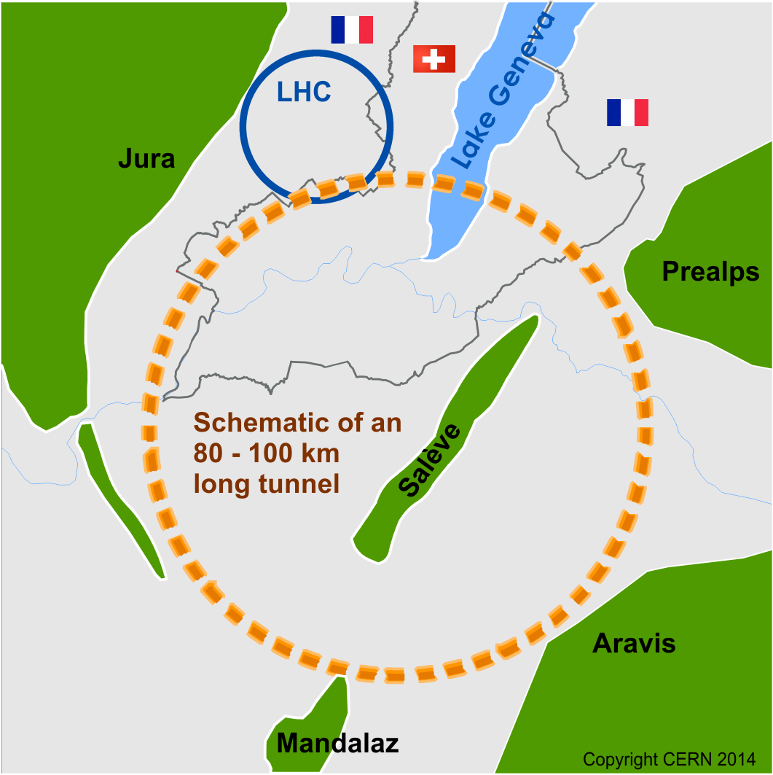
Future Circular Collider Study
International FCC collaboration (CERN as host lab) to study:
pp-collider (FCC-hh) → main emphasis, defining infrastructure requirements
80-100 km infrastructure in Geneva area
e⁺e⁻ collider (FCC-ee) as potential intermediate step
p-e (FCC-he) option
HE-LHC with FCC-hh technology
~16 T ⇒ 100 TeV pp in 100 km

Slide 5
e⁺e⁻ Beam Parameters
ILC (500) CLIC (3 TeV)
Electrons/bunch 0.75 0.37 ×10¹⁰
Bunches/train 2820 312
Train repetition rate 5 50 Hz
Bunch separation 308 0.5 ns
Train length 868 0.156 us
Horizontal IP beam size 655 40 nm
Vertical IP beam size 6 1 nm
Longitudinal IP beam size 300 45 um
Luminosity 2 6 ×10³⁴

Slide 6
The timing performance for experiments at the future colliders (1)
Two ways to pursue high luminosity at the future colliders:
To increase the number of bunches an decrease the inter-bunch crossing time down to 0.5 - 1 ns
To increase the number of particles per bunch at fixed inter-bunch crossing time
In both cases the detector timing will be crucial
To identify the correct bunch crossing
To resolve the pile up of events generated in the same bunch crossing
Already now the pile up at LHC is several tens of interaction vertices per bunch crossing

Slide 7
The timing performance for experiments at the future colliders (2)
A space-time tracking with space resolution ≤µm and time resolution ≤100 ps would be crucial for a correct association of each track to the corresponding vertex
The RPcs have already demonstrated to have the required space-time accuracy
Substantial improvements can be expected in the next future: a timing in the 20 ps range is possible and we should point to it

Slide 8
RPC timing for multidimensional tracking
The time coordinate can be associated to the space coordinates in a 4-Dimensional tracking
This is the most powerful method to exploit the RPC timing
The 4-D tracking can offer crucial advantages to analyze a large number of tracks coming from many different vertices generated in the same bunch crossing
Other parameters can be included in the tracking to eliminate ambiguities

Slide 9
Calorimetry
So far the RPCs were mainly considered excellent timing trackers
Now we should seriously propose them as ideal detectors for calorimetry with high timing performance
A pioneering work in this field has been already done by the CALICE DHCAL collaboration who tested a RPC Fe and W calorimeter with 1 cm² pads digital read out
The analog read out would greatly increase the RPC linearity range in calorimetry
A strong indication has been already given by the observation of the CR air shower core in the Argo-YBJ experiment. The hit multiplicity achievable with the analog read out exceeded 10⁴/m² in streamer mode
The avalanche mode operation would greatly improve this result
Further beam tests needed to measure the intrinsic RPC linearity range

Slide 10
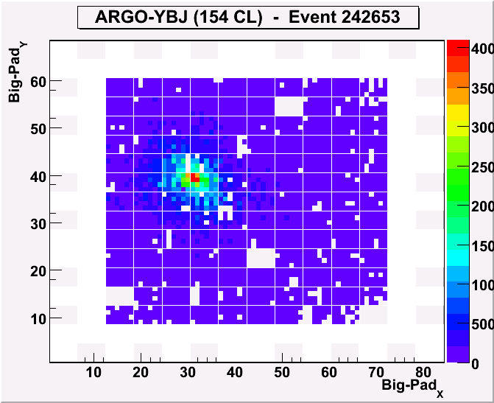
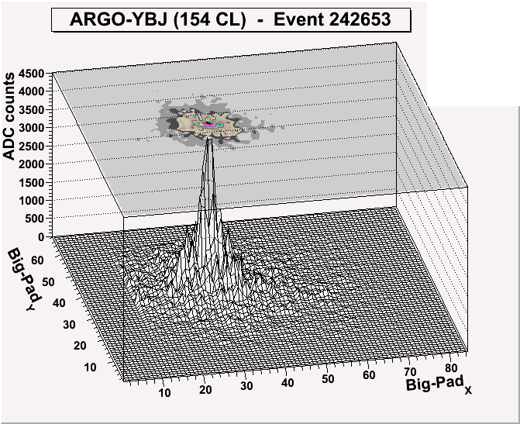
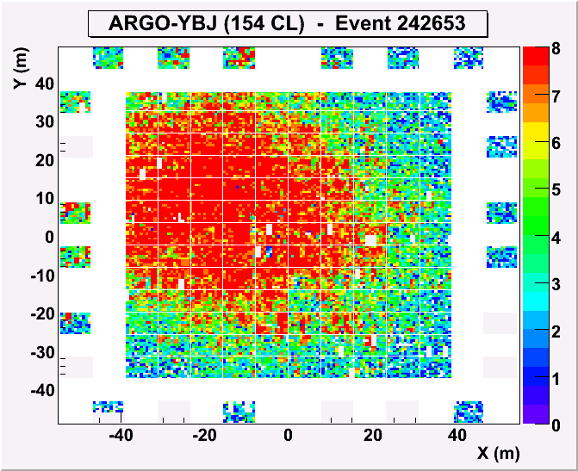
The RPC analog readout
Extending the dynamical range up to PeV
Is crucial to extend the covered energy range above 100 TeV, where the strip read-out saturates
Max digital density ~20/m² Max analog dens ~10⁴/m²
Access the LDF in the shower core
Sensitivity to primary mass
Info/checks on Hadronic Interactions
0
4000
3500
3000
2500
ARGO event
2000
0
1500
4000
0
3500
1000
3000
500
2500
Fs: 4000 -> 1300/m²

Slide 11
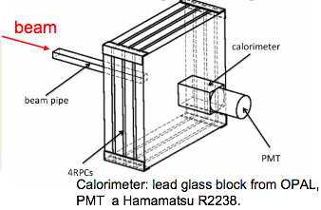
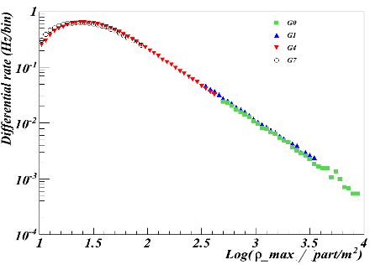
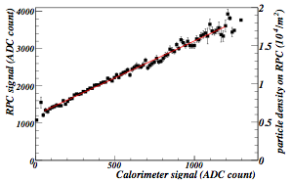
Intrinsic linearity: test at the BTF facility
Linearity of the RPC @ BTF in INFN Frascati Lab:
electrons (or positrons)
E = 25-750 MeV (0.5% resolution)
<N>=1÷10⁸particles/pulse
10 ns pulses, 1-49 Hz
beam spot uniform on 3⨉5 cm
4 RPCs 60 x 60 cm
Good overlap between 4 scales with the maximum density of the showers spanning over three decades
The RPC signal vs the calorimeter signal
Astrop. Phys. 67 (2015) 47Astrop. Phys. 67 (2015) 47
➔ Linearity up to ≈ 2・10⁴ particle/m²

Slide 12
Scaling from streamer to avalanche mode
Operating current distribution for the 1681 RPCs (3.5 m²)
Cluster (=12 chambers) counting rate distribution
Average current of 2.8 µA/Ch / average rate of 3.4 kHz/Ch → 820 pC charge delivered in the gas
For very similar chambers operating in avalanche mode in Atlas the delivered charge is 30 pC

Slide 13
Expected performance of RPCs operating in avalanche mode with analog pad read out
Linearity range
Streamer → avalanche: delivered charge reduced by a factor of 820/30 = 27
Thinner gaps with a very high sensitivity front end electronics: further gain by an estimated factor > 10
The overall expected gain in the delivered charge about 300
The expected linearity range should be extended from 2 mips /cm² to
600 mips /cm²
In order to exploit this range the front end electronics is required to have a linearity range from 1 mip to 600 mips /cm² !!
Timing
The high multiplicity of simultaneous particles in the same gap-pad should improve the timing in a substantial way
$σ\left(n\right)=\frac{σ\left(1\right)}{sqrt(n)}$ ?

Slide 14
Perspectives in RPC calorimetry
The very wide linearity range achievable with RPCs offers impressive perspectives in calorimetry
In accelerator particle physics
In astroparticle physics
Our community has the privilege/responsibility to fully exploit these opportunities

Slide 15
RPC perspective in Cosmic Ray physics (1)
The experiment Argo-YBJ opened a new way to study the Cosmic Ray physics
The key RPC features that made this possible are:
The time resolution that was perfectly adequate to the experiment requirements even in streamer mode operation
The read out segmentation, 128 000 strips, that was possible at the cost of 1 front end channel/strip
The simple construction method that allowed to fully cover about 6500 m² at a relatively modest cost
The analog read out that allowed to study the CR shower core with an unprecedented detail
The combination of these features with the laboratory high altitude, made Argo a unique experiment, which achieved relevant results even beyond the expectations of the proposal.
To extend this original approach to a new upgraded experiment will offer a relevant discovery potential
Two main upgrades concerning the RPCs, are:
The avalanche operation
The fully analog read out achievable with a new front end electronic

Slide 16
RPC perspective in Cosmic Ray physics (2)
A RPC wide FoV gamma-ray detector, in the energy range 100 GeV-10 TeV, located in the Southern Hemisphere, would be unique and complementary to other experiments planned to take data in the next decade
The Lattes/ STACEX collaboration is pursuing this ambitious idea:
Site: 5000 m altitude or more.
Area: 14,000 m² (full coverage);
surrounded by a comparable sampling array
Energy ranges:
Photons: 100 GeV – > 20 TeV
CRs: 300 GeV – 20 PeV
1-year gamma-ray sensitivity (@ 1 TeV): 50 mCrab

Slide 17
RPC as an ideal instrument to study the electrical phenomena inside a gas
So far we used our best knowledge about the discharge inside a gas in order to build excellent detectors
Now is time to reverse this point of view and to stress that the RPC is itself an ideal instrument to study the electrical phenomena occurring inside a gas under electric field:
Uniform electric field is by far the simplest configuration free from the problems of how to handle field gradients
Possibility to follow at the oscilloscope the first stages of the discharge with an unprecedented detail
The scope signal gives in «real time» the instantaneous current flowing inside the gas

Slide 18
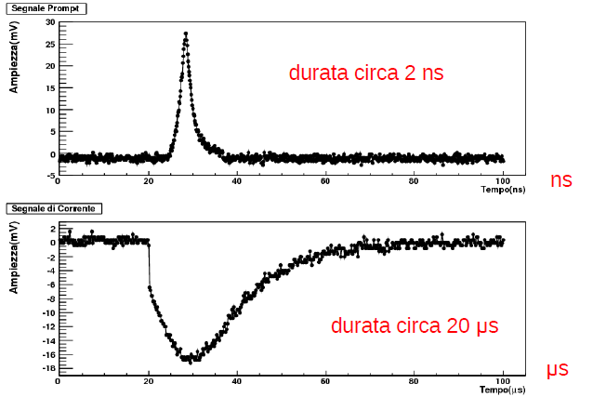
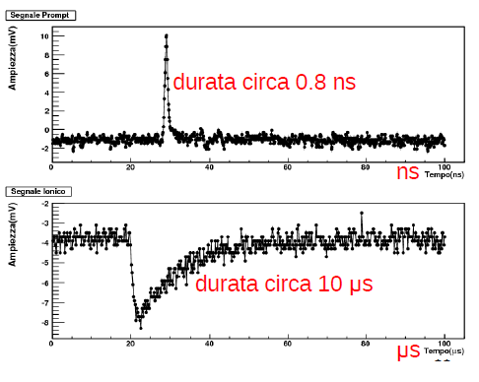
Prompt and ionic signals for 2 mm and 0.5 mm gap
amplitude (mV)
amplitude (mV)
time (ns)
time (ns)
amplitude (mV)
amplitude (mV)
time (μs)
time (μs)

Slide 19
Potential investigation fields
A relevant number of problems can be studied in this way:
Measurement of all parameters characterizing the avalanche development: Townsend coefficient, drift velocity, electron attachment
The avalanche-to-streamer transition as a transition to the plasma phase, because the streamer is just a thin plasma column interconnecting the two electrodes
The study of the interface between a gas and a solid material of the electrode. This is a very promising research line which can be extended to different materials independently of their direct interest for the RPCs

Slide 20
Conclusions (1)
The high resolution tracking-timing with
space resolution ≤100 µm
time resolution in the range 100 ps – 20 ps
is an ideal competition field for the RPCs at the future accelerators
The study of the RPC potential in calorimetry is a crucial item to be investigated in the near future
The Cosmic Ray physics is another important competition field as clearly demonstrated by the Argo-YBJ experiment
The RPC, independently on its applications, is itself an ideal instrument to study the physics of the electrical phenomena in gaseous media. The plasma physics could substantially benefit of the RPC approach

Slide 21
Conclusions (2)
The RPC community has to be aware to have in their hands a crucial detector for future collider experiments, a unique detector capable to combine:
Outstanding space-time resolutions
Counting rate in the range up to 100 Khz/cm2
very large detection areas
To compete with such a detector and to fully demonstrate its performance is our main task for the next future

