Slide 1


Developement of the MRPC for the TOF system of the MultiPurpose Detector
V. Babkin on behalf of the TOF MPD group
Abstract: The MultiPurpose Detector (MPD) is designed at JINR for properties of hot and dense baryonic matter study. The MPD is system of detectors surrounding one of the interaction points of the future ion collider NICA. Time-of-Flight identification system in this experiment will be based on MRPC. The MRPC satisfied of requirements of the experiments has been developed. The report presents main parameters of the detector and the latest beam test results. The achieved time resolution is about 40 ps by 99% of efficiency.
Notes:
Good morning!
My name is Vadim Babkin. I work in the Joint Institute for Nuclear Research at the V&B Laboratory of High Energy Physics.
I would like to tell you some words about our new project for studying hot and dense baryonic matter MPD (or MultiPurpose Detector) and detailed about contribution of the time-of-flight group to preparing of this experiment.

Slide 2
Contents
The NICA/MPD layout and stages
The Barrel TOF design
Readout electronics
New triple-stack MRPC
Nuclotron beam test results
Notes:
My report contents 5 main parts:
At first I will present you the NICA accelerator complex and design of the Multi-Purpose Detector at different stages of development.
Second, I will outline the requirements for TOF system and describe the technical details of its creation and integration into the MPD.
Next I will describe new triple-stack design of the MRPC for the TOF, which we proposed as tof detector.
The fourth part of the report will be devoted to the TOF readout and data acquisition electronics.
At parts 5 I will show you main results of the beam test of the full-scale MRPC prototype.

Slide 3
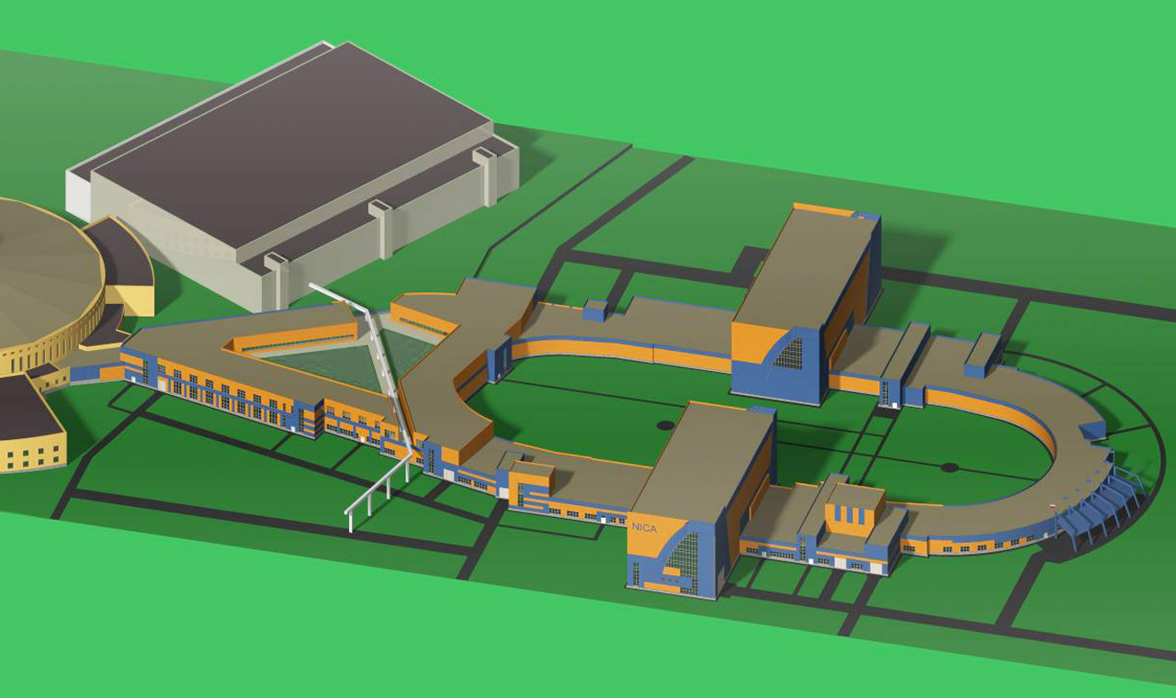
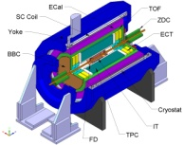
Nuclotron based Ion Collider fAcility (NICA)
Collider basic parameters:
√s_{NN} = 4 – 11 GeV (scan); beams: from p to Au; L~10²⁷ cm⁻² c⁻¹ (Au), ~10³² cm⁻² c⁻¹ (p)
BM@N
Nuclotron
& buster
NICA
MultiPurpose Detector (under construction)
Notes:
At this slide you can see the schematic view of the future Nuclotron based Ion Collider Facility (NICA).
The Nuclotron is the basic research facility of the LHEP and is the world’s first superconductive synchrotron. It was commissioned in 1993. The Nuclotron has internal target station and extracted beams. The largest new experiment at the extracted beam is the baryonic matter at Nuclotron (BM@N).
Particles for the colliding from the ion source and Linac accumulate in the buster then accelerate by the Nuclotron and extract to the rings of the NICA.
Main estimated parameters of the collider is:
Center of mass energy from 4 GeV to 11 GeV for gold-gold collisions.
Beams from protons to gold.
and luminosity about 10 in 27 per square cm per second.
NICA has two interaction points. One of them plan to use for the Multi-Purpose detector. Now the MPD hall is under construction by the STRABAG company.

Slide 4
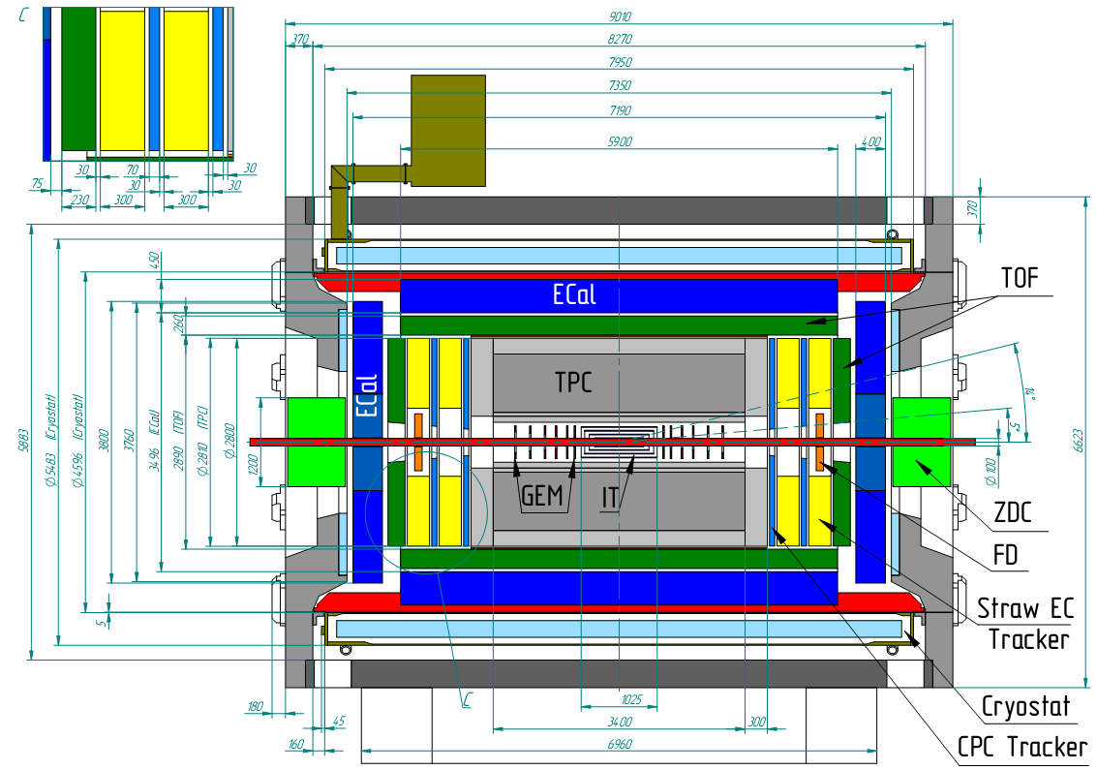
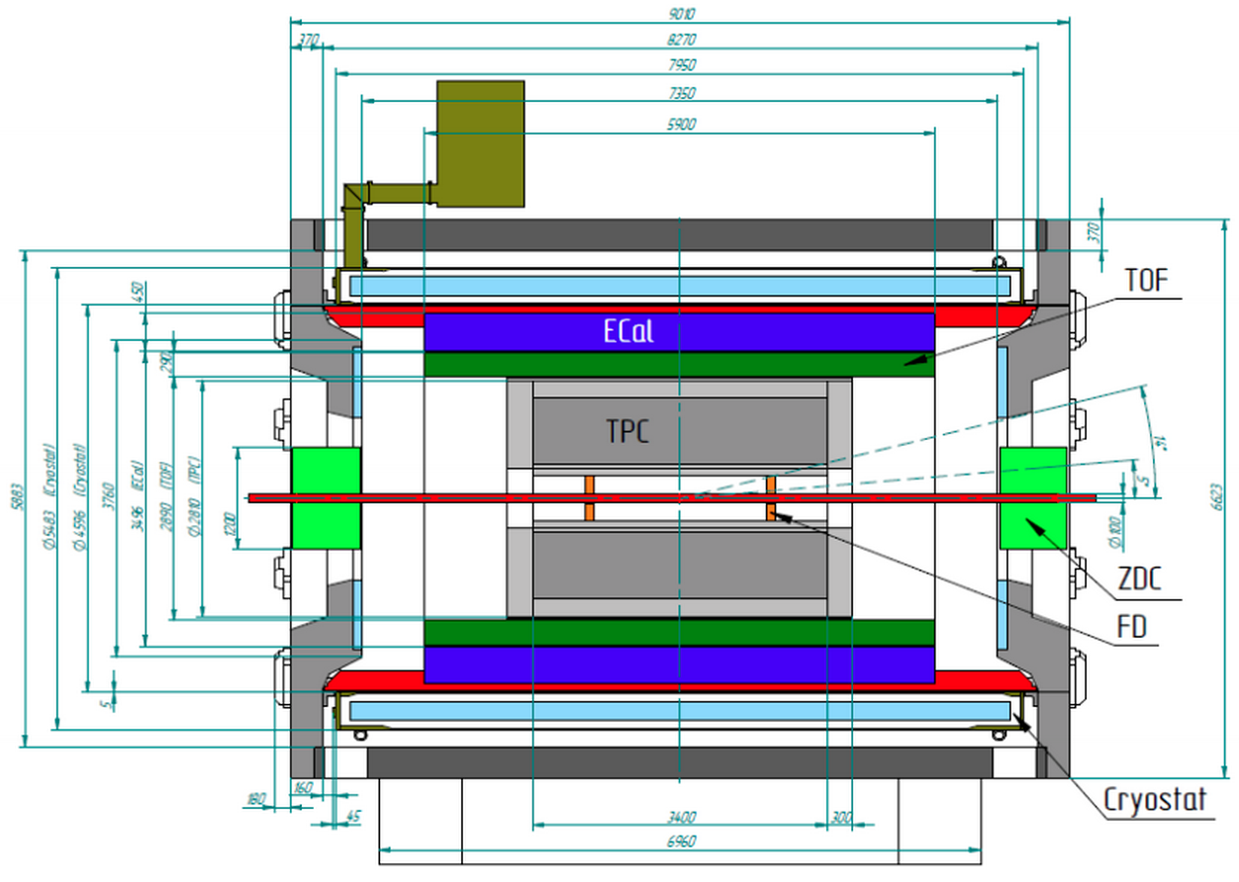
Two stages of the MPD experiment
First stage (2020): mid rapidity region
Particle yields and spectra (π,K,p,clusters,Λ,Ξ,Ω)
Event-by-event fluctuations
Femtoscopy involving π, K, p, Λ
Collective flow for identified hadron species
Electromagnetic probes (electrons, gammas)
Second stage (2023): extended rapidity + IT
Total particle multiplicities
Asymmetries study (better reaction plane determination)
Di-Lepton precise study (ECal expansion)
Exotics (soft photons, hypernuclei)
Notes:
MPD setup looks like a typical center of mass experiment – like a barrel inside the solenoid. Overall dimensions of the Magnet yoke is about 9 m length and 7 meters high.
Here you see the cut view of the barrel MPD at the first stage.
The MPD will be put into operation in 2020 in this configuration. Here you see main goals for the first stage.
- Setup covers pseudorapidity region less than 1.3 and consists of four main detector systems: TPC tracker, TOF hadron identification system, electromagnetic calorimeter for photons and leptons registration and ZDC with T0 detector.
Second stage will start in 2023. The main addition is inner tracker on this stage. Also the additional end cap tracker, TOF and calorimeter will be installed. The MPD cover pseudorapidity region up to 2.
The tof system presented at all stages and is important part of the detector.

Slide 5
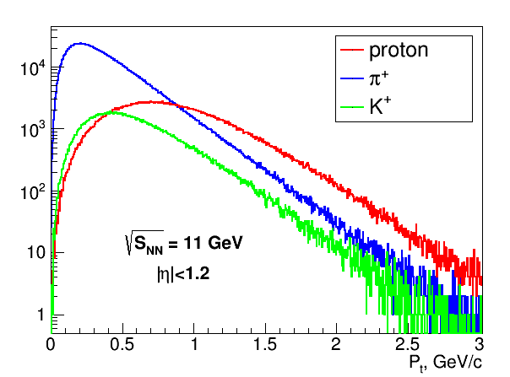
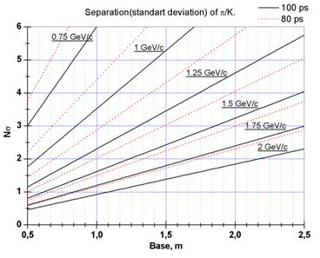
Requirements to the TOF MPD
π,K > 99%
The basic requirements to the TOF system are:
large phase space coverage |η| < 2 (optional 3);
time resolution < 100 ps;
high granularity to keep the overall system occupancy below 15%;
high geometrical efficiency;
identification of pions and kaons with up to p_{t} < 1.5 GeV/c;
identification of (anti)protons with up to p_{t} < 3 GeV/c;
rate capability <20 Hz/cm²
The best choice for this requirements is a Multigap Resistive Plate Chamber.
Notes:
The basic reqiurements to the TOF MPD is:
1) large phase space coverage |η| < 2 (optional 3);
2) time resolution < 100 ps; How you can see on the picture right pions and kaons are separated on the flight base of 1.5 into 2 and half sigma with transverse momentum up to 2 GeV/c.
3) Third we need to make such readout electrode which provide high granularity to keep the overall system occupancy below 15% (<1% of multihits);
4) The arrangement of detectors must be the best for the high geometrical efficiency;
5) In the left figure you see the transverse momentum distribution for protons, kaons and pions for collisions with energy of 11 GeV. Most of pions and kaons have momentum less then 1.5 GeV/c. Therefore it is enough to separate these particles up to that momentum. Protons can be separated it up to 3 GeV. rate capability
6) Particles rate at the MPD is low (<20 Hz/cm²). Therefore we can use MRPC with common float glass.

Slide 6
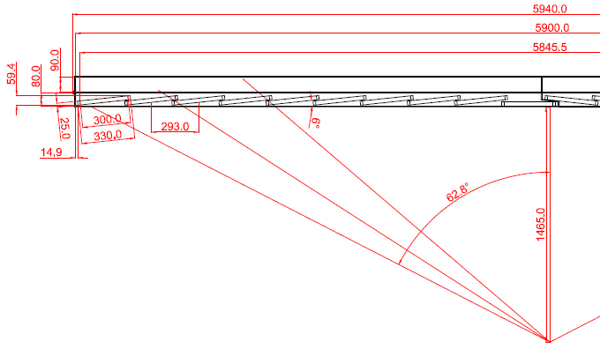
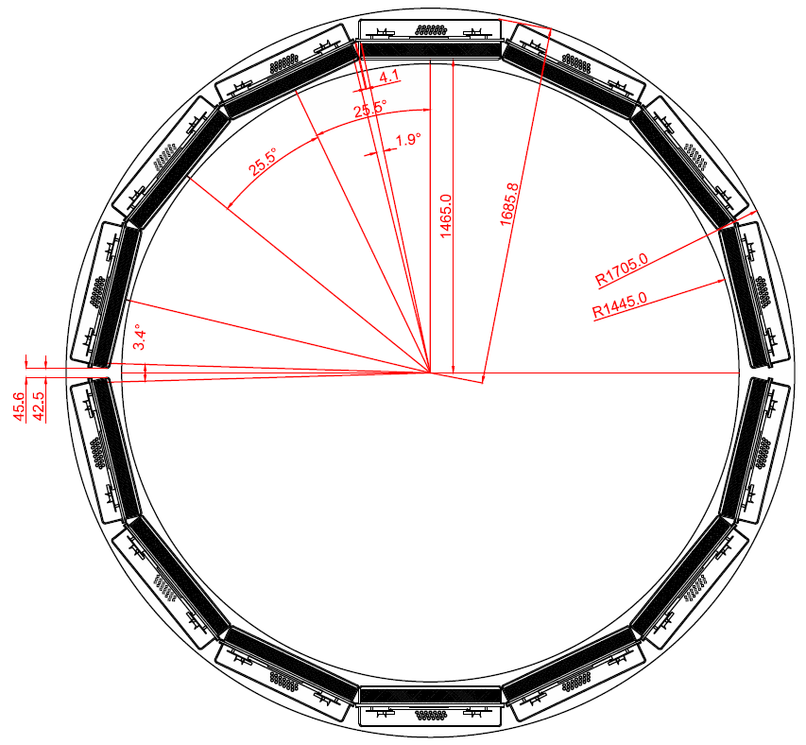
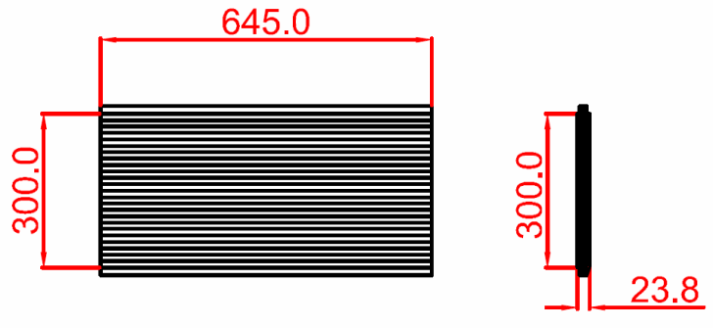
  Mechanical design of the TOF barrel
Est. Occupancy ~14%
Estimated coverage ~94%
Z-direction detectors layout
 | Number of detectors | Number of readout strips | Sensitive area, m² | Number of FEE cards | Number of FEE channels
MRPC | 1 | 24 | 0.2 | 2 | 48
Module | 10 | 240 | 1.85 | 20 | 480
Sector | 20 | 480 | 3.7 | 40 | 960
Barrel | 280 | 6720 | 51.8 | 560 | 13440 (1680 chips)
Notes:
Layout of the barrel TOF modules is presented on this slide.
The detector is segmented in φ into 14 sectors of ~5.9 m length. It is convenient for integration, because the ECal contains 24 sectors.
Each TOF sector carries 2 individual modules. Each module contains 10 MRPCs arranged at an angle of 6 degrees.
Total number of the MRPC in the barrel TOF is 280. Number of FEE channels is 13440.
Estimated geometrical efficiency is about 94% due to small dead areas between sectors in phi direction and wide gaps in the horizontal plane which are required for support structures for mounting the TPC. Estimated occupancy with this readout strip should be less than 15%.

Slide 7
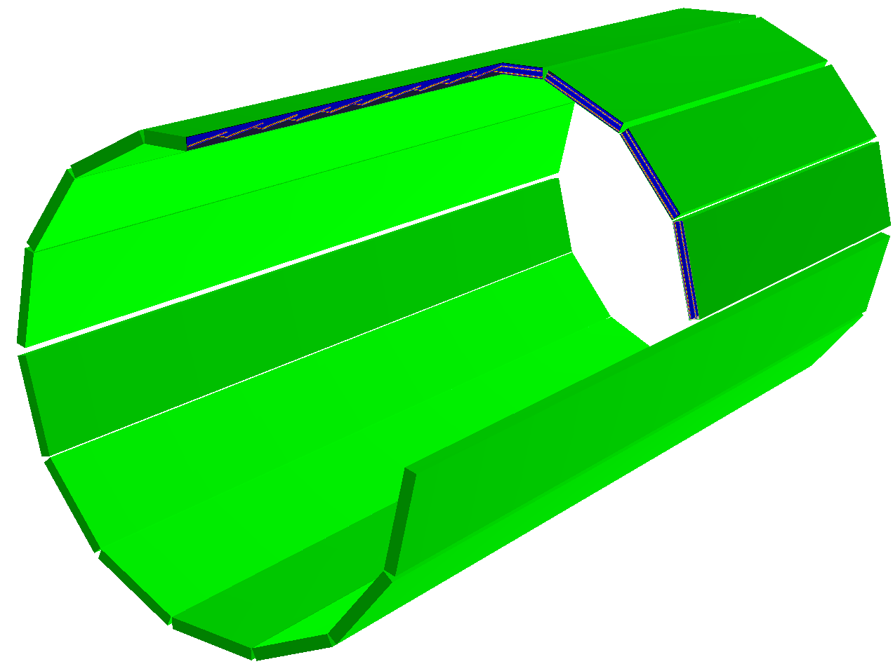
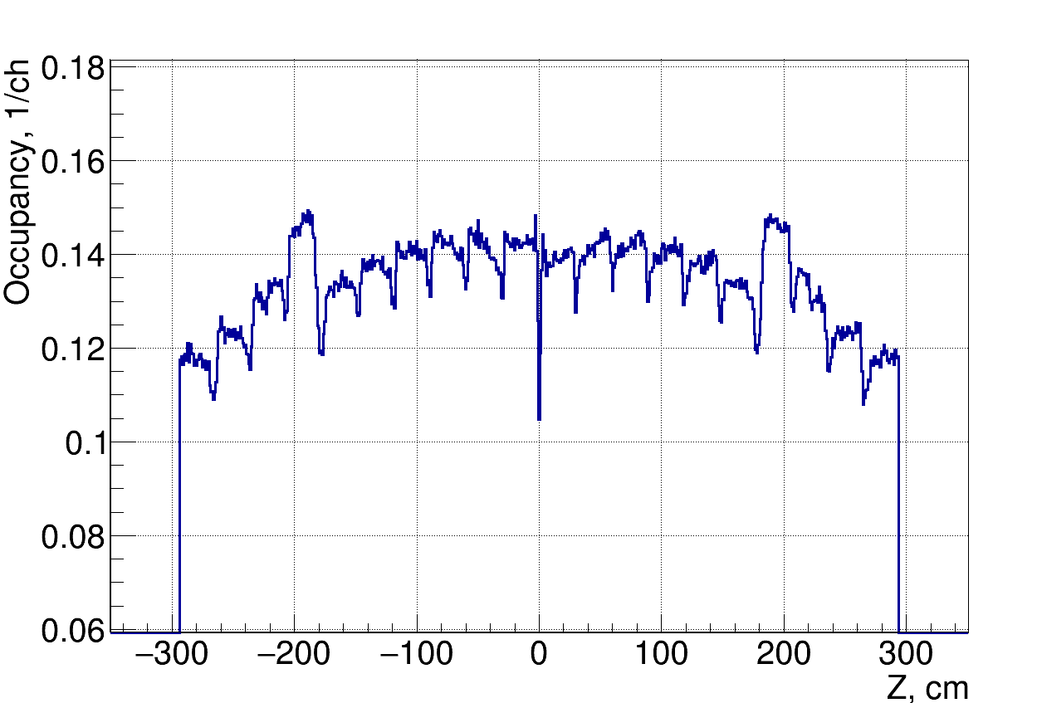
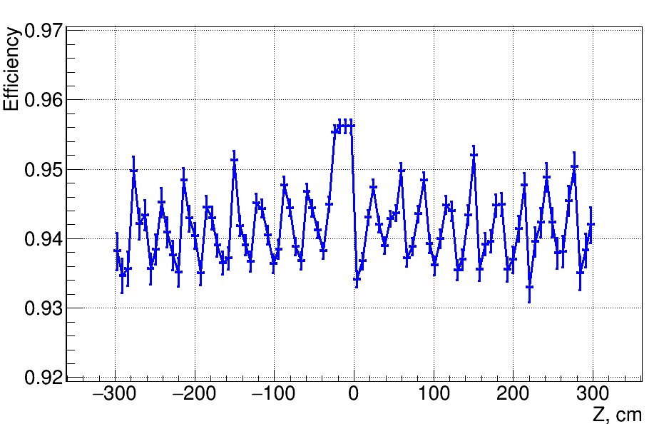
MC simulation results
Maximum occupancy <15%
Geometry efficiency ~94%
Notes:
GEANT simulation was carried out for the construction described above. QGSM generator was used.
Indeed, it can be seen from the histograms, the occupancy does not exceed 15% and the geometric efficiency of the TOF detectors in this arrangement is ~ 95%.

Slide 8
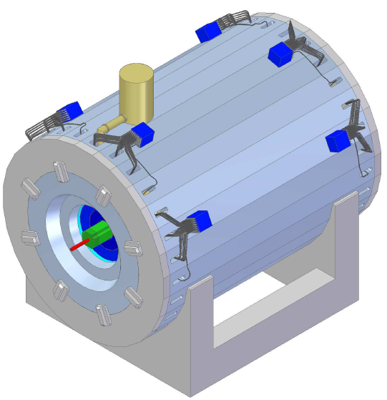
  Cabling and readout electronics location
Total cabling:
14 VME crates
196 TDC72VHL => 14 per crate
560 cables Molex CXP => 40 per crate
Cable lengths: 4 - 8 m
About 70 cm² in each technical hole for cables and tubes
Low heat dissipation inside the barrel! ~10 W/m²
Cooling?
VMEx64 crate
HV cable
NINO preamp
Molex InfiniBand cables
Distribution board
Notes:
A very important part of creating the TOF system is the correct cabling.
This is single module with all communications that should be placed inside it.
The readout electronics must be as close as possible to the detector for achieving best time resolution.
But each crate radiates heat up to 300 W. Therefore we decided to fix them directly on the yoke.
Cables taking the signals from the FEE, LV cables, gas tubes and slow control buses will be routed through the center of the module to its outer ends.
Then they will come out from the external sides of the sector and pass through special holes in the yoke.
The space about 70 cm² (<1% of total size) is enough in each hole in the yoke for all TOF system cables, tubes.
Total number of 72-channel TDC for the time-of-flight system is 196.

Slide 9
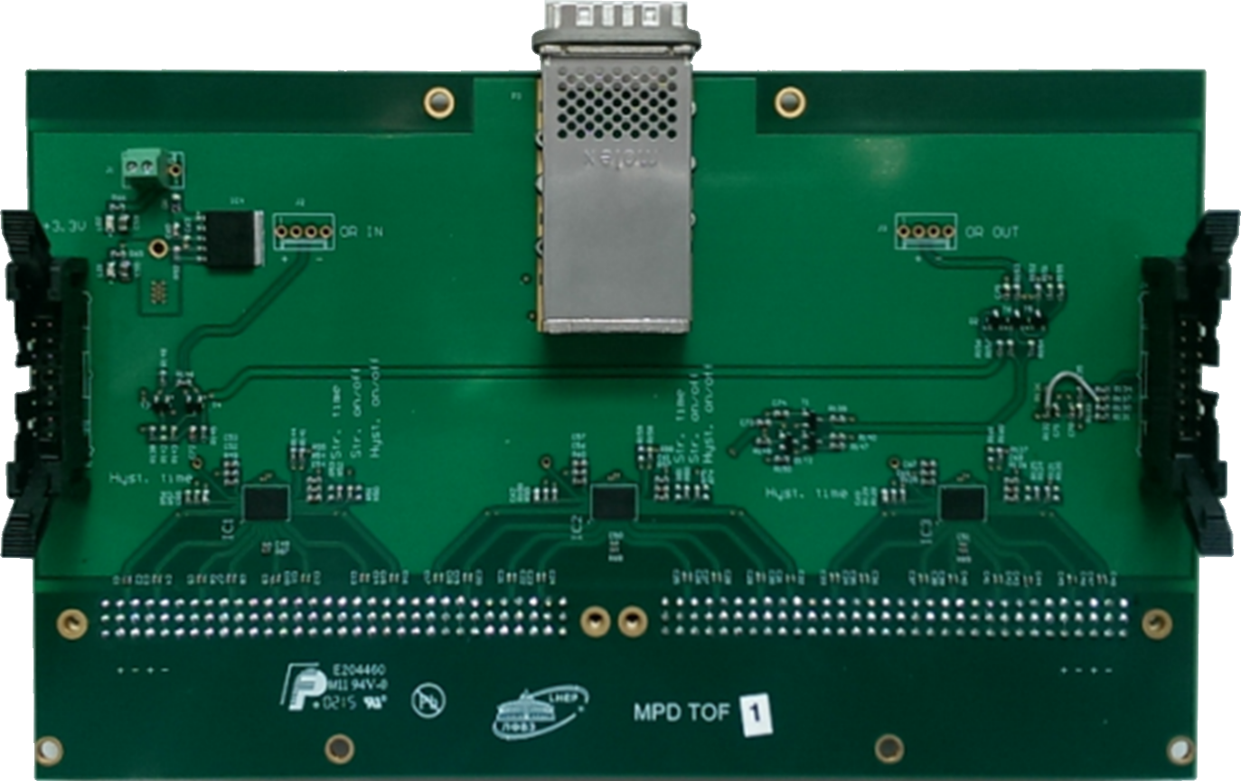
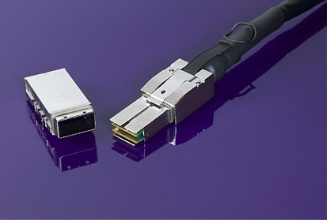
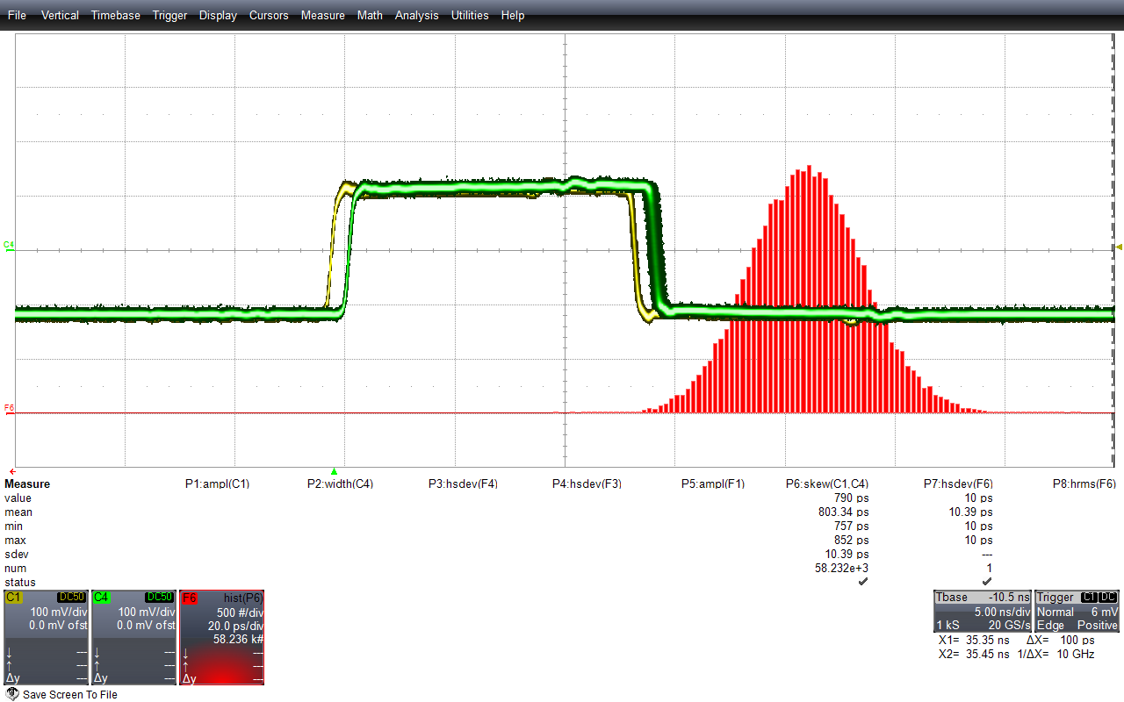
Front-End Electronics
MPD TOF amplifier-discriminator features:
Stabilized of the voltage (+2.5V)
Differential input signal ( Z_{diff} = 55 Ohm)
Overload protection for input channels
Capacitors on the inputs for double-end strip readout
CXP (InfiniBand) output transmitting line
The possibility to use as trigger (series “or” output)
Controlling and monitoring of the thresholds
Time resolution for one channel 10.4/√2 ≈ 7.3 ps
Time-over-Threshold correction possibility
24-channel amplifier based on NINO with CPX (InfiniBand) output connector.
σ=10.39 ps
Time difference distribution from two FEE channels
View of the Molex CXP cable with the connector.
Notes:
Front-end electronics based on NINO chip. Currently, it is the best ASIC for these detectors.
On the basis of this chip by our electronics have been designed board specially for two ends strip readout.
It has such remarkable features:
…. read.
The time resolution was measured between two channels.
Output connector and cable were taken from the InfiniBand technology.
This type of cable has been tested and has shown better results than with the used Alice blue cable to the VHDCI connectors. It is better matched and the signal is less attenuated.

Slide 10
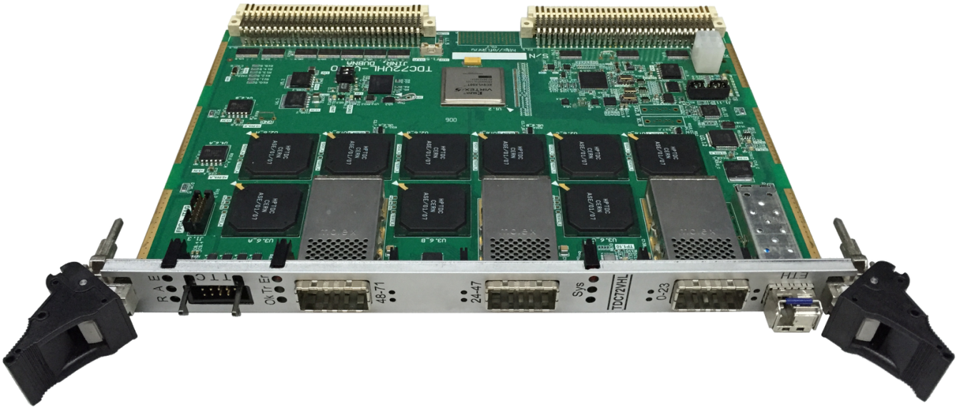

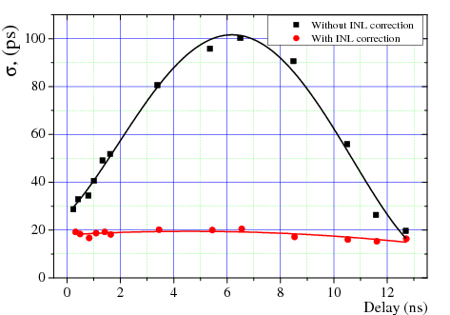
Readout & DAQ
TDC72VHL module specification:
VME64x interface;
TDC type: timestamping HPTDC chip;
Number of input channels: 72;
Input: differential 100 Ω (LVDS);
Resolution: ~ 25ps bin size (σ ≈ 20 ps);
Power consumption: +5 V 0.13 A; +3.3 V 5.6 A.
Standalone mode:
Ethernet or M-Link data transfer
Time synchronization by the White Rabbit
TDC72VHL with CPX(InfiniBand) connector
TOF DAQ estimation parameters
Parameter | Value
Raw data information type | Lead+trail time, 25 ps/bin
Channel size | 12 Bytes
Average event size | 24 kBytes
Data rate | < 1.5 Gb/s
Number of TDC72VHL | 196
Total power | 3500 W
TDC72VHL time resolution after INL correction
Notes:
A special 72-channel VME64x time-to-digital converter TDC72VHL (fig) is based on HPTDC ASIC. TDC72VHL was designed and produced at the LHEP NEOAFI department. It is used for digitizing the LVDS signals, coming from the output of the NINO amplifier. Time-sampling of the TDC72VHL is less than 25 ps. This time-to-digital converter was produced under both types of connectors, like the amplifiers were. Three amplifiers can be connected to one such module of the VME TDC.
The HPTDC chip has a very strong integral nonlinearity (INL). The code density test was used for calibration (consideration of nonlinearity) of the VME TDC72VHL modules. Native time resolution of one channel of electronics (including the NINO resolution) made up better 20 ps after applying the calibrations (fig).
The main estimated parameters of the TOF DAQ are in the Table bottom right.

Slide 11
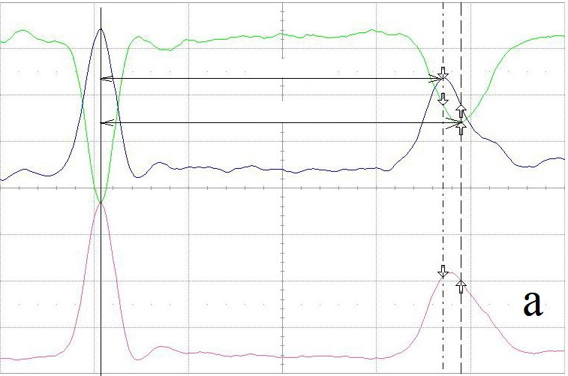
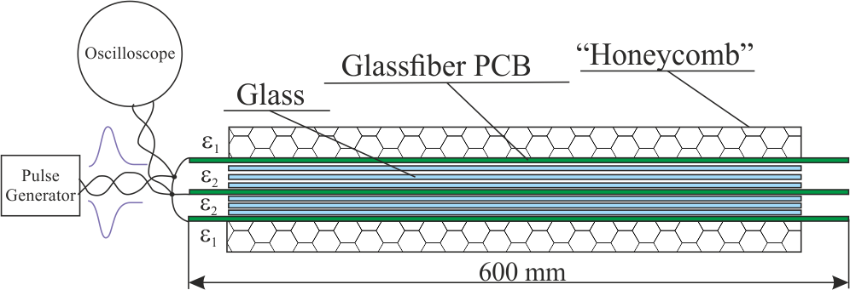
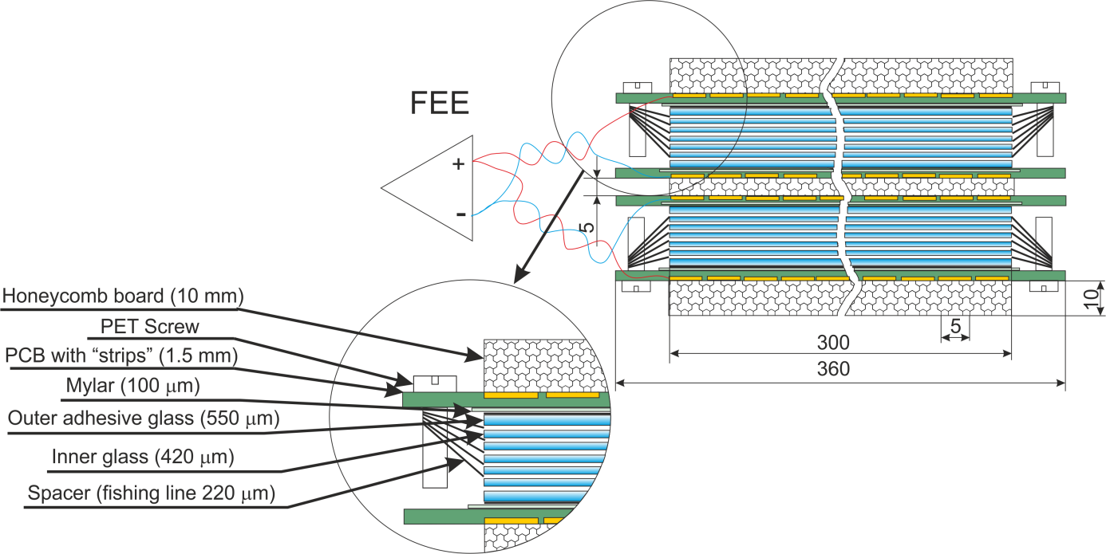
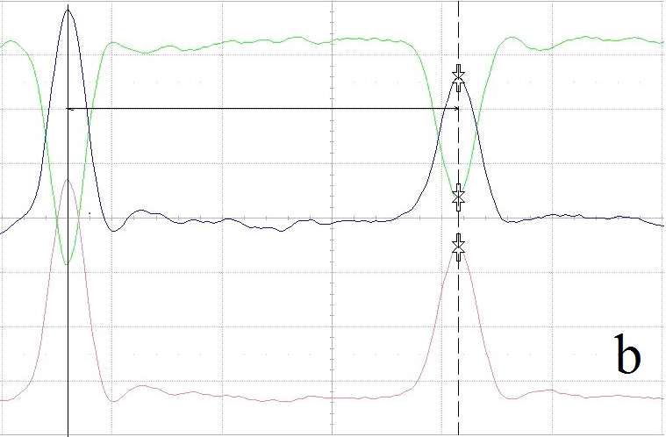
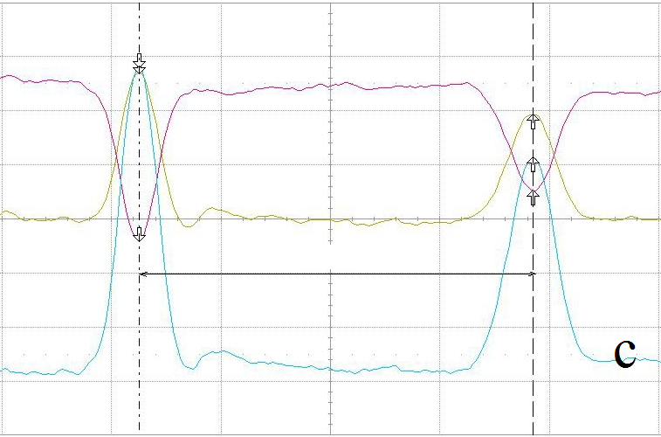
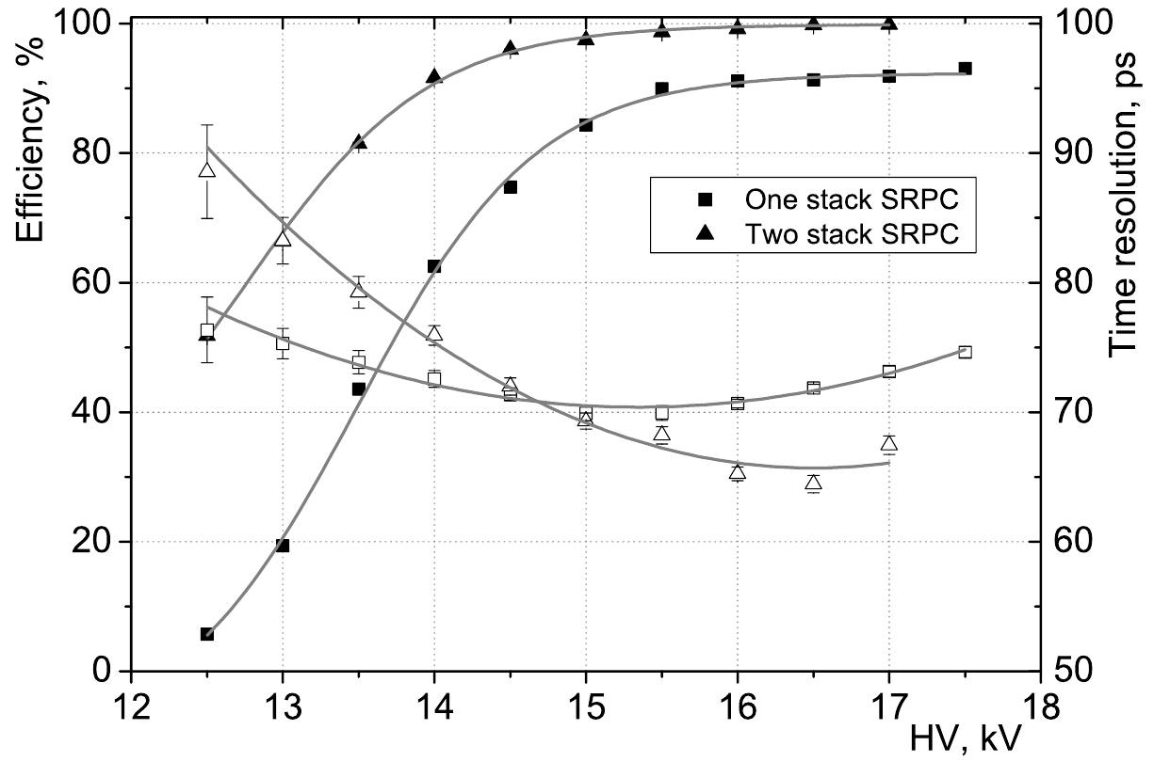
Selection of the detector design
7.30 ns
7.68 ns
Dispersion
Scheme of the reflection test setup
Double stack MRPC
Honeycomb spacer
7.10 ns
7.20 ns
Single stack MRPC
Triple stack MRPC
V.Babkin et al., PoS(TIPP2014)289 (http://pos.sissa.it/archive/conferences/213/289/TIPP2014_289.pdf)
Notes:
In order to get good time resolution from MRPC by using the time-over-threshold method one needs to provide very good termination of impedance between the strip, the cable and the preamplifier input. Any reflection could cause the wrong estimation of the signal width when the amplitude correction applied.
The setup for studying the differential signal reflection and deterioration during its propagation on the strip and cables to the preamplifier is shown in this figure. The differential signal from the pulse generator applied to the anode and cathode strips returns after reflection from the nonterminated end with delays.
Working with double stack MRPC with differential signal readout scheme one also has to pay attention to the fact that readout strips for positive and negative signals have different impedances. The inner strip is surrounded on both sides by the fiberglass PCB and glass with dielectric constants about ~4. The external electrodes have a honeycomb on one side and glass from the other. As a result the positive and negative parts of the signal propagate with different velocities and this leads to dispersion of the signals.
One solution of this problem is by introducing the honeycomb spacer between two inner PCBs. These results were published in PoS. Good time resolution and efficiency can be obtained with this double stack MRPC, but with one stack we had problems with efficiency. Although this design is the best for the signal propagation.
In the end, it proposed a new design which solves many problems. Primarily, this construction is symmetrical.

Slide 12
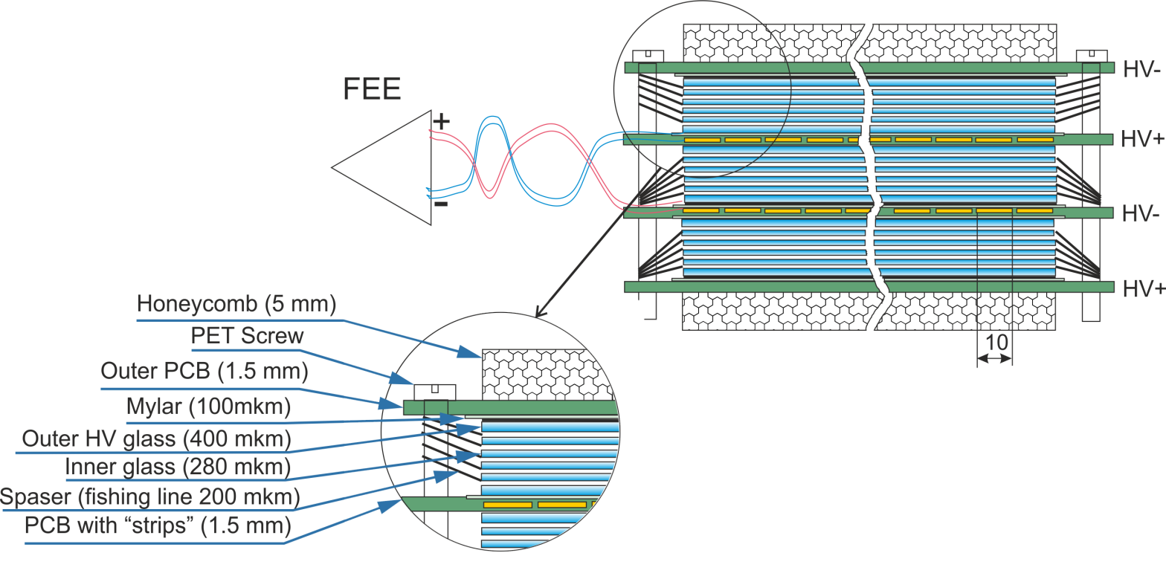
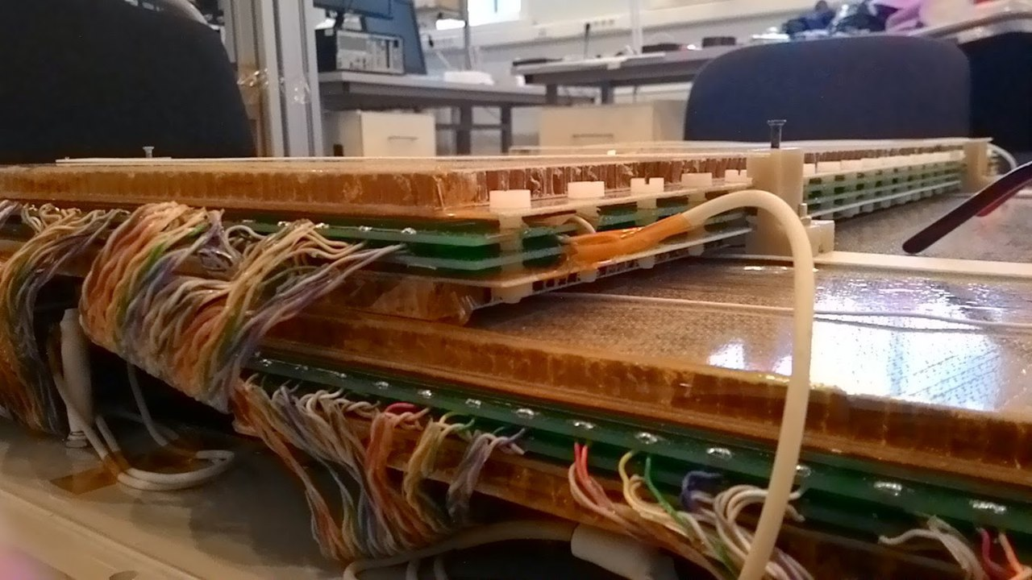
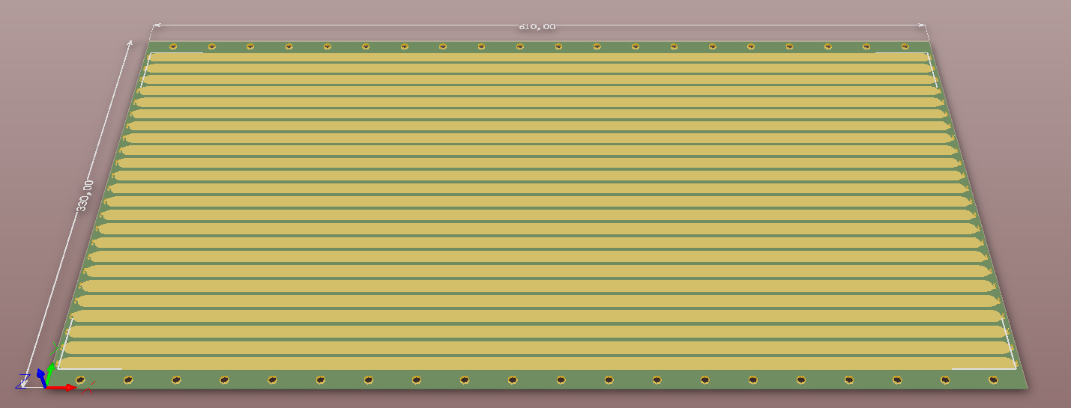
Triple-stack MRPC
Soda-lime
float glass
Triple-stack MRPC cut view
Inner readout board with strips
Assembled triple-stack prototypes in module
V. Babkin et al, Triple-stack multigap resistive plate chamber with strip readout, NIM A (http://dx.doi.org/10.1016/j. nima.2015.11.060.)
Notes:
This is the cat view of the triple-stack MRPC with strip readout. Each stack consists of 5 gas gaps of 200 mkm. Gaps are formed of common float glass with thickness of 280 microns.
The(i) active region is determined by the geometry of the entire TOF system. Currently it is 640 by 330 mm². The width of strips is 10 mm. Distance between them is 2.5 mm. Number of the strips is 24.
Why three stacks? First, we were looking for symmetric design to reduce dispersion of the differential signal on the readout strips due to different dielectrics near strips. The signal read out only from the inner stack. Thin glass plates were used to reduce the radiation length of the detector. The time resolution is improved due to large number of small gas gaps. For the same reason and due to thin glass the rate capability must be improved too.
For tests we made two prototypes: with inner glass with thickness of 280 mkm and with thickness of 400 mkm.

Slide 13
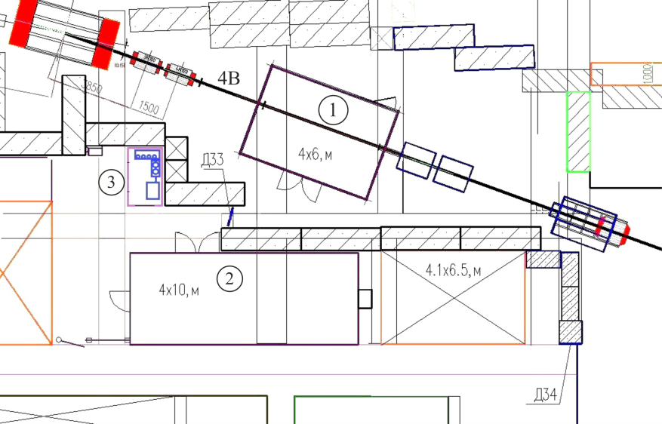
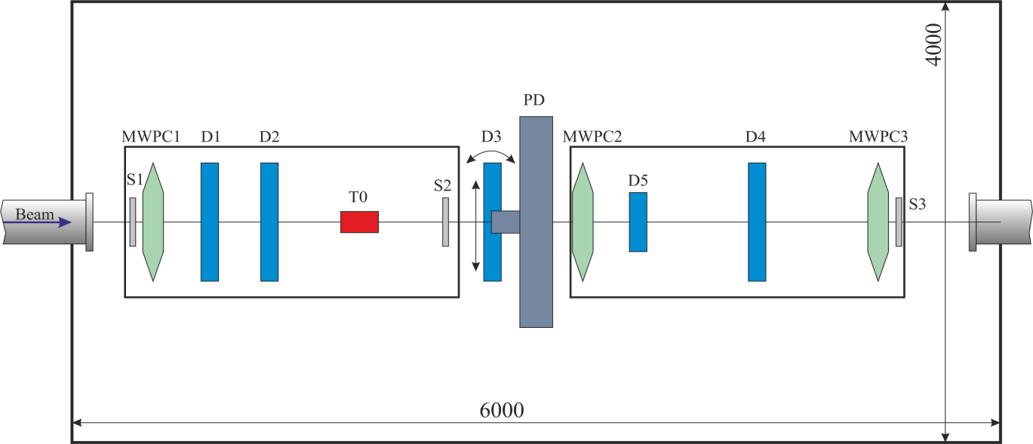
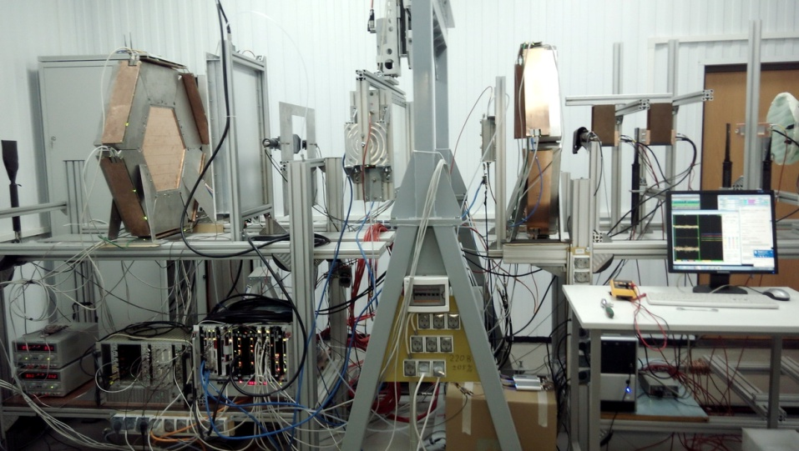
“Test beam MPD” setup
Schematic diagram of the test beam setup
two platforms made of aluminum profile;
the precision positioning device (PD);
three proportional chambers (MWPC 1, 2, 3) with an accuracy of determination of coordinate <1 mm;
trigger scintillation counters (S1-S3);
two independent gas system for various gas-filled detectors with different gas mixtures;
data acquisition system (DAQ) based on the VME and Ethernet.
March 2015 beam: deuterons, T = 2 & 3.5 GeV/A
General view of the “Test beam MPD” setup in the 51 Nuclotron session
Notes:
The basic setup for the test prototypes is the "Test beam MPD» setup.
It is situated at the channel 4B of the extracted beams of the Nuclotron.
It consists of two platforms for fixing all devices… etc
You can test all kinds of detectors.
On this basis, we test all created detectors.

Slide 14
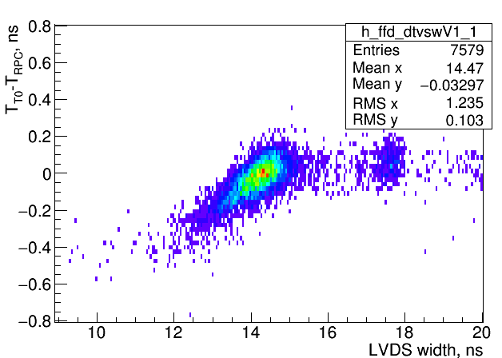
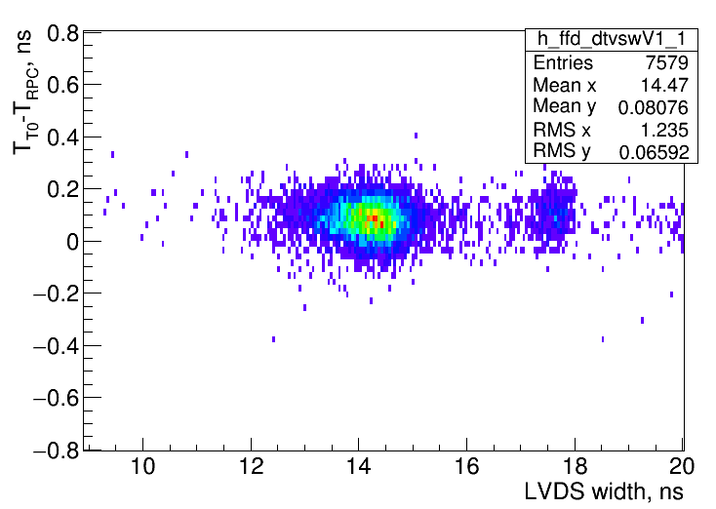
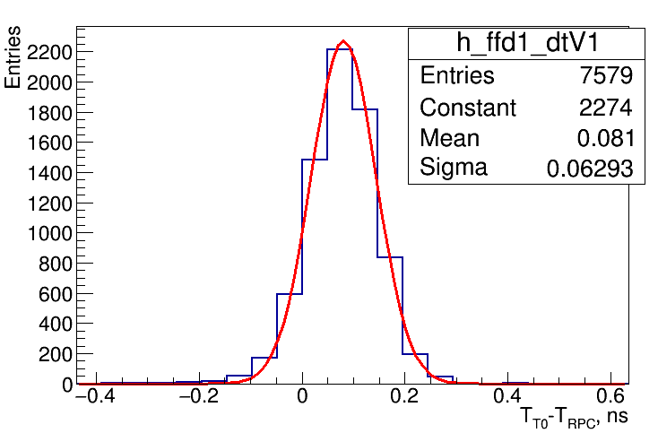
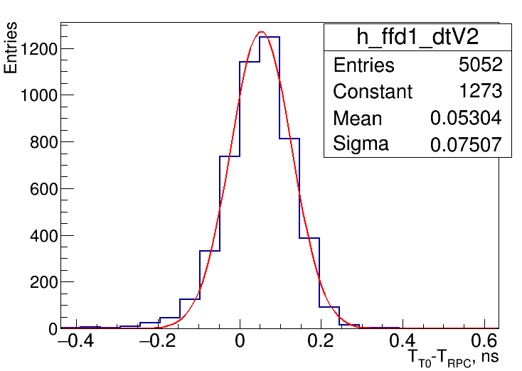
March 2015 test beam results
Before correction
After correction
280 μm, 12.25 kV
400 μm, 12.25 kV
Notes:
There are some figures which are shown t-o-t correction and typical time distribution spectra.
Time resolution for MRPCs were calculated from the difference of the squares of sigma parameter of gaus fit and time resolution of the T0.
The time resolution of the T0 detector was about 48 ps. (Due to thin quartz radiator).
Thus all the following dependencies were obtained.

Slide 15
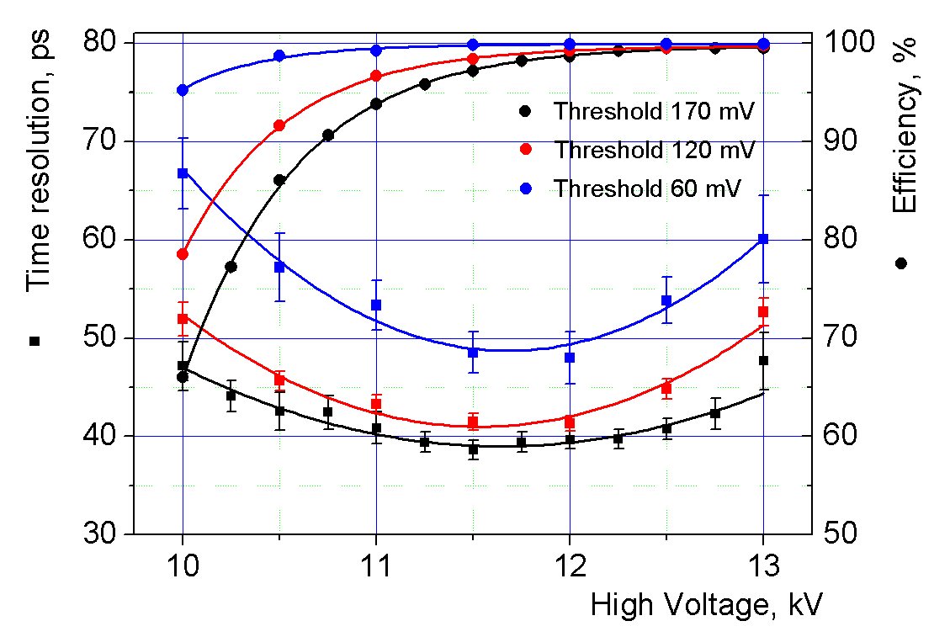
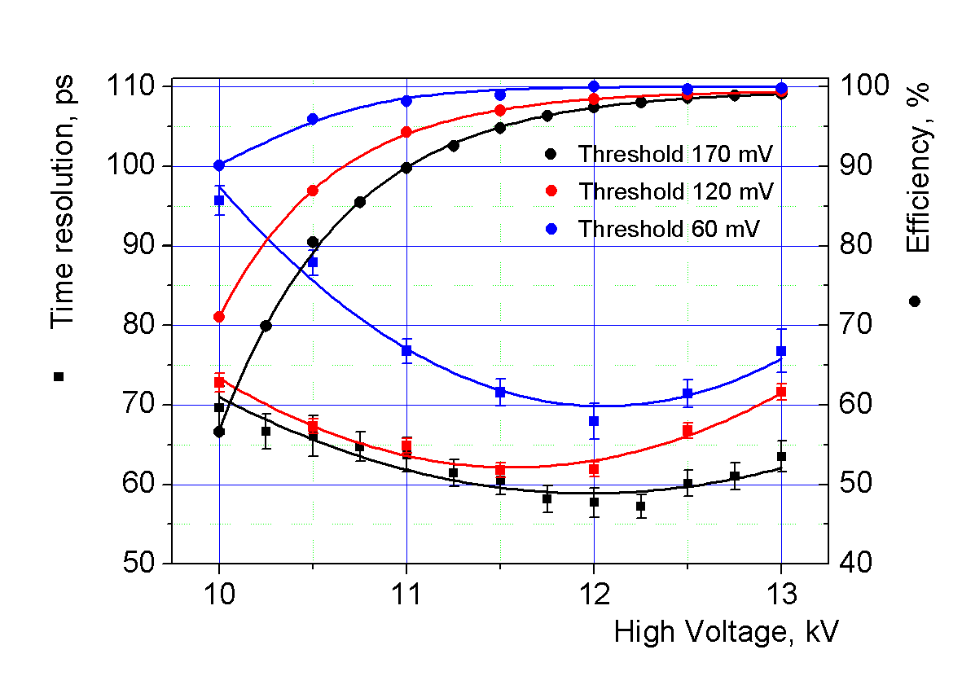
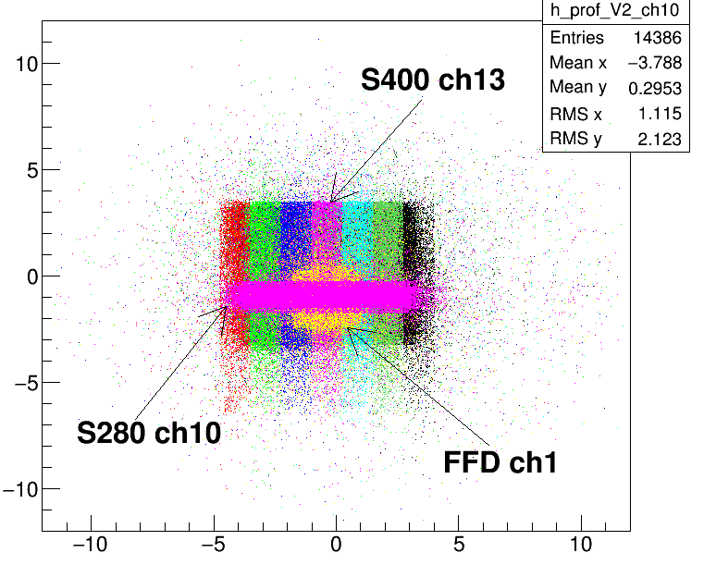
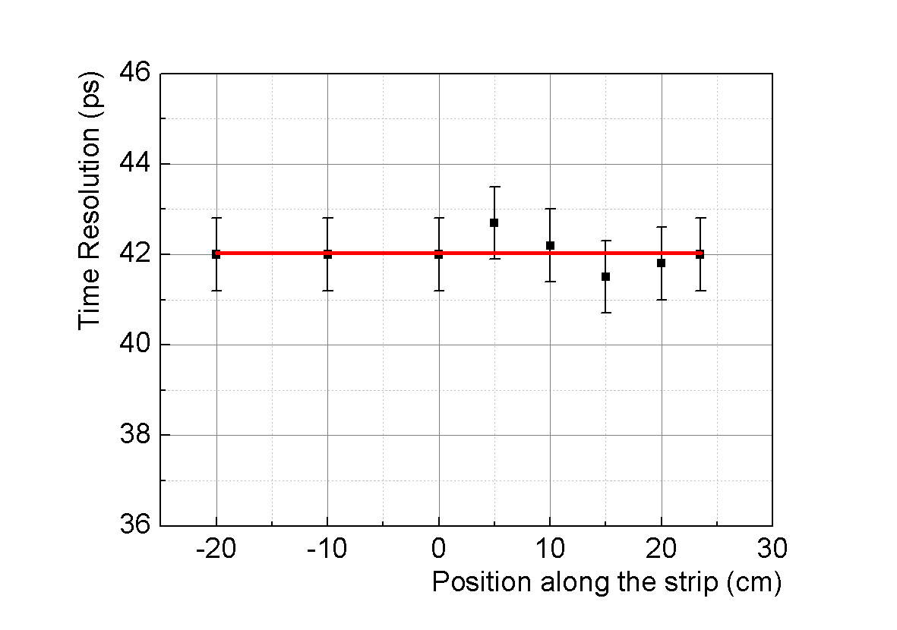
March 2015 test beam results
Time resolution and efficiency in dependence of applied high voltage
Glass thickness – 280 μm
Glass thickness – 400 μm
Y, cm
Time resolution along strip
X, cm
Notes:
First, we measured dependence of time resolution and efficiency from applied voltage for different discriminator threshold.
You see, the detector with thickness of glass of 280 mkm operated better than 400 mkm. I thought it if due to bad strip-cabel-pream impedances matching.
Because only one detector (with 280 mkm glass) was fixed on the positioning device and all other detectors was fixed and aligned, it was measured the time resolution along the strip only for this detector by moving in X direction. Time resolution is almost unchanged from the coordinates of the particles flight.

Slide 16
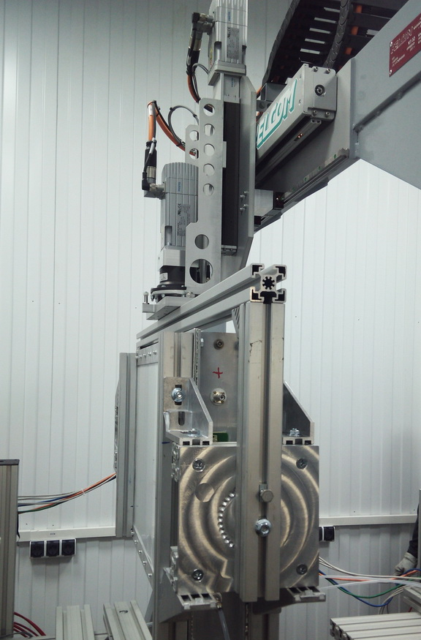
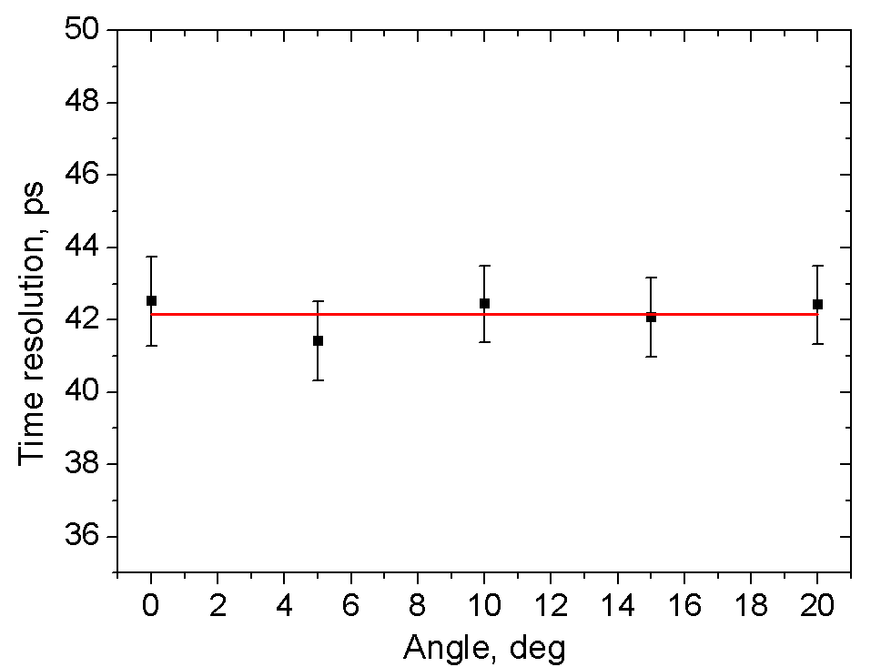
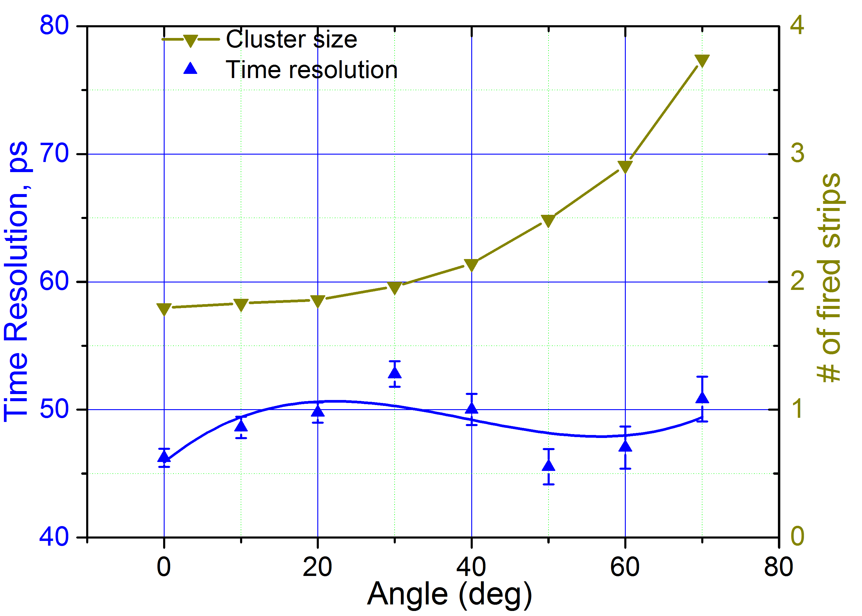
March 2015 test beam results
Influence of the angle of flight of the particles on the time resolution
Time resolution in dependence of rotation in surface XZ
The MRPC prototype in the positioning device
Time resolution in dependence of rotation in surface YZ
Notes:
Here you can see how the detector was fixed on the positioning device. We can move it in X,Y directions and rotate in two plates (XZ and YZ).
Dependence of the time resolution on the angle of particles flight were evaluated.
Changes were not observed when turning the detector in horizontal plane. But the maximum angle was only 20 degrees due to structural deficiencies of the frame. In future we plan to measure it for larger angles.
When we rotate detector in vertical plane it was observed some slight changes. But the time resolution almost did not exceed 50 ps.

Slide 17
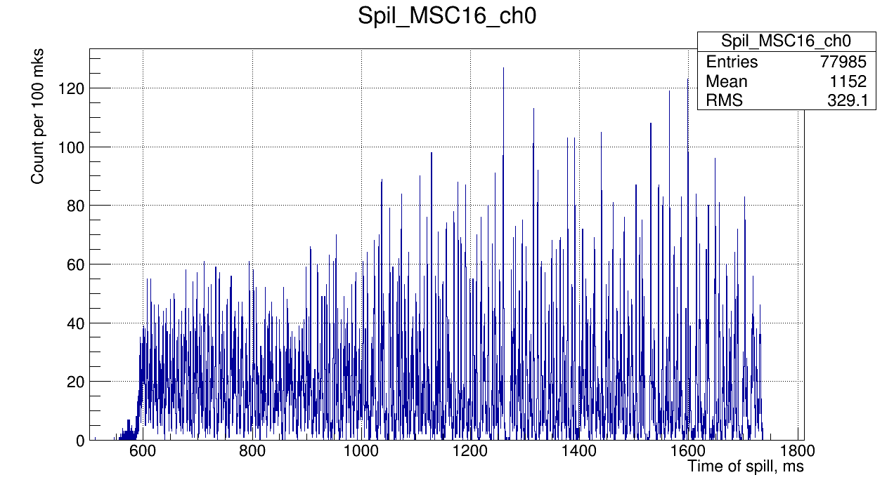
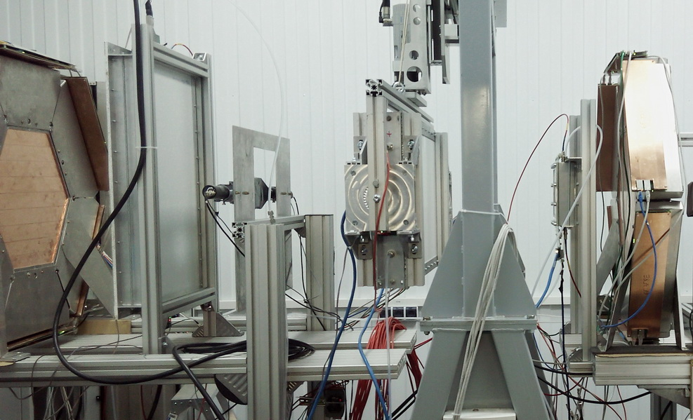
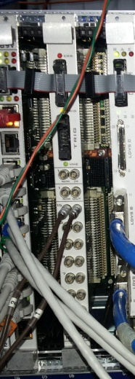
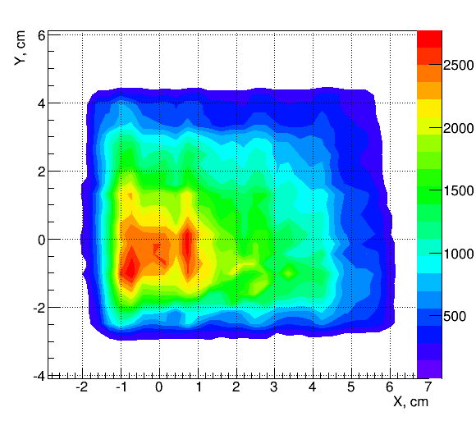
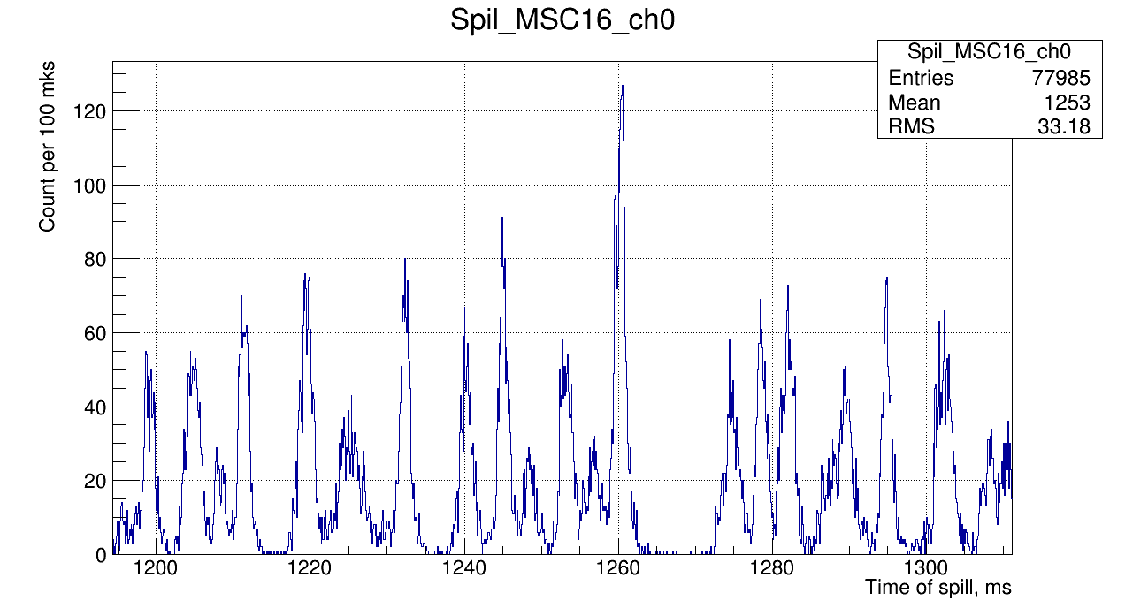
Rate scan results
How to calculate the flux of particles more accurate?
The beam profile in proportional chambers.
Red square is the area for processing. The intensity is determined by the ratio of the number of tracks in this area to the total number of tracks.
Multihit scaler
MSC16V
Notes:
Rate capability is not very interesting for barrel TOF, since the high rate region can be only on the end cups.
But it is interesting for the methodical study of the triple-stack MRPC (because we use large numbers of the thin gaps divided by thin glass).
First, how to calculate the flux of particles more accurate? We know that the structure of the Nuclotron beam is not stable in time.
We use for particles rate determination the beam profile in proportional chambers and counts of the scintillation counter.
With multihit scaler MSC16V we can measure particles rate with time sampling of 1 mks.
You can see that the structure of the beam has many peacks. But we can take into account this information in the calculations. The average intensity is sufficiently uniform.
Using time structure of the beam we divided it into some number of time intervals. Then we can calculate efficiency of time resolution for each interval.

Slide 18
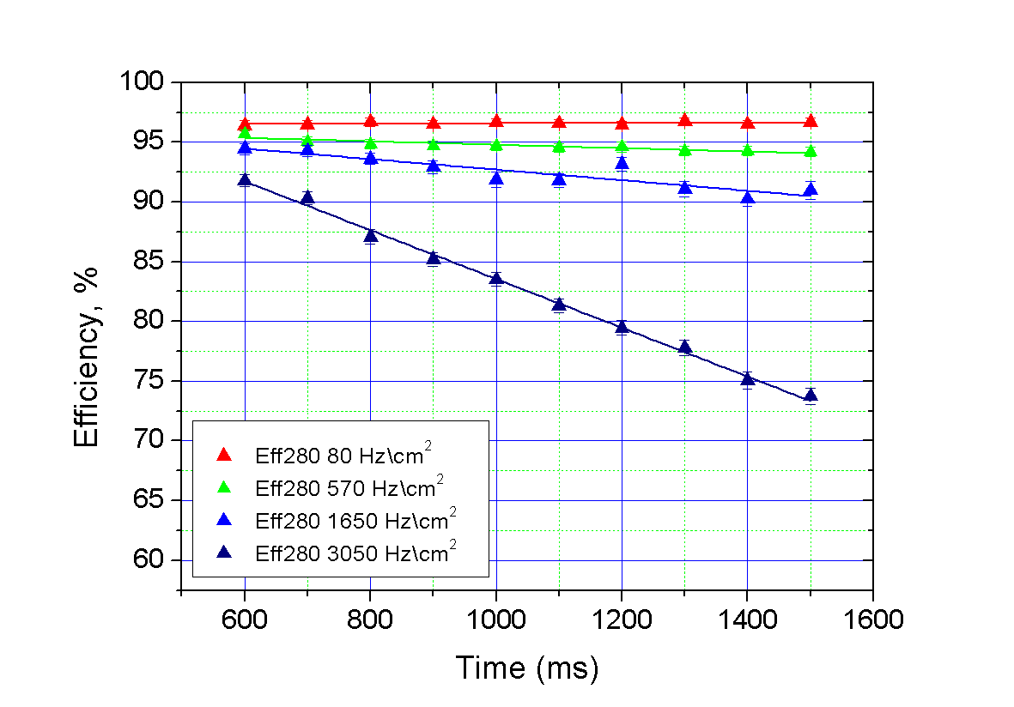
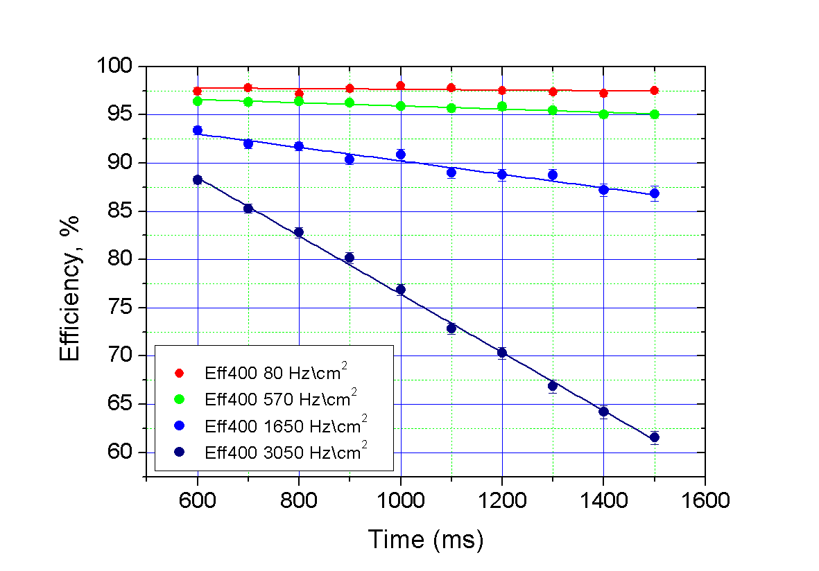
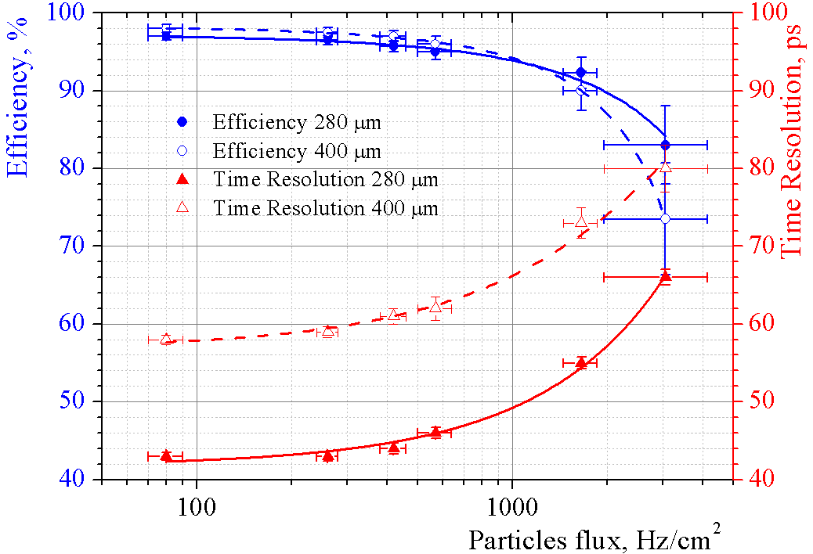
Rate scan results
Degradation of the detector efficiency due to particles flux in time.
MRPC280 (11.5 kV)
MRPC400 (12 kV)
2 kHz
The “time-averaged" efficiency and time resolution depending on intensity
Notes:
The results are very interesting. We discovered that the efficiency and resolution degrade slow in time.
Left picture for 280 mkm MRPC and right one for the 400 mkm MRPC. For 400 mkm prototype the efficiency drops from 86% to 60 % during 1 second.
Obviously, saturation for rates higher 500 must come during certain time.
In this case, demonstrating the rate capability of the detector, it is necessary to specify the duration of the measurements.Next beam test we plan to use longer extraction time for finding saturation region. For our detectors “time-averaged” eff and res looks something like this.

Slide 19
Summary:
The design of the TOF system for MPD/NICA was created and simulated.
The effect of dispersion of the signal on strips has been studied and taken into account in the design of the MRPC.
Triple stack MRPC was developed specially for TOF MPD.
Dependencies of the efficiency and time resolution from applied voltage, position and angle of the particle were measured.
It was found that the drop of efficiency depends from irradiation time. The triple stack MRPC with 280 μm glass operates with efficiency better 90% and time resolution <60 ps for particles flux up to 2 kHz/cm² during spill of 1 second .
Thank you for the attention!

Slide 20
Backup slides
Notes:
В завершении технического отчета приведен план-график работ по созданию установки и примерные оценки затрат.
Из данного графика можно выделить некоторые основные этапы (milestones):
С 2011 по 2014 годы изготавливались и проводились испытания прототипов детекторов и электроники.
В 2015 году оптимизируется конструкция модуля и начинается разработка электроники. К началу 2016 года заканчивается оборудование участок массового производства детекторов.
В 2016 году проводится подготовка к массовому производству. Закупаются все необходимые материалы и инструменты.
В 2017 – 2018 годах производится массовая сборка всех элементов TOF. С середины 2018 года начинается сборка системы считывания, газовой системы и системы медленного контроля.
В 2019 году производится тестирование всех дететоров. И с середины 2019 года начинается установка их в ярмо магнита. Начало 2020 года – ввод в эксплуатацию детектора.

Slide 21
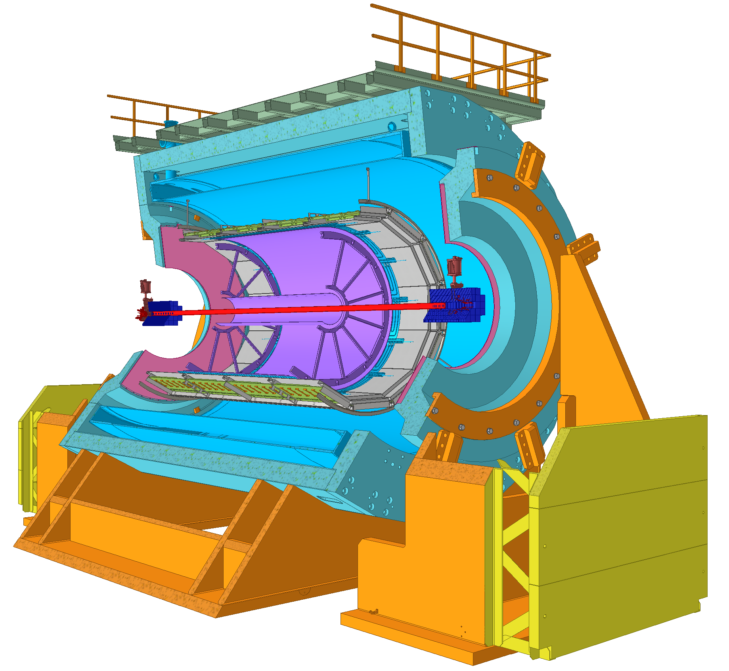
MPD setup design
The main systems of the MPD detector:
1. Particles Identification (PID) system:
– Time Projection Chamber (TPC) is measure momentum and dE/dx of charged particles;
– Time of Flight (TOF) for charged particles identification by time-of-flight;
– Electromagnetic Calorimeter (ECal) to identify electrons and photons and measure their energy.
2. Tracking system:
– Inner Tracker (IT) provide precise tracking and vertex determination;
– Time Projection Chamber (TPC) is the main device for tracking;
– Endcap Straw Tracker (ECT) and (CPC) are provide tracking for particles travailing in forward direction;
– TOF & ECal can used for additional tracking information.
3. Trigger system used for trigger definition, T0 and centrality determination:
– Fast Forward Detectors (FD);
– Zero Degree Calorimeters (ZDC).
Notes:
Представляется первая версия TDR времяпролетной системы MPD. При его написании мы придерживались рекомендованного экспертами порядка.
В введении приводится короткое описание целей эксперимента, описание геометрии центральной части многоцелевого детектора. Описывается задача идентификации частиц. И, наконец, приводятся требования и рекомендации к времяпролетной системе.
Во второй главе описываются основные прототипы МРПК, испытательные установки и полученные результаты.
Третья глава полностью посвящена техническим особенностям время-пролетной системы, а так же включает в себя результаты моделирования.
Четвертая глава содержит сведения о сервисных ситемах TOF, таких как: газовая система, высоковольтная система и тому подобное.
В конце приводится график планируемых работ с приблизительной оценкой затрат на создание детектора.
Итак, пройдемся по всем главам поподробнее.

Slide 22


Slide 23







MC simulation results
Acceptance estimation
Combined dE/dx and TOF particles identification for 0.5 < p < 1 GeV/c
Notes:
Для описанной выше конструкции была проведена симуляция GEANT. В основном, использовался генератор UrQMD.
Как видно из гистограммы (вверху справа), геометрическая эффективность TOF при таком расположении детекторов составляет ~95%.
Оценка акцептанса так же была проведена... картинки есть в тексте. В таблице приводятся конечные результаты… Видно, что…
И, наконец, оценка возможностей идентификации. Совместная с TPC de/dx дает… Необходимо более подробное изучение.

