Slide 1


Boron-10 based thin-gap Hybrid RPCs for sub-millimeter resolution thermal neutron detectors
L. M. S. Margato, ^{(a)} A. Morozov, ^{(a)} A. Blanco,^{(a)} F. A. F. Fraga, ^{(a)} P. Fonte ^{(a, b)}
(a) LIP-Coimbra, Departamento de Física, Universidade de Coimbra, Portugal
(b) ISEC - Instituto Superior de Engenharia de Coimbra, Portugal
B. Guérard ^{(a)}
(c) ILL-Institut Laue-Langevin, France
A. Mangiarotti ^{(d)}
(d) IFUSP, Institute of Physics, University of São Paulo, Brazil
R. Hall-Wilton,^{(f,} ^{g)} C. Höglund,^{(f,} ^{h)} S. Schmidt,^{(f, h)} L. Robinson ^{(f)}
(f) European Spallation Source (ESS ERIC), Sweden
(g) Mid-Sweden University, Sweden / (h) Linköping University, IFM, Thin Film Physics Division, Sweden

Slide 2

Outline
Motivation
¹⁰B4C thin gap Hybrid RPC
Experimental Setup
Results
Summary
2
L. Margato, RPC-2016 - XIII Workshop on Resistive Plate Chambers and related detectors, FEB 22-26, 2016

Slide 3
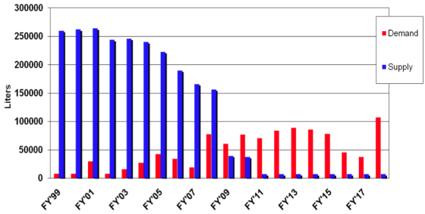
Motivation
3He crisis
New Spallation Sources(e.g. ESS)
New types of high performance 3He free thermal neutrons detectors are needed e.g. for SANS and Neutron Reflectometry.
For instance, high rate capability and high spatial resolution detectors for reflectometry applications at the ESS is a pressing need:
High detection efficiency
Spatial resolution of 1-3 mm, with a perspective of improvement into the sub-mm regime
Time resolution better than 100 μs
Local instantaneous rate capability of several kHz/mm²
He-3 is the gold standard for neutron detection in NSS (Neutron Scattering Science)
Low amounts or None Available
3
L. Margato, RPC-2016 - XIII Workshop on Resistive Plate Chambers and related detectors, FEB 22-26, 2016

Slide 4
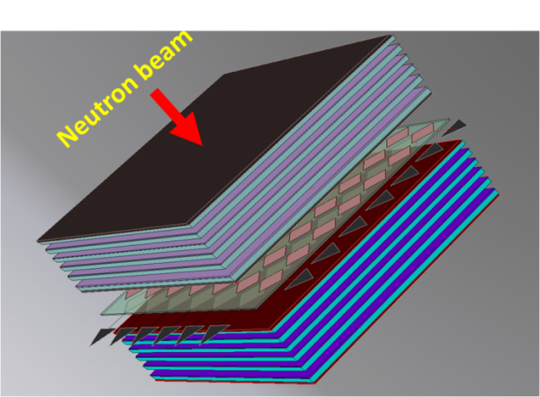
Motivation
RPCs
Well suited to operate in the multi-layer configuration - needed to ensure high neutron detection efficiency
Allow modular detector design and good scalability; Cheap technology
Well-established technique (e.g. large area detectors for high energy physics (HEP) and astroparticle physics)
Prior research showed that the idea to detect thermal neutrons with RPCs is feasible
RPCs to detect low energy neutrons has been suggested earlier (1993) by:
E. Calligarich ; R. Cardarelli ; A. Cesana ; Gianluca L. Raselli ; Rinaldo Santonico ; M. Terrani, Neutron-sensitive resistive plate chambers, Proc. SPIE 1737: doi:10.1117/12.138667
Significant works on the subject
M. Abbrescia et al. “Gd as a converter (Gd₂O₃ mixed with linseed oil) sprayed onto the bakelite electrodes of the RPC”, Nuclear Physics B (Proc. Suppl.) 125 (2003) 43-47
Arnaldi et al., NIMB 213 (2004) 284–288.
K. S. Lee, et al., Journal of the Korean Physical Society, Vol. 48, No. 4, April 2006, 846-849.
4
L. Margato, RPC-2016 - XIII Workshop on Resistive Plate Chambers and related detectors, FEB 22-26, 2016

Slide 5
Neutron detectors
Common nuclear reactions to convert neutrons
n + 3He → 3H + 1H + 0.764 MeV → Gaseous detectors (CF4, prop.)
n + 6Li → 4He + 3H + 4.79 MeV → Scintillators
n + 10B → 7Li* + 4He→7Li + 4He + 0.48 MeV γ +2.3 MeV (93%)
→ 7Li + 4H +2.8 MeV ( 7%)
n + 155Gd → Gd* → γ-ray spectrum → conversion electron spectrum
n + 157Gd → Gd* → γ-ray spectrum → conversion electron spectrum
n + 235U → fission fragments + ~160 MeV
n + 239Pu → fission fragments + ~160 MeV
5
L. Margato, RPC-2016 - XIII Workshop on Resistive Plate Chambers and related detectors, FEB 22-26, 2016

Slide 6
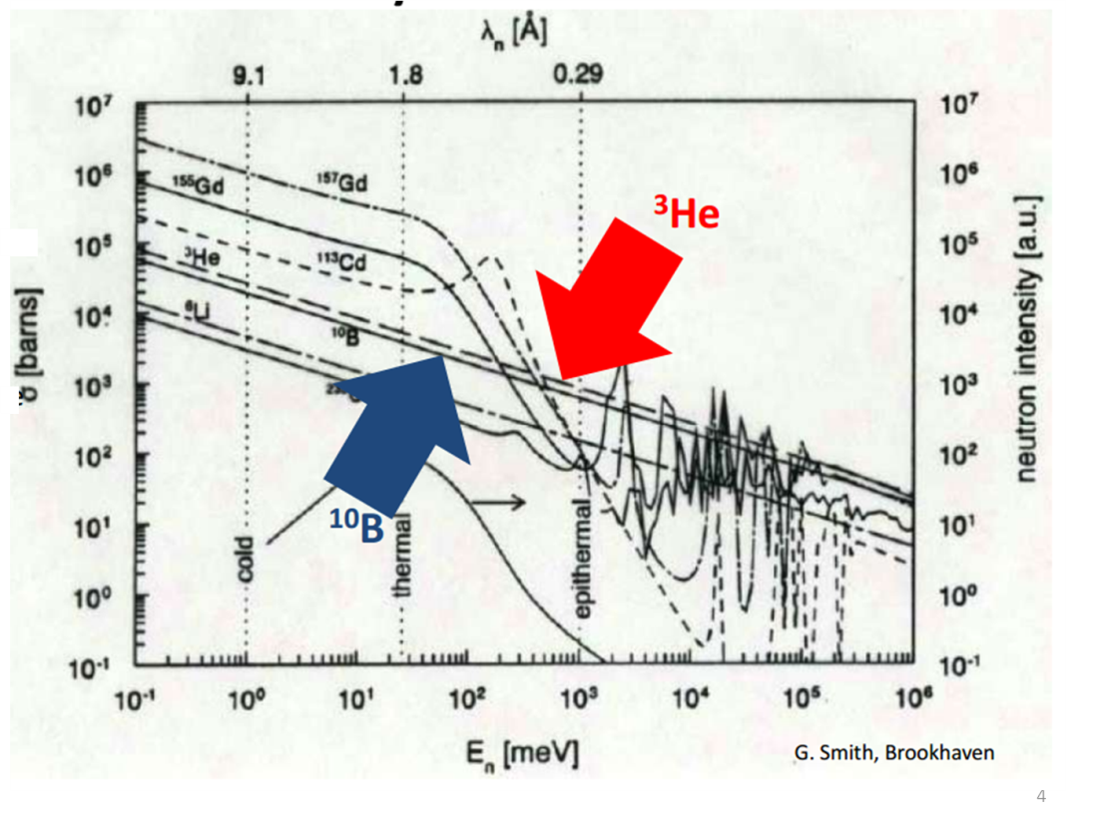
Neutron detectors
Neutron capture cross sections
6
L. Margato, RPC-2016 - XIII Workshop on Resistive Plate Chambers and related detectors, FEB 22-26, 2016

Slide 7
¹⁰B4C coated Hybrid RPC
Thermal neutron
Cathode (Al)
Li⁺
¹⁰B4C (2μm thick)
Gas gap
He⁺
E
Anode (glass)
Resistive Ink (HV)
Signal pick-up strips
Insulator
Plate of float glass (0.35 mm thick): 8 cm x 8 cm
Plate of Al (1.0 mm thick): 8 cm x 8 cm
Gas-gap width: 0.35 mm; filled with C2H2F4 @ 1 atm
Signal pick-up strips engraved on a PCB (1.5 mm thick):
  Strip width = 2 mm
  Pitch = 2.5 mm
7
L. Margato, RPC-2016 - XIII Workshop on Resistive Plate Chambers and related detectors, FEB 22-26, 2016

Slide 8

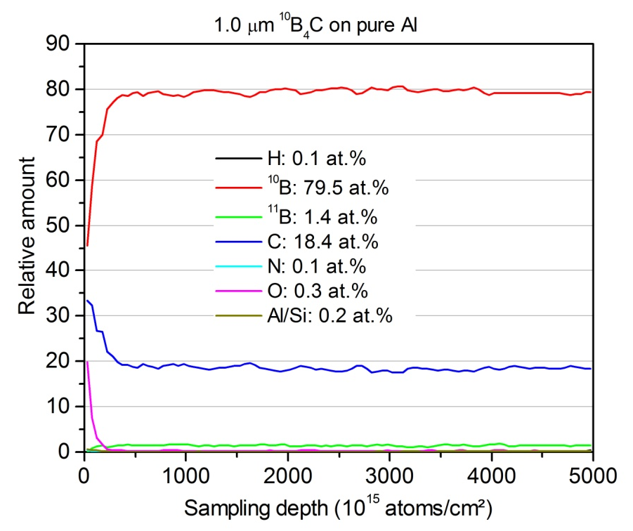
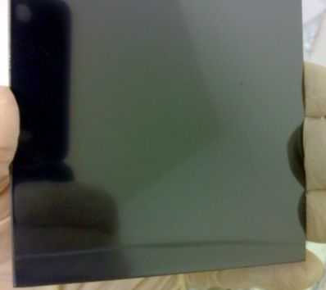
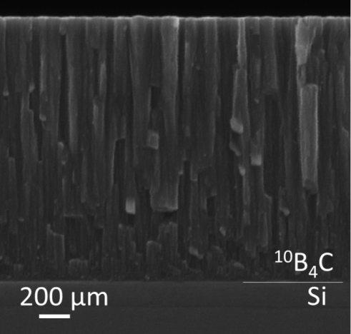
¹⁰B4C coatings deposited by DC magnetron sputtering
B4C coatings enriched in ¹⁰B (~98%) manufactured at the ESS Detector Coatings Workshop, Linköping Sweden
C.Höglund et al., J.Appl. Phys.111, 104908 (2012)
Courtesy of Susann Schmidt, ESS (SE)
SEM profile
Al plate (8cm x 8cm) coated with ¹⁰B4C (2μm thick)
ERDA depth profile of a¹⁰B4C thin film
8
L. Margato, RPC-2016 - XIII Workshop on Resistive Plate Chambers and related detectors, FEB 22-26, 2016

Slide 9
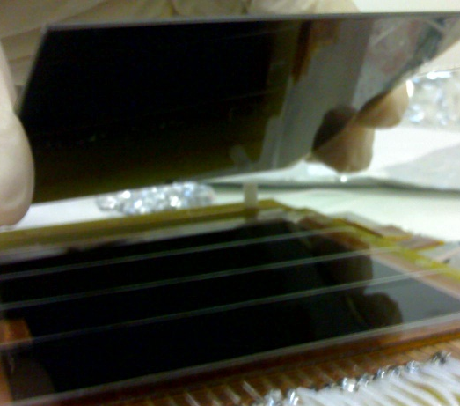
Experimental setup
Thermal neutron beam
RPC 2
Cathode (Al)
Li⁺
¹⁰B4C (2μm thick)
Gas gap
He⁺
E
Anode (glass)
Resistive Ink
(for HV distribution)
RPC 1
Signal pick-up strips
Insulator
Cathode (Al)
Gas gap
E
Anode (glass)
Mounting of the Al cathode over the anode separated by a 0.35 mm diameter monofilament of nylon.
Two RPCs with an identical geometry
RPC 1: no coating
RPC 2: Cathode (Al plate) coated with 2 μm thick 10B4C layer (enriched in ¹⁰B @ ~98%)
9
L. Margato, RPC-2016 - XIII Workshop on Resistive Plate Chambers and related detectors, FEB 22-26, 2016

Slide 10

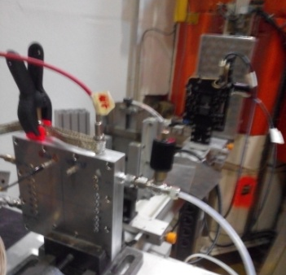
Experimental setup
Detector mounted on the CT2 monochromatic neutron beam line (λ_{n}=2.5Å) at ILL, Grenoble
RPC Detector
Collimator
neutron-beam
(2.5 Å)
Neutron beam is collimated by two cadmium slits mounted on an optical bench
10
L. Margato, RPC-2016 - XIII Workshop on Resistive Plate Chambers and related detectors, FEB 22-26, 2016

Slide 11
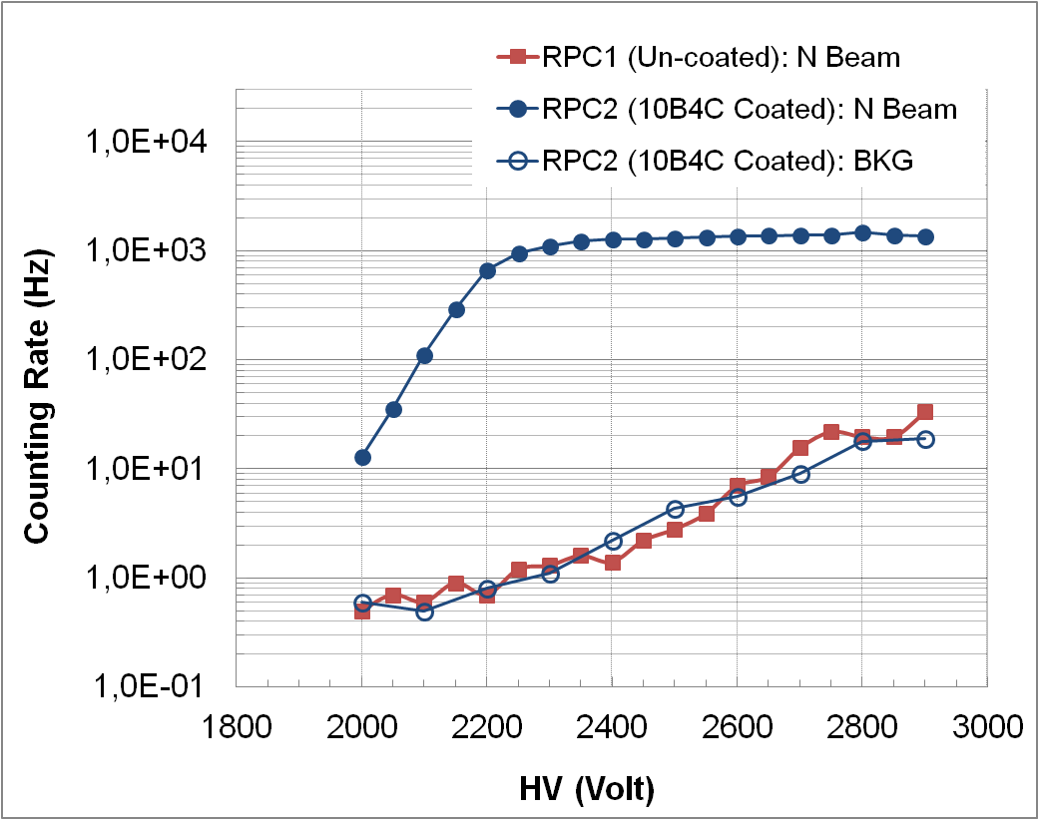
Experimental Results
Plateau measurement
  Neutron beam attenuated by 3 x plates of Plexiglass (3mm thick)
HV (Volt) | Efficiency
2400 | 5.9 %
From ANTS2 ^{(*)} simulation we got: 6.0% Obs.: ³He P. Counter used as Ref. Detector (Nominal Det. efficiency ~ 80%)
^{(*)} http://coimbra.lip.pt/ants/ants2.html
Open source code developed using CERN ROOT and Qt framework (C++)
11
L. Margato, RPC-2016 - XIII Workshop on Resistive Plate Chambers and related detectors, FEB 22-26, 2016

Slide 12
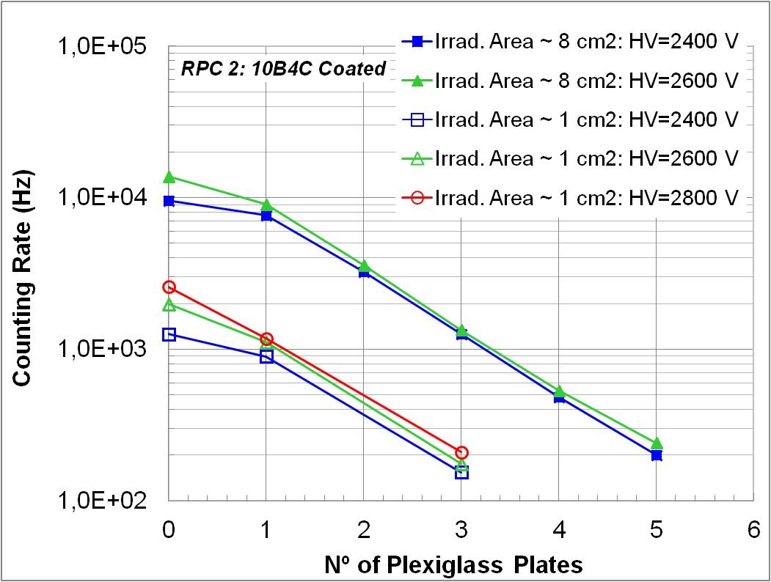
Experimental Results
Efficiency as a function of the beam intensity
Attenuators: Plates of Plexiglass 3mm thick
12
L. Margato, RPC-2016 - XIII Workshop on Resistive Plate Chambers and related detectors, FEB 22-26, 2016

Slide 13
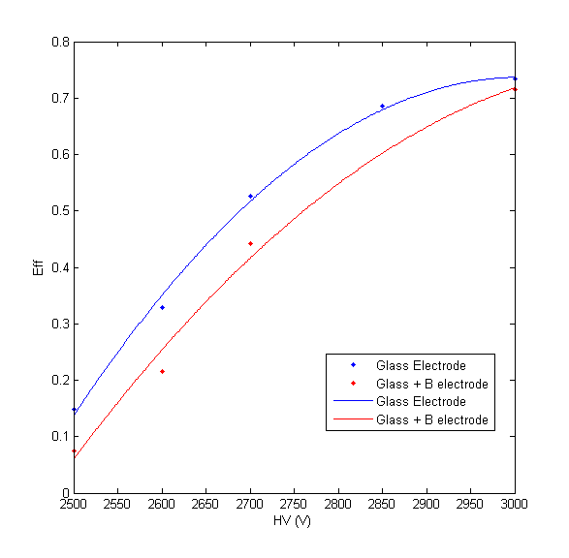
Experimental Results
Efficiency for thermal neutrons
Efficiency for cosmic rays
Measured in a monochromatic thermal neutron beam (2.5 Å)
Measured in a Cosmic Rays Telescope
13
L. Margato, RPC-2016 - XIII Workshop on Resistive Plate Chambers and related detectors, FEB 22-26, 2016

Slide 14
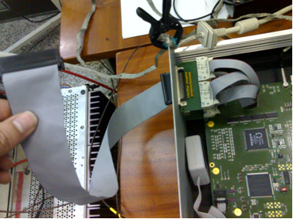
Experimental Results
DAQ System (spatial resolution measurements)
64 channels Data Acquisition System based on MAROC3 ASIC from Omega
Control and data analysis Software (developed at LIP):
  LULAS (LIP Ultra-Light Acquisition Software) for the board control
  and
  ANTS2 for Data Analysis
  http://coimbra.lip.pt/ants/ants2.html
14
L. Margato, RPC-2016 - XIII Workshop on Resistive Plate Chambers and related detectors, FEB 22-26, 2016

Slide 15
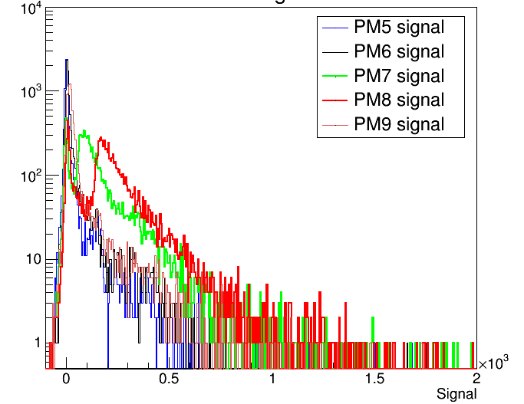
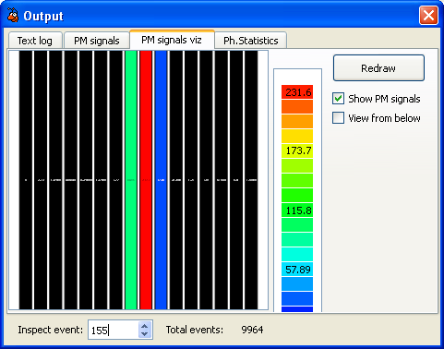
Experimental Results
Spatial resolution
  Neutron beam collimated by a slit: Slit width ~0.5 mm
HV=2600 V ; X = X0
The 3 strips fired for a chosen event
Charge spectra acquired with MAROC: 4 neighboring strips
15
L. Margato, RPC-2016 - XIII Workshop on Resistive Plate Chambers and related detectors, FEB 22-26, 2016

Slide 16
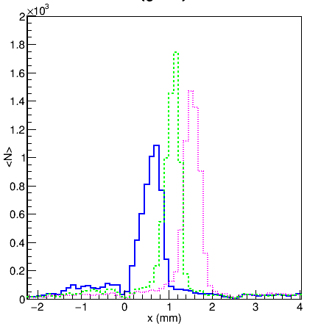
Experimental Results
Spatial resolution
Neutron beam collimated by a slit: ~0.5 mm width
  Moving stage step: 0.6 mm
  Neutron beam at 3 different positions
HV=2600 V
COG of 3 neighboring strips with the highest signal
Spatial Resolution: FWHM ~ 0.8 mm
(including the Slit width ~ 0.5 mm)
Viability for sub-millimeter resolution thermal neutron detectors
16
L. Margato, RPC-2016 - XIII Workshop on Resistive Plate Chambers and related detectors, FEB 22-26, 2016

Slide 17
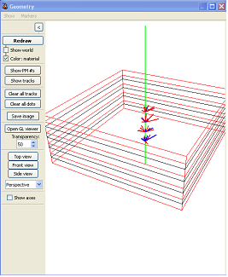
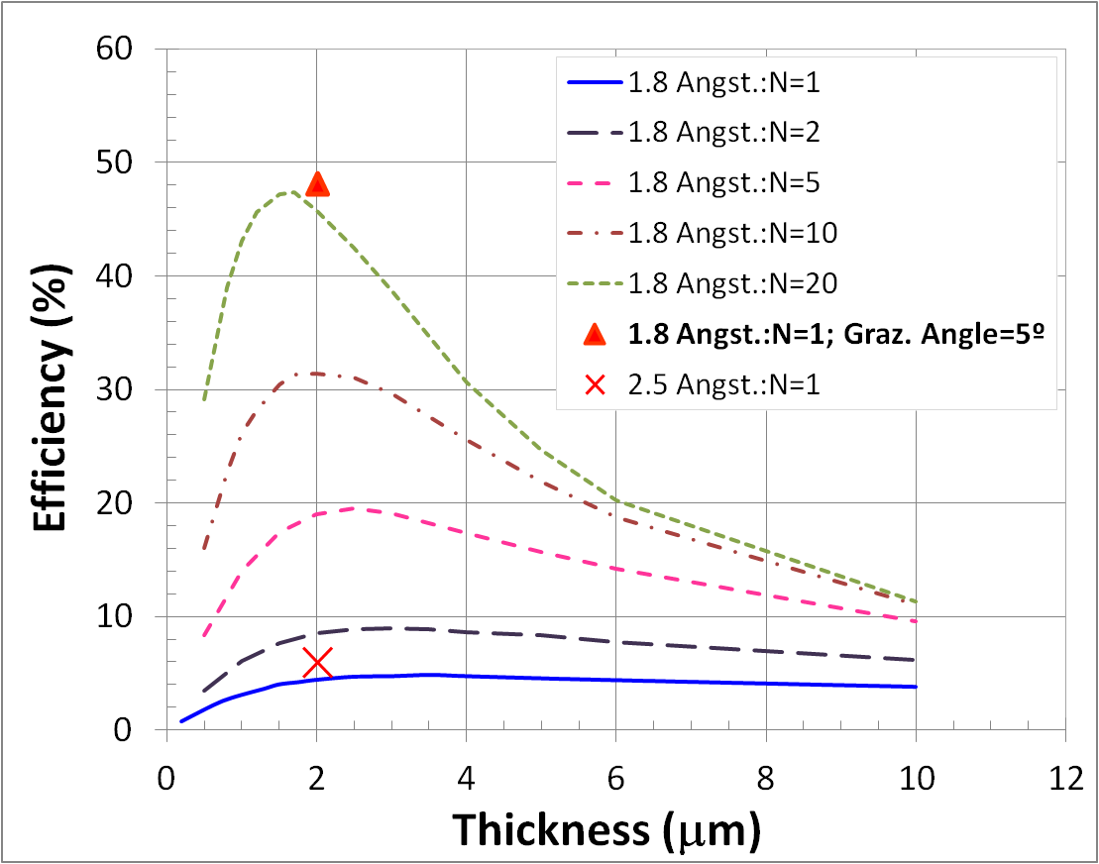
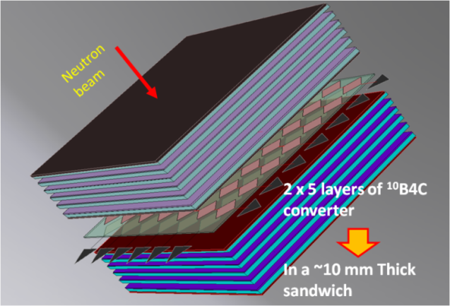
Future work
Detectors for NSS requires a efficiency ~ 50% or even higher
Detection efficiency of a single layer of ¹⁰B4C is only ~5%
How to overcome this limitation with RPCs?
Neutron converter in a multi-layer configuration
  Stack of single-gap or double-gap RPCs
  ¹⁰B4C coated multi-gap RPCs
But the ¹⁰B4C coatings should display a suitable value for the surface resistivity
17
L. Margato, RPC-2016 - XIII Workshop on Resistive Plate Chambers and related detectors, FEB 22-26, 2016

Slide 18
Summary
The ¹⁰B4C coated thin gap RPC shows a detection efficiency for thermal neutrons which are in agreement with the MC simulation.
An extended counting plateau is observed in a HV region where the RPC has low sensitivity to MIPs.
A spatial resolution better than 1 mm FWHM is measured, demonstrating the viability of ¹⁰B based thin-gap RPCs for PSNDs with sub-millimeter resolution.
Focus is now on the study of ¹⁰B4C RPC detector configurations able to provide high spatial resolution and high efficiency; In the framework of the a EU project (SINE2020) we are exploiting the feasibility of a ¹⁰B4C coated Multi-Gap RPC.
18
L. Margato, RPC-2016 - XIII Workshop on Resistive Plate Chambers and related detectors, FEB 22-26, 2016

Slide 19
Thank you for your attention
19
L. Margato, RPC-2016 - XIII Workshop on Resistive Plate Chambers and related detectors, FEB 22-26, 2016

Slide 20
Backup Slides
20
L. Margato, RPC-2016 - XIII Workshop on Resistive Plate Chambers and related detectors, FEB 22-26, 2016

Slide 21
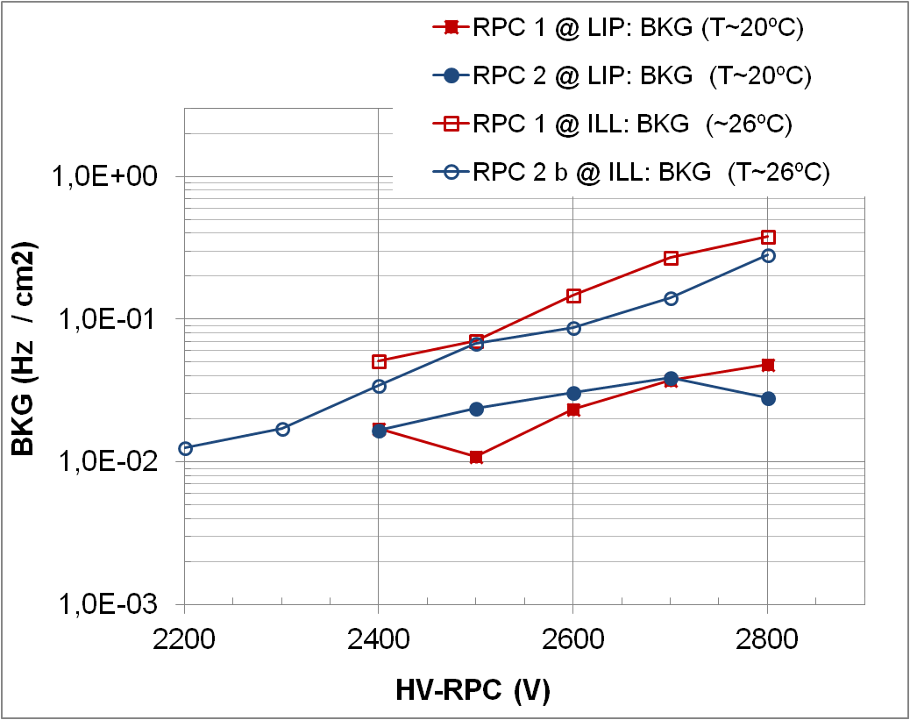
Experimental Results
Background measured at LIP (Coimbra) and at ILL in Grenoble
21
L. Margato, RPC-2016 - XIII Workshop on Resistive Plate Chambers and related detectors, FEB 22-26, 2016

Slide 22
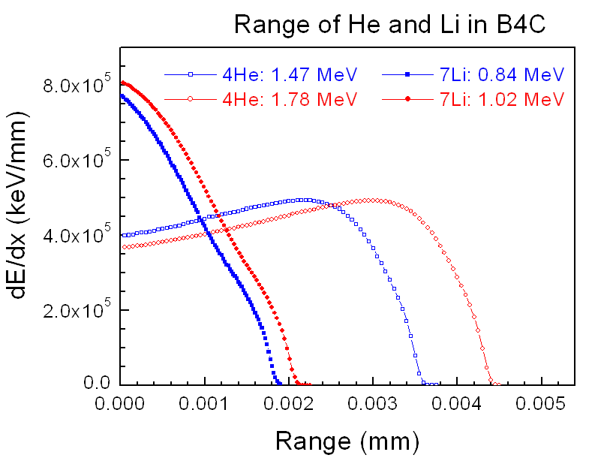
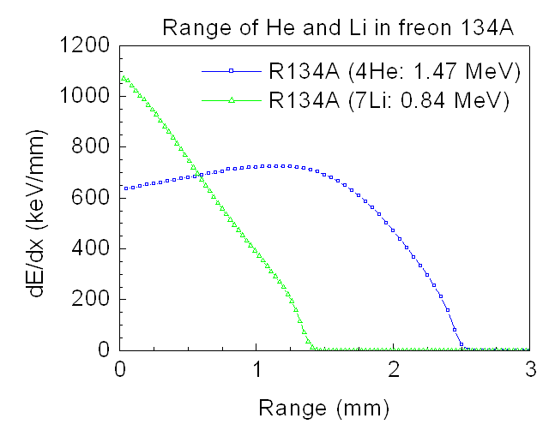
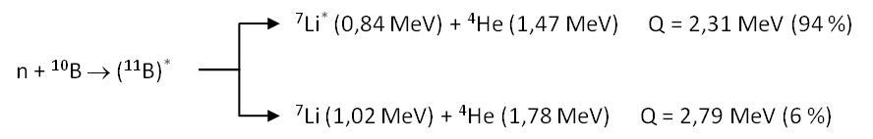
Ranges in the B4C
Ranges in the gas freon 134A
22
L. Margato, RPC-2016 - XIII Workshop on Resistive Plate Chambers and related detectors, FEB 22-26, 2016

Slide 23
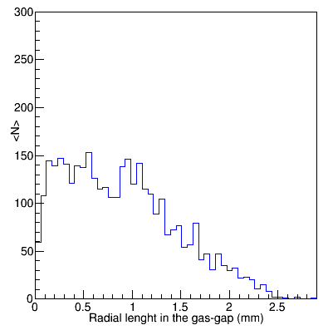
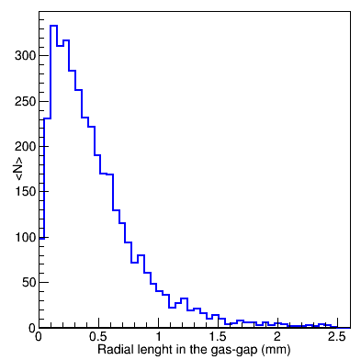
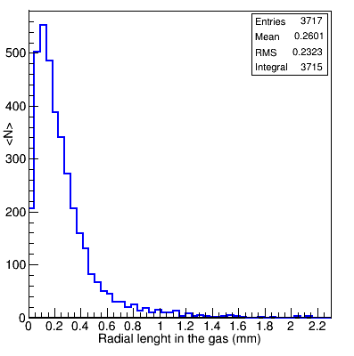
ANTS2 Simulations
Ranges for the 4He and 7Li particles in the gas-gap
10B4C thickness = 1.3 μm; λ = 1.8 Å; C2H2F4 @ 1 atm
Gas-gap: 5 mm
Gas-gap: 0.35 mm
Gas-gap: 0.175 mm
Distributions for the length of the Ranges projected in the direction parallel to the plane of the electrodes
23
L. Margato, RPC-2016 - XIII Workshop on Resistive Plate Chambers and related detectors, FEB 22-26, 2016

Slide 24
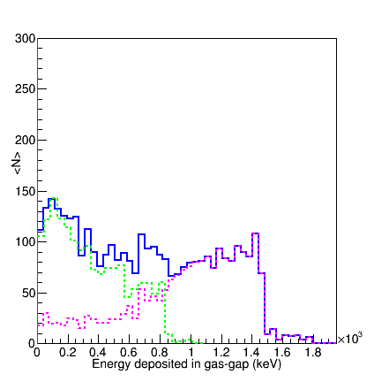
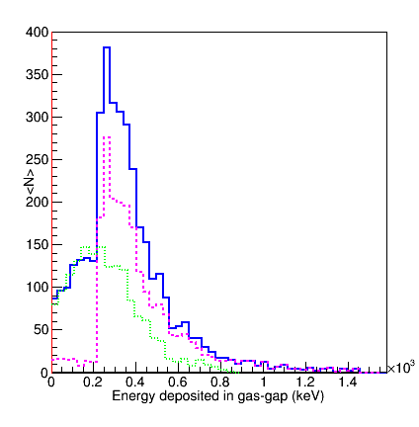
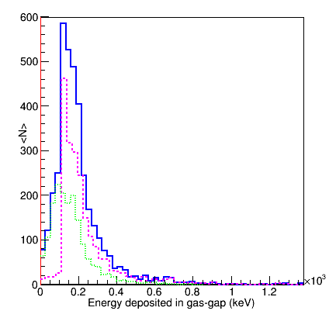
ANTS2 Simulations
Deposited energy in the gas-gap (C2H2F4 @ 1 atm) for the 4He and 7Li fissions fragments
vs. Gas-gap width
10B4C thickness = 1.3 μm; λ = 1.8 Å; C2H2F4 @ 1 atm
gas-gap: 5 mm
gas-gap: 0.35 mm
gas-gap: 0.175 mm
24
L. Margato, RPC-2016 - XIII Workshop on Resistive Plate Chambers and related detectors, FEB 22-26, 2016

Slide 25
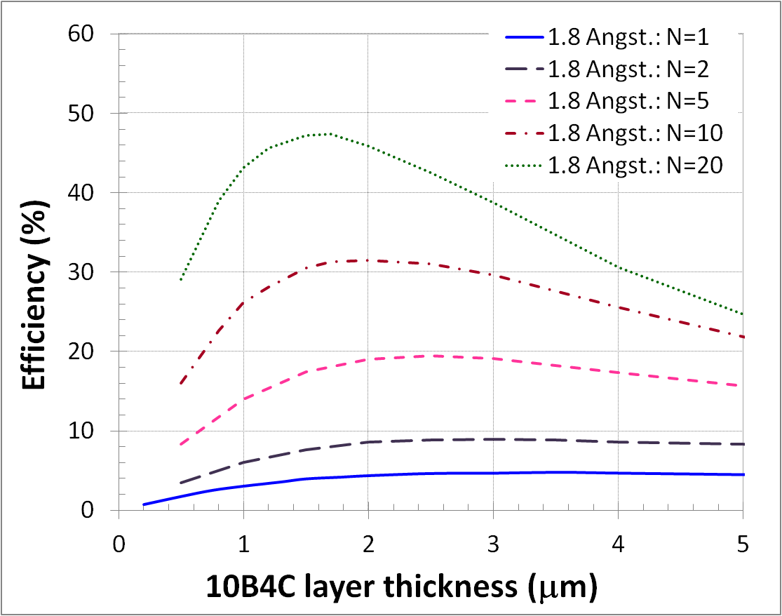
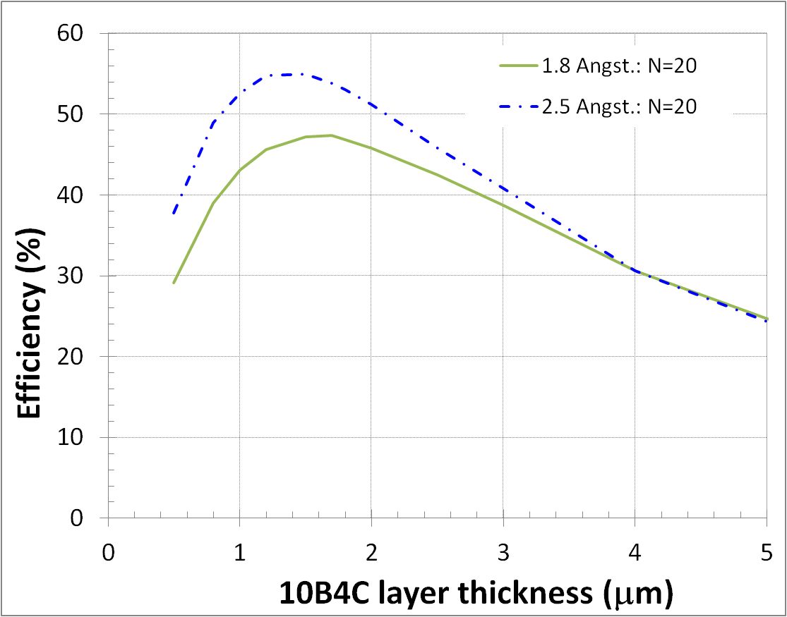
ANTS2 Simulations
10B4C layers thickness optimization
20 Layers are needed for ~ 50% Efficiency
25
L. Margato, RPC-2016 - XIII Workshop on Resistive Plate Chambers and related detectors, FEB 22-26, 2016

Slide 26
Data Acquisition
Hardware: MAROC3 test board by LAL/Omega
  64 channels
  Negtive polarity
  Dynamic range: 2 fC – 30 pC
  Low noise input optimized for PMT/SiPM
  Adjustable shaping time
  Self-triggered
  Individual gain settings per channel
  USB interface with host PC
Software: LULAS (LIP Ultra-Light Acquisition Software)
  Full control over MAROC3 configuration
  Automatic channel gain adjustment
  Acquisition rate up to 3 kHz @ 64 channels x 12 bits
  Multiplatform: Windows/Linux
26
L. Margato, RPC-2016 - XIII Workshop on Resistive Plate Chambers and related detectors, FEB 22-26, 2016

Slide 27
Charge spectra for 2 PA amplifiers having different Shaping times
HV = 2800V, BKG + ²²Na
PA-1: τ ~ 1 μs
S~1V/pC
Threshold set on the SCA (0.2) discriminates signals from the PA with a charge of ~0.1pC.
MAROC3 ASIC – ch0: τ ~ 200 ns
MAROC gain (ch0) = 200 ⇒ S~0.3 V/pC
27
L. Margato, RPC-2016 - XIII Workshop on Resistive Plate Chambers and related detectors, FEB 22-26, 2016

