Slide 1
Development and test of real-size MRPC for CBM-TOF
Wang Yi for CBM-TOF group
Department of Engineering Physics, Tsinghua University
Outline:
Introduction on FAIR and CBM-TOF
Development of low resistive glass
Design of strip-MRPC and pad-MRPC
Beam test @GSI and SPS
Conclusions

Slide 2
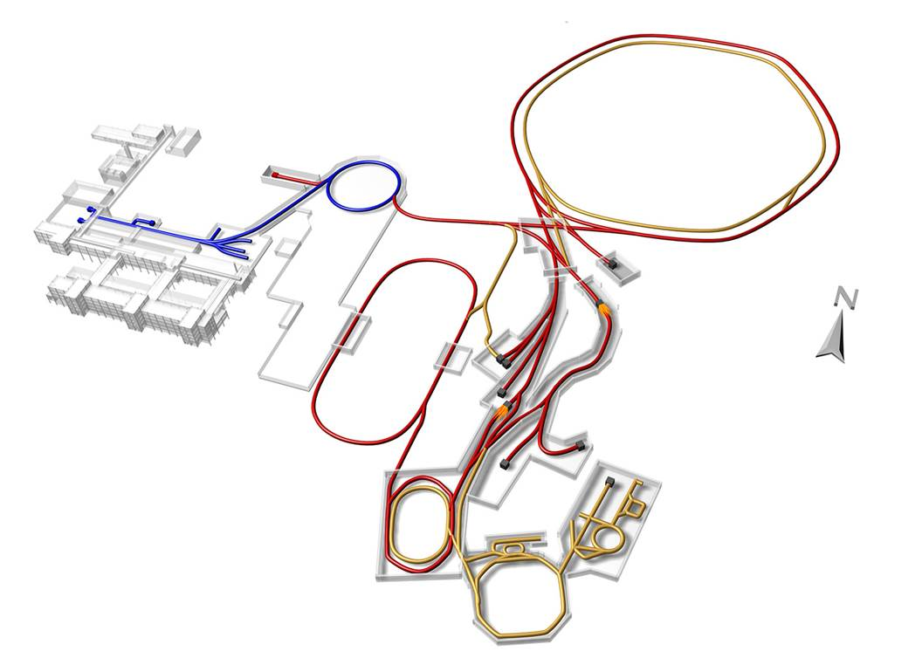
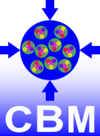
Facility for Antiproton and Ion Research
SIS18
SIS100/300
p-Linac
Atomic, Plasma, Applied Physics
Compressed Baryonic Matter
HESR
Primary Beams
Anti-Proton Physics
Super Fragment-Separator:
Nuclear Structure and Astrophysics
10¹²/s; 1.5 GeV/u; ²³⁸U²⁸⁺
10¹⁰/s ²³⁸U⁷³⁺ up to 35 GeV/u
3x10¹³/s 30 GeV protons
Secondary Beams
CR
range of radioactive beams up to 1.5 - 2 GeV/u; up to factor 10 000 higher in intensity than presently
antiprotons 3 - 30 GeV
FAIR phase 1
FAIR phase 2
100 m

Slide 3
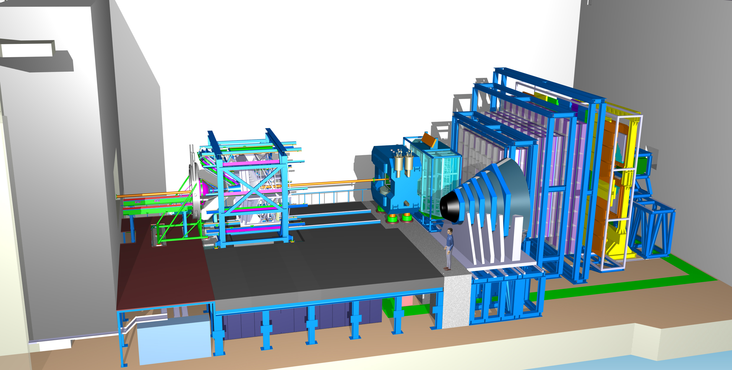
Layout of CBM detector
Ring
Imaging
Cherenkov
Time of Flight
Silicon
Tracking
System
Dipol
Magnet
Transition
Radiation
Detector
(SIS100)
Micro
Vertex
Detector
DAQ/FLES HPC cluster
(SIS100)
Projectile
Spectator
Detector
Muon
Detector
(SIS100)

Slide 4
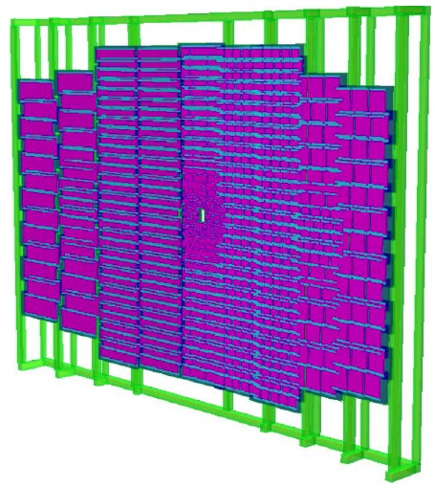
The structure of CBM-TOF wall
CBM-ToF Requirements
Full system time resolution σ_{T} ~ 80 ps
Efficiency > 95 %
Rate capability ≤ 30 kHz/cm²
Polar angular range 2.5°– 25°
Occupancy < 5 %
Low power electronics
(~100.000 channels)
Free streaming data acquisition
Au+Au, Center, 10AGeV
Simulated with CBM ROOT

Slide 5
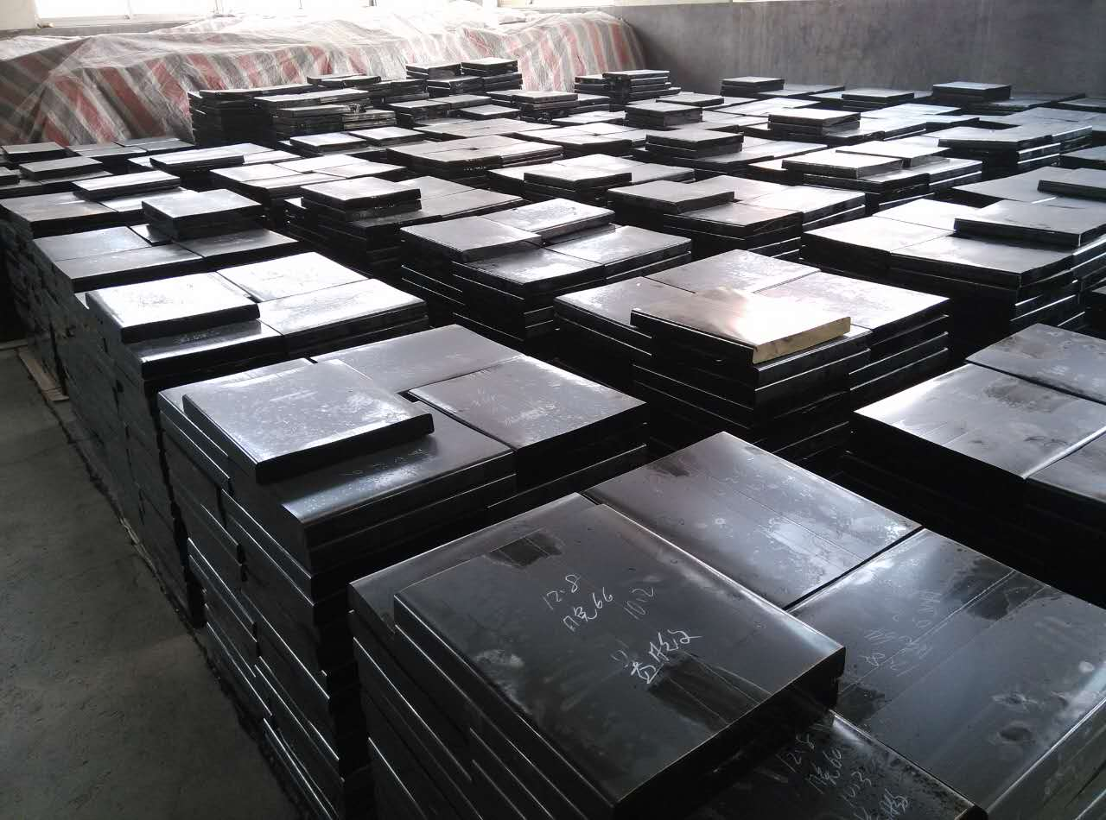
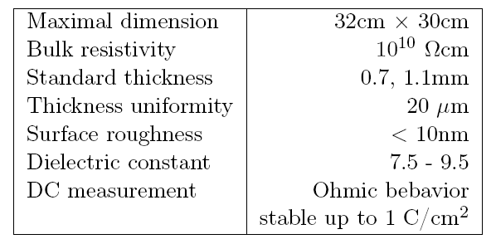
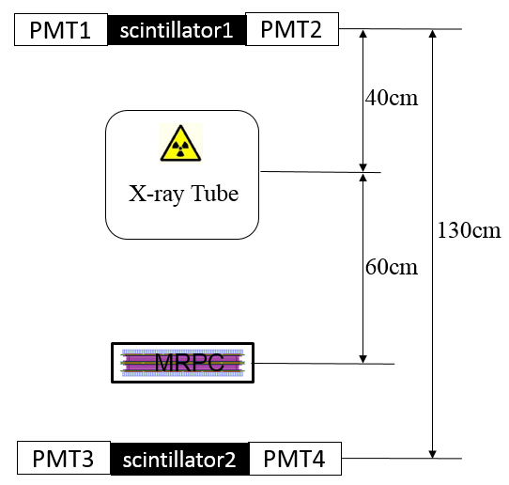
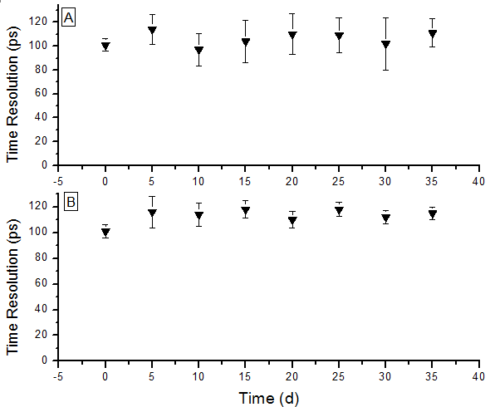
Development of low resistive glass
Performance of the glass
Glass mass production
Yield >100m²/month
Online test system. The efficiency and time resolution can be obtained by cosmic ray while irradiated by X-rays. 0.1C/cm² charge is accumulated in 35 days.
Aging test with X-ray source

Slide 6
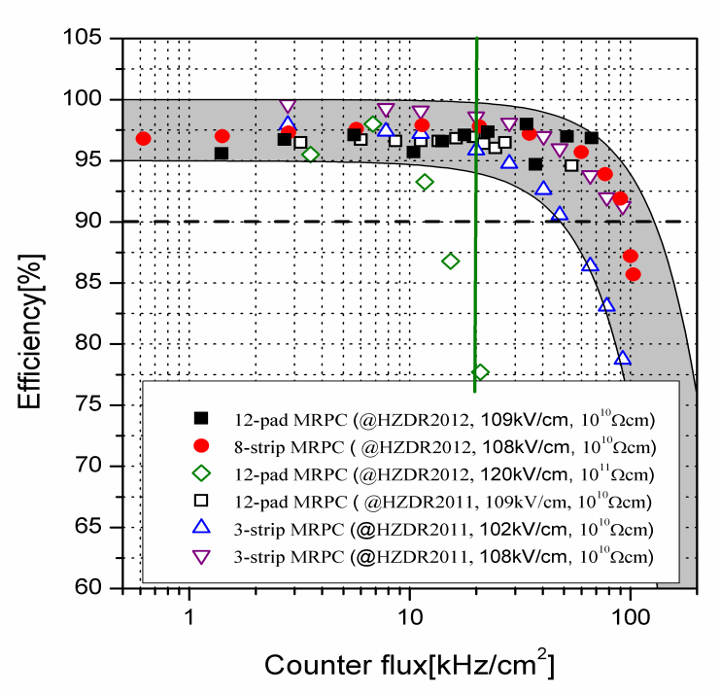
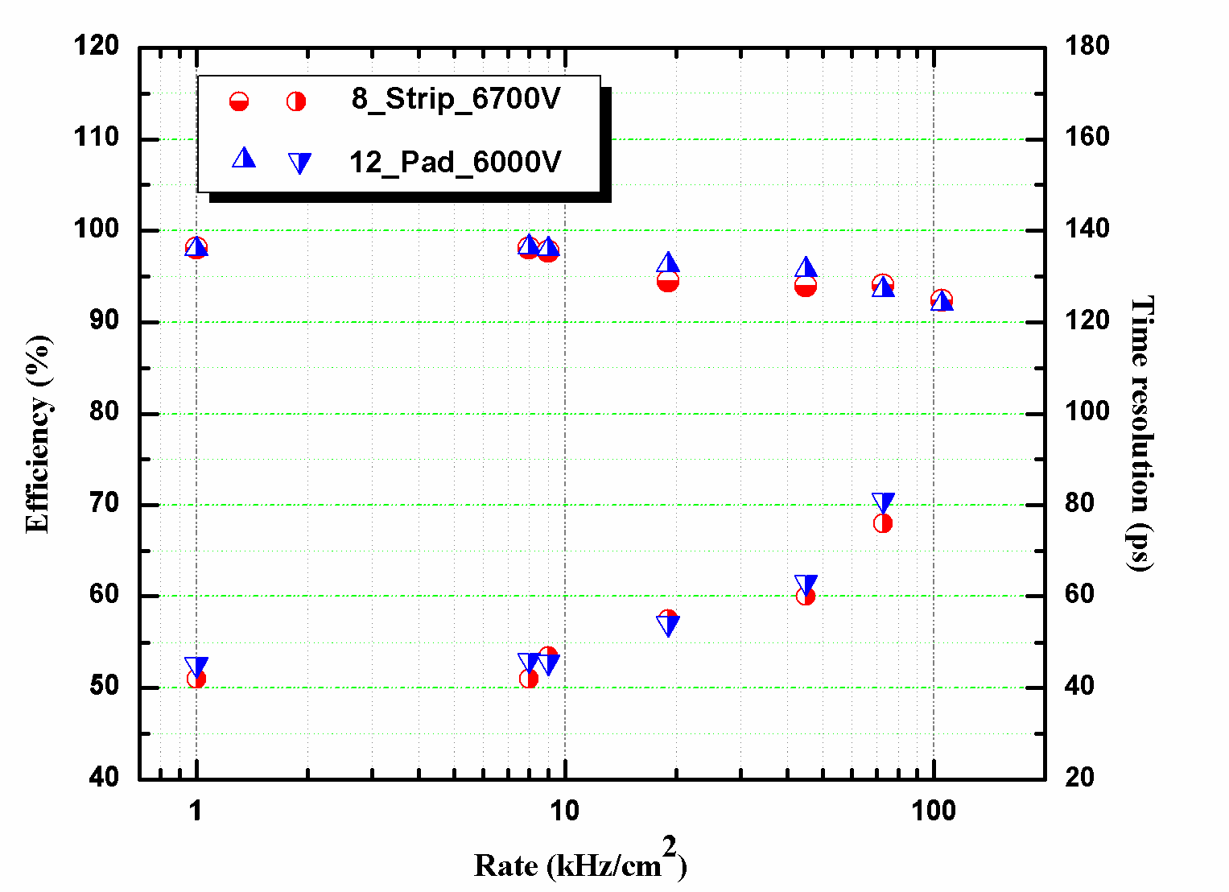
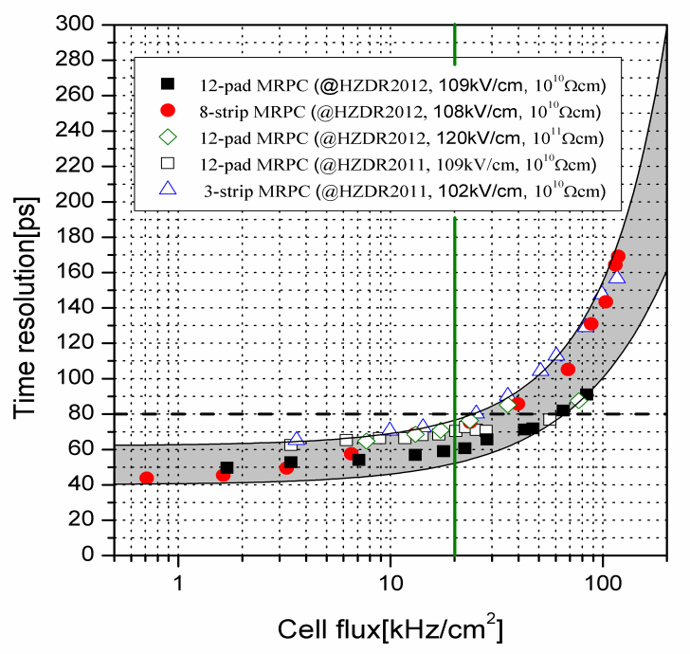
Rate capability of high rate MRPC
Test results at Nuclotron, Dubna
Rate: 70kHz/cm²
Time resolution: 40 ps
Even though the rate is 70kHz/cm², the efficiency is still higher than 90% and the time resolution is about 80ps.

Slide 7
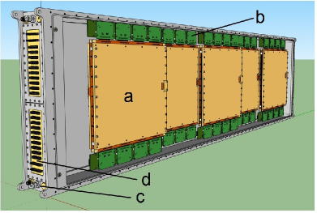
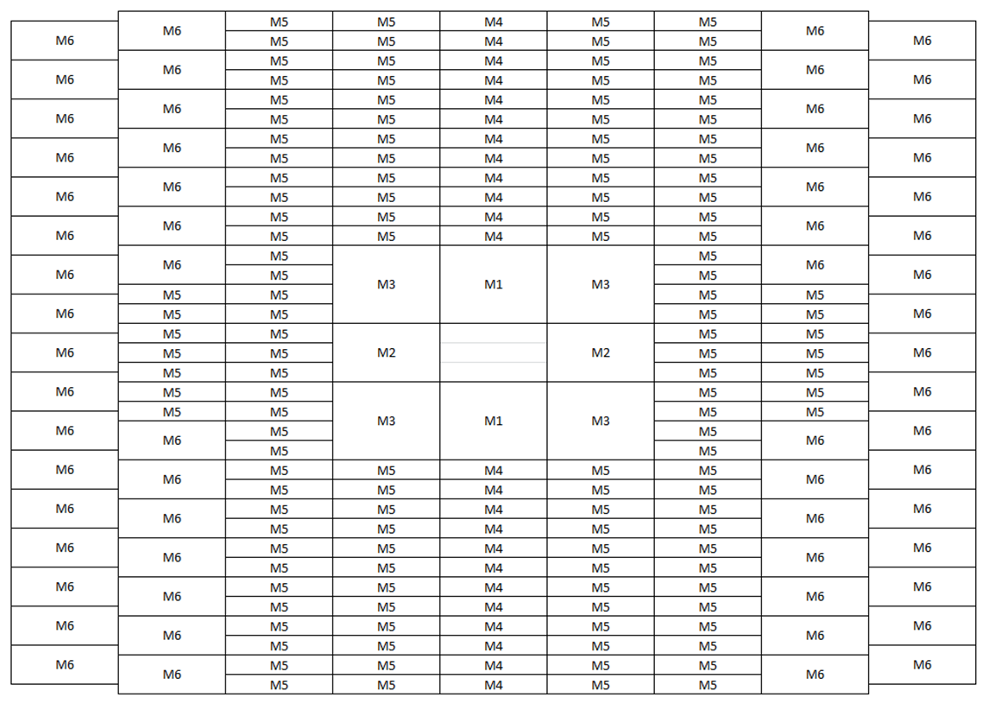
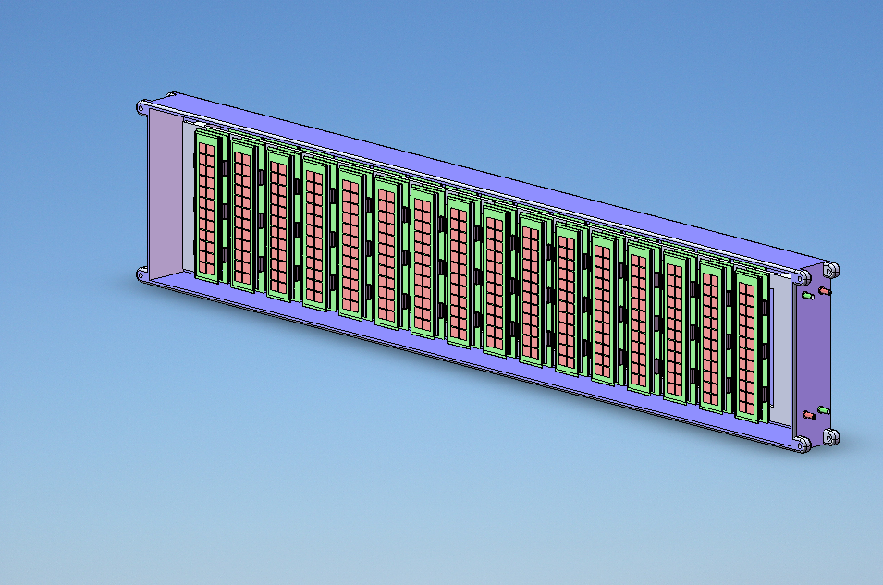
Prototype design for CBM-TOF
Strip-MRPC
Pad-MRPC

Slide 8
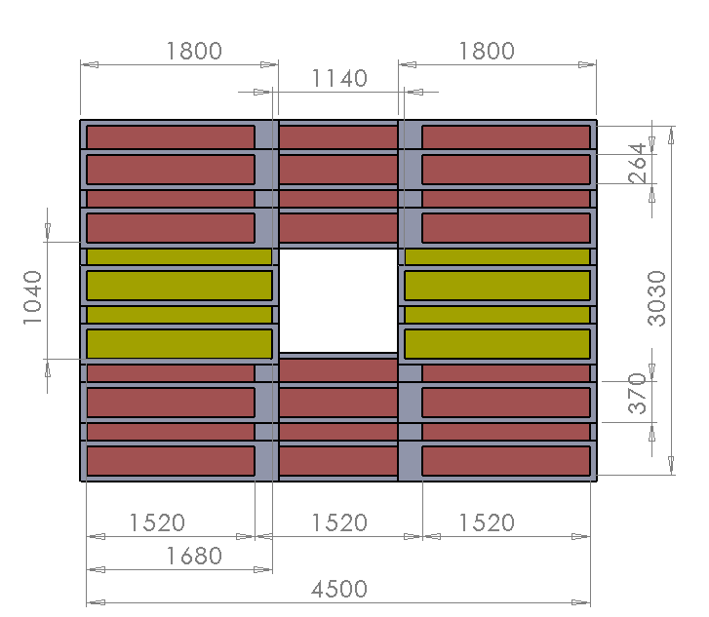
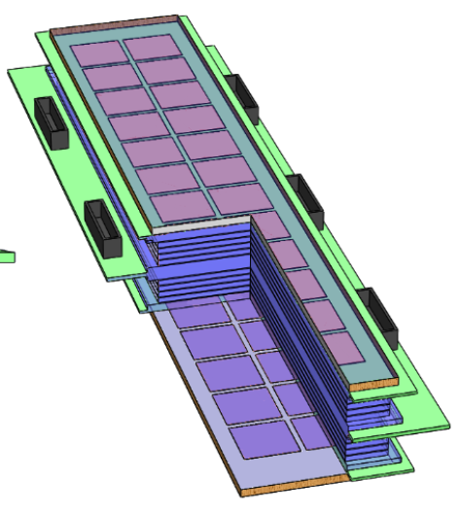
Design of inner wall based on pad-MRPC
Glass: 0.7mm, 5.2cm x 19.5cm
Pad: 2cm x 2cm, 16pads
Gas gap: 10 x 0.22mm

Slide 9
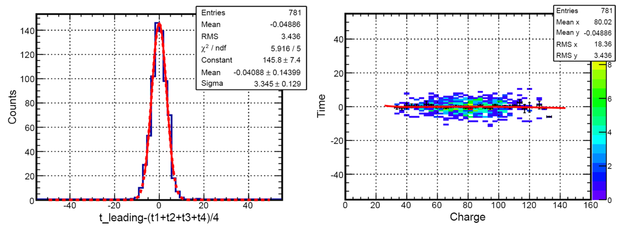
Cosmic test of pad-MRPC
HV: 6.0kV
Feature Module | Efficiency | Time resolution | Dark rate | Cluster size
MRPC_1 | 98.4% | 56.2 ps | 0.57 Hz/cm² | 1.23
MRPC_2 | 98.6% | 58.7 ps | 0.53 Hz/cm² | 1.30
MRPC_3 | 98.4% | 62.0 ps | 0.55 Hz/cm² | 1.25
The reference time is about 62ps (2.48x25ps).
9

Slide 10
Design of strip-MRPC for high rate region
Glass: low resistive glass
0.7mm thick, 27cm x 25cm
Strip: 27cm x 0.7cm, 0.3cm interval, 24 strips
Gas gap: 8 x 0.25mm, two stacks
Gas box: 600mm x 500mm x 72mm
w
t
h
ground
Differential strip: 7mm wide+3mm interval
Feed trough: Micro-strip, 50Ω
10
10

Slide 11
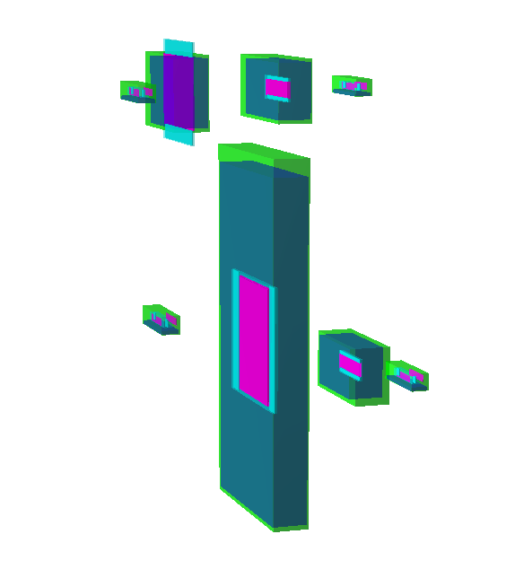
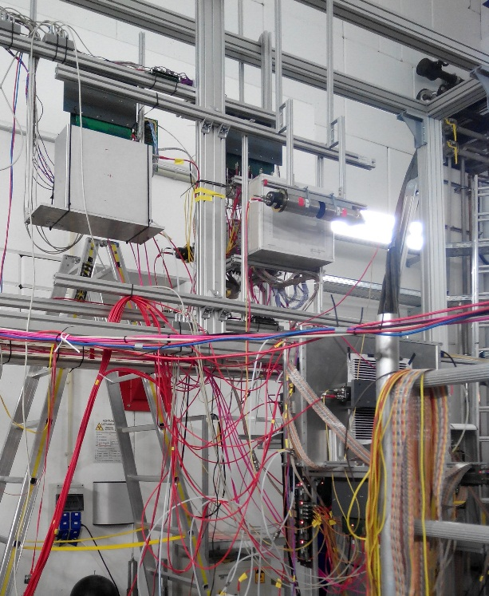
Beam test @GSI, Oct.2014
Experimental Setup:
Buc-2013
THU-Pad
Particle trajectory
BEAM
Buc-Ref
PMT
THU-Strip
HD-P2
HD-Ref
Beam time in October 2014 at GSI
1.1 GeV ¹⁵²Sm beam On 0.3mm/4mm/5mm Pb target
Flux rate several hundreds Hz/cm²
Particle trajectory
11
11

Slide 12
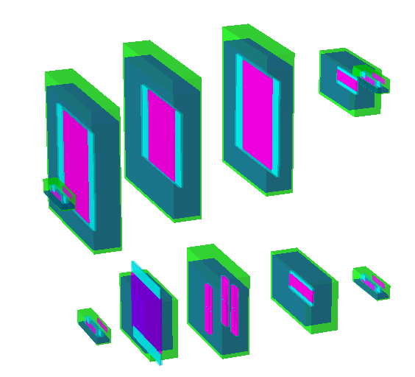
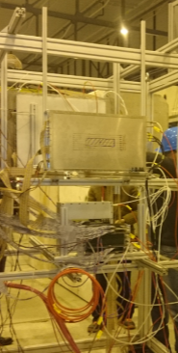
Beam test @ SPS Feb 2015
Experimental Setup:
USTC
THU-Strip
HD-Ref
HD-P2
Up setting
PMT
Down setting
High rate test in February 2015 at SPS CERN
13 GeV Ar beam
Flux rate around 1kHz/cm²
Buc-Ref
Buc-2013
THU-Pad
12

Slide 13
Data analysis method
The data analysis is based on CBM ROOT, macro developed by TOF Group.
Analysis Procedure: 3 Main Steps.
1
Unpacking
2
Cluster Building
3
Analysis
Converting LMD files into unpacked ROOT file, containing timing, TOT, super module type, super module, RPC, strip, side information of each hit.
Initial calibration: Align center of each strip in Detector Under Test and Reference Detector.
Build calibrated hits into clusters.
Iterative calibration: Calibrate data in time-walk, gain and velocity correction.
Calculating observables from fully calibrated hits include cluster size, time resolution and efficiency.

Slide 14
Calibration method
Time-walk correction
Large signals arrive at discriminator threshold faster, leading to a dependence of measured time and amplitude of the analogue signal.
Gain correction
Amplification gain of PADI varies between each channel, which should be corrected out to get initial amplitude for time-walk correction.
Strip alignment correction
Different cable length and electronic delay lead to the shifting of calculated center of different strip, influencing the position of hits.
Velocity correction
Slower particles need a longer time to cross the distance between Dut and Mref, widen the time difference distribution.

Slide 15
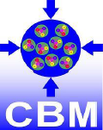
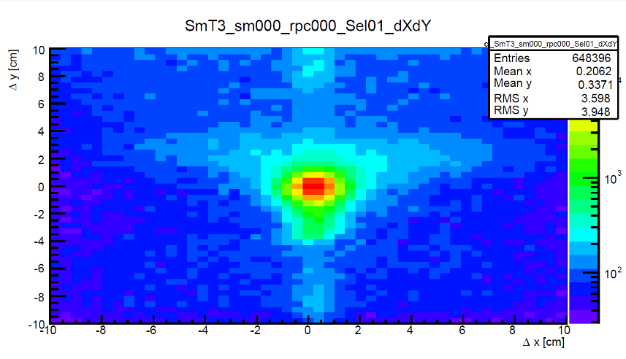
Analysis results: GSI Oct 2014
Analysis Setting:
Analysis Procedure:
Init_calib.sh (Initial calibration)
Iter_calib.sh (Iterative calibration)
iteration procedure: 1-6-8-2-10-2-10
Iter_hits.sh (Analysis)
analysis correction procedure: 1-2-3-4-1
Lower part of setup:
Diamond
THU-Strip
HD-Ref
Cut Selection: Cut 1
tofAnaTestbeam->SetMul4Max(1.);
tofAnaTestbeam->SetCh4Sel(8.);
tofAnaTestbeam->SetDCh4Sel(7.); tofAnaTestbeam->SetPosY4Sel(0.5);
tofAnaTestbeam->SetMulDMax(1.); tofAnaTestbeam->SetDTDia(0.);
Particle
BRef:
Starting counter for events.
Dut:
Counter under test.
MRef:
Reference measure for Dut.
15

Slide 16
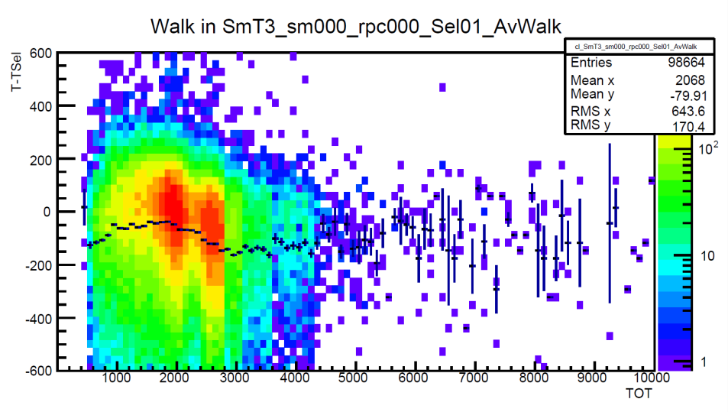
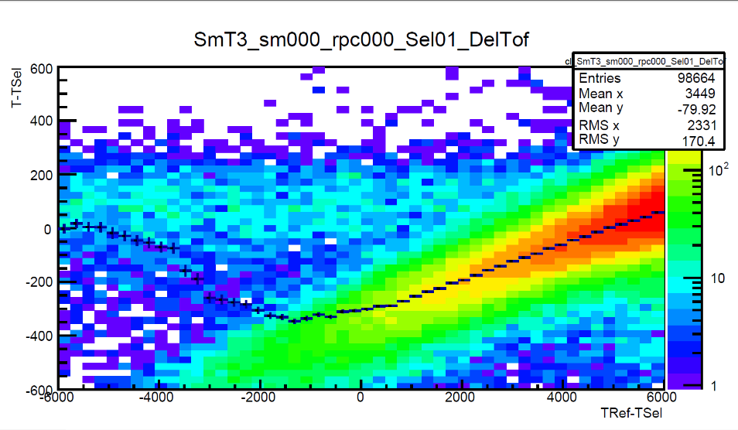
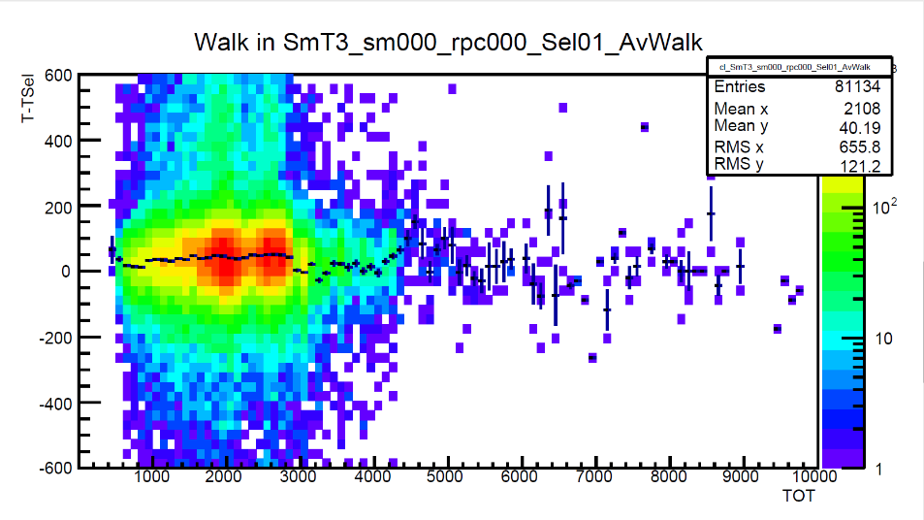
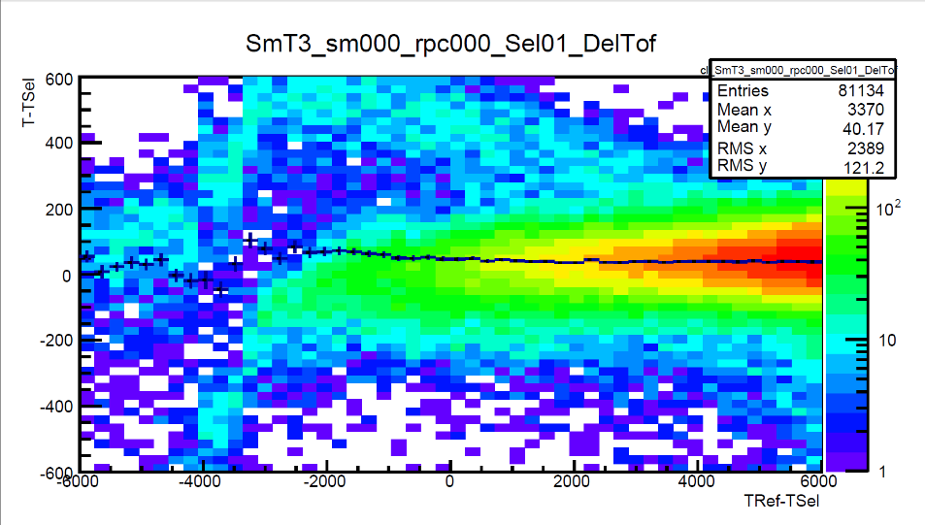
Run: Sun1205 – 5500V: Analysis Process
Time-walk correction
Velocity correction
Before Calibration
After Calibration

Slide 17
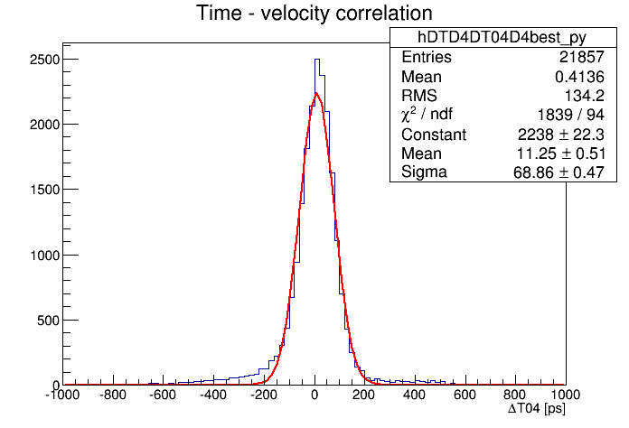
Results of strip-MRPC
Run: Sun1205 – 5500V Time Resolution
Efficiency:
Around 97%
Analysis Result under Different Threshold
Threshold | Efficiency | Time Resolution | Cluster Size
170mV | 97.0% | 71.6ps | 1.7
180mV | 97.0% | 68.9ps | 1.7
190mV | 97.0% | 71.0ps | 1.6
200mV | 96.7% | 68.9ps | 1.6
Time resolution:
Around 70ps

Slide 18
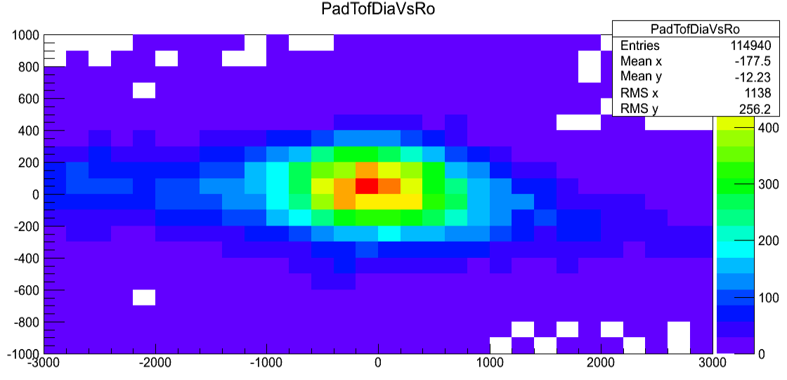
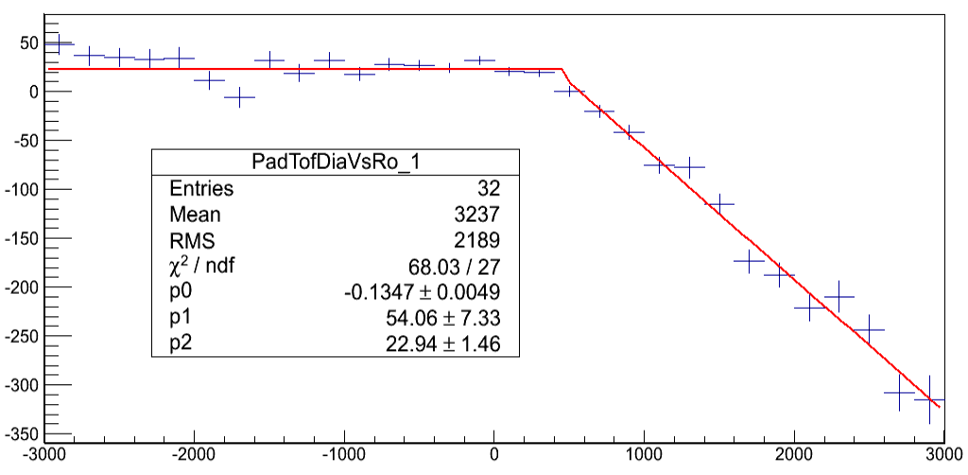
Velocity correction for pad-MRPC
We Plot Y: (ThuPad tdc - BucRef tdc) vs X: (ThuPad tdc –RefTdc(fastest diamond tdc)) and Y: (BucRef tdc - ThuPad tdc) vs X: (BucRef tdc – RefTdc)
FitSlicesY() for these plots, then fit the mean value of each bin with a function, fun = pol 0+pol 1, and correct every BucRef tdc with BucRef tdc ‘ = tdc – fun->Eval(ThuPad tdc –BucRef tdc)

Slide 19
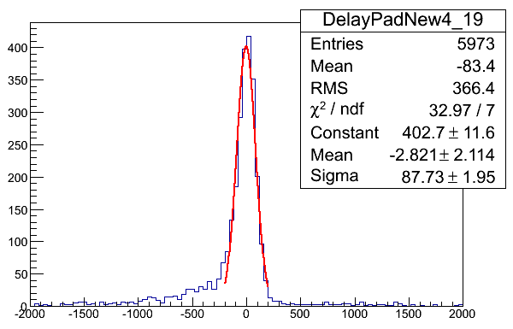
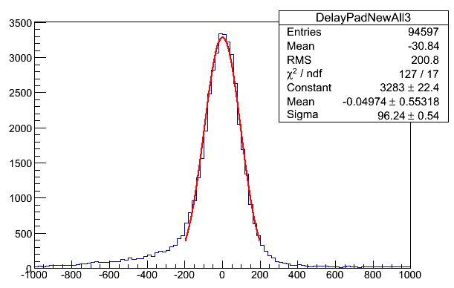
Results of pad-MRPC
Time resolution of Pad-19
Time resolution of 5 pads
Efficiency: 98.8% @6kV

Slide 20
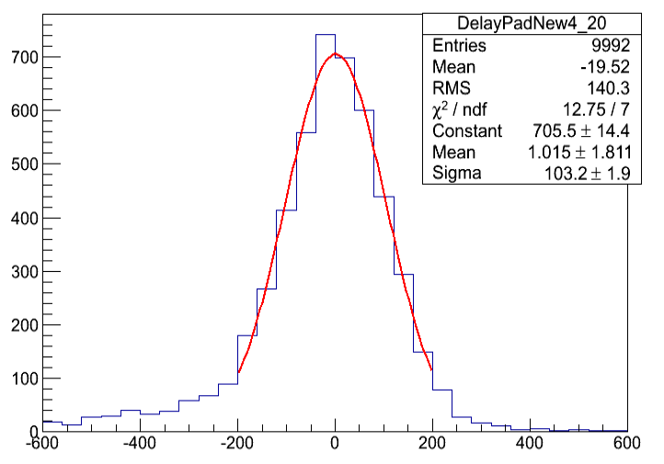
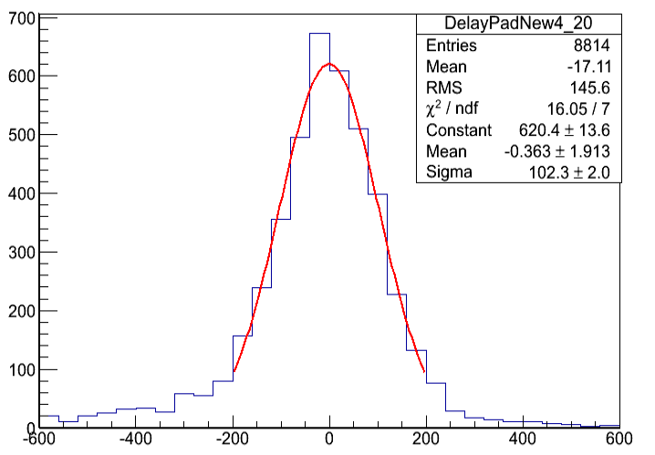
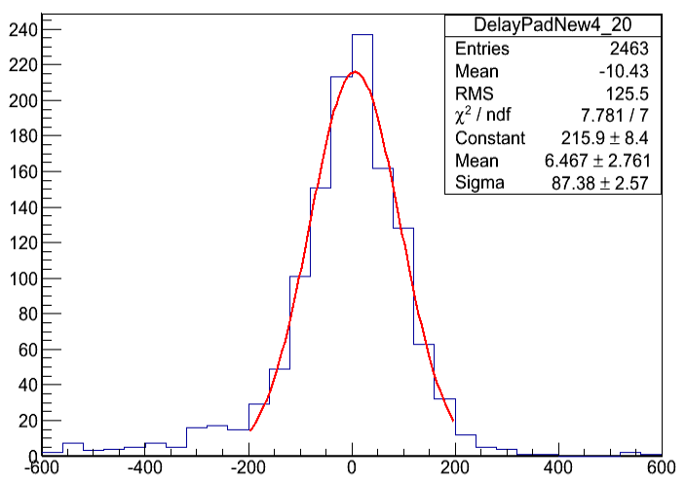
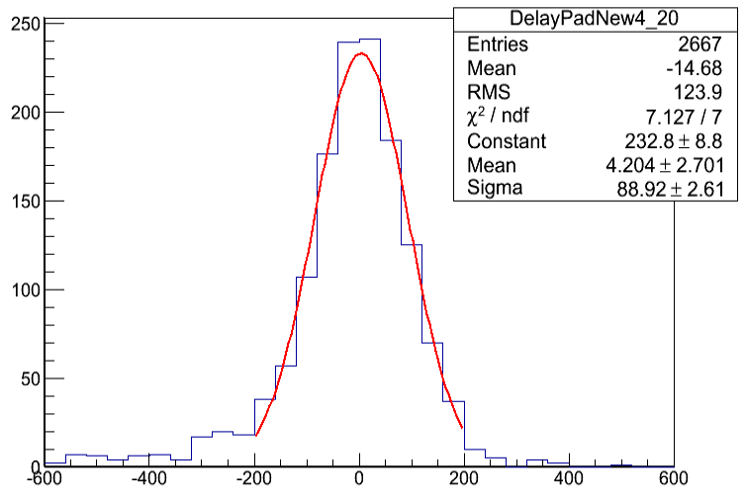
Single-hit event study
All events
Single-hit event for Thu-Pad
Single-hit event for BucRef and Thu-Pad
Single-hit event for BucRef
An overall time resolution of is obtained
Compared to strip-MRPC, pad-MRPC suffers less from multi hit events

Slide 21
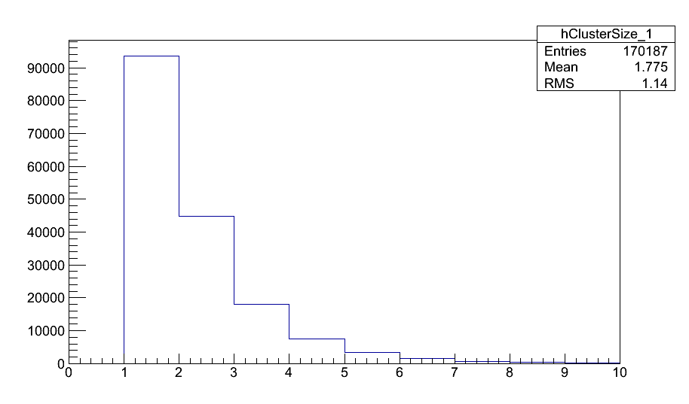
Cluster size
Choose event with Pad hits, count number of fired pads in this event: if nPadHits==1, single hit. If nPadHits>1, loop all fired pads, only record the pads with other fired pads near it.
Average cluster size: 1.7

Slide 22
Conclusions
Performance | Strip-MRPC | Pad-MRPC
HV | 5.5kV | 6kV
Efficiency | 97% | 98.8%
Time resolution | 49ps | 62ps
Cluster size | 1.7 | 1.7
Both strip-MRPC and pad-MRPC meet the requirement of CBM-TOF
Three new prototypes were developed and tested at SPS on November of 2015. Data analysis goes smoothly.

Slide 23
Thanks for your attention !

