Slide 1
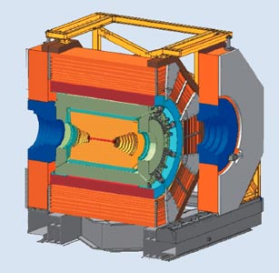
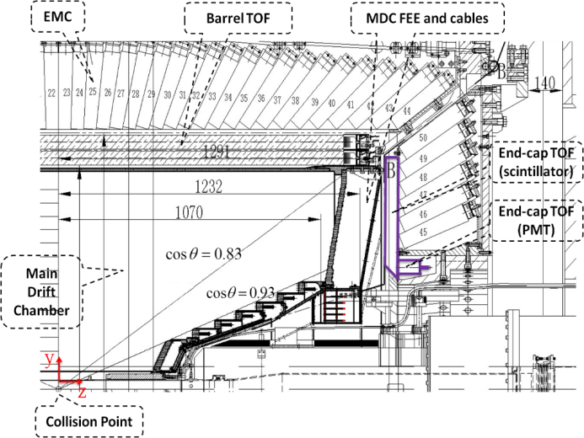
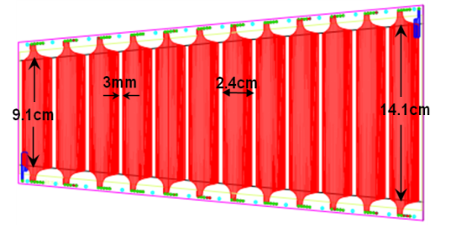
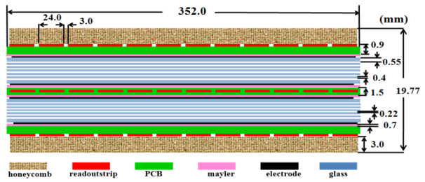
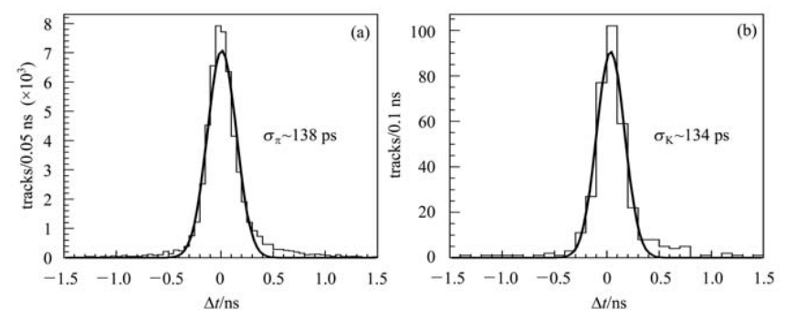
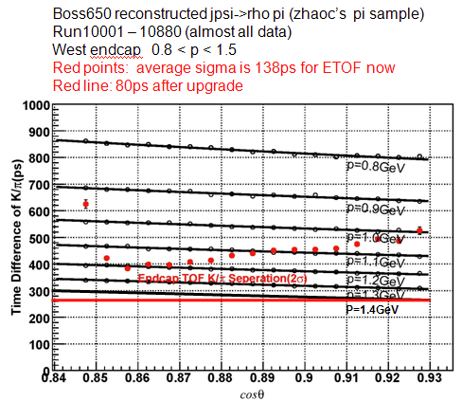
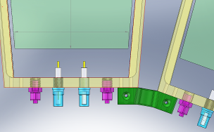
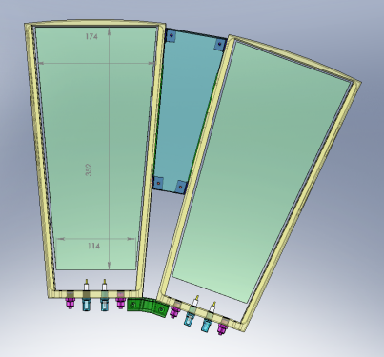
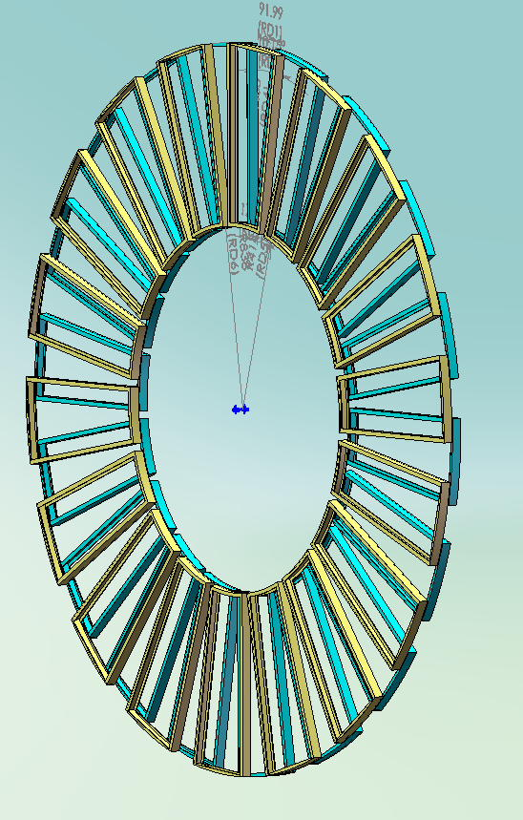
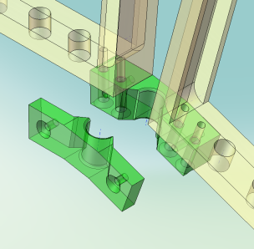
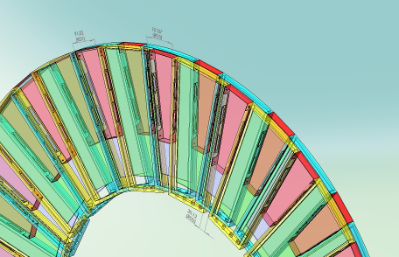
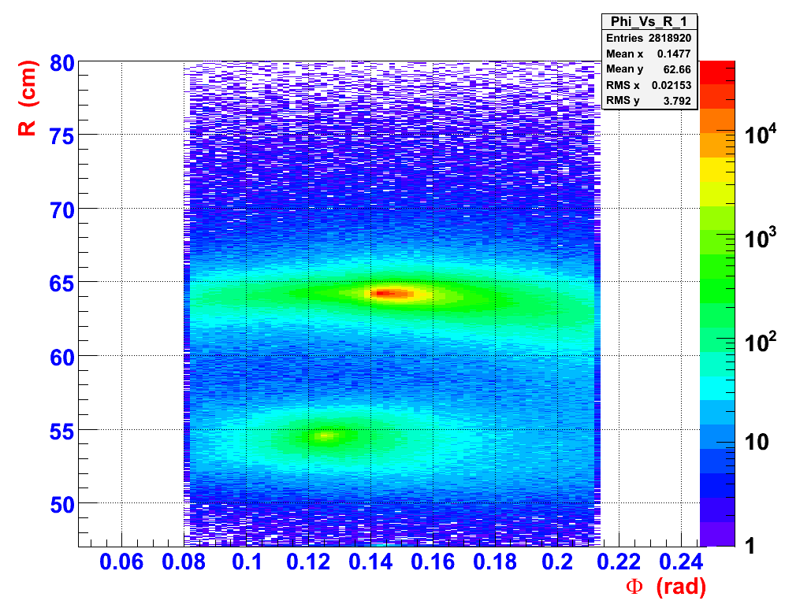
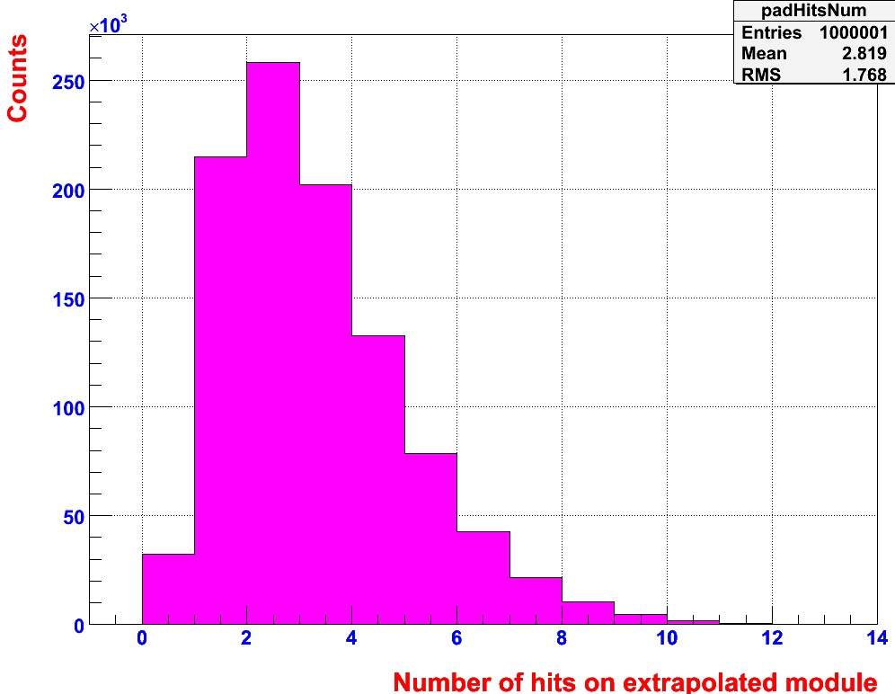
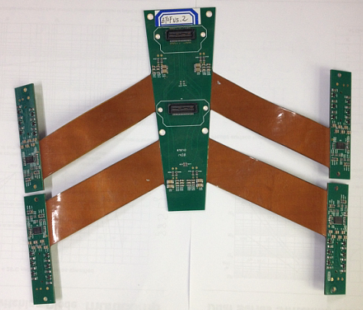
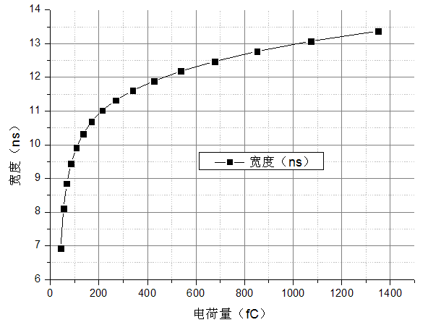
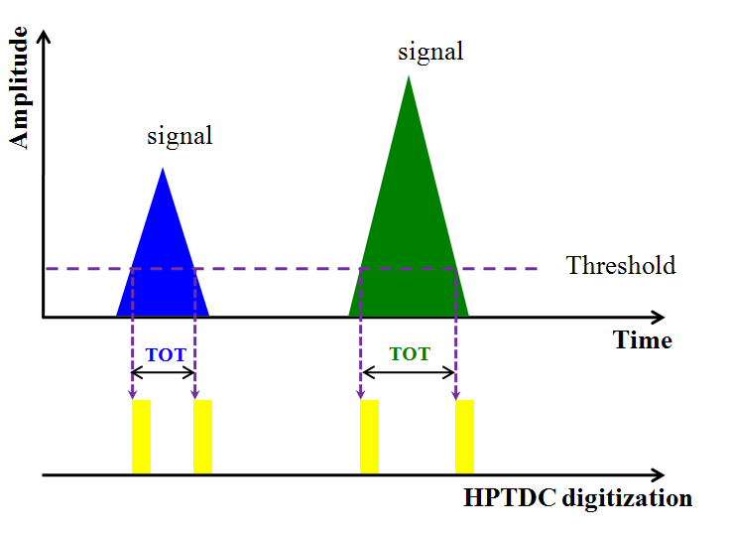
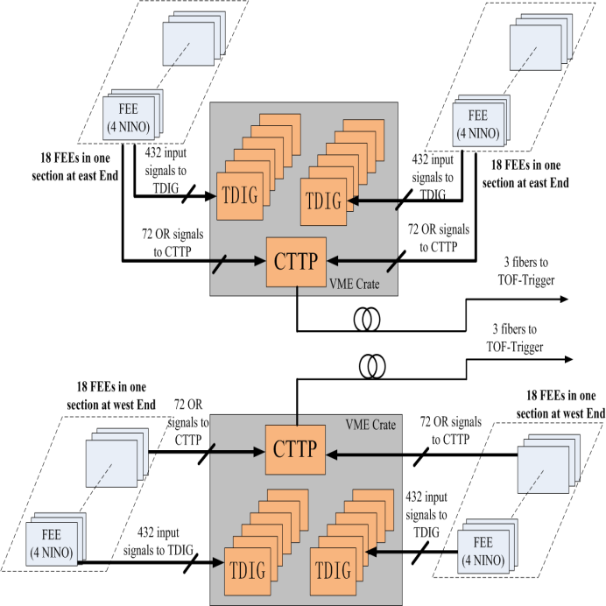
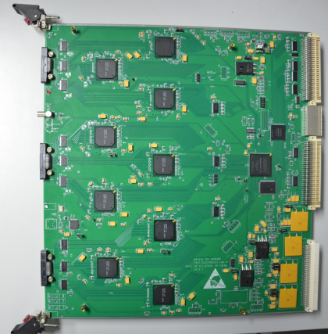
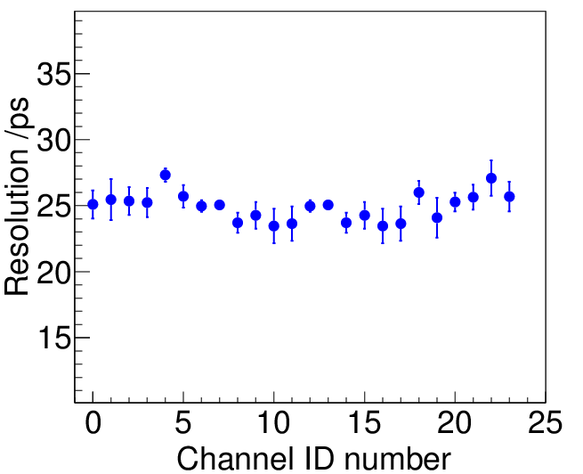
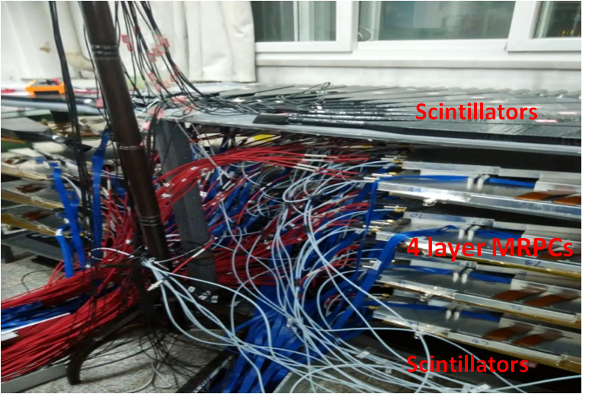
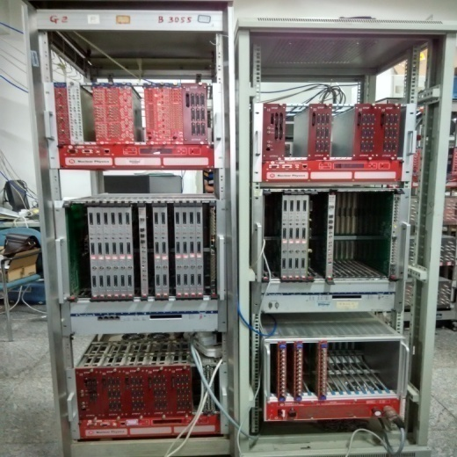
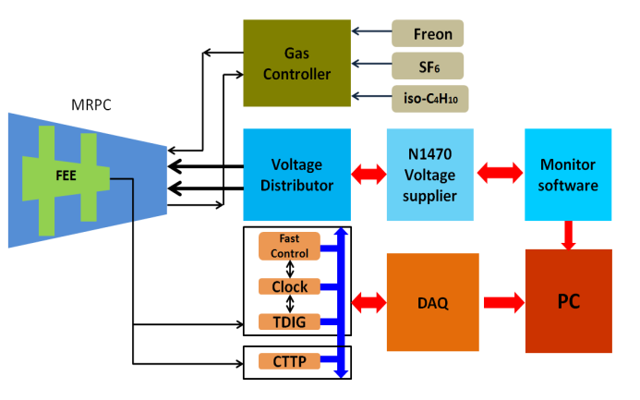
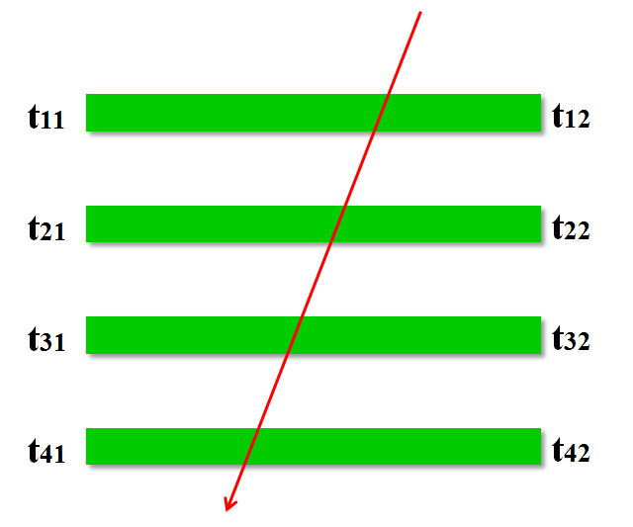
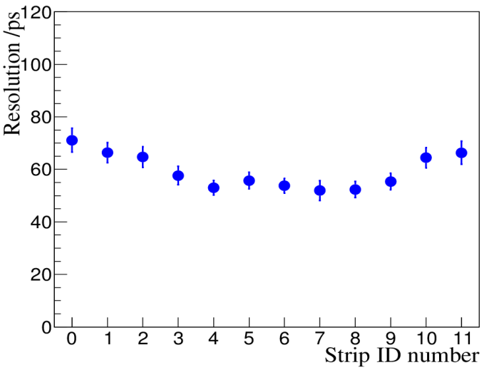
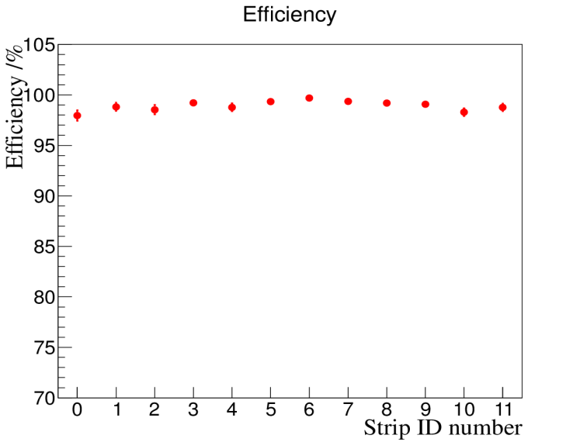
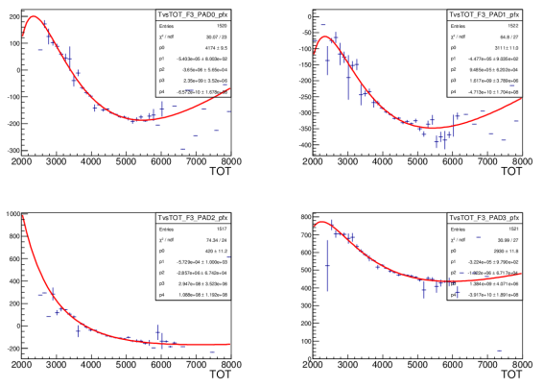
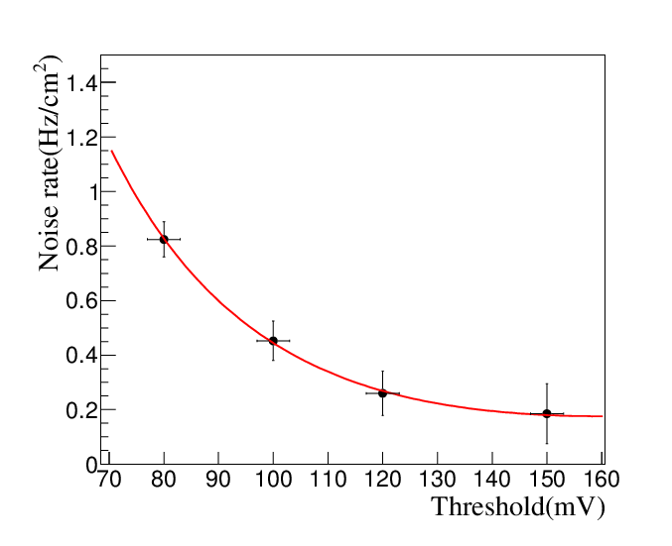
The cosmic ray test of MRPCs
for the BESIII ETOF upgrade
Xiaozhuang Wang, Zhi Wu
University of Science and Technology of China
Institute of high energy physics
Introduction
ETOF MRPC
The Beijing Spectrometer III (BESIII) is a highly precise general-purpose detector designed for high luminosity e⁺e⁻ collisions in the τ-charm energy region 2.0-4.6GeV.
The multi-gap resistive plate chamber (MRPC) is a new type of gaseous detector. Currently it has been widely used as TOF detector in many experiments, such as ALICE at LHC,STAR at RHIC.
The advantages of MRPC being TOF detector:
good time resolution;
high detection efficiency;
low cost;
insensitivity to neutral particles
The current TOF consists of fast scintillators (BC204) and fine-mesh photomultiplier tubes (Hamamatsu R5924). Endcap TOF (ETOF) is in θ region of 0.83<cosθ<0.93
The current BESIII E-TOF：BC204 scintillator + R5924 PMT
μ: 110ps
e: 148ps
π: 138ps
Strip width 2.4cm; Strip length: 9.1-14.1 cm;
Gas gap: 2 x 6 ;
Gap size: 0.22 mm ;
average 1.1 GeV for 2σ π/K separation
The design of MRPC boxes and mechanical parts:
Other possible reasons of time jittering:
Scattering effect
Valid speed
Tracking
Multi-hit
Electronics
TOT measurement
Based on NINO created by CERN group, HPTDC
TOT process
Upgrade with MRPC technology
Higher granularity
Better time resolution：
Total resolution 80~120ps
TOT(ns)
1.4 GeV for 2σ π/K separation
FEE
Charge(fC)
Cosmic ray test
~25ps
TDIG
readout electronics system process
Results
MRPC and scintillator
Electronics system
Blok diagram of test
The typical intrinsic resolution is about 60ps,the efficiency is 98%.
For the convenience of data analysis, we select same strip pad of every four vertically arranged MRPC modules in each cosmic ray event.
4 signals from 4 strips ，any 3 of them constructs Tr，the 4th Ti subtract Tr, we can get 4 distributions:
Every Ti is influenced by TOTi due to T-A effect，we can get 4 functions of TvsTOT in distributions:
1
2
resolution
efficiency
Repeat the step 2 and step 3 for some times In last correction we slew the jittering from the tot of Ti itslef ,and we get 4 equations of resolutions:
3
We take the time slewing and correction in Tr，and obtain the new funtions of TsvTOT；
Noise rate
The intrinsic time resolution mean of MRPC module is about 60 ps under ± 7000V;
The average detecting efficiency is 98.5%,
and the average noise rate of strip is at 0.2 Hz/cm² within working threshold range.
The entire system of ETOF could work steady and satisfy the requirements of upgrade.
4

