Slide 1
5D tracking concept for the next generation ATLAS muon trigger…and beyond
G. Aielli, R. Cardarelli, A. Di Ciaccio, B. Liberti, P.Camarri, L.Paolozzi, R. Santonico
Ghent– February, 24 2016

Slide 2
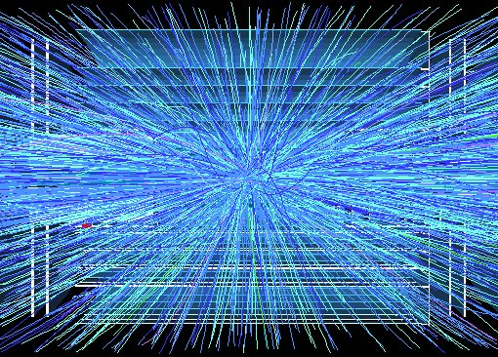
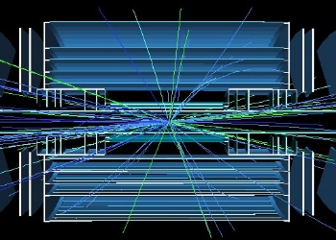
Future challenges and strategies
(ATLAS was designed for LHC: L=10³⁴ cm⁻²s⁻¹ )
[Now we expect 7.5 x instantaneous and 10 x integrated luminosity]
PILEUP: from ~30→>200 proton collisions/BC
Impact: High occupancy limits performance in vertex reconstruction and calorimeter. Maintain threshold for single isolated leptons as low as possible rejecting the pileup
Strategy: higher granularity and faster tracking detectors: time is a fourth coordinate → smarter Trigger DAQ

Slide 3
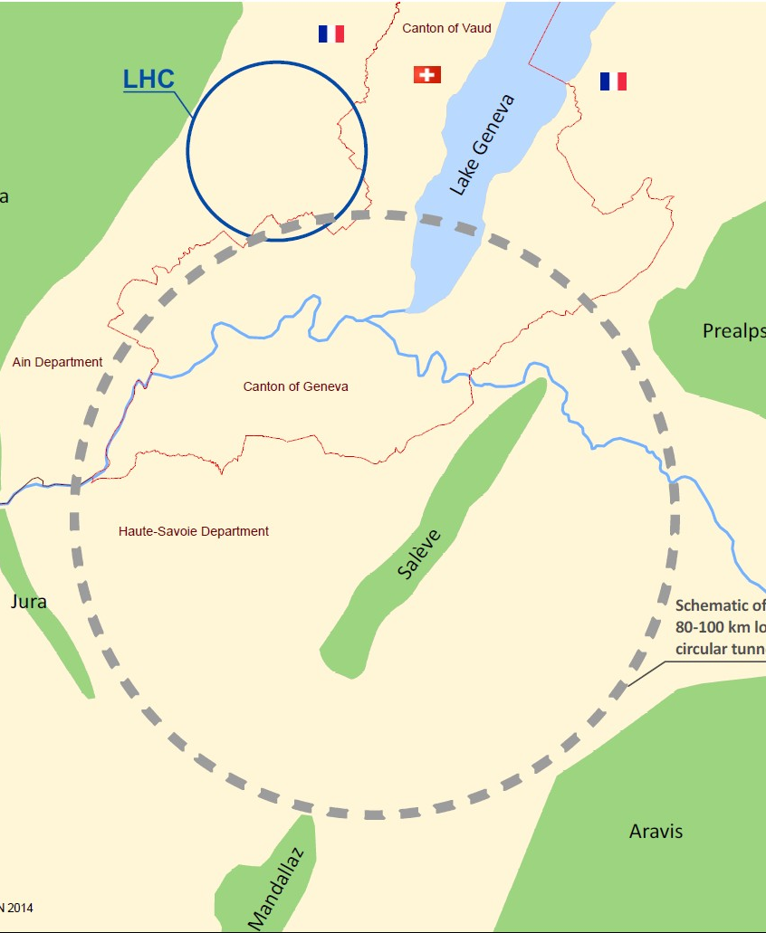
To keep in mind for the future
Ultimate FCC scenario
Center of mass energy: 100 TeV
peak luminosity ultimate: ≤ 30x10³⁴
Bunch Crossing <5 ns
integrated luminosity ultimate ~1000 fb⁻¹ (average per year)
25 years operation, leading to ~20 ab⁻¹
Consequence on detectors
Boosted objects→ up to η=6 coverage
High pileup and fast BC → very fast and granular detectors
Momentum resolution ≈15% at pT=10TeV
~1ns sharp BCID
Particle flow capability for calorimeters with high granularity 25 mrad^2
Fine timing against pileup → < 100 pS

Slide 4
RPC event Localization and parametric space
RPC events are extremely localized→ occupy a tiny volume in parametric space:
E.g. one hit in 1 mm gas gap
  ~ 2 ns FWHM duration
  ~ 4 mm² FWHM footprint
t(ns)
6
5
4
The equivalent parametric space of 1 cm² x 1 s can contain ~ 5 x 10⁹ separable states
1 GHz/cm² would produce ~10% occupancy
Δt=2ns
3
Δs=10 mm²
2
1
0

Slide 5
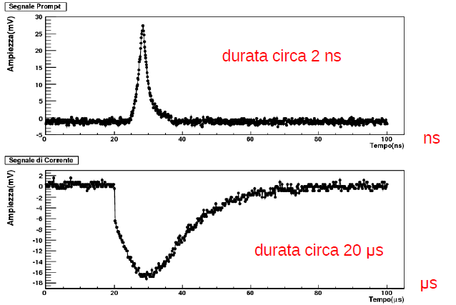
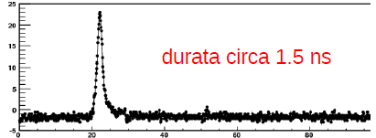
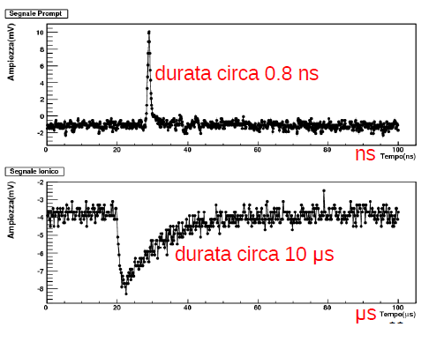
The timing features of rpcs
Absolute resolution → fluctuations w.r.t. an external coherent source
Relative resolution → fluctuations of multiple pickup of the same external signal (2D, CS..)
Signal fluctuations --> affect just the Absolute resolution
  Ionization and multiplication fluctuations are irreducible
  large dynamic range of the avalanche → can be compensated
Signal raise time → depends on the gap width
  A short rise time compresses the signal fluctuations
Affecting absolute and relative resolution
Electronics peaking time → in the ideal integrator is 0
  Should be << than the signal rise time to preserve timing information
Electronic noise →
  Overlaps to the signal and smears the discrimination time
Digitization binning
  Better if small with respect to the expected absolute resolution
Signal propagation (for strip lines)
  Can be eliminated by determining T0
Duration about 3 nsec
Amplitude (mV)
Time (ns)
Amplitude (mV)
Duration about 1.7 nsec
Time (ns)
Amplitude (mV)
Duration about 1.0 nsec
Time (ns)

Slide 6



The tracking features of rpcs
Planar detector with homogeneous 2D planar resolution
  The intrinsic space resolution is given by the localization of the avalanche. Results better than 50 μm have been reported. With a standard gas gap of 1mm 100 μ m have been reached with the centroid method
  The induced prompt charge distribution σ depends on δ which is the avalanche footprint on the readout electrodes. In the example δ=1.08 mm
$$t$$
$$d$$
$$t$$
1 mm
1.2 mm
1.2 mm
  The RPC has a linear response in terms of simultaneous track density better than 1 hit/mm²
  The ability of distinguishing neighboring hits the hits is limited primarily by δ
  Simultaneous multiple tracks can be separated at a distance ~δ providing an appropriate segmentation of the readout electrodes
2δ

Slide 7
Trak to track separation problem (pad vs strips)
No ambiguity on multiple tracks down to the PAD pitch
N² readout channels to localize the hit in 2D
FE localized on sensitive area and complex cabling
2N readout channels to localize the hit in 2D
FE away from the sensitive area
Ambiguity in case of multiple simultaneous hits

Slide 8


Trak to track separation problem (1D meantimer)
1D meantimer readout
Use the timing the signal pick up at both ends of the strips to determine the second coordinate (t1-t2) and T0 (t1+t2)/2
  Intrinsically robust against ghosts in multiple tracks
  The uncertainty is driven by the digitization binning (e.g. 200ps → 3/$\sqrt{12}$ cm)
L
doi:10.1016/j.nima.2013.02.044
(x2;t2)
(x1;t1)
x1$=V\left(t1−t0\right)$
X2 $=V(t2−t0)$
L = x1+x2 = V(t1+t2-2t0)
t0 = 1/2[(t1+t2)-L/v]
1D meantimer readout disadvantages
  Asymmetric resolution on the second coordinate
  2 amplifiers on the same strip → difficult layout for fast signals
  Large uncertainty for >1 hits on the same strip. However the probability of ambiguous events is reduced by 1/N (N= number of strips)

Slide 9
Trak to track separation problem (1D meantimer)
1D meantimer readout
Use the timing the signal pick up at both ends of the strips to determine the second coordinate (t1-t2) and T0 (t1+t2)/2
  Intrinsically robust against ghosts in multiple tracks
  The uncertainty is driven by the digitization binning (e.g. 200ps → 3/$\sqrt{12}$ cm)
L
(x2;t2)
(x1;t1)
x1$=V\left(t1−t0\right)$
X2 $=V(t2−t0)$
L = x1+x2 = V(t1+t2-2t0)
t0 = 1/2[(t1+t2)-L/v]
1D meantimer readout disadvantages
  Asymmetric resolution on the second coordinate
  2 amplifiers on the same strip → difficult layout for fast signals
  Large uncertainty for >1 hits on the same strip. However the probability of ambiguous events is reduced by 1/N (N= number of strips)

Slide 10
The 2d meantimer concept
Combining the advantages of x-y strip readout and of the meantimer.
2N channels for 2D homogeneous readout
No limitation of the detector resolution due to the meantimer
Electronics out of the active area
Performance driven by the FE electronics and the digitization: it requires high performance Amplifier-discriminator-TDC chain
Conceptually it is compatible with the classic ATLAS RPC layout down to the discriminator so it can be retrofitted on the present ATLAS RPCs. It would be sufficient to replace the readout electronics

Slide 11

2D meantimer basic definitions
Cluster list:
y_{l}; y_{k};
x_{i}; x_{j};
(y_{l};t_{yl};q_{yl}^{clus})
α
γ
Pitch and CS
(y_{k};t_{yk};q_{yk}^{clus})
δ
β
Real hit list:
α (x_{i}; y_{l})
β (x_{j}; y_{k})
2δ
$$i,j,l,k=1…N$$
Fake hit list:
γ (x_{i}; y_{k})
δ (x_{j}; y_{l})
(x_{i};t_{xi};q_{xi}^{clus})
(x_{j};t_{xj};q_{xj}^{clus})
Definitions
t₀= real impact time
v= signal propagation velocity (~0.15 m/ns)
2δ= avalanche signal distribution width (FWHM)
d= strip pitch
t_{n}= lowest time of a given cluster
x_{n}= strip id with the lowest time of a given cluster
y_{n}= strip id with the lowest time of a given cluster
q_{yl}^{clus}=∑q_{yl}estimated charge of the cluster (through ToT)
d < yδ ◊ CSz3 → dy1-2 mm
Best configuration for maximum resolution
d >> δ ◊ CSz1 → dy20-30 mm
Classic ATLAS case, spatial resolution limited by the strip pitch

Slide 12
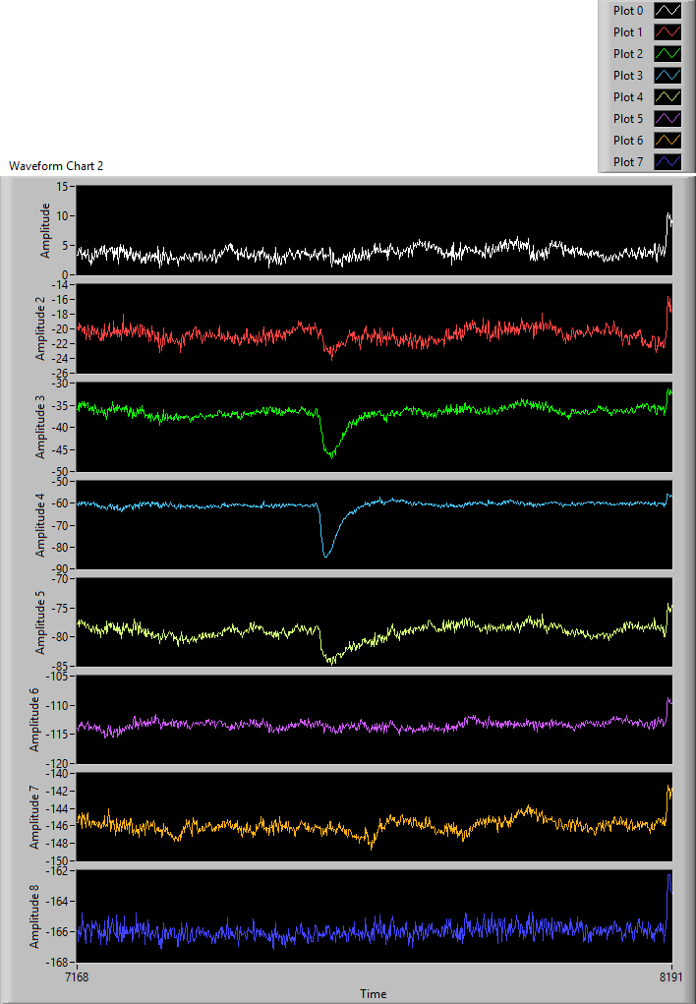

2D meantimer properties
Cluster list:
y_{l}; y_{k};
x_{i}; x_{j};
(y_{l};t_{yl};q_{yl}^{clus})
α
γ
(y_{k};t_{yk};q_{yk}^{clus})
δ
β
Real hit list:
α (x_{i}; y_{l})
β (x_{j}; y_{k})
Fake hit list:
γ (x_{i}; y_{k})
δ (x_{j}; y_{l})
(x_{i};t_{xi};q_{xi}^{clus})
(x_{j};t_{xj};q_{xj}^{clus})
Properties of real hits
$\left\{\begin{aligned}x_{i }d\text{=}v\text{(}t_{yl}\text{−}t_{0}\text{)} \\ y_{l}d\text{=}v\text{(}t_{xi}\text{−}t_{0}\text{)} \\ q_{xi}^{clus}=q_{yl}^{clus}\end{aligned}\right.$ ⇔ $\left\{\begin{aligned}{x_{i }}/{y_{l}}\text{=(}t_{yl}\text{−}t_{0}\text{)/(}t_{xi}\text{−}t_{0}\text{)} \\ \\ \text{(}x_{i }\text{−}y_{l}\text{)}d\text{=}v\text{(}t_{yl}\text{−}t_{xi}\text{)}\end{aligned}\text{⇒}\right.\left\{\begin{aligned}t_{0}\text{= }\frac{x_{i }t_{xi}−y_{l}t_{yl}}{x_{i }−y_{l }} \\ \frac{v}{d}\text{=} \frac{\text{(}x_{i }\text{−}y_{l}\text{)}}{\text{(}t_{yl}\text{−}t_{xi})}\text{=}\text{n} \\ \text{(}x_{i }\text{−}y_{l}\text{)=}\text{n}\left(t_{yl}\text{−}t_{xi}\right) \\ \end{aligned}\right.$

Slide 13
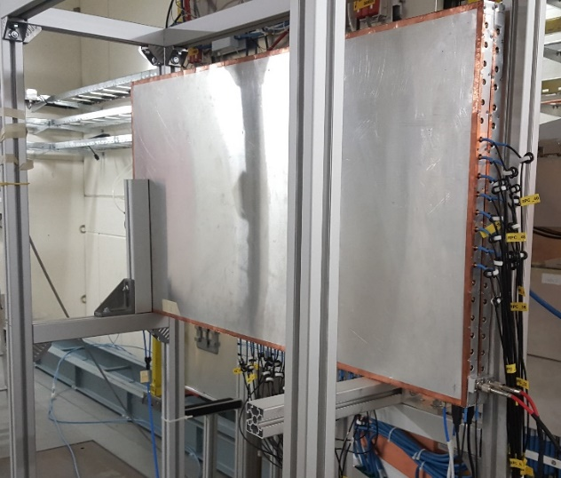
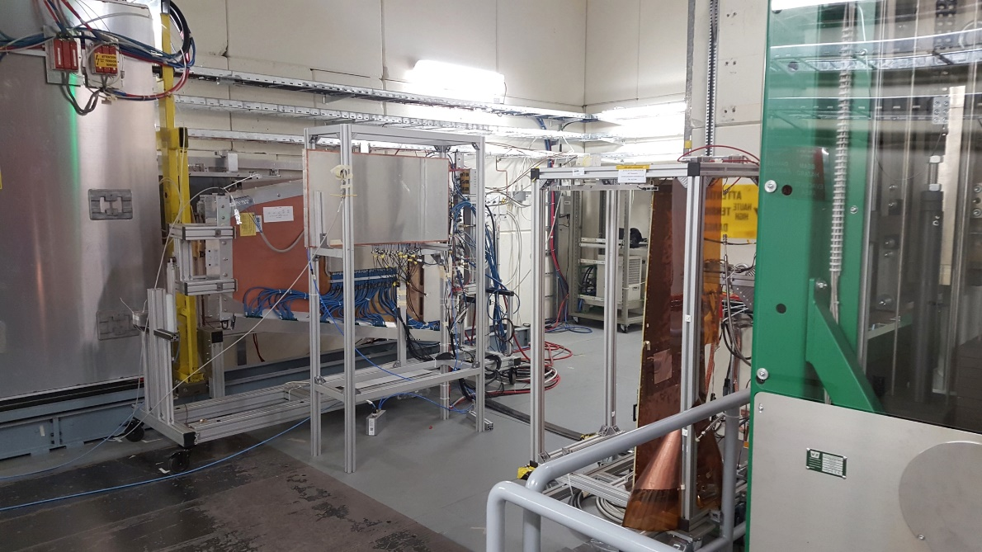
Preliminary results of 2015 test beam
Preliminary test on the ATLAS BIS78 prototype
2D readout connected to a CAEN digitizer DT5742
2.5 G samples/s (non optimal → 0.4 ns binning. 5 G samples/s not compatible with the trigger window)
12 m lemo cables → a few cm of length difference
Anyway we did the exercise….
2D readout
1 mm gas gap
1.2 mm electrodes
100 x 50 cm^2 single gap
25 mm pitch strips
New Front end

Slide 14



2D meantimer observables
Calibration
The distribution of ν_{i}¹, or t₀^{i}₁ (for single hits) gives the the measure of v/d and uncertainty distribution calibration. It’s a property of the system
Determination of the real hits α, β...
Given a list of x anf y hits we can calculate the
The resulting matrix will have elements compatible with $v/d$ corresponding to the strips $i,j$.
15.9 cm/ns
$$\left\{\begin{aligned}\text{(}i,j,k,l=1…N\text{ )} \\ \begin{aligned}ν_{x_{i }}^{y_{k}} \text{=} \frac{\text{(}x_{i }\text{−}y_{k}\text{)}}{\text{(}t_{yk}\text{−}t_{xi})} \\ \left(t_{yl}\text{−}t_{xi}\right)=d/v\left(x_{i }\text{−}y_{l}\right)\end{aligned}\end{aligned}\right.$$
Uncertainty
TDC bin; cable length, amplifier saturation, charge dispersion, strip pitch… FE noise contribution negligible
15.85 cm/ns
For a given $x_{i }$

Slide 15



2D meantimer Δt-Δxy test
Calibration curve with single hits
Calibration matrix
Using a sufficient statistics of single hits one can refine the calibration by measuring a calibration and error matrix:
Respectively the local distribution of $v/d$ and its variance
$${\overline{ν}}_{x_{1 }}^{y_{1}}\text{=} \frac{\text{(}x_{1 }\text{−}y_{1}\text{)}}{\text{(}t_{y1}\text{−}t_{x1})}; σ{\overline{ν}}_{x_{1 }}^{y_{1}}$$
The peak is displaced by taking wrongly coupled hits,
the width is broadened by taking different avalanches
Compatibility with a real hit
Fake hits distribution
$\left|\left(t_{yl}\text{−}t_{xi}\right)−{\left(\left.x_{i }\text{−}y_{l}\right.\right)}/ν\right|$ $≤$ $σ$
62% fake cut

Slide 16
The fifth dimension ?
Use of the charge for close tracks disambiguation:
The time based method can certainly disambiguate track which are at a minimum distance of TDC bin*v (e.g. 3 cm with 200 ps resolution)
hits belonging to the same physical event have the same total charge on the two projections
avalanche charge has a broad distribution, so that different avalanches are unlikely to produce the same charge
This can help to distinguish among hits falling on strips closer than TDC bin*v. This method although probabilistic, can work even with neighboring strips.
100 ps resolution
200 ps resolution
1cm

Slide 17



Charge based discrimination
The charge matrix:
$$\text{D}q_{xiyk}^{clus}\text{=}q_{xi}^{clus}−q_{yk}^{clus}$$
Locating the real hits only in correspondence of elements compatible with 0.
The condition of compatibility with a real hit
$$\left|\text{D}q_{xiyk}^{clus}\right|≤{\overline{σq}}_{x_{1}y_{1}}^{clus}$$
68% fake cut
95.5% efficiency
Overall fakes cut: 89%
Overall efficiency: 95%
…Using a poor time resolution
Saturated and uncalibrated amplifiers
Non optimized CS
Cable length uncertainties….
The charge calibration matrix:
$${\overline{σq}}_{x_{1}y_{1}}^{clus}$$
Is the distribution variance calculated on single hits

Slide 18
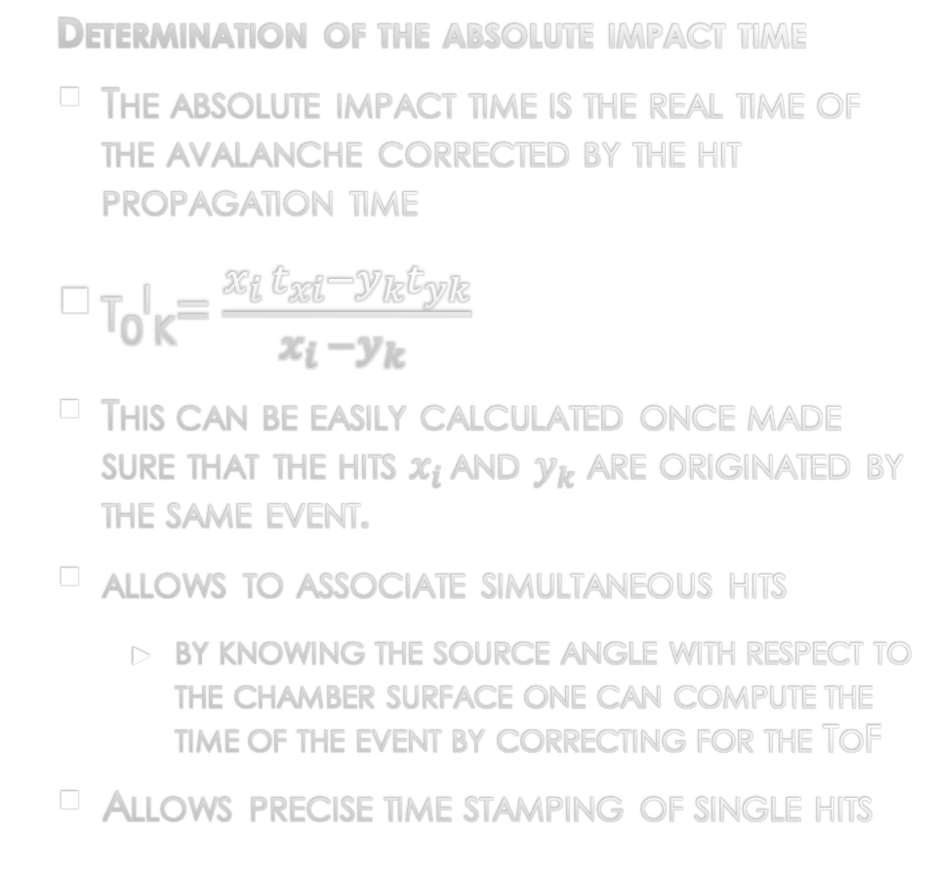
The 2d meantimer t₀ determination and multiple hits
Determination of the absolute impact time
The absolute impact time is the real time of the avalanche corrected by the hit propagation time
t₀^{i}_{k}= $\frac{x_{i }t_{xi}−y_{k}t_{yk}}{x_{i }−y_{k }}$
This can be easily calculated once made sure that the hits $x_{i }$and $y_{k}$ are originated by the same event.
allows to associate simultaneous hits
  by knowing the source angle with respect to the chamber surface one can compute the time of the event by correcting for the ToF
Allows precise time stamping of single hits
In case of 2 hits (one readout per strip)
For a signal duration of ~1ns → 20cm occupancy on the strip
For an amplifier shaping of 20 ns.
The first hit physically arriving at the FE is measured (could be the farther is has a lower t₀ ) and associated correctly
the presence of multiple hits is revealed by the ToT
5 ns
1ns
20 ns

Slide 19
The 2d meantimer for multiple hits on the same channel
In case of 2 hits
The hit 2y is not timely measured so it can not be paired to an orthogonal strip which we expect to contain an unpaired hit
This can be reconstructed ex post after all the other hits (1,3,4) have been paired
3
4
Full readout
Having the readout on both end of the strips would solve exactly this problem
This option is available if a very high occupancy is expected
Readout proposal for tracking calorimeters
Can use a very fine pitch → 1-2 mm strips
Enables particle flow measurement
2N (or 4N) channels out of the sensitive area
1
2

Slide 20
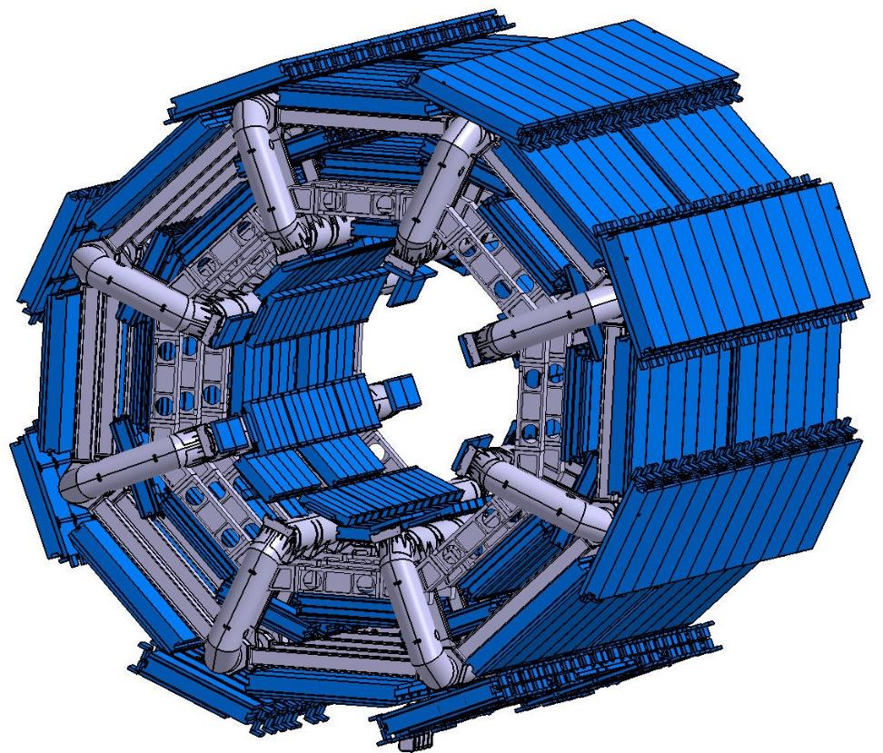
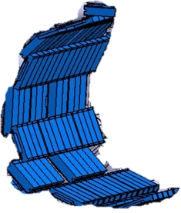
The ATLAS RPC Muon System today
No RPCs in the inner layer just MDTs
OUTER LAYER for High pT trigger
  One doublet chamber
MIDDLE LAYER for Low pT trigger
  Two doublet chambers
IN TOTAL 6 independent layers measuring Eta and Phi
Hard wired trigger system (on chamber)

Slide 21
Upgrade of the atlas muon barrel
The trigger chambers in the barrel will undergo a deep upgrade process
The readout and trigger electronics of the present system will be completely replaced for compatibility with the new DAQ system.
Opportunity to implement a new generation of fast TDC in BiCMOS technology
  Rad hard
  Low power consumption
  Time bin of 30 ps without effort
The front end embedded in the chambers is already designed to offer a sharp timing response (narrow band-pass circuit)
NEW chambers will be added to increase the system coverage and redundancy
Will be equipped natively with the new generation front end and TDC
Fully exploiting the potential of the existing ATLAS RPC chambers.
Better time resolution, charge measurement, 2D meantimer

Slide 22
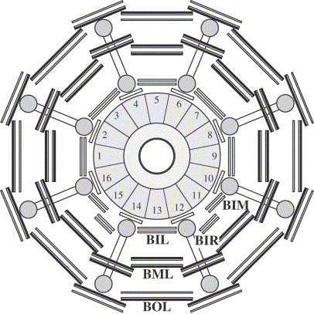
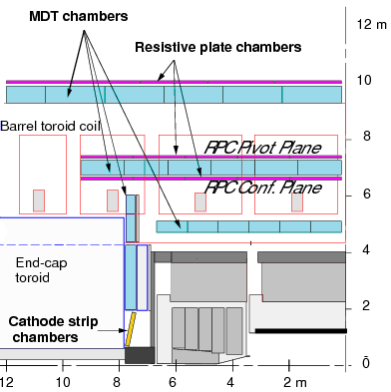
Trigger detector upgrade proposal: new rpcs
increase the redundancy by adding the RPC inner layer
  This idea was already considered in the original project of the barrel trigger detector, but at that time the need for the 3rd station was not stringent and it was canceled when a substantial downgrade was required to Atlas
BO
BM.PI
BM.CO
BI
9 layers instead of 6
4 chambers instead of 3

Slide 23
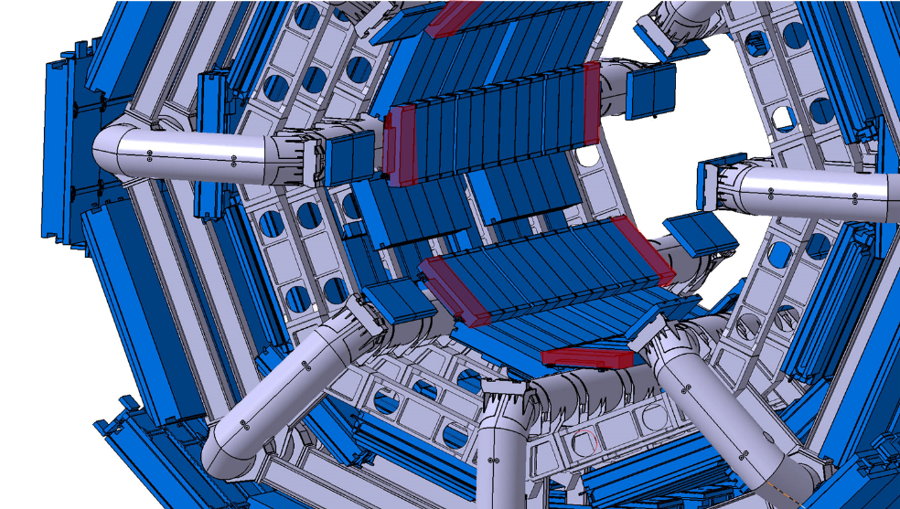
Complete the job: From the bis78 to the bi…

Slide 24
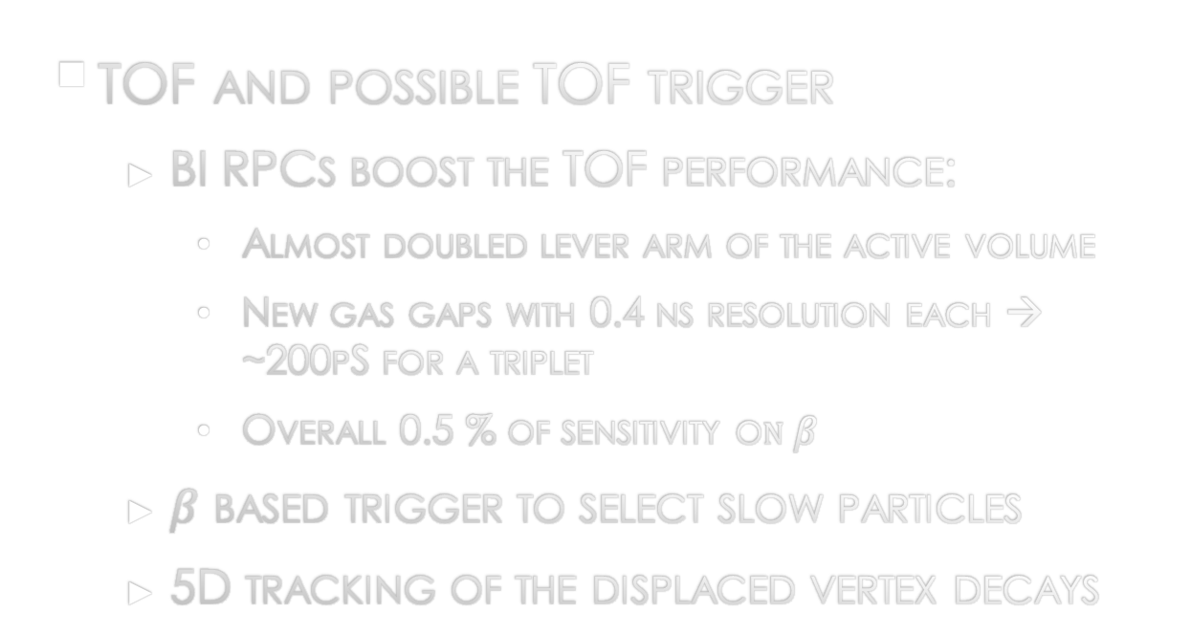
Impact on physics (just mention, real studies needed)
  Benefits of the extended coverage and the new electronics
  E.g. Channels with a single muon (for example W’)
  Eta distribution is more peaked in the barrel.
  Spatial correlation effect for two muon decays (also holes are very correlated in space).
TOF and possible TOF trigger
  BI RPCs boost the TOF performance:
    Almost doubled lever arm of the active volume
    New gas gaps with 0.4 ns resolution each → ~200pS for a triplet
    Overall 0.5 % of sensitivity o$n β$
  $β$ based trigger to select slow particles
  5D tracking of the displaced vertex decays
BO
9,5m
T2
BM
7,2m
T1
BI
5m
T0
Bunch crossing

Slide 25
conclusions
A innovative way of exploiting the RPC features is presented: the 2D meantimer readout
The success of this idea depended critically on the availability of high performance low cost low power consumption and rad hard TDC
This circuits are under development (R. Cardarelli) exploiting the features of BiCMOS SiGe technology
The present and future atlas chambers are fully compatible with this scheme, which would improve the ATLAS discovery potential
An extreme implementation of the 2D meantimer readout of RPCs would allow to simplify the design of a new generation of tracking calorimeters, avoiding the pad readout and the electronics on the sensitive area

Slide 26
Backup Slides

Slide 27
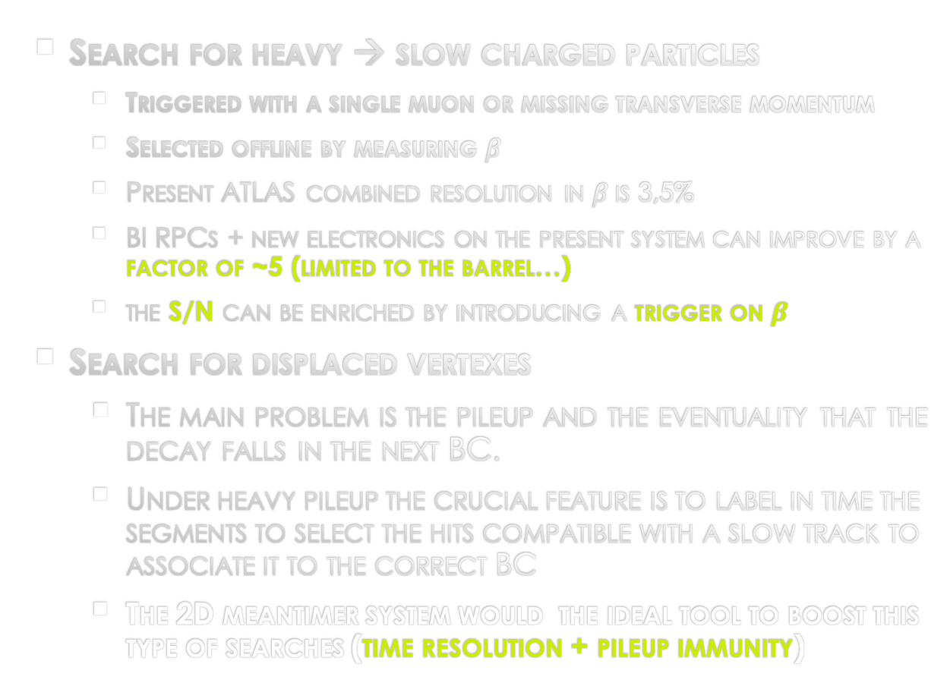
search for long lived sleptons and R-hadrons
CERN-PH-EP-2012-236
arXiv:1211.1597v2 [hep-ex] 25 Mar 2013
  Search for heavy → slow charged particles
    Triggered with a single muon or missing transverse momentum
    Selected offline by measuring $β$
    Present ATLAS combined resolution in $β$is 3,5%
    BI RPCs + new electronics on the present system can improve by a factor of ~5 (limited to the barrel…)
    the S/N can be enriched by introducing a trigger on $β$
  Search for displaced vertexes
    The main problem is the pileup and the eventuality that the decay falls in the next BC.
    Under heavy pileup the crucial feature is to label in time the segments to select the hits compatible with a slow track to associate it to the correct BC
    The 2D meantimer system would the ideal tool to boost this type of searches (time resolution + pileup immunity)

Slide 28
Trigger and detector performance issues
LIMITED COVERAGE
The present barrel coverage is 73%
78% including the feet but not Phase II compliant (just 4 Layers)
ADDITIONAL PERFORMANCE REQUEST
To keep the L1MU20 rate in a reasonable range we need to sharpen the momentum resolution and suppress fakes
RUNNING RPCs BEYOND THE QUAIFICATION LIMITS
10 Years of operation and 300mC/cm^2 at maximum 100 Hz/cm^2
It will be a risk to rely just on the present RPCs for the phase II run
In all cases additional redundancy is recommended…

Slide 29
Main advantages (anticipation)
The combination of a new electronics and an additional layer in the inner region will permit to gain several key advantages:
Coverage increase (from 73 → >96%) closing the holes in the barrel
VERY reliable BCID single layer resolution 0.4 ns (new chambers) 1 ns (old chambers)
Trigger robustness
  Increased redundancy to backup the old chambers
    → BI triplet can backup the old RPCs chambers where needed
    Very efficient the new generation of RPCs qualified for very high rate (> 15 kHz/cm²)
  stand alone dedicated system → reliable
  Uniform trigger detector → simpler trigger signal management
Trigger selectivity
  Pileup insensitive due to High space –time RPC granularity ~ 0.5 cm² x 0.5 ns
  sharper momentum threshold→ increase of the lever arm

