Slide 1
Proposal of a digital-analog RPC front-end for synchronous density particle measure for DHCAL application
R.Cardarelli and R.Santonico
INFN and University of Rome Tor Vergata

Slide 5
.

Slide 8
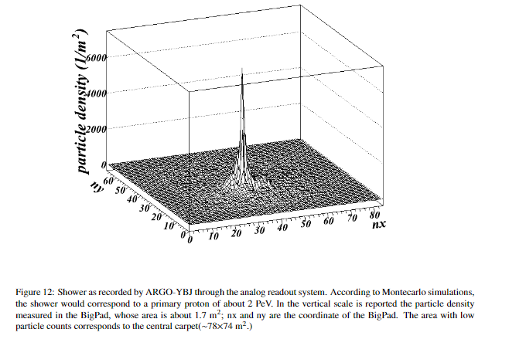
Starting from the Argo experience: digital vs analog read out

Slide 9
Test @ BTF (LNF)of a RPC working in streamer mode
Moto Giovane SRL

Slide 10
Extrapolation to the avalanche mode
avalanche mode
Particle density up to
2* 10⁵/m²
30 pC charge delivered
in the gas per mip
streamer mode
particle density up to
2*10⁴/m²
300 pC charge delivered
in the gas in per mip

Slide 11
Pad feature
.
Total charge delivered in the RPC gas
Prompt charge induced
in the pad
Pad 100pF
30 pC for a single mip
1pC
10uC
300 mm
0.3mC for 10.000 mips
(10mips/cm²)
300mm

Slide 12
Simulation of the front-end electronics for an input amplitude in the range 1pC - 10nC
Out amplifier pulse
Prompt charge pulse of the RPC
Pad capacitance 10pF

Slide 13
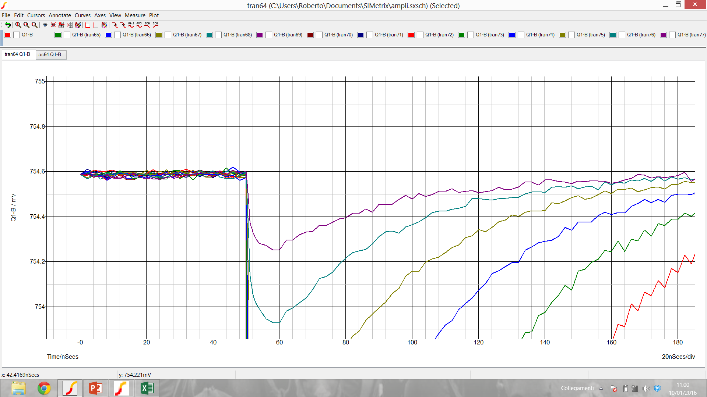
Simulated pad signal
mips
4 V
350uV
10.000 mips

Slide 14
Simulated output amplifier
1 mip
10.000 mips

Slide 15
Detail of the simulated out amplifier pulse for mips to 10.000 mips
10.000 mips
mips
Time of threshold

Slide 16
Time of threshold v.s. pad signal charge
Logarithmic part
Parabolic part

Slide 17
Fit of the time of threshold v.s. pad charge
ns
ns
pC
pC

Slide 18
Time resolution at high desity of particles

Slide 19
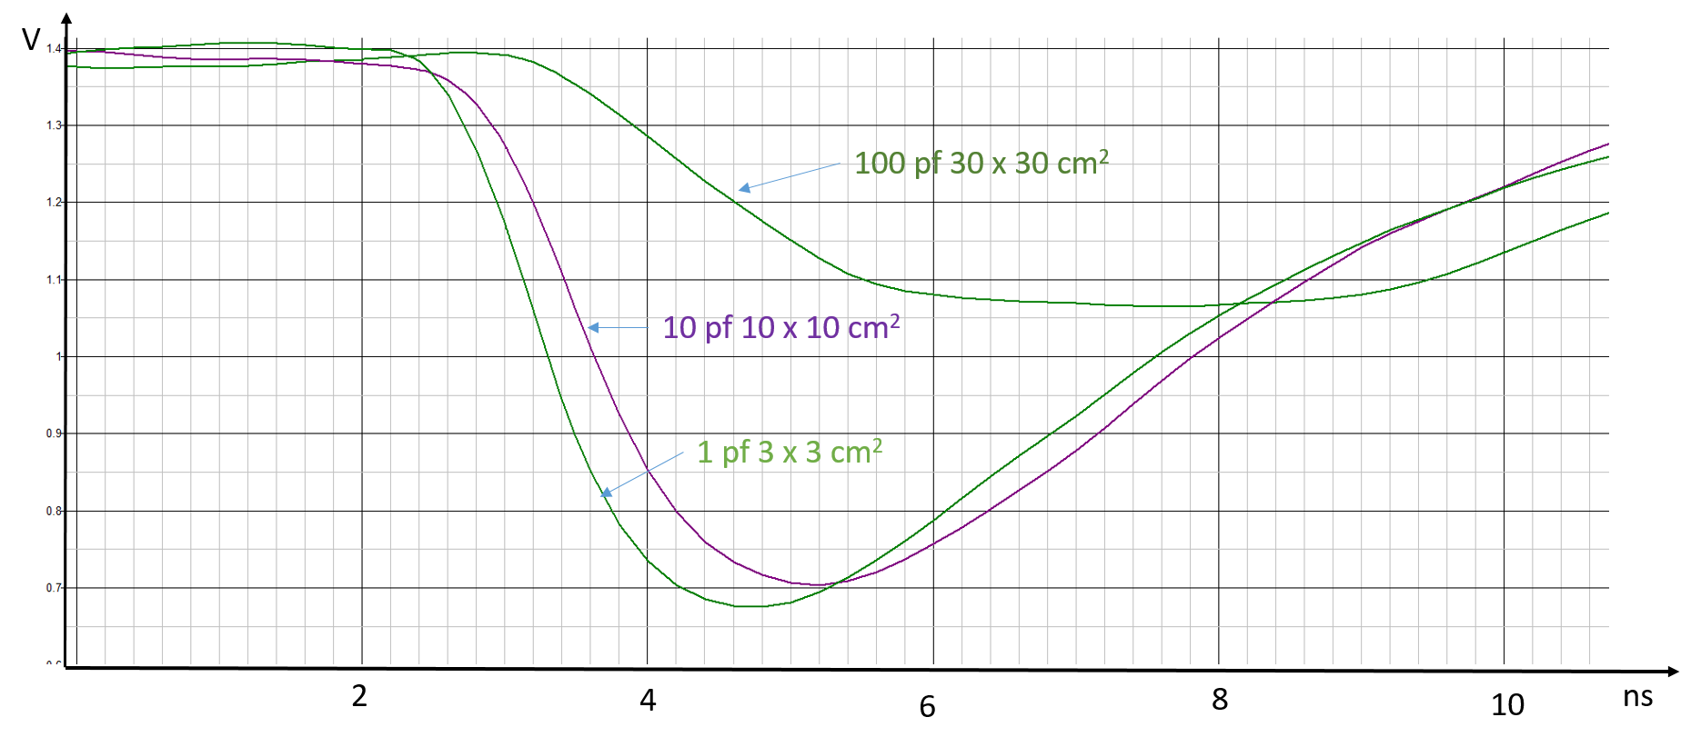
Time resolution of RPC for n synchronous particle
σ_{t} = σ_{RPC}/$\sqrt{n}$

Slide 20
RPC DHCAL layout
pad
RPC
iron

Slide 22
Tentative readout scheme of the experiment
cluster
module
30 x 30mm²
C=1pF
module
Optical link
6 Gbit/sec
pad
Front-end
16 ch +analog or
FPGA
Maximum readout
time 500 ns
7.5 mm

Slide 23
Circuit of the proposed front end
IN 1
Discr.
Digital out
Digital out
Tdc time over th
Digital out
Discr.
IN 16
Discr.
Digital out

Slide 24
FPGA function
.
in1
TDC 1
in2
TDC2
in10
TDC10
Optical link
Trigger in
in1
Digital in 1
Data ouput
in2
Digital in 2
in10
Digital in 10

Slide 25
Front end connection to the FPGA
+3V
We choose single ended LV TTL logic for the connection between FE and FPGA
The motivation is:
Minimize the driver consumption (benefits both FE and FPGA)
Simple and robust against noise
Pull up resistor
Open collector TTL
Front-end
Transmission line
FPGA
GND

Slide 26
Conclusions
We have shown the tentative scheme of digital-analog readout for DHCAL
The front-end electronics simulation shows that a dynamic factor of 10.000 is feasible
This simulation shows also that a 20 ps time resolution with 2 mm gas gap is possible with high multiplicity.
Nevertheless the same front end electronics can be optimize for DHCAL application

Slide 27
Backup slides

Slide 28
Tentative carpet structure

Slide 29
Improving the Argo analog read out
The Argo results suggest that the Argo approach can be improved up to the limit of fully switching from the digital to the analog read out
Requirements
Small size squared read-out pads instead of strips
New front end electronics to fully exploit the extremely wide amplitude range of the detector: a factor of about 10000 required eg for 30x30 cm2 pads
Full sensitivity for a single mip
Advantages
Trigger threshold based on the total amplitude instead of the number of firing pads
Low multiplicity trigger preserved by the front end sensitivity to mip
Possibility to study the core/multicore shower structure in the range from low energies up to 100 PeV
Possibility to study, even at low energy, events releasing a large amplitude in a single pad (small showers, end range protons…)

Slide 30
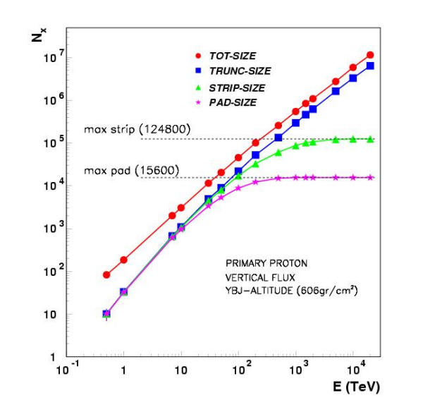
Particle density v.s. distance of the shower core for different energies
ARGO ybj

Slide 31
Tentative readout scheme of the experiment
cluster
module
module
Optical link
6 Gbit/sec
Front-end
4 ch
pad
FPGA
300 x 300mm²
Maximum readout
time 500 ns
C=100pF
FPGA

Slide 32
Skeme of the proposed front end
IN 1
Discr.
Digital out
IN 4
Discr.
Digital out

