Slide 1
New generation of high rate RPCs
G. Aielli, R. Cardarelli, A. Di Ciaccio, B. Liberti, P.Camarri, L.Paolozzi, R. Santonico

Slide 2
Why a new Front-end design
For a reliable RPC system working in HL-LHC muon triggers and future colliders it is mandatory to increase the performance of the front-end
The existing amplifiers are not optimized for fast pulse operation at the required level of performance < 1000 e noise, wide dynamic range and low sensitivity to coupling capacitance noise
Decrease the noise for short shaping (need for low occupancy)
Decrease the rise time (for real time TOF capability)
Increase the performance of the discriminator and the Time-Digital Converter
Minimize the complexity (high reliability)
Minimize the cost
Minimize power consumption
Rad-Hard technology (1 Mrad)

Slide 3
High performance FE for high performance RPCs
How to scale the RPC performance by a factor >10?
Increase the FE S/N by a factor of 10 (or better)
Count on the fact that the avalanche physics scales almost linearly
Under this condition the present ATLAS RPC technology would be substantially extended to high rate
The new FE design is optimized for pulsed signals and exploits the good features of BJT transistors
Two technology considered: Si and SiGe
Si BJT
SiGe BJT

Slide 4
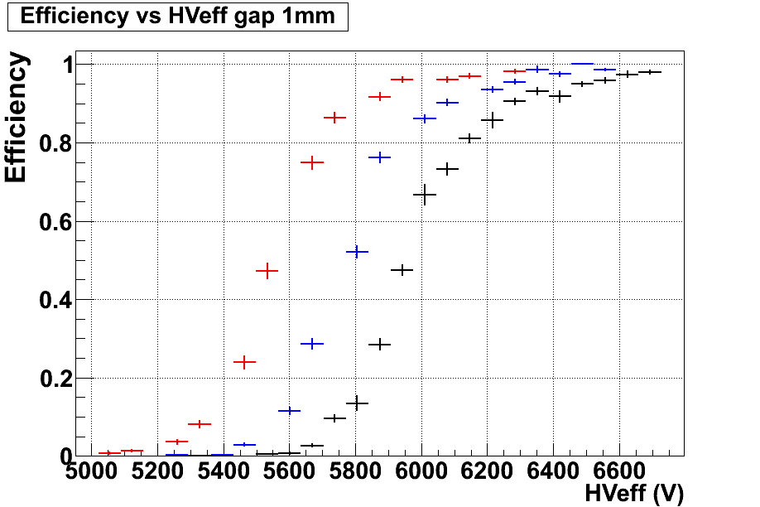
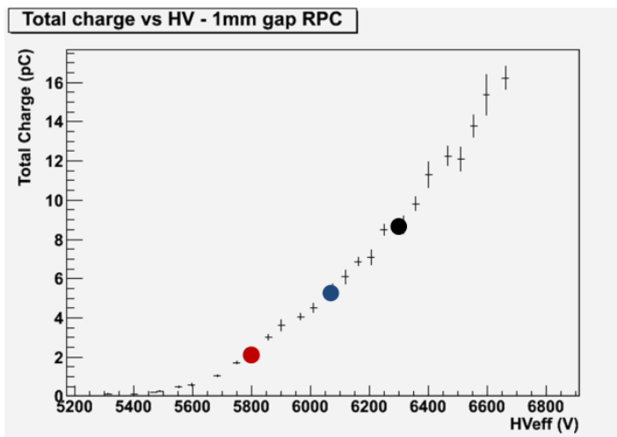
Performance of the new amplifier for RPCs
A 1 mm gap RPC detector read out with a ATLAS like threshold (black), the new preamplifier in silicon technology (blue) and in SiGe technology (red)
Using a more sensitive front end allows to operate the detector at a lower gas gain.
Total delivered charge per count in the detector. The working point with different front ends is reported.
Data from a cosmic ray test.
Data from a cosmic ray test.
ATLAS like threshold
Lower gain means lower charge per count.
NOTE: the total charge reported is not the prompt charge collected in the front end.
Silicon new preamplifier
SiGe new preamplifier

Slide 5
Early (2009) results at GIF: 2mm gap
RPC rate = 7 kHz/cm²
from about 1.4 x 10⁶ gamma cm⁻² s⁻¹
Scintillators trigger
ATLAS like gas gap
MDTs
GIF source
Efficiency x acceptance for a 2 mm gap RPC irradiated at GIF. Early measurement → no tracking

Slide 6
Early (2011) results at GIF: 1+1mm bi-gap
Efficiency x acceptance (left scale) and counting rate (right scale) of a 1+1mm bi-gap in serial configuration. Test carried out at the CERN GIF. Sensitive area 18 x 18 cm².
Operating current (left scale) and delivered charge per count (right scale) vs. operating voltage.
The delivered charge at source ON and full efficiency is as low as 2.7 pC with a gain of almost one order of magnitude with respect to the present ATLAS chambers.

Slide 7
Early results (2011) timing at high rate
Time distribution for a 1 mm gap RPC at a counting rate of 3 kHz/𝑐m². Raw resolution 730±9 ps including the trigger scintillator jitter of 550±5 ps.
𝛔𝐭=𝟒𝟖𝟎±𝟐𝟎 𝐩𝐬
The result obtained at high rate is compatible with the one obtained at lower rate with the same setup

Slide 8
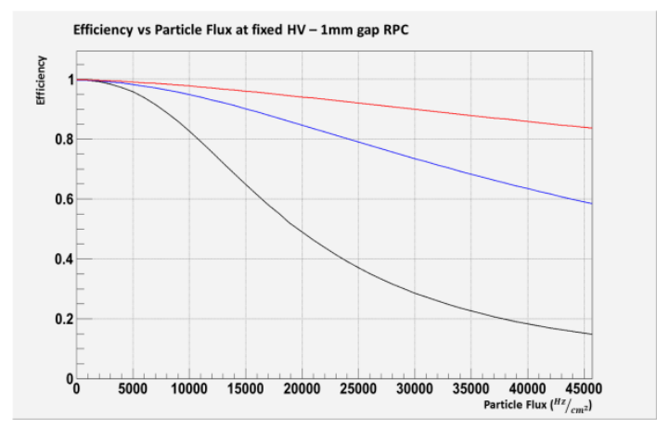
Extrapolation to higher rates
Operating the detector at a lower charge per count means improving rate and reducing the ageing of the detector.
Efﬁciency vs counting rate simulated for a 1mm single gap RPCs.
SiGe new preamplifier
Silicon new preamplifier
ATLAS like threshold
Starting from experimental data at 7 KHz/cm² we simulated the efficiency VS counting rate for a RPCs with ATLAS standard electrode plates. The applied voltage is 200 V above the plateau knee. The results are in agreement with the experimental data collected at the CERN GIF.

Slide 9
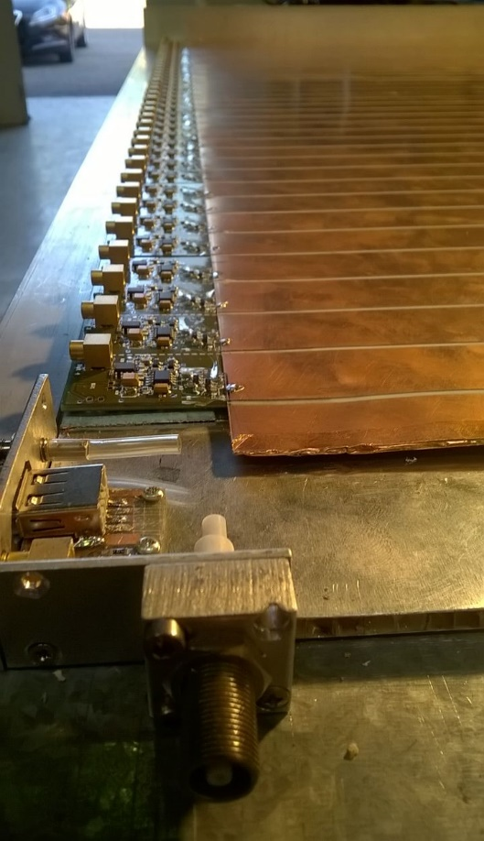
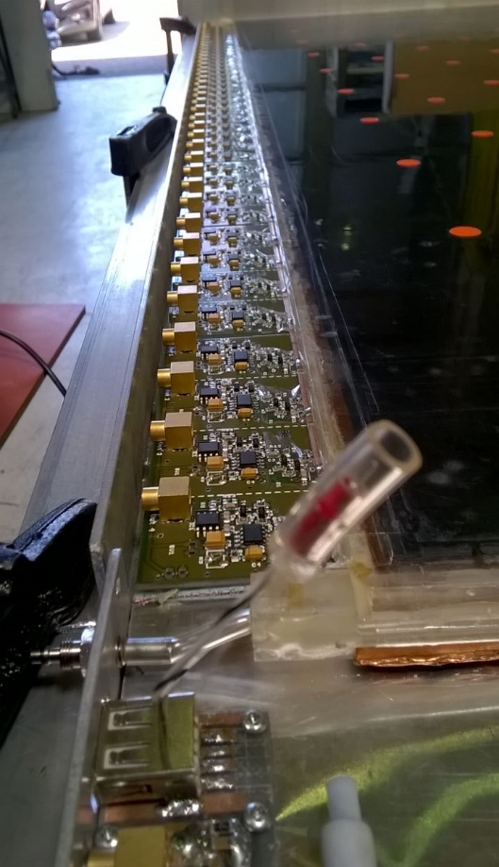
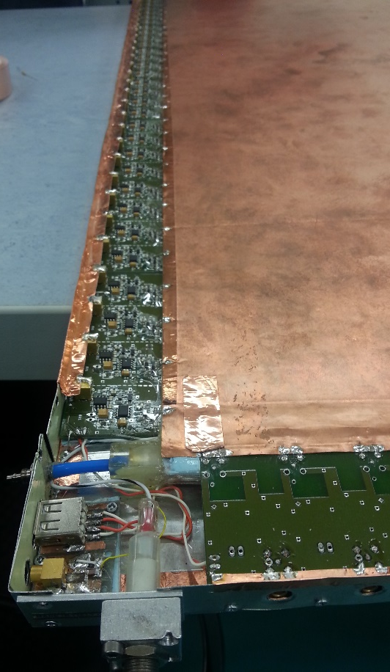
BIS8 like singlet for the GIF++ test
New lgap layout
  50 x 100 cm^2
  1 mm gas gap
  1.2 mm electrode
  new FE Board
  2D readout
  New production of resistive electrode 10¹¹ Ω x cm
Special care of the faraday cage
  Iterative refining of the grounding
  Test in noisy environment (H4)
  The result is satisfactory: Vth settable to the limit of the electronic noise ( ~1000 e)

Slide 10
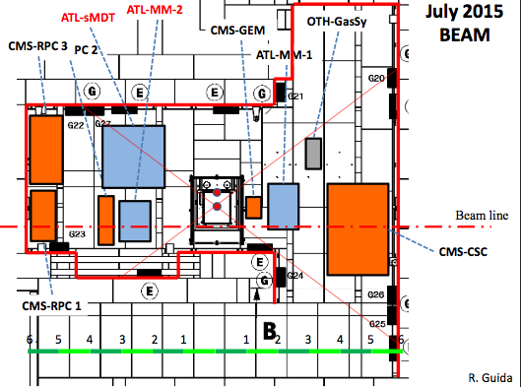
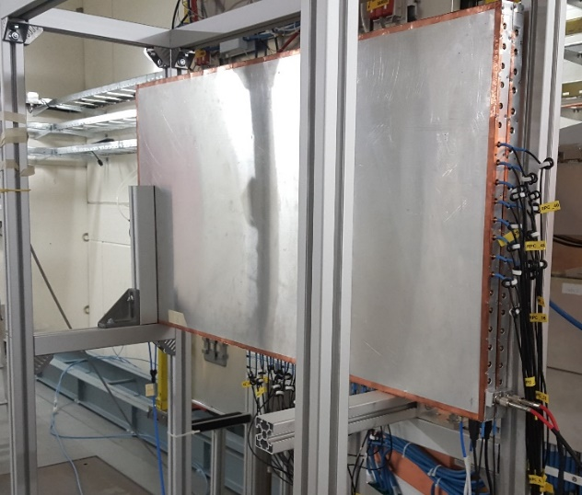
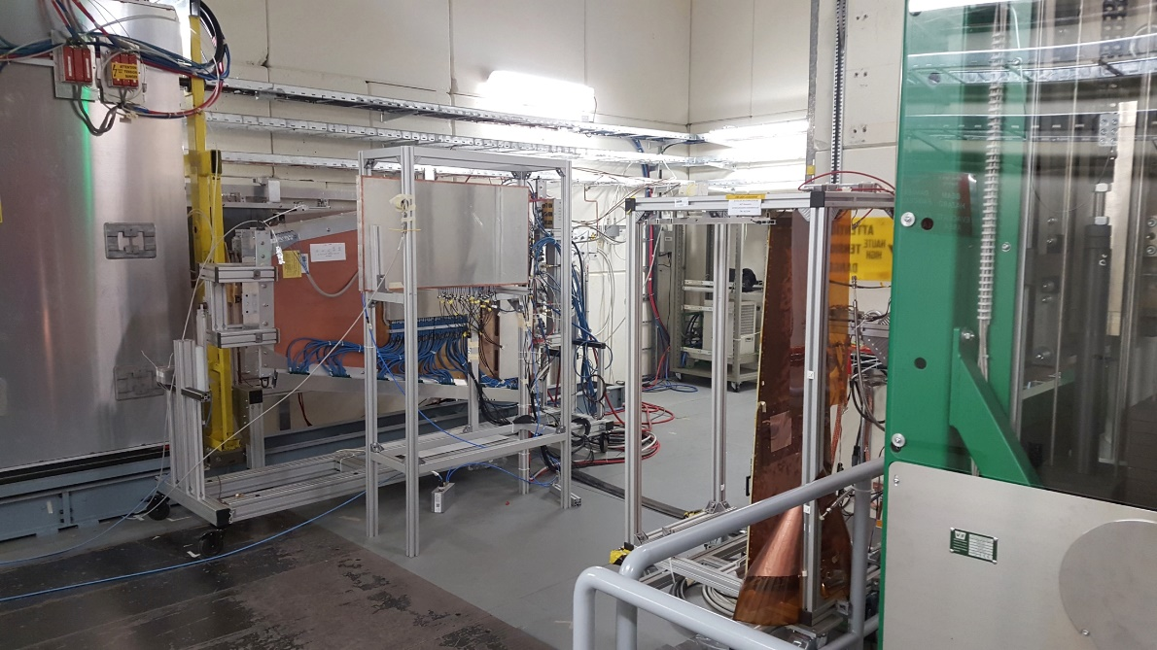
Preliminary results of 2015 test beam
Data taken with beam and g intensity up to 20 kHz estimated counting rate
Chamber distance 3.6m → solid angle fraction = 0.0154
Source full intensity: 13.9 TBq ₁₃₇Cs
Expected impacting photons 0.2*10¹² s⁻¹
Expected rate including sensitivity 0.4% → 85 kHz/cm²
Expected rate with ABS factor 10 ~ 8 kHz/cm²
2D readout

Slide 11
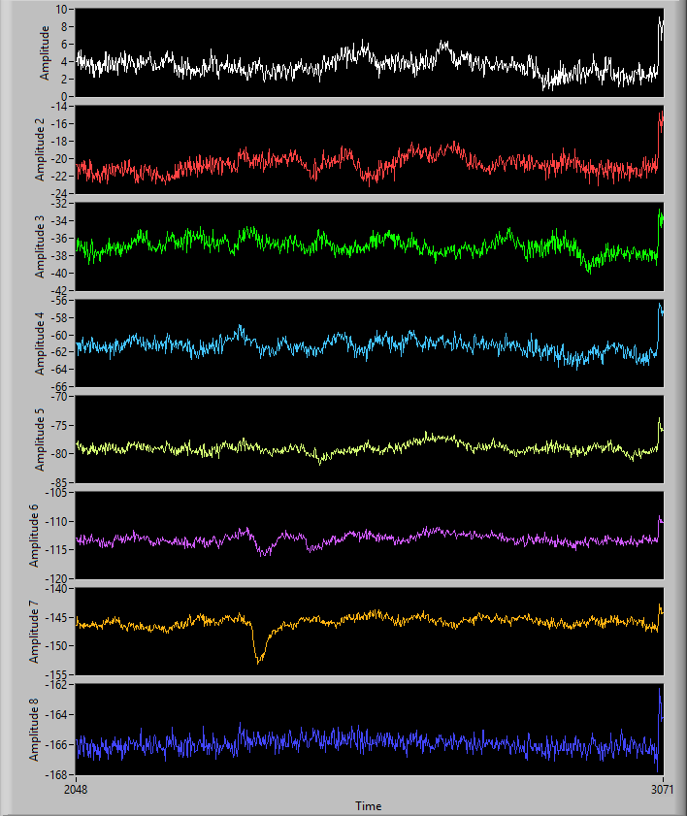
Effective noise in H4 area
Gain 7 mV/fC
Noise 1 mV RMS → < 1000 e-
Vth → 6 mV (6σ)

Slide 12
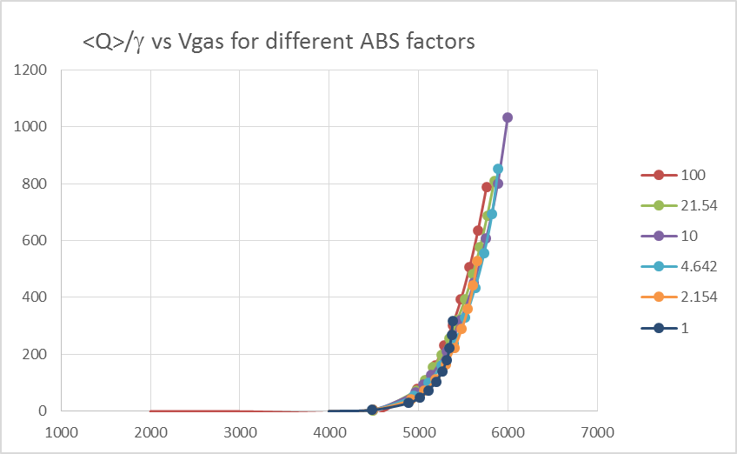
Preliminary results of 2015 test beam
Raw efficiency vs Vgas at different ABS
New electronics → 1000e RMS noise measured on chamber operating in the GIF++ area. Final Vth limited by the Lecroy discriminator (30 mV)
Plateau measured up to ~20 kHz/cm^2 (pink points) No visible loss up to 7 kHz/cm^2 (green points)
Notwithstanding the relatively high resistivity the chamber outperforms the previous tests
ABS factor
infinite
100
33
10
3
infinite
100
33
10
3
New HPL1.2 mm thick → resistivity higher than wanted ρ=7*10¹⁰ Ω cm at 26°C
I/source intensity vs. Vgas
This is the characteristic gain of the RPC
ρ=7*10¹⁰ Ω cm

Slide 13
Winter test using a digitizer
Absorption factor 33 measured 1.1 kHz background
8 μA
5000 cm²
1.1 kHz/cm²
1.4 pC/count!!
Factor 15 over ATLAS!!
Record performance!!
ρ=1.4*10¹¹ Ω cm at 17°C
Consistent with previous test
50% efficiency at 5100 → 4959 @26 °C v → 250 V lower than using a standard discriminator Vth= 30 mV

Slide 14
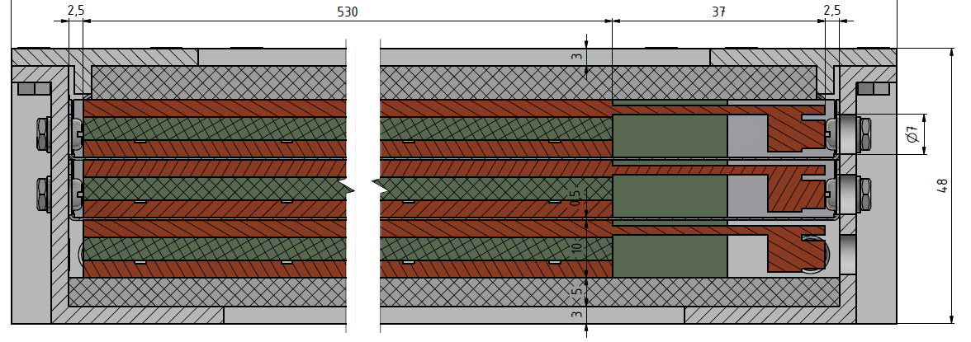
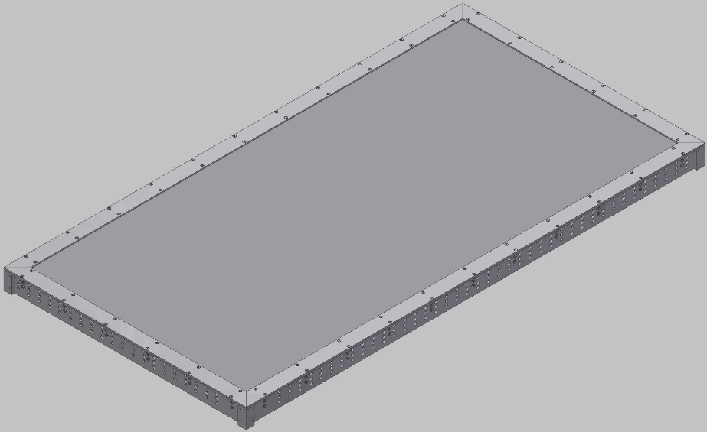
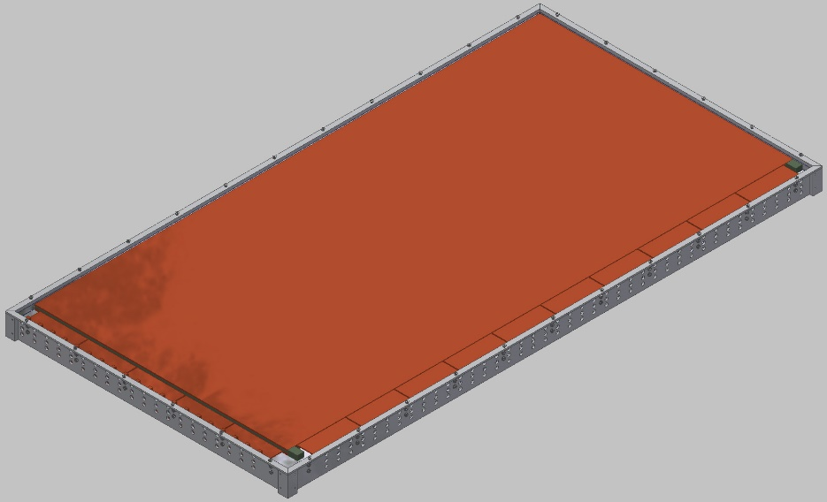
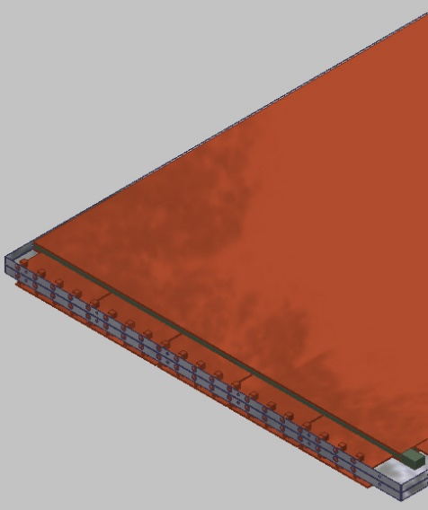
  Future: Beam test of a fully equipped triplet
Basing on the singlet experience a BIS 7/8 RPC prototype is in progress. Expected by June 2016
Joint effort ROMA Tor Vergata + MPI
H8/H4 beam time scheduled by May 2016 for extended test
Triplet of new RPCs with 1mm gas gap in support frame and Faraday cage of 48 mm overall thickness → fits into assigned 50 mm envelope.
Construction and test of new RPC triplet prototype in spring 2016.

Slide 15
Conclusions
~ 10 kHz/cm² counting rate operation is commonly achieved by applying the New FE to the classic ATLAS/CMS like RPCs
Successfully tested on large surface chambers setting the record of low gain operation for this type of RPCs (absolute record?) → it seems that the avalanche physics still scales down linearly…
The new FE is compatible with the 2D ATLAS readout, noise measured ~1000 e⁻ RMS
Time resolution for a 1 mm gap measured under uniform irradiation of 3 kHz/cm² compatible with the theoretical limit
All the results obtained with a standard Silicon transistor, SiGe transistors are not yet in play….

