Slide 1
Study of MRPC simulation performance at BESIII
Fenfen An
anff@ihep.ac.cn
Institute of High Energy Physics, Beijing
2016.02.24
RPC2016@Ghent

Slide 2
Introduction
Introduction
BESIII is a general-purpose detector located at the upgraded Beijing Electron-Positron Collider (BEPCII), which runs at $τ$-charm physics energy region
The TOF sub-detector, part of the BESIII PID system, its endcap has not so good resolution and fine ability to separate $K/π$. Improvement is determined to better meet BESIII physics goals
We upgrade the scintillator endcap with MRPC and develop the simulation software using Geant4
The simulation method is introduced and its performance is studied about time resolution and efficiency based on data taken from two test modules

Slide 3
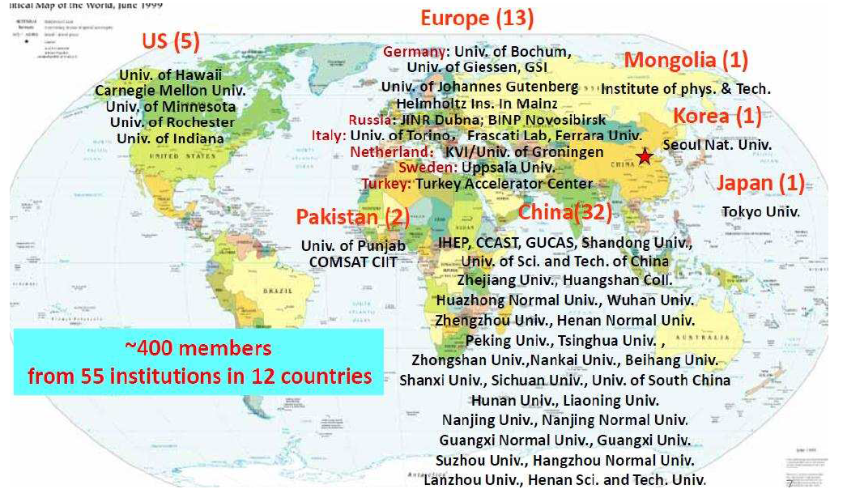
BESIII Collaboration
Introduction

Slide 4
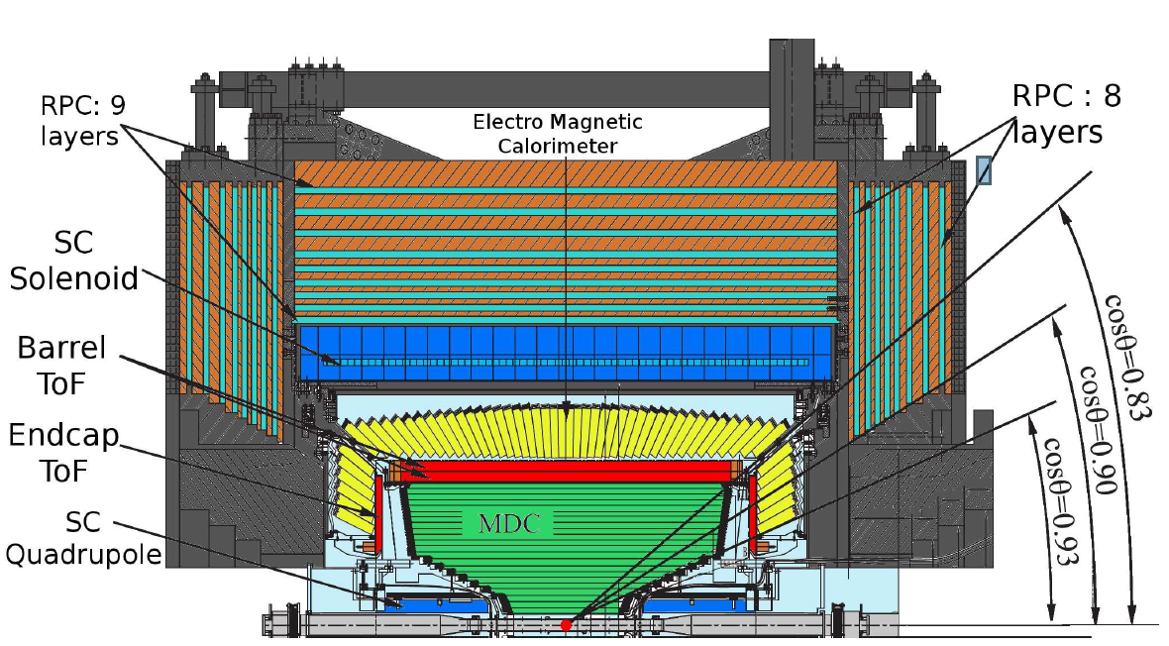
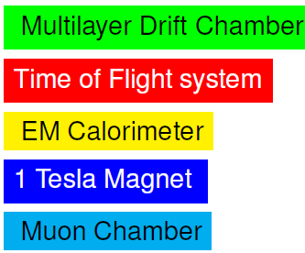
BESIII Detector
Introduction
BESIII is designed cylindrically symmetric around the interaction point, covering 93% of the solid angle
TOF endcap locates between MDC and EMC. It’s upgraded with MRPC, replacing the old scintillator

Slide 5
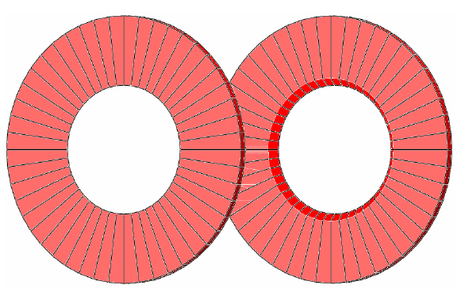
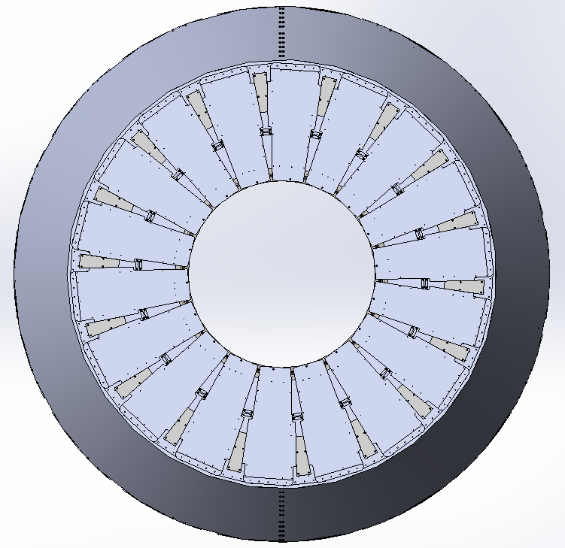
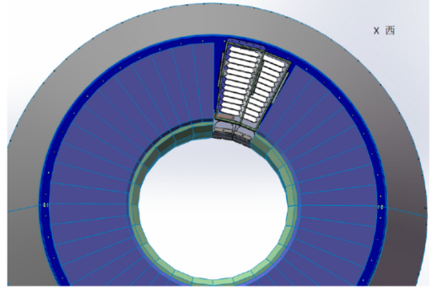
TOF Endcap Upgrade
Introduction
2015 before
2015.01
2016.02
R & D
MRPC prototype
Two testing modules are installed into BESIII and take data
The whole endcap is updated and take data
MRPC
Performance
pre-research
hardware
simulation software development and performance study based on test data
Tune MC to real data. Guide physics analysis
simulation

Slide 6
MRPC Detector
Simulation Method
Each MRPC module consists of 12 gas gaps (0.22 mm) separated by glass plates (0.4mm)
Signal charge is induced in the readout strips inset in the PCB boards, and is read out on both sides
Working gas: 90% C2F4H2 (R134a), 5% SF6, 5% iso-butane

Slide 7
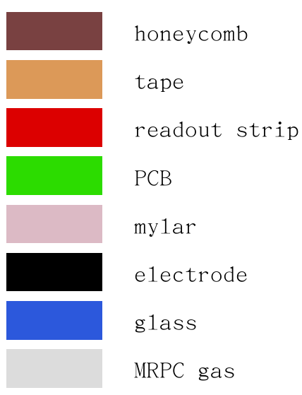
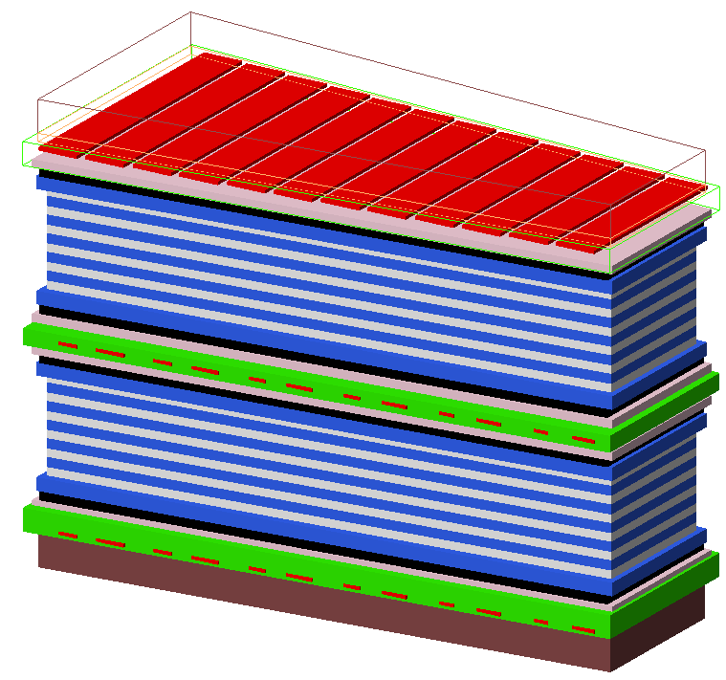
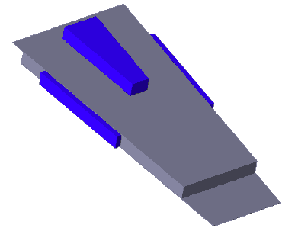
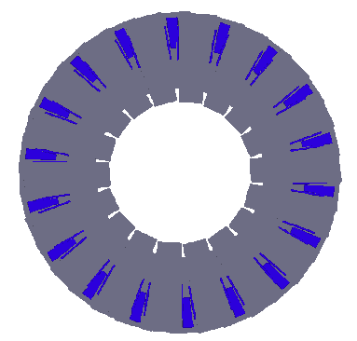
Detector Construction
Simulation Method
Bare chamber built of layers of materials
Placed in an 25 mm thick aluminum frame with FEE boxes
Two layers face-to-face in one endcap to overcome dead areas at the borders
Use Geant4 !!!

Slide 8
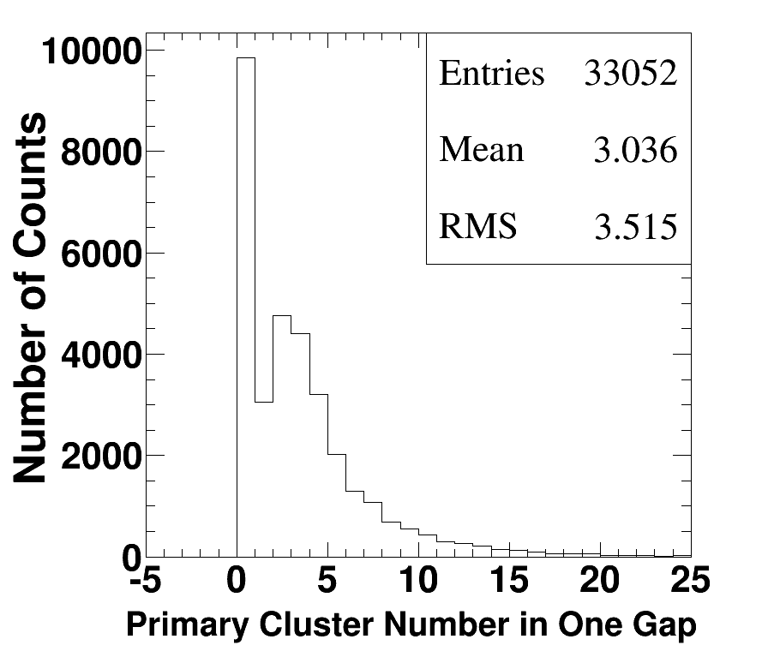
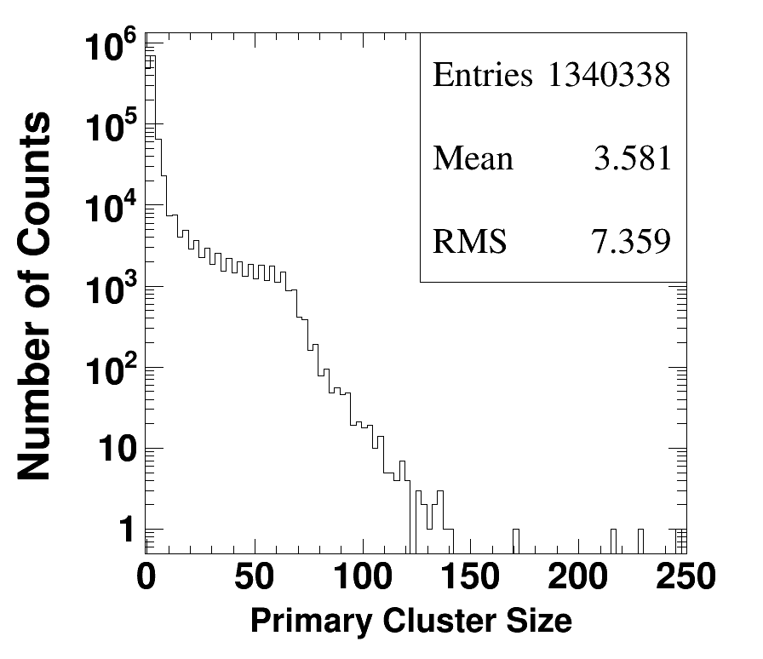
Primary ionization
Simulation Method
Primary ionization characteristics of the working gas are determined by Geant4
Working gas: 90% $C_{2}F_{4}H_{2}$ + 5% iso-butane + 5% $SF_{6}$
Using the energy deposition provided by Geant4, the number of ionized electron-ion pairs in tracking can be calculated, and the uncertainty is considered by smearing a Gaussian function
A average of ~3 clusters in one gap
A primary cluster ~3.6 electron-ion pairs

Slide 9
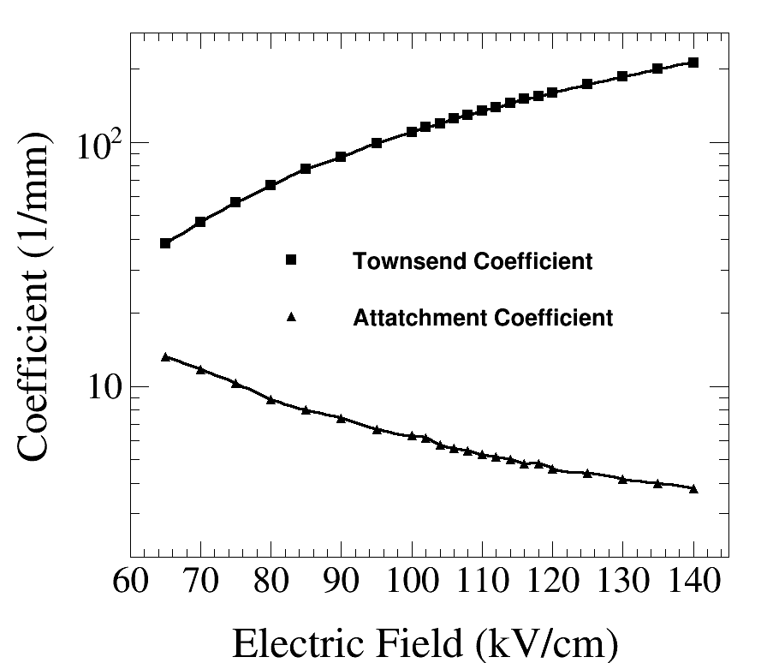
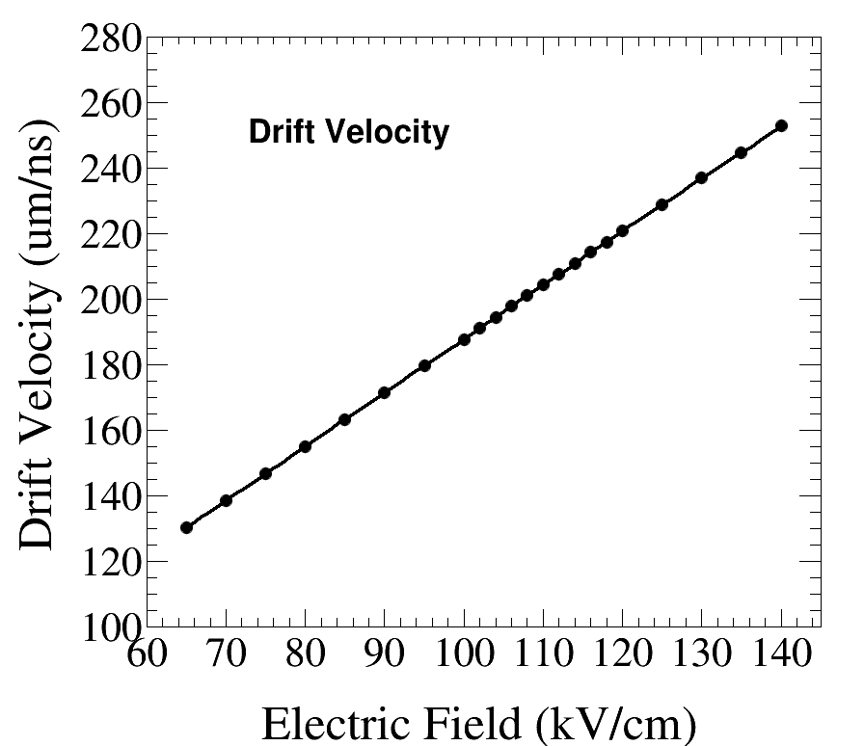
Electron Multiplication
Simulation Method
Electrons from primary ionization are multiplied under electric field. Avalanche development exclusively depends on the field intensity E.
The probability to get secondarily ionized and attached are characterized by Townsend ($α$) and attachment ($η$) coefficients.
The avalanche speed is characterized by drift velocity $v_{drift}$
Simulation results from MAGBOLTZ for our working gas under standard temperature and pressure

Slide 10
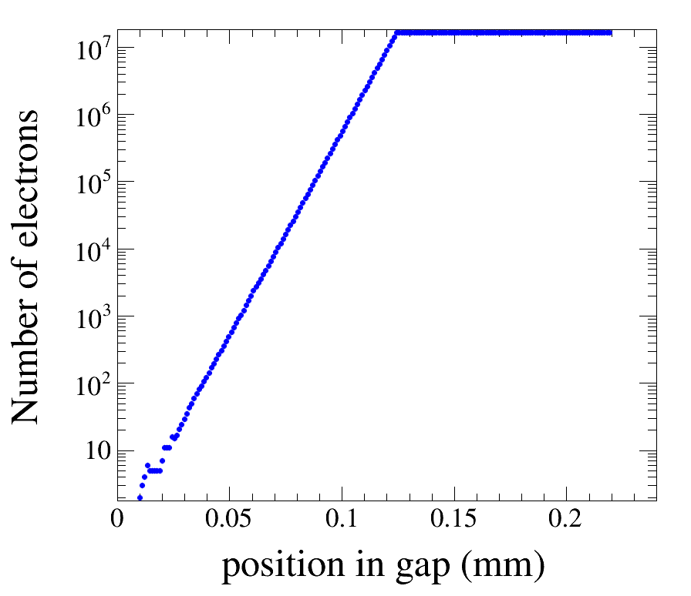
Electron Multiplication
Simulation Method
Avalanche process is simulated based on the 1D-model introduced in Ref. [Nucl. Instrum. Meth. A 500 1-3]
1. Each gas gap is divided into N steps of size dx
2. Primary electron-ion pairs distribution along
the gap is provided by Geant4
3. The number of electrons $n\left(x+dx\right)$ at distance
x+dx is calculated according to the predicted
probability
4. Repeat step 3 until all electrons have left the gap
Saturation effect is considered by applying a simple cut-off at $1.5×{10}^{7}$. It is satisfactory because the main characteristics such as efficiency and resolution are only sensitive to the early stage of an avalanche

Slide 11
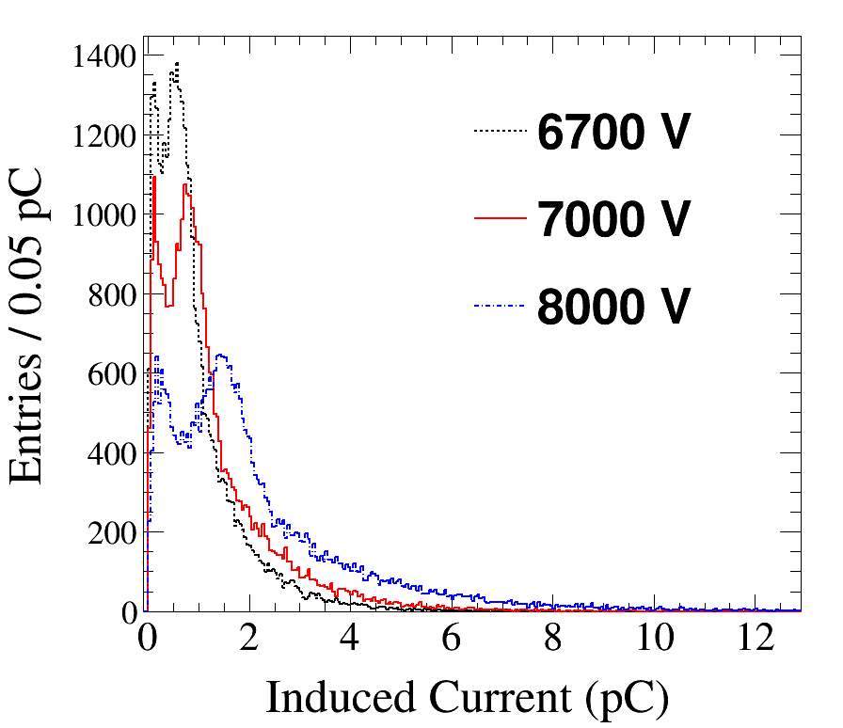
Charge Induction
Simulation Method
Signal current is induced on the strips by the electron movement in the electric field, which can be calculated by Ramo’s theorem
[S. Ramo, Proceedings if IRE 27 (1939)]
$$i\left(t\right)=E_{weight}v_{drift}Q_{e}N(t)$$
𝑖(𝑡)=𝐸_𝑤𝑒𝑖𝑔ℎ𝑡 𝑣_𝑑𝑟𝑖𝑓𝑡 𝑄_𝑒 𝑁(𝑡)
electronic charge
Weighting field
Drift velocity
the number of electrons in an avalanche at time $t$
the number of electrons in an avalanche at time 𝑡
Charge spectra in different electric fields
The left peak is caused by hits at the chamber borders or under the strip intervals
7000 V HV is applied by the BESIII experiment, resulting in a signal peak around 1 pC

Slide 12
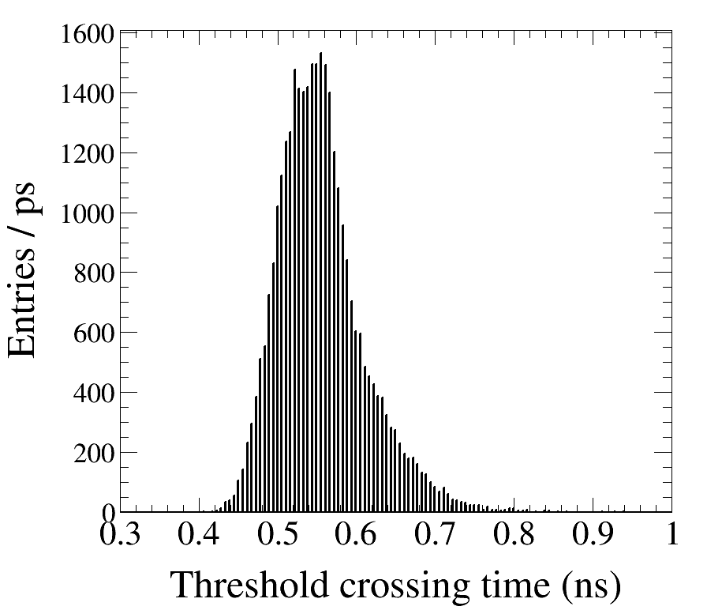
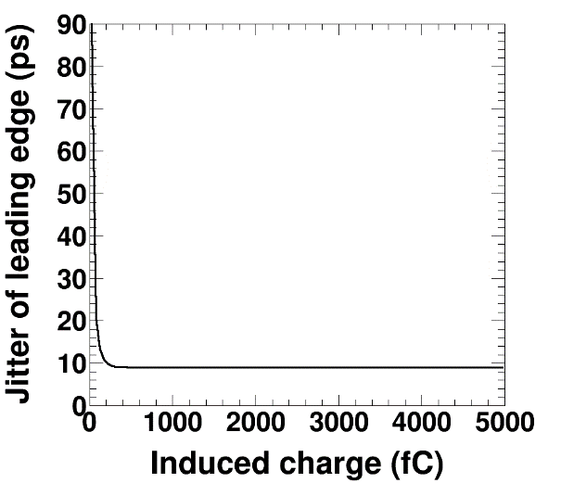
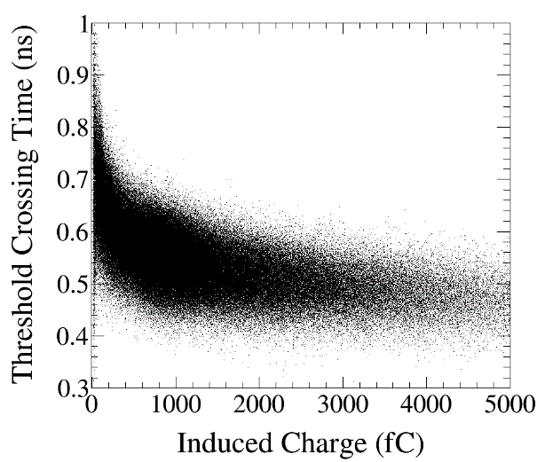
Charge-Time Conversion
Simulation Method
Threshold crossing time $t_{thre}$: time when induced charge exceeds $Q_{thre}$
$t_{thre}$ projection
$t_{thre}$ jitter vs Charge
$t_{thre}$ vs Charge
Propagation time $t_{prop}$: time propagating along the strips, assuming a propagation speed of 0.8$c$

Slide 13
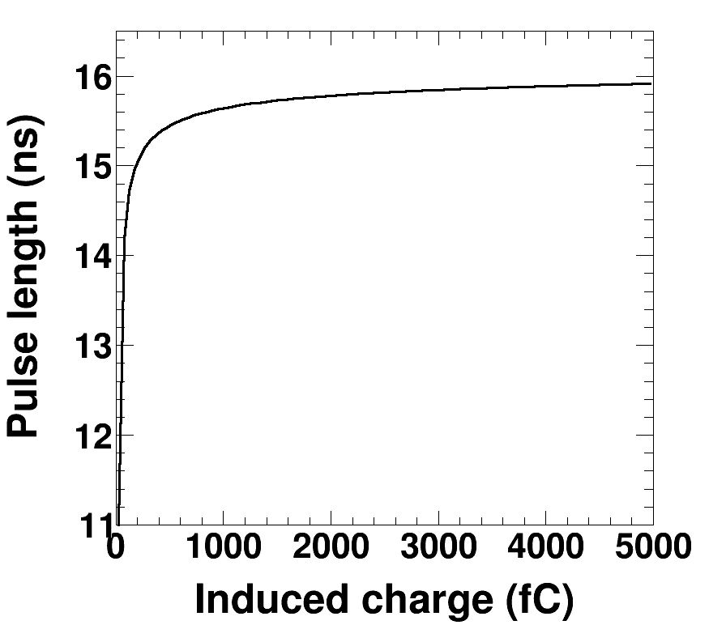
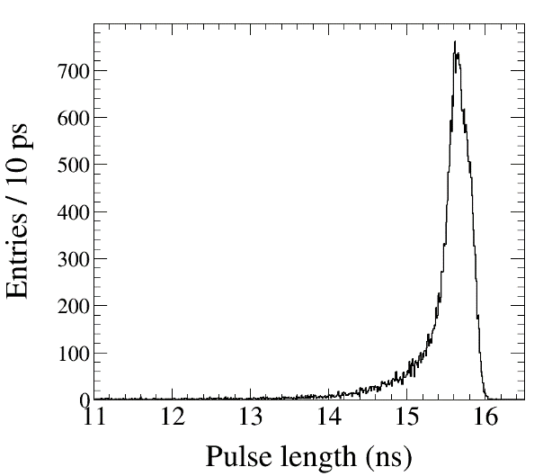
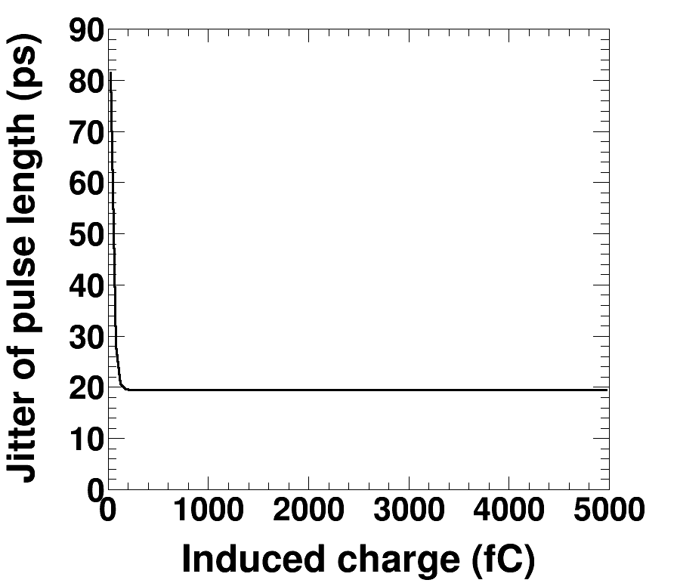
Charge-Time Conversion
Simulation Method
Time over threshold TOT: converted from the charge spectrum
Charge to TOT conversion
TOT projection
TOT jitter vs Charge

Slide 14
Performance Study
Performance Study
We simulate Bhabha events with electric field E and charge threshold $Q_{thre}$ set at different values and reconstruct the time following the same way as when dealing with real data.
Two testing MRPC modules have participated
in taking physics collision data under such
working points:
Seven high voltages (V): 6700, 6850, 7000,
7150, 7300, 7450
Four thresholds (mV): 110, 150, 200, 250
The behavior of detection efficiency and time resolution with E and $Q_{thre}$ is studied and compared with experimental data
Two testing modules are installed, replacing the old scintillator

Slide 15
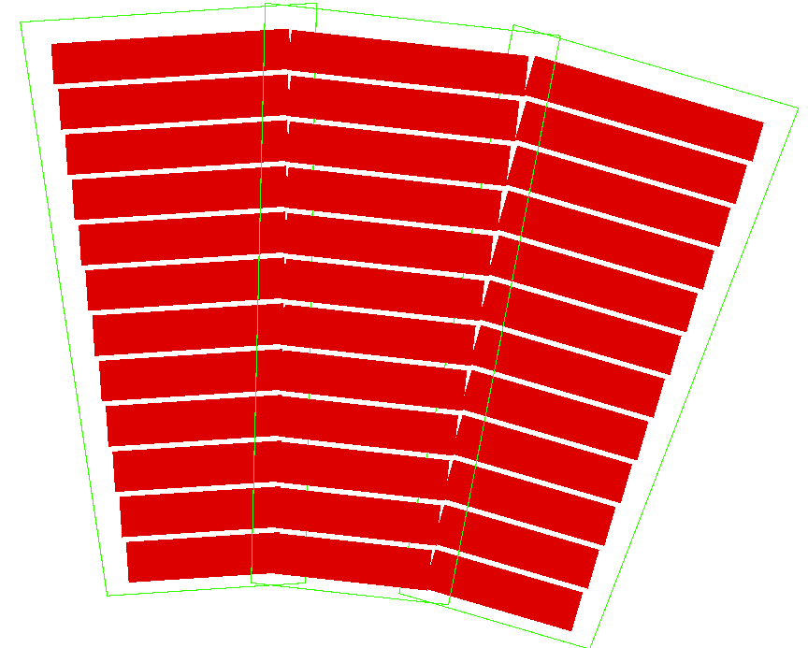
Time Reconstruction
Performance Study
Time reconstruction method:
MDC tracks is extrapolated to determine
the impact position
Signal is searched for in the matched and
neighbor strips
Measured time is calculated
Character variables
MC and data reconstruction follow the same way, except that the correction item $t_{cor}\left(Q,z\right)$ is different
Expected time of flight
$$t_{exp}=L/β$$
Time difference: $Δt=t_{meas}−t_{exp}$
Measured time of flight
$t_{meas}=t_{raw}−t_{0}−t_{cor}\left(Q,z\right)$
Detection efficiency: $ε=\frac{N_{\left|Δt\right|<0.8}}{N_{extrapolated}}$

Slide 16
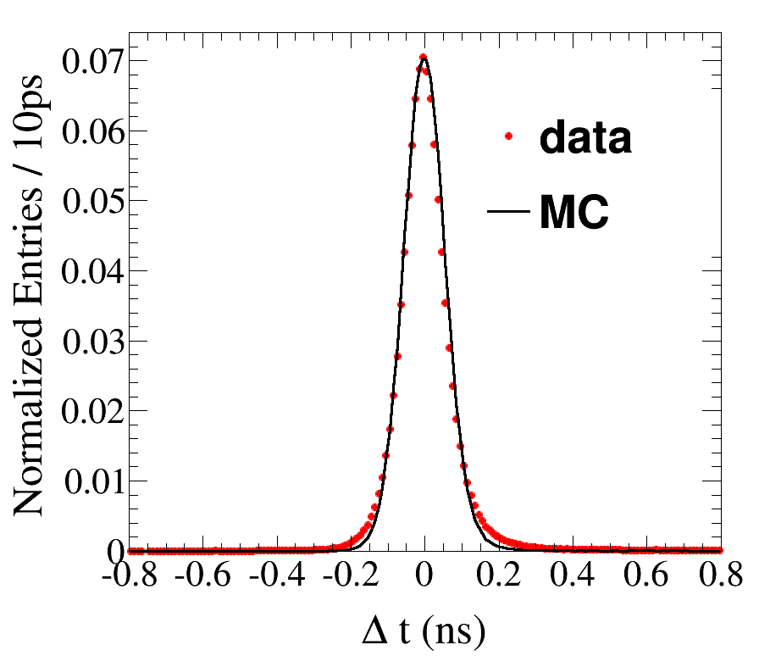
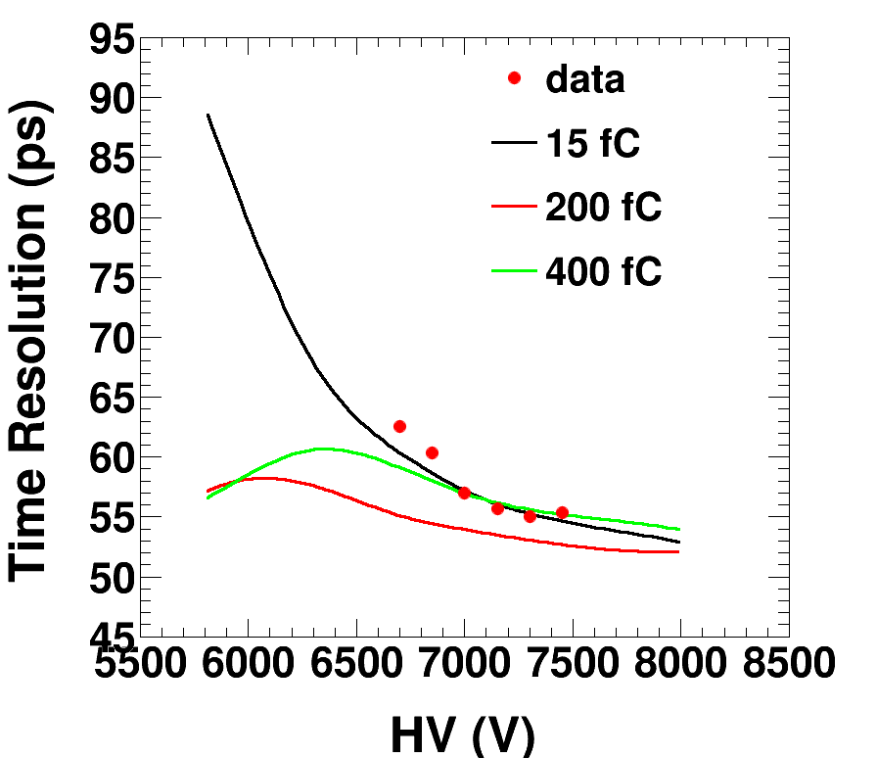
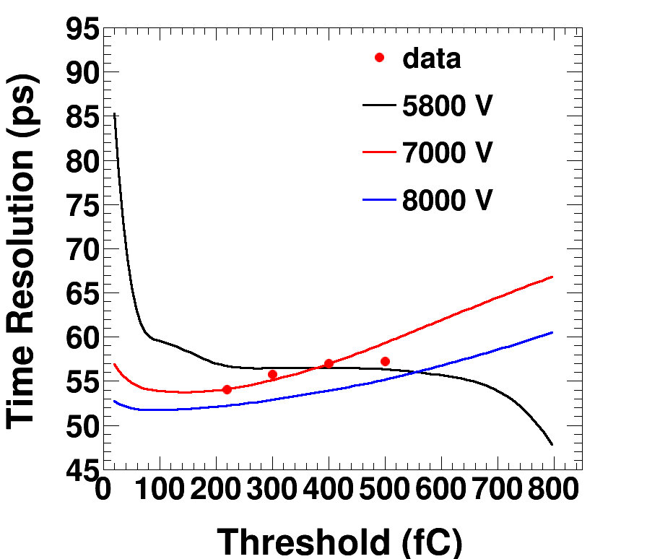
Time Resolution
Performance Study
$σ_{t}$: resolution of $Δt$ distribution
A comparison between data and MC at:
E=7000 V, $Q_{thre}$=400 fC
$σ_{t}∼$57ps includes:
Jitters depending on charge; TDC: 25ps;
Arising from 12 gaps: 10ps; Electronics: 20ps;
Others: 15 ps
Time resolution ~ HV
Time resolution ~ threshold

Slide 17
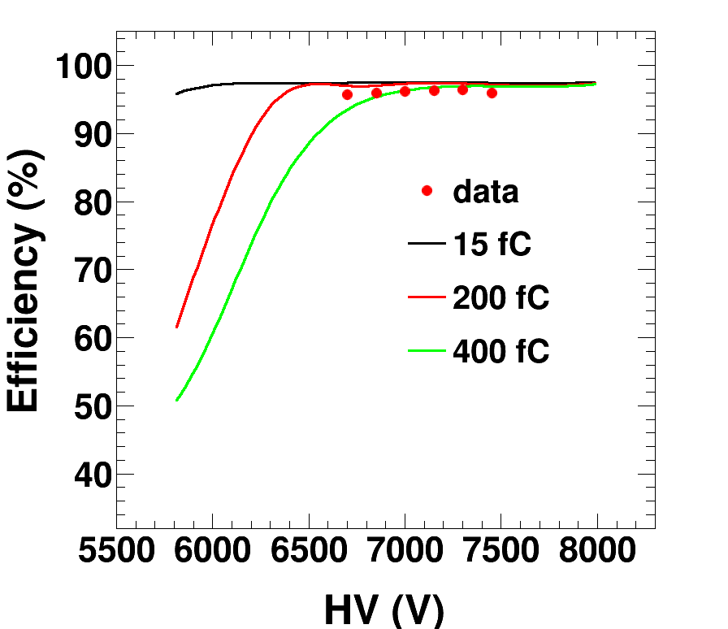
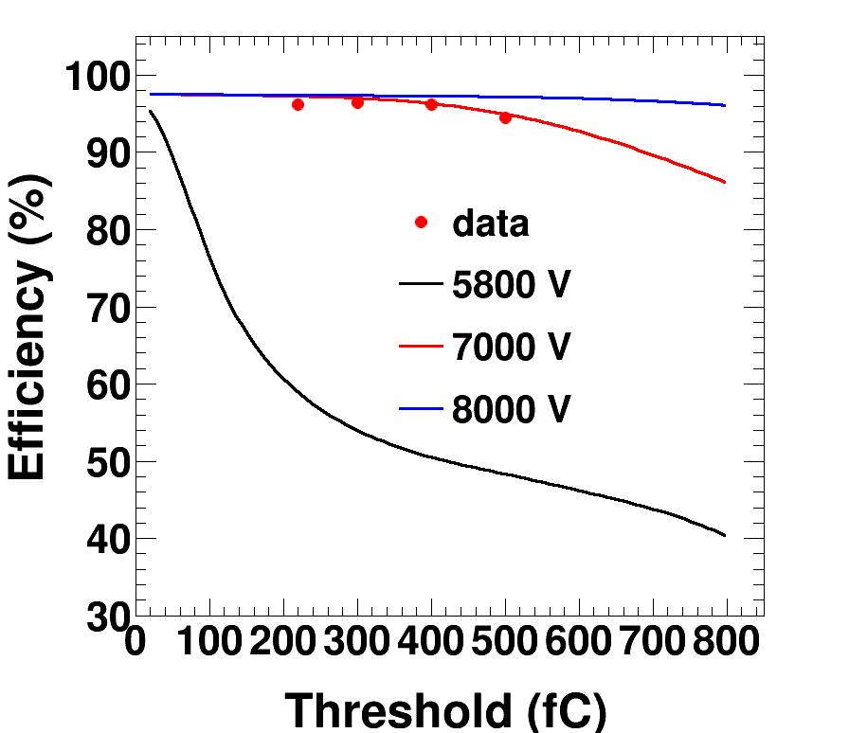
Detection Efficiency
Performance Study
$ε=\frac{N_{\left|Δt\right|<0.8}}{N_{extrapolated}}$, ratio of the number of good signals over that of extrapolated MDC tracks
$Δt$ is required to be less than 0.8 ns to suppress backgrounds
MC efficiency plateau around 97%. The 3% loss is due to event start time determination, limited signal search area …
Detection efficiency ~ HV
Detection efficiency ~ threshold

Slide 18
Summary & Outlook
Summary & Outlook
Simulation software is developed for the new MRPC detector at BESIII
Simulation method is introduced
Simulation performance with HV and threshold is studied. Data points taken by testing modules are also plotted for comparison
More precise tuning will be done based on the future collision data. Put into use for data analysis
Thank You

