Slide 1
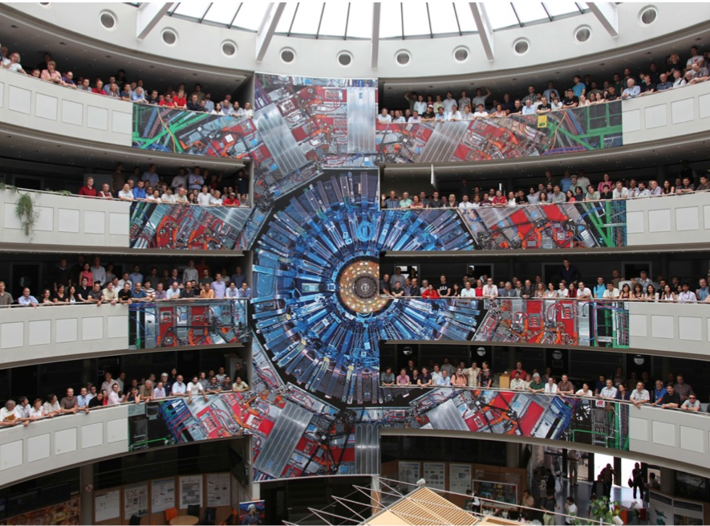


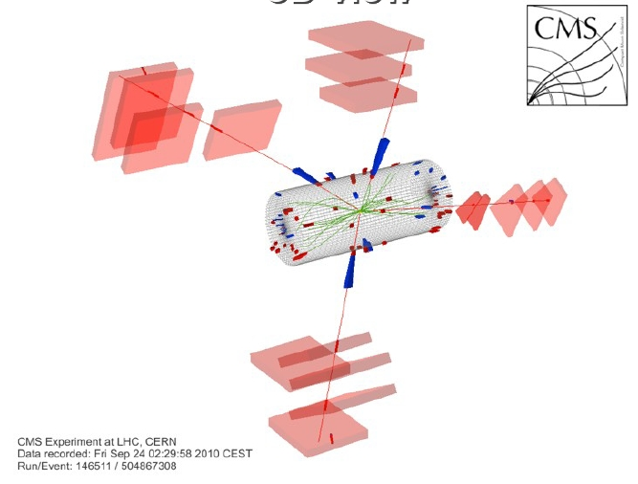
Improving
rate capability of
Resistive Plate Chambers
Marcello Abbrescia
Dipartmento Interateneo di Fisica
University of Bari

Slide 2

Let us start from…
… one of prof. Santonico’s presentations:
(Second ECFA workshop on HL-LHC, Aix-les-Bains, 21-23 Oct. 2014)
In the static limit the voltage applied to the chamber Δ V_{appl} is entirerly transferred to the gas; but, for a working current i, part of this voltage is needed to drive the current in the electrodes
Δ V_{gap}= Δ V_{appl} – RI = Δ V_{appl} - Δ V_{el}
With Φ =counts/surf. the voltage transferred to the electrodes can be written as:
Δ V_{el} = ρ d Φ <Q>
Charge/count
Electrode resistivity
Electrode total thickness
“A high rate requires to keep
Δ V_{el} at a negligible value wrt.
Δ V_{gap} even under heavy irradiation”

Slide 3
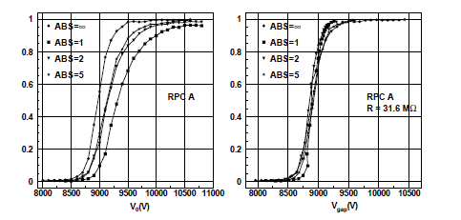
Let us start from…
Essentially the same approach used in:
G. Carboni et al. A model for RPC detectors operated at high rate, NIM A 498(2003), 135-142
“ The current drawn by a detector exposed to a particle flux Φ (particles/s) is:
I = Φ q = Φ G q_{i}
where q_{i} is the ionization charge and G is the gain.”
“In a given detector the electric field, the gain and the current are uniquely determined by
Δ V_{gap}, where
Δ V_{gap} = V₀ – IR
And R is the total electrode resistance, given by:
Basically the application of the Ohm’s law

Slide 4
What we learn from that formula
It is a first (rough) approximation of complex processes.
At first order:
  Electrode resistivity does influence rate capability;
  Electrode thickness does influence rate capability;
  Gap thickness does not seem to play any role.
There is not a direct way to compute which is the effect of a reduction on ΔV_{el}= Δ V_{appl} - Δ V_{gap} on the rate capability.
Bakelite thickness can account for a 25-50% reduction on Δ V_{el}
  (Ex. from 2→1.5-1 mm)
Bakelite resistivity can account a 10 (or more) factor on Δ V_{el}
(Ex. From 5 × 10¹⁰ → 5 × 10⁹ Ωcm)
→ Electrode thickness seems to play a second order role.
ΔV_{el} = ρ d Φ <Q>
Later on…

Slide 5

Let us use something more elaborate
x_{sat}
Exponential growth
Saturation
μ
“Drift”
Exponential growth
Saturation
Note that most of the variables here are stochastic variables (q_{ind} is the convolution off all these probability distributions), so it is
not immediate to get analytical results…

Slide 6
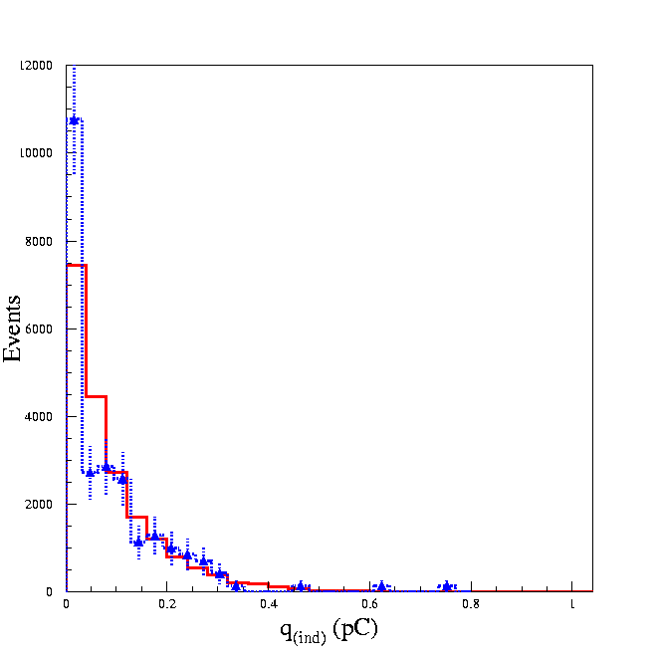
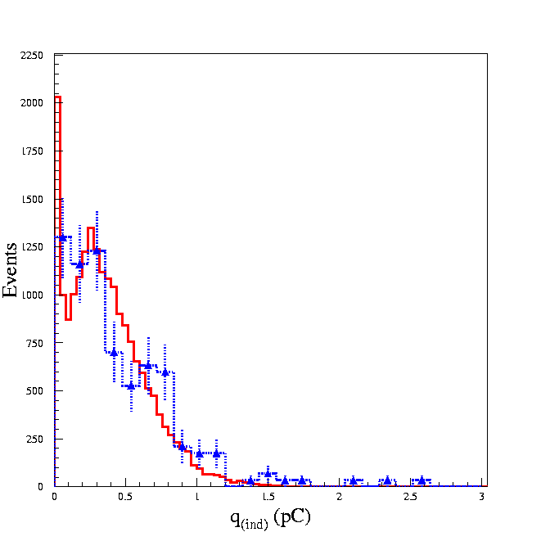
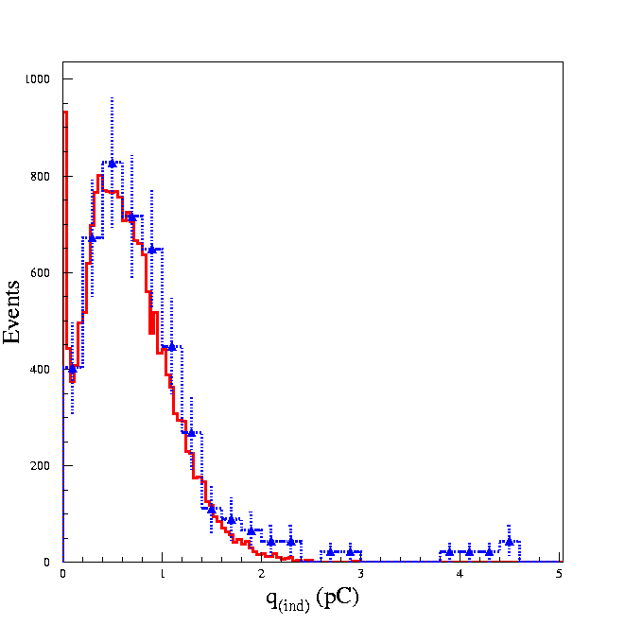
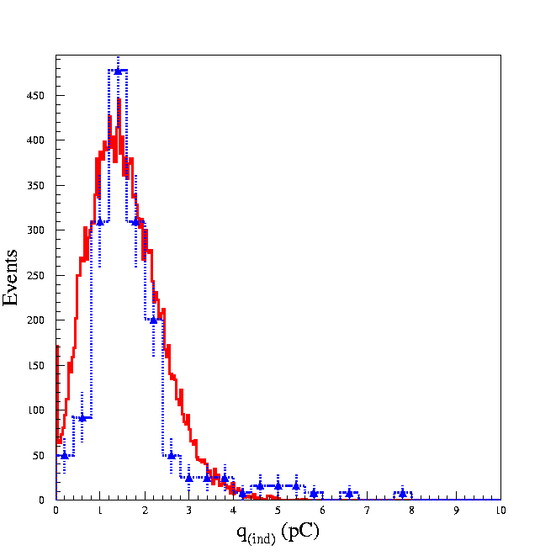
Quite a successful model...
This is not a fit!
Simulation
Simulation
Experiment
Experiment
HV=9.2 kV
HV=9.5 kV
“Inefficiency”peak
“Saturation” peak
Simulation
Simulation
Experiment
Experiment
HV=9.7 kV
HV=10.1 kV
Input for simulation: Colucci et al., NIM A 425 (1999) 84-91
Gas mixture:
C₂H₂F₄/C₄H₁₀ 97/3 + SF₆ 2%
Experimental data from Camarri et al., NIM A 414 (1998) 317-324

Slide 7
Let us move to a dynamic model
μ
μ
≈
C_{g}
C_{b}
R_{b}
Time constant τ depending only on material characteristics and not on “cell” dimensions
Also capacitive effects taken into account
typical avalanche radius: 100 μm
typical avalanche charge: 1 pC
typical external charge contained in 100 μm: 10 pC
A few numbers:

Slide 8
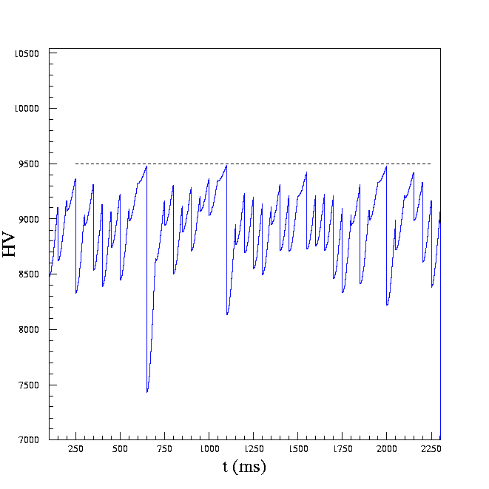
And what REALLY happens…
ν=20 Hz
We assume that the voltage on the electrodes goes back to HV_{appl} following an exponetial law
Applied HV
τ=1500 ms
Note that “big” pulses come only after that HV_{appl} has been restored, and they are followed by “small” pulses
Average HV_{gap} value of the “static” model
ρ ≈ 5 × 10 ¹¹ Ωcm
Cell area = 1 mm²
Complex “feedback” mechanisms…

Slide 9
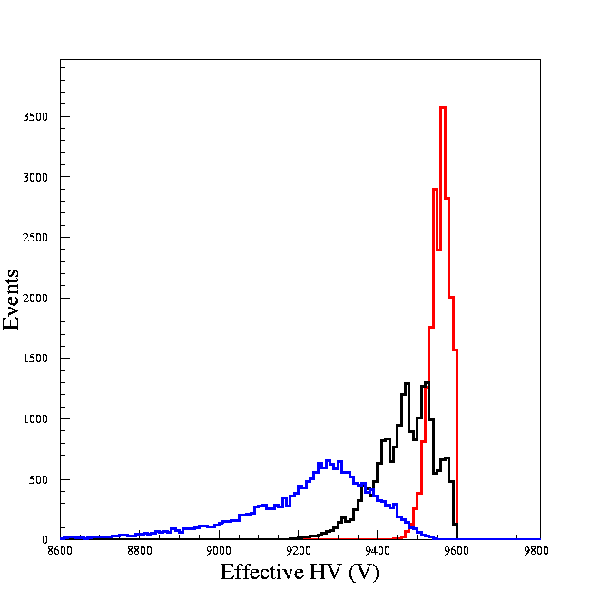
Some of the differences
Applied HV
10 Hz
The effective HV diminishes and its distribution is broader.
13 Hz
20 Hz
Reduction off the effective HV correctly foreseen by the static (ohmic) model)
Spread of the effective HV not foreseen at all
Average HV_{gap} of the “static” model
Two consequences:
lower HV at high rate
greater HV variations at high rate

Slide 10
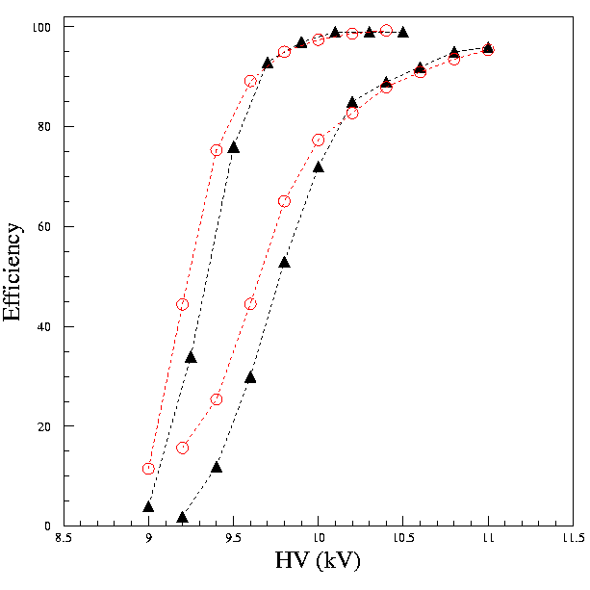
Efficiency: comparison with data
Note that there also exists an approximated formula for efficiency:
~ 2 Hz/cm²
~ 1.5 kHz/cm²
Basic aspects reproduced:
Plateau efficiency reduced at high rate
Shift of the efficiency curves
Change in slope of the efficiency curves
Experimental
Simulation
Not so immediate (if possible) to reproduce the same effect with the static model
Data from G. Aielli et al., NIM A 478(2002) 271-276

Slide 11
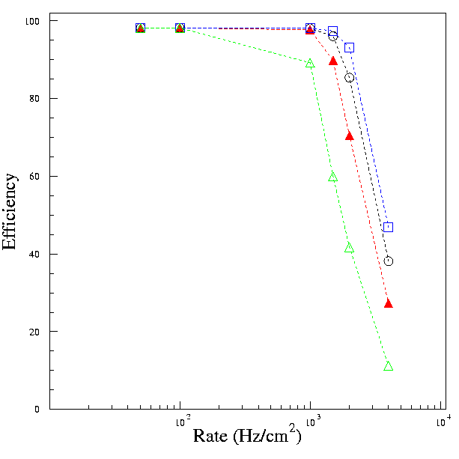
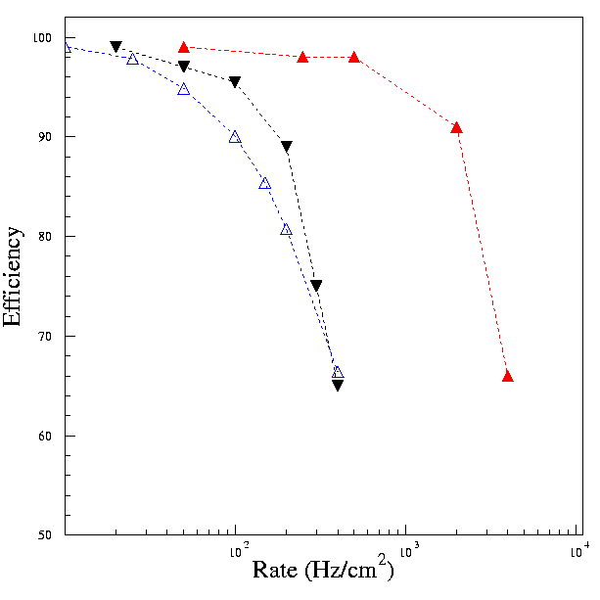
Rate capability dependances
ρ≈ 8 × 10¹⁰ Ωcm
“Low” resistivity
“Low” charge
ρ≈ 8 × 10¹⁰ Ωcm
ρ≈ 10¹¹ Ωcm
ρ≈ 4 × 10¹¹ Ωcm
“High” charge
ρ≈ 6 × 10¹¹ Ωcm
Simulation
streamer
“High” resistivity
Exp. avalanche
Electrode resistivity
Exp. streamer
Charge contained in the discharge
HV=10100 V
Here we find the other important aspect related to the charge travelling in the gap and the importance to reduce it
Data from R. Arnaldi et al., NIM A 456(2000) 73-76
  But this implies a signal reduction as well!

Slide 12
About gap thickness:
Q_{gap}
Saturation term
0
1
0
n_{g}= number of gaps
The trick to increase rate capability is to increase q_{ind} keeping Q_{gap} constant, while
ηg stays (roughly)constant.
0

Slide 13
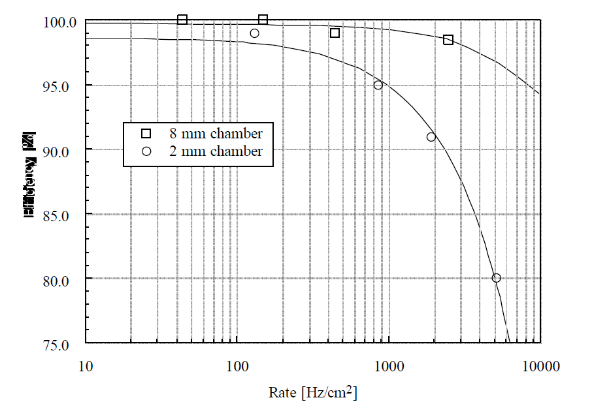
About gap thickness:
1
The point is that if you reduce the gap thickness only the shielding electrostatic effect of the bakelite plates increases in proportion
  q_{ind} is reduced (keeping Q_{gap} constant)
  Rate capabity is reduced
The voltage drop in the gap related to the weighting field should be as high as possible
If you reduce the electrode thickness at the same time, the two effects cancel out
0
1
0
Experimental data show that wider gaps show higher rate capability
(also for other reasons)
It would be “strange” that the 2 mm gap is the minimum
Efficiency

Slide 14
Time resolution in an RPC
What is the origin of signal time fluctuations in an RPC?
There are very good analytic studies (Mangiarotti et al.),
here just a few hints will be given from a MC point of view.
Only present at high rate
Fluctuations of η
Fluctuations of v_{d}
Present at low rate
Total number of clusters
Total number of electrons in each cluster
Fluctuations superimposed on the exponential growth
All the cluster in the gap contribute at the same manner to the signal
Fluctuation are not (directly) related to the particle transit time in the gas gap

Slide 15
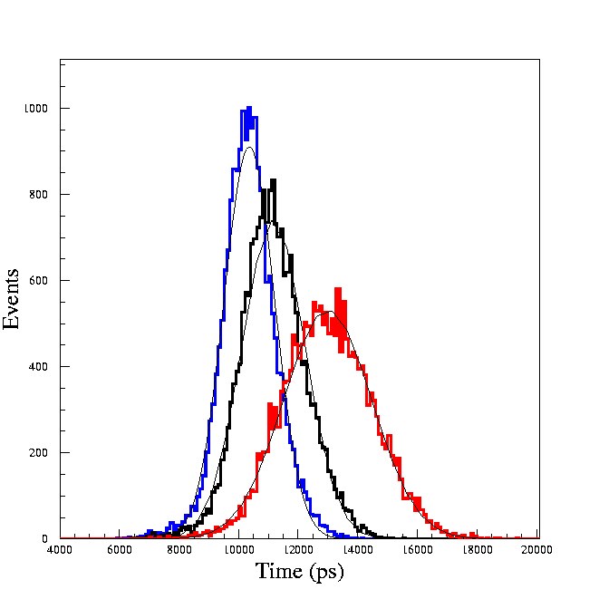
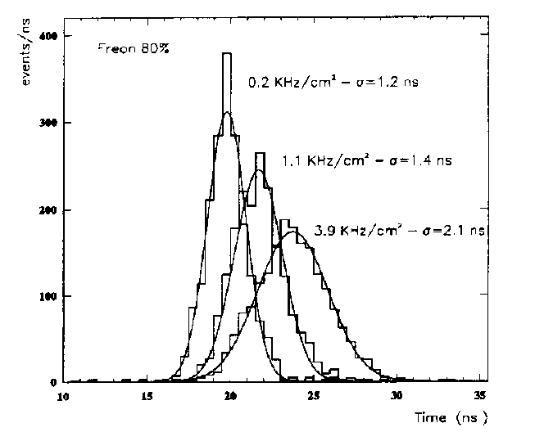
Time resolution at high rate
Data from C. Bacci et al., NIM A 352(1995) 552-556
Simulated
Experimental
0.2 kHz/cm²
σ=0.9 ns
1 kHz/cm²
σ=1.2 ns
4 kHz/cm²
σ=1.6 ns
General behaviour well reproduced ...
Simulated time resolutions slightly less than experimental
“Instrumental” effects not included
Note that all these aspects related to time resolution cannot be accounted for in the static model

Slide 16
Reality is more complex…
The avalanche charge arriving on the electrodes surfaces spreads more or less depending on ration between surface resistivity ρ_{sur} and volume resistivity ρ_{vol}
It has a direct influence on the amount of voltage drop in the gap
avalanche
“large”
“small”
The result is that the current flows not only in the “central” cell, but also in the neighbouring ones.
  The time constant depends on the two parameters ρ_{vol} AND ρ_{sur}
C_{g}
R_{s},_{b}
“Surface” coupling resistors
C_{b}
R_{b}
μ

Slide 17


(Some) Conclusions
The static model used in many discussions
(presentations) is a first order approximation of what happens
  Like putting a straight line where a complex phenomenon is happening
  Assumes a purely resistive behaviour while capacitive effects can be predominant
Clear dependances of rate capability on some constructive parameters are clearly spotted in a more complete view
  Resistivity, charge, electrode thickness
  All this should be considered in current R&D
Amazingly, the most complete and interesting view is still to be thoroughly investigated
More calculations and considerations are welcome!

