Slide 1

New Detector Material to Construct the Low Resistive RPC
Ran HAN 韩然
BISEE, Beijing, China
北京卫星环境工程研究所

Slide 2
Outline
Motivation
R&D on Low Resistive RPC based on polyimide foil
Existed problem
Future steps need to do

Slide 3
Motivation
More and more high energy experiment need high rate RPC
With the increase of CM energy and luminosity, LHC detectors, namely the muon detectors, in the high η region should be able to support high rate.
CBM at the Facility for Antiproton and Ion with very high beam intensities and beam power,interaction rate: 10 MHz (central Au+Au)
Medical application (proton therapy monitoring, PET…) could also use the capabilities of high-rate GRPC
Heavy Ion detection possibility since this very thin electrode

Slide 4
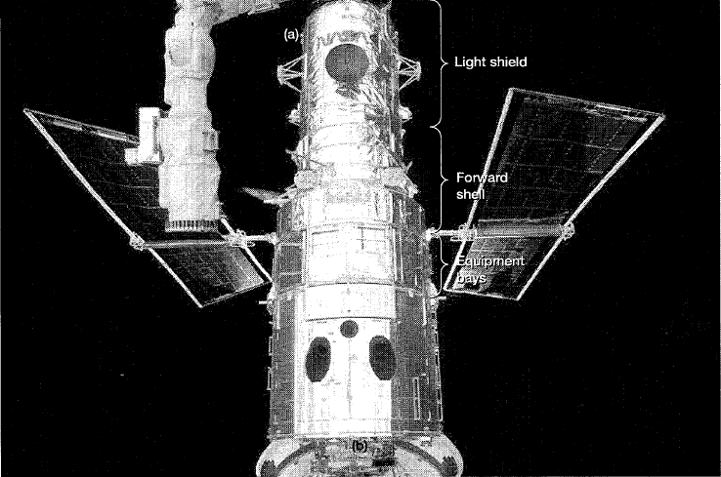
Why polyimide foil
hubble space telescope
The GEM detector is a thin Cu-coated polyimide foil perforated with a high density of holes
To antistatic, they
Produce the conductive polyimide foil
Is it possible to make proper resitivie Polyimide foil used for RPC ?

Slide 5
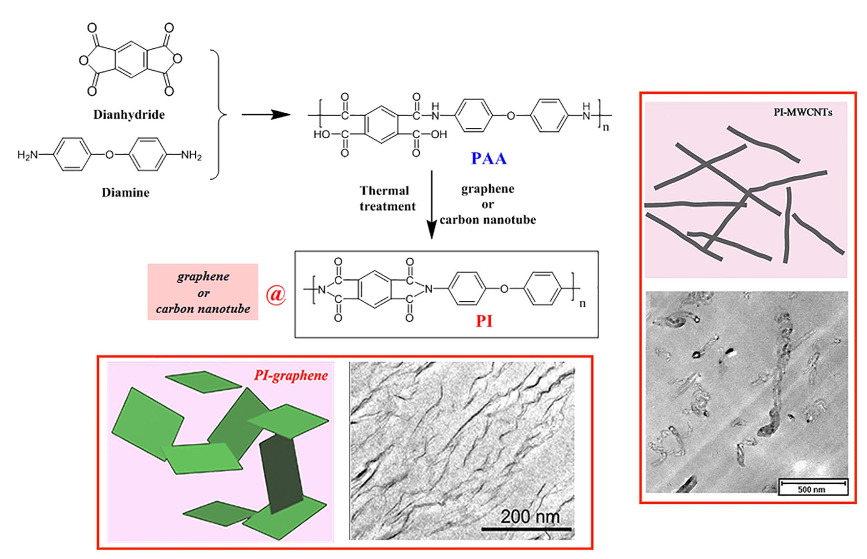
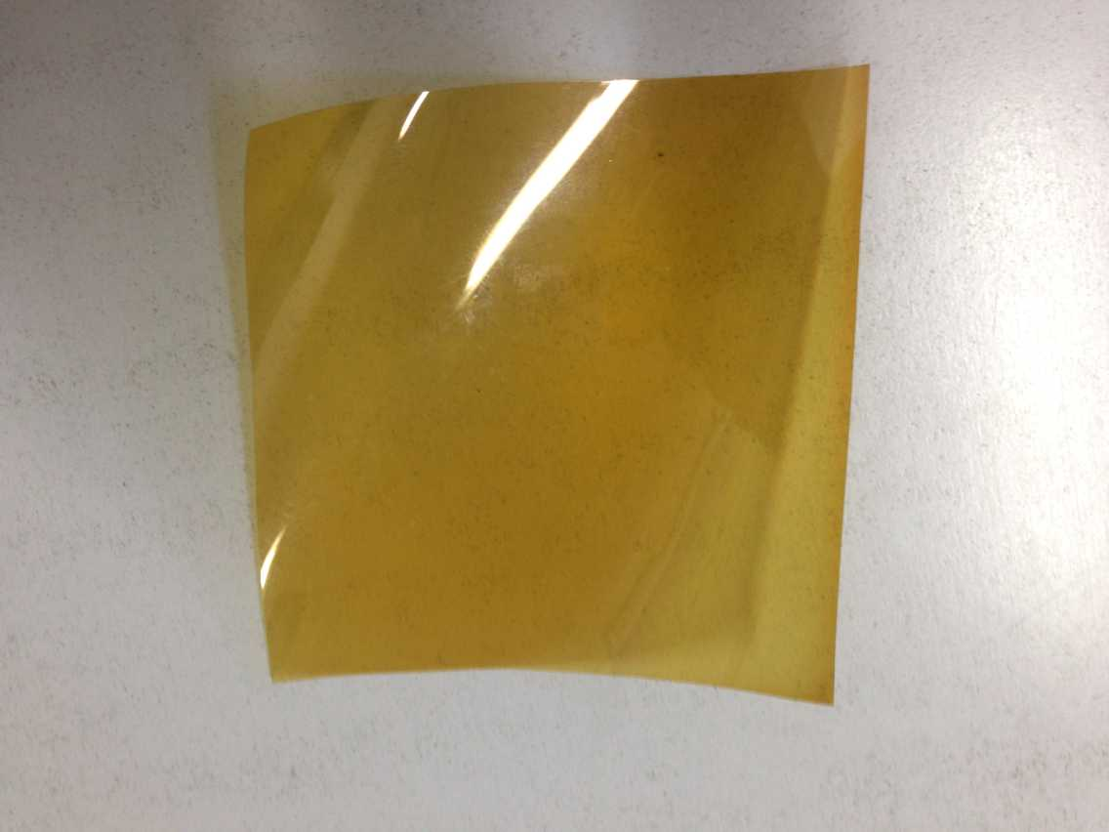
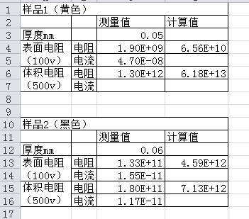
The low-resistive polyimide foil

Slide 6
Polyimide-carbon RPC
polyimide-carbon foil
Acrylic Frame
-HV
Spacer
Gas outlet
Gas inlet
Sealed box
Readout Pad
+HV
The thickness of polyimide-carbon film are around 40um, the normal technical cannot be used to make this kind of RPC, we developed a new stress method to make the gap between two polyimide-carbon foil, to fix them in a frame made by Acrylic.

Slide 7
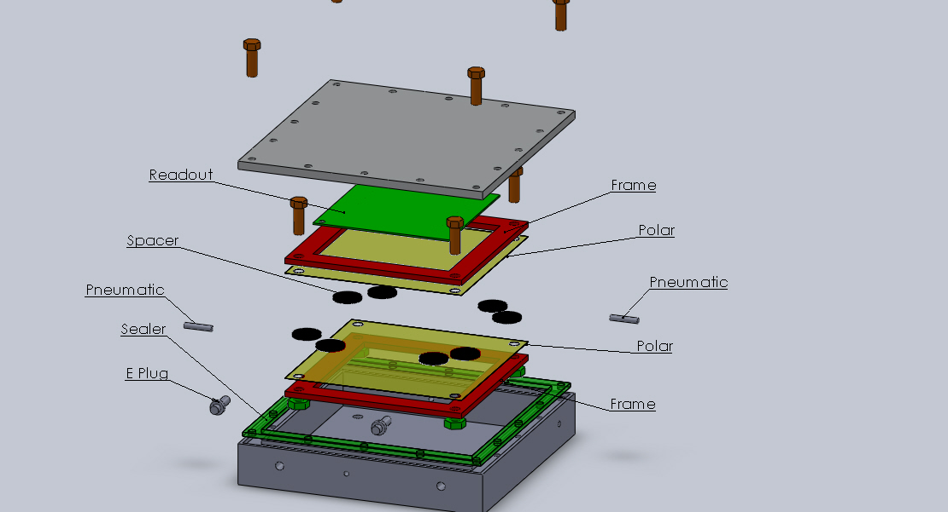
The structure of Polyimide-carbon RPC

Slide 8
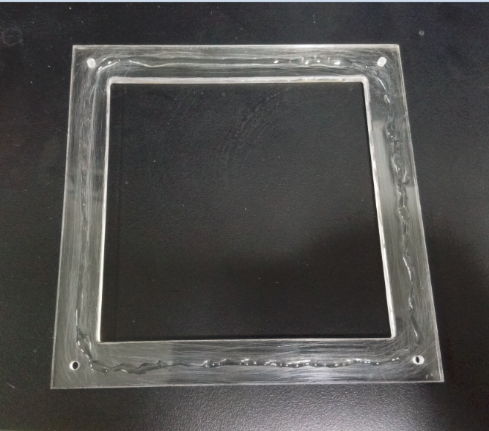
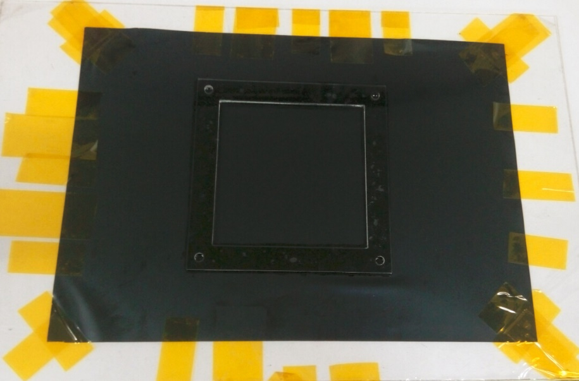
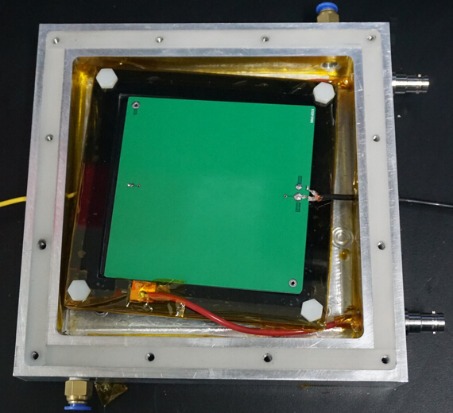
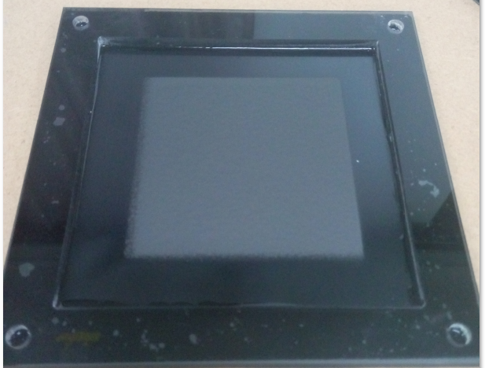
Assembly the chamber
Glue the foil to frame
Stress the foil to make it flat
Coating
Fix to Box

Slide 9
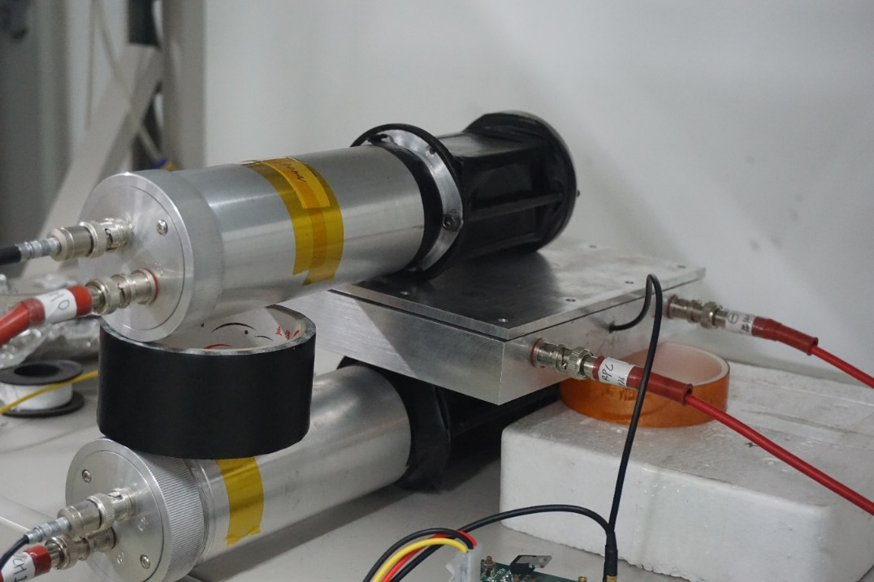
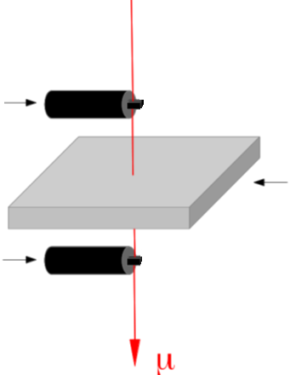
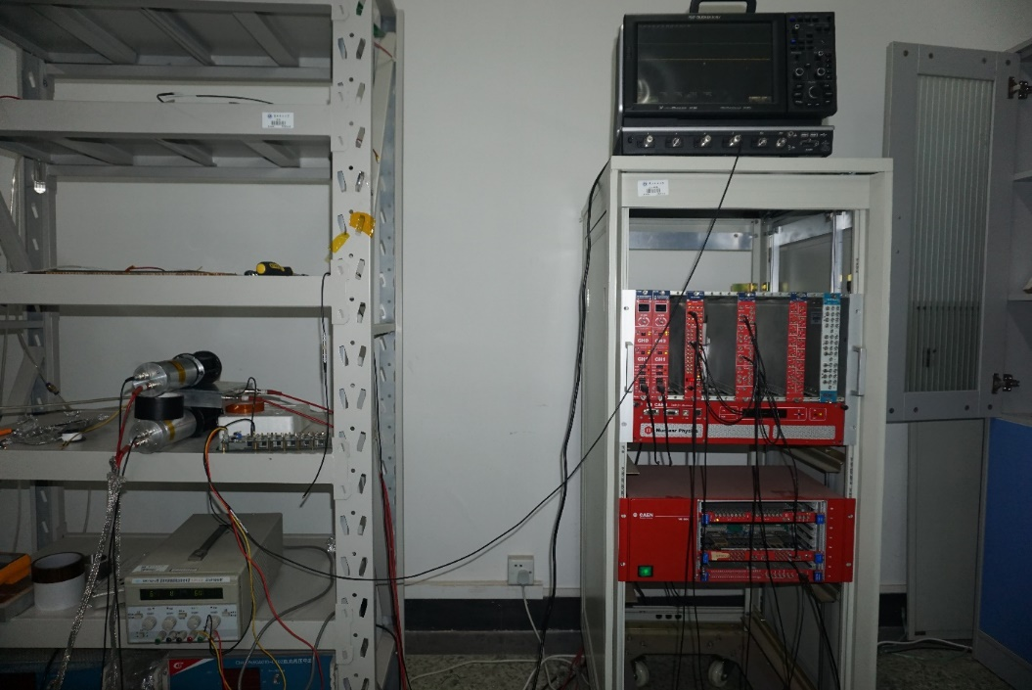
The cosmic test setup
Sci 1
RPC
Sci 2
R134A:CO2: SF6=94.5%:5%:0.5%

Slide 10
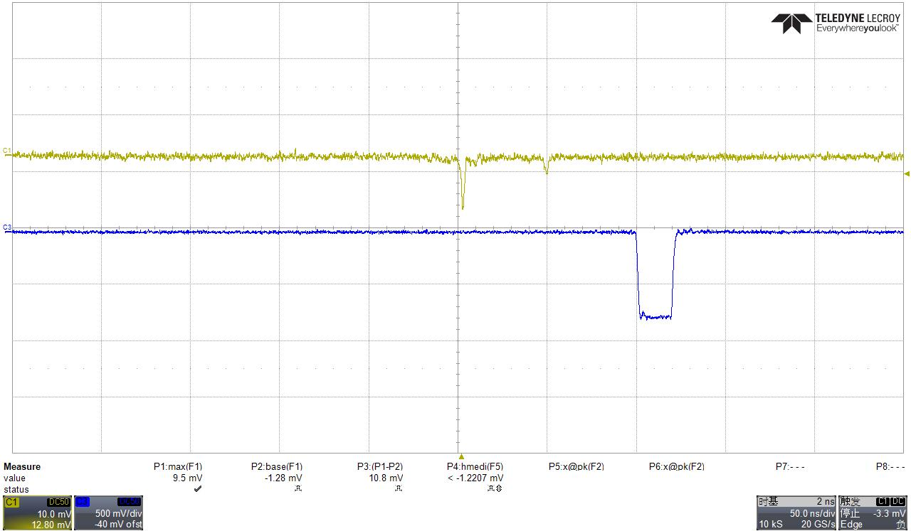
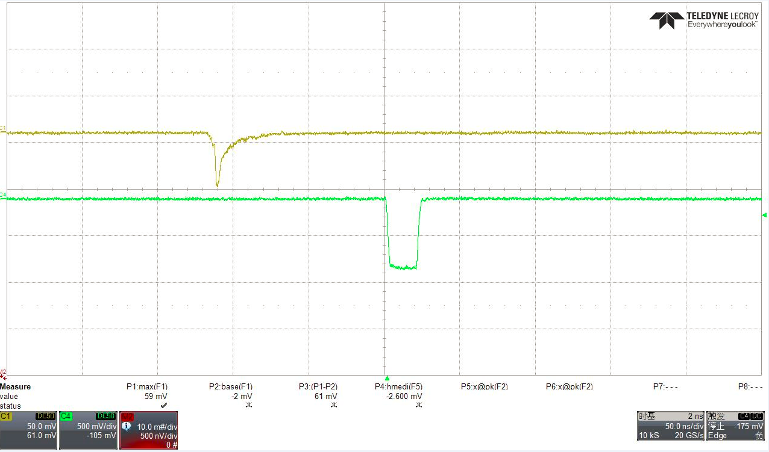
The Signals
HV @8000V

Slide 11
The existed problems
The status is not stable, after running one hour, there is no signal at all, so we can’t make the efficiency and noise rate measurement. It seems there is no high voltage on, may be the thickness is not well.
The single foil itself is not uniform, and between the different foils are also not the same, some foils are even conductive, the technology should be still studied and improved

Slide 12
Future
Keep develop the low resistivity polyimide foil to make the resistivity to 10⁹ – 10¹⁰Ω∙cm
Develop the thickness from 40um to 100um
Develop the stress method to make the detector more flat
To do the efficiency measurement
To do the aging test

