Slide 1
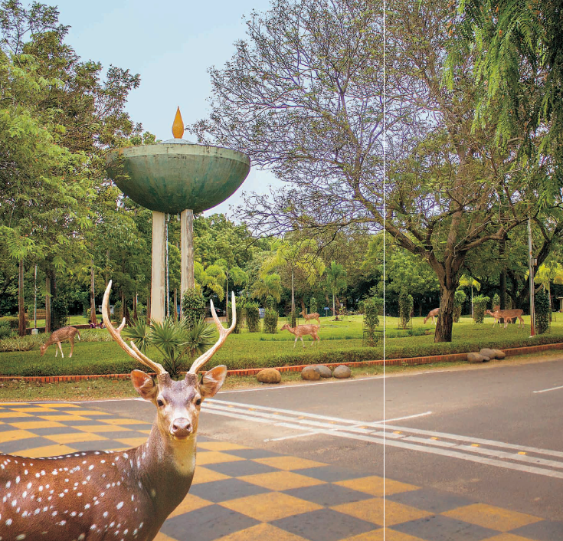
Study of glass properties as electrod for RPC
Prafulla Kumar Behera
(K. Raveendrababuª, Jafar Sadiqª, B. Satyanarayana@TIFR)
ªIIT Madras, India,
The XIII workshop on Resistive Plate Chambers and Related Detectors (RPC2016)
Ghent University, Belgium
25th February, 2016

Slide 2
Outline
Introduction
Motivation
Studies
Elemental composition
Density measurements
Electrical properties
Summary
RPC performance studies
Conclusions
Prafulla Kumar Behera, IIT Madras
RPC2016 workshop@UGent

Slide 3
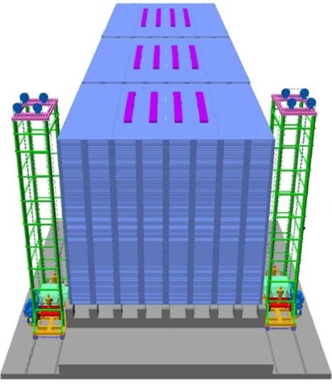
Motivation
The India-based Neutrino Observatory (INO) collaboration is planning to build a 50 kton magnetized Iron Calorimeter (ICAL).
The main aims of the ICAL experiment is to precisely measure the θ₁₃ , θ₂₃ and to determine the ordering of neutrino masses that are involved in the atmospheric neutrino oscillations.
The layout of three modular form of INO-ICAL detector.
Prafulla Kumar Behera, IIT Madras
RPC2016 workshop@UGent

Slide 4
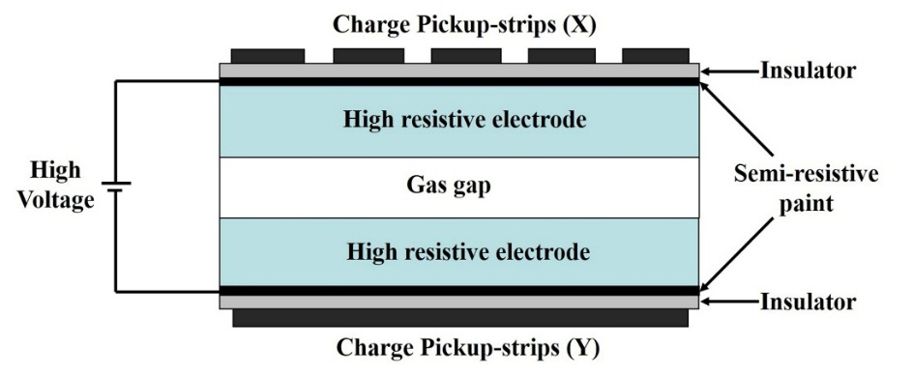
Motivation
The active elements in the INO-ICAL detector are glass RPCs of 2 m x 2 m in area and are 28,800 in number
There is a need of rigorous studies on the glass samples for the better selection of RPC electrodes
Resistive Plate Chamber (RPC)
A detailed characterization studies on the glass samples from various manufacturers, viz. Asahi, Italian, Japanese and Saint-Gobain, have been performed
Prafulla Kumar Behera, IIT Madras
RPC2016 workshop@UGent

Slide 5
Elemental Composition Study
Measured using FEI Quanta 200 Scanning Elemental Microscope (SEM) and from Energy-dispersive X-ray Spectroscopy (EDS) technique.
Element | Asahi (%) |  |  | Italian (%) |  |  | Japanese (%) |  |  | Saint-Gobain (%) |  |  | Variation (%)
 | Area-1 | Area-2 | Average | Area-1 | Area-2 | Average | Area-1 | Area-2 | Average | Area-1 | Area-2 | Average
Silicon (Si) | 15.43 | 16.69 | 16.06 | 17.56 | 16.85 | 17.21 | 16.6 | 16.86 | 16.73 | 17.24 | 17.69 | 17.47 | 1.44
Oxygen (O) | 70.93 | 68.65 | 69.79 | 68.76 | 69.81 | 69.29 | 71.06 | 70.38 | 70.72 | 71.03 | 70.65 | 70.84 | 1.55
Sodium (Na) | 10.46 | 10.71 | 10.59 | 10.33 | 10.02 | 10.18 | 9.18 | 9.26 | 9.22 | 8.70 | 8.21 | 8.46 | 2.13
Magnesium (Mg) | 2.21 | 2.51 | 2.36 | 2.13 | 2.21 | 2.17 | 2.21 | 2.34 | 2.28 | 1.64 | 2.19 | 1.92 | 0.44
Calcium (Ca) | 0.96 | 1.38 | 1.17 | 1.18 | 1.08 | 1.13 | 0.91 | 1.12 | 1.02 | 1.39 | 1.26 | 1.33 | 0.31
Iron (Fe) | 0.02 | 0.05 | 0.035 | 0.05 | 0.04 | 0.045 | 0.04 | 0.04 | 0.04 | 0.00 | 0.00 | 0.00 | 0.045
Variation in composition is less than 3%
Prafulla Kumar Behera, IIT Madras
RPC2016 workshop@UGent

Slide 6
Density Measurement
The density of the glass samples were measured using METTLER-AE163 laboratory weighing balance, which works on the Archimedes buoyancy principle. The pure water is used as reference fluid.
Volume of the sunken object = Volume of the displaced fluid
ρ = (W₁/W₂) ρ_{0,}
W₁ = Weight of the object in air,
W₂ = (Weight of object in air – Apparent weight of object in water),
ρ₀ = density of water at 27.4⁰C
(room temperature) = 0.996676 g/cc.
Prafulla Kumar Behera, IIT Madras
RPC2016 workshop@UGent

Slide 7
Density Measurement
Manufacturer | Sample number | W1 (g) | W2 (g) | Density (g/cc) | Average density (g/cc)
Asahi | 1 | 0.8958 | 0.357 | 2.5 | 2.4996
 | 2 | 0.9464 | 0.3757 | 2.51
 | 3 | 0.8232 | 0.3296 | 2.489
Italian | 1 | 0.5186 | 0.3148 | 1.6418 | 1.6467
 | 2 | 0.5685 | 0.3464 | 1.6356
 | 3 | 0.5801 | 0.3477 | 1.6627
Japanese | 1 | 0.4414 | 0.1744 | 2.5224 | 2.5029
 | 2 | 0.4052 | 0.1597 | 2.5286
 | 3 | 0.4212 | 0.1708 | 2.4577
Saint-Gobain | 1 | 0.705 | 0.2814 | 2.4968 | 2.4963
 | 2 | 1.0387 | 0.4162 | 2.4872
 | 3 | 0.8144 | 0.324 | 2.505
Italian glass density is ~ 50 % lower than others
Prafulla Kumar Behera, IIT Madras
RPC2016 workshop@UGent

Slide 8
Relative Permittivity
In ideal conditions, most of the applied voltage should be dropped across the gas gap. From the continuity of electric filed displacement at the electrode/gas interface
D = ε_{p} E_{p} = ε_{g} E_{g} .
Where, ε_{p} and ε_{g} are the relative permittivities, and E_{p} and E_{g} are the electric fields for the electrode plate and the gas gap, respectively.
The bigger the inequality of ε_{p}> ε_{g}, the voltage drop across the gas gap.
Prafulla Kumar Behera, IIT Madras
RPC2016 workshop@UGent

Slide 9
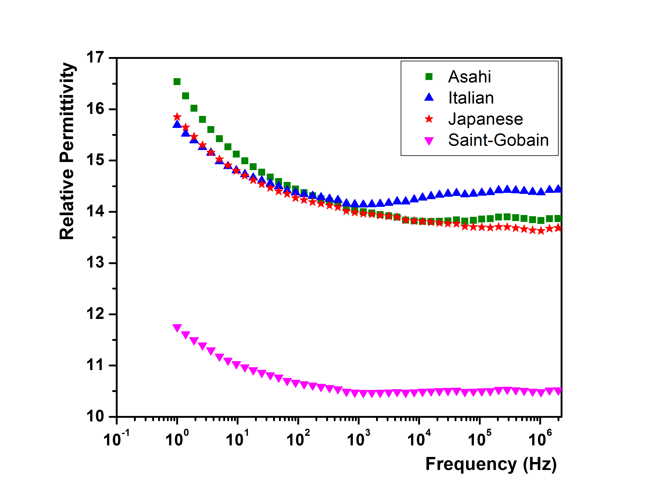
Relative Permeability Conti…
The relative permittivity of the glass samples was measured using “Novocontrol Broadband Dielectric/Impedance Spectrometer” at 20⁰C.
Saint-Gobain glass sample is having the lowest relative permittivity values among the four glass samples.
The RPCs made of electrodes with larger relative permittivity
values can be operated at lower bias voltages.
Prafulla Kumar Behera, IIT Madras
RPC2016 workshop@UGent

Slide 10
Summary
Variation in composition is less than 3%
Italian glass density is ~ 50 % lower than others
Saint-Gobain glass sample is having the lowest relative permittivity values among the four glass samples.
Prafulla Kumar Behera, IIT Madras
RPC2016 workshop@UGent

Slide 11
RPC Performance Studies
The 2 mm gap glass RPCs of 30 cm X 30 cm size were made from Asahi and Saint-Gobain manufacturers. The thickness of electrodes is 3 mm.
The outer surfaces of the electrodes were coated with specially made graphite paint, which facilitates applying high voltage across the electrodes.
The electrodes were separated using polycarbonate spacers having a bulk resistivity ~ 10¹² Ω-cm.
The conductive pickup-strips are orthogonally mounted on the external surfaces of the gap.
A layer of mylar insulator separates the electrodes and the pickup-strips.
Prafulla Kumar Behera, IIT Madras
RPC2016 workshop@UGent

Slide 12
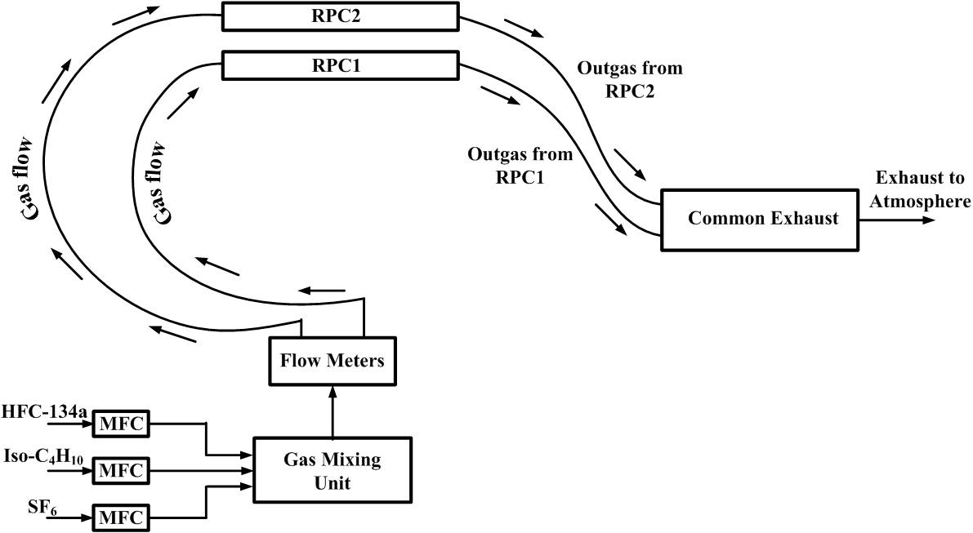
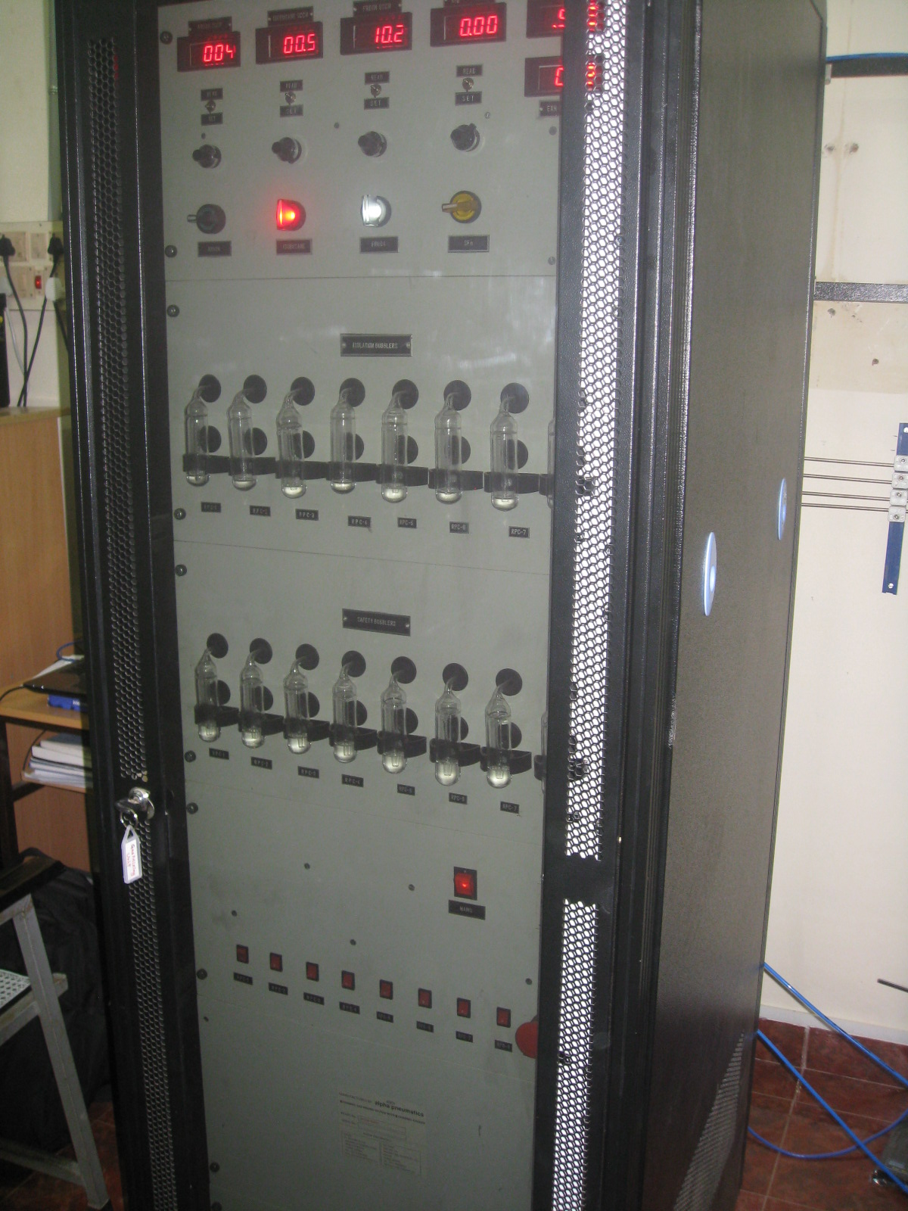
Gas flow system
A gas mixture of HFC-R134a/iso-C₄H₁₀/SF₆ = 95/4.5/0.5 was flown through the RPCs using polyurethane tubes and the detectors were operated in avalanche mode.
Detector is operated at flow rate of 10 SCCM
Prafulla Kumar Behera, IIT Madras
RPC2016 workshop@UGent

Slide 13
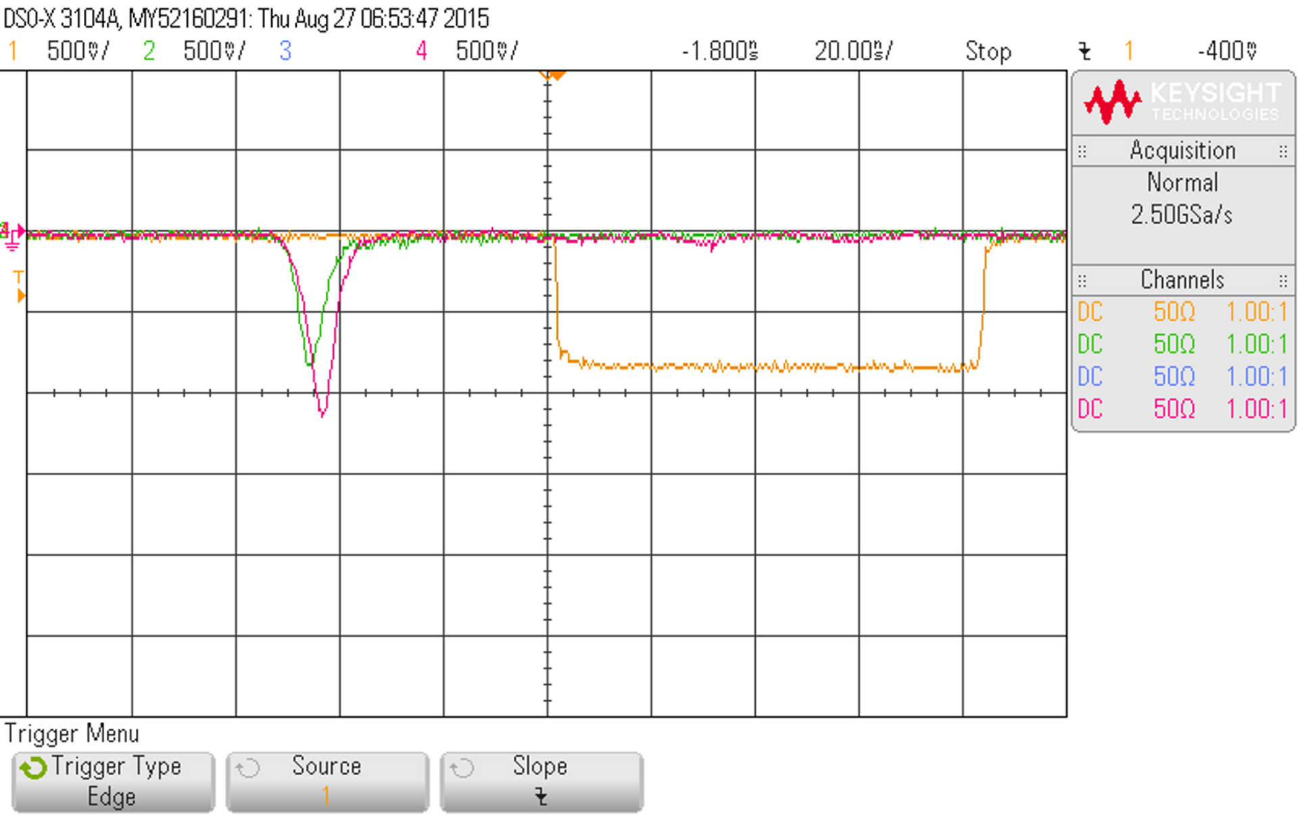
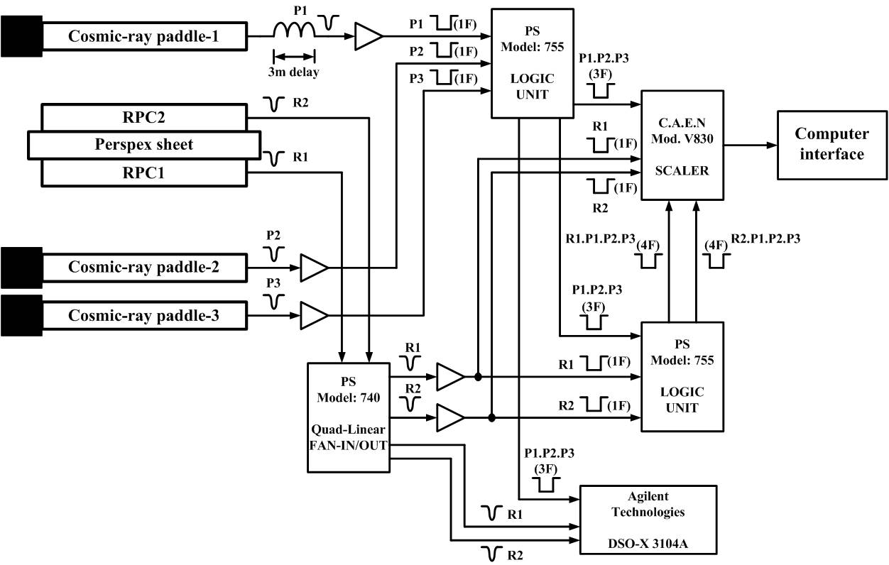
Experimental Set up
A common telescope was set up with three plastic scintillation counters to get a 3-fold coincidence. The dimensions of the scintillation counters are:
Scintillation counter position | Dimension (Length X Width X Thickness)
Top | 30 cm X 2 cm x 1 cm
Middle | 30 cm x 3 cm x 1 cm
Bottom | 30 cm x 5 cm x 1 cm
Prafulla Kumar Behera, IIT Madras
RPC2016 workshop@UGent
Notes:
Insert a photo

Slide 14
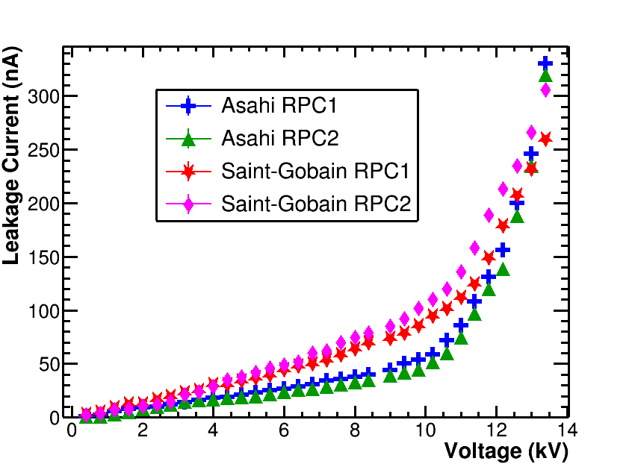
Results
Higher value of relative permittivity implies the better insulator and that implies the less leakage current. Hence, RPCs made of Asahi glass electrodes show comparatively low values of leakage current than the Saint-Gobain RPCs.
Prafulla Kumar Behera, IIT Madras
RPC2016 workshop@UGent

Slide 15
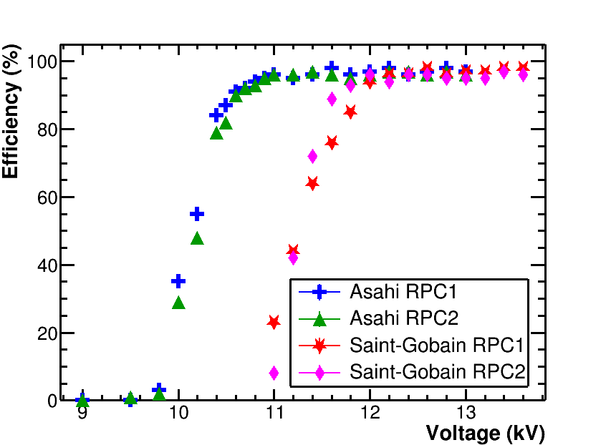
Detector Efficiency
The knee of efficiency plateaus of Asahi RPCs started from 10.7 kV, Saint-Gobain RPCs started from 12 kV.
Prafulla Kumar Behera, IIT Madras
RPC2016 workshop@UGent

Slide 16
Conclusions
The RPC electrode properties were studied in detail. The glass samples from four of the manufacturers shown the identical elemental composition.
The density of Italian glass sample is about two-thirds of that of the other three samples.
Saint-Gobain glass sample is having the lowest relative permittivity values among the four glass samples.
RPCs are made with the glass electrodes from Asahi and Saint-Gobain manufacturers. Asahi glass RPCs could be operated at about 1 kV lower bias voltages than Saint-Gobain glass RPCs.
Prafulla Kumar Behera, IIT Madras
RPC2016 workshop@UGent

Slide 17
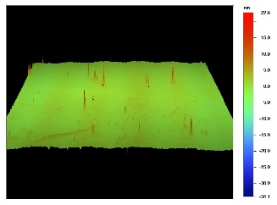
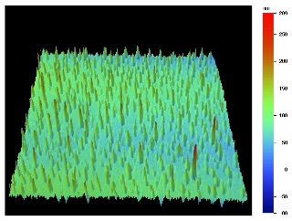
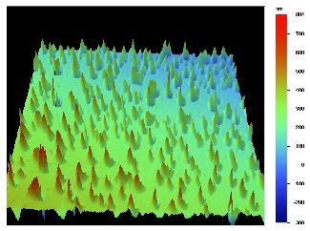
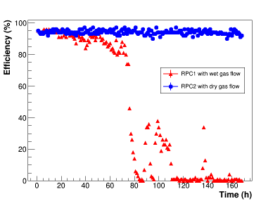
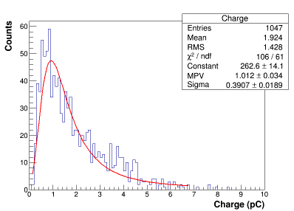
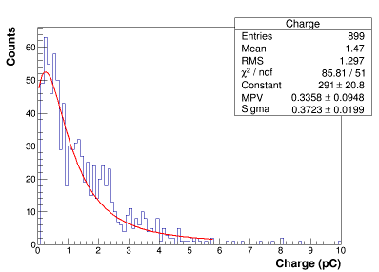
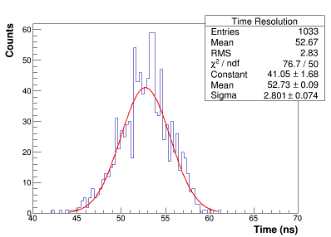
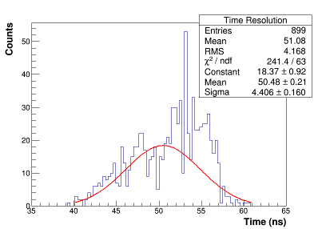
Ageing studies of glass RPC in avalanche mode operation
The effect of water vapor on the performance of glass RPC in avalanche mode operation.
It was observed significant degradation in the performance of RPC with wet gas flow.
Investigations are made to understand the causes of degradation.
Anode
Cathode
New Glass
Charge collected per an event
Dry gas
Wet gas
Dry gas
Wet gas
Time resolution
Prafulla Kumar Behera, IIT Madras
RPC2016 workshop@UGent

Slide 18
Thank You
Dr. Prafulla Kumar Behera, IIT Madras

