Slide 1
Notes:
1

Slide 2
Characterization of Sipm’s
department < ... >
  research group < ... >
Masterthesis | 2024-25 | Danté Bouckhout

Slide 3
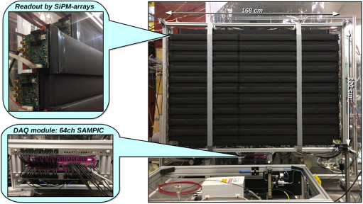
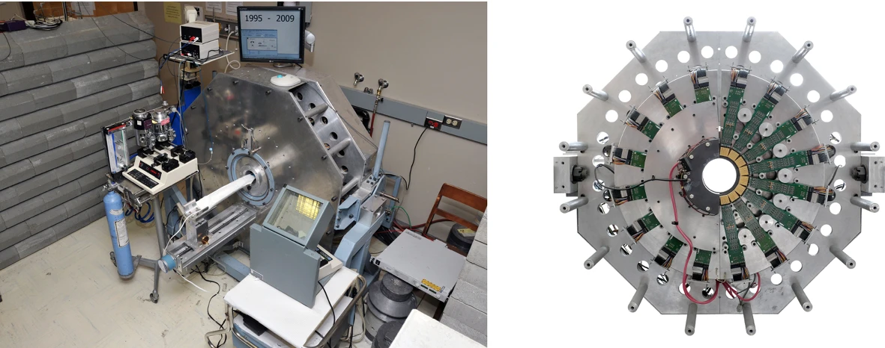
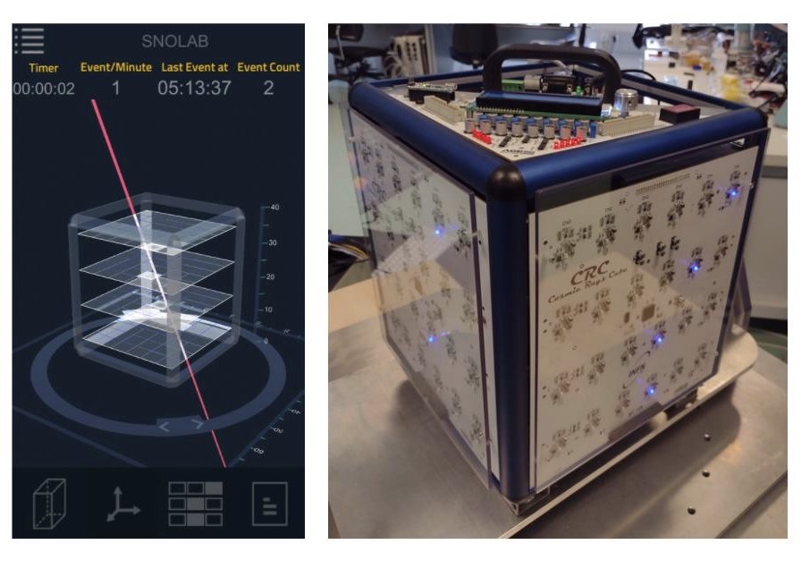
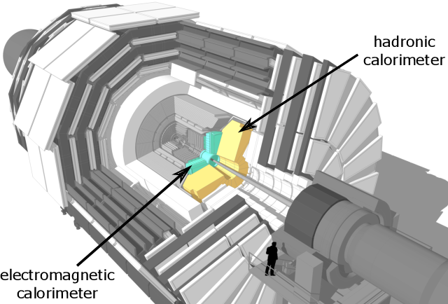
Introduction
The Sherbrooke small animal PET, the first PET with APDs
The timing detector prototype as seen in the testbeam area of the SHiP experiment
Location of the HGCAL at the CMS endcap
SNOLAB SiPM detector for live cosmic rays

Slide 4
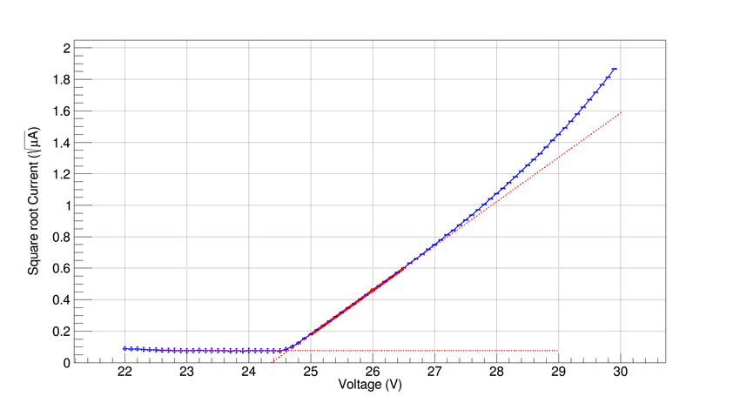
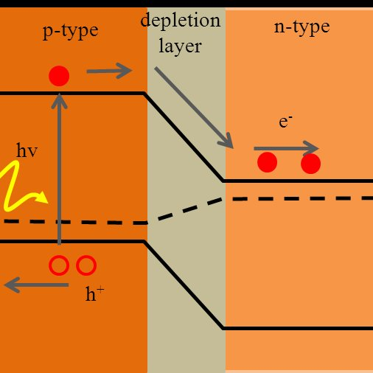
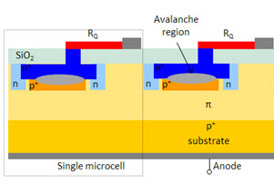
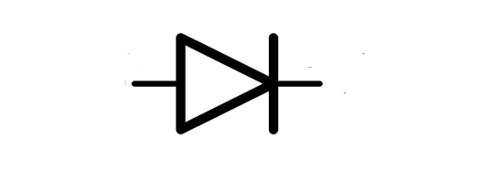
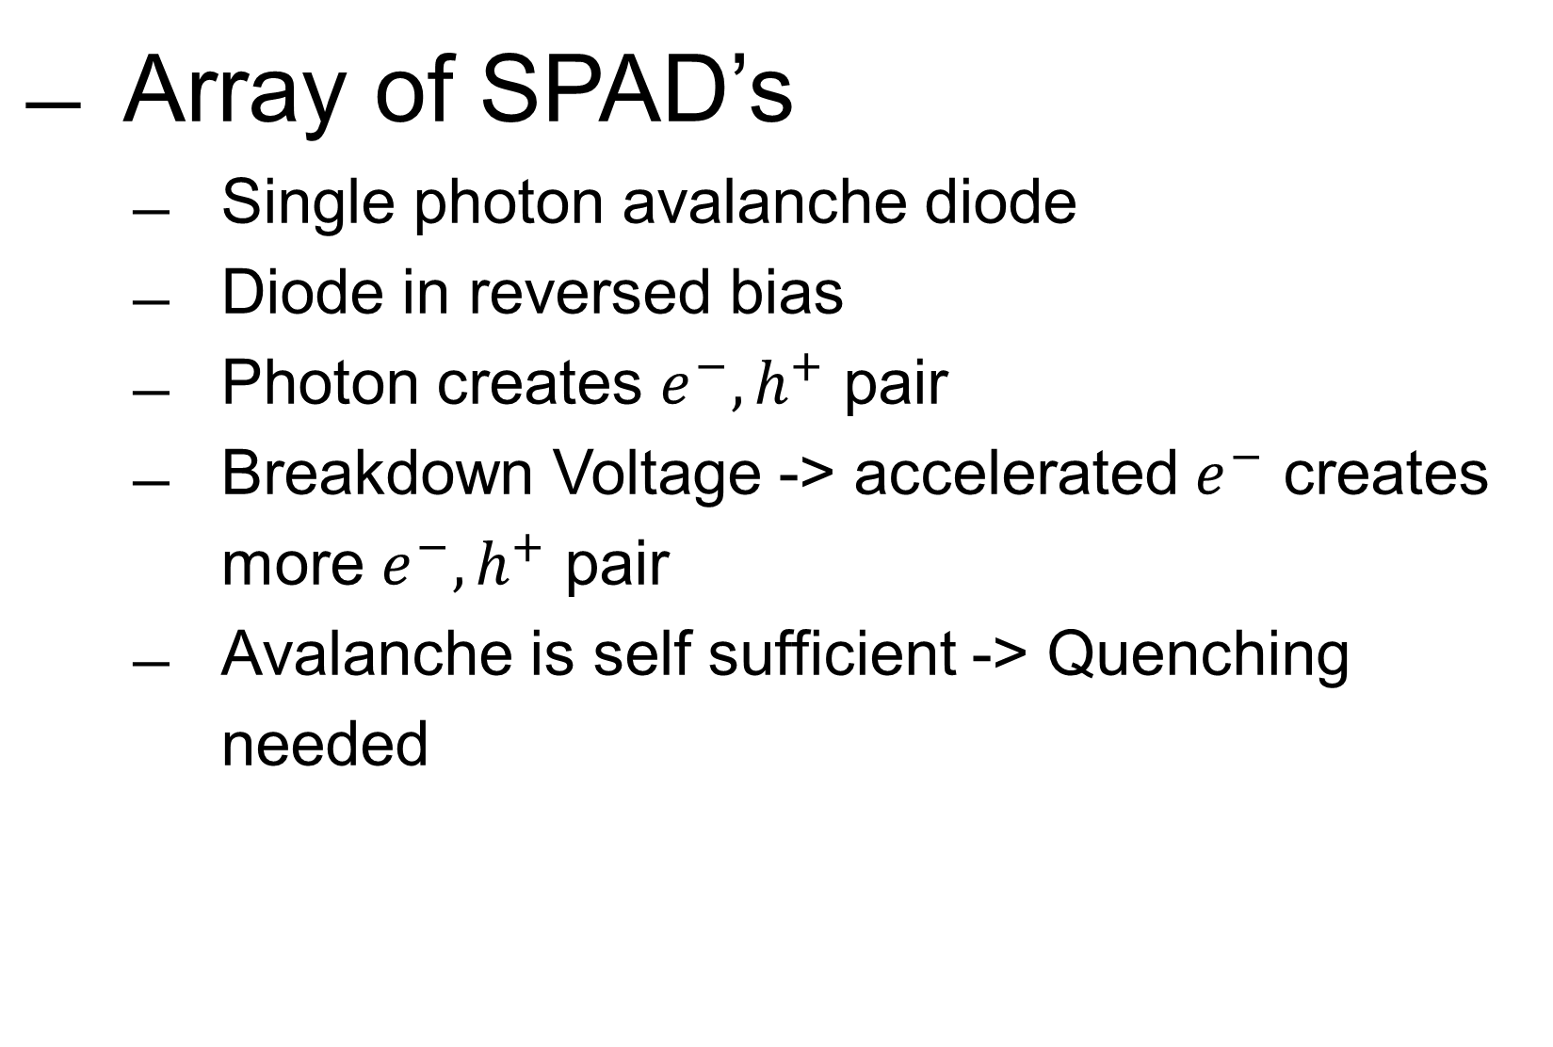
Silicon Photomultiplier
Array of SPAD’s
  Single photon avalanche diode
  Diode in reversed bias
  Photon creates $e^{−},h^{+}$ pair
  Breakdown Voltage -> accelerated $e^{−}$ creates more $e^{−},h^{+}$ pair
  Avalanche is self sufficient -> Quenching needed
4
Notes:
4

Slide 5
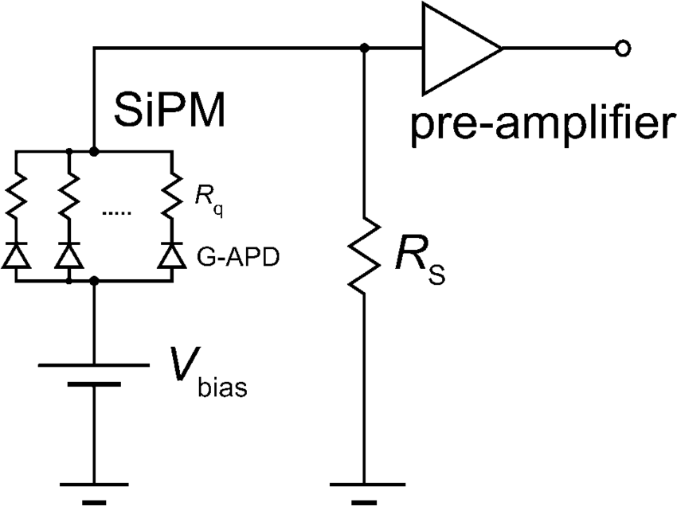
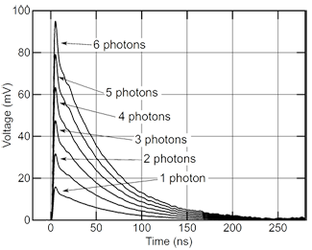
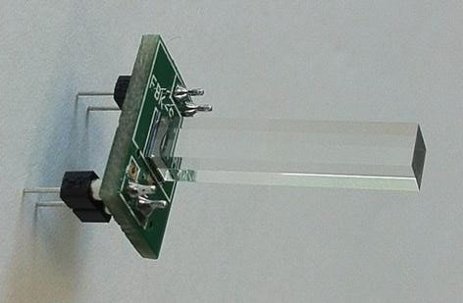
Silicon photomultiplier
SiPM outputs sum of all SPAD charge contributions
    Photons easily countable
  Particle detection
      used together with scintillator
5

Slide 6
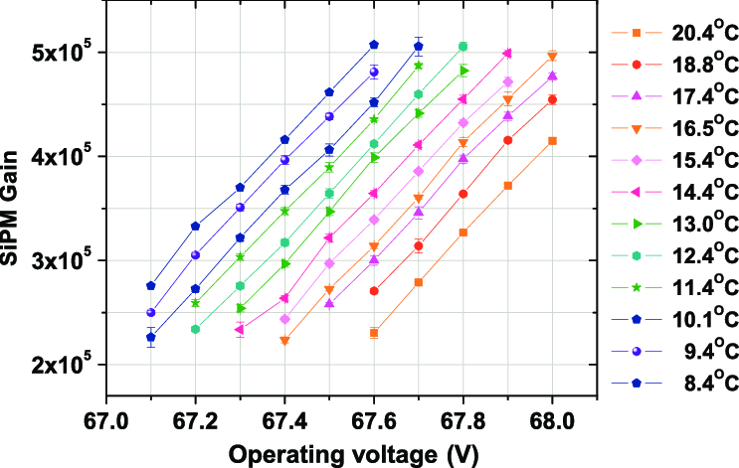
Characteristics
Gain
  Charge produced by one photon
  Influences the sensitivity and accuracy of the SiPM
  Varies with temperature
Dark Count Rate
Breakdown voltage
Afterpulsing & crosstalk
Photon detection Efficiency
6
Notes:
Gain Characterization:
What It Measures: The gain of the SiPM, which is the amplification factor when a photon is detected.
How It’s Measured: Use a controlled light source (e.g., a fiber-coupled LED) and measure the output pulse height at different temperatures. This helps establish the relationship between gain and temperature.
Dark Count Rate (DCR) Measurement:
What It Measures: The rate of spontaneous pulses (noise) generated by the SiPM when no light is present.
How It’s Measured: Measure the SiPM output in complete darkness at various temperatures. The dark count rate typically increases with temperature.
Photon Detection Efficiency (PDE):
What It Measures: The efficiency of the SiPM in detecting incoming photons.
How It’s Measured: Illuminate the SiPM with a known number of photons and compare the detected signal at different temperatures. Changes in PDE can be correlated with temperature variations.
Afterpulsing and Crosstalk:
What It Measures: Afterpulsing is the generation of additional pulses following a primary pulse. Crosstalk refers to signals generated in adjacent cells of the SiPM.
How It’s Measured: Analyze the time distribution of pulses after an initial event. Temperature control helps determine how these effects vary with temperature.
Breakdown Voltage Determination:
What It Measures: The voltage at which the SiPM enters Geiger mode (breakdown voltage).
How It’s Measured: Record the SiPM output while sweeping the bias voltage at different temperatures. The breakdown voltage typically increases with temperature.
Overvoltage Optimization:
What It Measures: The optimal overvoltage setting that maximizes performance (gain, PDE) while minimizing noise.
How It’s Measured: Adjust the bias voltage (overvoltage) while controlling the temperature and measure the SiPM response. This helps identify the best operating conditions.
6

Slide 7
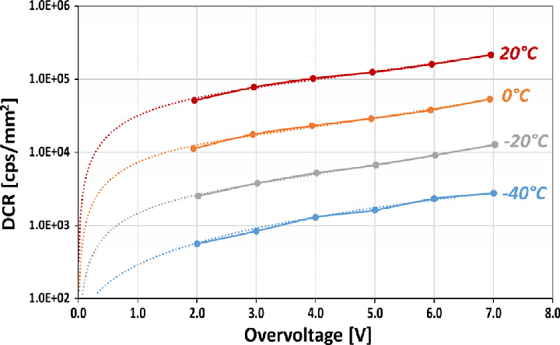
Characteristics
Gain
Dark Count Rate
  Rate of pulses generated in absence of light
  From thermal electrons
  Can overwhelm low-light signals
Breakdown voltage
Afterpulsing & crosstalk
Photon detection Efficiency
7
Notes:
Gain Characterization:
What It Measures: The gain of the SiPM, which is the amplification factor when a photon is detected.
How It’s Measured: Use a controlled light source (e.g., a fiber-coupled LED) and measure the output pulse height at different temperatures. This helps establish the relationship between gain and temperature.
Dark Count Rate (DCR) Measurement:
What It Measures: The rate of spontaneous pulses (noise) generated by the SiPM when no light is present.
How It’s Measured: Measure the SiPM output in complete darkness at various temperatures. The dark count rate typically increases with temperature.
Photon Detection Efficiency (PDE):
What It Measures: The efficiency of the SiPM in detecting incoming photons.
How It’s Measured: Illuminate the SiPM with a known number of photons and compare the detected signal at different temperatures. Changes in PDE can be correlated with temperature variations.
Afterpulsing and Crosstalk:
What It Measures: Afterpulsing is the generation of additional pulses following a primary pulse. Crosstalk refers to signals generated in adjacent cells of the SiPM.
How It’s Measured: Analyze the time distribution of pulses after an initial event. Temperature control helps determine how these effects vary with temperature.
Breakdown Voltage Determination:
What It Measures: The voltage at which the SiPM enters Geiger mode (breakdown voltage).
How It’s Measured: Record the SiPM output while sweeping the bias voltage at different temperatures. The breakdown voltage typically increases with temperature.
Overvoltage Optimization:
What It Measures: The optimal overvoltage setting that maximizes performance (gain, PDE) while minimizing noise.
How It’s Measured: Adjust the bias voltage (overvoltage) while controlling the temperature and measure the SiPM response. This helps identify the best operating conditions.
7

Slide 8
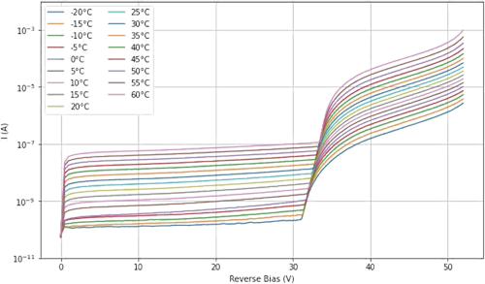
Characteristics
Gain
Dark Count Rate
Breakdown voltage
  voltage at which the SiPM operates in Geiger mode
  increases with temperature, affecting the optimal bias voltage setting
Afterpulsing & crosstalk
Photon detection Efficiency
8
Notes:
Gain Characterization:
What It Measures: The gain of the SiPM, which is the amplification factor when a photon is detected.
How It’s Measured: Use a controlled light source (e.g., a fiber-coupled LED) and measure the output pulse height at different temperatures. This helps establish the relationship between gain and temperature.
Dark Count Rate (DCR) Measurement:
What It Measures: The rate of spontaneous pulses (noise) generated by the SiPM when no light is present.
How It’s Measured: Measure the SiPM output in complete darkness at various temperatures. The dark count rate typically increases with temperature.
Photon Detection Efficiency (PDE):
What It Measures: The efficiency of the SiPM in detecting incoming photons.
How It’s Measured: Illuminate the SiPM with a known number of photons and compare the detected signal at different temperatures. Changes in PDE can be correlated with temperature variations.
Afterpulsing and Crosstalk:
What It Measures: Afterpulsing is the generation of additional pulses following a primary pulse. Crosstalk refers to signals generated in adjacent cells of the SiPM.
How It’s Measured: Analyze the time distribution of pulses after an initial event. Temperature control helps determine how these effects vary with temperature.
Breakdown Voltage Determination:
What It Measures: The voltage at which the SiPM enters Geiger mode (breakdown voltage).
How It’s Measured: Record the SiPM output while sweeping the bias voltage at different temperatures. The breakdown voltage typically increases with temperature.
Overvoltage Optimization:
What It Measures: The optimal overvoltage setting that maximizes performance (gain, PDE) while minimizing noise.
How It’s Measured: Adjust the bias voltage (overvoltage) while controlling the temperature and measure the SiPM response. This helps identify the best operating conditions.
8

Slide 9
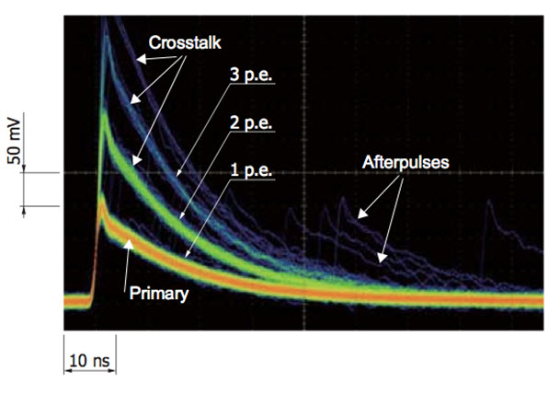
Characteristics
Gain
Dark Count Rate
Breakdown voltage
Afterpulsing & crosstalk
  Secondary pulses caused by trapped charges from a previous event.
  Signals generated in neighboring cells due to charge carriers triggering adjacent pixels.
Photon detection efficiency
9
Notes:
Gain Characterization:
What It Measures: The gain of the SiPM, which is the amplification factor when a photon is detected.
How It’s Measured: Use a controlled light source (e.g., a fiber-coupled LED) and measure the output pulse height at different temperatures. This helps establish the relationship between gain and temperature.
Dark Count Rate (DCR) Measurement:
What It Measures: The rate of spontaneous pulses (noise) generated by the SiPM when no light is present.
How It’s Measured: Measure the SiPM output in complete darkness at various temperatures. The dark count rate typically increases with temperature.
Photon Detection Efficiency (PDE):
What It Measures: The efficiency of the SiPM in detecting incoming photons.
How It’s Measured: Illuminate the SiPM with a known number of photons and compare the detected signal at different temperatures. Changes in PDE can be correlated with temperature variations.
Afterpulsing and Crosstalk:
What It Measures: Afterpulsing is the generation of additional pulses following a primary pulse. Crosstalk refers to signals generated in adjacent cells of the SiPM.
How It’s Measured: Analyze the time distribution of pulses after an initial event. Temperature control helps determine how these effects vary with temperature.
Breakdown Voltage Determination:
What It Measures: The voltage at which the SiPM enters Geiger mode (breakdown voltage).
How It’s Measured: Record the SiPM output while sweeping the bias voltage at different temperatures. The breakdown voltage typically increases with temperature.
Overvoltage Optimization:
What It Measures: The optimal overvoltage setting that maximizes performance (gain, PDE) while minimizing noise.
How It’s Measured: Adjust the bias voltage (overvoltage) while controlling the temperature and measure the SiPM response. This helps identify the best operating conditions.
9

Slide 10
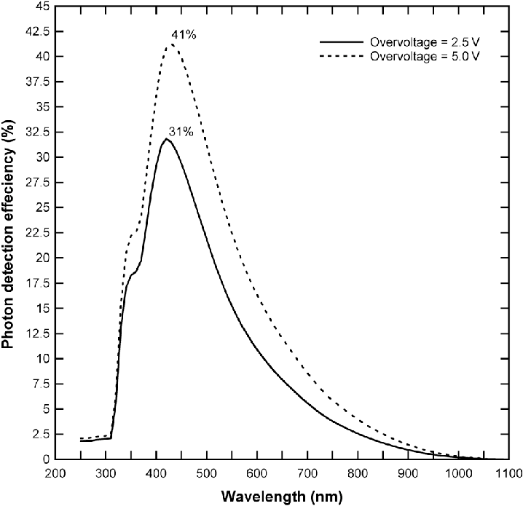
Characteristics
Gain
Dark Count Rate
Breakdown voltage
Afterpulsing & crosstalk
Photon detection Efficiency
  Probability that incoming photon is successfully detected
  vary with temperature, bias voltage, and photon wavelength
10
Notes:
Gain Characterization:
What It Measures: The gain of the SiPM, which is the amplification factor when a photon is detected.
How It’s Measured: Use a controlled light source (e.g., a fiber-coupled LED) and measure the output pulse height at different temperatures. This helps establish the relationship between gain and temperature.
Dark Count Rate (DCR) Measurement:
What It Measures: The rate of spontaneous pulses (noise) generated by the SiPM when no light is present.
How It’s Measured: Measure the SiPM output in complete darkness at various temperatures. The dark count rate typically increases with temperature.
Photon Detection Efficiency (PDE):
What It Measures: The efficiency of the SiPM in detecting incoming photons.
How It’s Measured: Illuminate the SiPM with a known number of photons and compare the detected signal at different temperatures. Changes in PDE can be correlated with temperature variations.
Afterpulsing and Crosstalk:
What It Measures: Afterpulsing is the generation of additional pulses following a primary pulse. Crosstalk refers to signals generated in adjacent cells of the SiPM.
How It’s Measured: Analyze the time distribution of pulses after an initial event. Temperature control helps determine how these effects vary with temperature.
Breakdown Voltage Determination:
What It Measures: The voltage at which the SiPM enters Geiger mode (breakdown voltage).
How It’s Measured: Record the SiPM output while sweeping the bias voltage at different temperatures. The breakdown voltage typically increases with temperature.
Overvoltage Optimization:
What It Measures: The optimal overvoltage setting that maximizes performance (gain, PDE) while minimizing noise.
How It’s Measured: Adjust the bias voltage (overvoltage) while controlling the temperature and measure the SiPM response. This helps identify the best operating conditions.
10

Slide 11
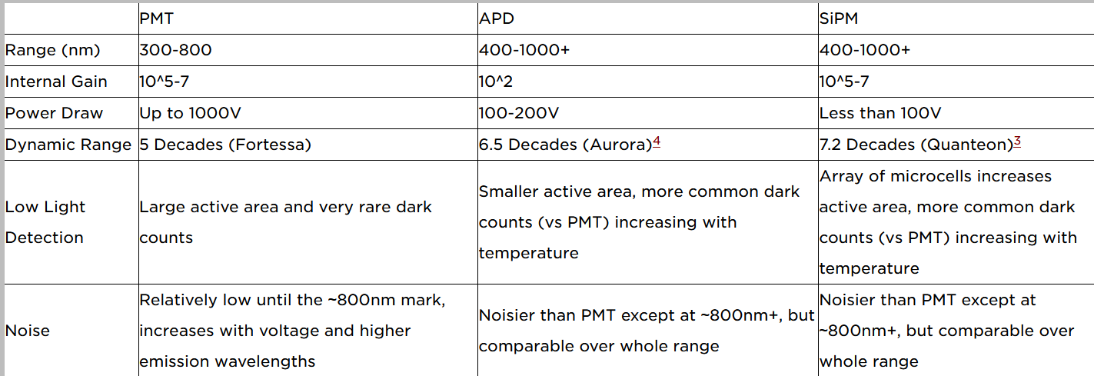
Comparing to PMT
Advantages
  Cheaper
  Lower bias voltages
  Smaller volume
Disadvantage
  For low E photon
  more noise and worse PDE
Source: Uchicago, B. Ladd, PMT vs SiPM: A Photon Finish

Slide 12
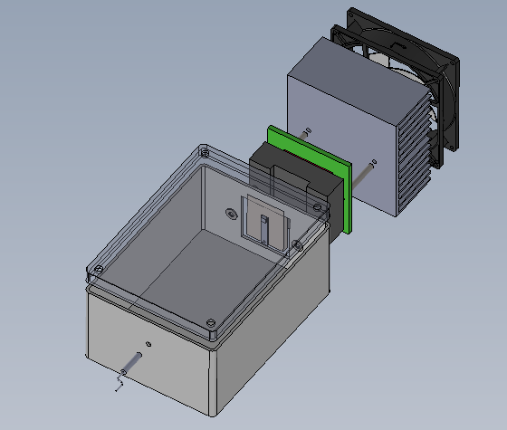
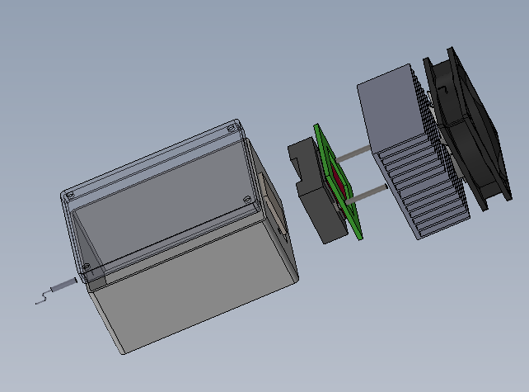
Setup
Temperature controlled light-tight box
  Peltier elements
  Arduino
  Controlled photon input
  Temperature + env sensors
Front end electronics
  Amplifier
  Signal shaper
12
Notes:
Input of photons with an optical cable

Slide 13
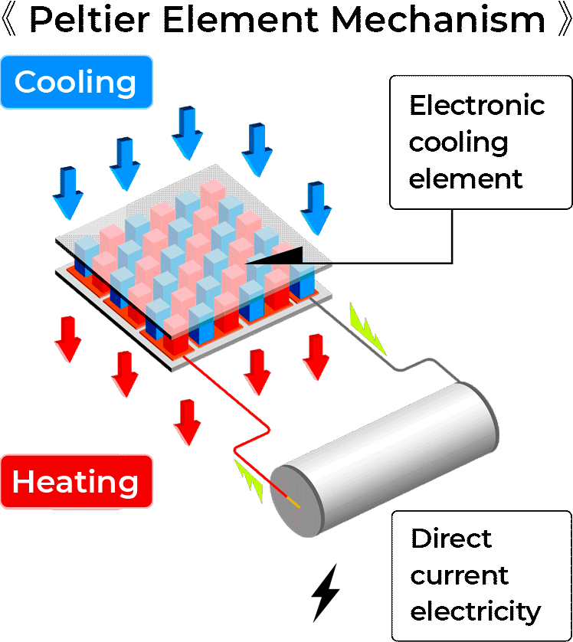
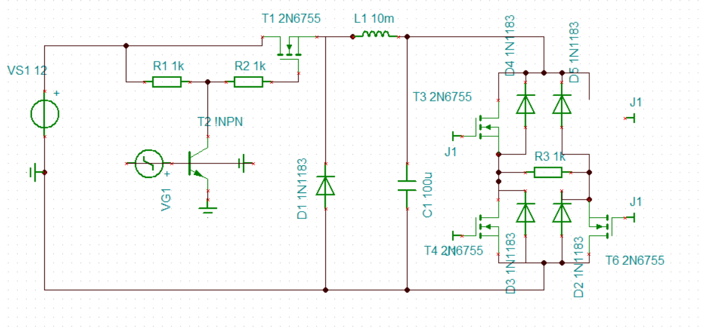
Peltier cooling
PWM of arduino into LC and H-bridge
  Controll peltier to heat or cool side with SiPM
Automative setup
  Using arduino to read temperature and adapt Peltier current

Slide 14
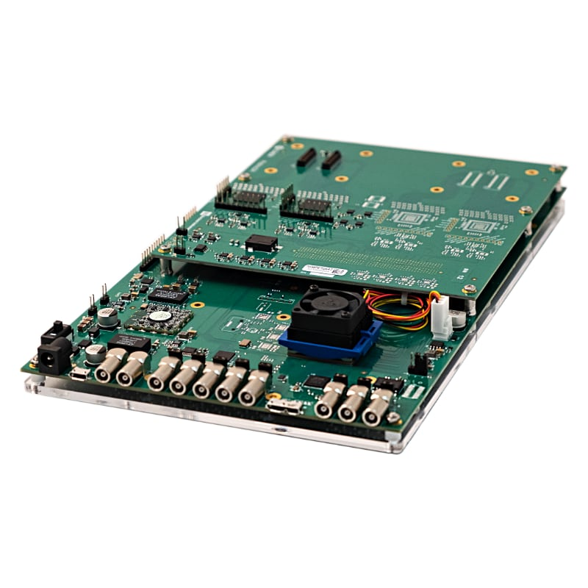
Future
Making of the box
  Light tightness, ease of use
SiPM readout
  Also automatable
Using SiPM and scintillator grids to track particles
Lokalenverhuur voor jeugdverenigingen
14

Slide 15



Danté Bouckhout
Master thesis
Experimental Particle Physics and Gravity
E Dante.bouckhout@ugent.be
M +32 484 69 21 11 www.ugent.be
Universiteit Gent
@ugent
@ugent
Ghent University

Slide 16
importance
Development for SHIP experiment, Large-Sized Telescope of the Cherenkov Telescope Array, …
Use new SiPM to build simple telescope
  2 layers of scintillation blocks with SiPM grid readout
16

Slide 17



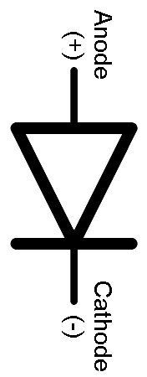



$$Gnd$$
p ++ doped
electrons
p doped
Depletion region
n ++ doped
holes
n epitaxial
n substrate
$+V_{Bias}$

Slide 18
Silicon Photomultiplier
SPAD’s
  Diode in reversed bias
  Breakdown Voltage -> Avalanche
  Quenching needed
18
Notes:
18

