Slide 1
Feasibility study of soil moisture monitoring using scintillation detectors
Department of Physics and astronomy
  experimental particle physics and gravity
Aiko Decaluwe / 21-11-24

Slide 2
introduction
Notes:
So I will start off with a short introduction in which I will try to explain to you the importance of this project.

Slide 3
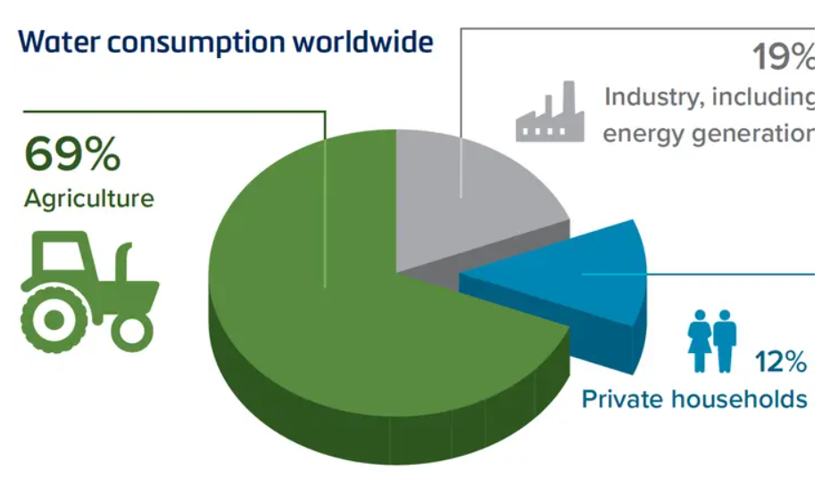
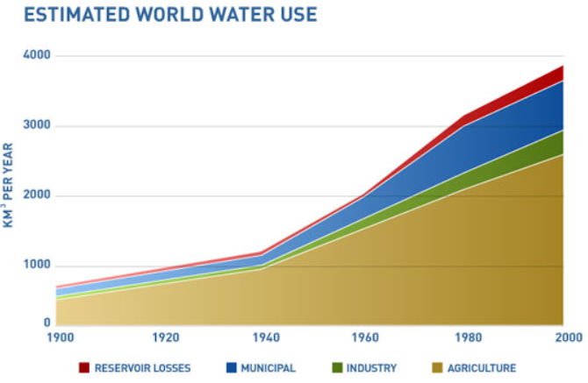
Why study soil moisture?
Problem agriculture: water efficiency only 50%
Knowledge about soil moisture can help
Goal project: Improving water management using CRNS
Notes:
This project specifically studies soil moisture for farming applications, but why would we do that?
Agricultural production consumes about 70% of the world’s water, mainly for irrigation → Figure: population grows so also the water needed
But the water use efficiency is less than 50%. So the challenge here is to ensure a good agricultural production while achieving a maximal efficiency of irrigation water use. Measurements of soil moisture can help meet this challenge, because it allows farmers to have a better idea of when and where to irrigate.
The project explores the possibility of Improving water management in irrigation practices in farming applications through the development of cosmic-ray neutron sensors as a completely non-invasive method to determine the soil moisture in agricultural fields

Slide 4
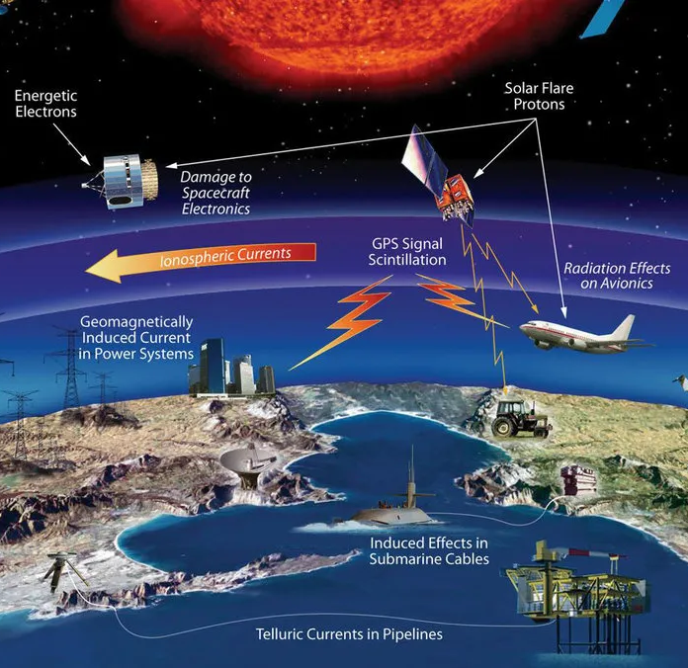
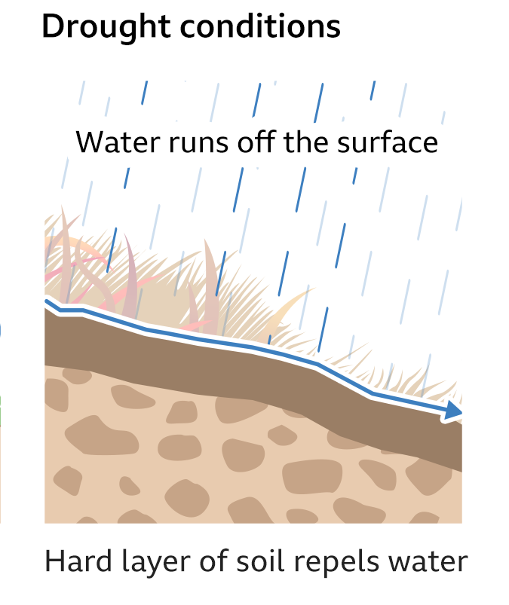

Other applications
Forecasting and mitigation of natural disasters
→ droughts, landslides and flood risks
Climate and global warming
Monitoring cosmic radiation and
space weather
Notes:
Besides Improving water management in irrigation practices, soil moisture measurements also have many other important applications:
the forecasting and mitigation of natural disasters. Soil water content plays a critical role in the analysis of droughts, landslide and flood risks and so also in the prediction of these natural hazards.
Then because of its long residence time, soil moisture moderates regional climate, much as the ocean does, So the quantification of soil moisture is crucial for short term climate forecasting and the understanding of global warming.
And a final example, is not really about the soil moisture itself, but about the cosmic ray neutron sensing method used to measure it. This method can help monitor cosmic radiation and Space weather, meaning conditions in the solar system produced by the Sun’s activity. This space weather can seriously impact satellites and communications systems → Only 1 station in Belgium that measures these neutrons resulting from variabilities in space weather

Slide 5
Table of contents
Cosmic ray neutrons and their connection with soil moisture
CRNS
Scintillation detectors
GEMs
What to do next
Notes:
As I mentioned before this project will measure soil moisture using cosmic-ray neutron sensors, So first I will talk about Cosmic ray neutrons and their connection with soil moisture
Then I will talk about the cosmic ray neutron sensing method
Then I will explain the different set ups I have been using to try and detect neutrons myself
I would also very briefly mention GEMs and what else I am planning on doing for this project

Slide 6
Cosmic ray neutrons

Slide 7
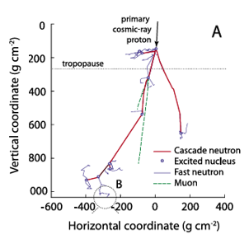
Cosmic ray neutrons
Origin
→ primary cosmic rays interact with
air molecules atmosphere
→ secondary cosmic rays (p, n, other)
→ fast neutrons (E≈1MeV) through
nuclear evaporation process
Figure: simulation MCNPX
Notes:
Origin cosmic ray neutrons
Cosmic rays are high energy particles, mostly protons (90%) and atomic nuclei (9% alpha:2p+2n/helium, 1% heavier), that were created somewhere in our universe (sun, our galaxy, other galaxies, supernovas)
Upon reaching the atmosphere, these primary cosmic rays will collide with air molecules, which will create a shower of protons, neutrons and other subatomic particles. These secondary cosmic rays will initiate new interactions as they traverse the atmosphere which will eventually produce Fast neutrons or cosmic ray neutrons(1-2MeV) through the nuclear evaporation process: when weaker cascade particle collide with a terrestrial nucleus (e.g. Si, O, N nuclei), the nucleus may simply heat up rather than immediately bursting into fragments. The nucleus then rapidly cools off by ejecting (evaporating) fast neutrons.
Figure: simulation of this process
Particle tracks from a cascade simulated with the radiation transport code MCNPX (Monte Carlo N‐Particle Extended)
Coordinates are in massshielding units (distance multiplied by density)
A 10 GeV primary cosmic ray proton collides with nitrogen in the upper atmosphere, triggering a chain reaction. Fast neutrons are generated at each collision marked by a circle.

Slide 8
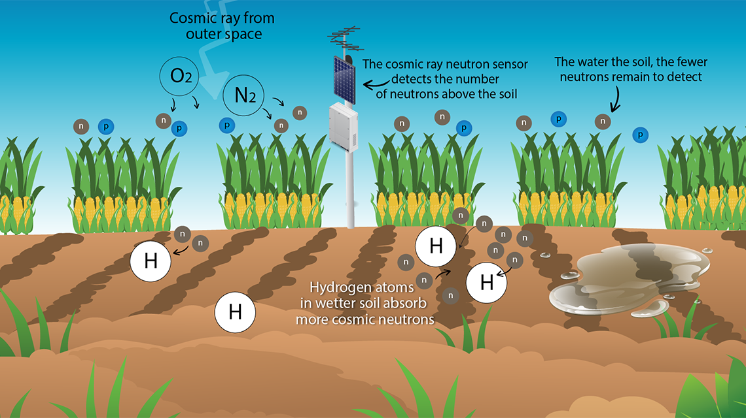
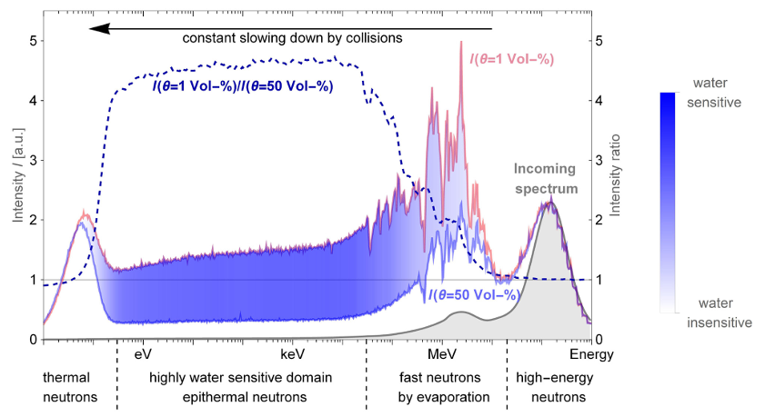
Connection with soil moisture
Fast neutrons moderated and thermalized by hydrogen
atoms in soil
→ captured or diffused back into air as slow neutrons
(E~1eV)
Notes:
Connection with soil moisture
The cosmic-ray neutrons, upon reaching the surface of the earth, will be slowed down/moderated and thermalized through elastic collisions with hydrogen atoms present in soil until it is either captured by a nearby nucleus or diffused back into the air as now a slow neutron (E<1eV). (thermal neutron, any free neutron that has an average kinetic energy corresponding to the average energy of the particles of the ambient materials.)
Hydrogen is unique in its ability to rapidly moderate or slow down neutrons, because of it’s low mass and relatively large elastic scattering cross section. Because a neutron and a hydrogen atom almost have the same mass, a fast neutron can theoretically be brought to rest through a single head-on collision with hydrogen
Dry soils → few hydrogen atomes → many neutrons diffused back into the air.
Wet soils → many hydrogen atoms → more neutrons are captured→ les neutrons diffused back into the air
Right figure: Simulated cosmic-ray neutron spectrum with focus on the hydrogen-sensitive energy domain.
Grey curve is input spectrum. Above-ground neutron intensities are shown for dry(light red)and moist conditions (light blue). Neutrons with energies between 0.3eV and 30keV are most suitable as a proxy for the environmental hydrogen content.

Slide 9
Cosmic ray neutron sensing (CRNS)

Slide 10
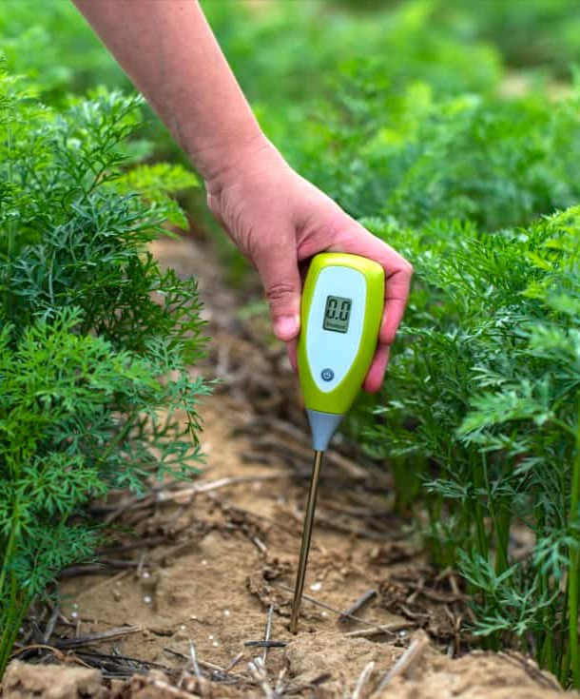
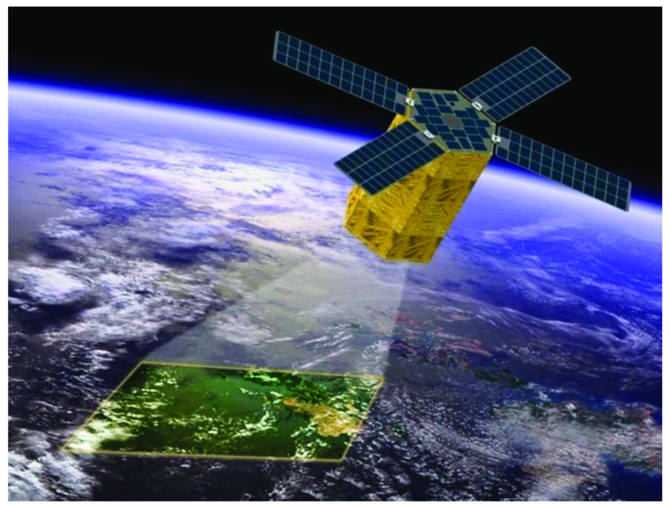
How to measure soil moisture?
Soil moisture measurements
→ small scales: visual, gravimetric method, invasive sensors
→ large scales: remote sensing using satellites
→ field scale: CRNS
Notes:
The soil moisture can be measured using different methods
→ visual: unreliable, gravimetric method (dry soil and take difference in weight to find soil moisture): to much work to do regularly, sensors: very local and disrupts the operations in the field if you use many of them
scale to large for agricultural purposes
CRNS is a pretty recent method which fills this gap which measures soil moisture at field scales and it does not disturb the agricultural operations in the field
The CRNS uses the slow neutrons (0.2eVto 100 keV) to determine the amount of water present in the soil and relies on the inverse relationship between soil moisture and the amount of above ground slow neutrons
(measuring microwaves reflected or emitted by Earth's surface. The intensity of the measured signal depends on the amount of water in the soil) (dry soil emits little or no moisture to the atmosphere and heats up more strongly during a hot day, thus intensifying heatwaves. Wet soils, on the other hand, have a cooling effect on the atmosphere)

Slide 11
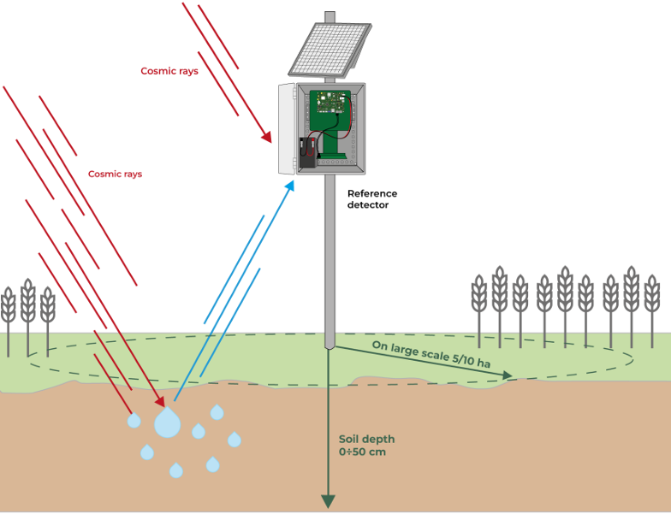
Finapp CRNS detector
Counts slow neutrons
Radius: 125 m
Depth: 0-50 cm depth
Average soil moisture
measurement
Notes:
The probe measures soil moisture in real time and installed on a pole, typically 1.8m high. In this configuration the sensor counts the slow neutrons that escape from the ground after being moderated by the hydrogen atoms in the soil over a radius of about 125m (5ha), , for a 0-50cm depth.
-> So why is the measurement area so large, This is because neutrons have a large collision mean free path in air (∼32 ) and the
energy loss per atmospheric collision is low (∼7 collisions per log decrement of energy loss). So a random walk involving tens of elastic collisions in air can transport a neutron several hundred
meters from where it was first emitted
The measurement of soil moisture is understood as the average value over circular area with radius 125 m

Slide 12
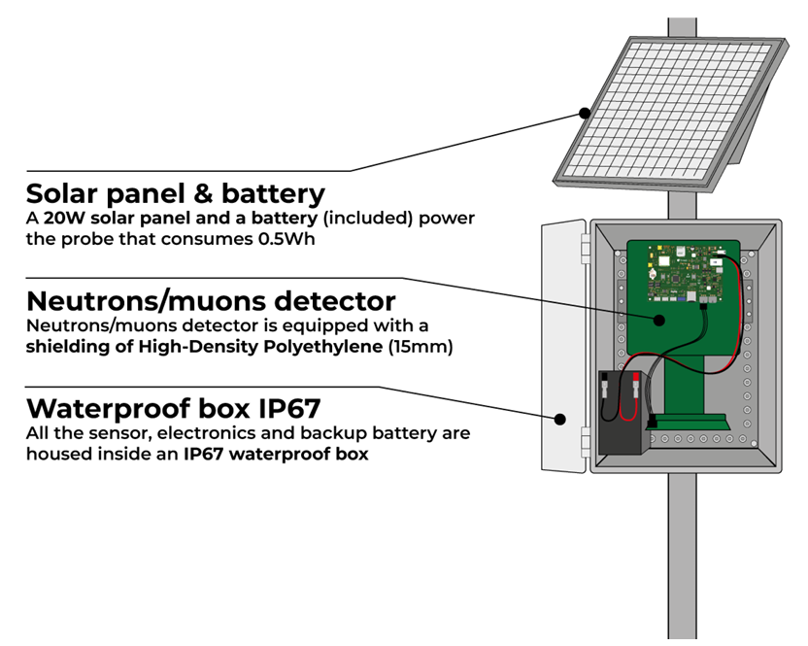
Finapp CRNS detector
Detector
→ sheets:
    ⁶LiF: thermal neutrons
    ZnS:Ag (scintillator): ³H, ⁴He, muons
→ Pulse Shape Discrimination algorithm
Powered by solar panel and battery
Notes:
The detector:
The detector consists out of a layered structure of sheets sensible to thermal neutrons
The thin sheet able to detect thermal neutron contains lithium- 6-fluoride (6LiF) and zinc sulfide phosphor (ZnS:Ag) dispersed in a colorless silicon binder
The neutron detection process employs the nuclear reaction (cross section of 941 barns for 0.025 eV neutrons): The resulting triton and alpha particle are detected by zinc sulfide phosphor.
The zinc sulfide phosphor is a scintillator so it can also detect muons. Discrimination between neutron and muons is made by a Pulse Shape Discrimination algorithm already installed in the probe
Powered by batteries and solar panels, so it can work completely autonomous

Slide 13
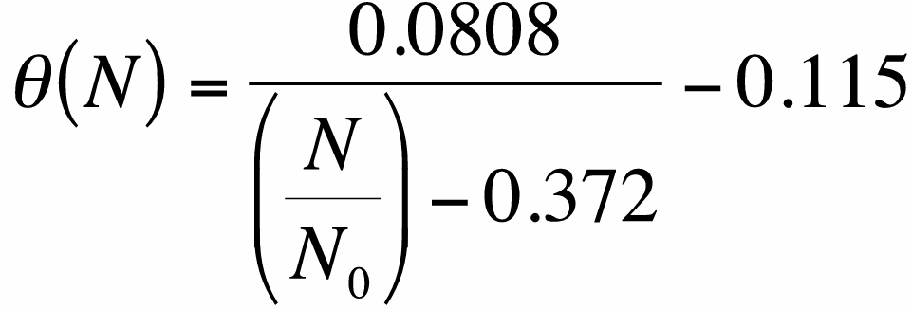
From neutron count to soil moisture
But calibration and corrections needed!
Soil moisture
Neutron count
Neutron count over dry soil
Notes:
The CRNS uses a simple formula to convert the neutron count to the soil moisture
N is the neutron counting rate, N0 is the counting rate over dry soil
To be able to use this formula we first have to apply some corrections to the neutron count N and we have to calibrate the sensor, meaning we have to find N0. I will not explain it here, because it will take me to long, but if you want you can ask me about it later
(We obtained a calibration curve for soil water content by fitting ground‐level neutron fluxes simulated in MCNPX to the shape‐defining function

Slide 14
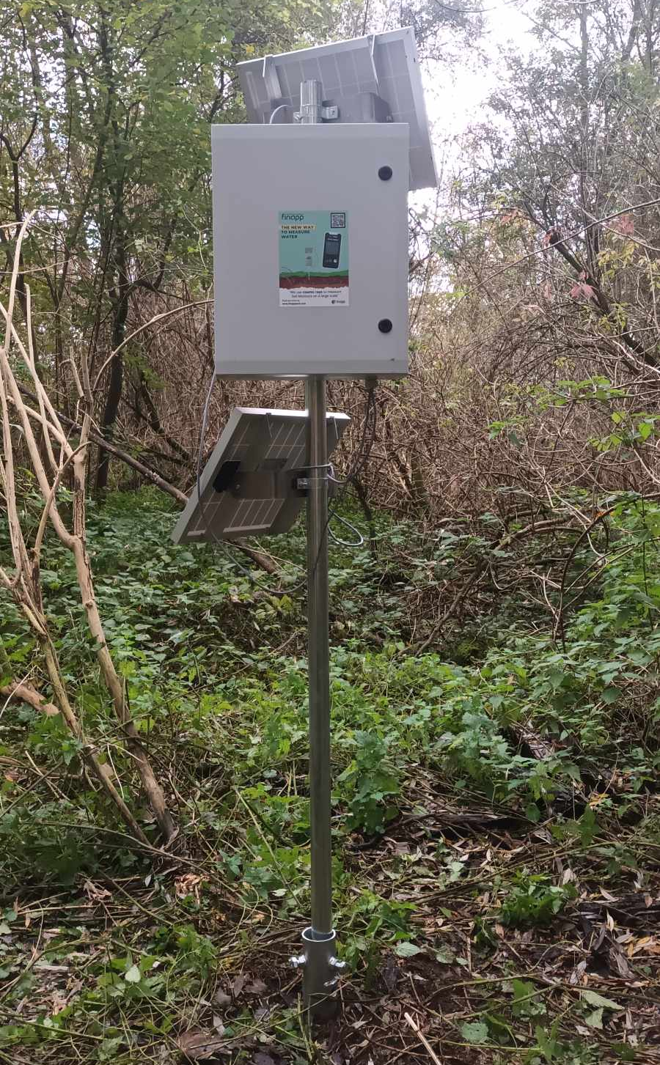
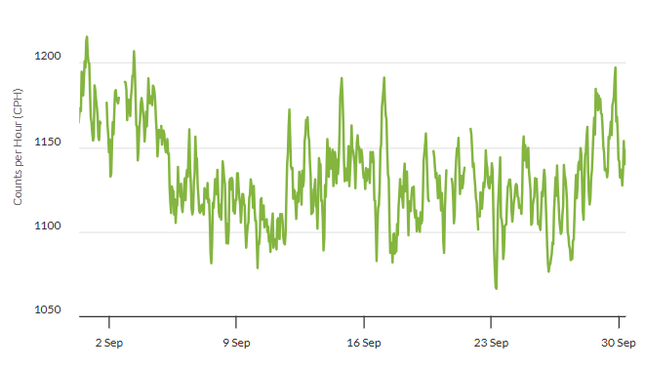
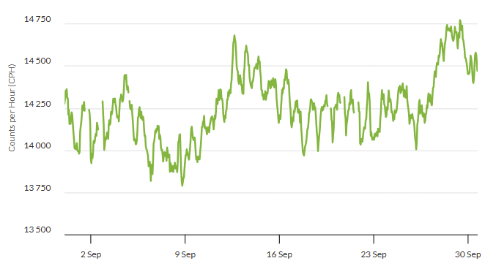
Our crns
Notes:
Now: in proeftuin and not yet calibrated it is currently measuring the neutron and muon count in counts per hour
Soon: agricultural field in Bottelare to take data→ analyse this data (seasons, weather)
Figures: neutron and muon count
(add expected fluxes)

Slide 15
Scintillation detectors

Slide 16
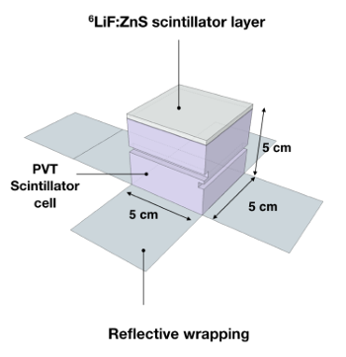
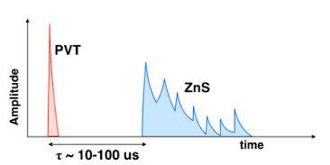
Scintillation detectors
Set-up 1:
→ plastic scintillator cube
→ neutron screens
→ wavelength shifting fiber
→ SiPM
→ HV supply
→ oscilloscope
→ detects mostly muons,
sometimes neutrons
Notes:
We would like to make our own scintillation detector that measures the neutron count. We would like this detector to be cheaper and smaller, so it is more mobile and portable. Up until now I have been working with a few different setups to try and detect cosmic ray neutrons.
The detector is built out of a small plastic scintillator cube. On 3 sides of the cube a neutron screen is placed, that employs the same reaction as before to detect neutrons. A wavelength shifting fibre is placed in a groove on the side of the cube to detect the scintillation light. Then a SiPM is connected to the fibre to convert the light into an electrical current which will then be read out by an electrical circuit. The scintillator cube is wrapped in reflective paper and put inside a closed box for optical isolation. This is the connected to a high voltage supply and an oscilloscope to sea the particle signals.
How do we distinguish muon and neutron signals visualized with an oscilloscope
muons: They deposit their energy in the cube which creates a very bright and short pulse.
neutrons: As 3H and α are highly ionizing particles, a neutron captured on 6Li induces a slowly decaying pulse (200ns) in the zinc sulfide phosphor scintillator. This longer decay time
means that the energy deposited by the triton and α particles will emit its light over a much longer time period.
When a particle moves through the plastic scintillator cube, it’s electrons will be excited. When they return to their original state, the energy will be released in the form of light (visible or UV).
(high cross section: cross section of 941 barns for 0.025 eV neutrons energy for thermal neutrons).
Wavelength shifting fibres placed in grooves on the sides of the PVT cubes. The fibres shift the blue light from the scintillation (425 and 450 nm emission peaks respectively) to green light (500 nm emission peak) by absorbing the light and emitting at longer wavelengths
Coating with reflective paper reflects photons back into the PVT cube, thereby increasing the light collection efficiency.

Slide 17
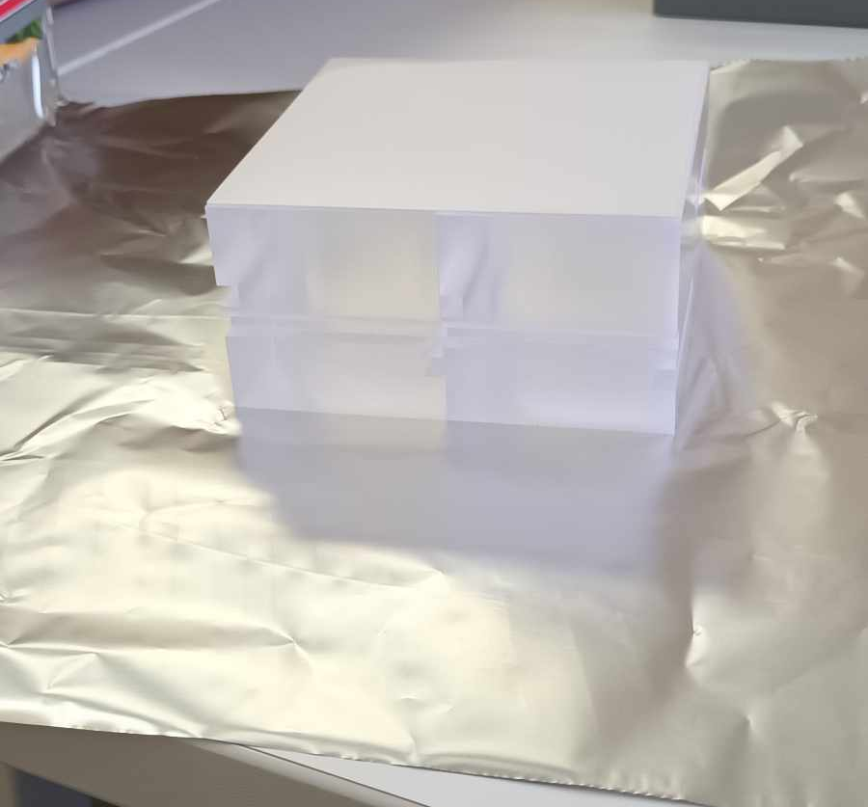
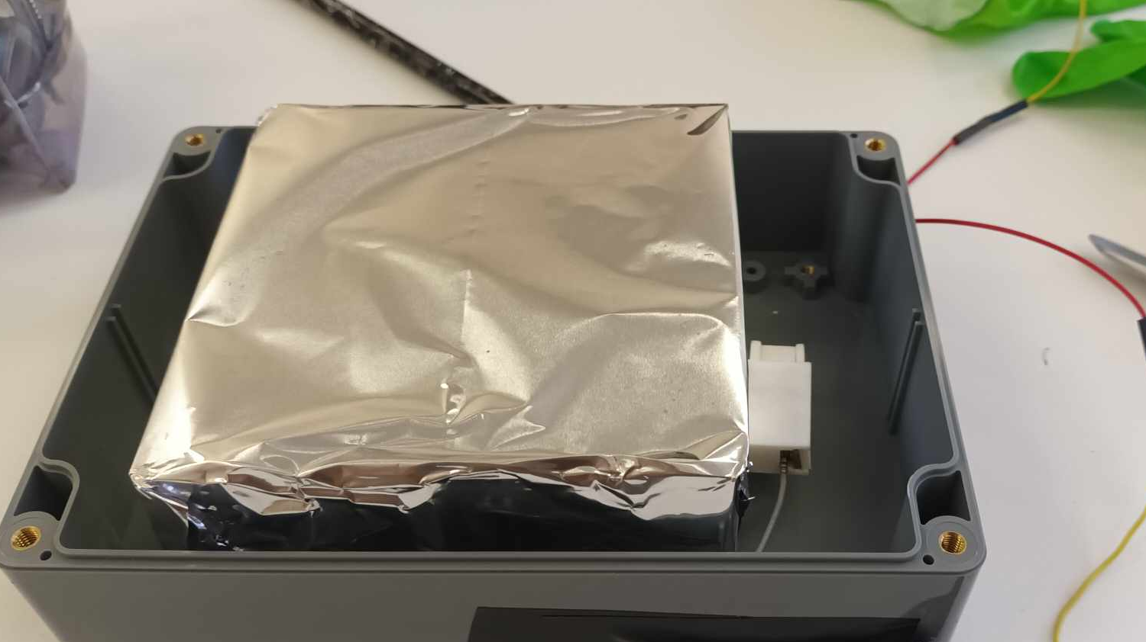
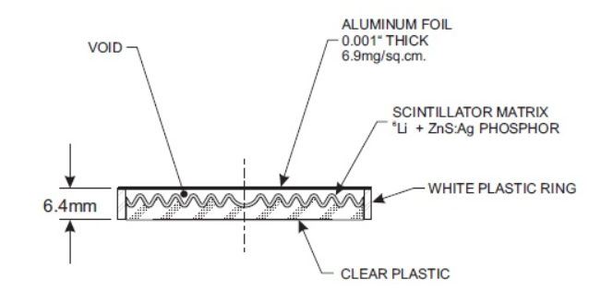
Scintillation detectors
Set-up 2
→ 4 cubes
→ mostly muons
Set-up 3
→ small thermal neutron detector
→ should only be able to detect
neutrons
Notes:
Now 4 cubes and 1 bigger neutron screen on 1 side of the detector wrapped in aluminium foil for reflection
Small thermal neutron detector connected to readout circuit.
No scintillation cube so not a big enough volume to detect muons, so in principle you should only detect neutrons
Employs again the same reaction as before
Neutron/muon flux at ground level

Slide 18
GEMs
Notes:
I would briefly like to mention GEMs cause I have been working intensively with them the past couple of months

Slide 19
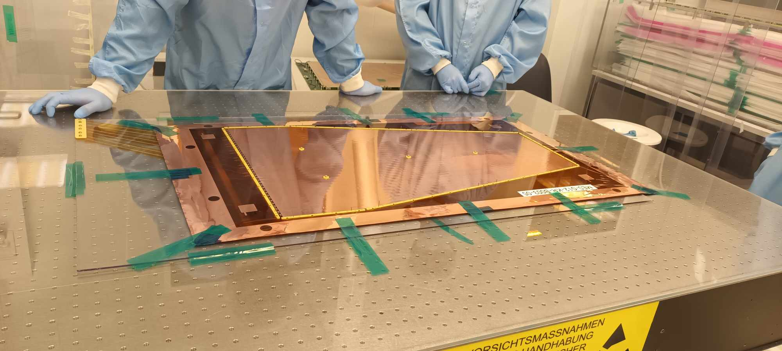
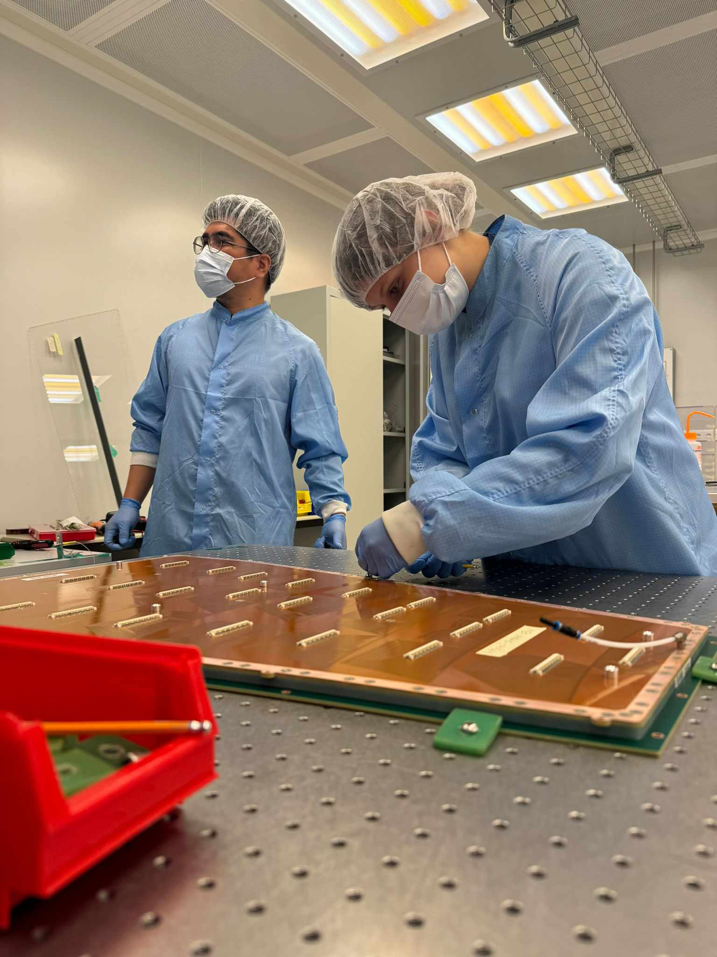
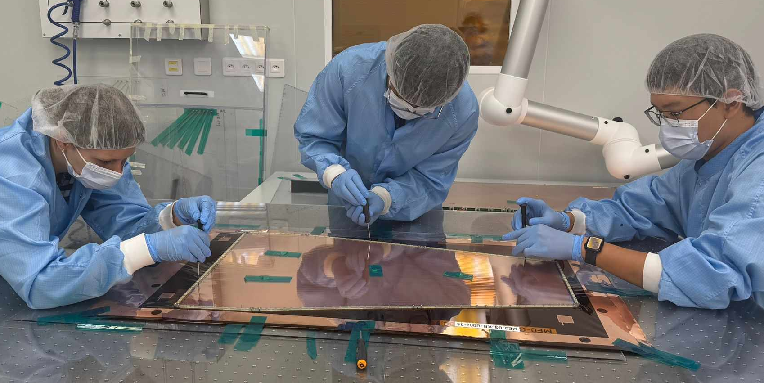
GEMs
Notes:
These GEMs if they are adapted in the right way can also detect neutrons. Still in very early stages and much more research is needed. So I will not further elaborate on the subject

Slide 20
What to do next

Slide 21
What to do next
Simulations: URANOS, Geant4
Use digital scope for different set-ups
Comparative study of different sensors
Notes:
Simulations (what fluxes to expect from neutrons)
URANOS is a Monte Carlo toolkit specifically tailored for environmental sciences. It can be used to simulate cosmogenic neutron radiation near the Earth's surface and to study its response to
environmental factors, such as soil water content, snow, or biomass
Geant4: Toolkit for the simulation of the passage of particles through matter.
Compare to our results and better idea of what neutron and muon counts to expect
Collect data with digital scope to dry and detect neutrons
Try to compare sensors: CRNS, own detectors, invasive soil moisture detector
README.md · main · Markus Köhli / Uranos · GitLab

Slide 22



Aiko Decaluwe
Master student
Experimental particle physics and gravity
E Aiko.Decaluwe@ugent.be www.ugent.be
Universiteit Gent
@ugent
@ugent
Ghent University

Slide 23
From neutron count to soil moisture
invert to find N₀
Probe measures N and calculates θ
Notes:
Now that we have N and a value for the soil moisture N0 can be calculated by inverting this formula

Slide 24

Corrections to neutron count
Atmospheric pressure
Air humidity
Incoming neutrons
biomass
Notes:
We also need to correct the neutron count Nraw detected by the CRNS since it was be influenced by many factors
Atmospheric pressure correction
Since the cosmic-ray flux through the atmosphere is exponentially attenuated as a function of the traversed cumulative mass, measured neutron count rates must be normalized to standard atmospheric pressure
Air humidity correction:
We accounted for the effect of atmospheric water vapor fluctuations on neutron count rate
Incoming neutron correction
The galactic cosmic radiation, or incoming radiation I(t), that penetrates the upper atmosphere varies in time
Biomass correction
Biomass can affect neutron count rates and should be considered when large temporal changes in biomass occur at a CRNS site
(material that comes from living organisms, such as plants and animals)

Slide 25
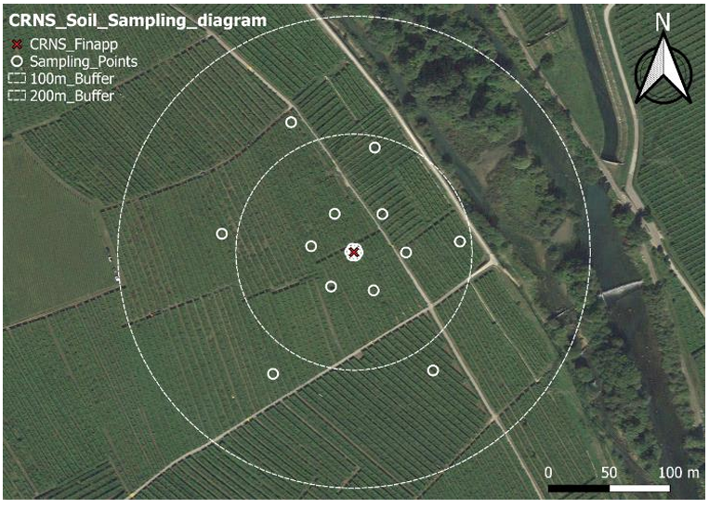
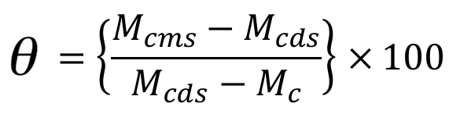
Calibration
Gravimetric method: N₀
1) 72 samples
2) weigh samples
3) dry in oven
4) weigh samples again
5) soil moisture of every sample:
6) take average
→ problem: sensitivity CRNS
→ solution: weighted average
Notes:
Typically, to determine the N0 parameter, a gravimetric soil sampling survey is carried out to quantify a reference soil moisture observation in time.
Take samples at different places around the probe and at different depths
standard scheme:
soil samples are taken in 18 points around the CRNS probe every 60° at 3−35−120 m distance from the CRNS position and at four depth intervals of 0−5 / 10−15 / 20−25 / 30−35 cm for a total of 72 soil samples
Weigh the samples
placing it in an oven at 105°C for 24-48 hours to dry
weigh them again
soil moisture for every sample = wet-dry/dry
take average of the soil moisture of every sample, problems:
This signal is, however, more sensitive to closer distances and shallower depths. So probe will give you a weighted value for the soil moisture which is different from the average of the samples. Vertical and horizontal weighting process is needed

Slide 26
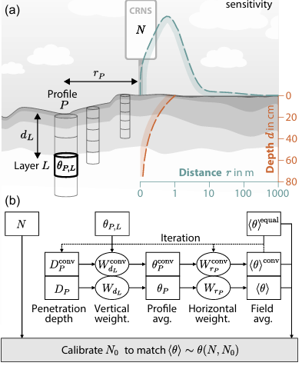

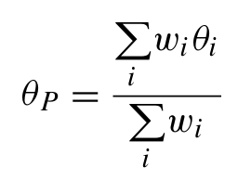
Calibration: weighted average
1) Estimate average value
2) Calculate the penetration depth D of
the neutrons for each profile P
3) Vertically average the values θ_{P,L} over
layers L, to obtain a weighted
average for each profile P
Notes:
To get a more accurate average value, we will assign different weights to each sample depending on their distance to the probe and their depth and through an iterative process we will eventually come to an average with an accuracy range of about 1%:
We will use the non weighted average that we get from the previous slide
This depth depends on the average soil moisture value from step 1
θ_{P,L} so the soil moistures of eacht sample, these are also used to calculate the new average

Slide 27
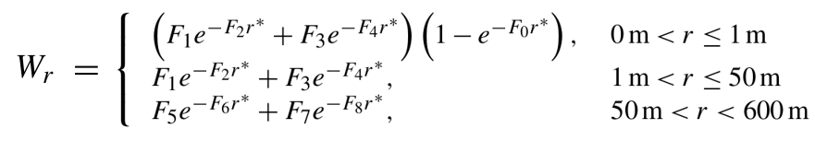
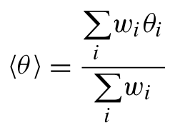
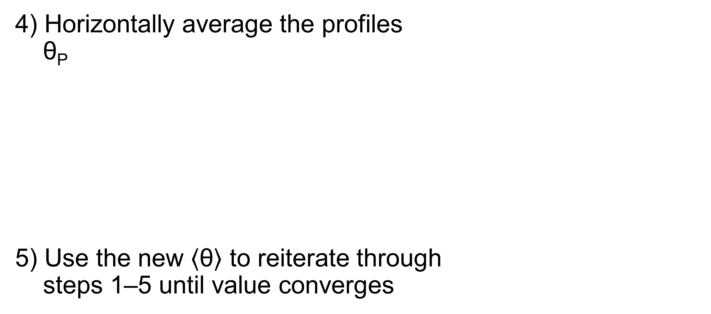
Calibration: weighted average
4) Horizontally average the profiles
θ_{P}
5) Use the new $\left\langle \text{θ}\right\rangle$ to reiterate through
steps 1–5 until value converges
Notes:
To get a more accurate average value, we will assign different weights to each sample depending on their distance to the probe and their depth and through an iterative process we will eventually come to an average with an accuracy range of about 1%:
We will use the non weighted average that we get from the previous slide
This depth depends on the average soil moisture value from step 1
θ_{P,L} so the soil moistures of eacht sample, these are also used to calculate the new average
The weight uses 3 formulas depending on the distance of the sample from the probe, the F and r* are parameters depending on soil moisture from step 3, vegetation, air pressure

Slide 28
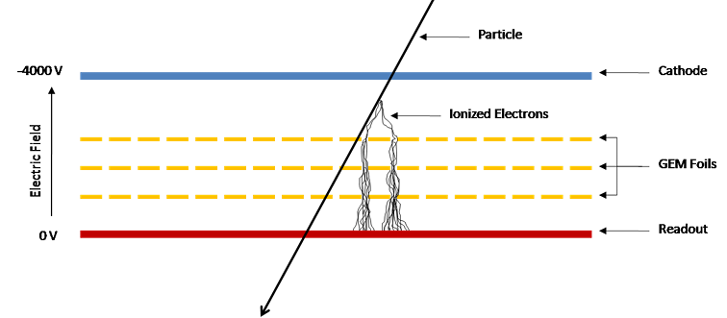
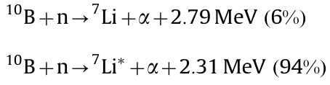
GEMs
Gas electron multiplier
→ thin foils with holes
→ filled with ionizing gas
→ strong electric fields
create electron avalanches
GEM B coated on foils can detect neutrons
Notes:
Gas Electron Multiplier (GEM) detector is a gaseous charge amplification structure. The main component of the GEM detector is a thin multilayer foil with many high precision holes. A GEM detector is filled with an ionizing gas. By applying a potential difference over the detector, strong electric fields develops inside the holes, so when a particle enters the detector it will ionize the gas molecules inside. These ionized electrons will then travel through the strong electric fields inside the GEM holes, gain more energy, and ionize other gas molecules creating electron avalanches. The amplified electron avalanches will be captured by the readout board which creates a signal. More foils mean more electrons and so a bigger signal,
Combining with neutron converter, the GEM could be fabricated to be a neutron detector. When a neutron converter, such as ¹⁰B , is coated onto both sides of the GEM foils, the thermal neutron can be measured. These emitted alpha particles will ionize gas molecules inside the GEM detector, The electrons produced by this ionization will later be amplified in the amplification stages and they will get captured by readout pads.

