Slide 1
Study of top quark production at future electron-positron colliders
department < ... >
  research group < ... >
Stijn Verhulst
Promotor: prof. Didar Dobur
Mentor: dr. Kirill Skovpen

Slide 2
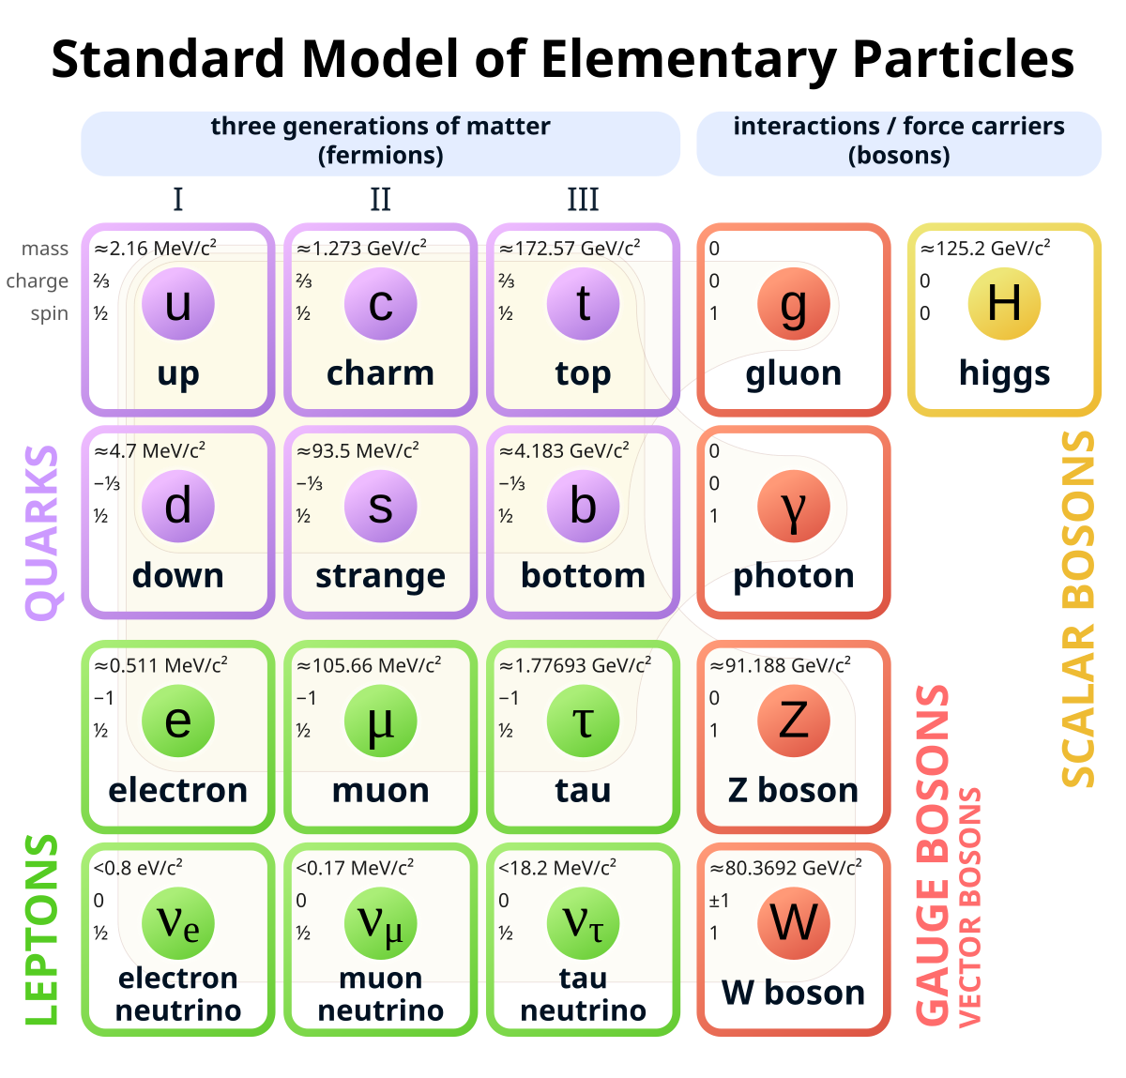
Why study Top quarks?
Unique properties:
Clean decay signature:
Heaviest SM particle
Decays before hadronizing
Yukawa coupling ≈ 1
BSM physics:
More precise measurements yield a deeper insight
Notes:
a top-quark pair production threshold scan would provide a precise measurement of the top-quark mass, which is a fundamental SM parameter;

Slide 3
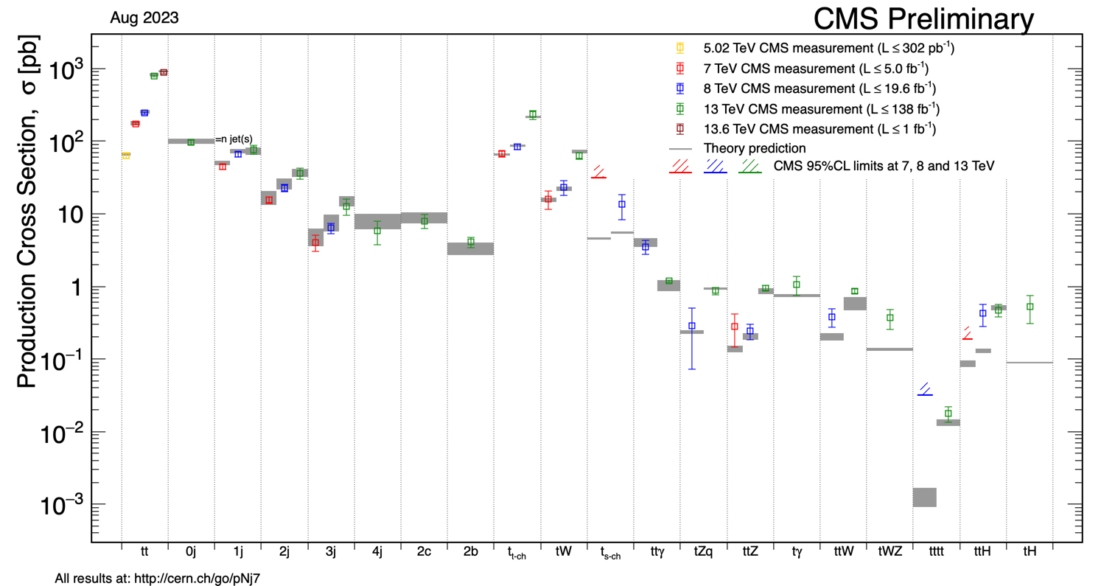
Extensive top quark research at LHC

Slide 4
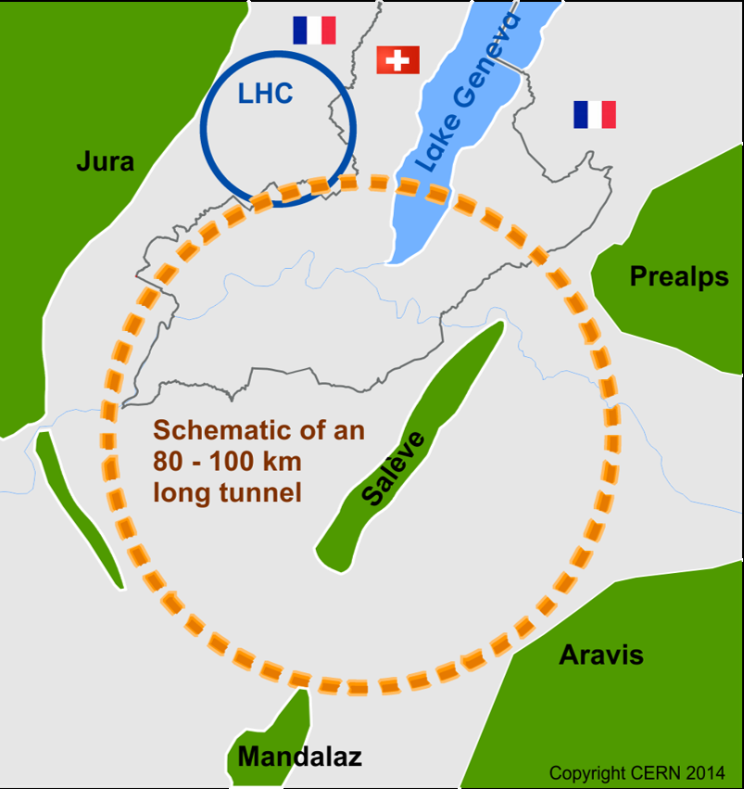
The Need for a new collider
Notes:
Now we know why top quark physics is important we also need a new way to study it at very high precision

Slide 5
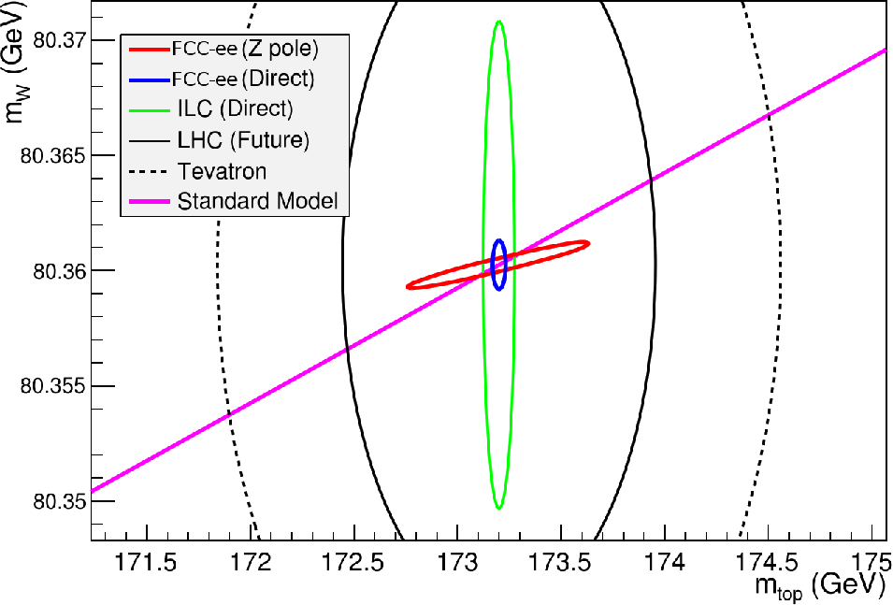
The need for a new collider
Improve precision in:
  electroweak observables
Look for new physics effects through this high precision
d'Enterria, David (CERN)

Slide 6
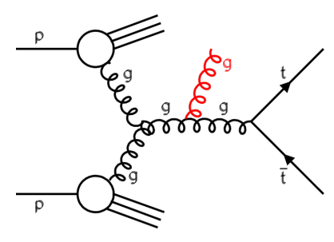
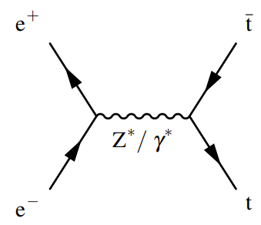
Hadron and lepton colliders
Proton is a compound object:
Initial state unknown
Limits in achievable precision
High Energy Circular colliders possible
High rates of QCD backgrounds
e⁺e⁻ are pointlike
Initial state well-defined
Beam polarization distinguishes Z/γ
High-precision measurements
High energies (> 380 GeV) require linear colliders
Clean experimental environment
Notes:
LHC has been invaluable as a top quark factory, however: (sqrt(s)) no pileup
E+e- we know the initial state bcs in pp we dont know which partons were used in the collision and don’t know the exact energy

Slide 7
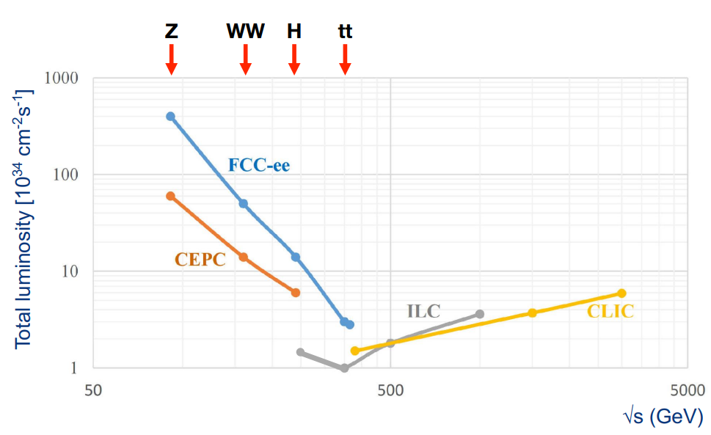
Future lepton colliders luminosities
Notes:
Clear advantage in Luminosity for circular colliders, Linear colliders have higher energy reach but less than pp colliders and FCC-ee will go to FCC-hh
Also multiple interaction points for FCC,

Slide 8
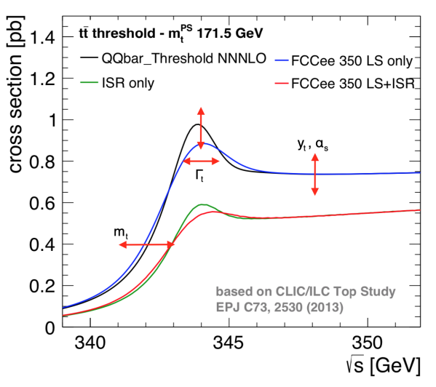
Cross section threshold scan
FCC improves precision on measurements of the top quark:
Mass and Width
Couplings: $y_{t}$, $g_{tWb}$, $g_{Ztt}$, $g_{γtt}$
Couplings: 𝑦_𝑡, 𝑔_𝑡𝑊𝑏, 𝑔_𝑍𝑡𝑡, 𝑔_𝛾𝑡𝑡
FCNC and rare decays
Asymmetries and other properties
Notes:
FCC-hh also improves lots of stuff see ref , and be able to explain all of these!!! What is LS?

Slide 9
Analysis of the Top Quark
Notes:
It is obvious that Future colliders will improve precision and set stringent limits on new physics phenomena, but to do this we need to make sense of the data. Thats why we need to be able to reconstruct the top quark from measurements and analyse this data

Slide 10
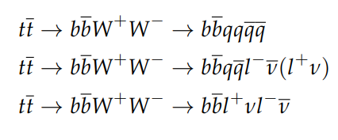
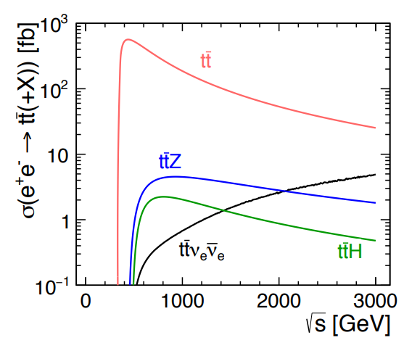
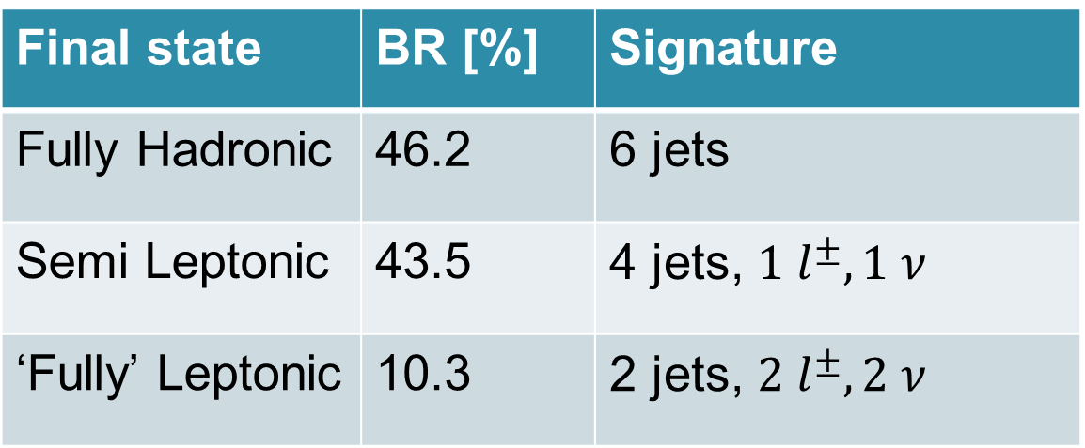
Strategy
Decay Channels:
Threshold energy range
    Gives less background
Final state | BR [%] | Signature
Fully Hadronic | 46.2 | 6 jets
Semi Leptonic | 43.5 | 4 jets, $1 l^{±}, 1 ν$
‘Fully’ Leptonic | 10.3 | 2 jets, $2 l^{±}, 2 ν$
Notes:
To do this analysis I employ different strategies to make it easier ask If there need to be any changes here

Slide 11
Simulation framework: Key4HEP
Event Generation:
Detector Simulation:
Data Format: EDM4HEP
Contains full information about simulation and reconstruction
FCCAnalysis:
Machine Learning
Madgraph + Pythia8
Delphes
preform associations
Event Selection and Reconstruction
Notes:
No real data yet, I will show you the full workflow of how to do the analysis and reconstruction of the top quark

Slide 12
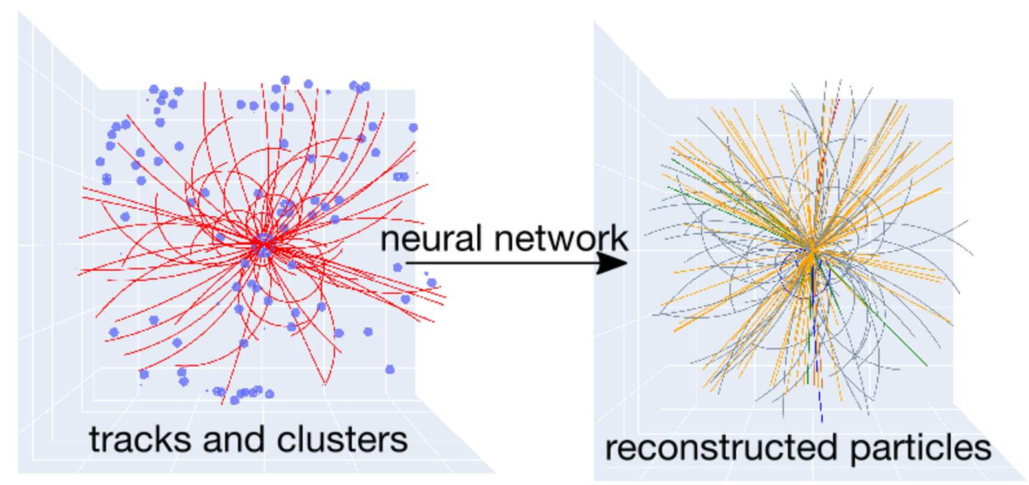
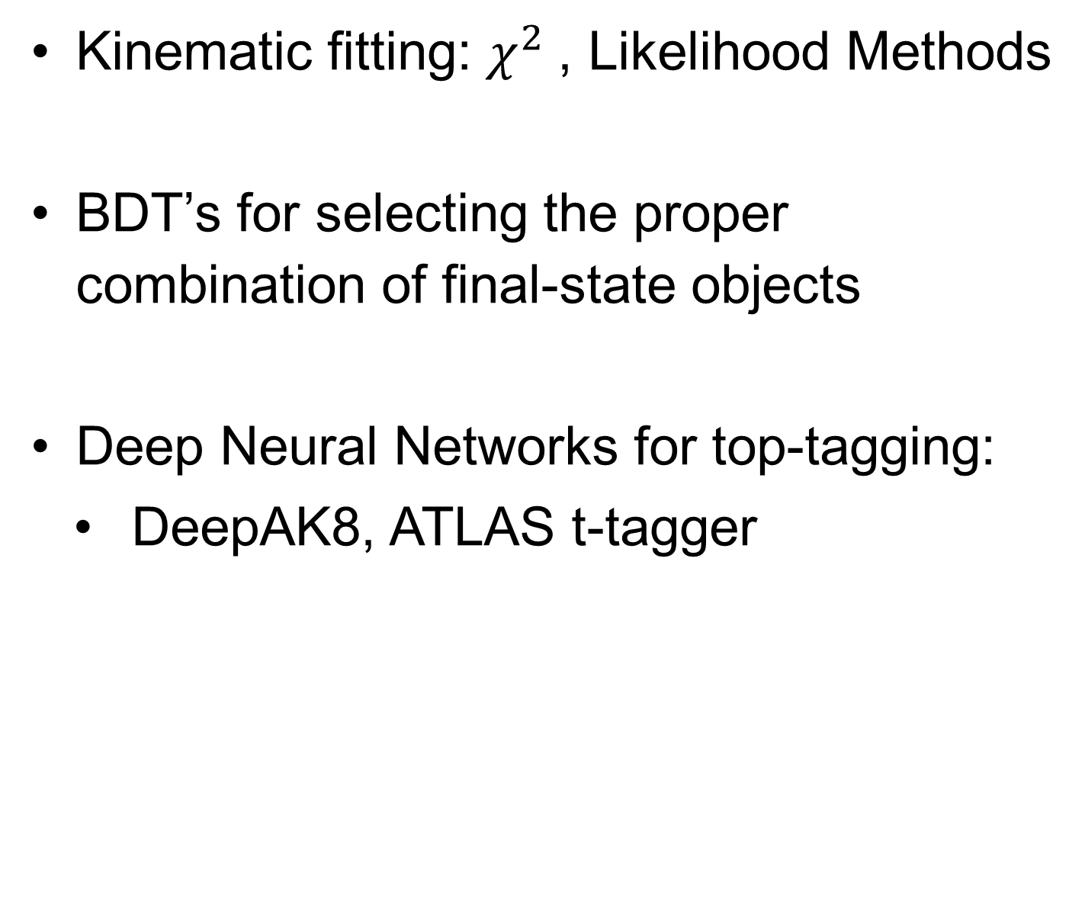
Methods of reconstruction
  Kinematic fitting: $χ^{2}$, Likelihood Methods
  BDT’s for selecting the proper combination of final-state objects
  Deep Neural Networks for top-tagging:
    DeepAK8, ATLAS t-tagger
Notes:
When we have our data we can apply machine learning (kinematic fitting bcs e+e- collisions we know the initial state
BDTs : we need to find the right combination of jets, energies,... That is from top quark and the wrong combinations, to be able to say for any given data is this from a top quark? See kirill 5:34

Slide 13
Next Steps
Develop advanced algorithms to:
  Reconstruct the top quark with high precision
  Separate signal vs background
Investigate how to measure top quark parameters from the threshold cross section scan
A look into Toponium?
  Spin correlations

Slide 14
QUESTIONS?

Slide 15
Backup

Slide 16
FCC timeline
The tentative timeline is:
2025: Completion of the FCC Feasibility Study
2027–2028: Decision by the CERN Member States and international partners
2030s: Start of construction
Mid-2040s: FCC-ee begins operation and runs for approximately 15 years
2070s: FCC-hh begins operation and runs for approximately 25 years

Slide 17
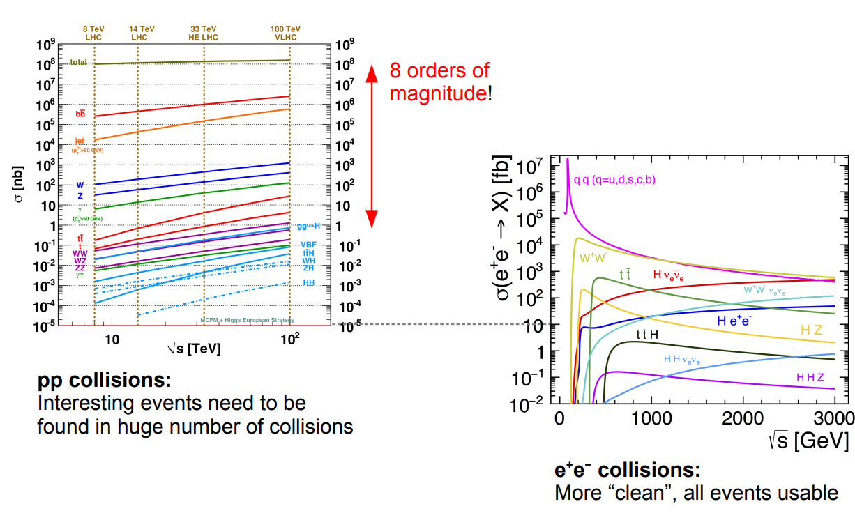
Discussion on Backgrounds

Slide 18
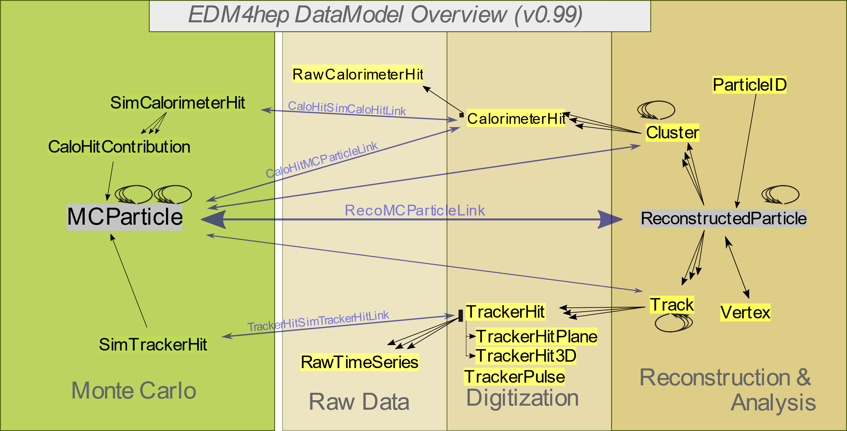
Top quark reconstruction

Slide 19
Key4hep detailed
  Madgraph + Pythia8
    generate simulated event samples and compute cross sections for hard scattering and decay processes of particles
    Specify additional parameters such as ISR/FSR
    generates Monte Carlo data and hold information about all of the event particles at all stages before detection.

Slide 20
Key4hep detailed
  Delphes
    Takes the input from Madgraph/Pythia
    Simulates the detector (IDEA) response
    Reconstructs our particles and saves them
    Represents the detector’s “view”

Slide 21
Key4hep detailed
  FCCAnalysis
    Works on top of EDM4hep
    Allows one to preform various associations like:
      Reconstructed with MC generated particles
      Vertex reconstruction
      ...

Slide 22
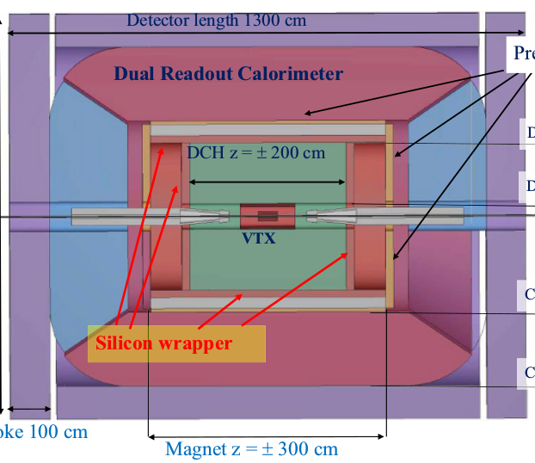
Detectors
IDEA (International Detector for Electron-positron Accelerators)
CLD (CLIC-like Detector)

