Slide 2

Project 8
eppg
  Neutrino physics
Intermediary presentation november / Lars Willocx – Juliana Stachurska

Slide 3
P8

Slide 4

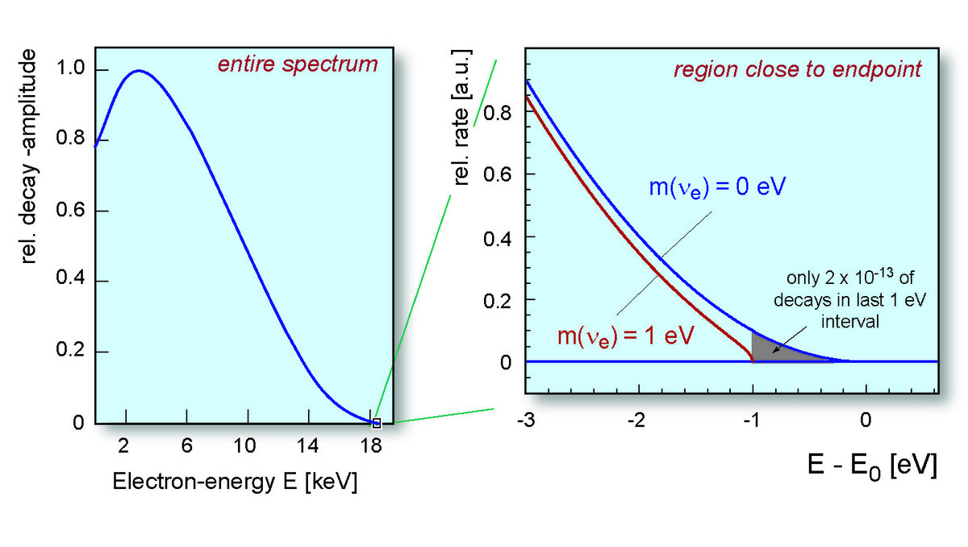

What?
Neutrino mass experiment
$\overline{ν_{e}}$
β-decay

Slide 5
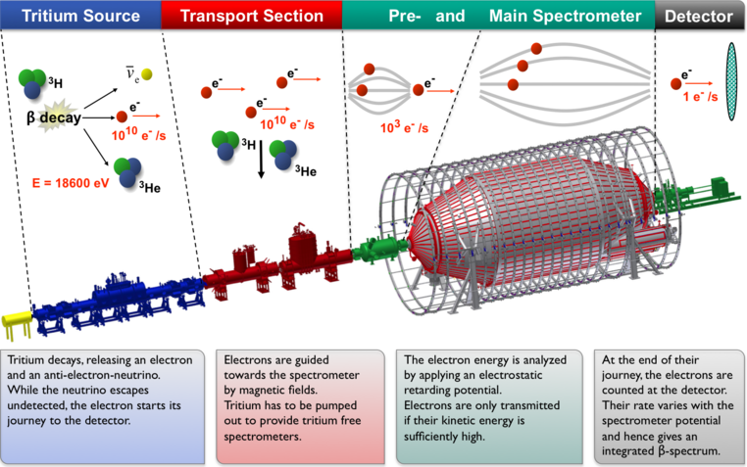
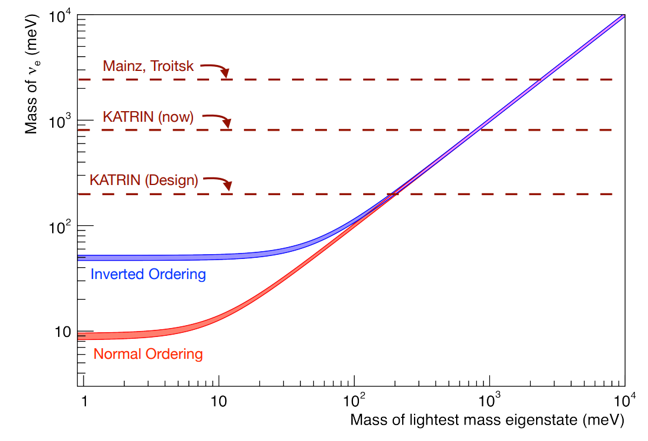
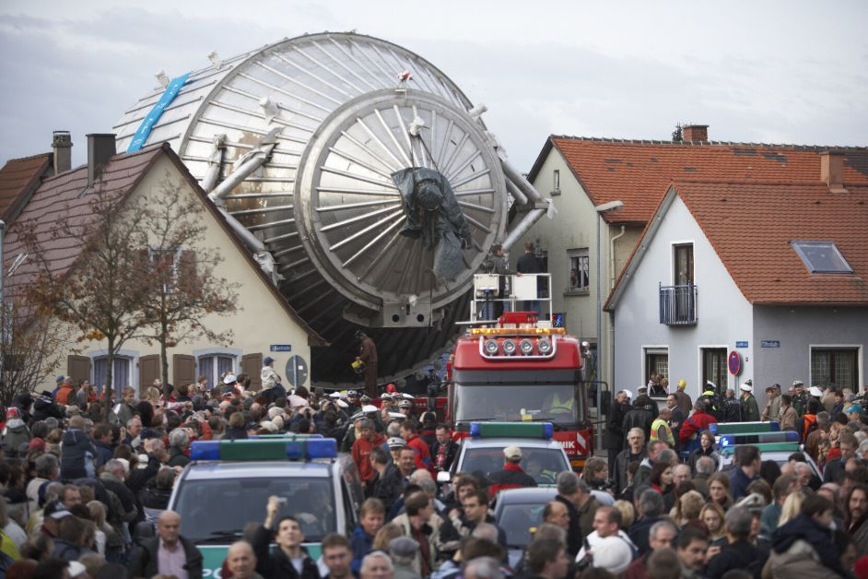

WHAT?
KATRIN
Size spectrometer $∝$ r

Slide 6
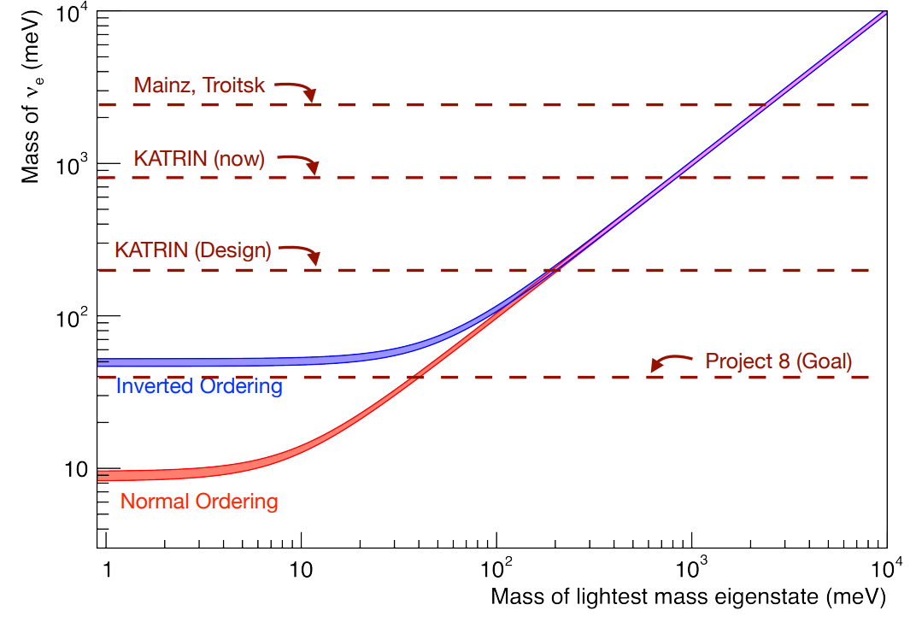
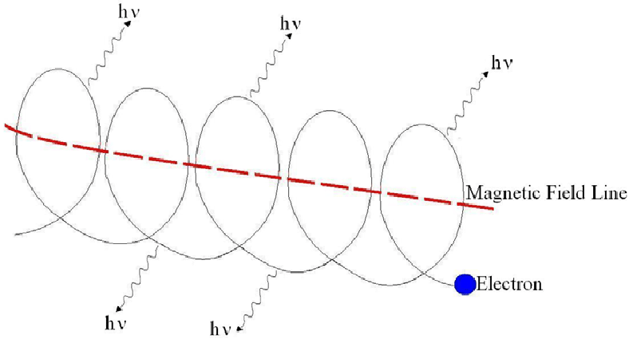
WHAT?
Project 8:
CRES (cyclotron radiation emission spectroscopy)

Slide 7
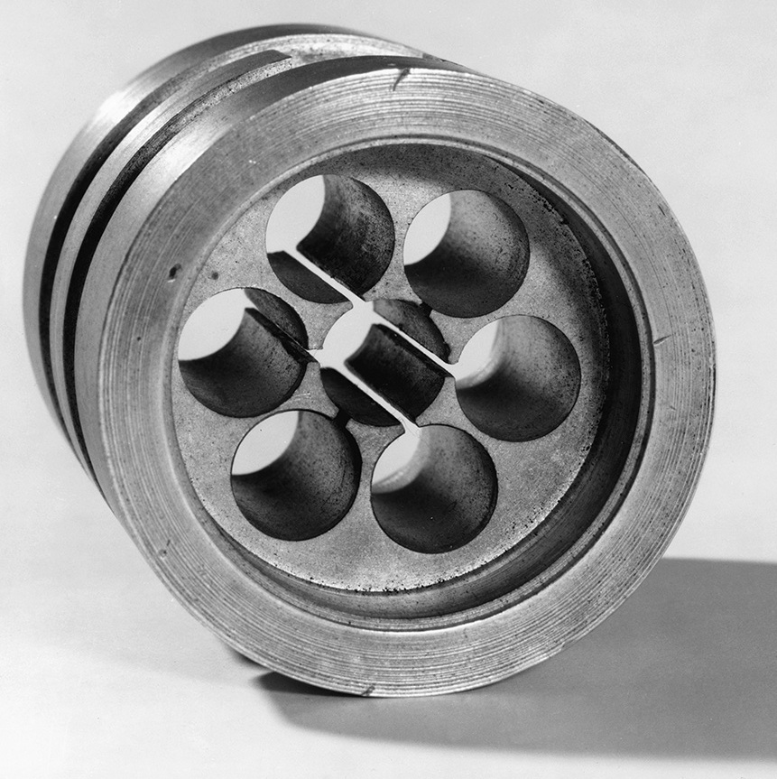
How?
Microwave magnetron cavity

Slide 8
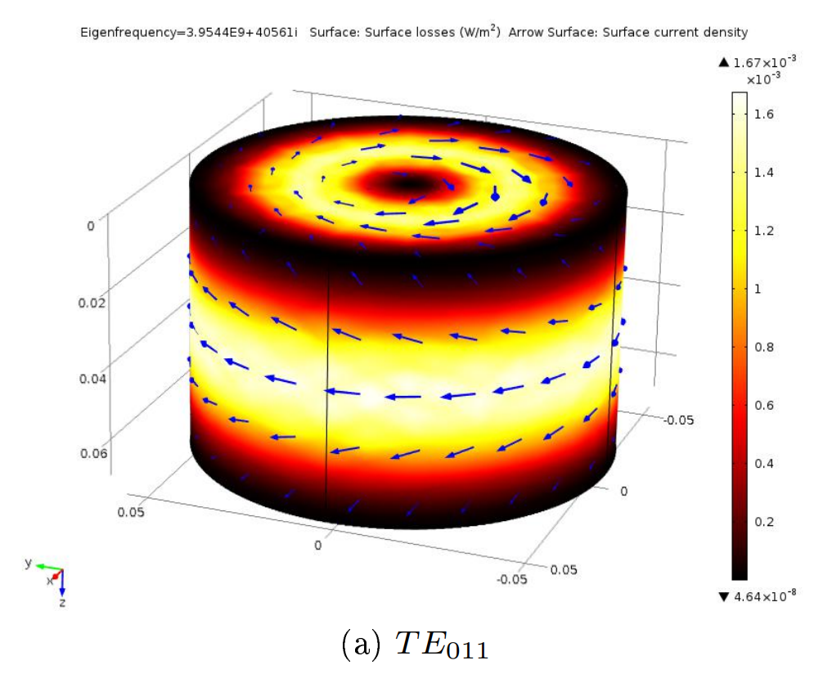
How?
Microwave magnetron cavity
Project 8: opposite

Slide 9
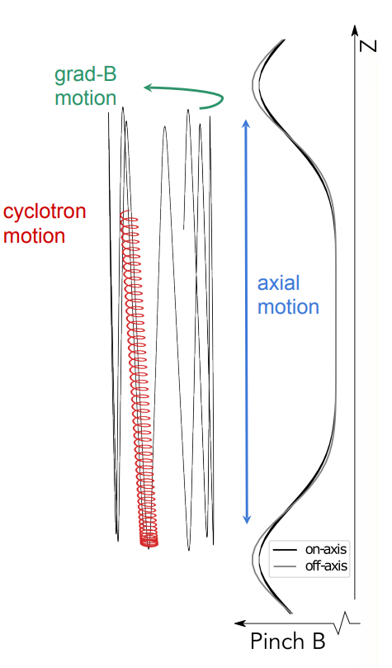
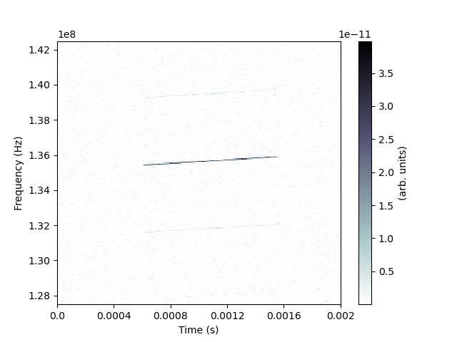
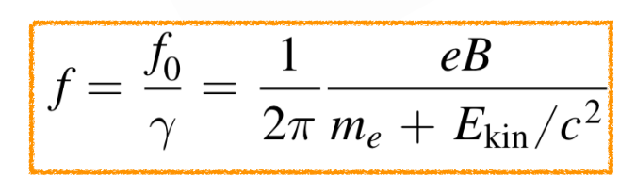
How?
Credit: Srinikitha Bhagvati

Slide 10
studies

Slide 11
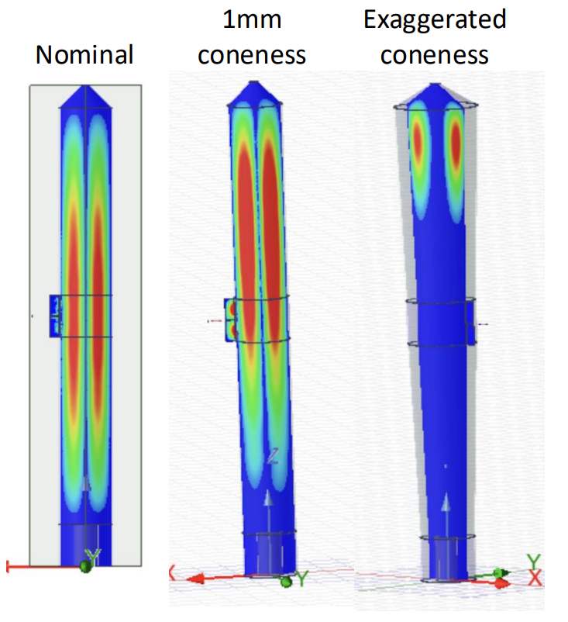
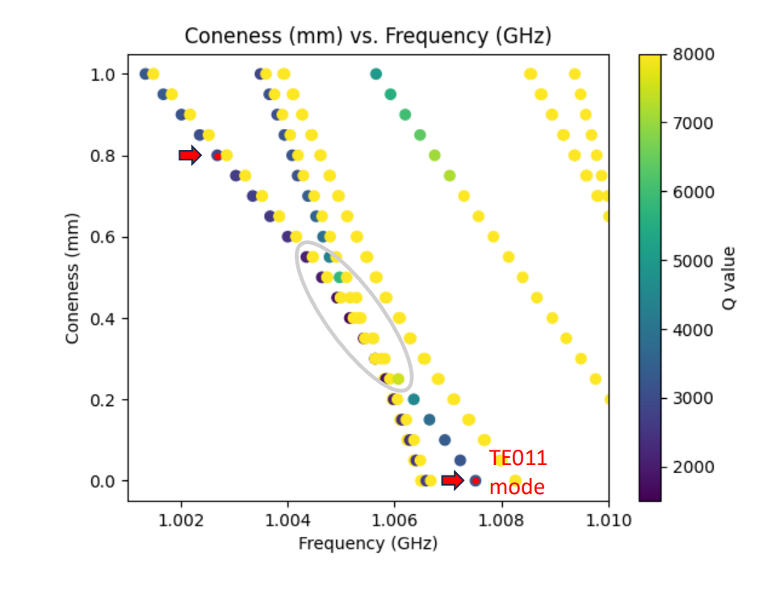
Distortions study
Coneness study (Hannah Binney)

Slide 12
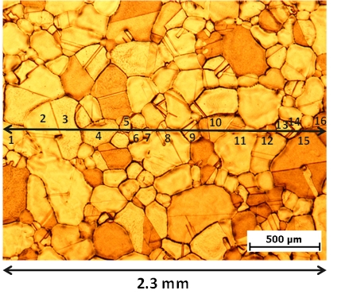
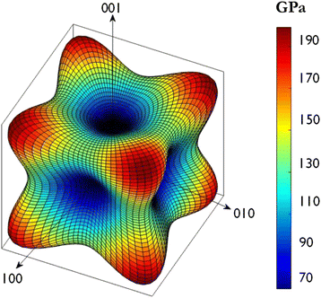
Material study

Slide 13
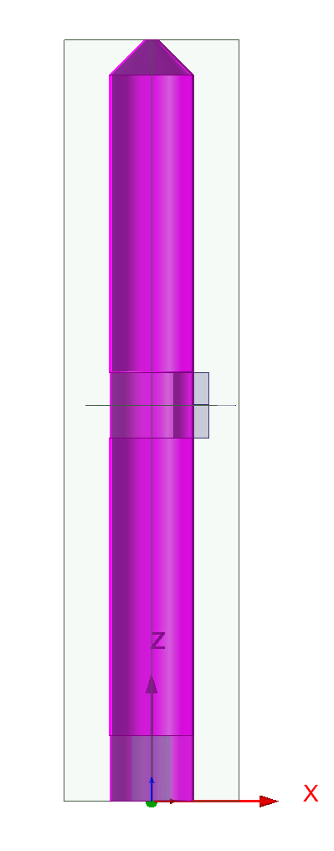
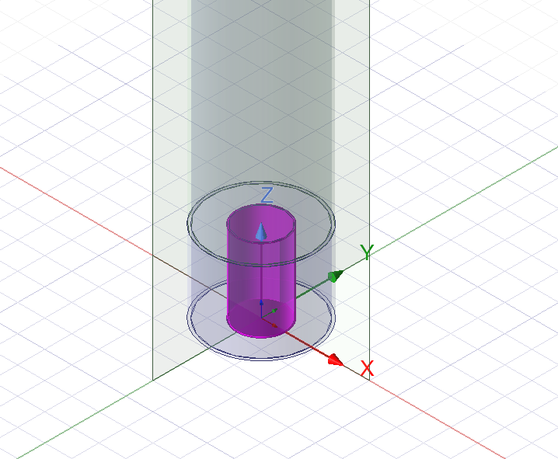
Endcap terminal length study

Slide 14
other

Slide 15
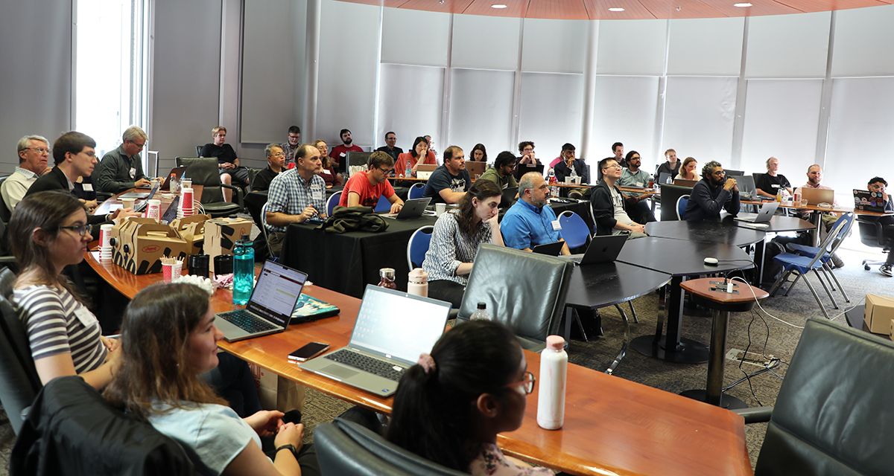
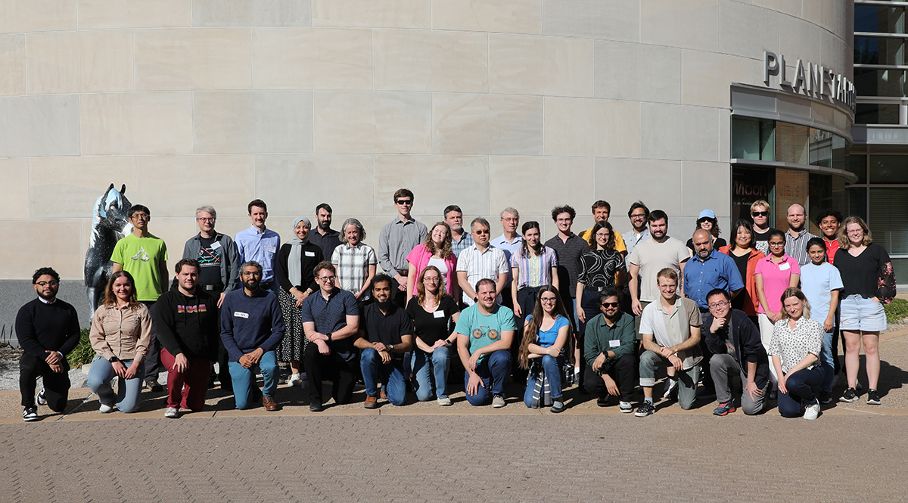

Collaboration meetup texas

Slide 16
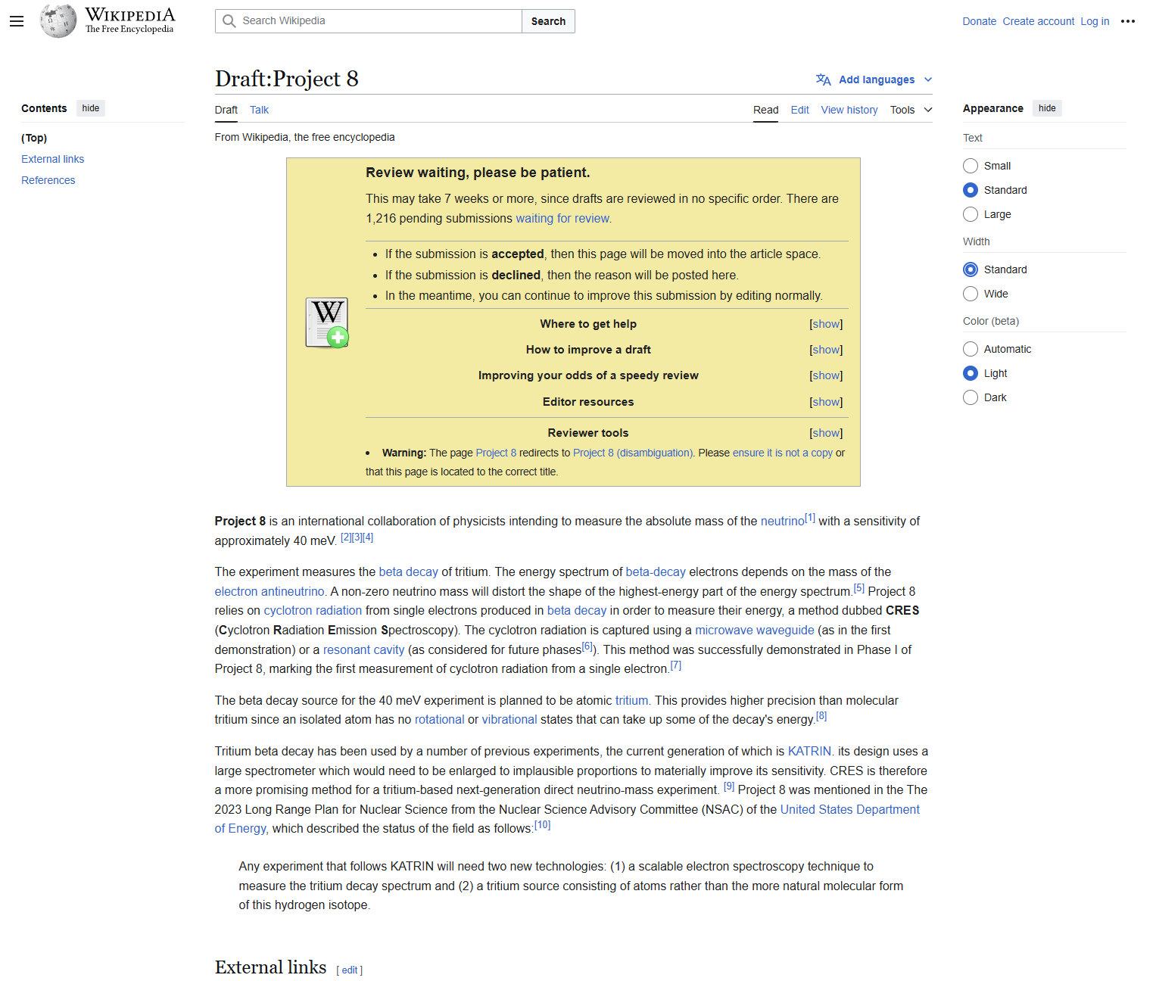
Wikipedia article

Slide 17



< presenter’s name >
< job title >
< DEPARTMENT OR RESEARCH GROUP >
E <first name>.<surname>@ugent.be
T +32 9 000 00 00
M +32 400 00 00 00 www.ugent.be
Universiteit Gent
@ugent
@ugent
Ghent University

