Slide 1
Gravitational Waves from Extreme Mass-Ratio Inspirals
department of physics and astronomy
Ghent gravity group
Robrecht Keijzer
Int. promotor: prof. Archisman Ghosh (UGhent)
Ext. promotor: prof. Thomas Hertog (KULeuven)
Mentor: Simon Maenaut (KULeuven)

Slide 2
Contents
1. Introduction
2. General approach
3. Calculations
My progress
Next steps

Slide 3
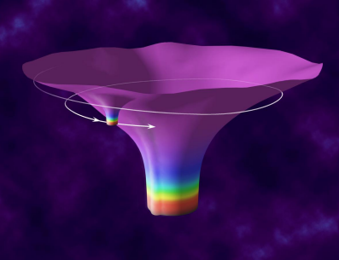
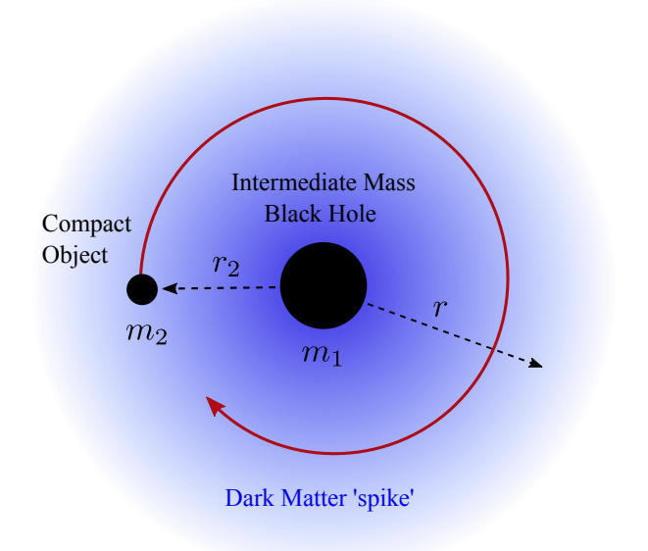
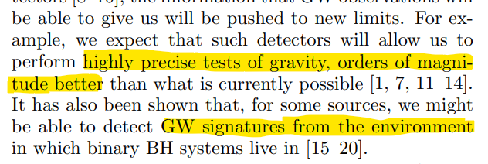
Introduction
LISA: a new class of
objects → EMRIs!

Slide 4
General approach
Strong gravity?
Scalar cloud backreaction to metric?
small mass ratio, small scalar field amplitude
(https://arxiv.org/pdf/2307.16093: Richard Brito & Shreya Shah - 2/10/2023)
Vacuum background BH + perturbations
Paper: Schwartzschild + spherical/dipolar scalar cloud

Slide 5
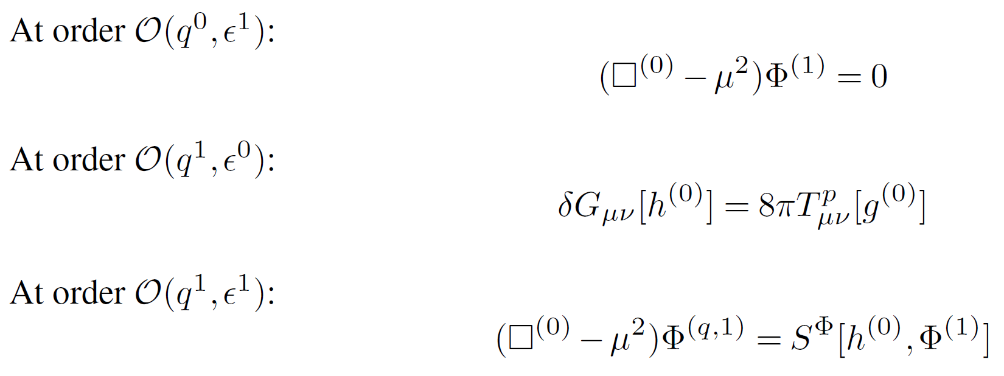
Calculations
Make the expansion:
Mass ratio q
Scalar field amplitude $ε$

Slide 6
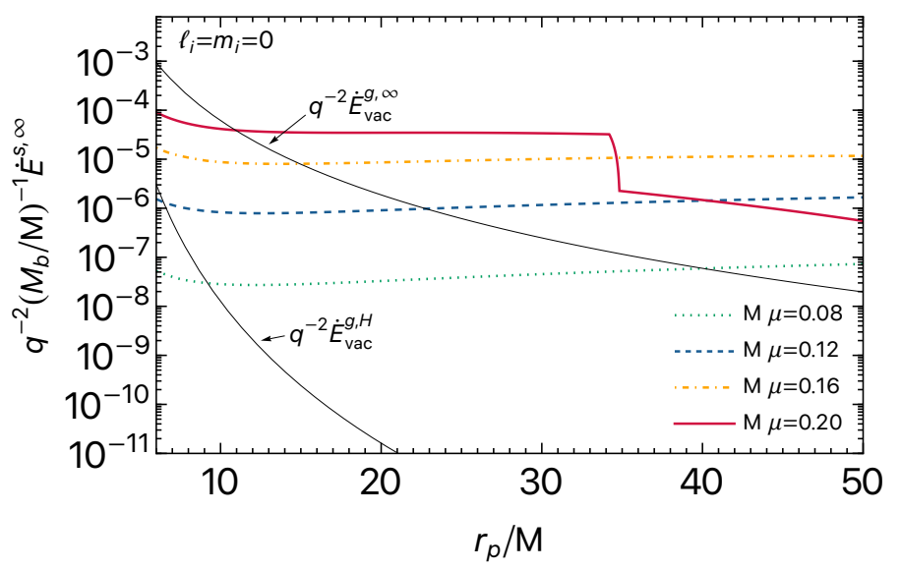
Scalar power: results
$Mμ=0.2$
→ for M = 100 000$M_{\text{☉}}: μ\sim {10}^{−16}eV$

Slide 7
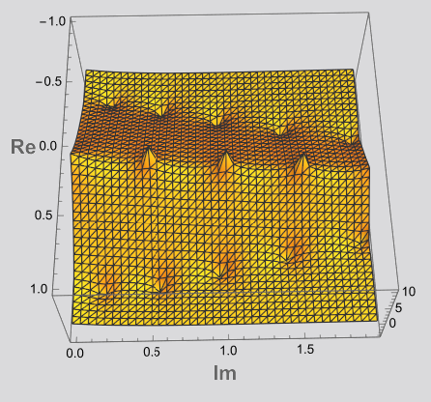
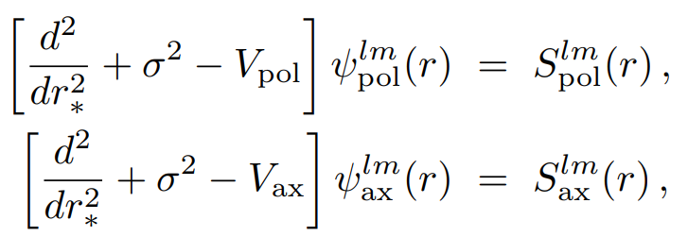
My progress
Remember:
Two components: axial & polar → Two master equations
QNFs:

Slide 8
Next Steps

Slide 9
Next Steps
- Paper (2023):
Schwartzschild
→ Slowly rotating

