Slide 1
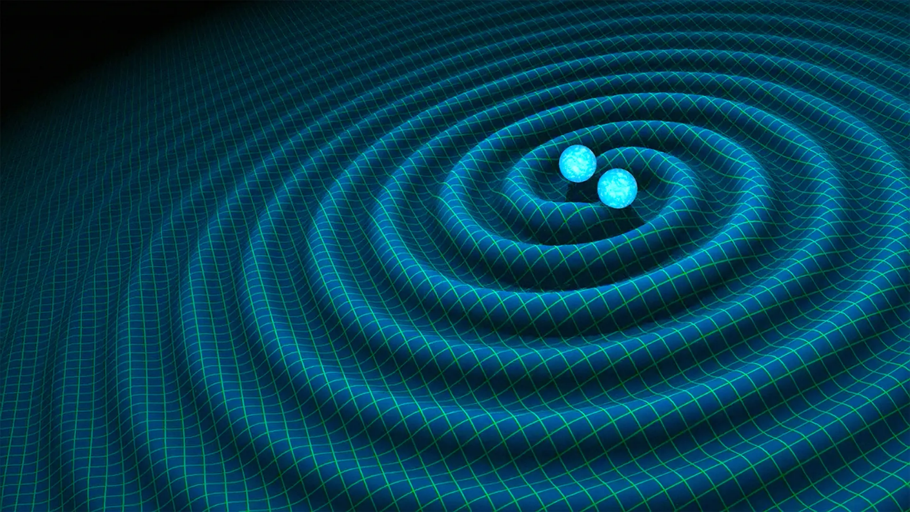
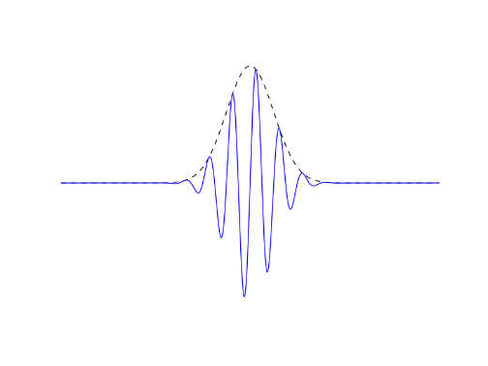
Hunting for exotic resonances in compact binary mergers
department of Physics and astronomy
  Experimental particle physics and gravity
Robin Chan
Intermediate thesis presentation

Slide 2
What to expect?
Current GW observations
Exotic compact objects
  What are they?
  How to find them?
tBilby
Results
  Gaslighting a large collaborative codebase
Future steps

Slide 3
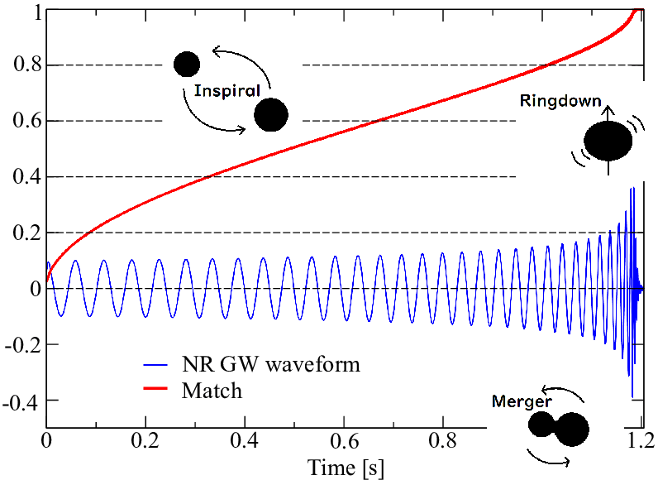
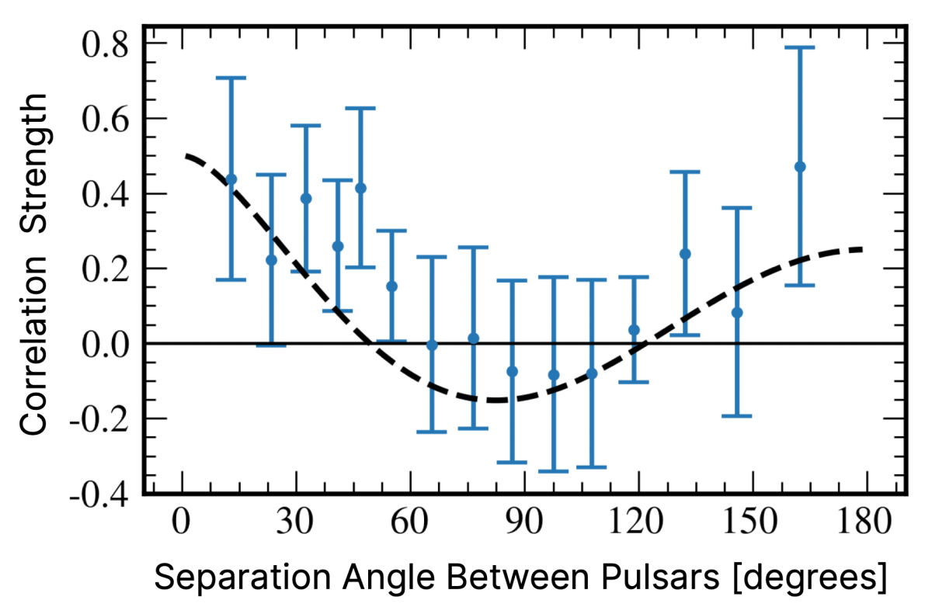
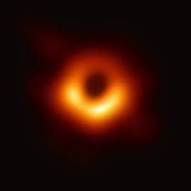
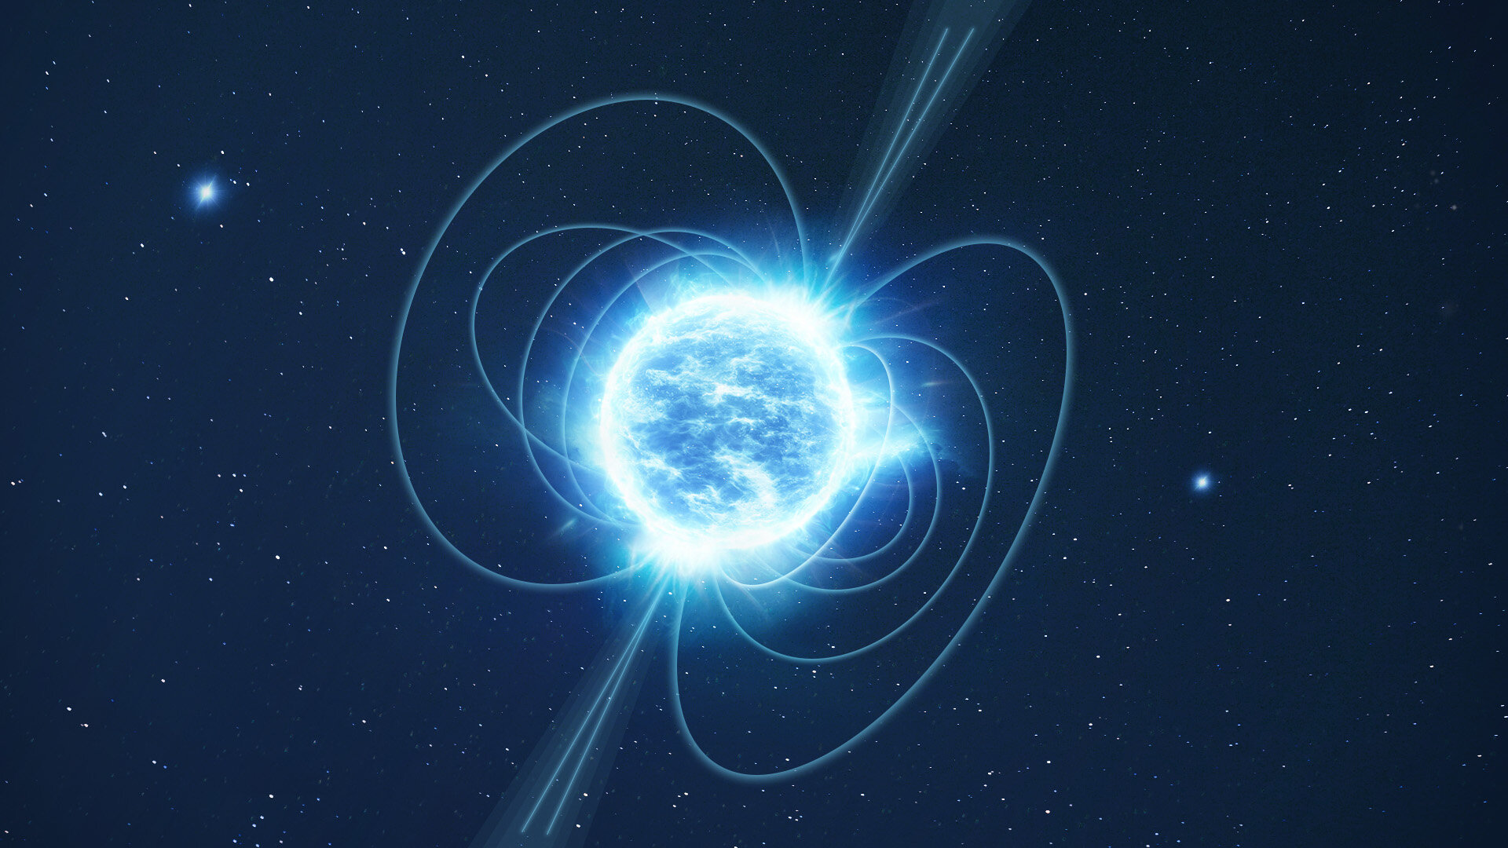
What do we currently see in the gw sky?
Binary coalescence
Stochastic GW background

Slide 4
What do we currently see in the gw sky?
Binary coalescence

Slide 5
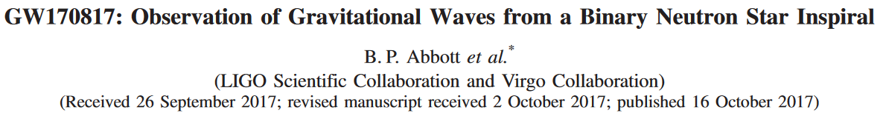
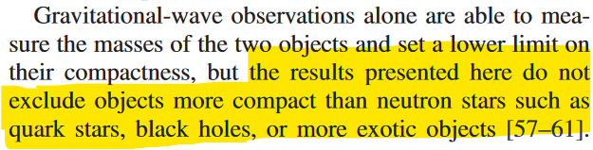
Gravitational waves

Slide 6
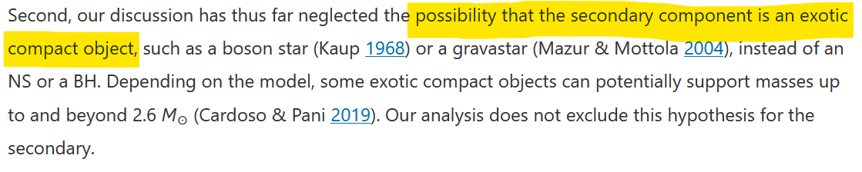
Gravitational waves

Slide 7
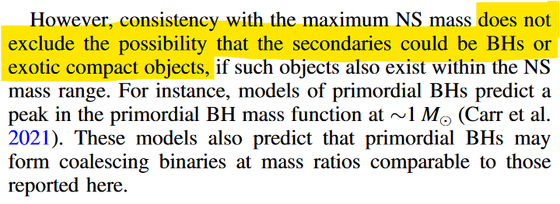
Gravitational waves

Slide 8
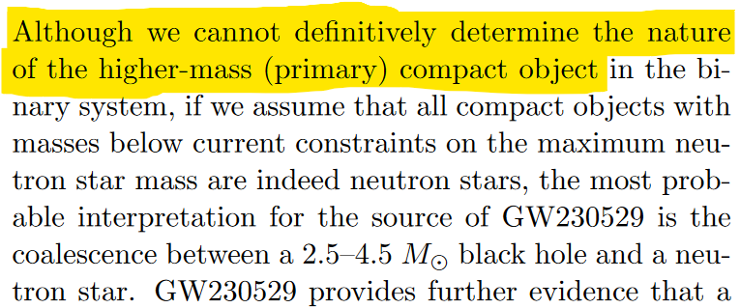
Gravitational waves

Slide 9
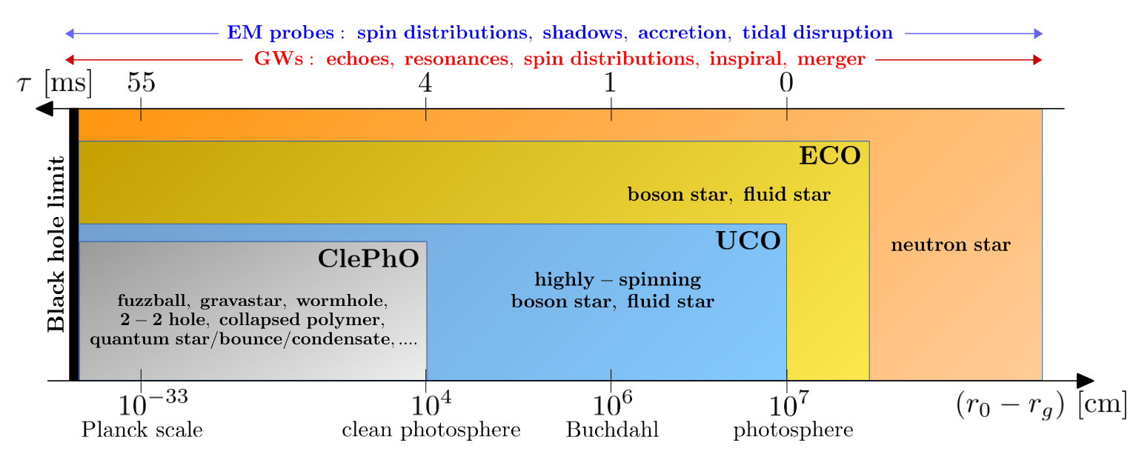
Exotic compact objects
Hypothetical objects between neutron stars (NSs) and black holes (BHs) in compactness
Hard to distinguish with EM observations

Slide 10
Exotic compact objects
Why are they interesting?

Slide 11
Exotic compact objects
Why are they interesting?
  New states of matter
  Beyond the Standard Model physics
  Extensions of GR
  Quantum gravity

Slide 12
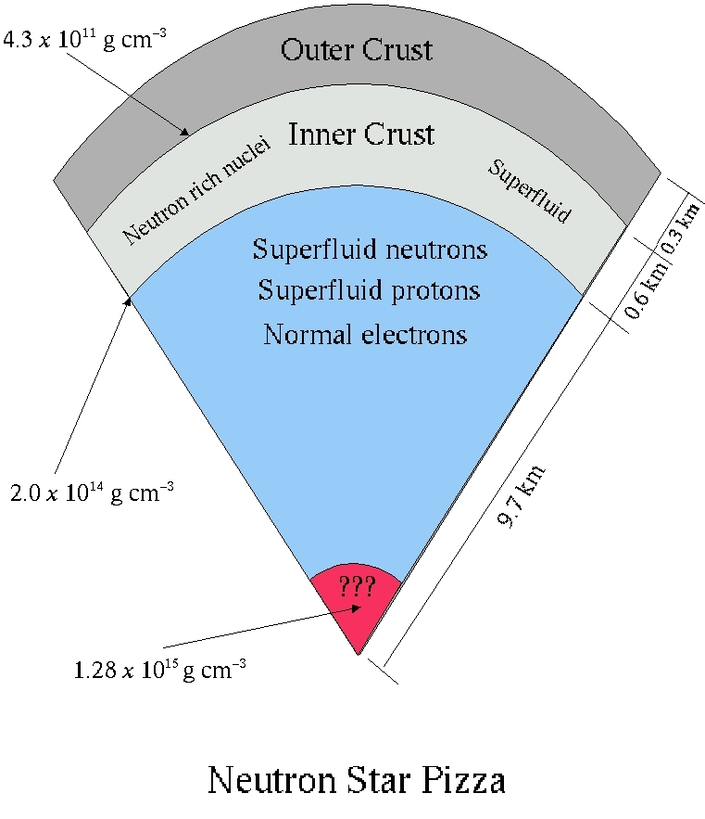
Gravitational waves
EM observations probe surface
(NS glitches are an exception)
GWs probe mass-distribution dynamics
  Inner structure

Slide 13
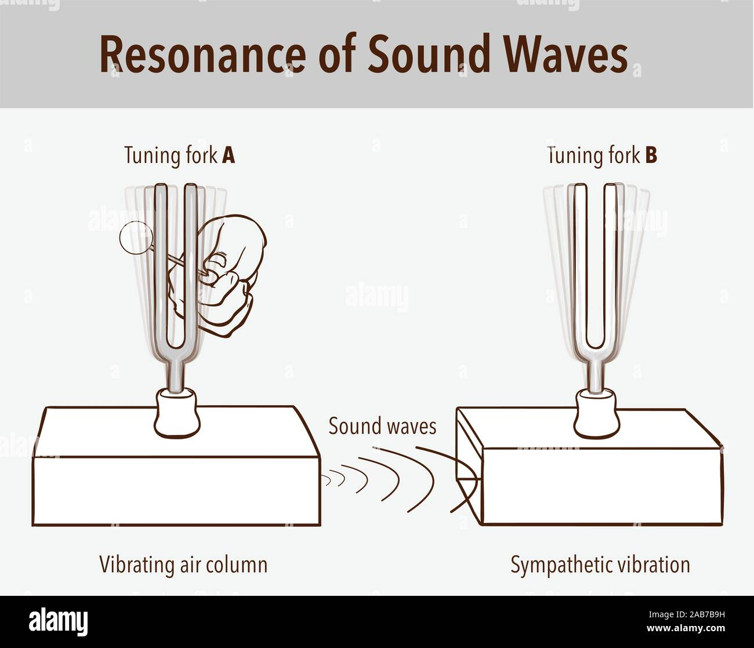
ECOs and how find them
Look for tidal resonances during inspiral
Leave imprint on phase evolution
Not detected thus far

Slide 14
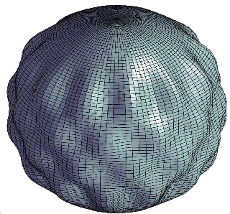
ECOs and how find them
Look for tidal resonances during inspiral
Leave imprint on phase evolution
Not detected thus far
Gravitational Waves
(E)CO
(E)CO
gravitational
spacetime

Slide 15
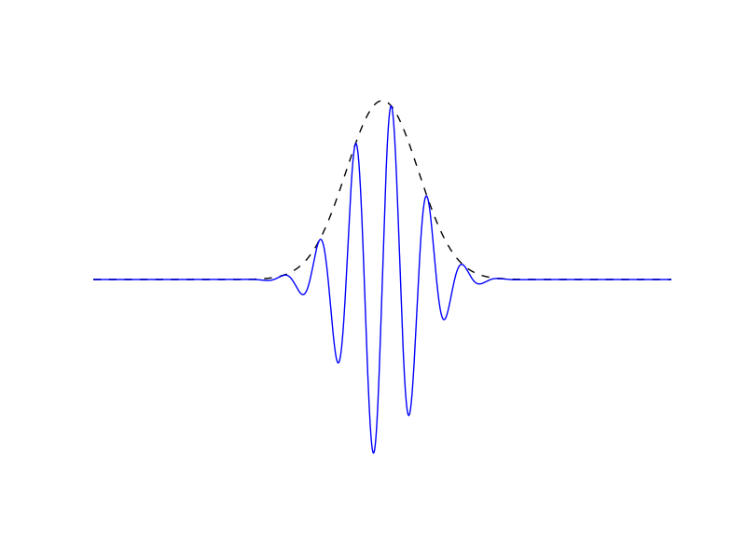
ECOs and how find them
Resonance and phase shift are linked to “rigidity” (composition) of objects
Constrains EOS
Basis of sine-gaussian wavelets to model resonance

Slide 16
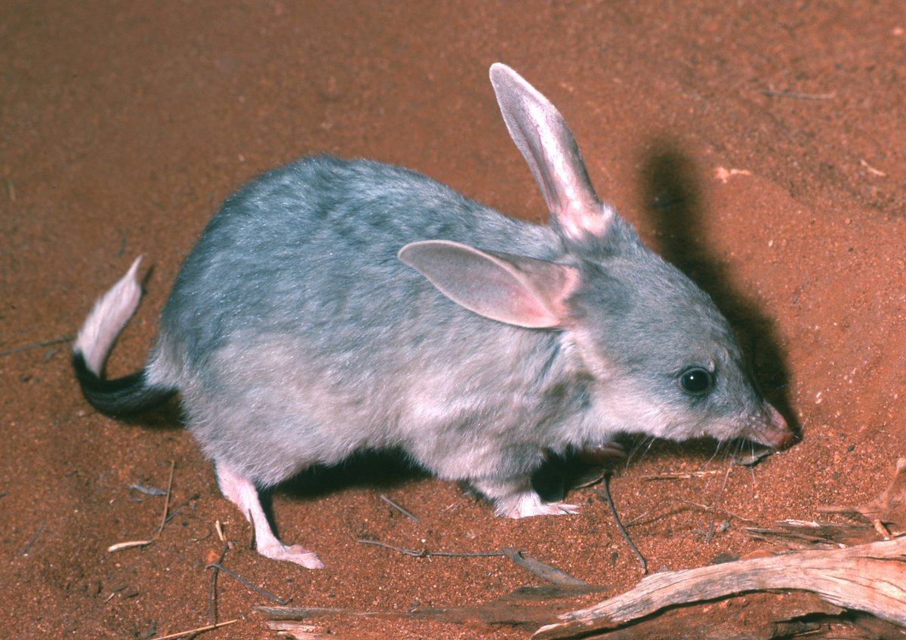
tbilby
Each wavelet adds 5 DOF => computational cost!
Use tBilby
Transdimensional Bilby
t

Slide 17
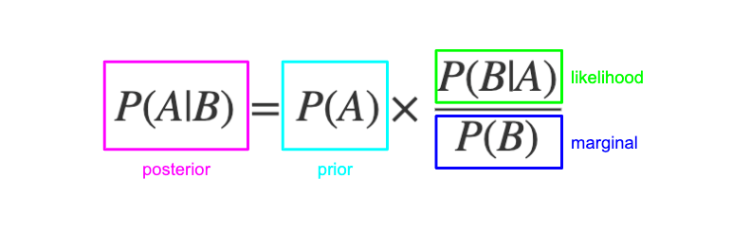
Transdimensional sampling
Dimensionality N = sampling parameter
  Reversible Jump MCMC
Posterior penalised by Occam factor (weighs model complexity)

Slide 18
tbilby
Extension to Bilby for transdimensional inference
tBilby samples in full N, but evaluates likelihood over
≤ N
Likelihood evaluation is the most expensive step, according to the tBilby authors

Slide 19

Where are we now?
Extended Bilby to use multiple wavelets
Allow for superposition of IMR* signal and wavelet
Recover injected wavelet
*Inspiral - Merger - Ringdown

Slide 20
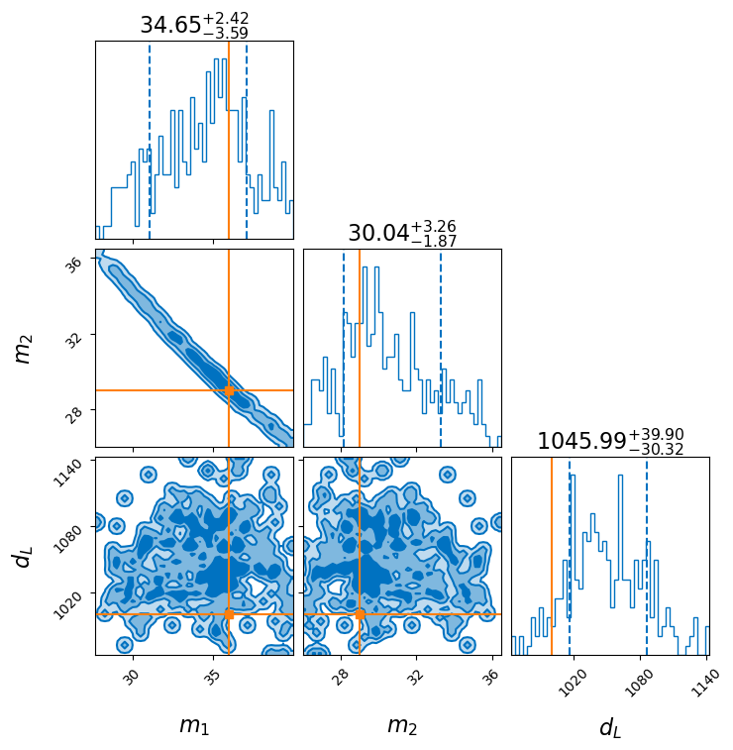
Corner plots
Visualise multi-dimensional data
On-diagonal: parameter distributions
Off-diagonal: parameter correlations

Slide 21
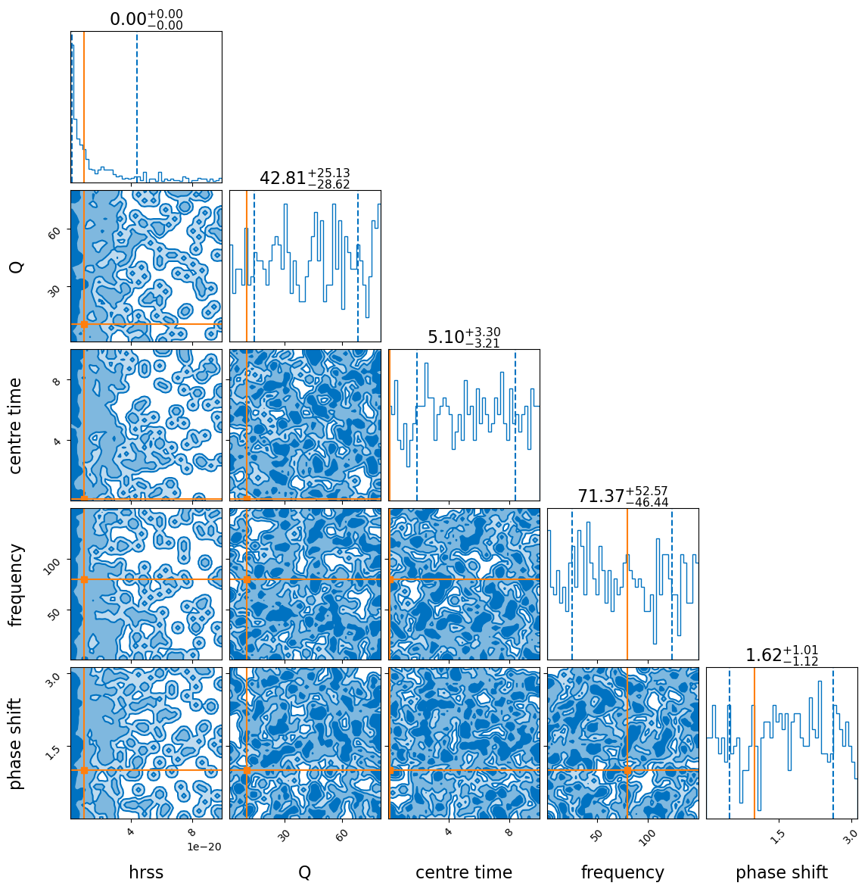
Recovery results
Sampler seems to sample prior. Issue occurs for different samplers
Possibly too high SNR
  Pipeline is designed for relatively low SNRs, here SNR = 1000+
Possibly bug in code
  Bilby still works on other inference jobs, so hard to find what it is

Slide 22
Next steps
Recover wavelet(s) with Bilby
Recover wavelet + IMR with Bilby
Implement wavelets in tBilby
Check computational limits

Slide 23
Future plans: tbilby runs well
Recovery on more complex waveforms
  Artificially added phase shift
  Ringdown modes of resonance during inspiral
  Full NR-simulated waveform (if they exist)

Slide 24
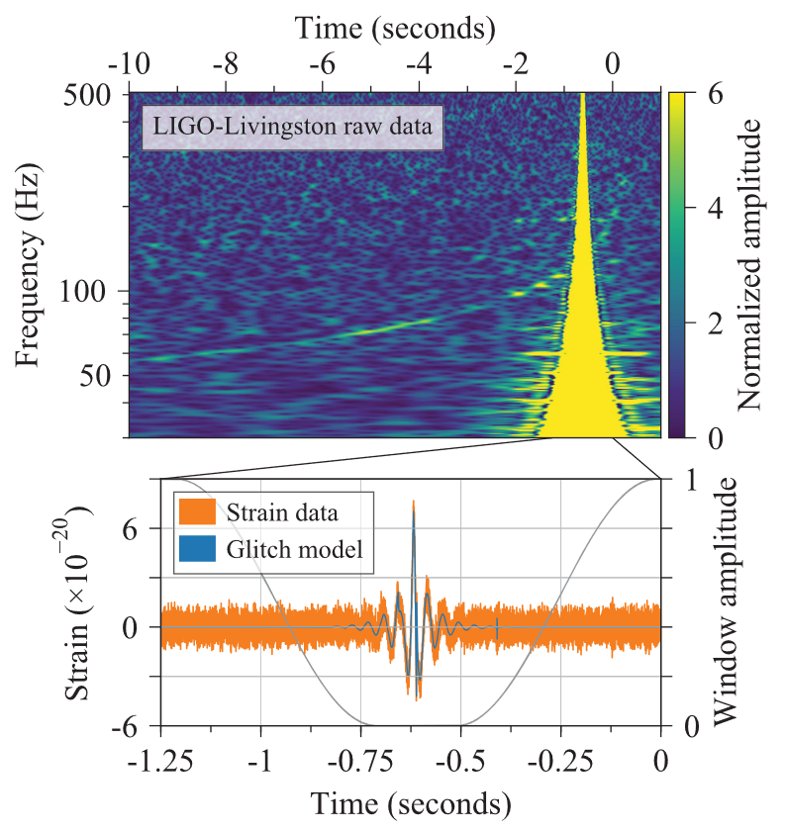
Future plans: tbilby runs poorly
RJMCMC probably needed, not in Bilby currently
Try using wavelets to model simpler signals (e.g. detector glitches)

Slide 25



Robin Chan
Experimental Particle Physics and Gravity
E robin.chan@ugent.be www.ugent.be
Universiteit Gent
@ugent
@ugent
Ghent University

