Slide 1
A novel approach to discover unmodelled features in gravitational wave signals
Matteo Vereertbrugghen
Promotor: Archisman Ghosh
Mentor: Freija Beirnaert

Slide 2
Recap
Machine learning algorithm
Results
Future plans

Slide 3
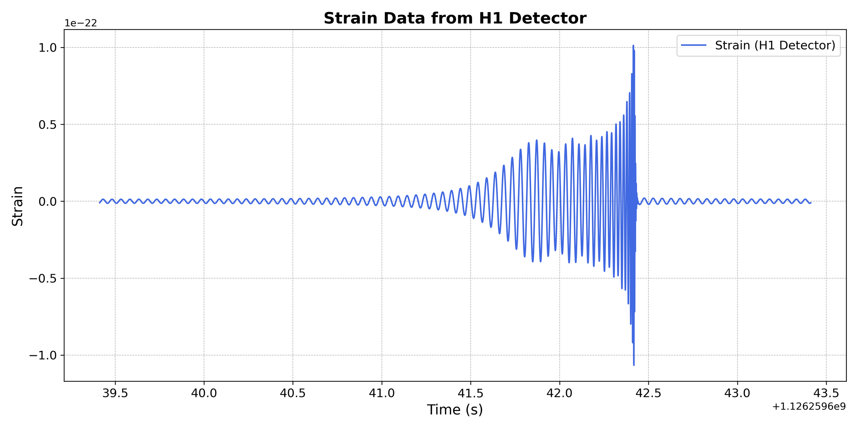
Gravitational waves from CBC
(Top) Kip Thorne; (Bottom) B. P. Abbott et al. [8]; adapted by APS/Carin Cain
Notes:
compact binary coalescences

Slide 4
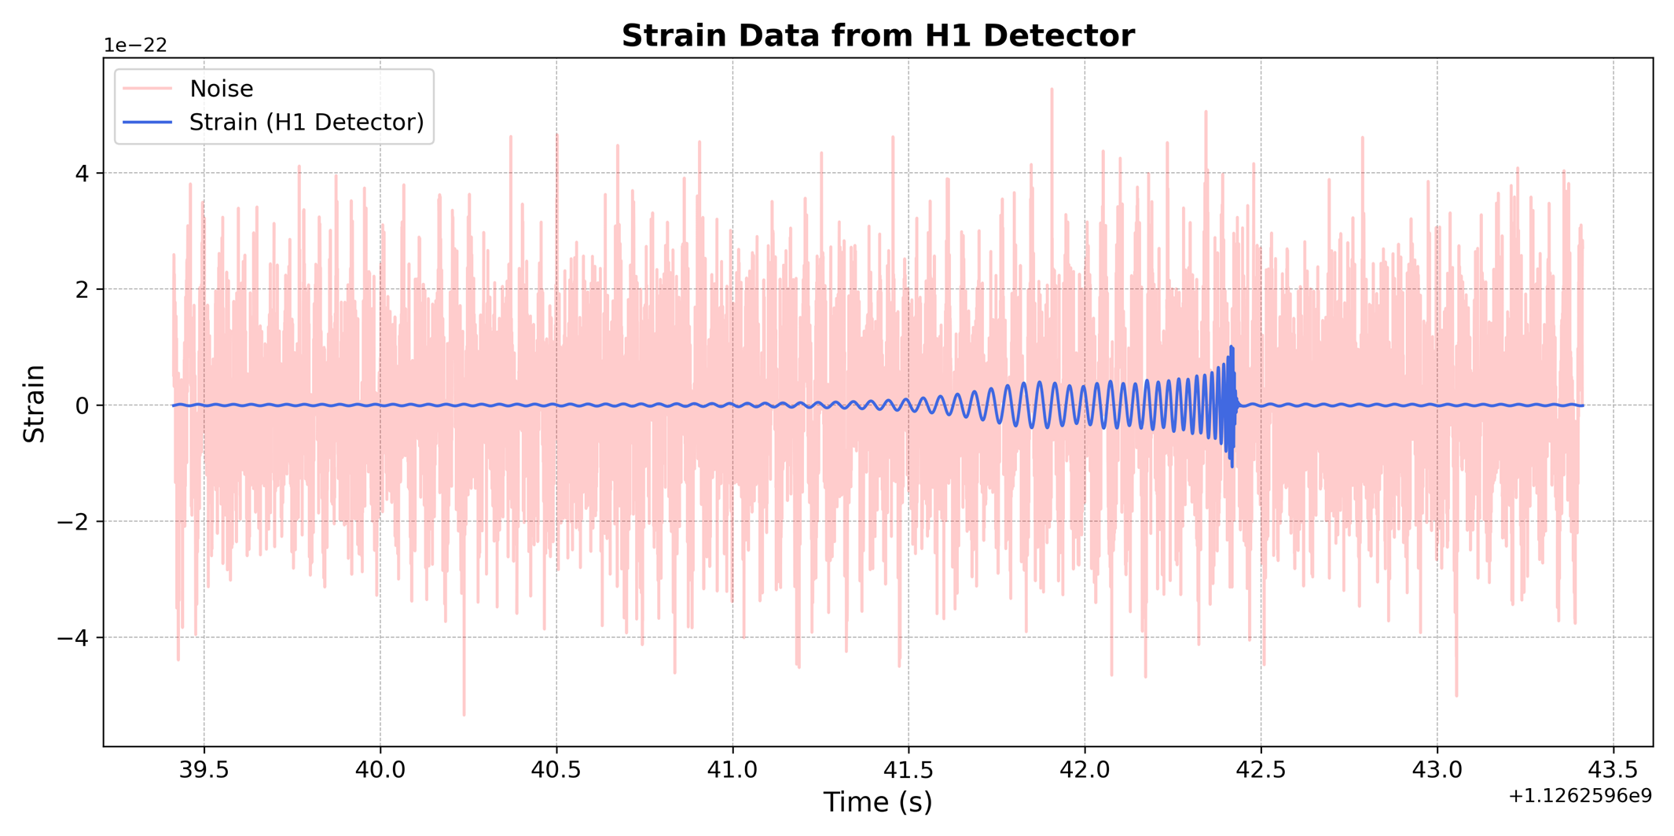
The noise

Slide 5
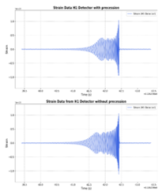
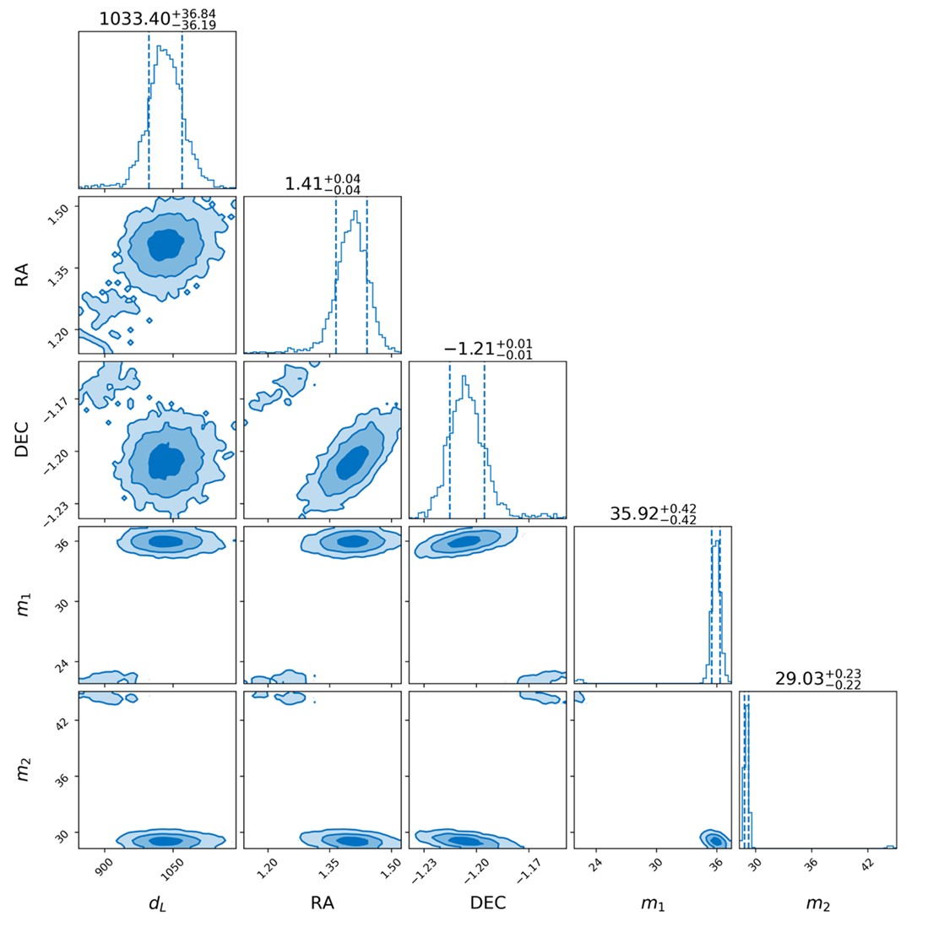
Extracting parameters
Injecting signal and noise into bilby
Choose model with parameters
Monte Carlo Markov chain
Returns Posterior distribution

Slide 6
Calculate parameters with Bilby
$$m_{1}=…$$
$$m_{2}=…$$
$$DEC=…$$
$$RA=…$$
Very slow

Slide 7
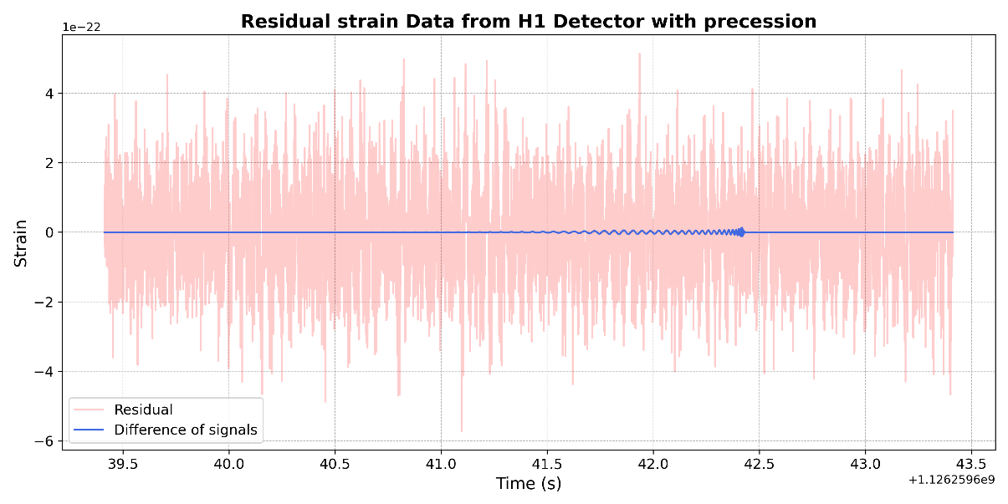
Residual analysis

Slide 8
Which waveform to use?
Waveform | Precession | Higher harmonics
IMRPhenomD
IMRPhenomHM
IMRPhenomPv2
IMRPhenomXPHM

Slide 9
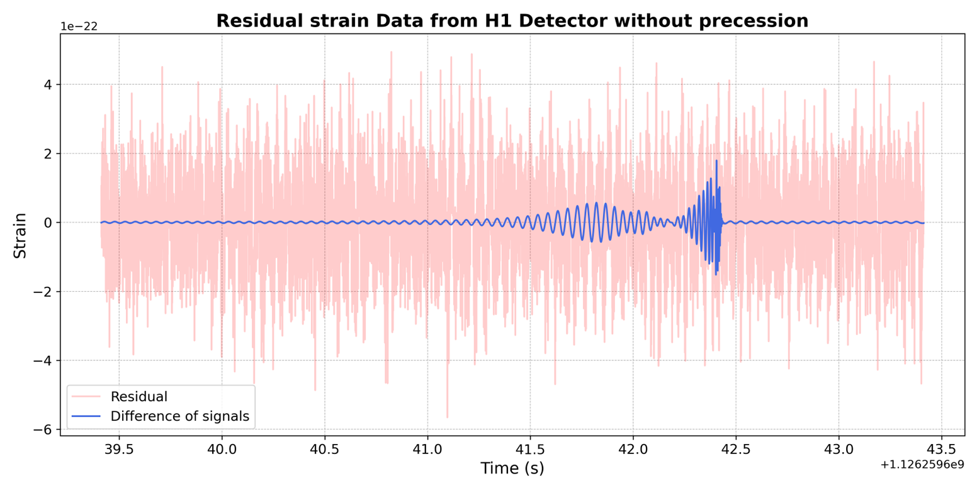
Different residuals
Correct Waveform
Wrong waveform
Real GW event: No blue part can be plotted

Slide 10
Goal of thesis
Advancing detectors → More data
Better waveform → Curse of dimensionality
→ long runtimes
Less advanced waveforms → less parameters
2 goals:
Dirty run →Which features are we missing?
Search for unmodeled features

Slide 11
Convolutional neural network

Slide 12
General structure
Convolutional layers
Pooling layers
Dropout, fully connected layers
Taherkhani, A., Cosma, G. & McGinnity, T.M. A Deep Convolutional Neural Network for Time Series Classification with Intermediate Targets

Slide 13
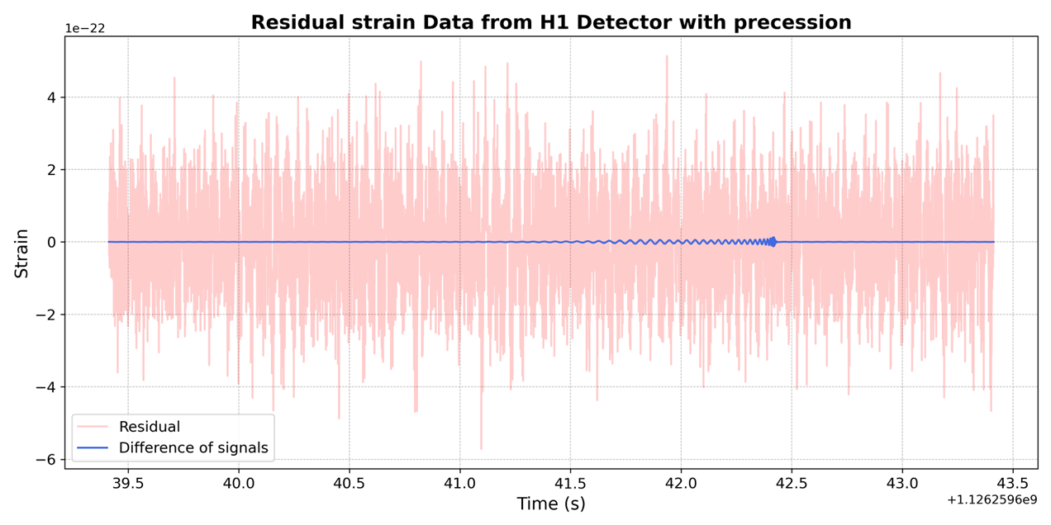
Pipeline
Inject simulated signal
Choose waveform for reconstruction
Create residual
Train ML model
Test classifier with simulated signals not in the training set

Slide 14
Results

Slide 15
Data generation
100k residuals + Bilby = Computational expensive
Solution : SciPy optimize
Injection signal → randomly generated parameters
Injection waveform → IMRPhenomXPHM
Recovered signal → SciPy parameters
Recovered waveform → IMRPhenomXPHM or IMRPhenomPv2

Slide 16
Data
Class labels 1 or 0:
1: injection waveform = recovered waveform
0: injection waveform ≠ recovered waveform
If 0 → recovered parameters error larger
Check this: Relative mistake, 2000 runs

Slide 17
Difference relative error

Slide 18
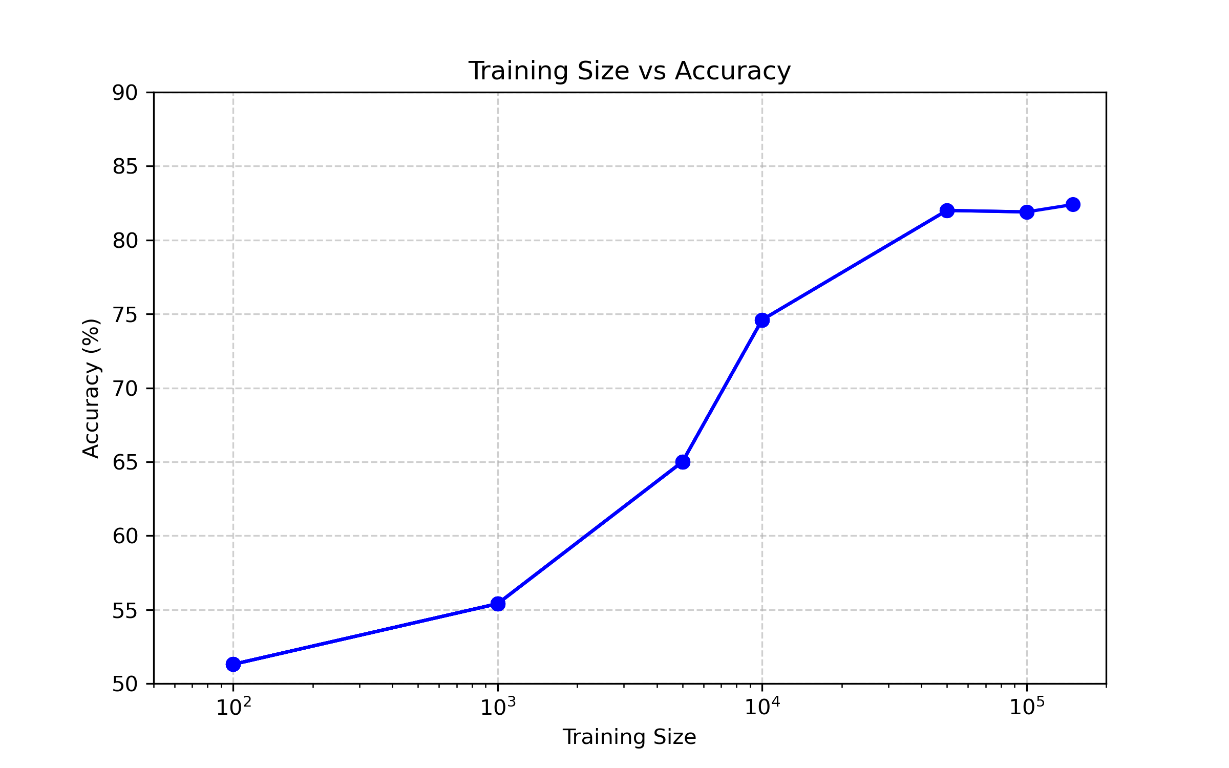
Test on training size

Slide 19
Best results
100k training set
50k test set
IMRPhenomPv2 and IMRPhenomXPHM
Result: 82.9% accuracy

Slide 20
Confusion matrix
Correct waveform =1
Wrong waveform =0
= 39.01%
= 11.64%
= 9.89%
= 39.46%

Slide 21
Possible reason for 80% accuracy
 | Correct waveform, Label 1 | Wrong waveform, Label 0
Good reconstruction
Bad reconstruction

Slide 22
Future plans

Slide 23
Optimization of algorithm
Adding more waveforms
Testing on real gravitational waves
Search unmodelled features

Slide 24
Questions?

Slide 25
Extra CNN structure

