Slide 1
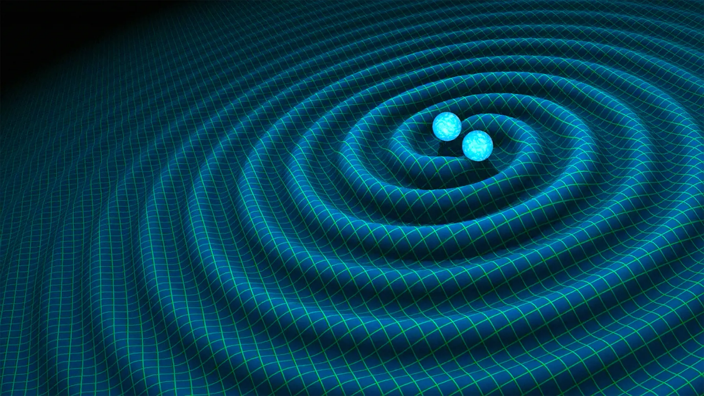
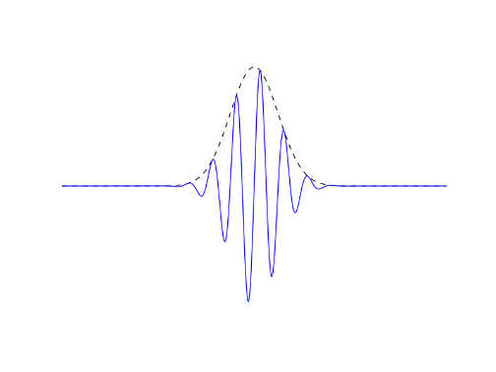
Hunting for exotic resonances in compact binary mergers
department of Physics and astronomy
  Experimental particle physics and gravity
Robin Chan
Intermediate thesis presentation
Supervisor: Prof. Dr. Archisman Ghosh

Slide 2
What to expect?
Quick recap
Bilby inference runs
Samplers
tBilby inference runs
NR waveforms update
Next steps

Slide 3
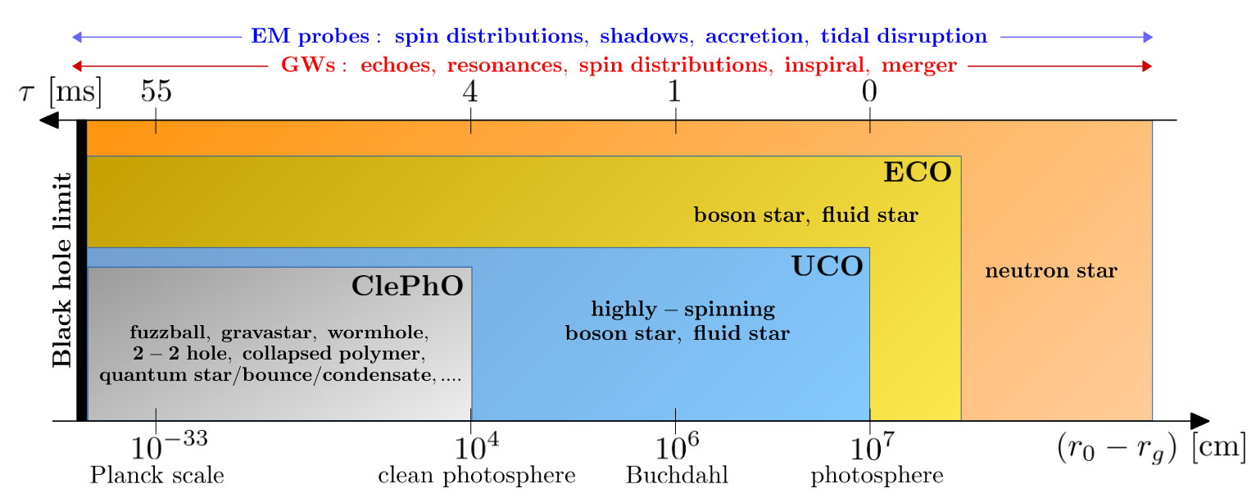
Exotic compact objects
Hypothetical objects between neutron stars (NSs) and black holes (BHs) in compactness
Hard to distinguish with EM observations
Cardoso V., Pani P. (2017), Tests for the existence of horizons through gravitational wave echoes

Slide 4
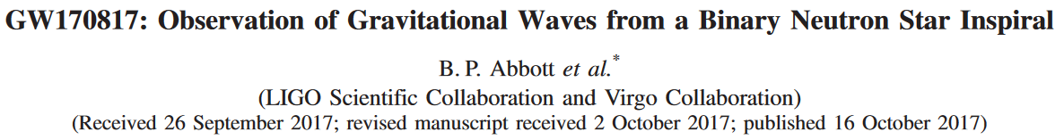
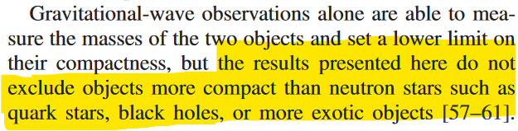
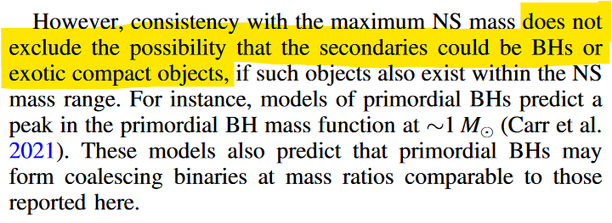
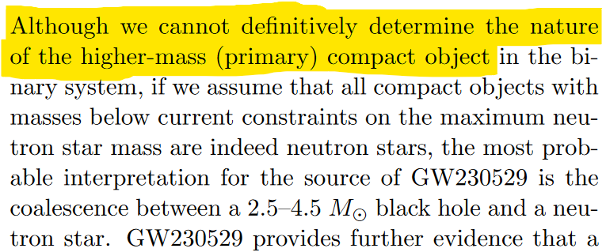
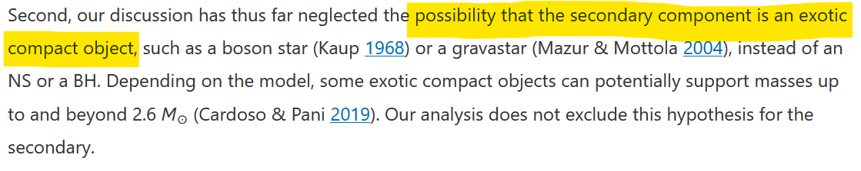
Gravitational waves: ECOs

Slide 5
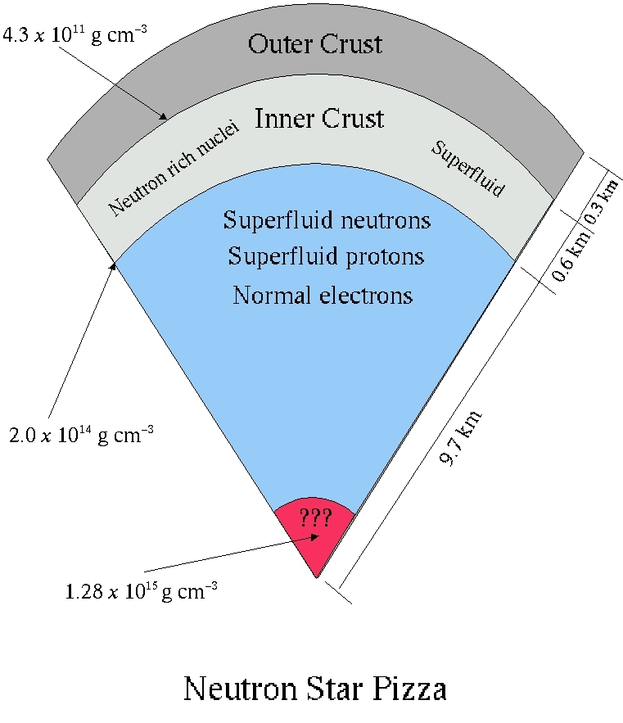
Gravitational waves
EM observations probe surface emission
GWs probe mass-distribution dynamics
  Inner structure
Tod Strohmayer’s Webpage: https://asd.gsfc.nasa.gov/Tod.Strohmayer/ns_intro.html

Slide 6
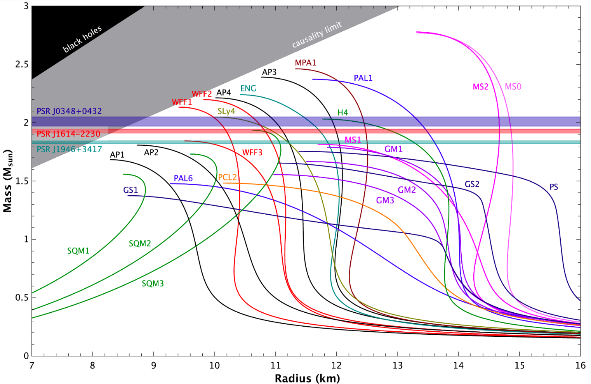
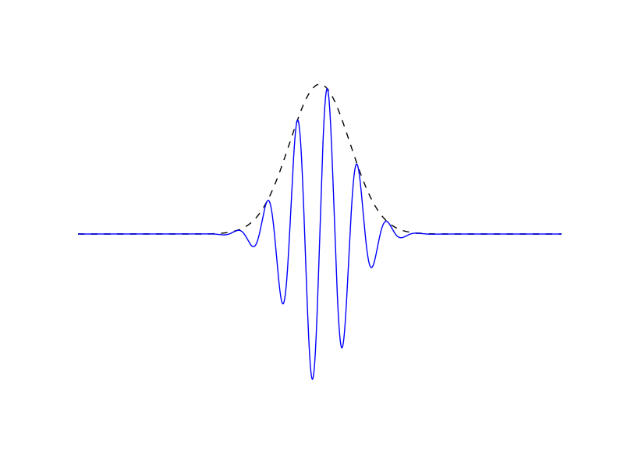
ECOs and how find them
Inspiral can pass through resonance of (E)CO
Leaves imprint on GW signal
Linked to composition of object → constrains EOS
Find something more exotic?
Basis of sine-gaussian wavelets to model resonance
Karsai S., Barnaföldi G., Forgacs-Dajka E. Correspondence of Many-flavor
Limit and Kaluza-Klein Degrees of
Freedom in the Description of
Compact Stars

Slide 7
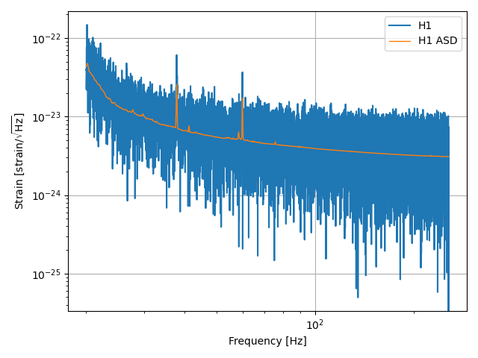
Gw inference
GW detector signals are noisy!
Different techniques to recover GW signal parameters
Here: Bayesian Inference

Slide 8

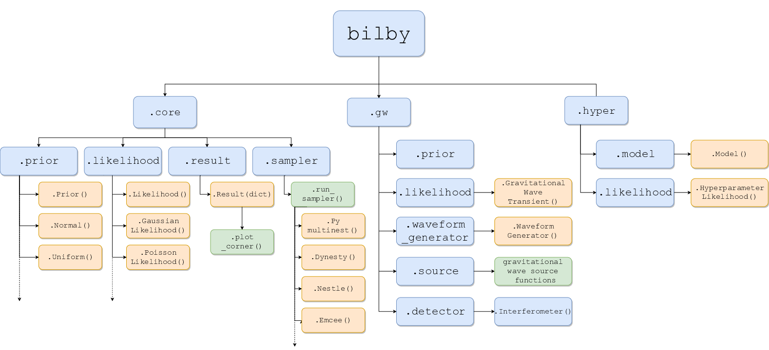
General purpose Bayesian Inference Library, but developed for GW science
Assumes gaussian detector noise
Inconvenient to hack
Bilby documentation: https://lscsoft.docs.ligo.org/bilby/index.html
Ashton G. et al. (2018). Bilby: A user-friendly Bayesian inference library for gravitational-wave astronomy

Slide 9
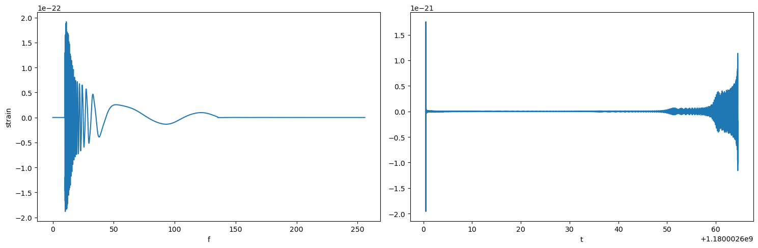
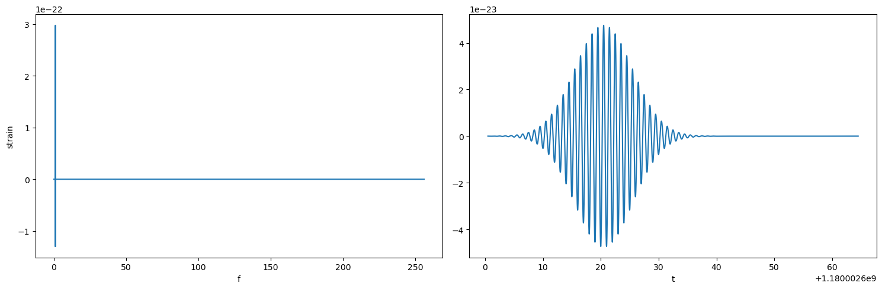
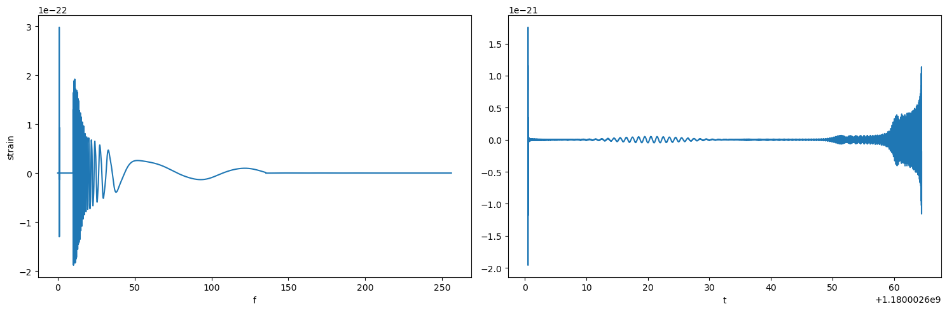
Bilby runs: injection
IMR signal
(Inspiral – Merger - Ringdown)
+
Wavelet
5 DOF: amplitude, width, time, frequency, phase
=
Composite signal
→ injected into detector noise

Slide 10
Bilby runs: recovery
Sampler (Dynesty, ptemcee, …)
Most extrinsic parameters fixed
Recovered parameters

Slide 11
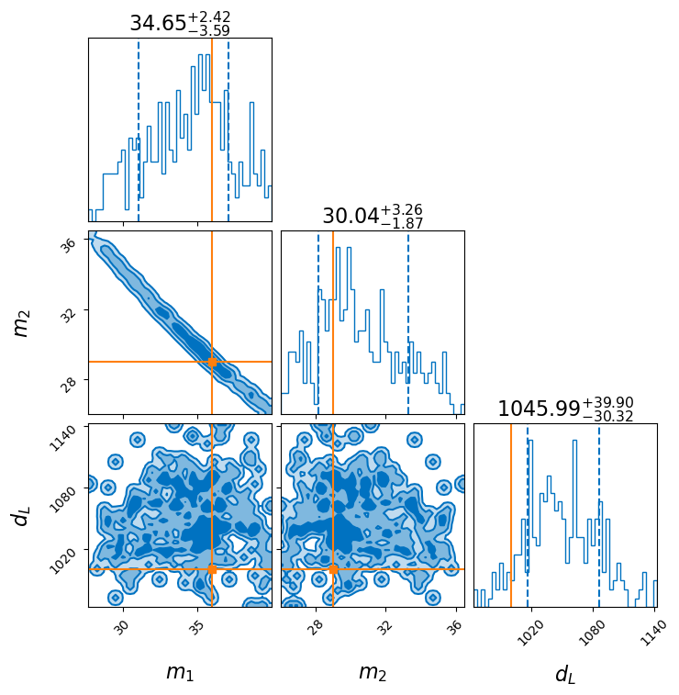
Corner plots
Visualise multi-dimensional data
On-diagonal: parameter distributions
Off-diagonal: parameter correlations

Slide 12
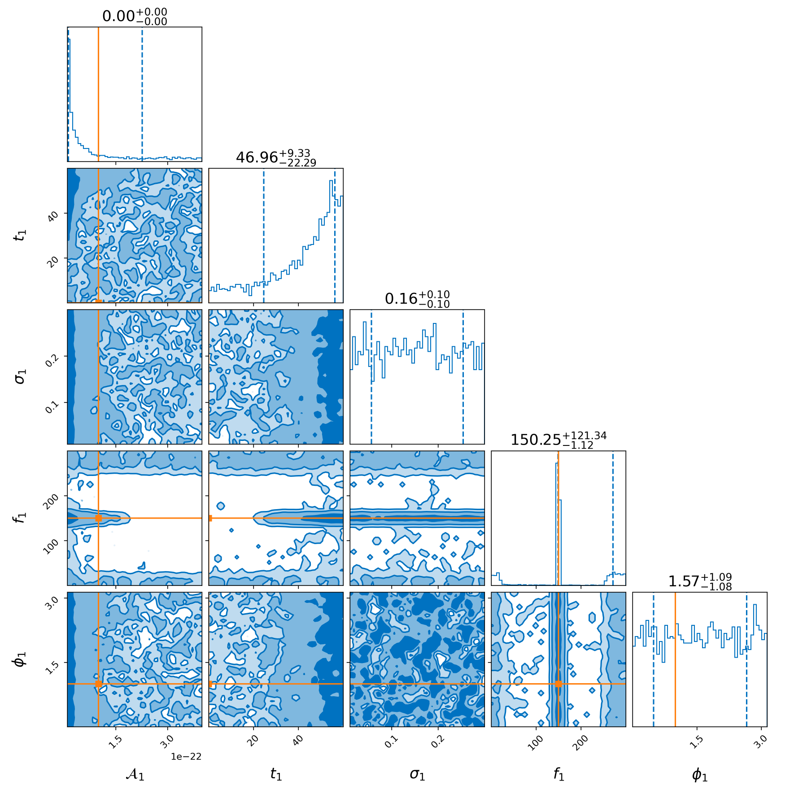
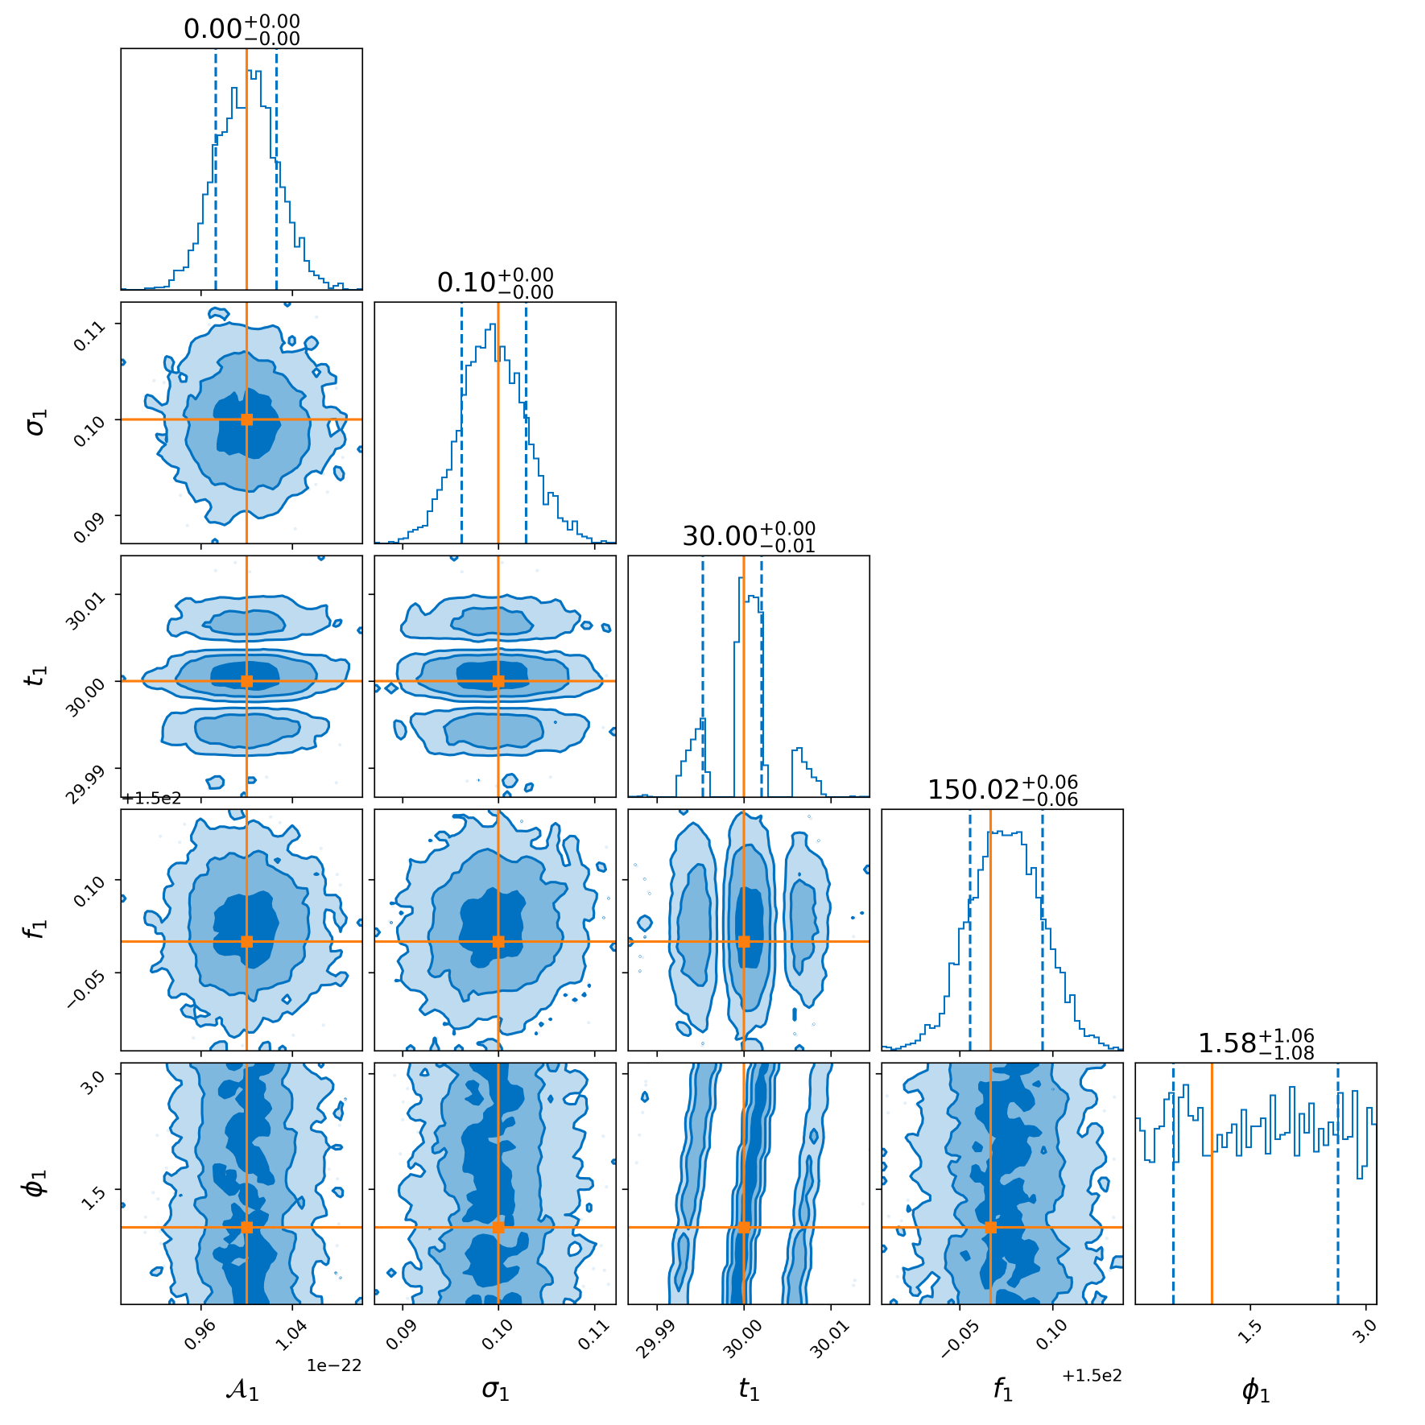
Bilby Results: IMR+wavelet (imr fixed)
Results for 2 different runs
First run is an older one with less suitable priors

Slide 13
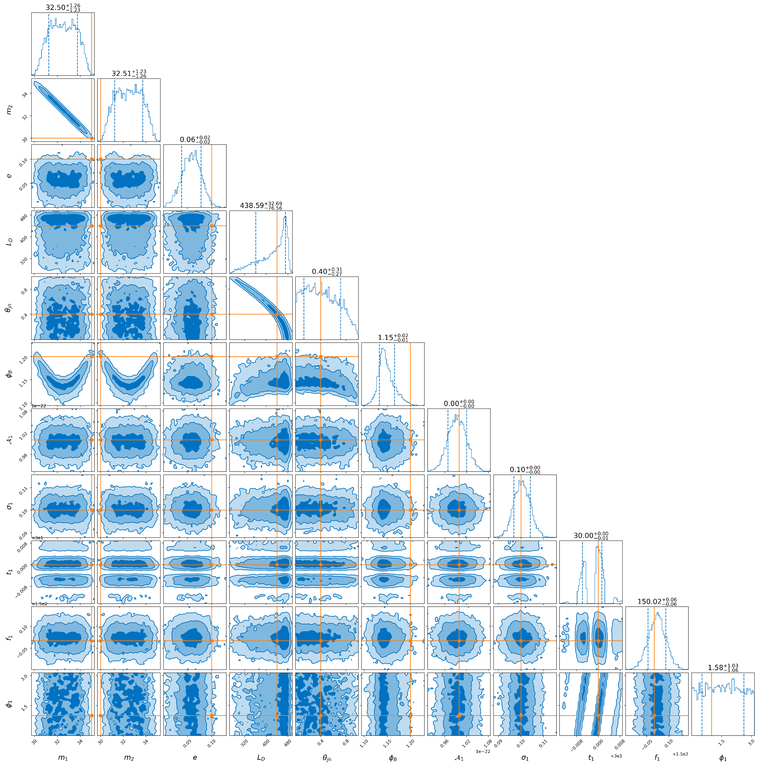
Bilby Results: imr + wavelet
Wavelet in inspiral

Slide 14
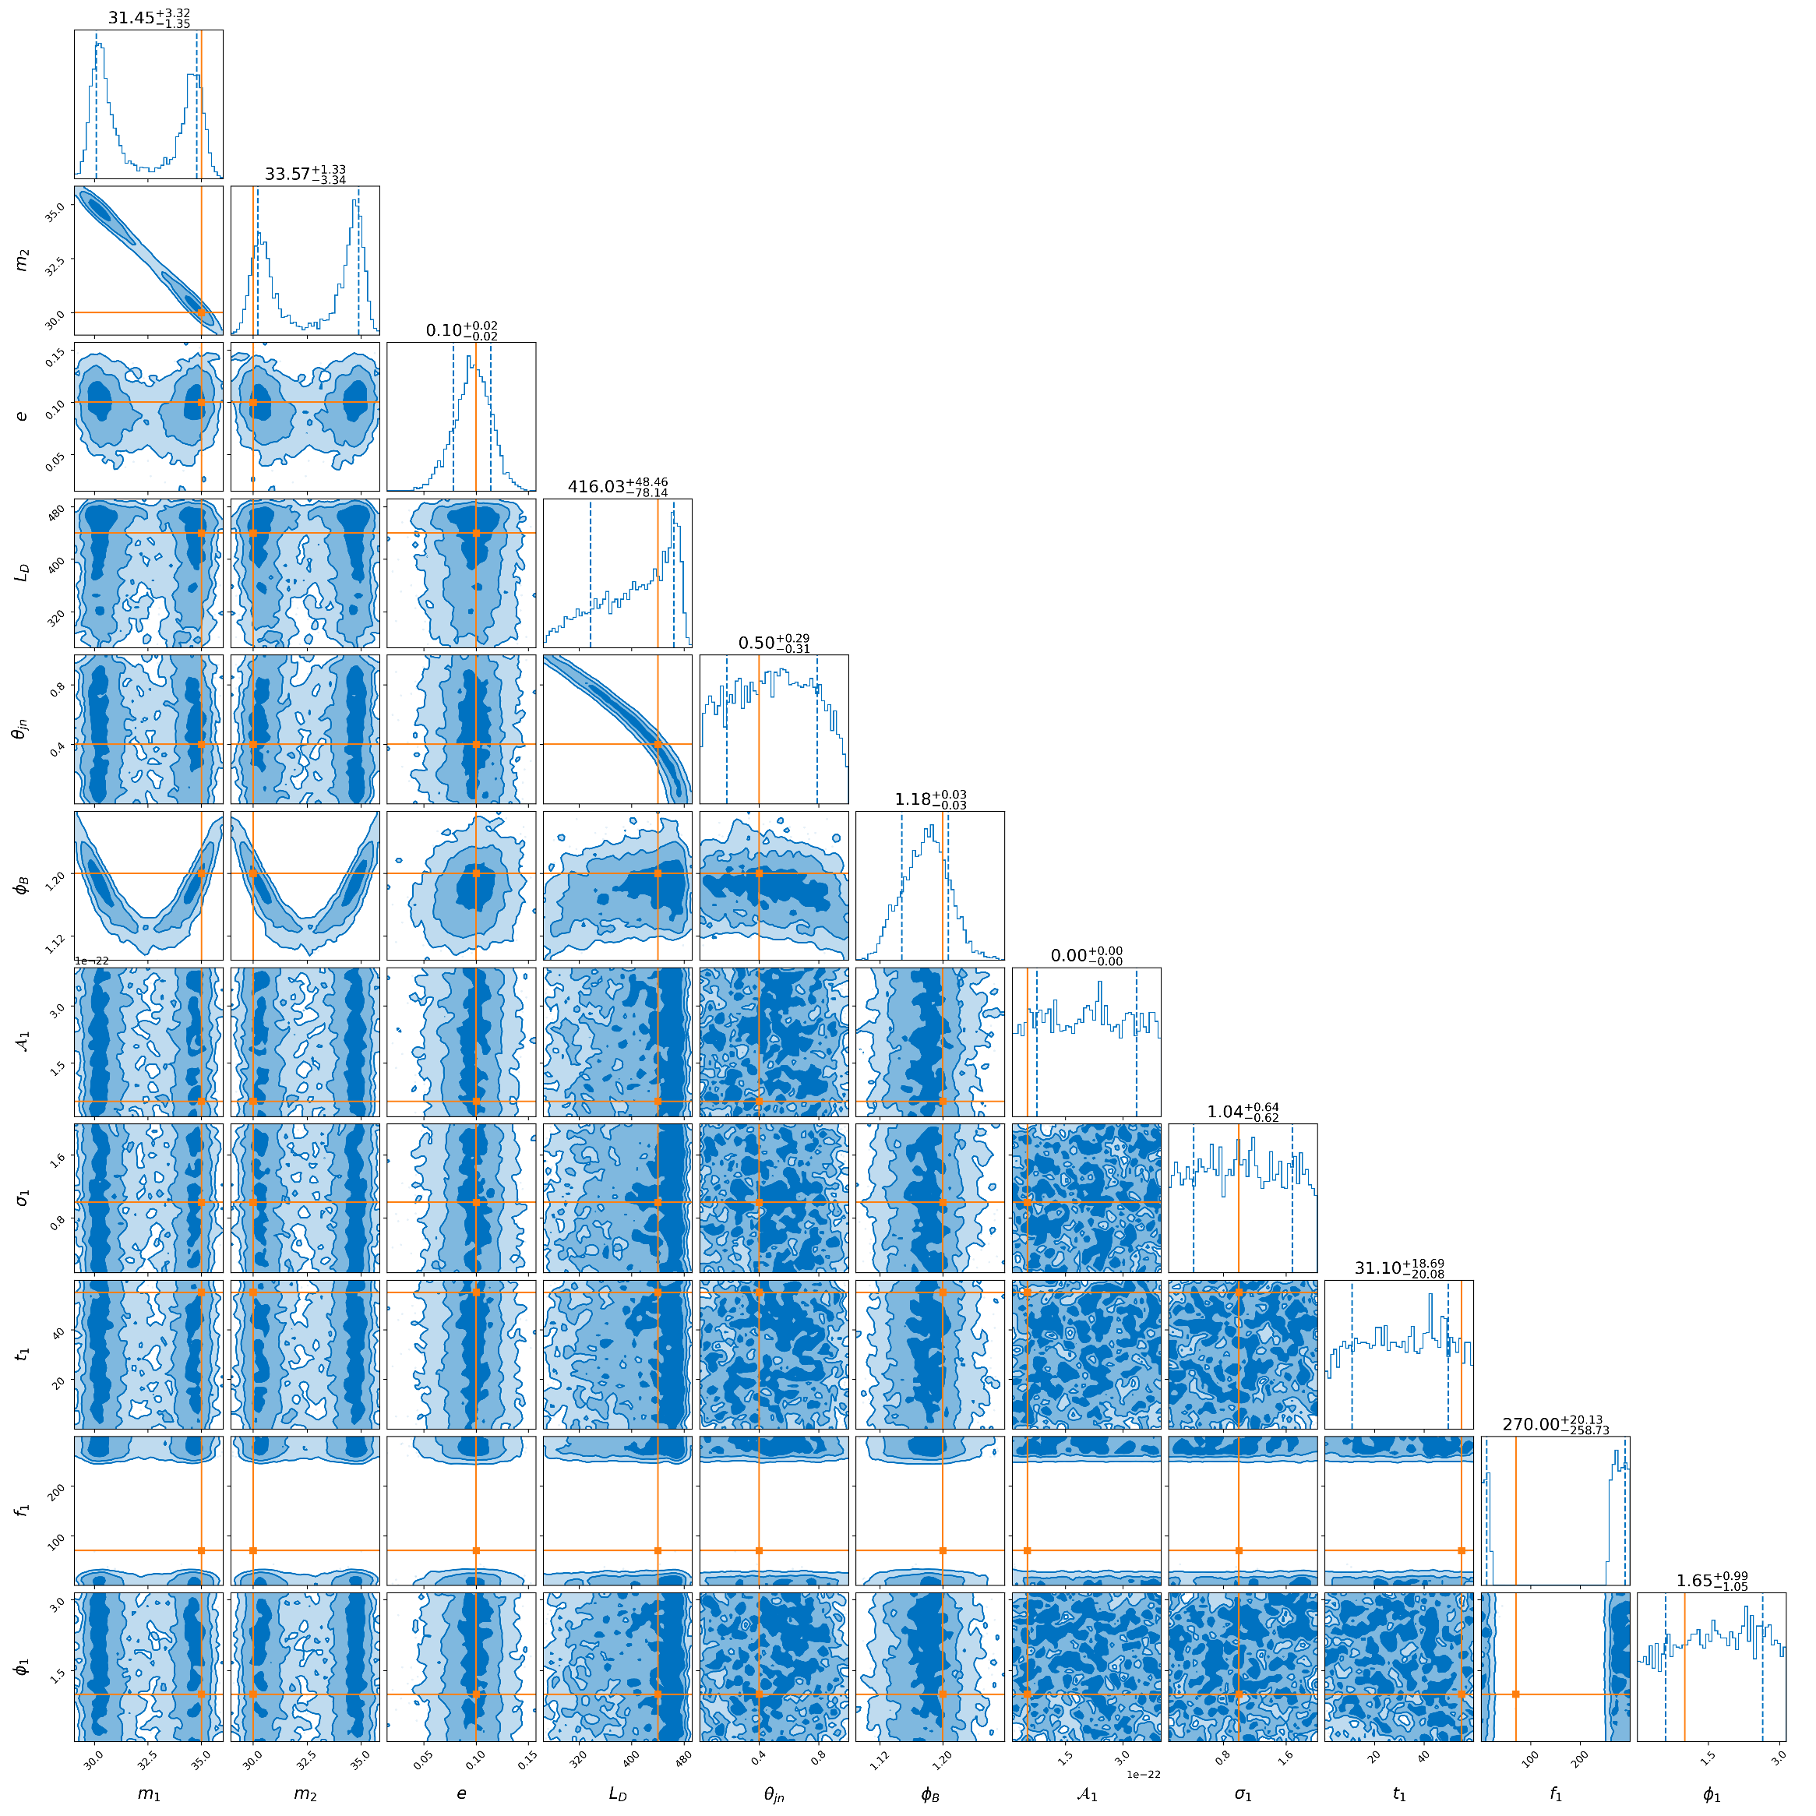
Bilby Results: imr + wavelet
Wavelet in merger

Slide 15
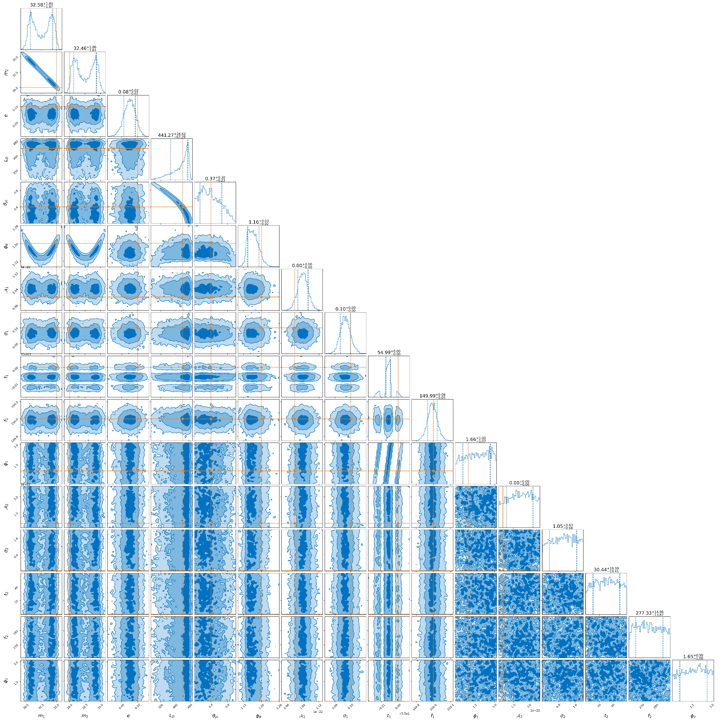
Bilby Results: imr + double wavelet
1 wavelet in merger
1 wavelet outside

Slide 16
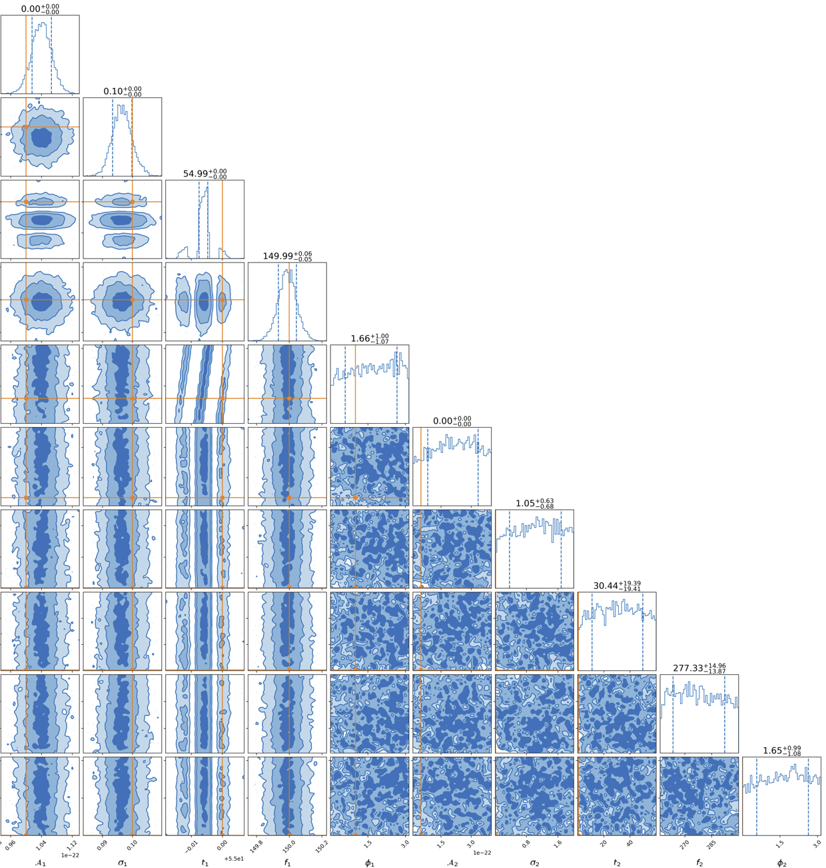
Bilby Results: imr + double wavelet
(zoomed in on wavelet parameters)

Slide 17
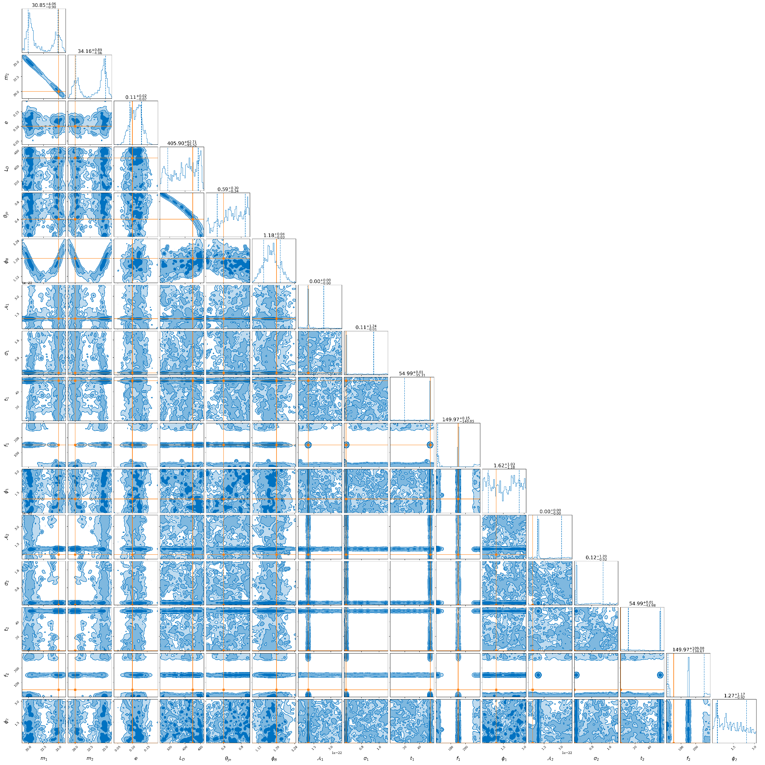
Bilby Results: imr + double wavelet
(ptemcee)
1 wavelet in merger
1 wavelet outside

Slide 18
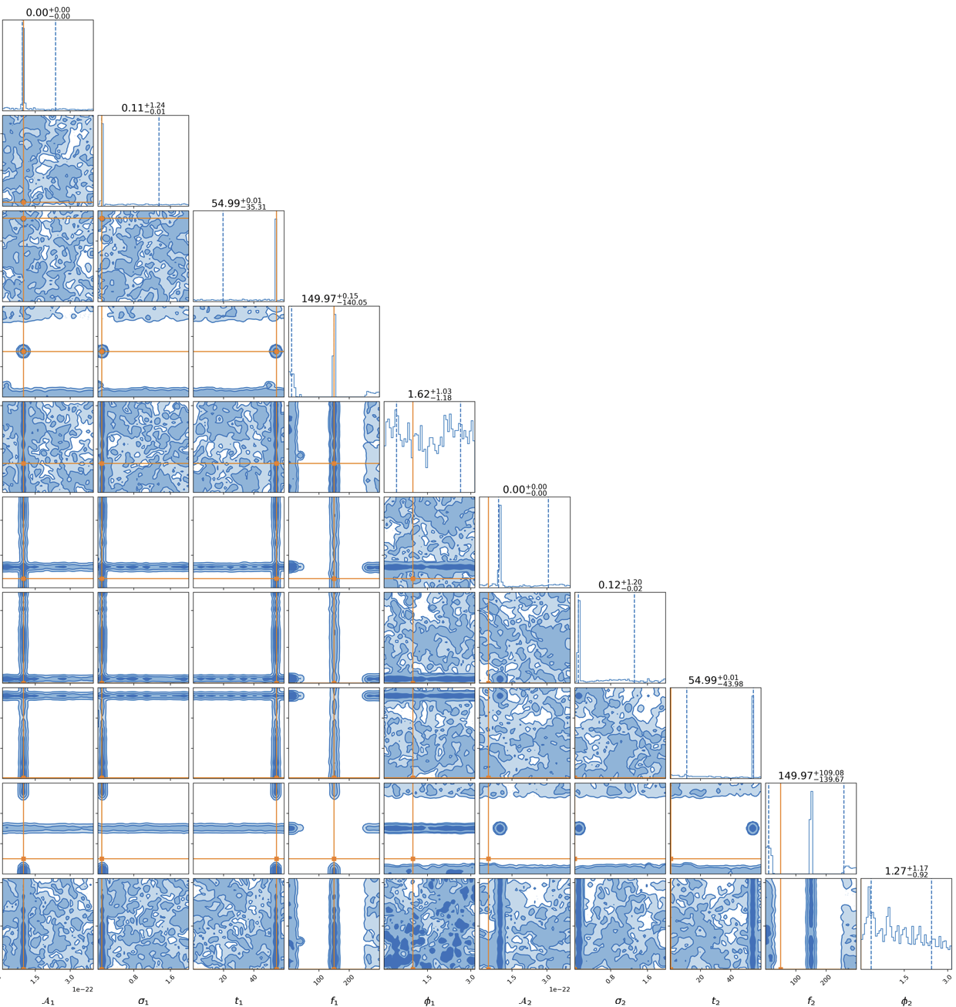
Bilby Results: imr + double wavelet
(ptemcee)
(zoomed in on wavelet parameters)

Slide 19
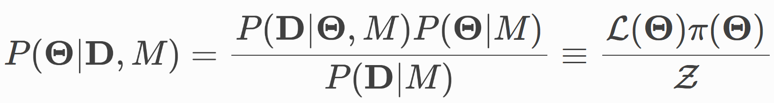
Dynesty vs ptemcee
(pt)emcee: (Parallel-tempered) MCMC
  Solve hard problem ONCE: distribution proportional to posterior
dynesty: Dynamic Nested sampler
  Solve easy problem MANY TIMES: sample inside iso-likelihood contour
  Estimate posterior AND evidence (latter allows for model comparison)
  Informative priors needed
Likelihood
Prior
Posterior
source: Dynesty documentation
Evidence

Slide 20
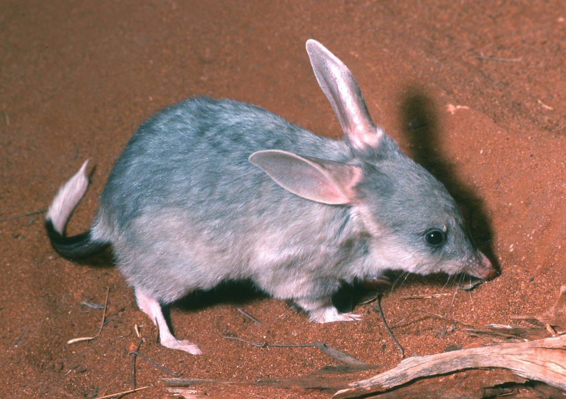
tbilby
Each wavelet adds 5 DOF => computational cost!
Use tBilby
Transdimensional Bilby
t

Slide 21
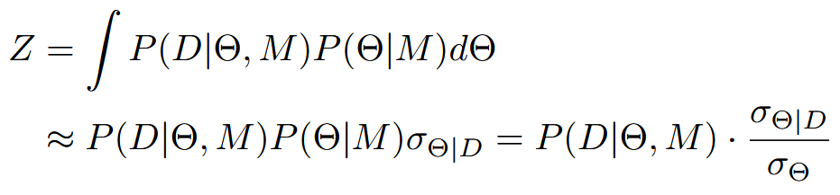
Transdimensional sampling
Dimensionality N = sampling parameter
  Reversible Jump MCMC
Posterior penalised by Occam factor (weighs model complexity)
Prior volume
Posterior volume

Slide 22
tbilby
tBilby samples in full N, but evaluates likelihood over
≤ N
Sampling from priors = cheap
Evaluating likelihood = expensive
Patched a possible bug in code

Slide 23
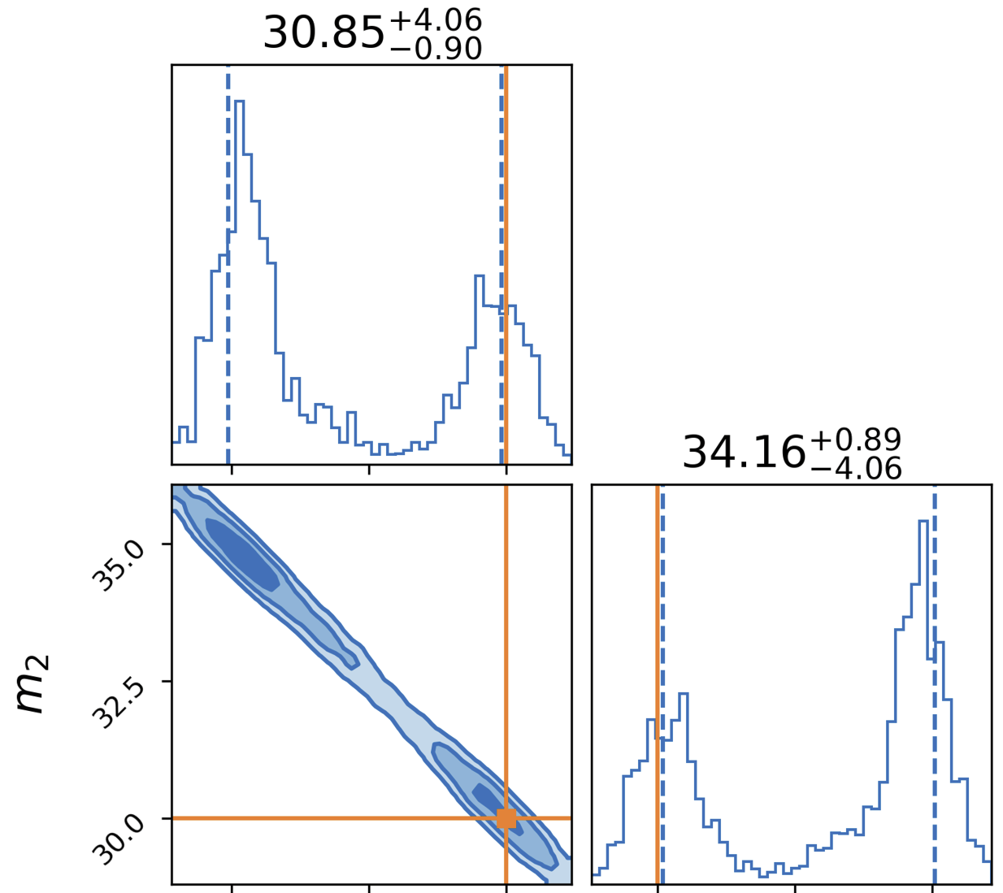
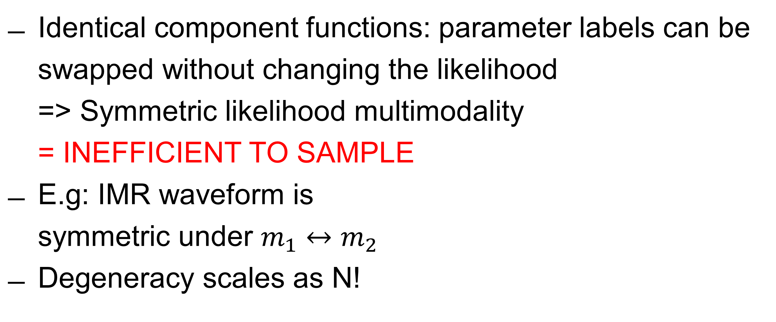
Tbilby: order statistics
Identical component functions: parameter labels can be swapped without changing the likelihood
=> Symmetric likelihood multimodality
= INEFFICIENT TO SAMPLE
E.g: IMR waveform is
symmetric under $m_{1}↔m_{2}$
Degeneracy scales as N!

Slide 24
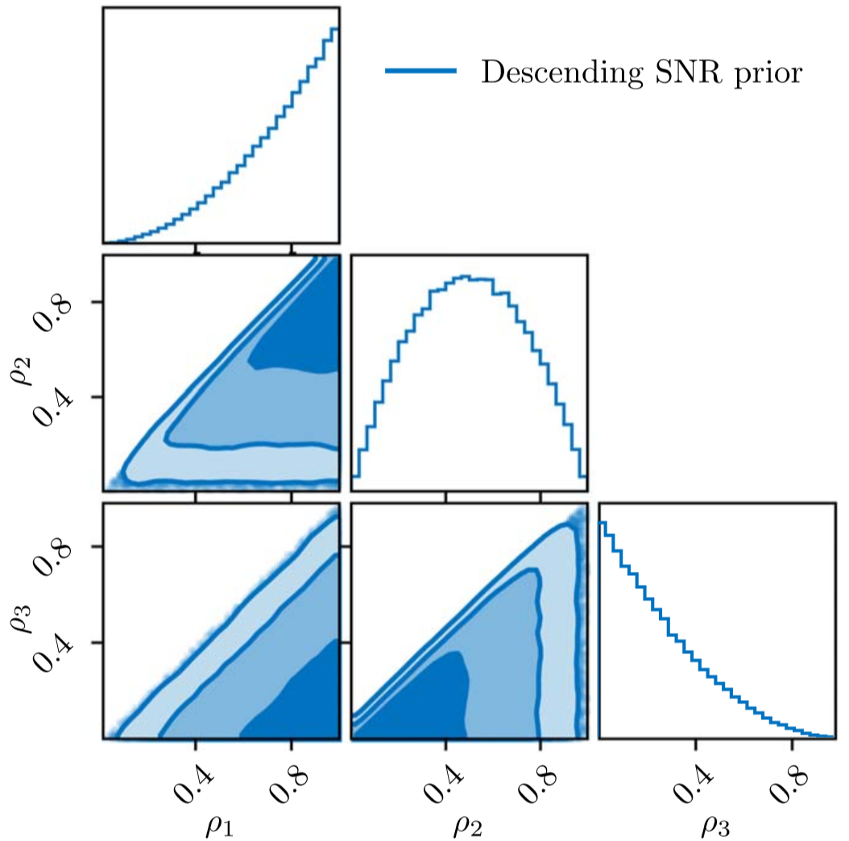
Tbilby: order statistics
(a) SOLUTION: break symmetry
Rank/order component functions (wavelets)
Wavelets can be ordered by time, frequency, SNR, …
SNR is most natural: loudest wavelet most likely to be found first
Ordering adopted in the priors
Transdimensional Inference for Gravitational-wave Astronomy with Bilby (2025), Tong H. et. al

Slide 25
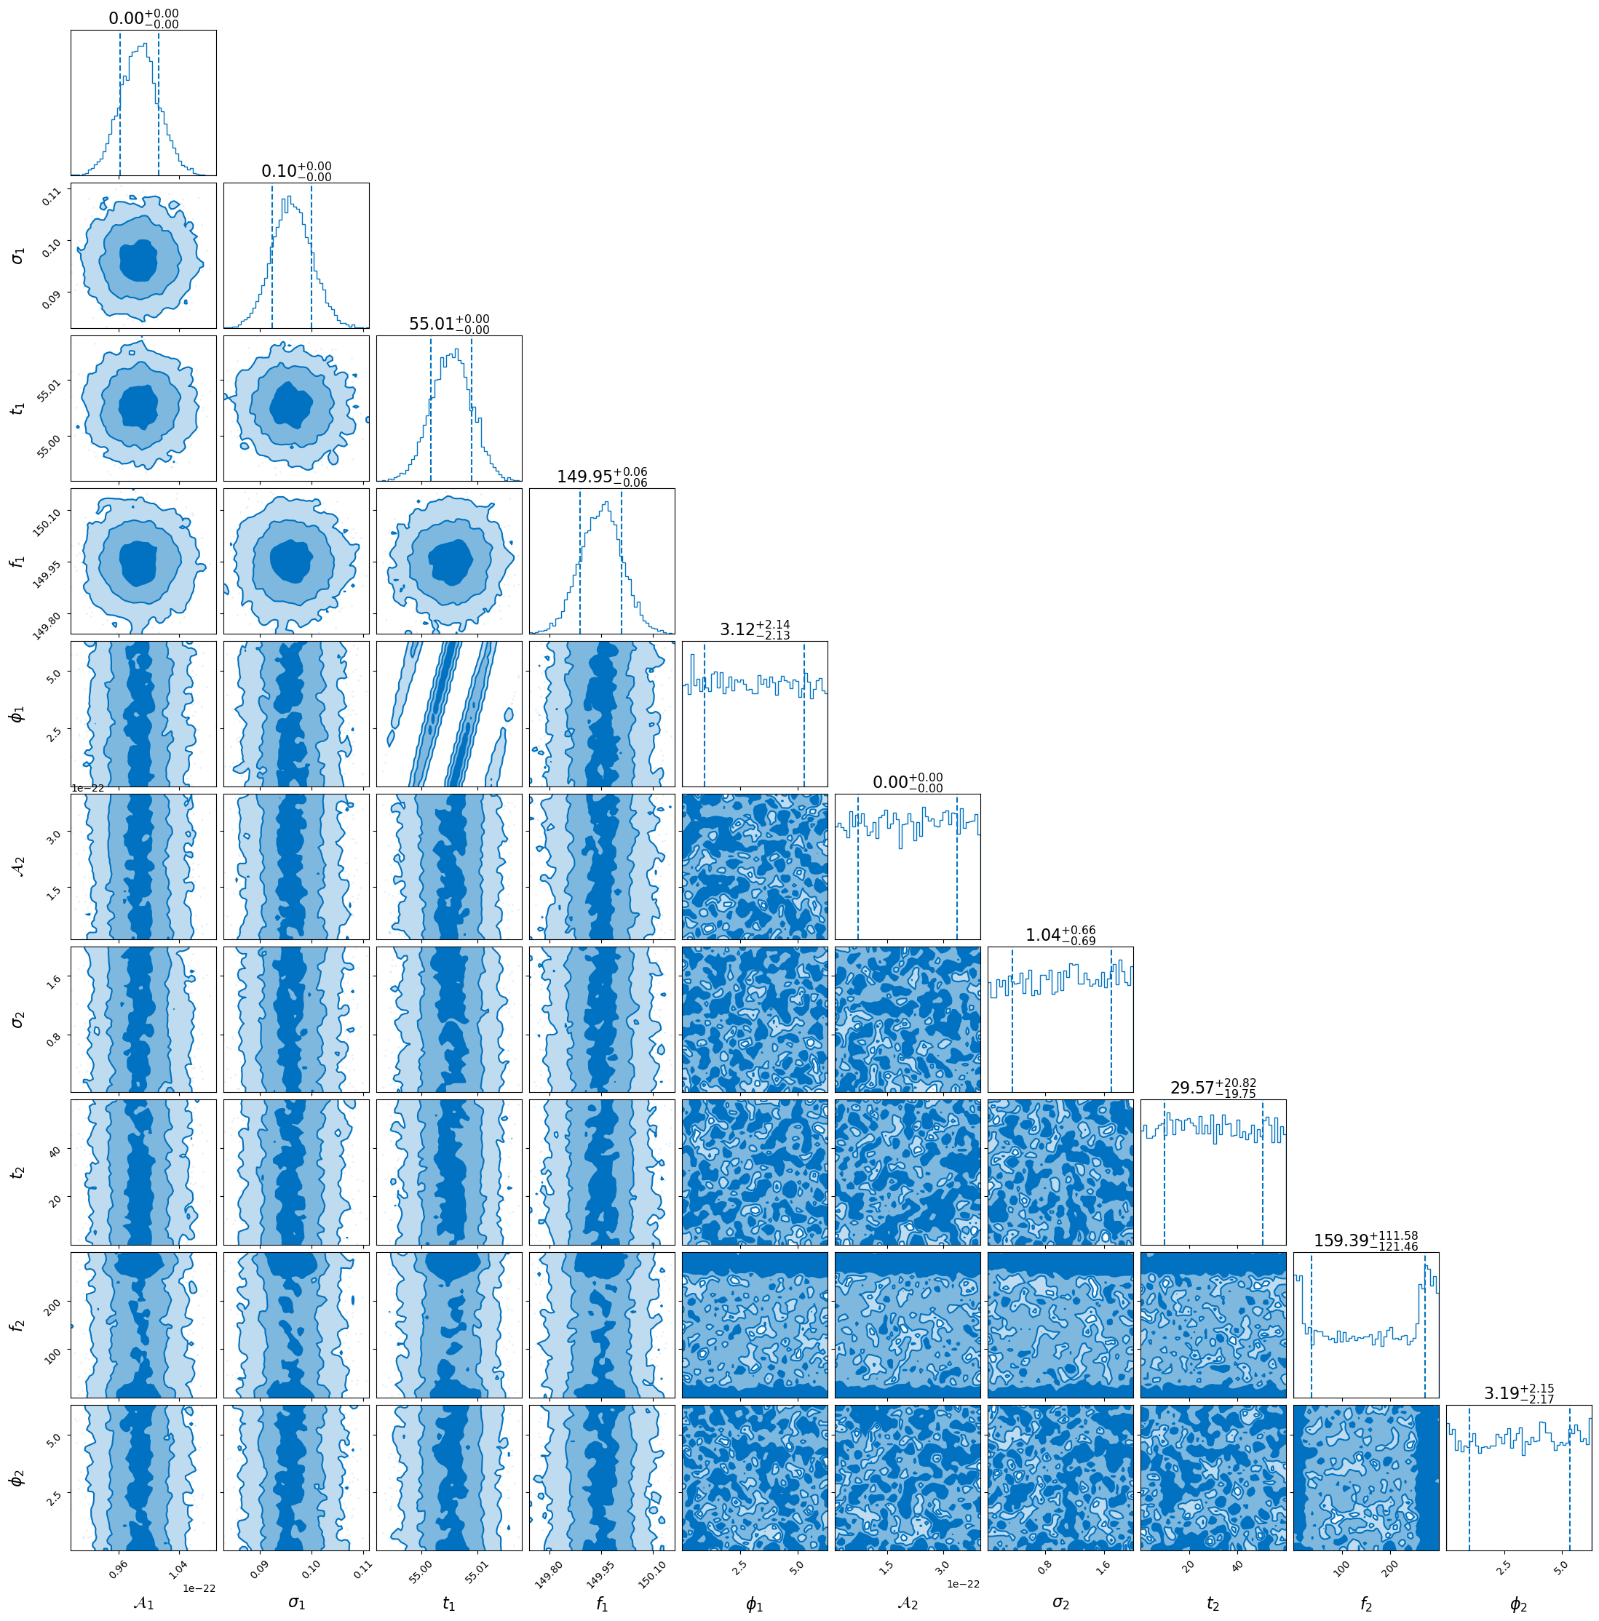
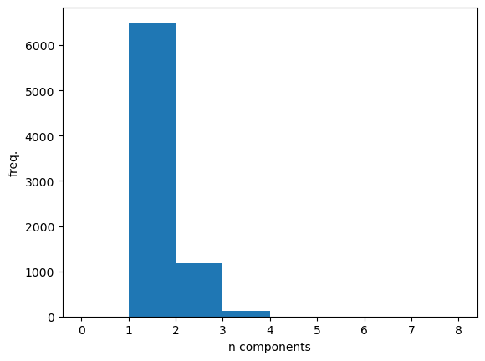
Tbilby results
2 wavelets injected
Time ordering
Only 1 recovered
  Loudest wavelet

Slide 26
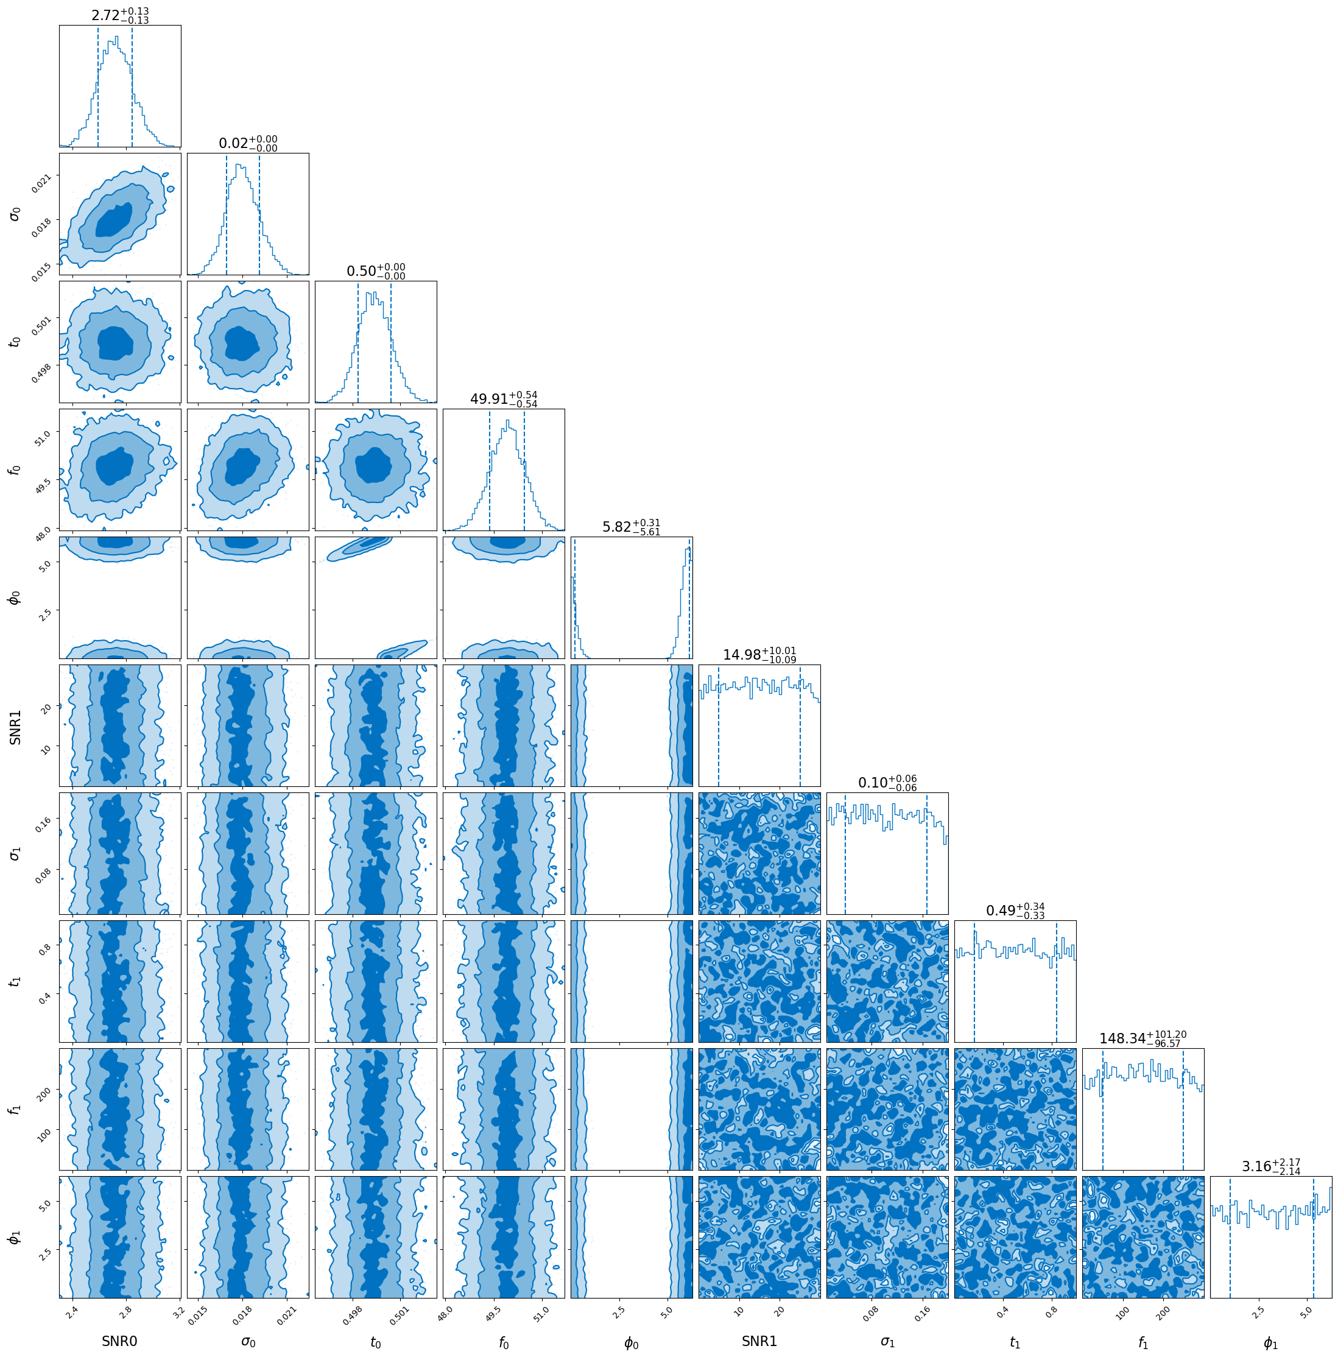
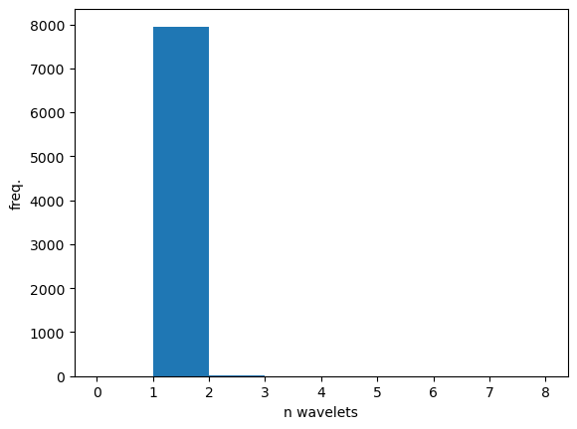
Tbilby results:
2 injected wavelets
Very strong preference for loudest wavelet
Same for different runs

Slide 27
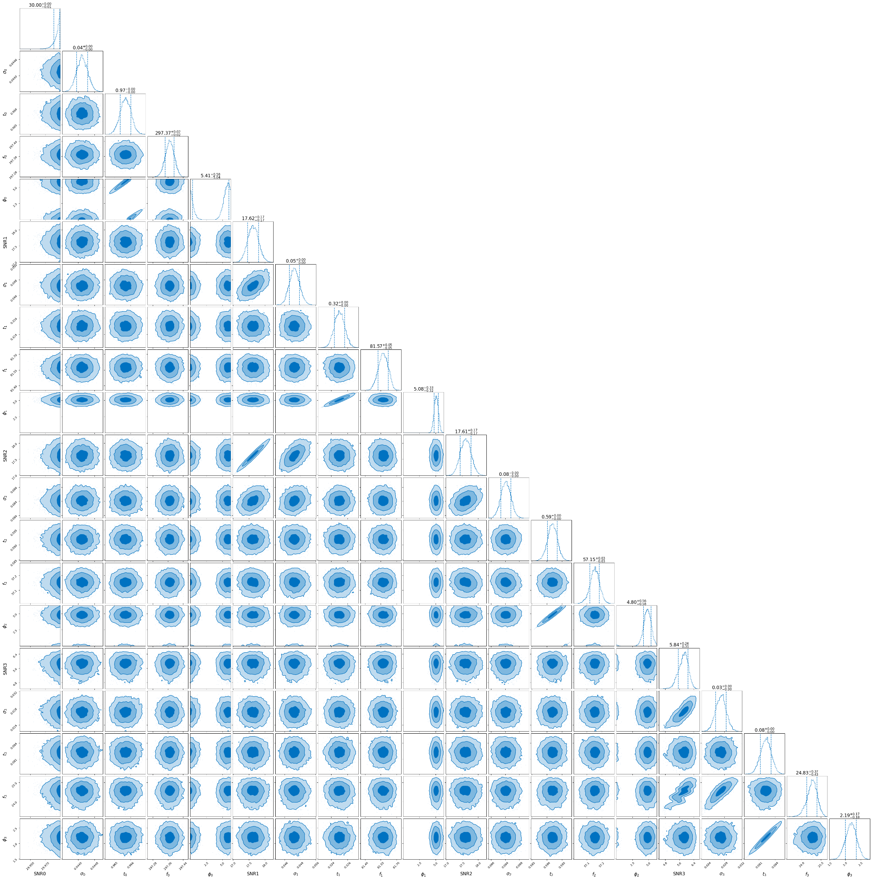
Tbilby results:
4 random wavelets
Corner plots get very messy

Slide 28
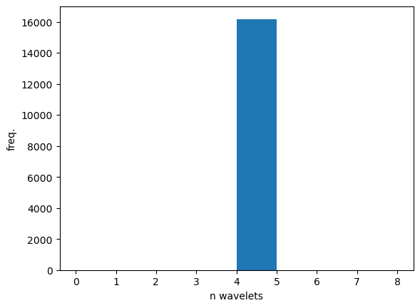
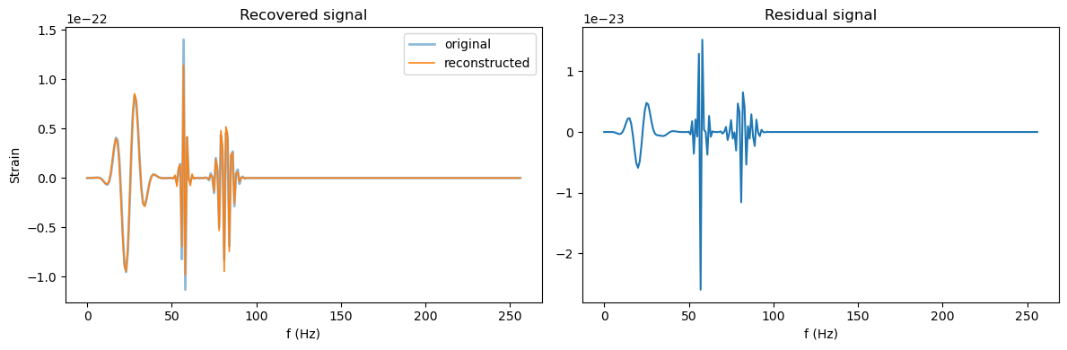
Tbilby results:
tBilby only sampled in 4 wavelets
Lucky initial guess?
Saturated the SNR prior

Slide 29

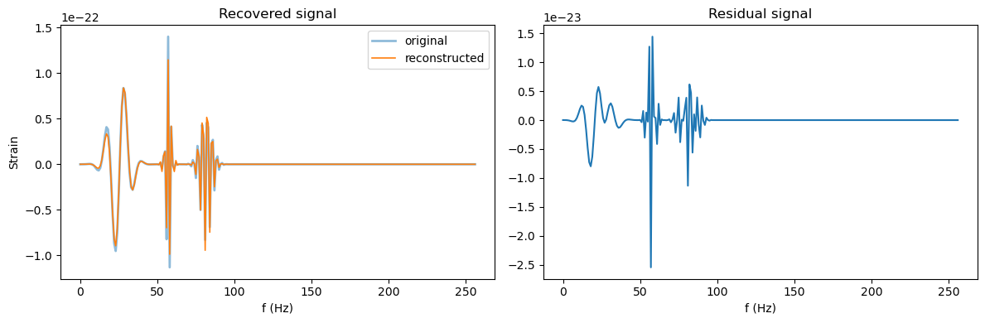
Tbilby results:
Second run confirms result
Does tBilby only work well on complex signals?

Slide 30
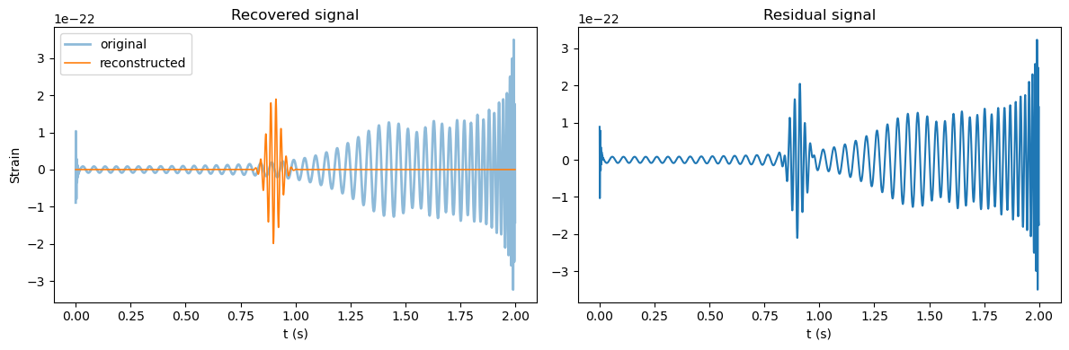

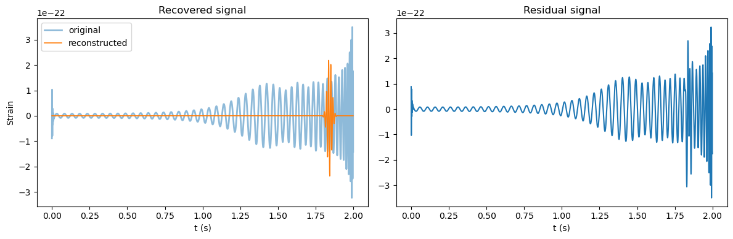
Tbilby results: BBH
Nmax = 8
Only modelled with 1 wavelet each time

Slide 31
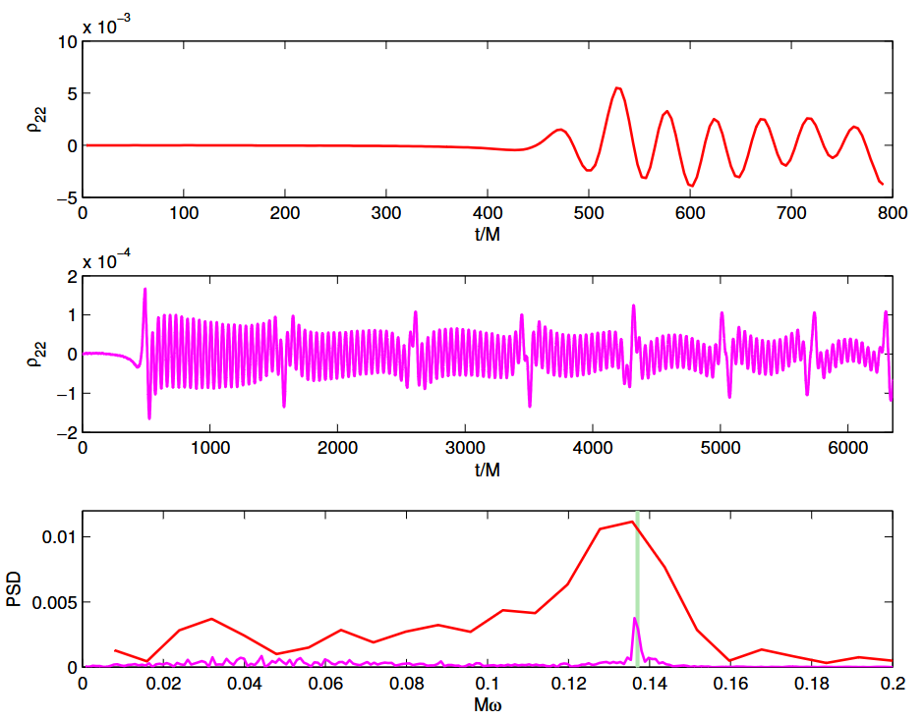
NR waveforms with resonances
Useful as a final test
NR waveforms are expensive and thus rare!
Found a few people who have such waveforms
Gold R. et al. (2013), Eccentric binary neutron star mergers

Slide 32
Next steps
See what tBilby authors have to say about my patch
  Perhaps I broke the code
Modify sampling parameters
  σ → Q (quality factor)
tBilby: IMR + wavelet(s)
  tBilby can model multiple resonances
Test on NR waveforms
, again

Slide 33



Robin Chan
Experimental Particle Physics and Gravity
E robin.chan@ugent.be www.ugent.be
Universiteit Gent
@ugent
@ugent
Ghent University

