Slide 1
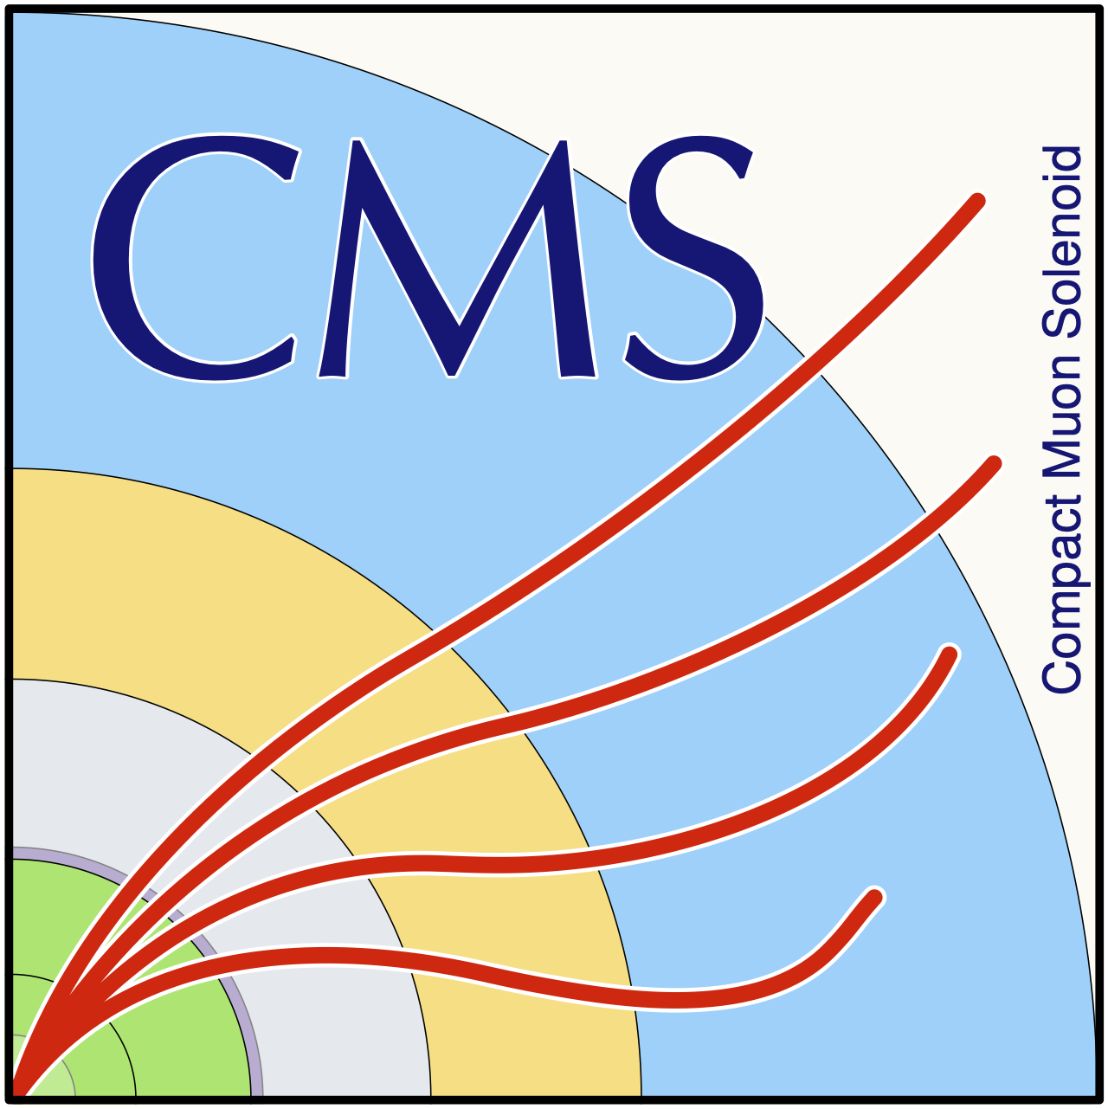
Measuring spin correlations in diboson systems with CMS
department Of physics and astronomy
  research group elementary particle physics and gravity
Gill Jacobs, 13/03/2025

Slide 2
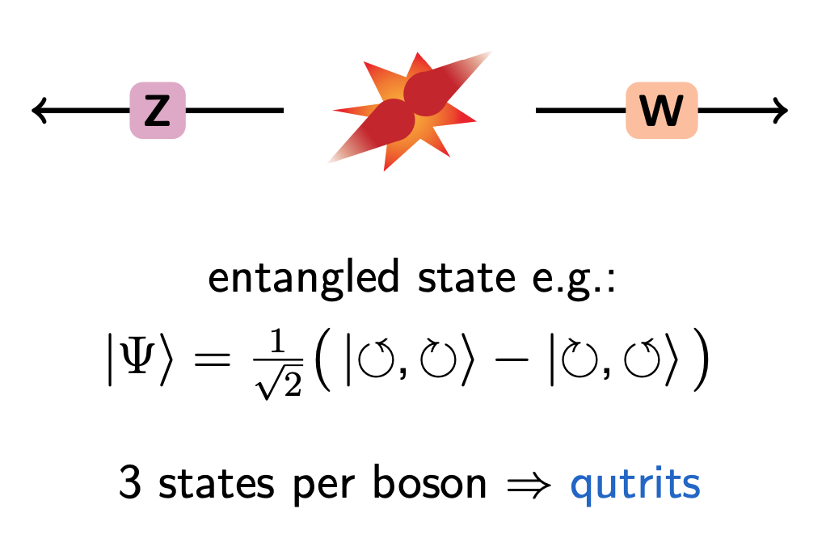
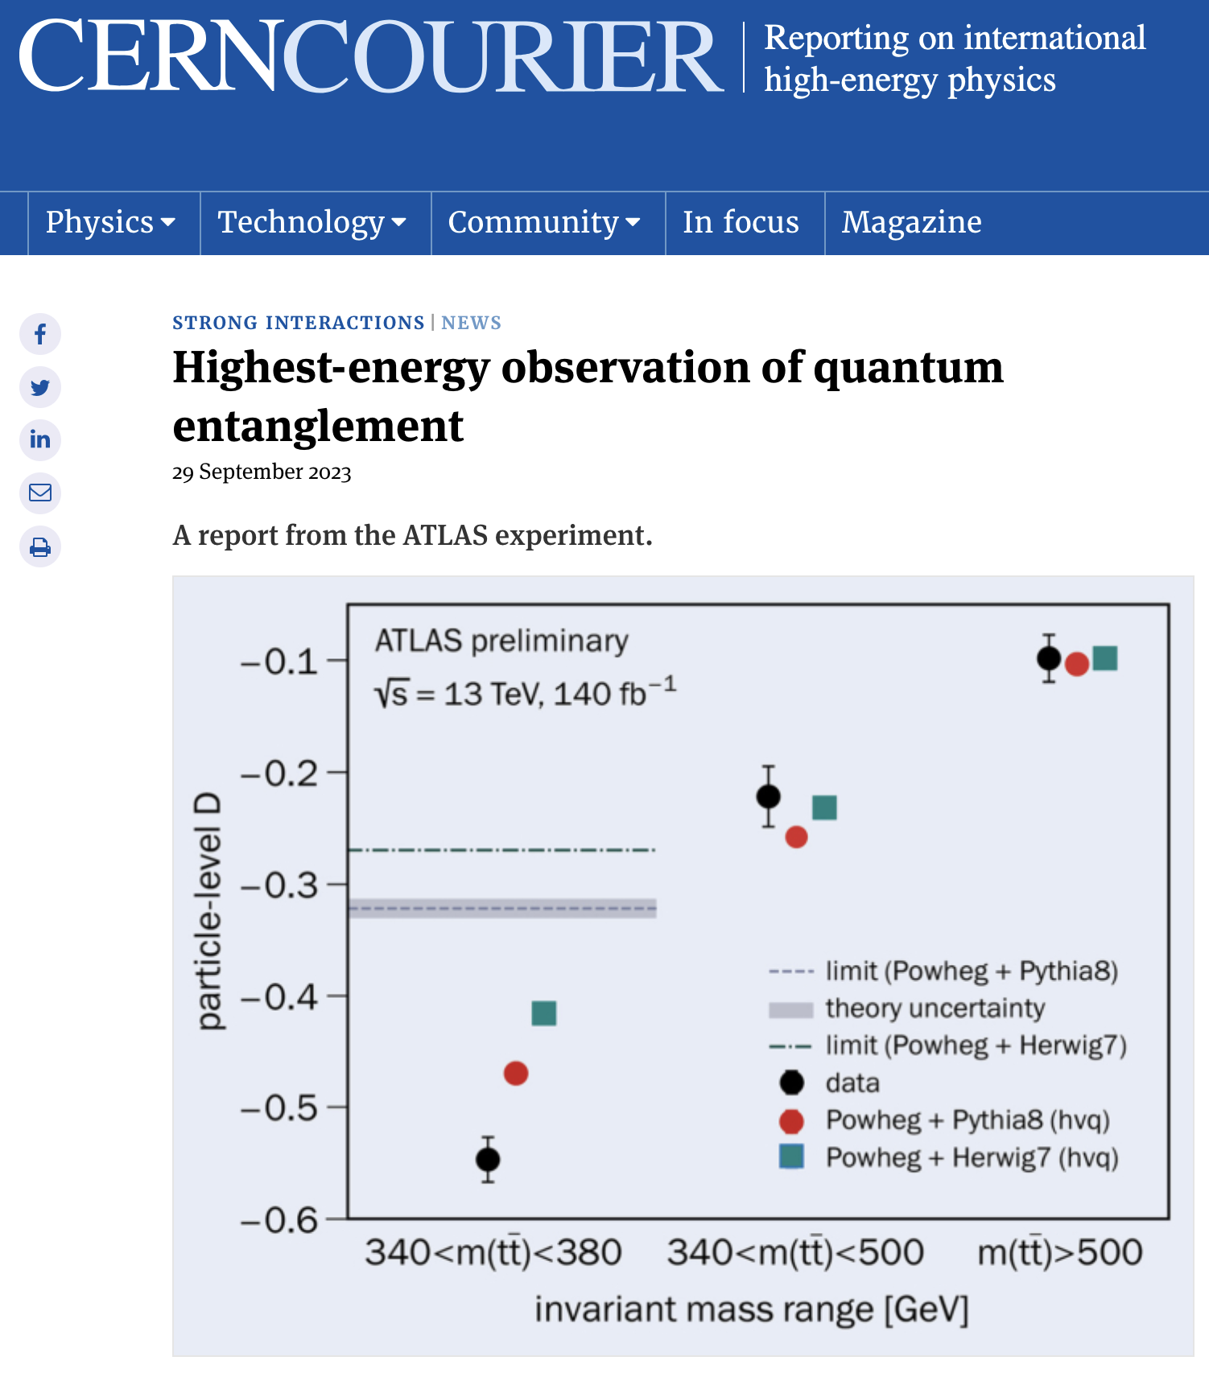
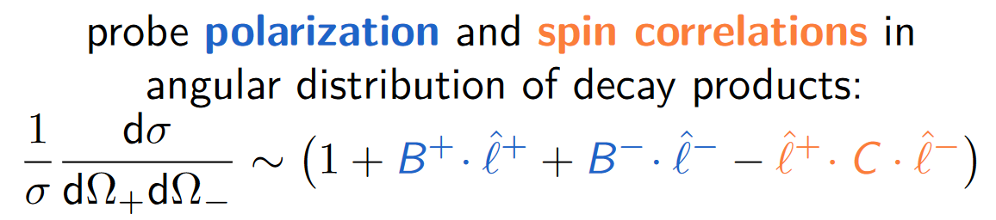
Particle physics and entanglement
https://cerncourier.com/a/highest-energy-observation-of-entanglement/

Slide 3
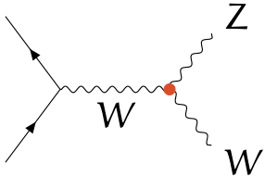
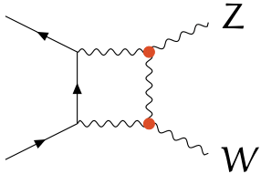
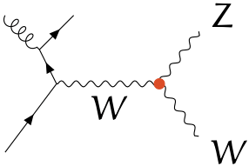
WZ self-interaction

Slide 4
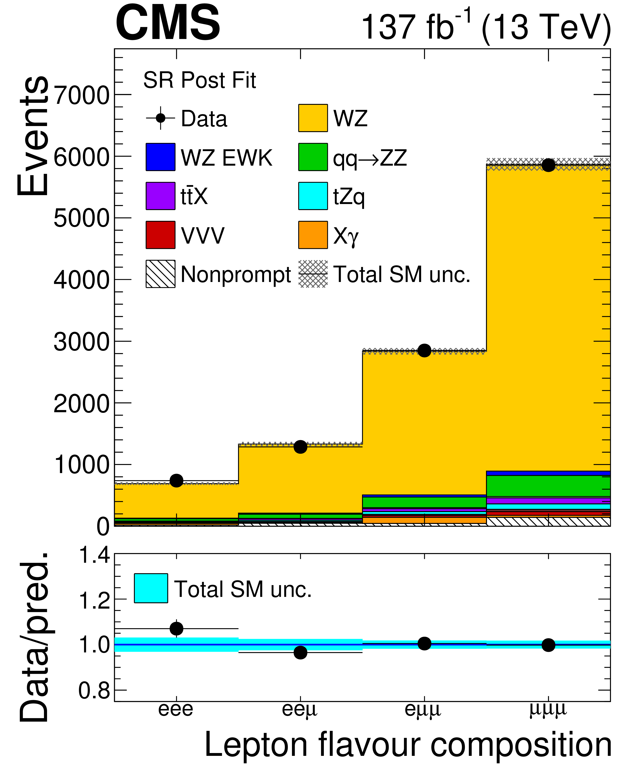
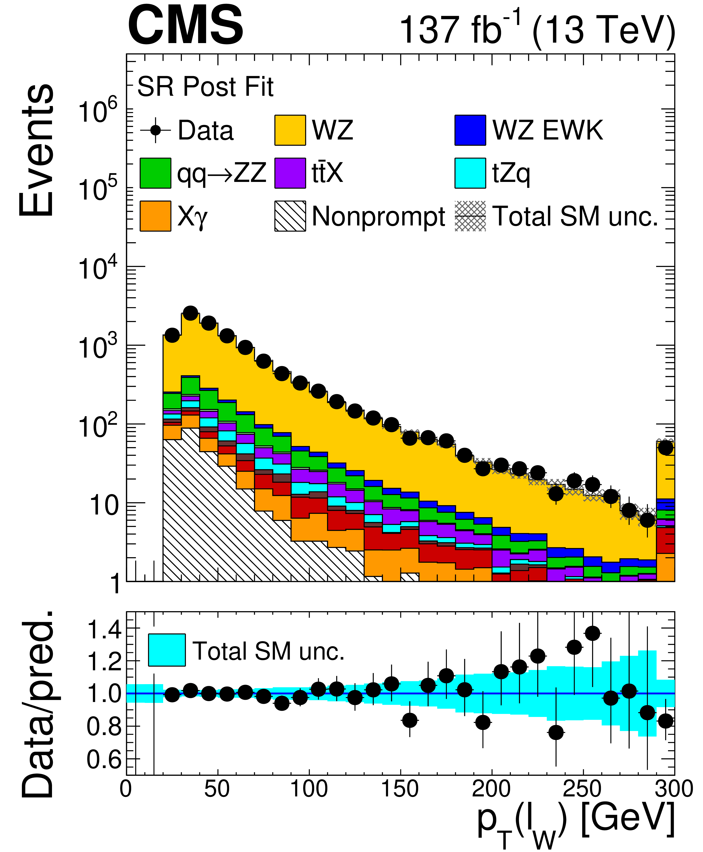
How to measure WZ events
We select the following events:
Exactly 3 leptons (electrons or muons)
Exactly 1 opposite-sign pair of same-flavour leptons with invariant mass M(ℓℓ) ~ M(Z)
p_{T}^{miss} > 30 GeV
JHEP 12 (2024) 120

Slide 5
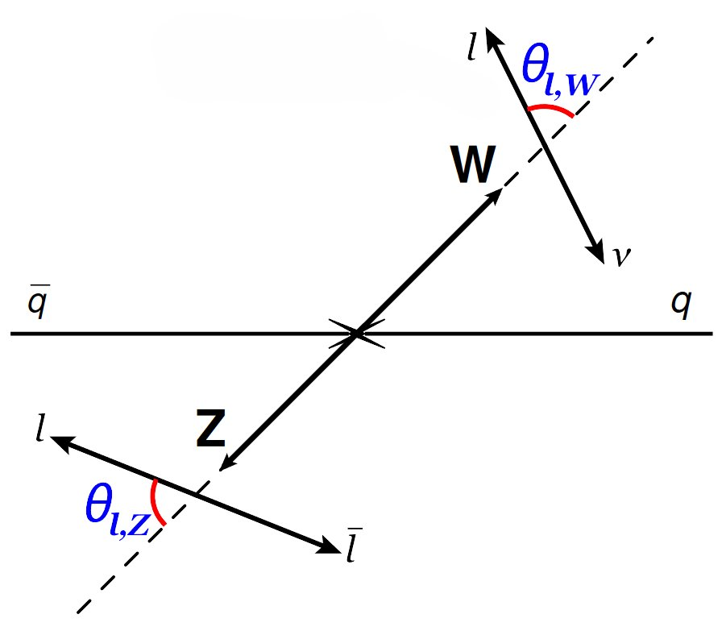
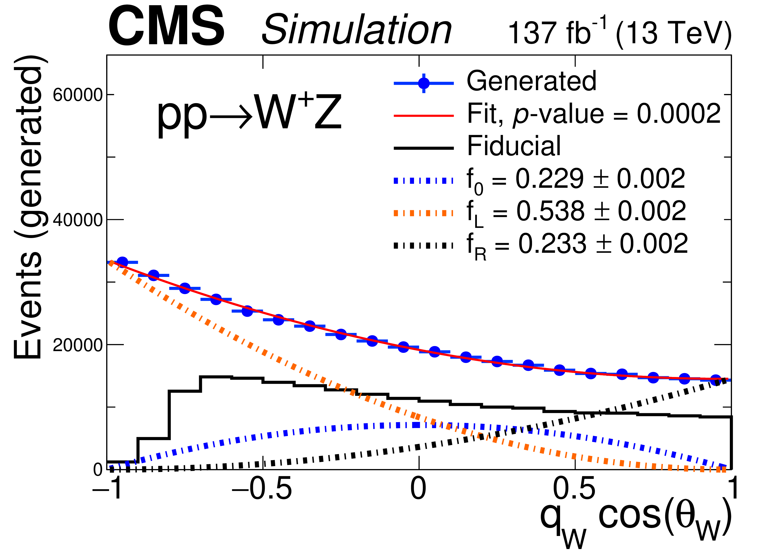
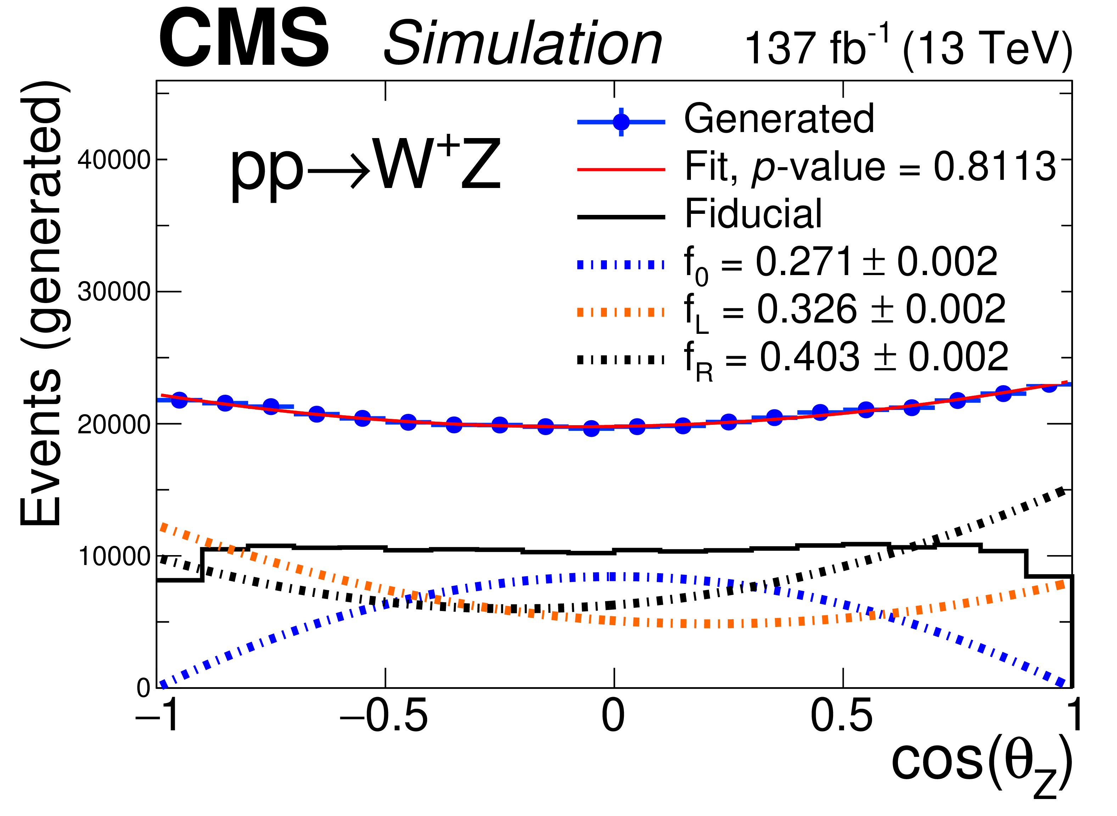
Previous CMS results: polarization fractions
Eur.Phys.J.C 79 (2019) 6, 535
JHEP 12 (2024) 120

Slide 6
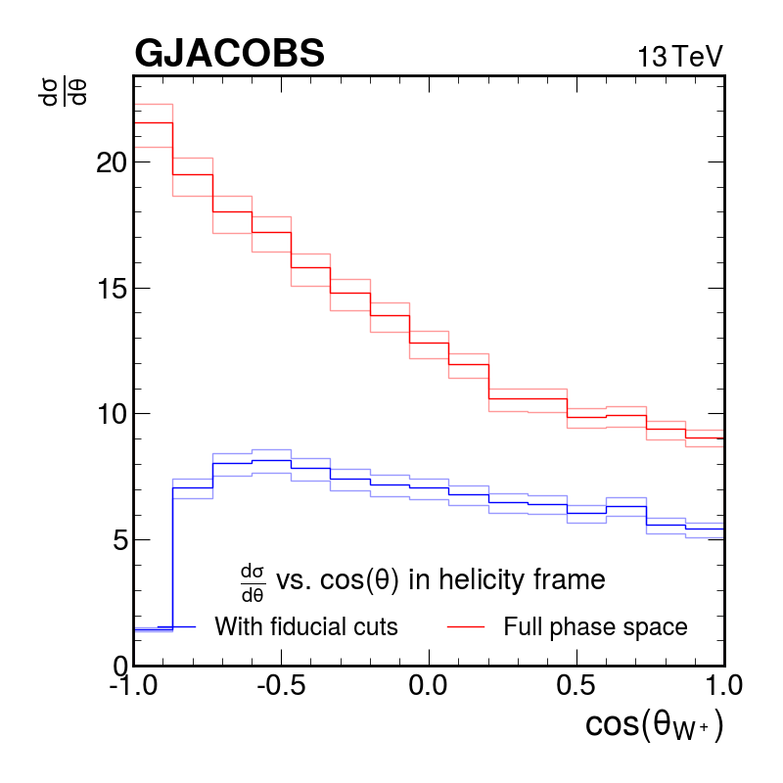
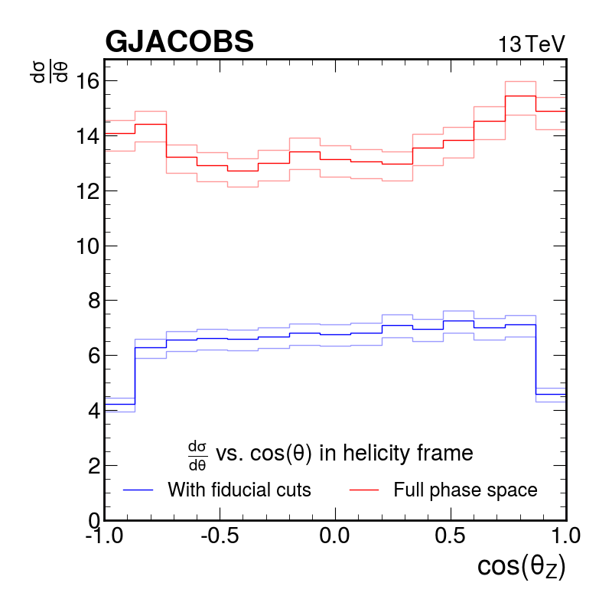
MATRIX results

Slide 7
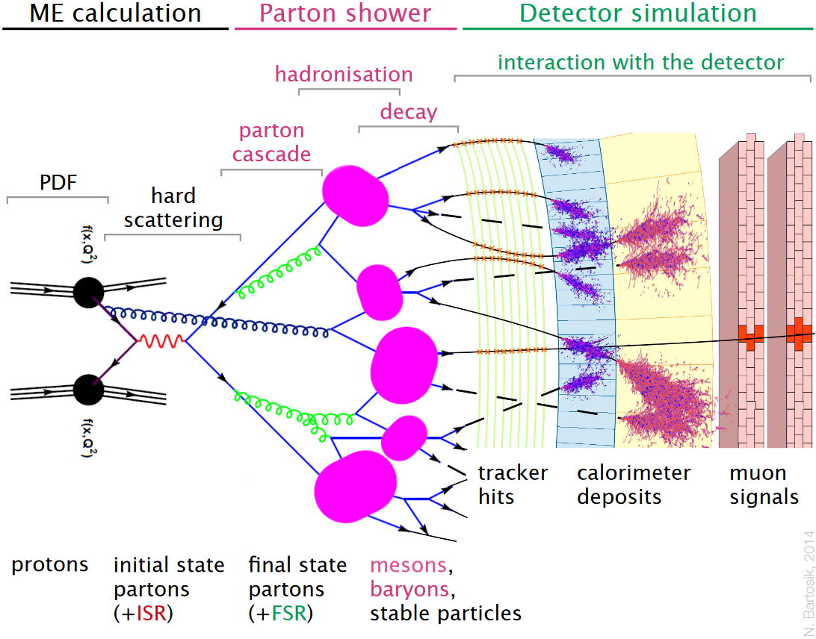
Monte Carlo event generation
POWHEGv2
PYTHIA8
MG5_AMC@NLO variation
Geant4 (CMS)
Courtesy of Juan Darte

Slide 8
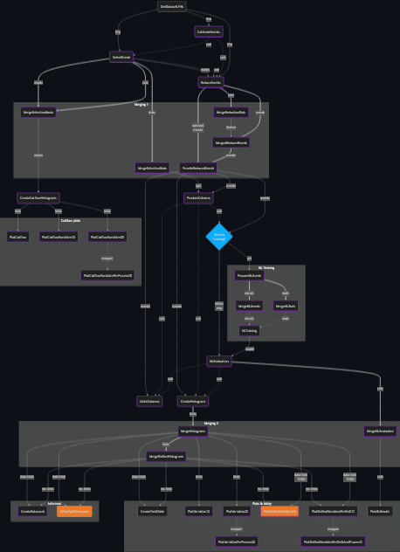
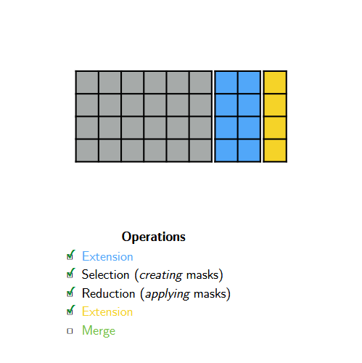
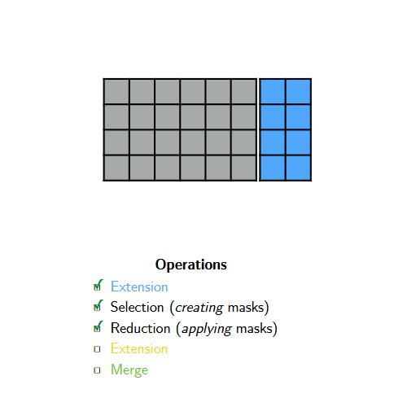
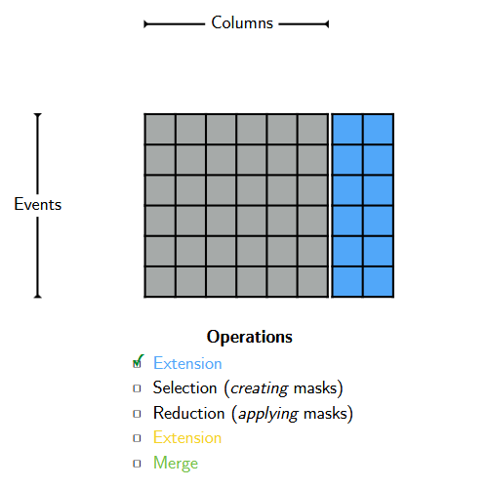
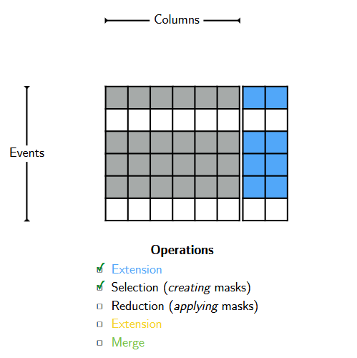
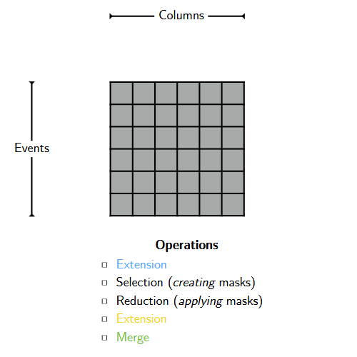
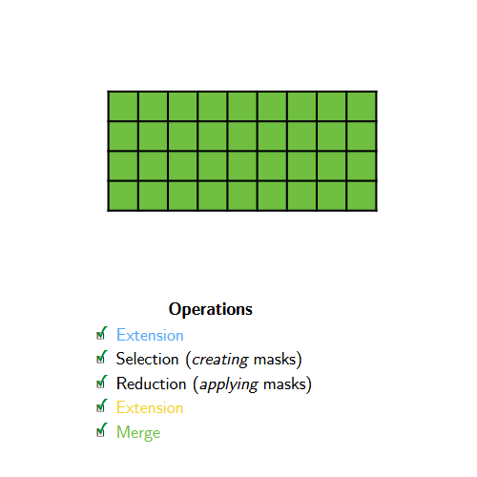
Processing MadGraph data with ColumnFlow
Marcel Rieger @ ACAT 2024

Slide 9
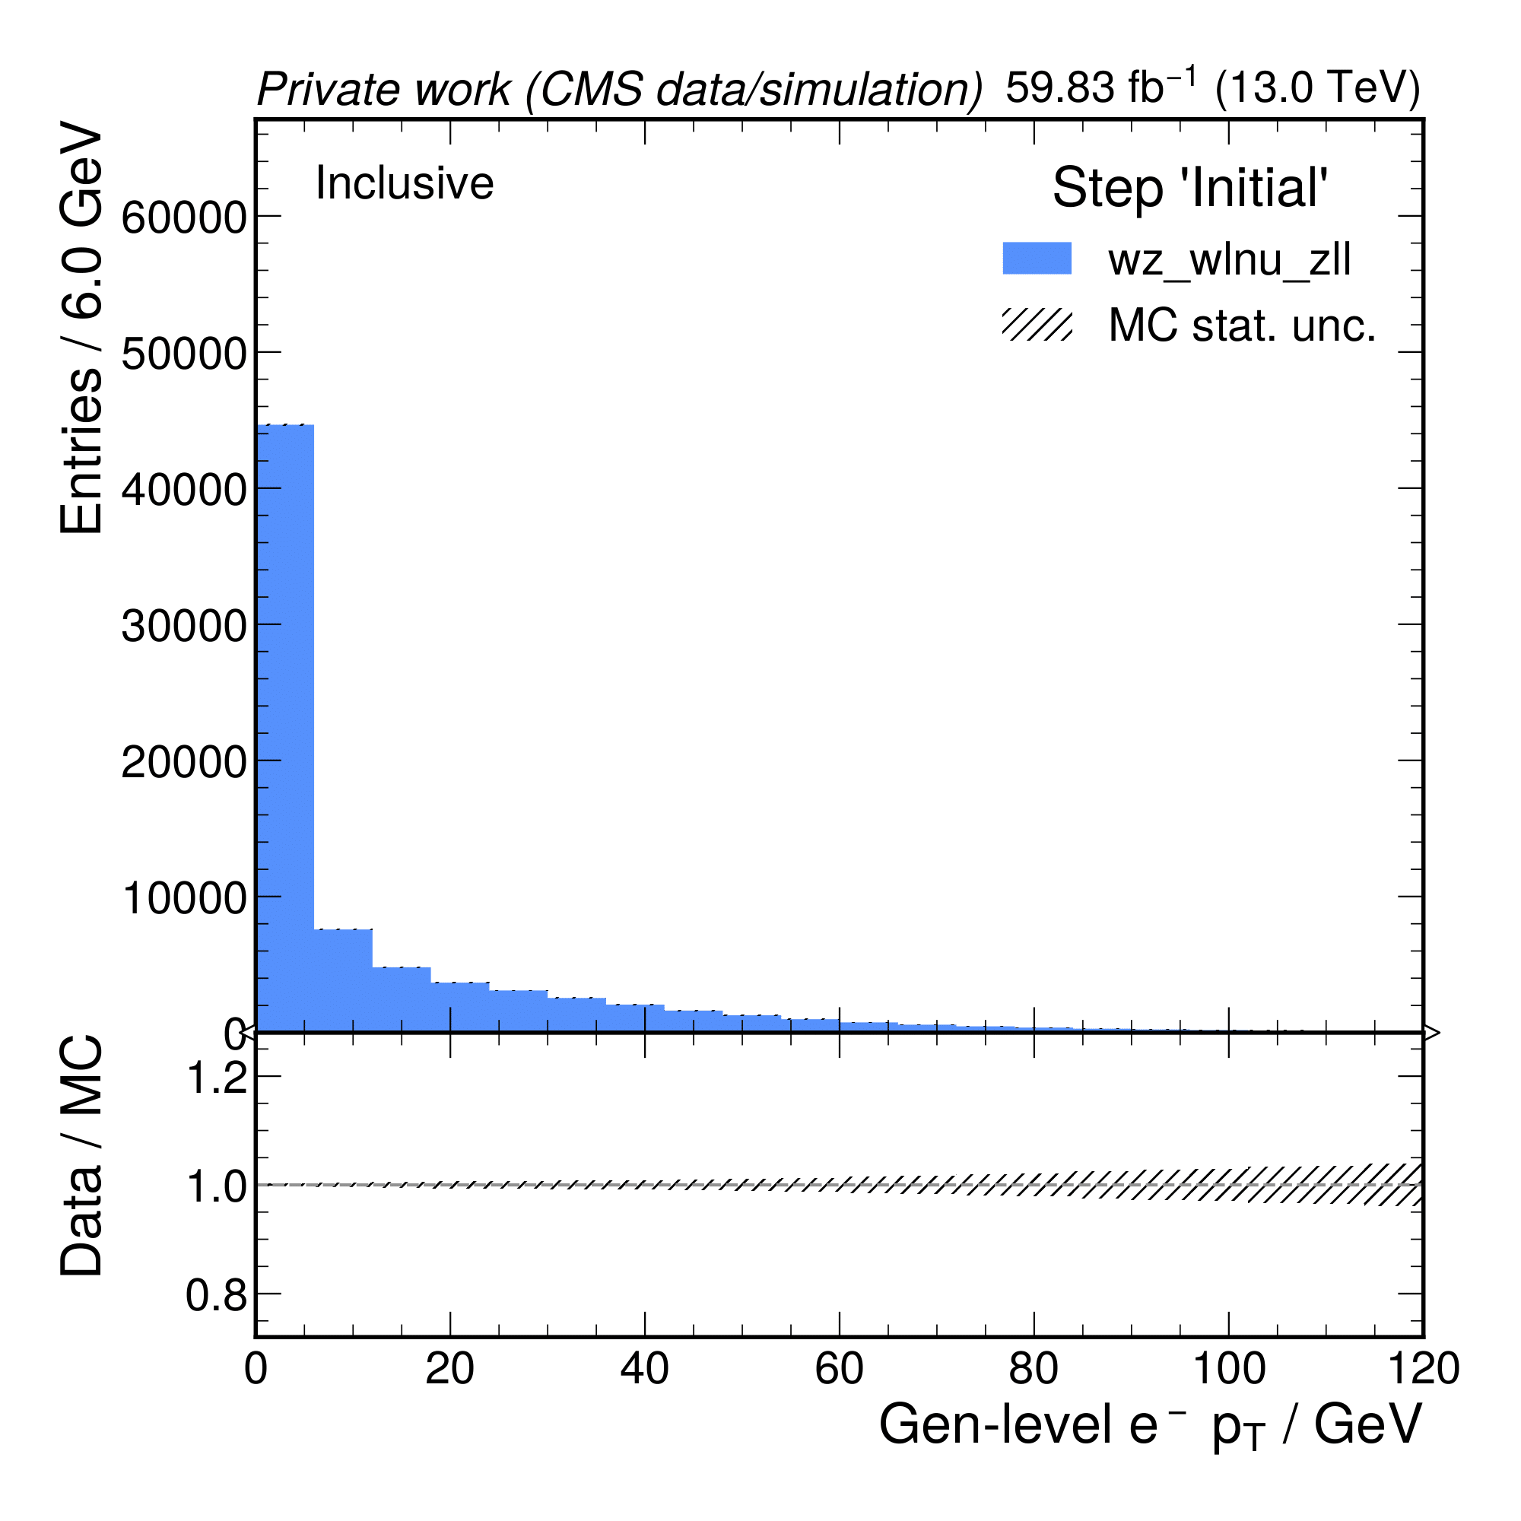
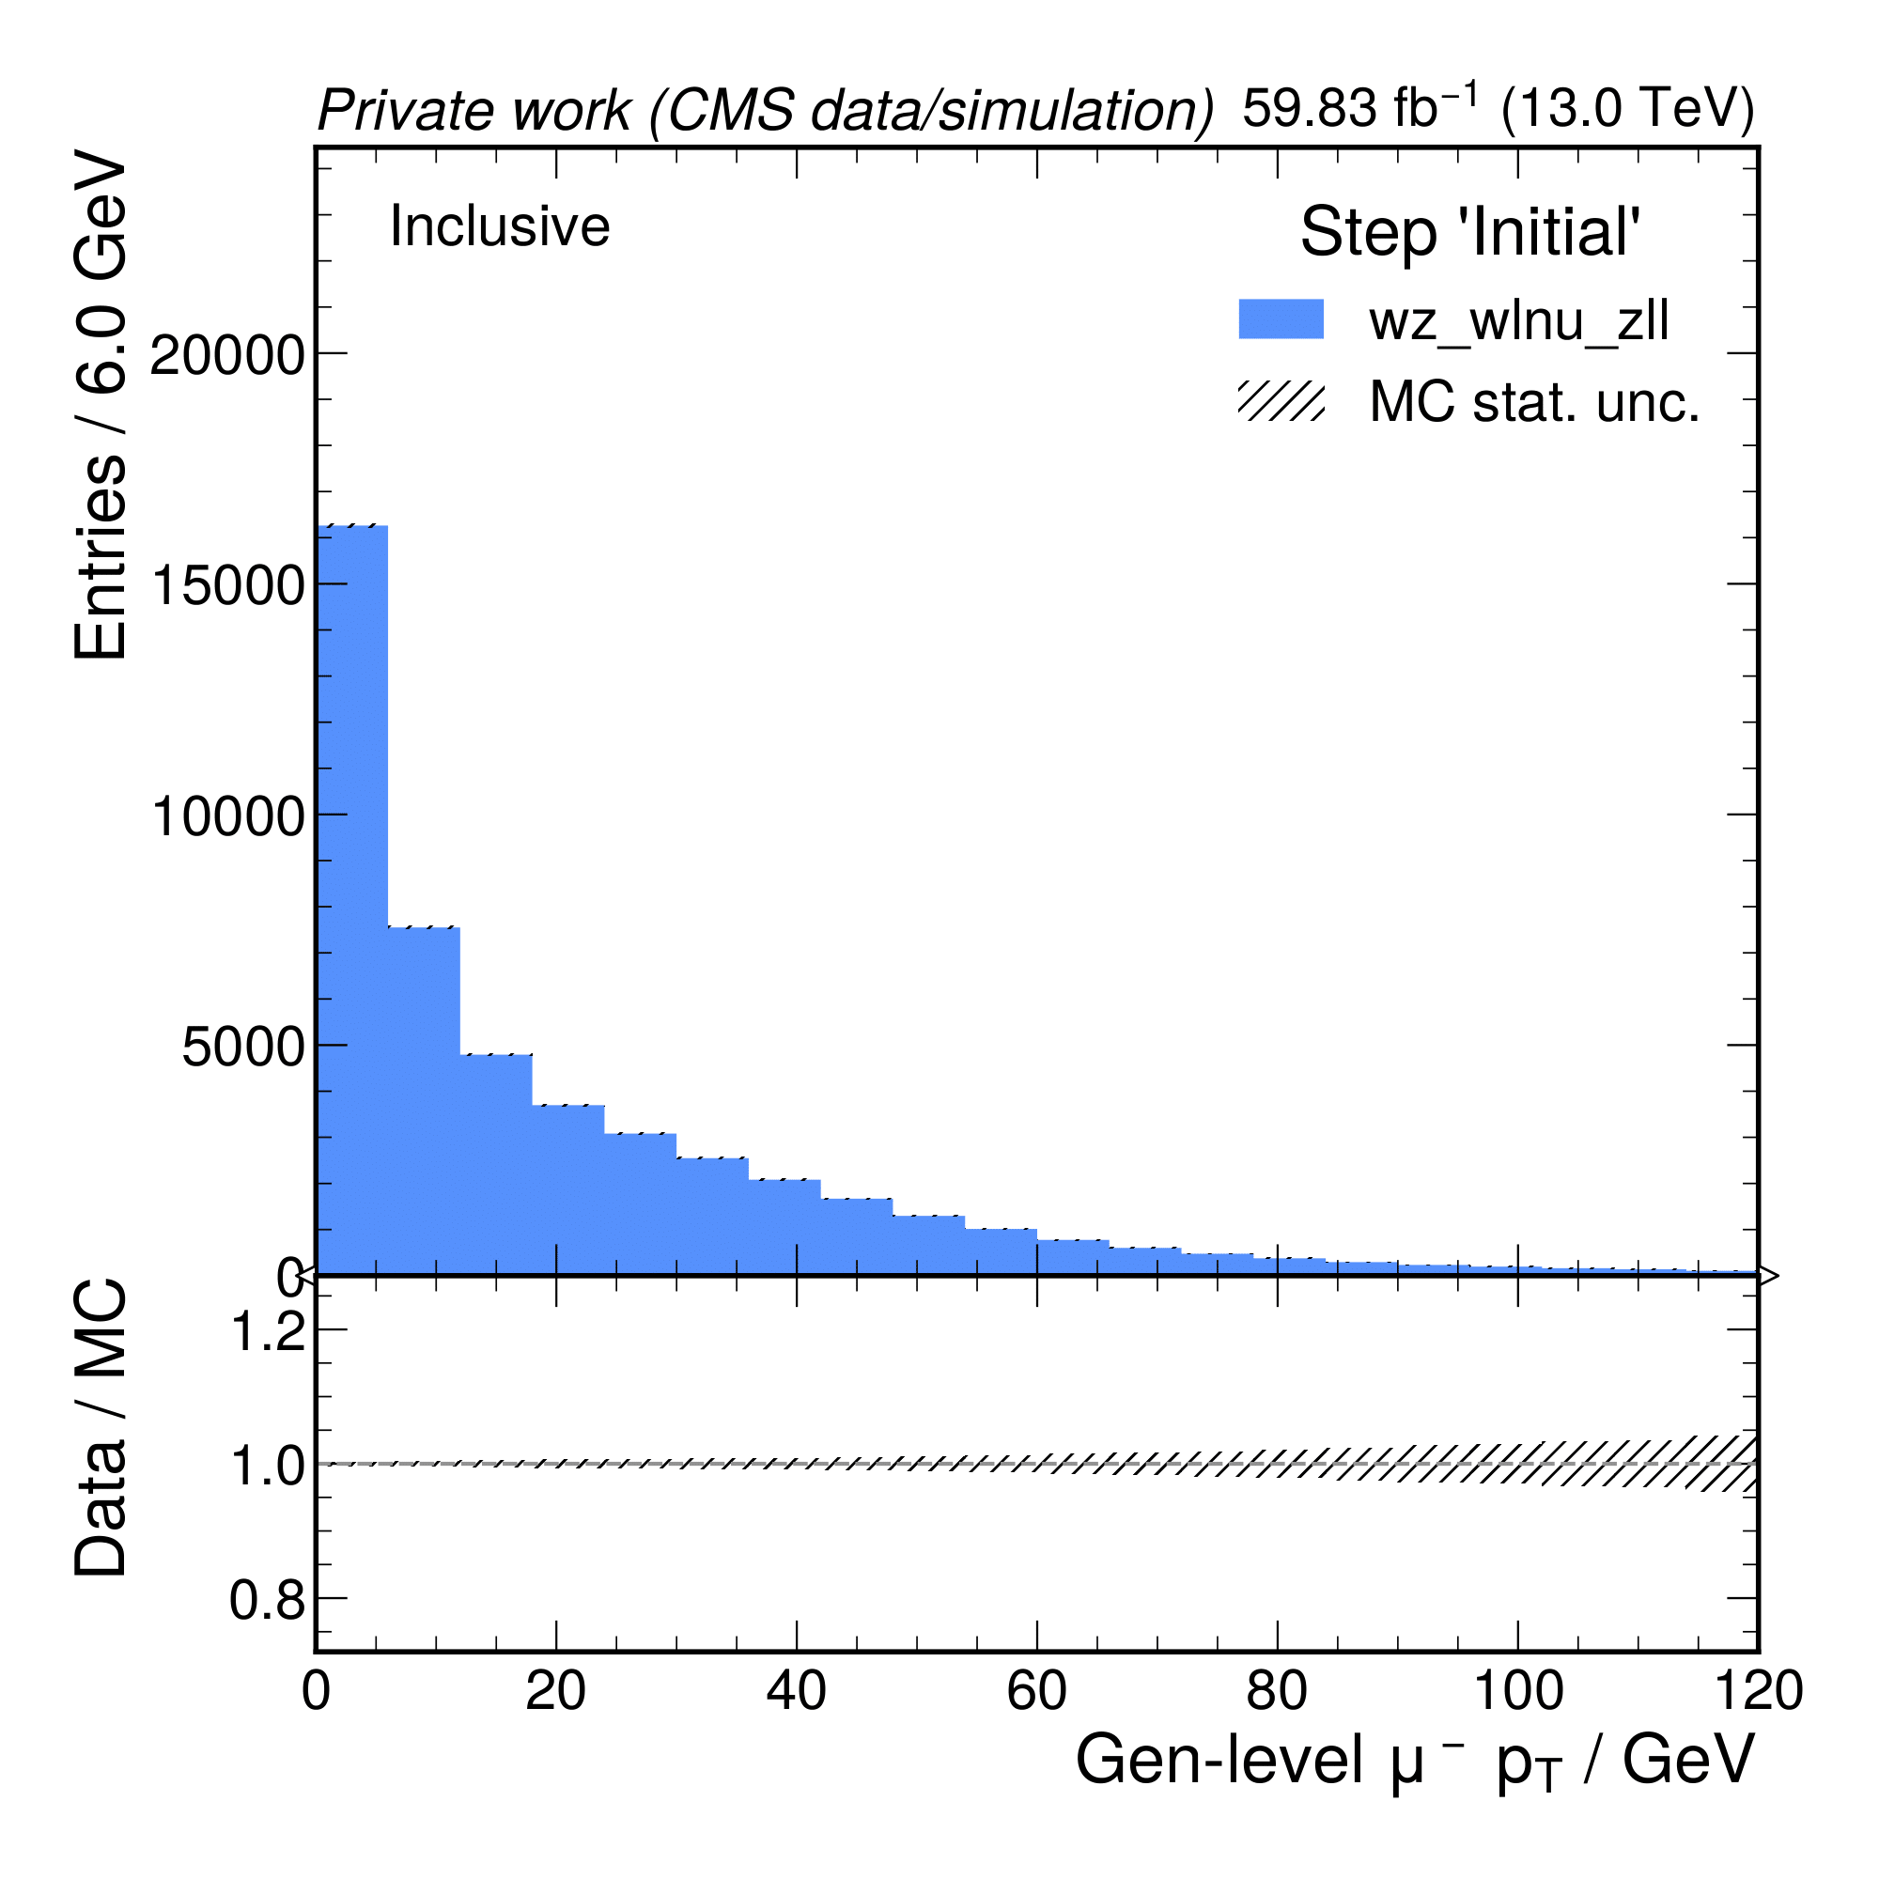
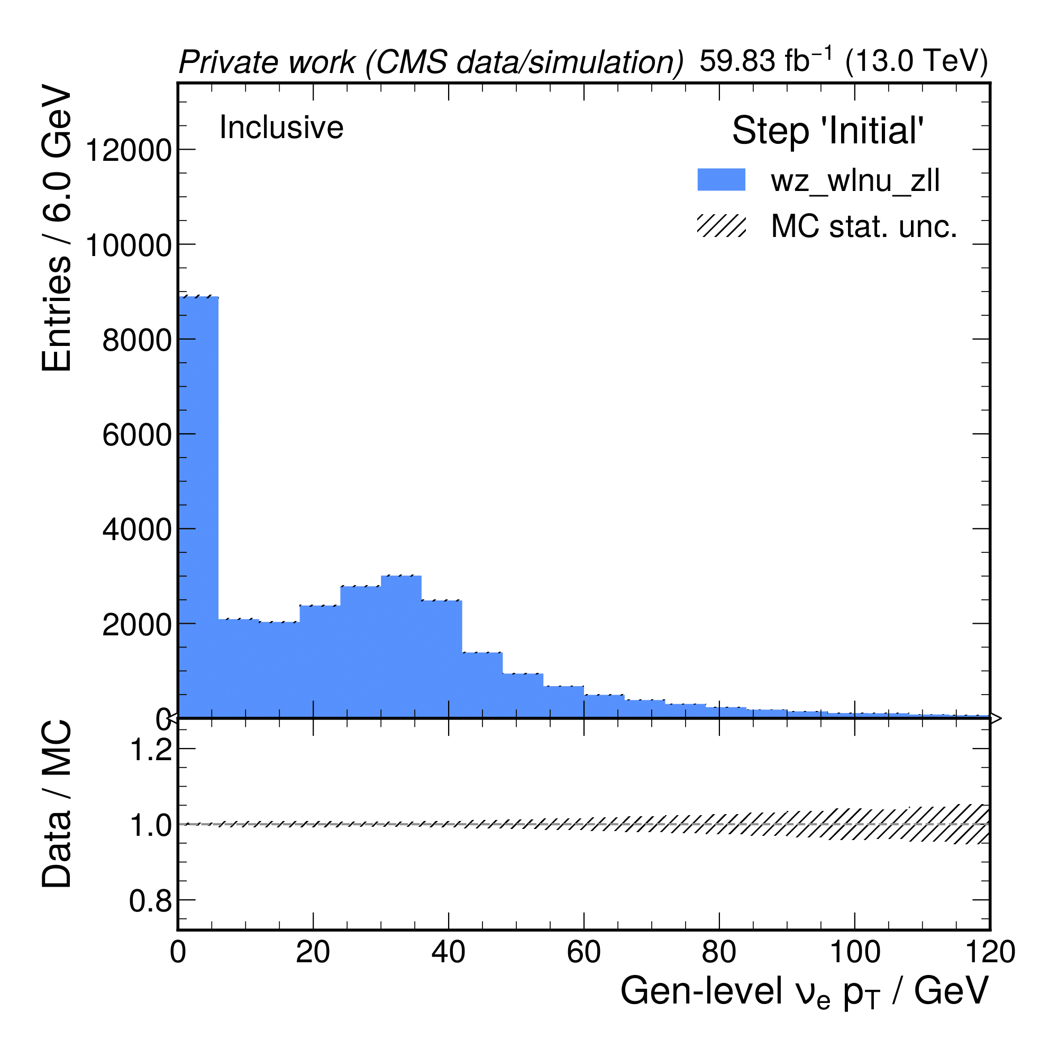
Preliminary results using MadGraph and CF

Slide 10
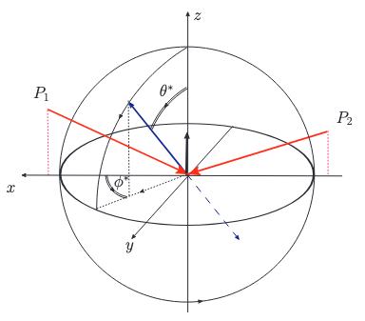
The azimuthal angle
Eur.Phys.J.C 79 (2019) 6, 535
Phys.Rev.D 84 (2011) 034008

Slide 11
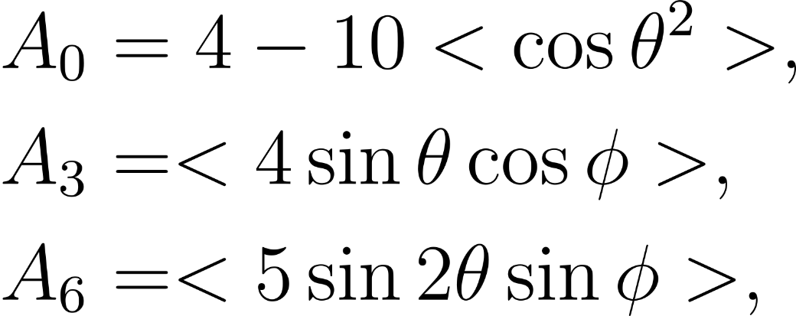
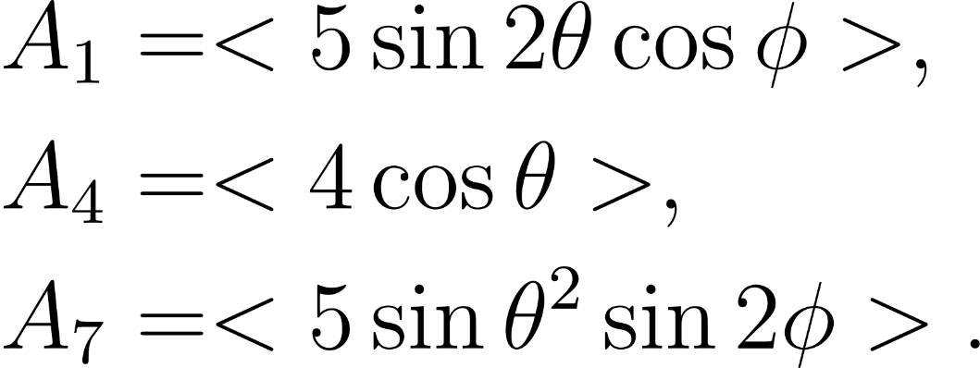
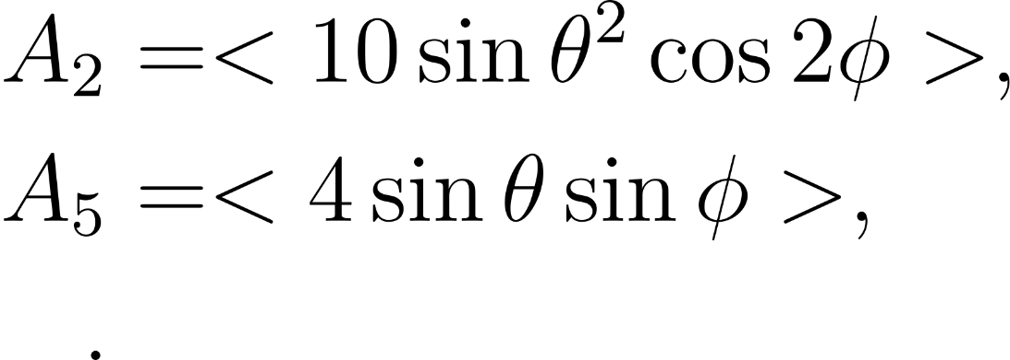
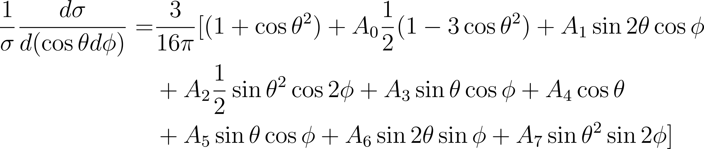
Polarization & correlation coefficients
Phys.Rev.D 84 (2011) 034008

Slide 12
Summary and outlook
Summary
Implemented polarization fractions for W & Z bosons in MATRIX -> 4 / 80 parameters
Ran LO and NLO calculations with MATRIX
Prepared ColumnFlow & MADGRAPH for comparison
Defined the azimuthal angle
Outlook
Implement the polar & azimuthal angles in MATRIX & MADGRAPH
Compare results of MATRIX & MADGRAPH
Extract polarization & correlation coefficients
Evaluate observables at detector level

Slide 13



Gill Jacobs
Master Student
Elementary Particle Physics and Gravity
E Gill.Jacobs@ugent.be
M +32 489 00 58 05 www.ugent.be
Universiteit Gent
@ugent
@ugent
Ghent University

