Slide 1
Seeing Ultrasound through Mechanoluminescence
1
Simon Michels
Mathias Kersemans, Philippe F. Smet, Nicolas Lammens, Joris Degrieck and Wim Van Paepegem
2
1
2
Simon.Michels@UGent.be Philippe.Smet@UGent.be

Slide 2
Content
What is luminescence?
Mechanoluminescence and ultrasound
Visualization of an US radiation field
Seeing (Ultra-)Sound through Mechanoluminescence

Slide 3
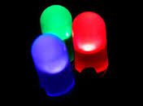
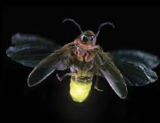
What is luminescence?
Terminology depends on the means of excitation
Common term for a luminescent material: “Phosphor”
Seeing (Ultra-)Sound through Mechanoluminescence

Slide 4
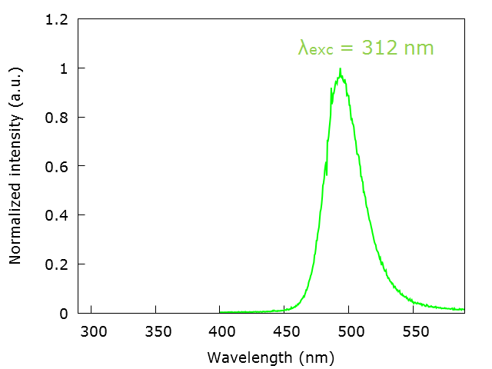
What is luminecence?
2+
Ba0.98Si2O2N2:Eu0.02 : Emission spectrum
λem = 312 nm
Seeing (Ultra-)Sound through Mechanoluminescence

Slide 5
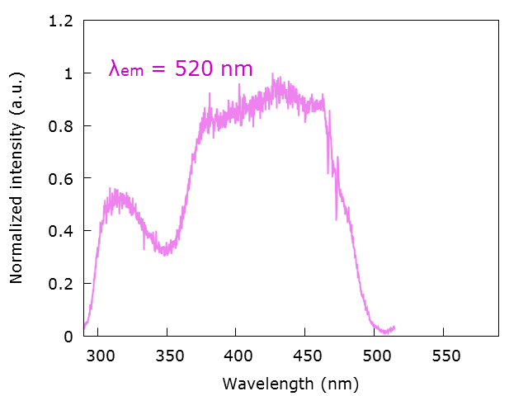
What is luminecence?
2+
Ba0.98Si2O2N2:Eu0.02 : Excitation spectrum
Seeing (Ultra-)Sound through Mechanoluminescence

Slide 6
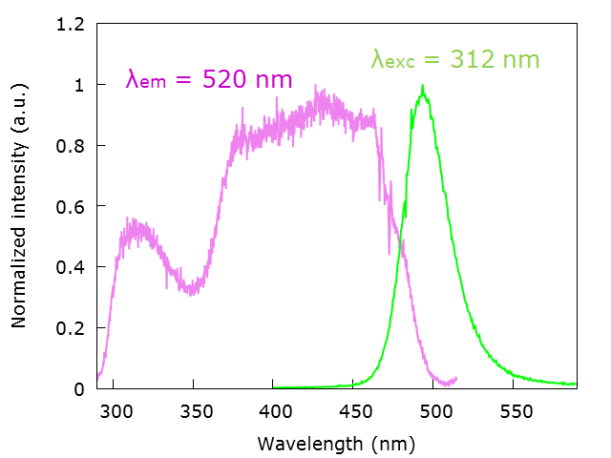
What is luminecence?
2+
Ba0.98Si2O2N2:Eu0.02
λem = 312 nm
Seeing (Ultra-)Sound through Mechanoluminescence

Slide 7
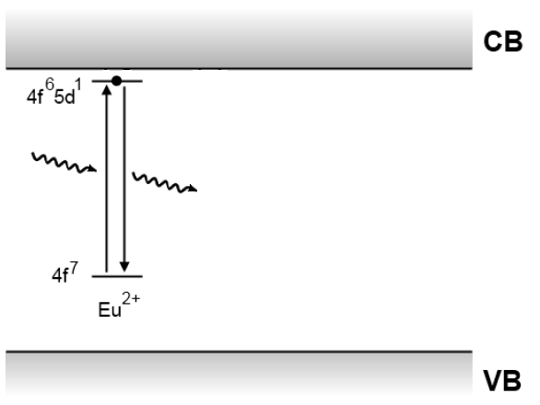
What is luminecence?
Persistent luminescence: afterglow at RT
Mechanism: traps in the host material
Seeing (Ultra-)Sound through Mechanoluminescence

Slide 8
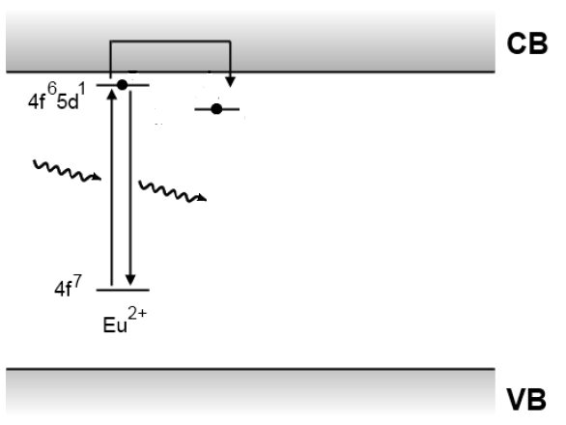
What is luminecence?
Persistent luminescence: afterglow at RT
Mechanism: traps in the host material
Seeing (Ultra-)Sound through Mechanoluminescence

Slide 9
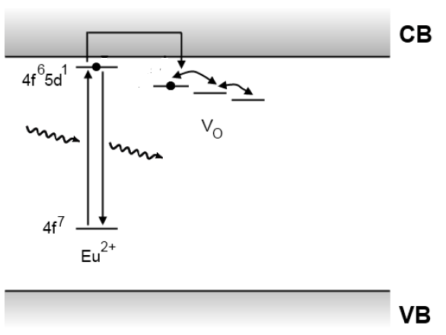
What is luminecence?
Persistent luminescence: afterglow at RT
Mechanism: traps in the host material
Seeing (Ultra-)Sound through Mechanoluminescence

Slide 10
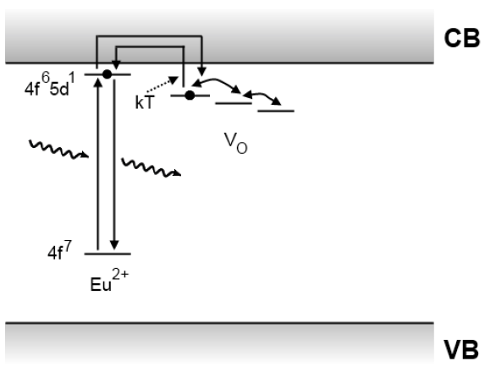
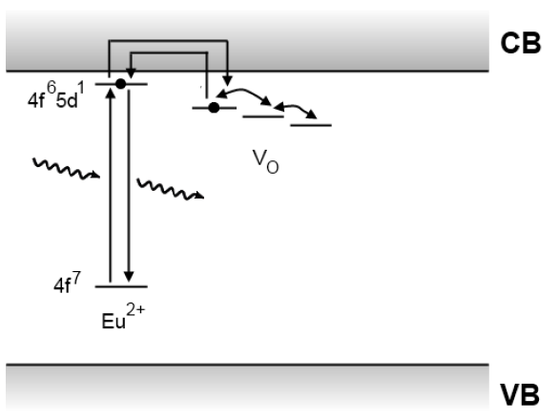
What is luminecence?
Persistent luminescence: afterglow at RT
Mechanism: traps in the host material
ΔE
Detrapping by phonon absorption
with probability:
$p=s.exp⁡(−\frac{ΔE}{kT})$
Seeing (Ultra-)Sound through Mechanoluminescence

Slide 11
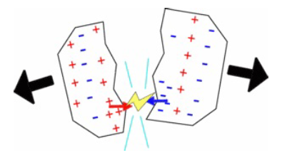
Mechanoluminescence and ultrasound
ML: Sudden and intense emission after mechanical stimulation (most often an increase in afterglow)
Destructive ML: fracturing
Non-destructive ML: piezoelectric host crystal
Piezoluminescence, Elasticoluminescence
Seeing (Ultra-)Sound through Mechanoluminescence

Slide 12
Mechanoluminescence and ultrasound
ML: Sudden and intense emission after mechanical stimulation (most often an increase in afterglow)
Destructive ML: fracturing
Non-destructive ML: piezoelectric host crystal
Piezoluminescence, Elasticoluminescence
Seeing (Ultra-)Sound through Mechanoluminescence

Slide 13
Mechanoluminescence and ultrasound
Piezoelectrically induced electron detrapping model
Seeing (Ultra-)Sound through Mechanoluminescence

Slide 14
Mechanoluminescence and ultrasound
Piezoelectrically induced electron detrapping model
Non-centrosymmetric unit cell
Seeing (Ultra-)Sound through Mechanoluminescence

Slide 15
Mechanoluminescence and ultrasound
In this work:
Mechanical stimulation through ultrasound
Acoustically induced
Piezo-
Luminescence
Seeing (Ultra-)Sound through Mechanoluminescence

Slide 16
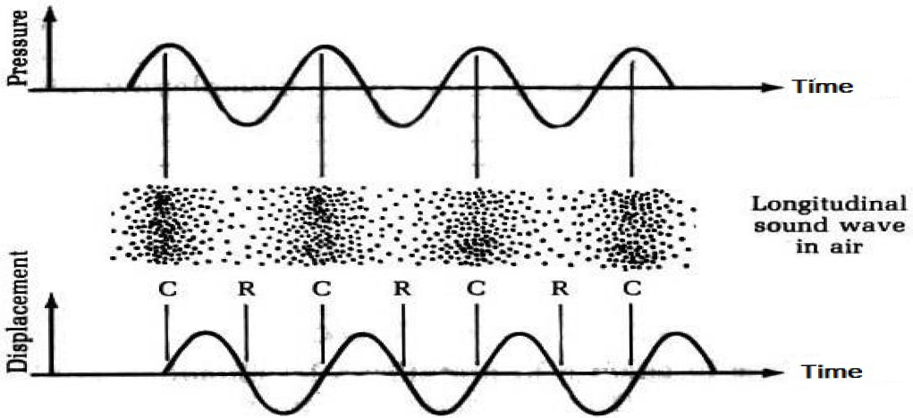
Mechanoluminescence and ultrasound
Ultrasound: longitudinal pressure wave in a medium
with f > 20 kHz
Alternating compression and rarefaction: continuous ML stimulation
Image from Physics of Musical Sounds, John Askill. D. Van Nostrand Company (1979)
Seeing (Ultra-)Sound through Mechanoluminescence

Slide 17
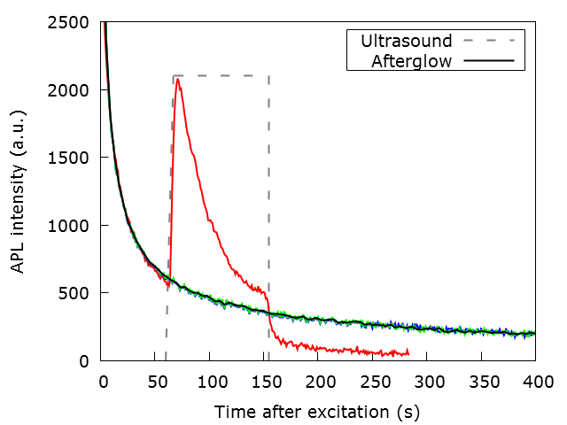
3D-reconstruction of US radiation
1 min of UV charging, integration between 450 and 550 nm
Seeing (Ultra-)Sound through Mechanoluminescence

Slide 18
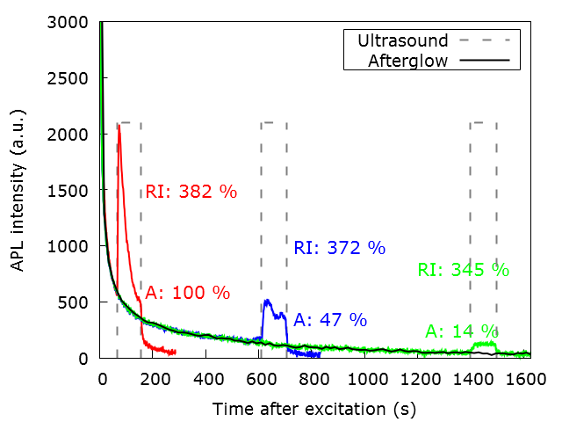
3D-reconstruction of US radiation
Relative Increase (RI) and Area (A)
Seeing (Ultra-)Sound through Mechanoluminescence

Slide 19
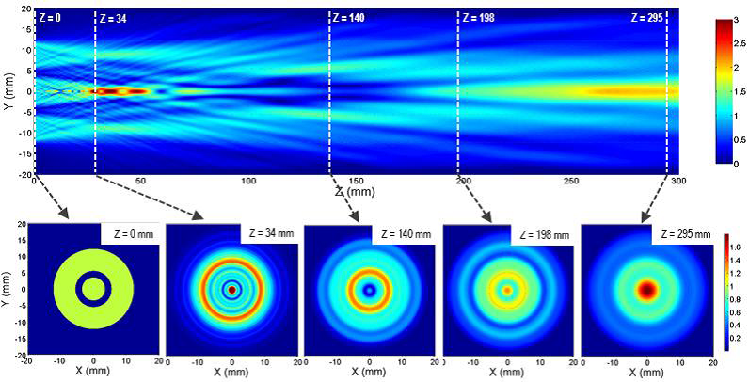
Mathias Kersemans et al. Fast Reconstruction of a Bounded Ultrasonic Beam
using Acoustically induced Piezo-Luminescence. Apl. Phys. Let. 107, 234102 (2015)
Numerical simulation using FFT-BPM
Seeing (Ultra-)Sound through Mechanoluminescence

Slide 20
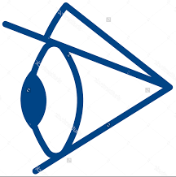
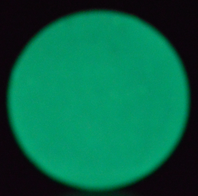
Mathias Kersemans et al. Fast Reconstruction of a Bounded Ultrasonic Beam
using Acoustically induced Piezo-Luminescence. Apl. Phys. Let. 107, 234102 (2015)
Experimental setup: detection in reflection
Seeing (Ultra-)Sound through Mechanoluminescence

Slide 21
Mathias Kersemans et al. Fast Reconstruction of a Bounded Ultrasonic Beam
using Acoustically induced Piezo-Luminescence. Apl. Phys. Let. 107, 234102 (2015)
Seeing (Ultra-)Sound through Mechanoluminescence

Slide 22
Mathias Kersemans et al. Fast Reconstruction of a Bounded Ultrasonic Beam
using Acoustically induced Piezo-Luminescence. Apl. Phys. Let. 107, 234102 (2015)
Seeing (Ultra-)Sound through Mechanoluminescence

Slide 23
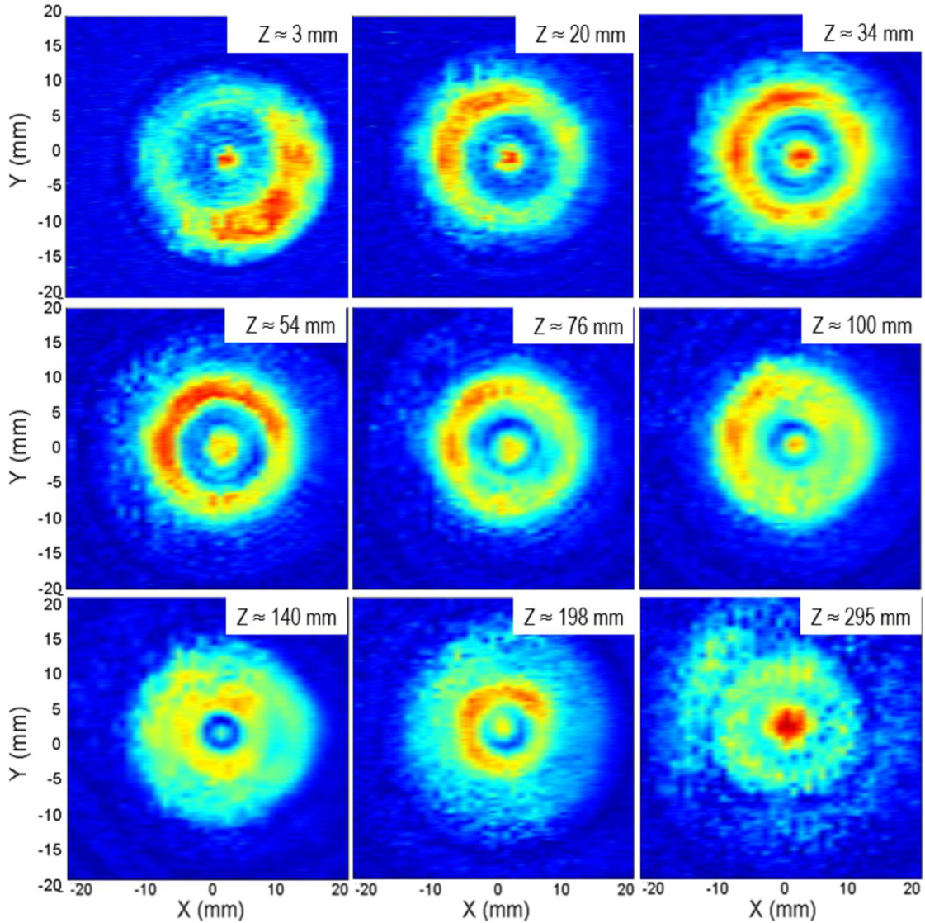
Mathias Kersemans et al. Fast Reconstruction of a Bounded Ultrasonic Beam
using Acoustically induced Piezo-Luminescence. Apl. Phys. Let. 107, 234102 (2015)
Medical transducer with f = 3.3 MHz and I = 2.0 W/cm²
Scans with conventional hydrophone
Seeing (Ultra-)Sound through Mechanoluminescence

Slide 24
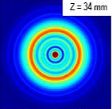
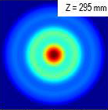
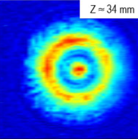
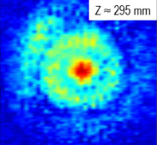
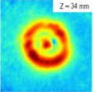
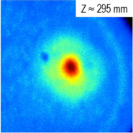
Mathias Kersemans et al. Fast Reconstruction of a Bounded Ultrasonic Beam
using Acoustically induced Piezo-Luminescence. Apl. Phys. Let. 107, 234102 (2015)
Near-Field Far-Field
Computed
Hydrophone
APL
Seeing (Ultra-)Sound through Mechanoluminescence

Slide 25
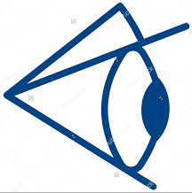
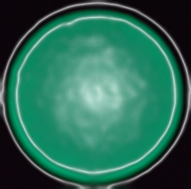
3D-reconstruction of US radiation
Experimental setup: detection in transmission
semi-transparent sample
Seeing (Ultra-)Sound through Mechanoluminescence

Slide 26
3D-reconstruction of US radiation
Seeing (Ultra-)Sound through Mechanoluminescence

Slide 27
3D-reconstruction of US radiation
Seeing (Ultra-)Sound through Mechanoluminescence

Slide 28
Conclusion
Much faster/cheaper than conventional scanning
Similair spatial resolution, can be improved
Further automatisation of the setup
Phosphors: much room for improvement
Short afterglow
High APL peak intensity
High relative increase
Seeing (Ultra-)Sound through Mechanoluminescence

Slide 29
Thank you for your attention

