Slide 1
Soliton-core filling in superfluid Fermi gases with spin imbalance
Wout Van Alphen
May 18, 2016
Collaboration with: G. Lombardi, S.N. Klimin & J. Tempere

Slide 2
Introduction: ultracold quantum gases
Clouds of typically 100 000 atoms, bosons or fermions
Trapped in a magneto-optical trap with size of microns
Quantum degeneracy temperature is of the order of 100 nK
Interatomic interactions determined by single number: s-wave scattering length, order of nanometers
Notes:
Systems of interest are ultracold quantum gases: these are clouds of typically 100 000 atoms, either bosons or fermions, which are trapped in a magneto-optical trap, the size of which is usually of the order of microns. Then these gases are cooled down to below their quantum degeneracy temperature, about 100 nK. At these ultralow temperatures, the interatomic interations are determined by one single quantity: the s-wave scattering length, order of nanometers.

Slide 3
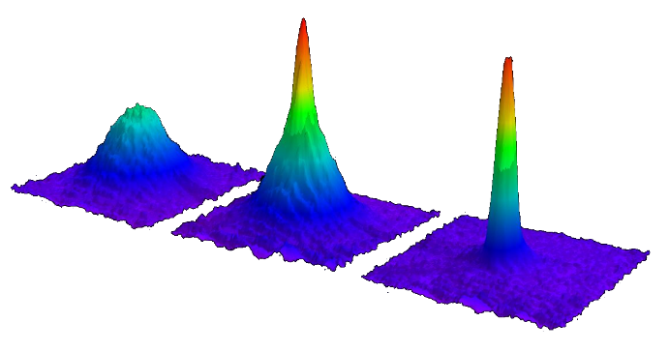
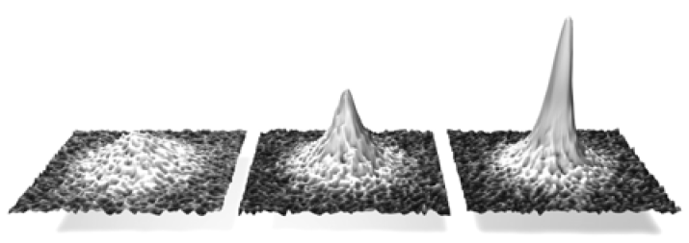
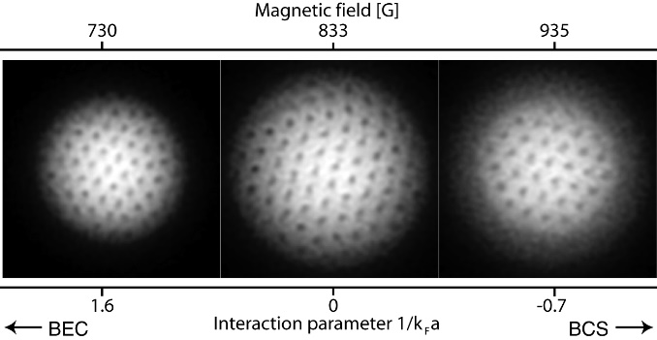
Introduction: ultracold quantum gases
1995: Bose-Einstein condensation observed in a Bose gas
1999: Superfluidity in a dilute Bose gas observed through vorticity
2003: Bose-Einstein condensation of pairs observed in a Fermi gas
2005: Superfluidity in a dilute Fermi gas observed through vorticity
M. H. Anderson, J. R. Ensher, M. R. Matthews, C. E. Wieman, and E. A. Cornell,
Science 269, 198 (1995);
K. B. Davis, M.-O. Mewes, M. R. Andrews, N. J. Van Druten, D. S. Durfee, D. M. Kurn, and
W. Ketterle, Phys. Rev. Lett. 75, 3969 (1995);
C. C. Bradley, C. A. Sackett, J. J. Tollett, and R. G. Hulet, Phys. Rev. Lett. 75, 1687 (1995).
“Spin-up”
“Spin-down”
M.R. Matthews, B.P. Anderson,P.C. Haljan, D.S. Hall, C.E.Wieman,
E.A. Cornell, Phys. Rev. Lett. 83, pp. 2498 (1999);
K.W. Madison, F. Chevy, W. Wohlleben, and J. Dalibard,
Phys. Rev. Lett. 84, 806 (2000);
C. Raman, J.R. Abo-Shaeer, J.M. Vogels, K. Xu, and W. Ketterle,
Phys. Rev. Lett. 87, 210402 (2001).
μ₁
μ₂
M.W. Zwierlein et al., Phys. Rev. Lett. 91, 250401 (2003);
S. Jochim, et al., Science 302 (2003);
M. Bartenstein et al., Phys. Rev. Lett. 92, 120401 (2004);
C. Regal et al., Phys. Rev. Lett. 92, 040403 (2004);
T. Bourdel et al., Phys. Rev. Lett. 93, 050401 (2004).
M. W. Zwierlein et al., Nature 435, 1047-1051 (2005).
Notes:
Using this kind of setup, researchers observed a transition to a new state of matter, a bose-einstein condensate, in a gas of bosons in 1995. A few years laters, these gases were demonstrated to be superfluids (like superfluid helium) through the onset of vortex grids. After this, research also focused on ultracold fermionic gases. In these gases, it are not individual particles that form a superfluid condensate Instead, fermionic atoms of different spin type of different spin type form pairs

Slide 4
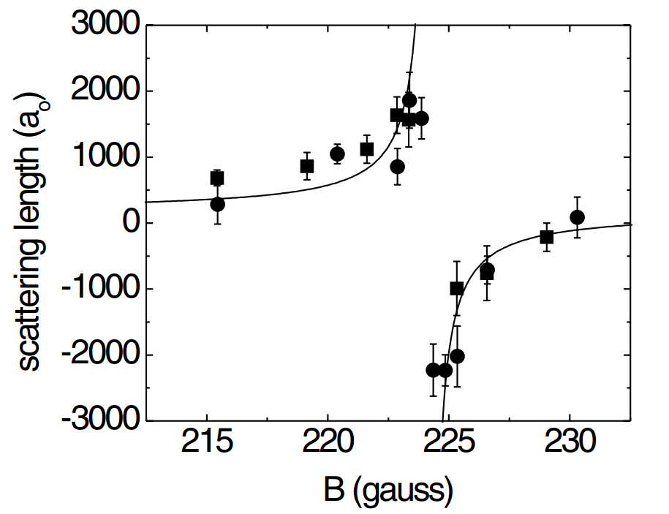
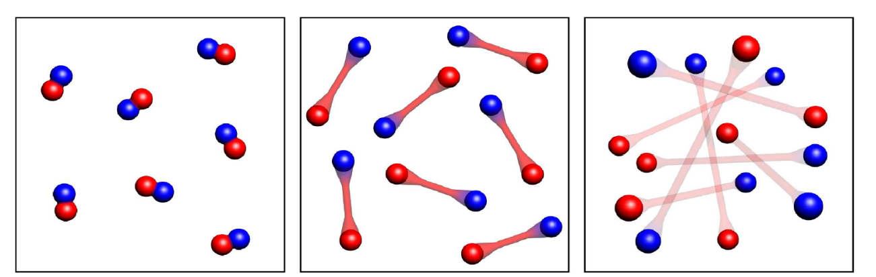
BEC-BCS crossover in ultracold Fermi gases
BEC
Crossover
BCS
Notes:
A remarkable and useful property/important aspect: effective interaction at low temperatures is completely determined by one parameter: the scattering length. Morover, the value and sign of the scattering length can be tuned using an external magnetic field. Especially interesting for fermionic gases : a whole continuum of interaction regimes we can investigate: At one side: strongly bound molecules forming a BEC, at other side: weakly bound cooper pairs forming a BCS superfluid Verschillen duidelijk uitleggen tussen sterk gebonden moleculen en veel zwakker gebonden, grotere Cooperparen (fermi karakter nog duidelijker). Hoewel verschillend van aard, dus toch sterk met elkaar verbonden
[bose: paarvorming voor condensatie, BCS: gebeurt op zelfde moment]

Slide 5
Population imbalance
Number of “spin-up” and “spin-down” atoms can be manipulated
Unpaired particles remain in normal state
Frustrates pairing mechanism and superfluidity
μ₁
μ₂
Notes:
Another interesting apsect for fermionic gases: We don’t necessarily have to use equal amount of spin up and spin down particles, but we can experimentally tune the number of particles of each spin type. (Another interesting aspect of the ultracold fermi gases that is important here is that one can very accurately tune the number of particles for each spin type,) allowing for population imbalance. Now, when pairs are formed and condense into a superfluid state, unpaired particles remain in the normal state. This imbalance frustrates the pairing mechanism, and when it becomes too big, superfluid state is destroyed. These spin-imbalanced ultracold fermi gases are the first ingredient of our research

Slide 6
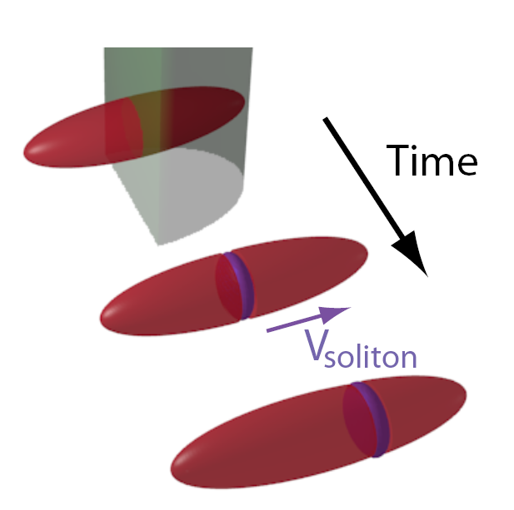
Solitons
Soliton = solitary wave that maintains its shape while propagating at constant velocity
Realisation in ultracold quantum gases through “phase imprinting” technique
Notes:
Next ingredient is a phenomenon called soliton. Appear in wide variety of systems, and can also be realised in ultracold fermi gases. In these systems, these solitons are actually associated with a phase jump in the order parameter. In experiments this is obtained by the phase imprinting technique, in which they shine a laser beam on one half of the gas, thus changing the phase of that half
Komen in uiteenlopende systemen voor: water, fibers, etc. Nu ook in kwantumgassen proberen te maken

Slide 7
Solitons in superfluid Fermi gases
(2013) First experiment: detection of long lived excitations similar to dark solitons
(2013) Reinterpretation of the results²: excitations were solitonic vortices
(2015) Observation of solitons decaying into solitonic vortices³ through “snake instability”
Solitons & spin imbalance?
t
¹T. Yefsah et al., Nature 499, 426 (2013)
²M. J. H. Ku et al., Phys. Rev. Lett. 113, 065301 (2014)
³M. J. H. Ku et al., arXiv:1507.01047 (2015)
Notes:
Some experimental highlights. Reason: solitons decay into solitonic vortices through so called snake instability, direct observation of this fact was made in 2015
These and other experiments and descriptions solitons carried out for spin balanced fermi gases. Our goal is to try to theoretically describe the properties of a soliton would it be created in a spin-imbalanced fermi gas.

Slide 8
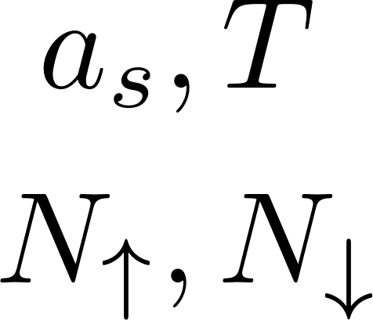
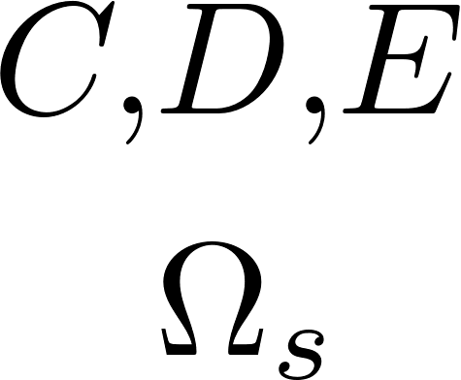
Effective field theory
Path-integral formalism
Following Gor’kov
(BCS)
Gap equation
Number equation
[1],[2]
(To obtain regular Ginzburg-Landau formalism)
[1] S.N. Klimin, J. Tempere, G. Lombardi and J.T. Devreese, Eur. Phys. J. B. 88, 230404 (2015)
[2] S.N. Klimin, J. Tempere and J.T. Devreese, Phys. Rev. A. 90, 053613 (2014)
Notes:
Scheme for theoretical description: our input parameters are: s-wave scattering length, temperature, number of spin up and spin down particles. We then start from well-established path-integral formalism for fermi superfluids, which lead to a gap and number equation. Plugging in our input parameters, we find a constant bulk value for the superfluid pair field, the average chemical potential and the imbalance chemical potential. This would be sufficient to describe homogeneous fermi superfluid. To go beyond this, our group developed an effective field theory for the pair field psi, based on assumption that the pair field varies slowly in space and time. This is implemented by a gradient expansion of the order parameter, leading to an effective action functional for the pair field, determined by coefficients C, D, E and the thermodyn pot omega.(i.e. slow variatons). From this action we can make link to Ginzburg Landau by expansion of therm pot for small psi, we get the well-known ginzburg landau form. Ginzburg landau is based on assumption of small order parameter, so valid close to Tc, while our formalism is, in principle, valid from zero to critical, because based on slowly –varying order parameter instead of small

Slide 9
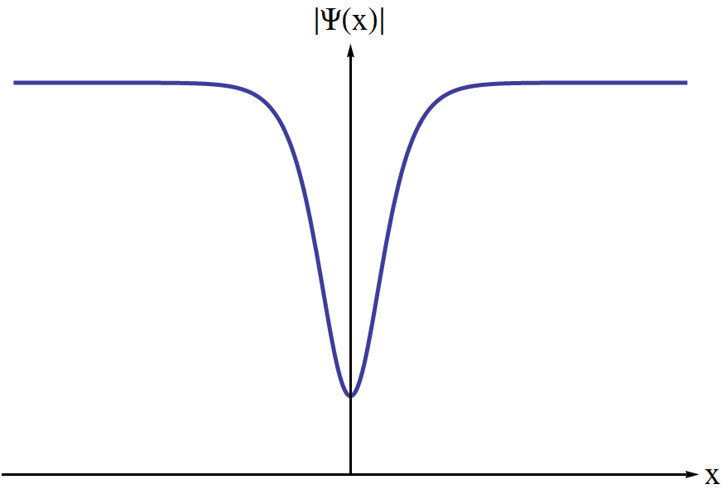
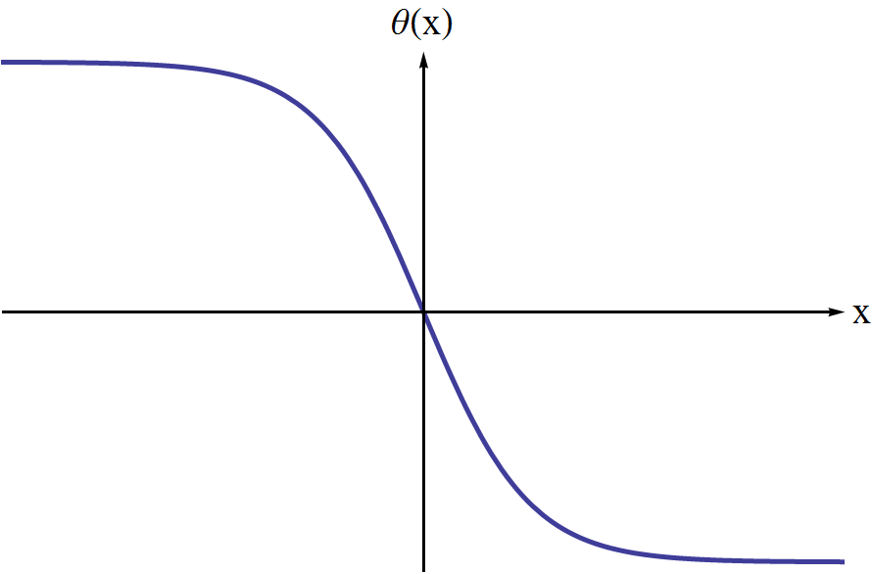
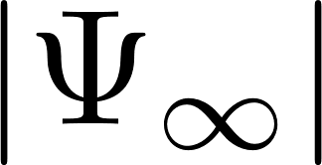
Amplitude-phase notation
Modulus ( pair density)
Phase ( superfluid velocity field)
0
0
Notes:
In één keer samen zetten en figuren voor a en theta
Soliton is characterized by local density dip and phase jump across the soliton center. We need a formalism to account for these two characteristics, so we write it out
Soliton is heel lokale en plaatselijke verstoring → write out order parameter in modulus and phase, and modulus as product of bulk value times factor that modulates bulk value at position of the soliton. handig om modulus te schrijven als bulkwaarde maal een factor die de bulkwaarde moduleert

Slide 10
Solution for 1D dark soliton
Condition: the soliton keeps its shape as it moves at constant speed along the x direction
The Lagrangian density becomes¹
From this we obtain equations of motion for a(x) and θ(x)
¹S. N. Klimin, J. Tempere and J. T. Devreese, Phys. Rev. A 90, 053613 (2014)
Notes:
Impose the following conditon. (Condition eliminates snake instability from theoretical description, we won’t be able to look at it like this, we only look at solitons before the decay/but we are now interested in the properties of the soliton before the decay). +This makes the problem a quasi-1D problem

Slide 11
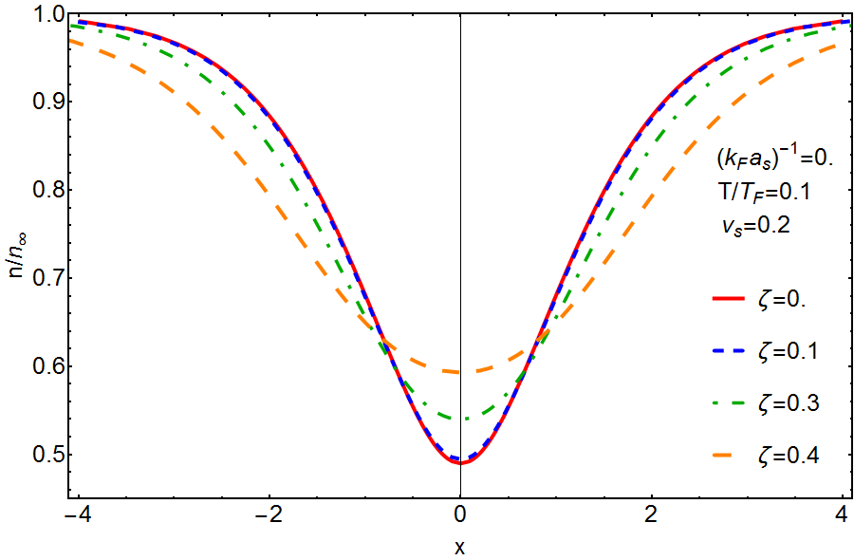
Fermion density profile
Notes:
First quantity of interest: Density profile (LDA) for different values of imbalance parameter zeta, relative difference in chemical potentials: as it becomes larger, the soliton core is filled up with particles. This is for certain value of interaction length, Same effect through the whole crossover

Slide 12
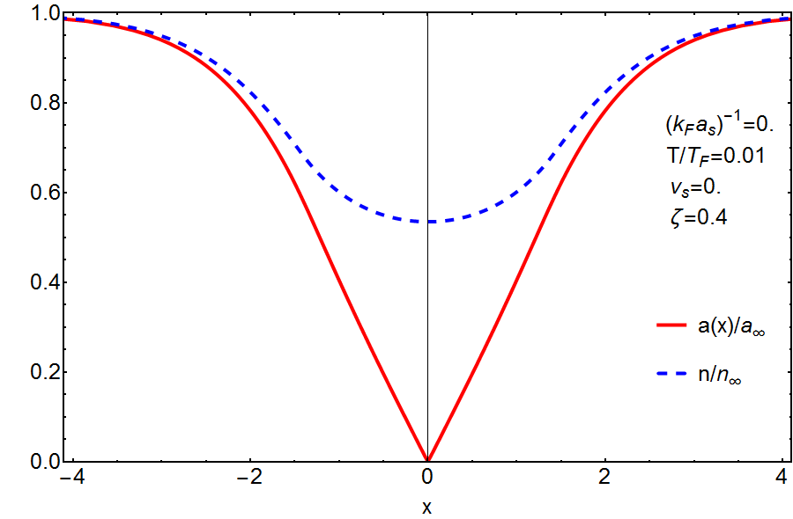
Pair field amplitude vs density profile
Notes:
A comparison of the pair field amplitude and the density tells us that these particles are the unpaired particles: voor vs = 0 the pair amplitude and associated pair density are zero at the center, while the fermion density is not. Feasible explanation for why they would fill up the soliton: in experiments with spin-imbalanced fermi gases we see phase separation between superfluid pairs and unpaired in normal state, they are expelled. If we now create a soliton, we give the superfluid a natural, convenient place to efficiently separate these unpaired particles from the superfluid state → so it turns out there is a strong connection between presence of imbalance and the structure of the soliton and we can expect this will also effect dynamical properties of soliton

Slide 13
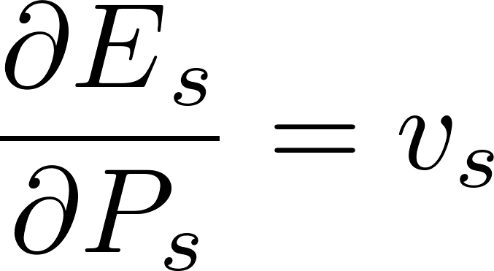
Effective mass
Dark soliton obeys classical energy-momentum relation
Define effective mass as
In general different from physical mass of the soliton
Notes:
Next aspect: how does this influence dynamical properties. Quantity that gives us acces to dynamical properties: effective mass. One can verify that solitons in superfluid fermi gases obey classic energy-momentum relation, so it makes sense to define an effective mass

Slide 14
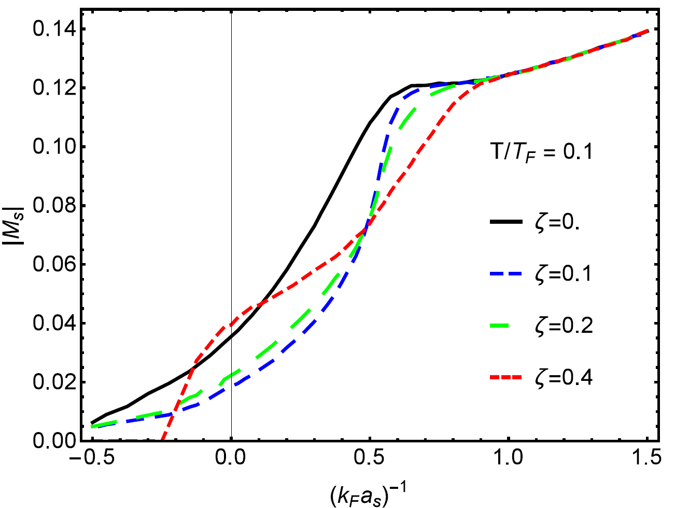
Effective mass
Notes:
Effective mass in function of inverse scattering length (so across the whole crossover) for different values of imbalance. Positive: BEC, negative: BCS. In BEC BCS regime, effects small and straight forward, in crossover regime effect much less straight forward, effective mass doesn’t seem to have a fixed behavior in function of the spin imbalance across the interaction spectrum, difficult to give intuitive explanation, (It does go to show again that there is a strong connection between spin imbalance and soliton structure,) and that especially in crossover regime, spin imbalance considerably influences dynamical properties of soliton through filling of soliton core
The change in the behavior due to ζ is more evident in the vicinity of the unitarity regime. While in the BEC and BCS limits we observe that |MS| is
larger for small values of the imbalance and decreases with increasing ζ as could be intuitively expected in consideration of the discussion about the filling of the soliton by imbalance, in the intermediate region we see that the behavior is much less straightforward. In the immediate vicinity of (kF as )−1 = 0 in fact, the higher value of |MS| is not reached for a balanced system but for a highly imbalanced one (ζ = 0.4). This graph shows that, especially in the crossover region, tuning the imbalance strongly affects the dynamical properties of the soliton

Slide 15
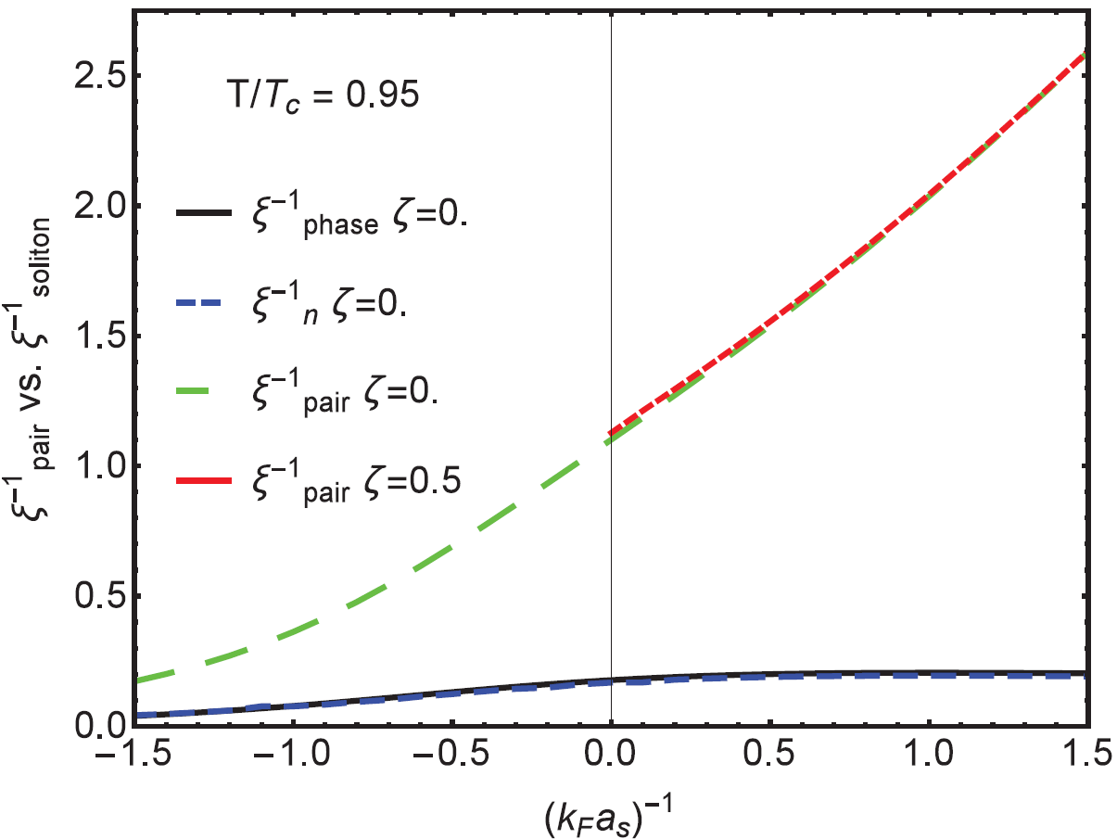
Validity domain
Long-wavelength approximation is valid if dimension soliton is larger than dimension Cooper pairs
Compare soliton width and pair coherence length
Notes:
Motivated by discrepancies with other results, we made an analysis of the validity of our theory. Theory was based on long-wave length approx that psi varies slowly, i.e. soliton width larger than dimension cooper pairs. Two measures for inverse width of soliton, inverse coherence length for different values imbalance. As long as inverse width is lower than inverse coherence length: OK At higher temperatures, no problem across the whole interaction spectrum, at lower temperatures, problem in BCS
Two quantities for size soliton: soliton width and healing length (calculated at vs=0 by modelling the spatial profile of the order parameter with a trial form of the amplitude modulation tanh(x/sqrt(2) xi) and minimizing the free energy with respect to this variational parameter + rescaling factor 1,175 because of independent definitions xipair and xiphase that have to coincide in extreme BCS T=0 limit). The coherence length of the pairs is calculated in terms of the pair correlation function. At unitarity difference between width and healing because while both in BCS and BEC hyperbolic tangent is suitable for amplitude, it is generally not true in unitarity.

Slide 16
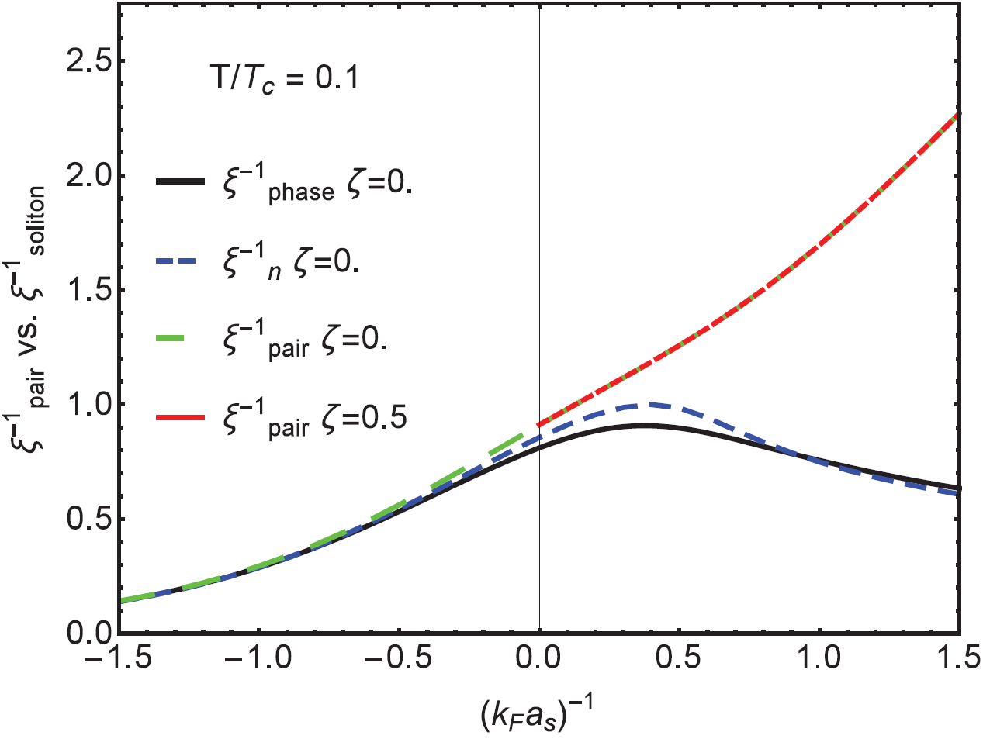
Validity domain
Long-wavelength approximation is valid if dimension soliton is larger than dimension Cooper pairs
Compare soliton width and pair coherence length
Notes:
Theory was based on long-wave length approx that psi varies slowly, i.e. it is valid as long as the soliton width larger than dimension cooper pairs. Two measures for inverse width of soliton, inverse coherence length for different values imbalance. At higher temperatures, no problem across whole interaction spectrum, at lower temperatures, problem in BCS regime
, is indeed region of parameter space where discrepancies showed up.
Two quantities for size soliton: soliton width and healing length (calculated at vs=0 by modelling the spatial profile of the order parameter with a trial form of the amplitude modulation tanh(x/sqrt(2) xi) and minimizing the free energy with respect to this variational parameter + rescaling factor 1,175 because of independent definitions xipair and xiphase that have to coincide in extreme BCS T=0 limit). The coherence length of the pairs is calculated in terms of the pair correlation function. At unitarity difference between width and healing because while both in BCS and BEC hyperbolic tangent is suitable for amplitude, it is generally not true in unitarity.

Slide 17
Conclusions and future developments
EFT description of dark solitons in ultracold Fermi gas
Important link between population imbalance and solitonic properties
Increasing the imbalance results in filling of the soliton
Soliton core is a convenient location to accomodate excess component particles
Filling modifies dynamics of the soliton
Analysis of the validity domain of the EFT
Analysis of the snake instability mechanism

Slide 18
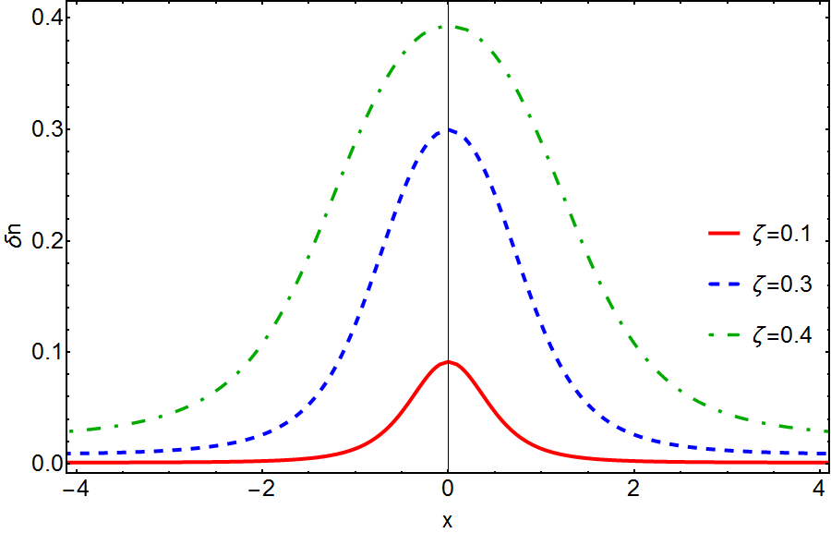
Excess-density profile

