Slide 1
Heat-transfer method-based cell culture quality assay through cell detection by surface imprinted polymers
Kasper Eersels, Bart van Grinsven, Mehran Khorshid, Veerle Somers, Thomas Cleij, Ronald Thoelen, Patrick Wagner

Slide 2
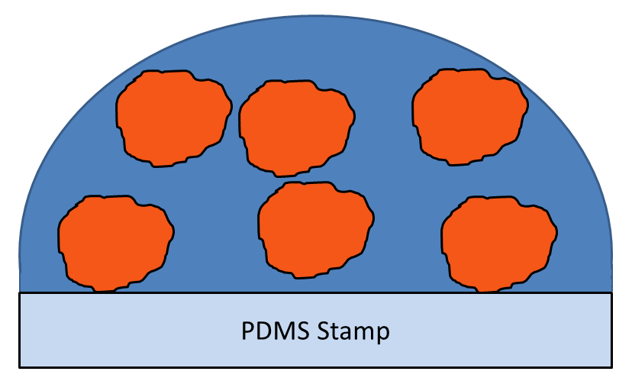
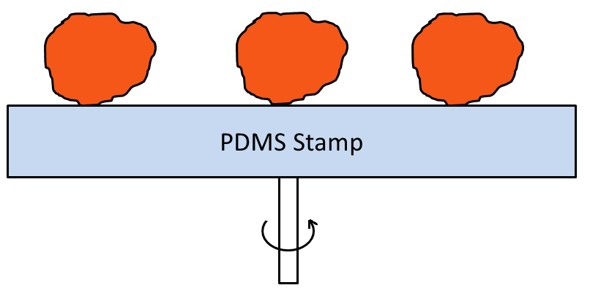
Surface Imprinting?
Sediment cells on a home-made silicone stamp (PDMS)
Spin coating removes excess buffer solution and target cells form a monolayer on the stamp
Hayden, O. and Dickert, F.L. Adv. Mater. 2001, 13, 1480-1483.

Slide 3
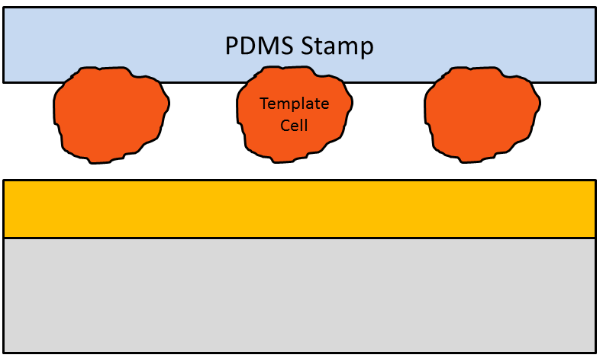
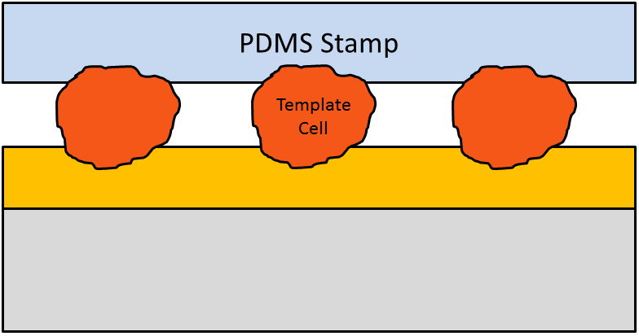
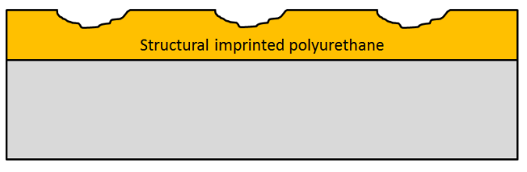
Surface Imprinting?
Removal of the stamp and cells creates a SIP layer imprinted for target cell type
Spin coating of a semi-cured PU layer onto aluminum substrate
Stamping of the cells in the PU layer, curing the layer overnight at 65°C
PU: polyurethane

Slide 4
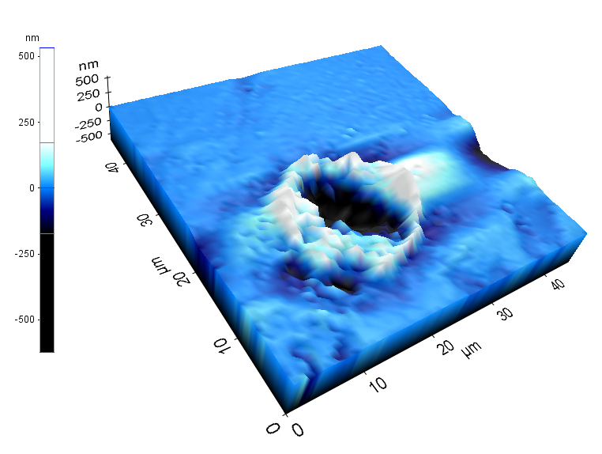
SIP Surface Characterization
Optical microscopy
Atomic Force Microscopy
K. Eersels, B. van Grinsven et al. ACS AMI 2013, 5(15), 7258-7267.

Slide 5
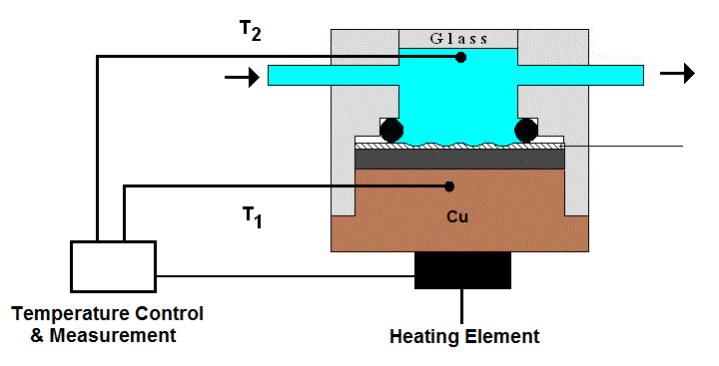
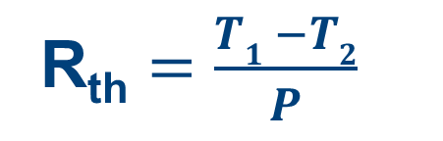
Read-Out: the Heat-Transfer Method
SIP
R_{th} $=\frac{T1 −T2}{P}$
B. van Grinsven et al. ACS Nano 2012, 6(3), 2712-2721.

Slide 6
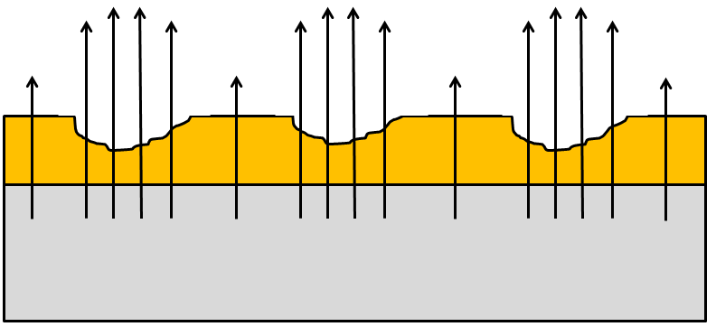
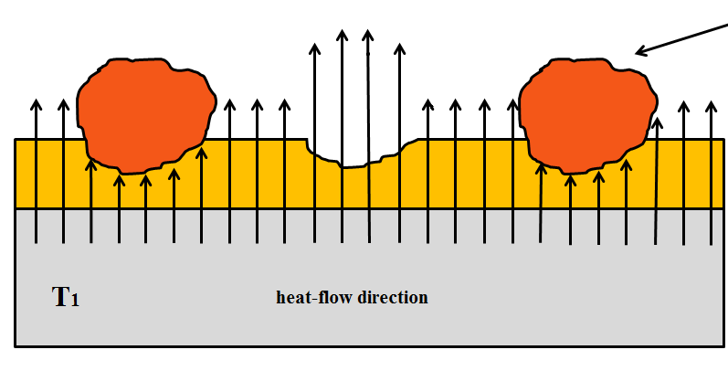
Read-Out: the Heat-Transfer Method
Microcavities form preferential heat channels
Cell binding causes an increase in thermal resistance (Nakano et al.)
Heat is forced to transfer over thicker, non-imprinted region
Measured as a decrease in T₂ → Increase in R_{th}
K. Eersels, B. van Grinsven et al. ACS AMI 2013, 5(15), 7258-7267.

Slide 7
Detection of Circulating Tumor Cells?
Selective discrimination between tumor cells and healthy cells
Sensitivity limits applicability in CTC detection
→ Improve sensitivity and find other applications
K. Eersels, B. van Grinsven et al. ACS AMI 2013, 5(15), 7258-7267.

Slide 8
Experiment
RWTH Aachen: problem with ZR-75-1 cells, grow pattern changed
STR DNA profile: over-passaging led to cross-contamination with a faster growing cell line
Reproduce circumstances: grow both cell lines for 3 months and about 25 passages in the same lab
Analyze ZR-75-1 cells with SIP-based assay on HTM

Slide 9
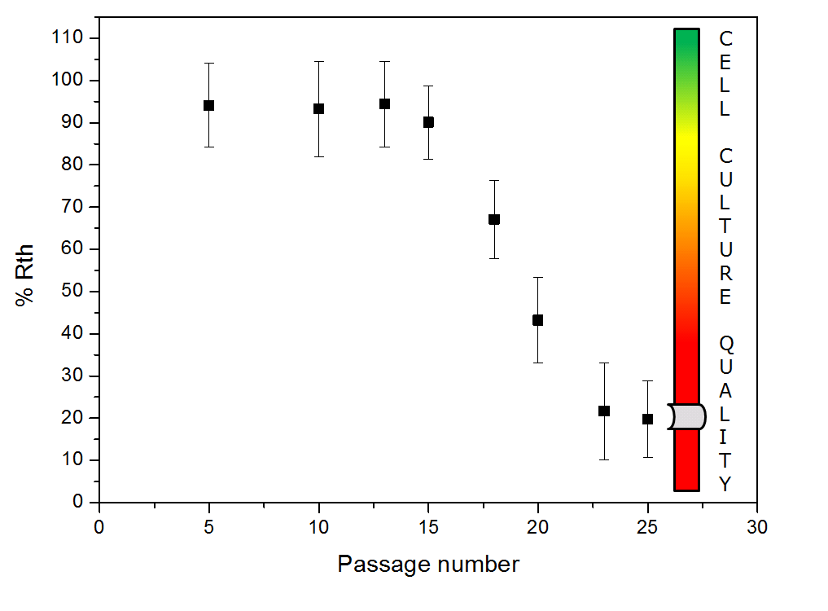
Results
At passage number 15 “something” happens
Effect increases with passage number
At passage 22 Rth minimum reached
→ STR DNA profile: cross-contamination!

Slide 10
Conclusions
State-of-the-art devices (FACS) or assays (STR DNA profile) too slow and expensive for routine screening
HTM can offer a low-cost and fast alternative
Sensitivity is sufficient
Limited to changes at the membrane
Setup needs to be tested for other cell lines

Slide 11

The end? Questions?

