Slide 1

Self-organisation of stochastic oscillators in a predator-prey model
¹Sara Moradi and ²Johan Anderson
¹Fluid and Plasma Dynamics, Université Libre de Bruxelles, Brussels, Belgium
²Department of Earth and Space Sciences, Chalmers University of Technology, Göteborg, Sweden
S. Moradi et al PRE 2015
S. Moradi and J. Anderson, PoP 2016
S. Moradi et al, to be submitted.

Slide 2
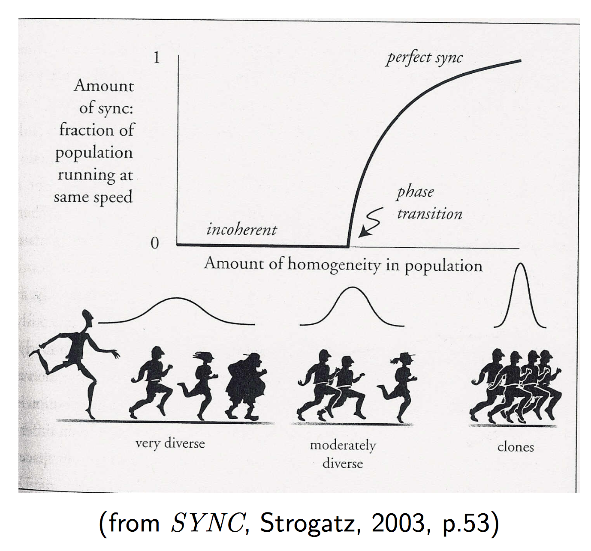
Collective synchronization in nature
Examples are:
Metabolic synchrony in yeast cell suspensions,
Mutual synchronization of cardiac pacemaker cells
Synchronized firings of cardiac pacemaker cells,
Flashing in unison by groups of fireflies,
Voltage oscillations in an array of current-biased Josephson junctions,
Phase synchronization in electrical power distribution networks,
Rhythmic applause,
Animal flocking behavior,
Etc.

Slide 3
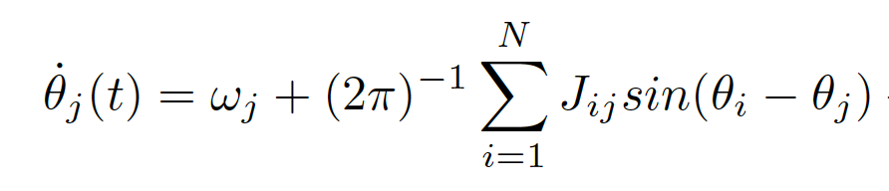
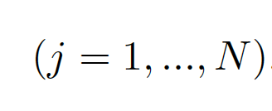
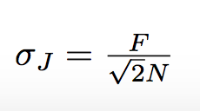
Kuramoto Model of limit cycle oscillators
θ_{j}
θ_{j} : phase of jth oscillator
ω_{j} : natural frequency and Gaussian distributed
J_{ij} : coupling strength and Gaussian distributed with J_{ij} > 0 and J_{ij} = J_{ji}
with SD as
This equation is solved numerically by RK 4th order method

Slide 4
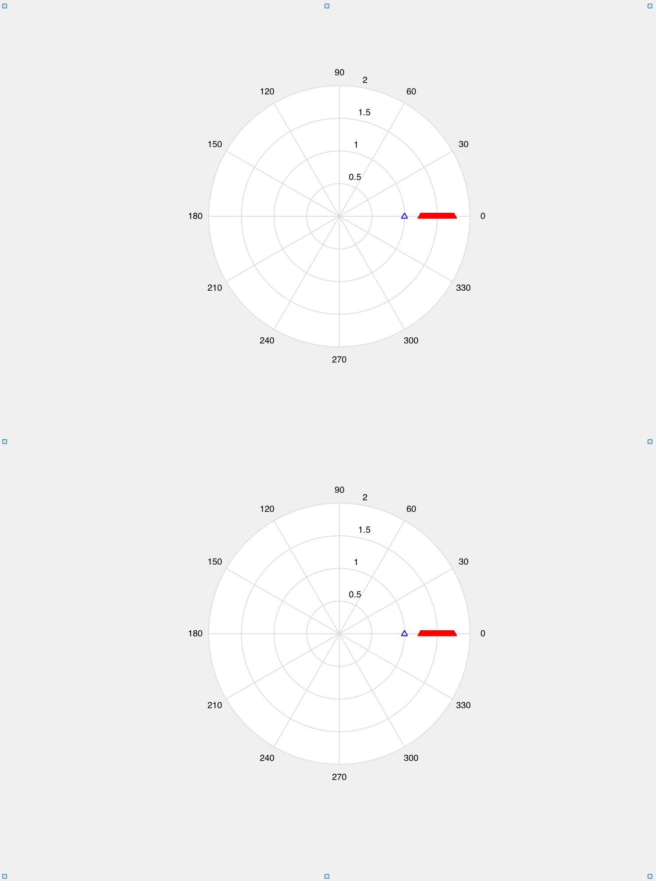
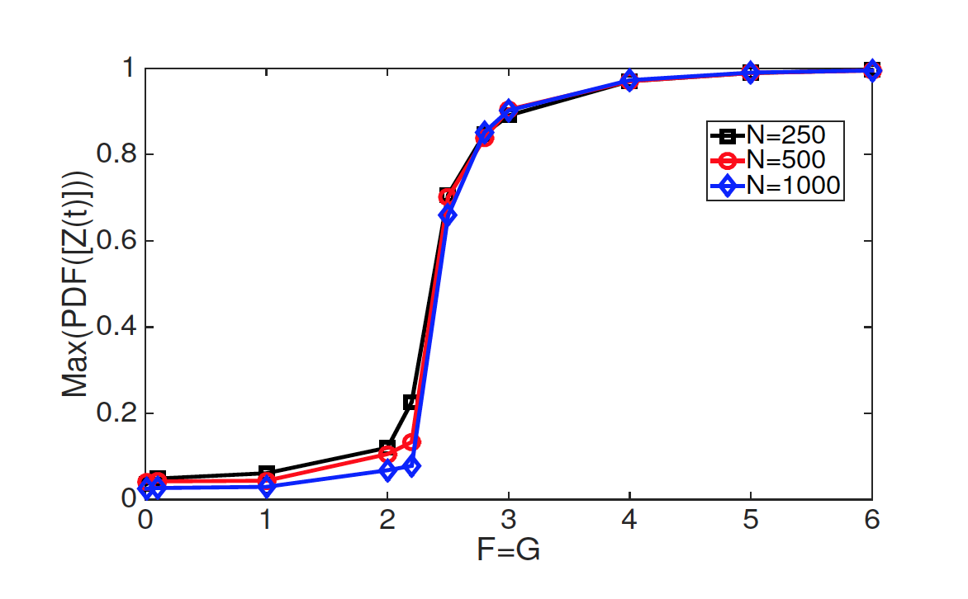


Bifurcation to a synchronized state

Slide 5
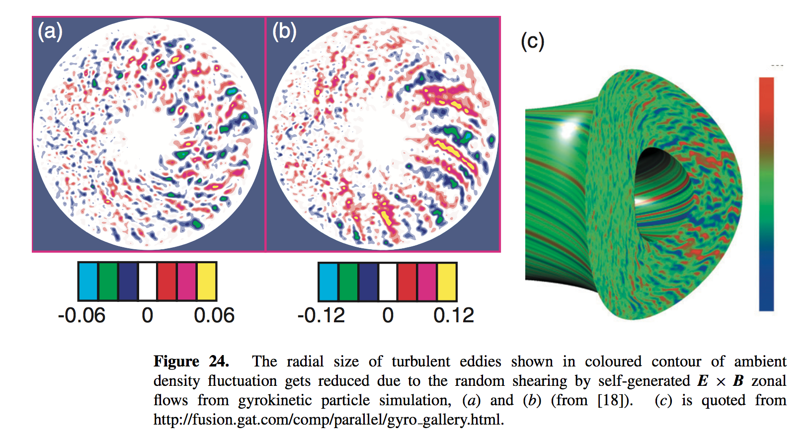
Predator-prey behavior in magnetically confined plasma turbulence
In magnetically confined plasmas drift wave (DW) turbulence is believed to be responsible for the anomalous transport and the generation of inherent sheared zonal flows (ZF) providing a self-regulating mechanism which may control the turbulence itself.
The predator-prey paradigm is used to explaine this dynamical self-regulating behaviour of the dual system of DW-ZF. That is, much like a predator-prey system the damping of DW (i.e. prey) by ZF (i.e. predator) weakens the very source of ZF generation.
P H Diamond et al, Plasma Phys. Control. Fusion 47 (2005) R35–R161

Slide 6
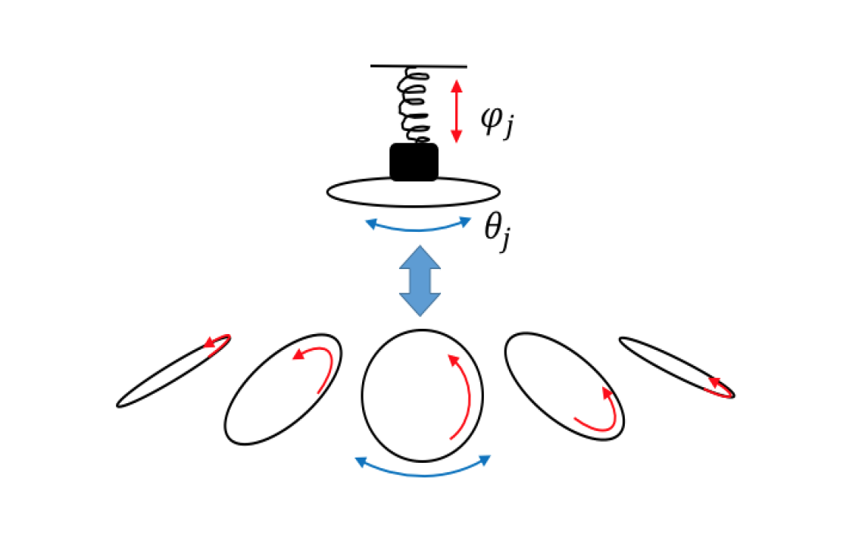
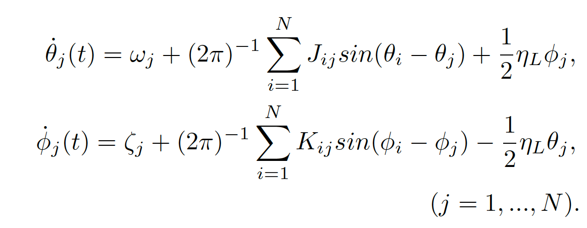
Collective synchronization in 2D
θ_{k} , ϕ_{k}: phases of the kth oscillator
ω_{k} , ξ_{k} : natural frequencies and Gaussian distributed
J_{ik} , K_{ik}: coupling strength and Gaussian distributed with J_{ik} > 0 and J_{ik} = J_{ki}
η_{L} : strength of the linear coupling
This equation is solved numerically by RK 4th order method

Slide 7

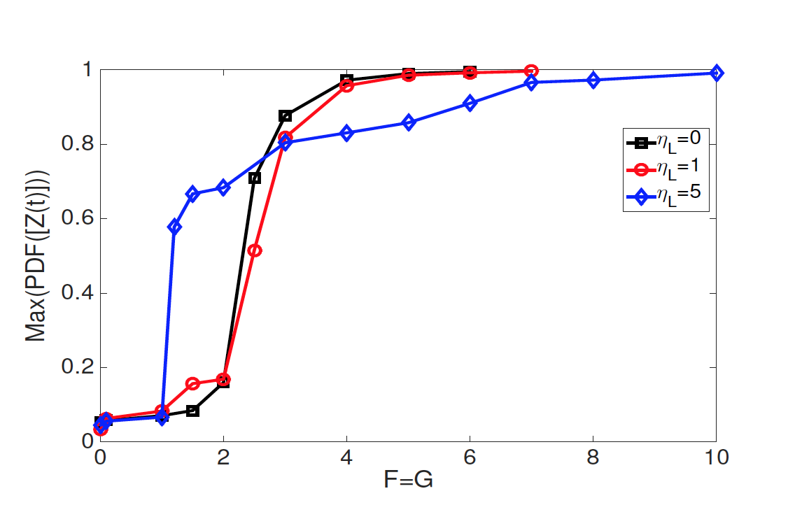
Predator-Prey behavior between the two phases

Slide 8
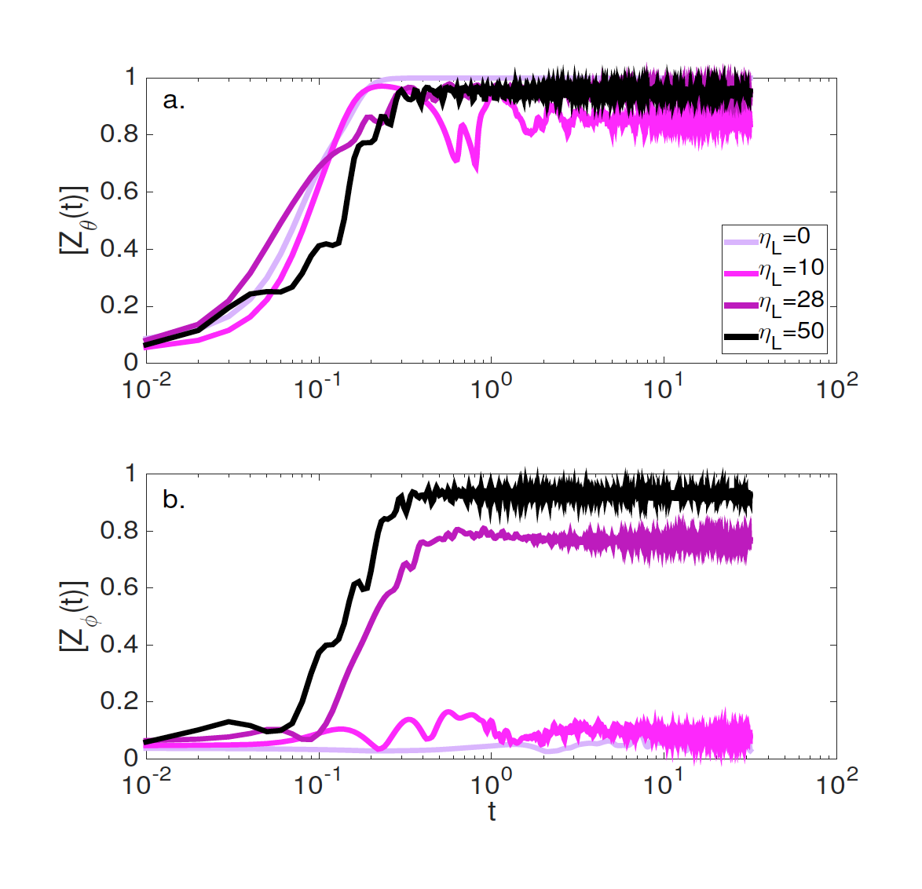
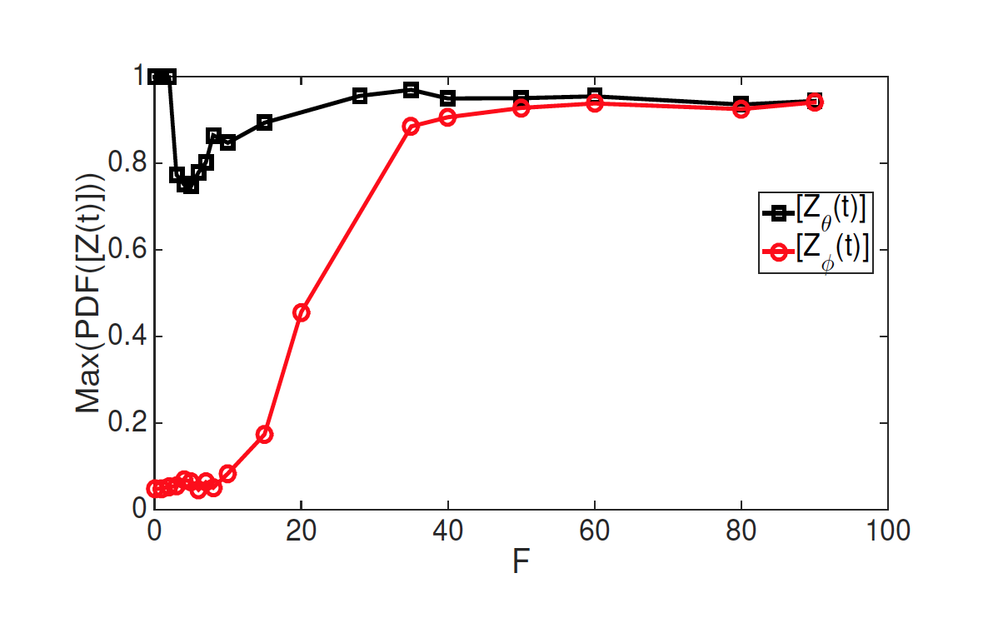

Transfer of synchronization between populations

Slide 9
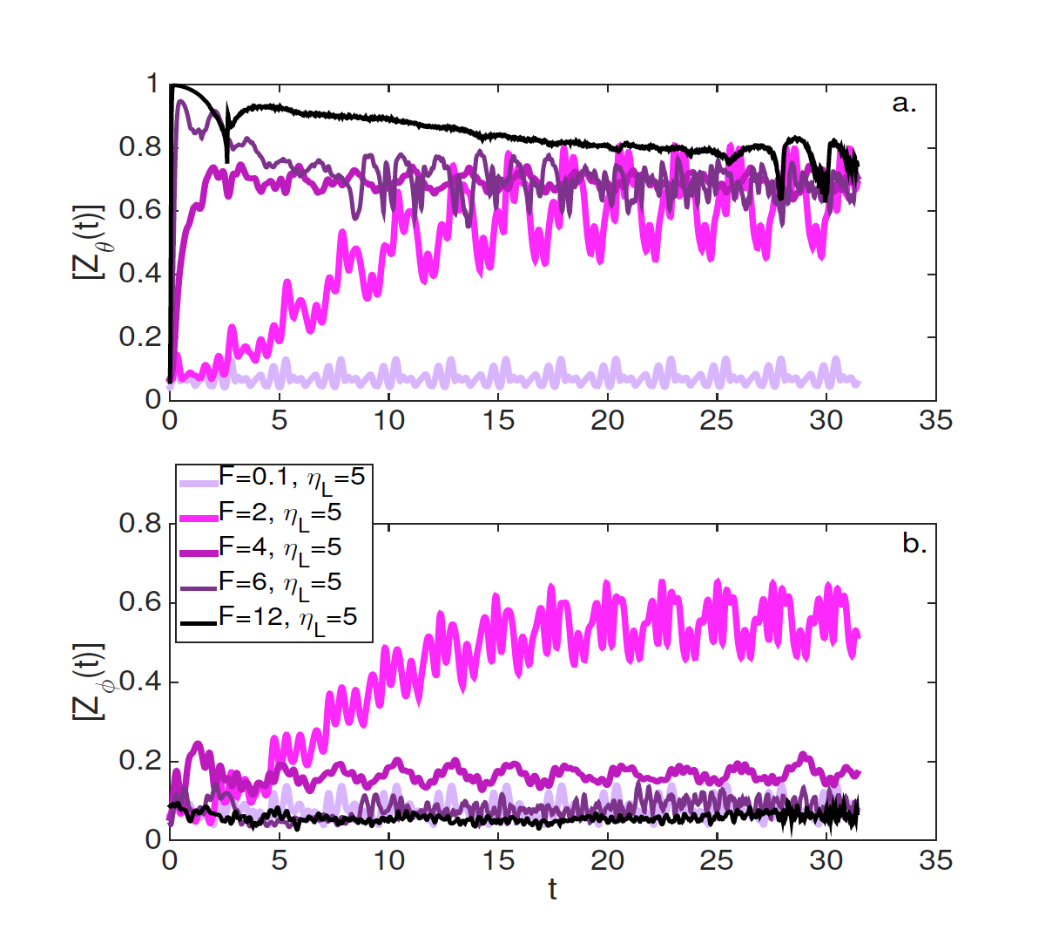
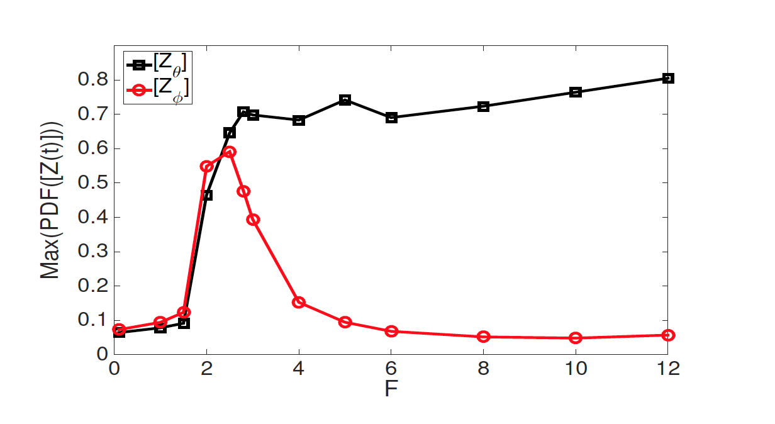
Transfer of synchronization between populations

Slide 10
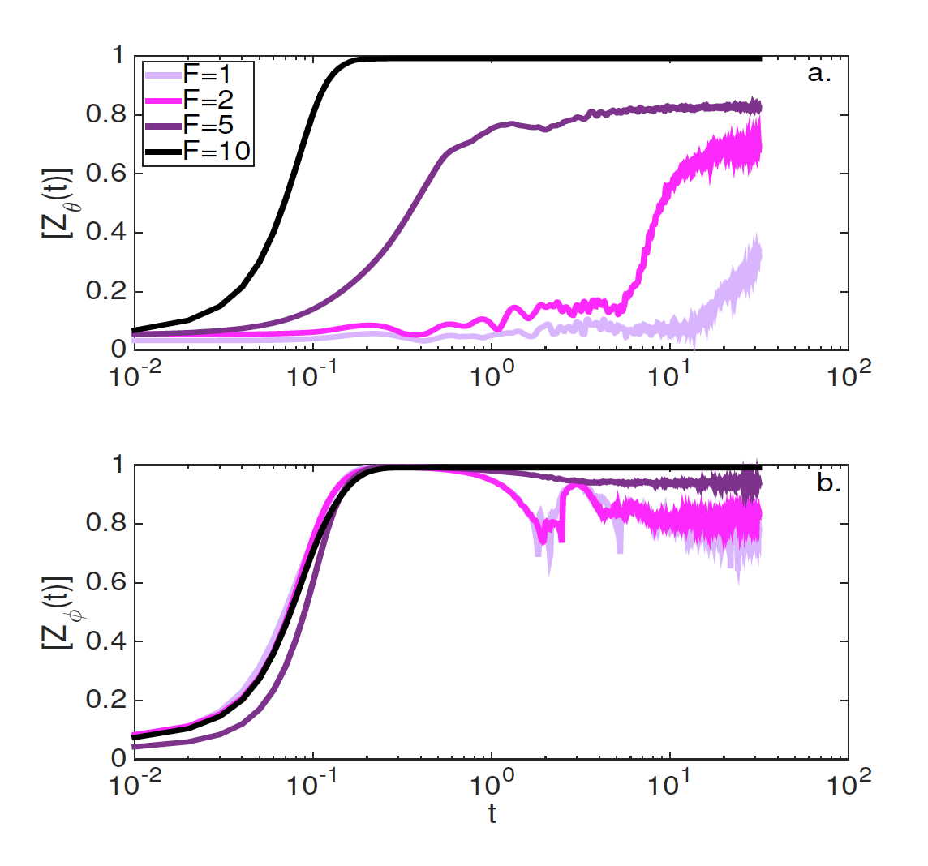
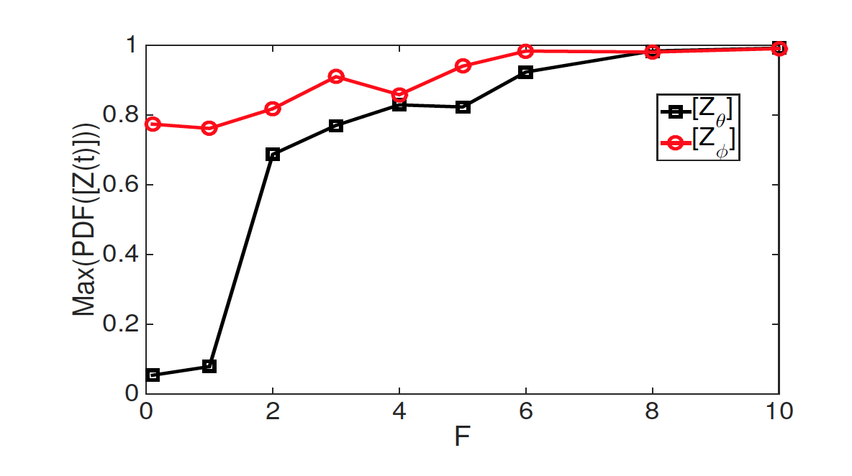
Transfer of synchronization between populations

Slide 11
Motivation
In turbulence theory the phase dynamics of the fluctuations have hitherto been largely neglected and most often random phases are assumed (RPA).
One would think that the rate of stochastization occurring in non-linear interactions increases as the amplitude of the modes increase, however the increased energy flux through nonlinear mode coupling processes allows for coherent structures (sheared flows, geodesic acoustic modes etc. ) to be formed which can even grow in the presence of random fields or cascade to smaller scales.
This is one manifestation of the so-called self-organization process.
What is the role of phase dynamic in a turbulent system?

Slide 12
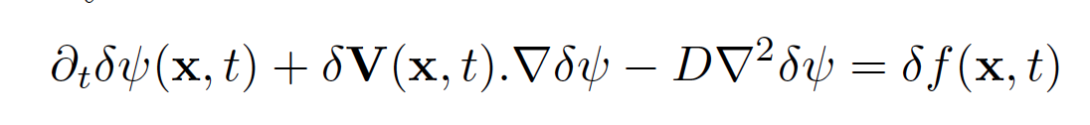
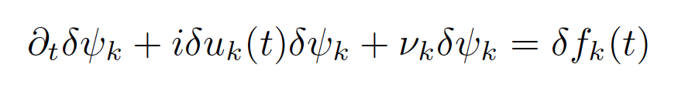
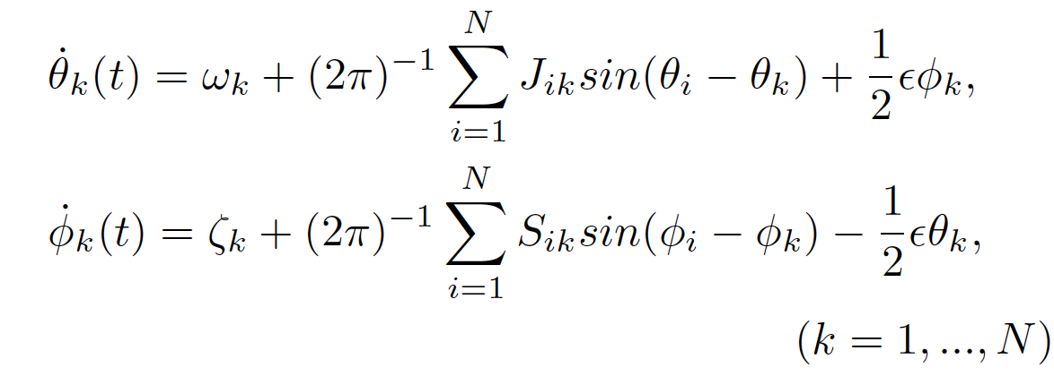
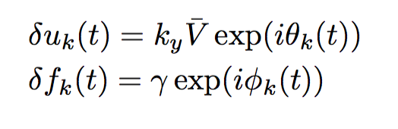
Phase dynamic in passive-advective model

Slide 13
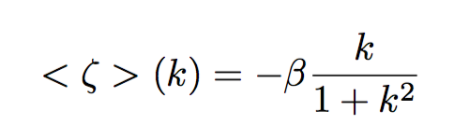
Phase dynamic in passive-advective model

Slide 14
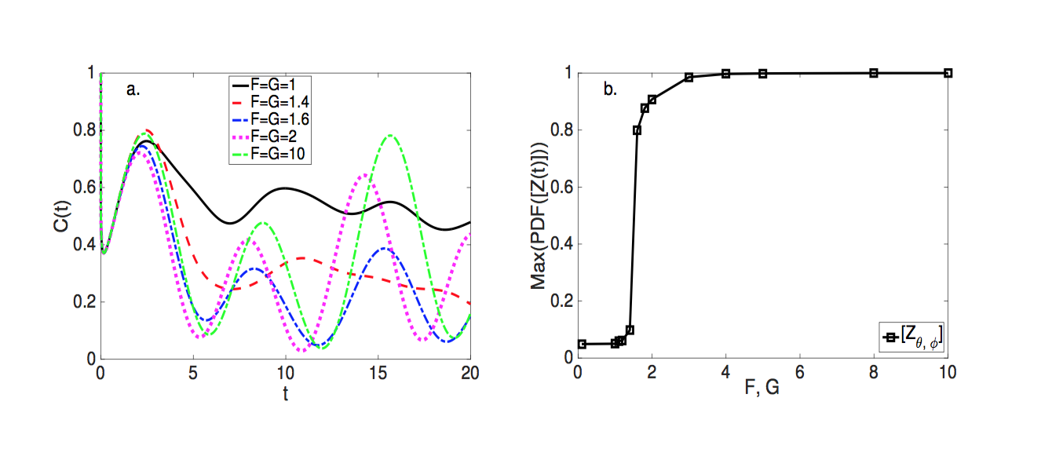

Colective phase synchronization impact on the fluctuations

Slide 15
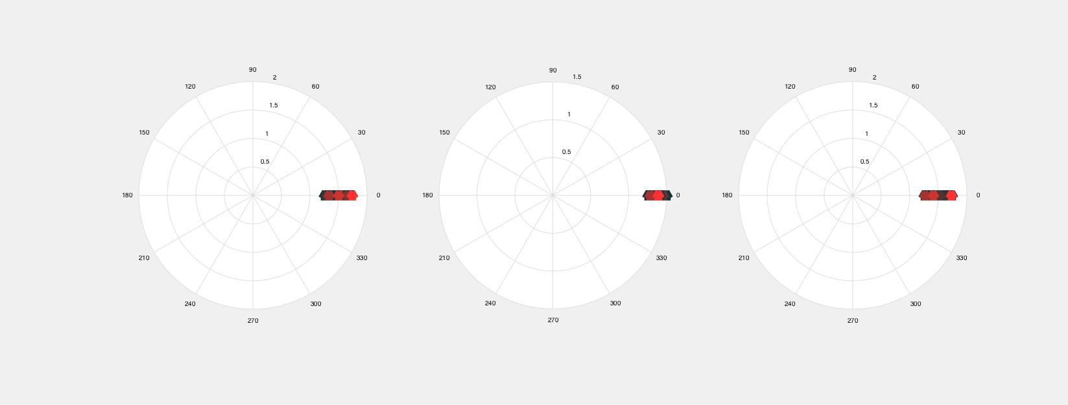
Dynamic of the fluctuations phases
A-synchonized state

Slide 16
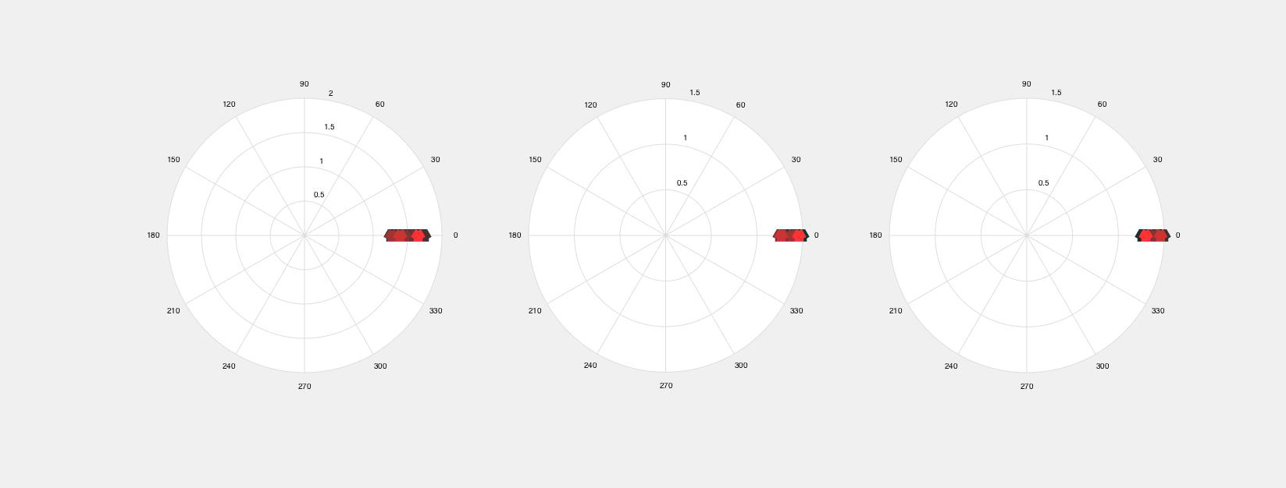
Dynamic of the fluctuations phases
Synchonized state

Slide 17
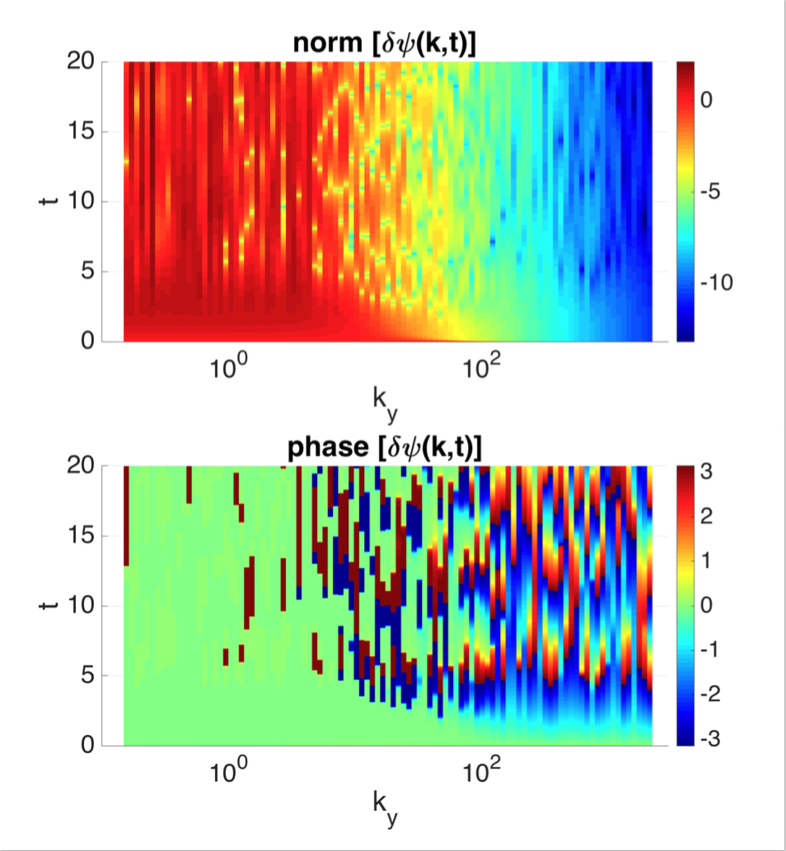
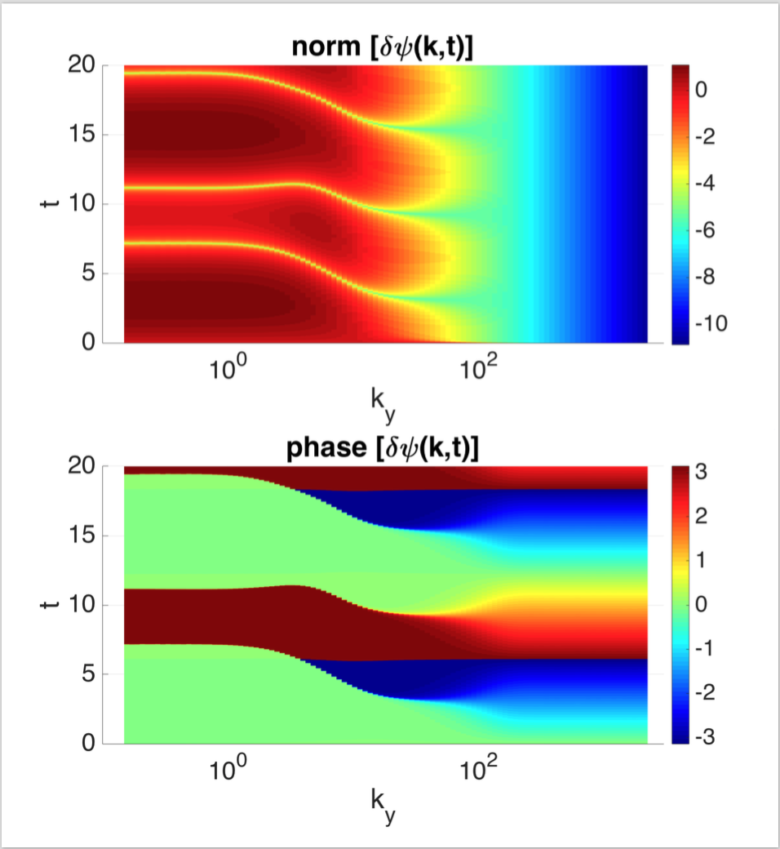
Modulational behavior obsevered in case of synchronized phases

Slide 18
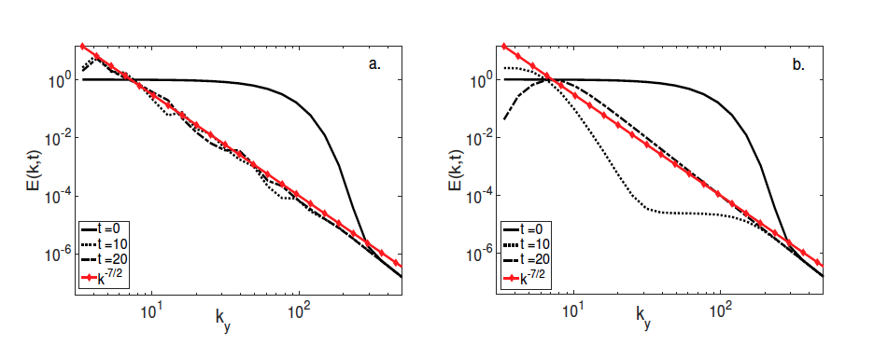
Power decay of the energy spectrum

Slide 19
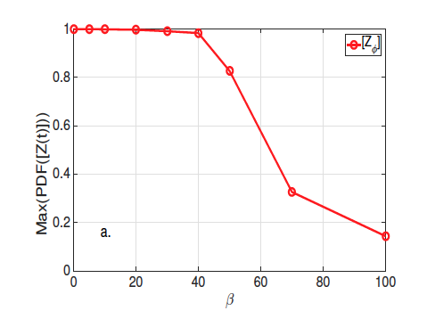
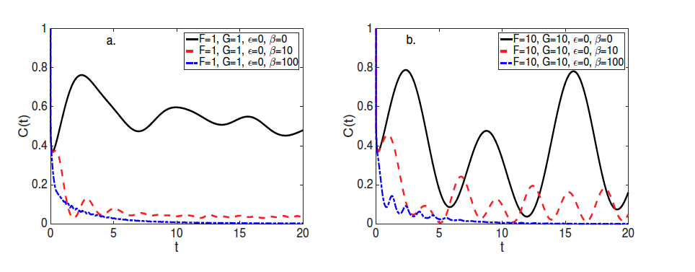
Desynchronization due to dispersion relation

Slide 20
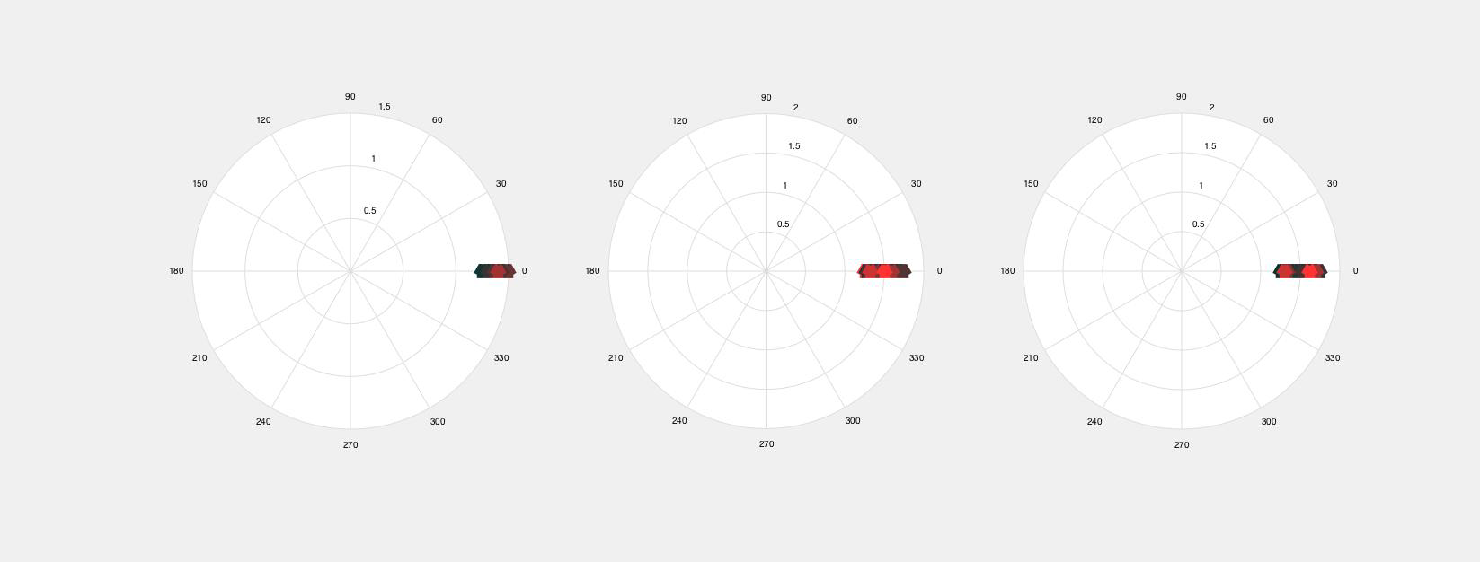
Desynchronization due to dispersion relation
Synchonized case

Slide 21
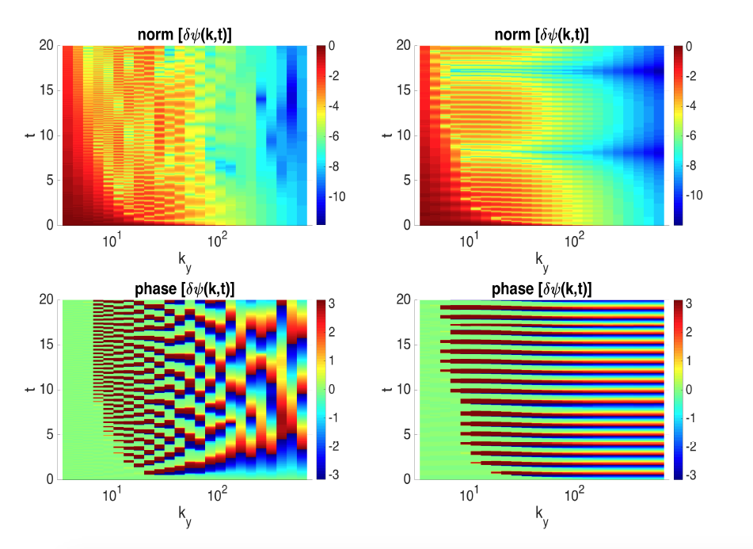
Desynchronization due to dispersion relation

Slide 22
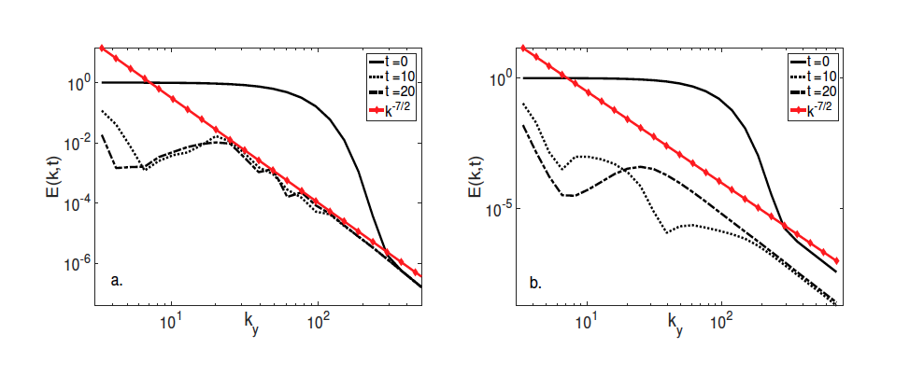
Desynchronization due to dispersion relation

Slide 23
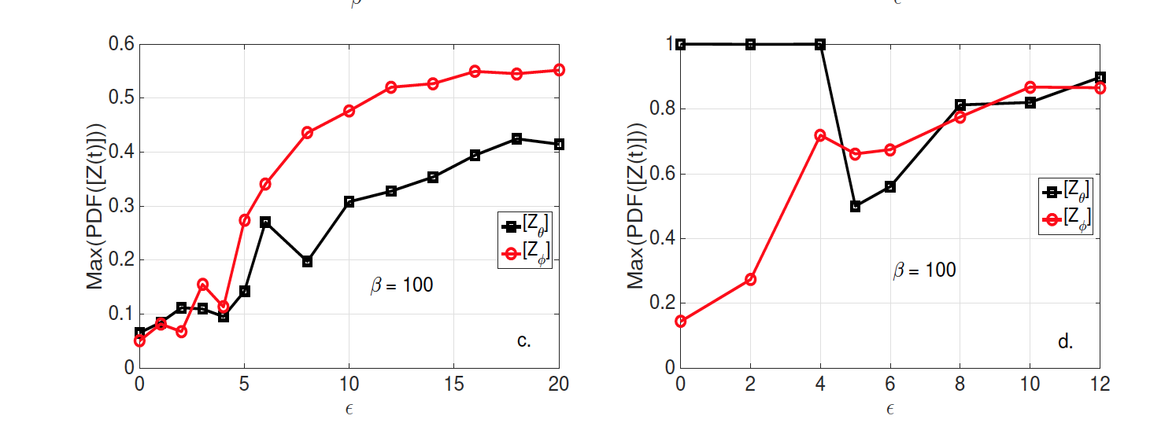
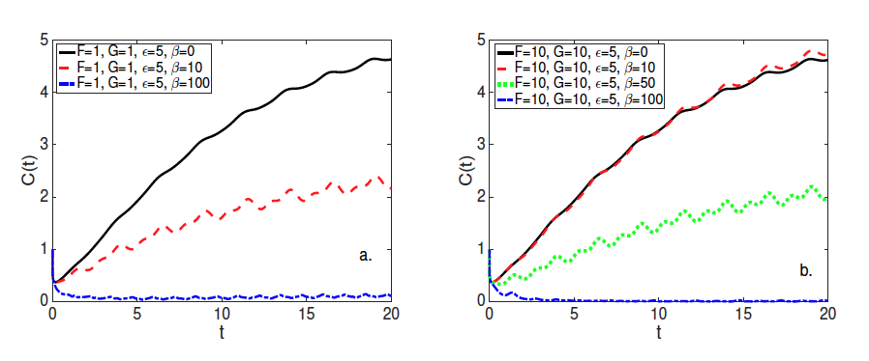
Predator-prey model of the phases

Slide 24
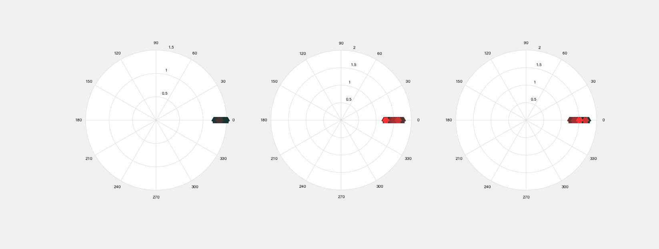
Predator-prey model of the phases
A- synchonized case

Slide 25
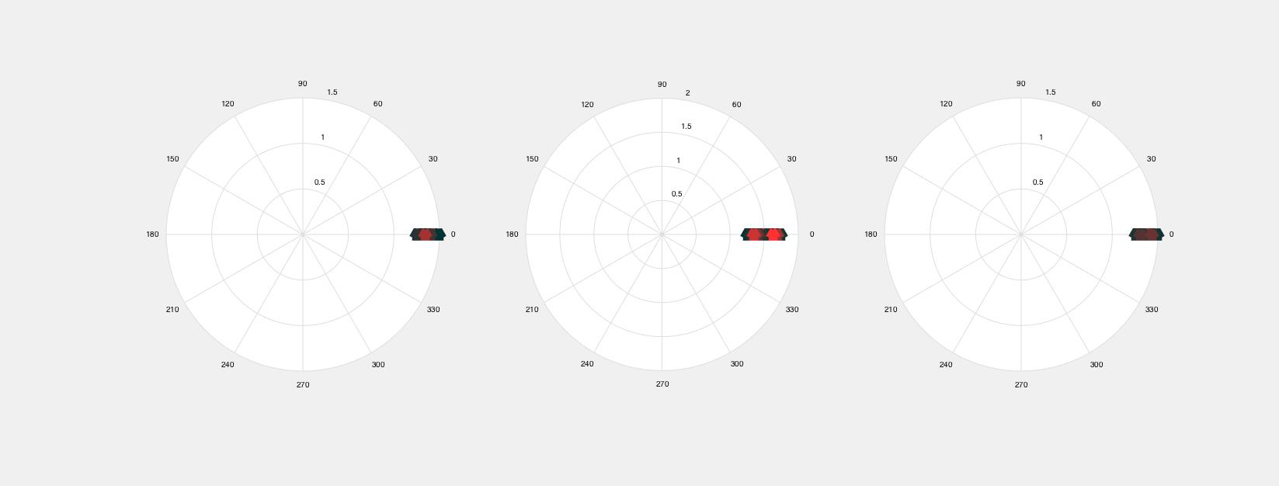
Predator-prey model of the phases
Synchonized case

Slide 26
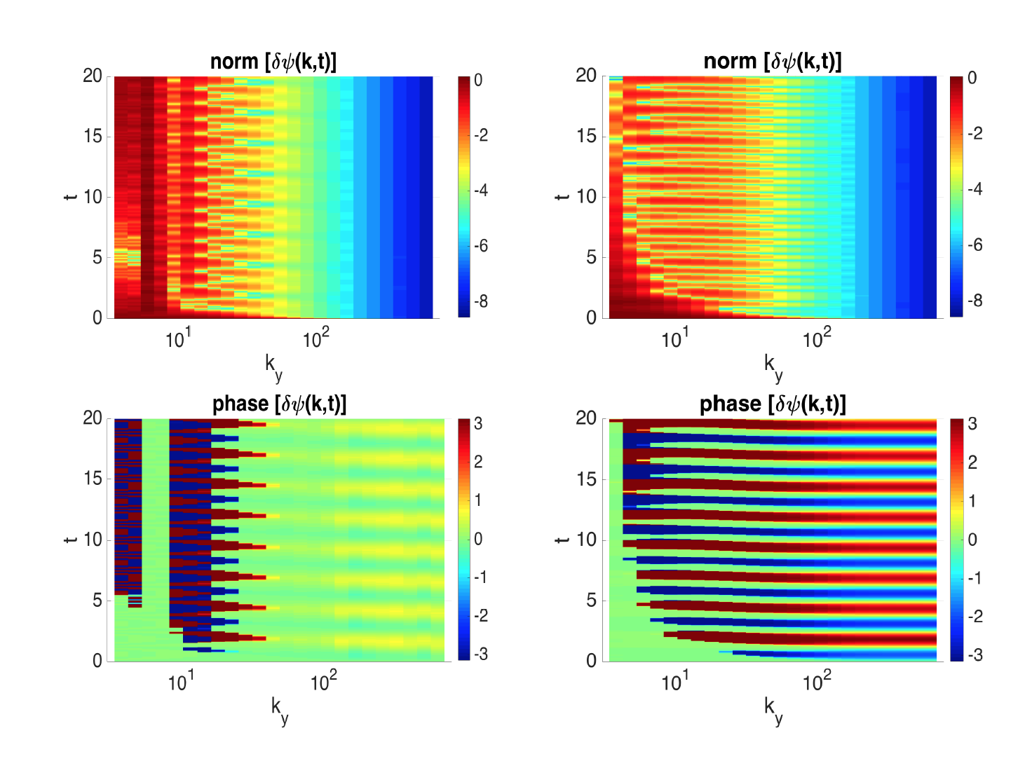
Predator-prey model of the phases

Slide 27
Predator-prey model of the phases

Slide 28
Summary and Discussion
A transfer of synchionization from one population to another is obseverd.
The assumption of a fully stochastic phase state of the turbulence is more relevant for high values of scale separation with the energy
For lower scale dependence the asynchronised and synchronised phases differ signicantly, and one could expect the formation of coherent modulations in the latter case.
A self-consistant model for the phase dynamic is ongoing (to be submitted).

