Slide 1
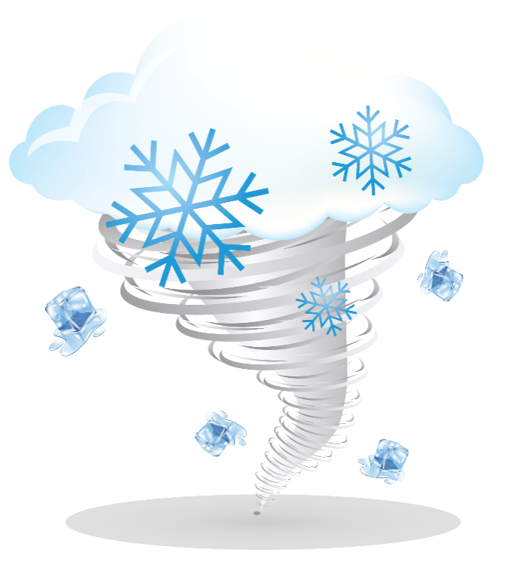
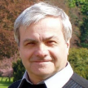
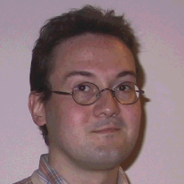
Vortex structures in ultracold Fermi gases
In collaboration with:
Dr. Klimin
Prof. Tempere
Nick Verhelst, Sergei Klimin and Jacques Tempere
Theory of Quantum Systems & Complex Systems (TQC) – University of Antwerp
General Scientific Meeting 2016 of the Belgian Physical Society
Condensed Matter and Nanostructure Physics
Notes:
Presentatie wordt gegeven in het Engels, slides zijn voor de studenten in het Nederlands. Jammer genoeg zet ik niet veel tekst op mijn slides, maar
Onderwerpen die in de show aan bod komen:
De BEC-BCS crossover
De Gross-Pitaevskii vergelijking
Over vortices (waarom hebben ze een gat, …)
Een stap verder: de structuur van vortices (…)

Slide 2
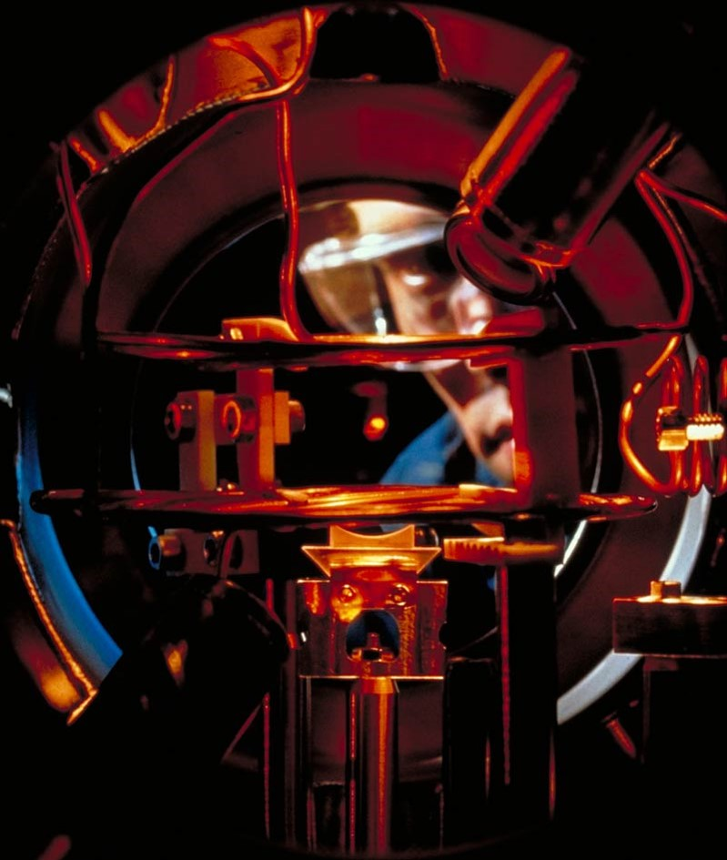
Introduction: The system of ultracold quantum gases
 | Clouds of typically 100’000 atoms, bosons (such as ²³Na) or fermions (such as ⁴⁰K). Trapped in a magneto-optical trap, typically a parabolic confinement with frequency 2π·150 Hz, or size (a_{HO}) of microns. Quantum degeneracy temperature is of the order of 100 nK. Interatomic interaction of neutral atoms at low temperatures is characterized by a single number, the scattering length: nanometers. Photo: H.M. Helfer/NIST
System parameters
Harmonic oscillator length a_{HO}
Tuning parameters:
Temperature T
“Spin-up” and “Spin-down” atoms N↑ and N↓
Scattering length a_{s}
Notes:
Before we start it’s a good idea to illustrate how our system looks like.
At the left you see a picture of a magneto-optical trap containing a cloud of trapped atoms. The glass cel is vacuum-pumped, and has protrusions where the cooling laser beams enter. A coil for the magnetic quadrupole trapping is also visible at the edge of the figure.

Slide 3
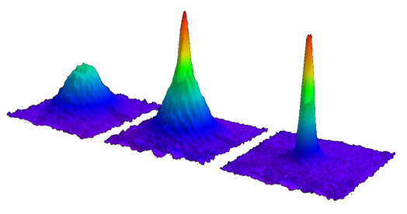
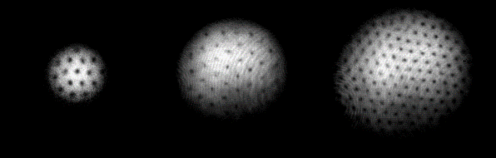
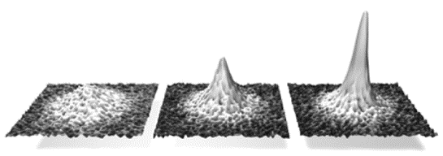
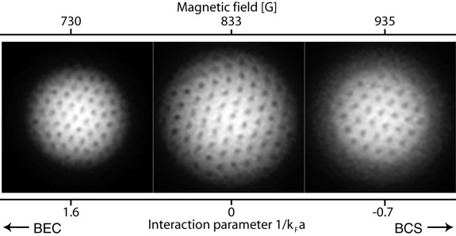
Introduction: The “history” of ultracold quantum gases
1995: Bose-Einstein condensation demonstrated in a Bose gas M. H. Anderson, J. R. Ensher, M. R. Matthews, C. E. Wieman, and E. A. Cornell, Science 269, 198 (1995); K. B. Davis, M.-O. Mewes, M. R. Andrews, N. J. Van Druten, D. S. Durfee, D. M. Kurn, and W. Ketterle, Phys. Rev. Lett. 75, 3969 (1995); C. C. Bradley, C. A. Sackett, J. J. Tollett, and R. G. Hulet, Phys. Rev. Lett. 75, 1687 (1995).
1999: Superfluidity in a dilute Bose gas demonstrated through vorticity M.R. Matthews, B.P. Anderson,P.C. Haljan, D.S. Hall, C.E.Wieman, E.A. Cornell, Phys. Rev. Lett. 83, pp. 2498 (1999); K.W. Madison, F. Chevy, W. Wohlleben, and J. Dalibard, Phys. Rev. Lett. 84, 806 (2000); C. Raman, J.R. Abo-Shaeer, J.M. Vogels, K. Xu, and W. Ketterle, Phys. Rev. Lett. 87, 210402 (2001).
2003: Bose-Einstein condensation of pairs demonstrated in a Fermi gas. M.W. Zwierlein et al., Phys. Rev. Lett. 91, 250401 (2003); S. Jochim, et al., Science 302 (2003); M. Bartenstein et al., Phys. Rev. Lett. 92, 120401 (2004); C. Regal et al., Phys. Rev. Lett. 92, 040403 (2004); T. Bourdel et al., Phys. Rev. Lett. 93, 050401 (2004).
2005: Superfluidity in a dilute Fermi gas demonstrated through vorticity M. W. Zwierlein et al., Nature 435, 1047-1051 (2005).
Notes:
A brief history of this rather young topic op ultracold qauntum gases
1995: First Bose-Einstein condensation
1999: Superfluidity demonstrated through vortices
2003: Bose-Einstein condensation of Fermi gas

Slide 4
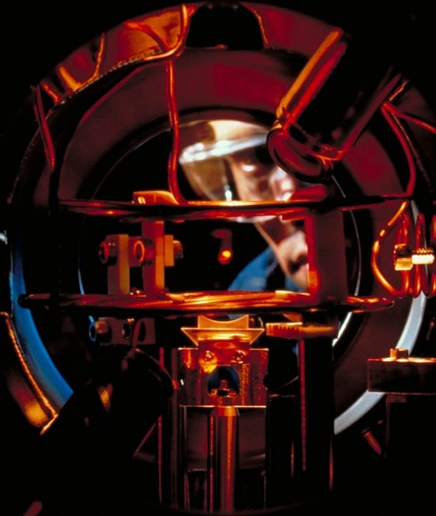
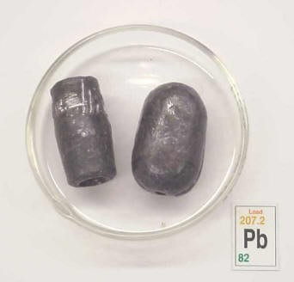
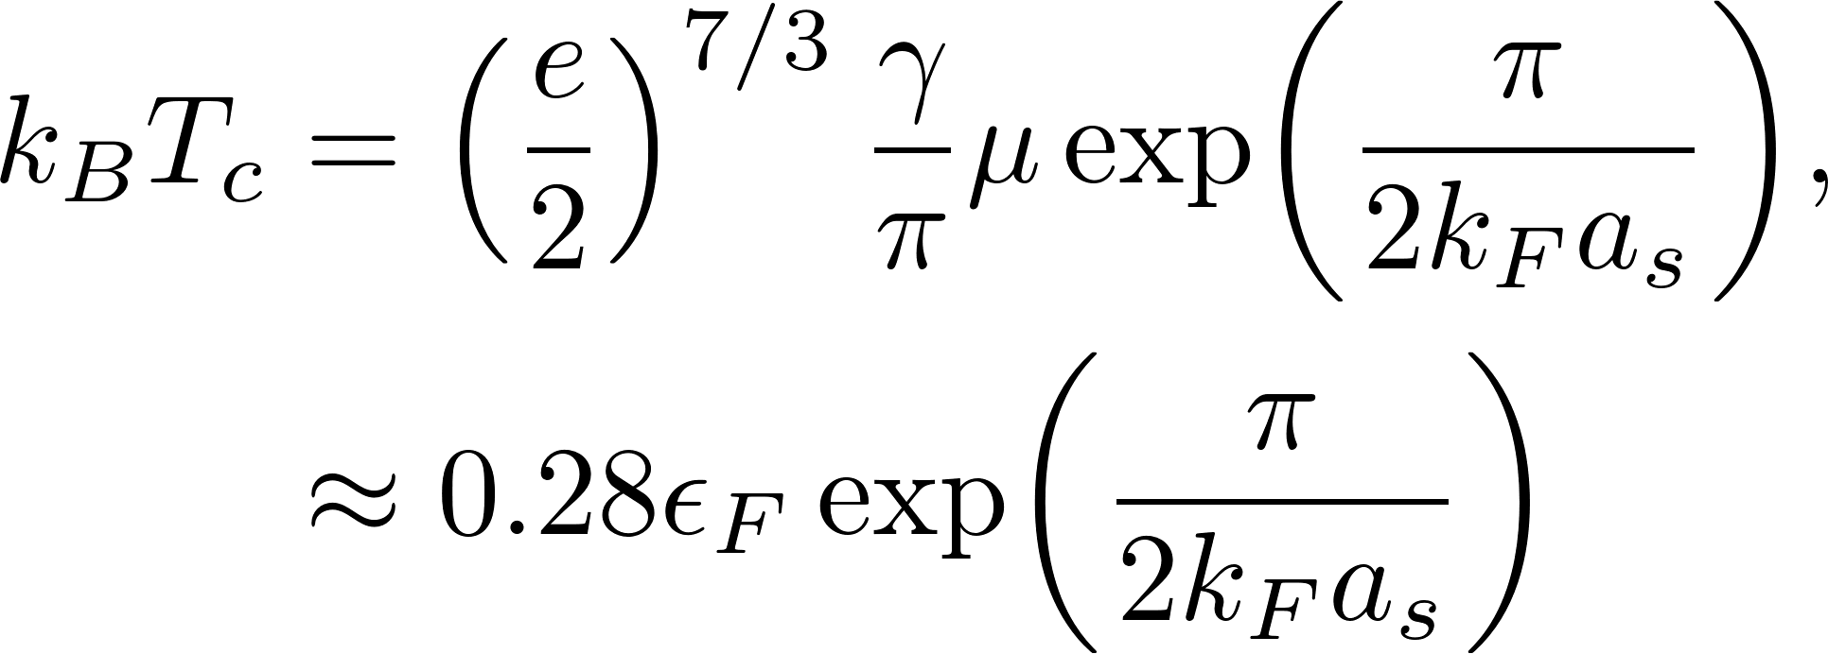
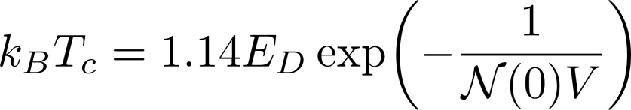
Introduction: Superfluids versus superconductors
ε_{F}: Fermi energy
a_{s}: Scattering length (BCS <0; BEC >0)
k_{F}: Fermi wave vector
Adaptabele interaction strength (& T_{c})
Adaptable spin-imbalance δN/N
E_{D}: Debeye energy
V: BCS interaction strength
N(0): DOS at Fermi level

Slide 5
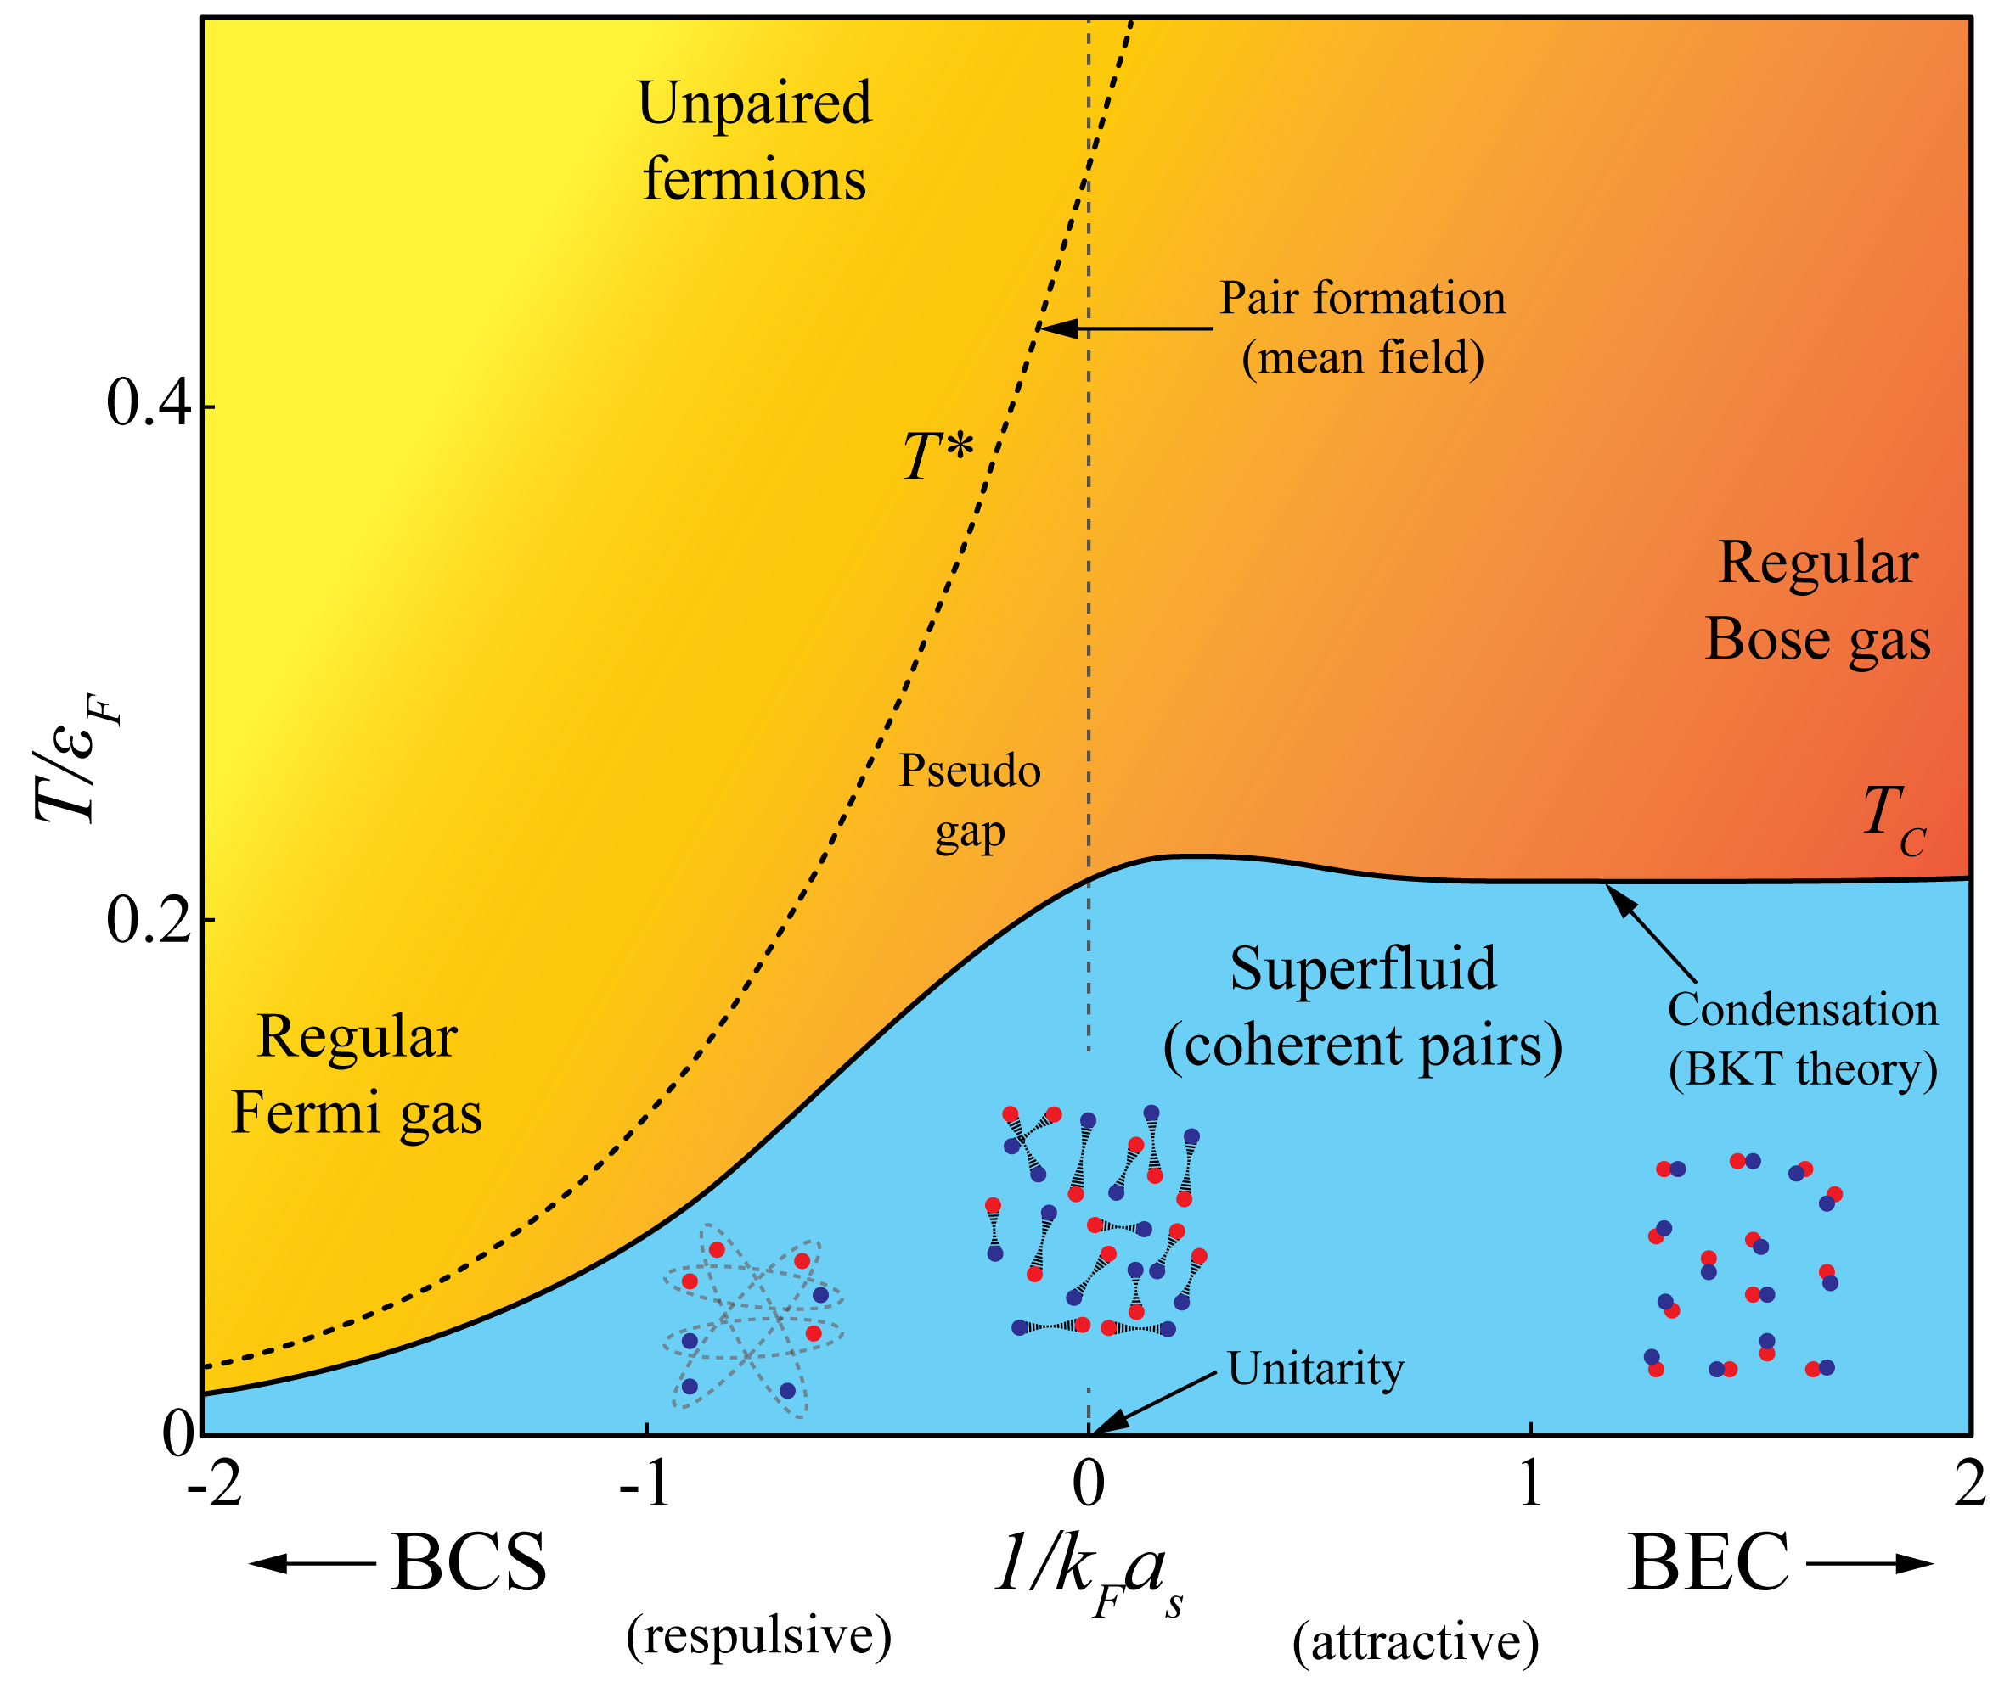
Introduction: the BEC ↔ BCS crossover
M. Randeria, Pre-pairing for condensation, Nat. Phys. 6, 561-562 (2010).
Notes:
Voor Fermionen is de beweging die je dus maakt van links naar rechts als je de logica correct wil uitleggen.
Tpair is in de gemiddelde veld benadering: Wanneer zullen de fermionen (die een gemiddeld veld voelen) paren.
TC is berekend door middel van het in rekening brengen van fluctuaties in dit gemiddelde veld (wanneer krijg je superfluiditeit ?)

Slide 6
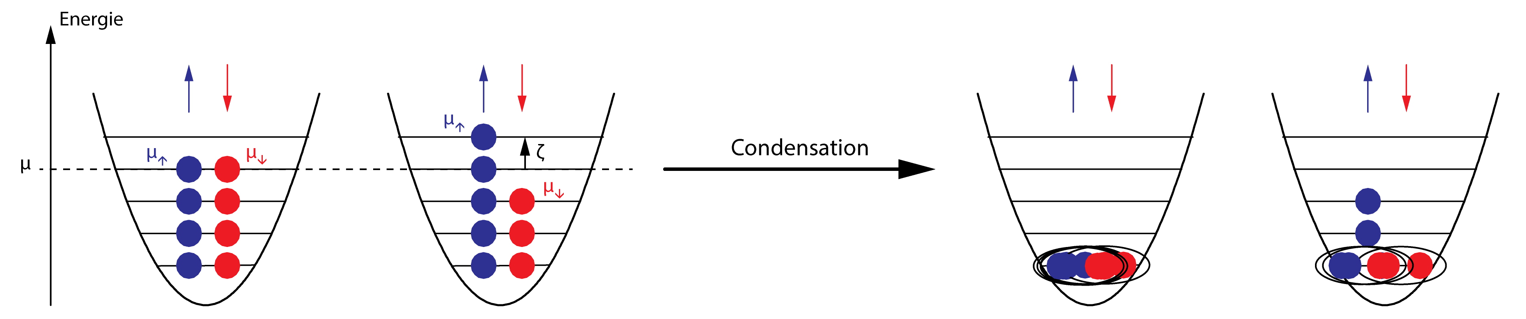
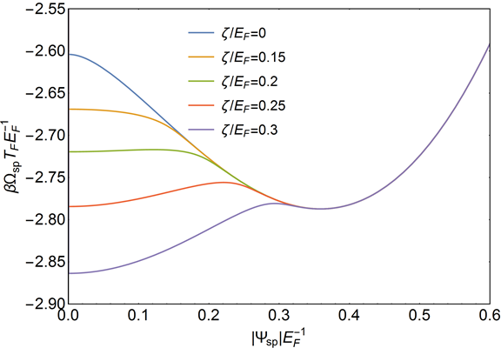
Introduction: the Clogston limit
T=0.01T_{F}
Saddle point minimum
About 0,38 E_{F}
(balanced superfluid)
Imbalanced normal state
Grows as ζ increases
A. M. Clogston, Phys. Rev. Lett. 9, 266 (1962).
B. S. Chandrasekhar, Appl. Phys. Lett. 1, 7 (1962).
M. W. Zwierlein, A. Schirotzek, C. H. Schunck and W. Ketterle, Science 311, 492 (2006).
Notes:
Balanced superfluid: derivative of free energy to polarization equals zero.

Slide 7

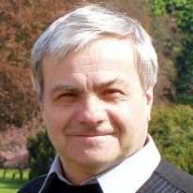
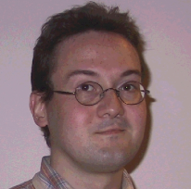
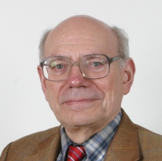
Theoretical description: The KTD effective field theory
Main idea: Ultracold gases → Assume slow fluctuations of the pair field
Expand fluctuations up to quadratic terms.
Saddle point value
Long wavelength fluctuation
(Gradient expansion)
Result: Path integral can be resummed up to all orders
Advantages:
Range of applicability
Computational effort
Details of the calculation:
S.N. Klimin, J. Tempere and J.T. Devreese, Phys. C. 503,136-139 (2014),

Slide 8

The KTD effective field theory: practical calculations
Solve gap and
number equation
Input parameters
T
N↑ and N↓
a_{s}
Saddle point
Pair field (gap equation)
μ Chemical potential (first number equation)
ζ Spin-Imbalance (second number equation)
Hard
Easy
Following
Gor’Kov
(BCS)
Reduces to Ginzburg-Landau for small values of |ψ|²
KDT parameters
Ω_{sp} Saddle point free energy
C, D, E, … KDT coefficients
Details of the calculation:
S.N. Klimin, J. Tempere and J.T. Devreese, arXiv:1508.04693.
Notes:
Gor’Kov was the first to link the microscopic variables to the macroscopic Ginzburg-Landau parameters using a gradient expansion.

Slide 9


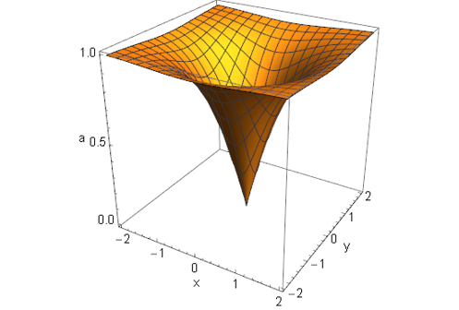
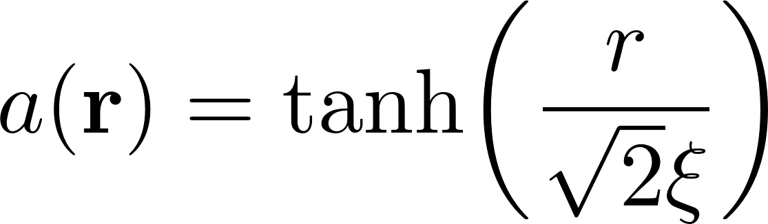
Describing vortices in the KTD effective field theory
Suppose general shape for vortex structure
Phase field
around vortex line
Background
amplitude
Amplitude modulation
Not analytically solvable,
Popular choice variational model:
Variational parameter
Question: How good is this guess?

Slide 10
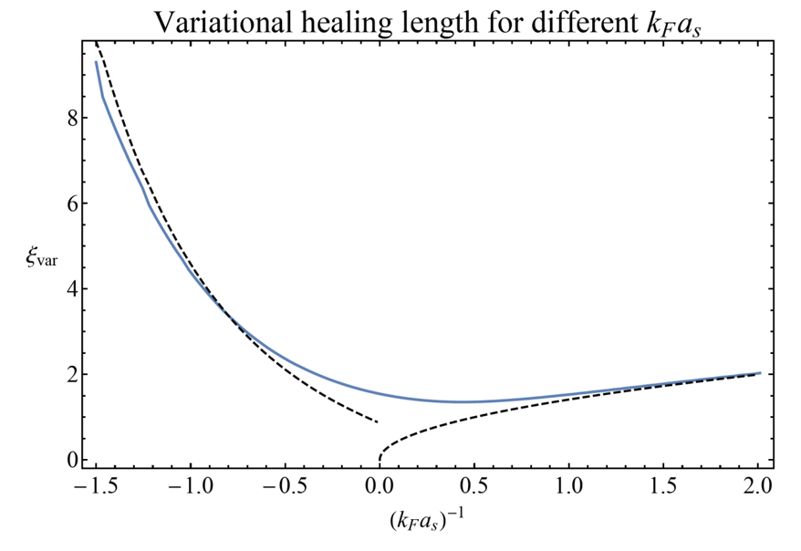
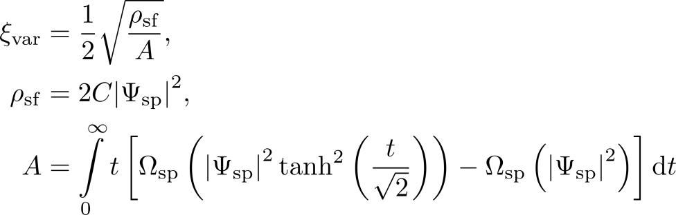
Describing vortices in the KTD effective field theory
Using the variational model we find:
With:
Superfluid density ρ_{sf}
Free energy to make a vortex core A
Dashed lines: L. P. Pitaevskii, Sov. Phys. JETP 13, 451 (1961); M. Marini, F. Pistolesi and G.C. Strinati, Eur. Phys. J. B 1,151 (1998).
Full line: N. Verhelst, S.N. Klimin, J.T. arXiv: 1603.02523 ; results in argreement with Palestrini and Strinati, Phys. Rev. B 89, 224508 (2014).
Also in good agreement with BdG theory at finite T
S.N. Klimin, G. Lombardi, J. Tempere and J.T. Devreese, Eur. Phys. Journ. B 88, 122 (2015),

Slide 11
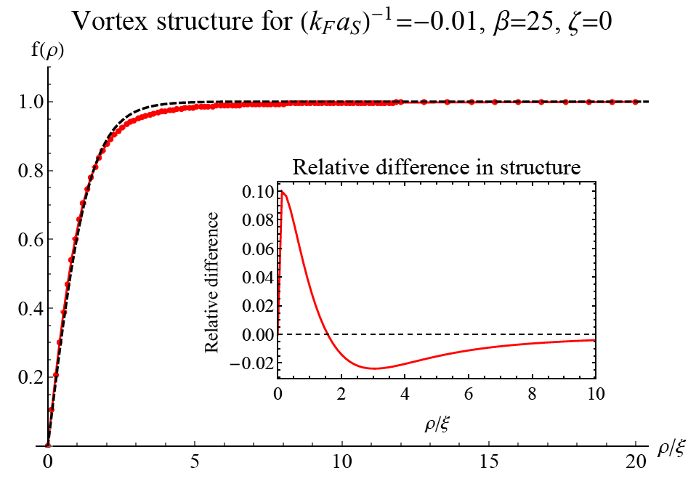
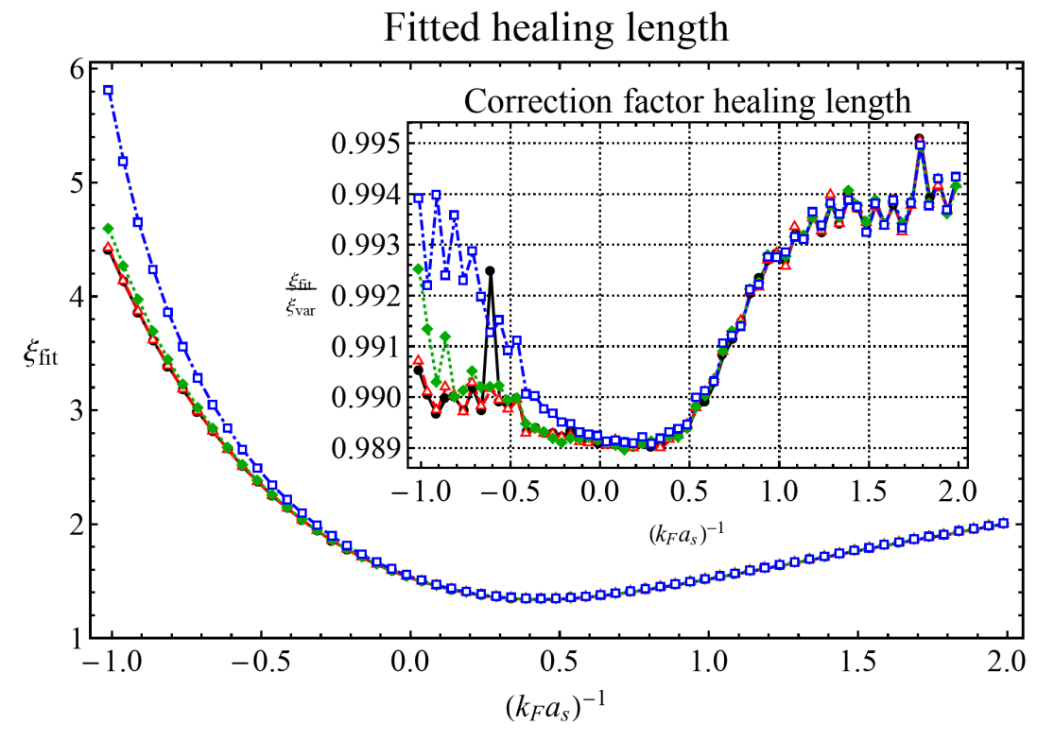
Describing vortices in the KTD effective field theory
Looking for the exact numerical solution we find:
BdG^{[1]} finds oscillations around a tanh profile in low-T, deep BCS regime – here this is never observed.
[1] S. Simonucci, P. Pieri, G.C. Strinati, Phys. Rev. B 87, 214507 (2013).
Our results: N. Verhelst, S.N. Klimin, J.T. arXiv: 1603.02523
Notes:
Explain the numerical algorithm that was used. As said we have a hard problem combined with an easy problem.

Slide 12
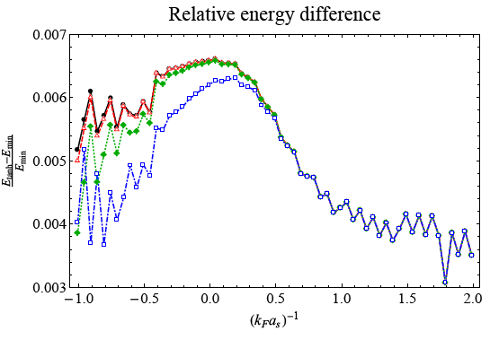
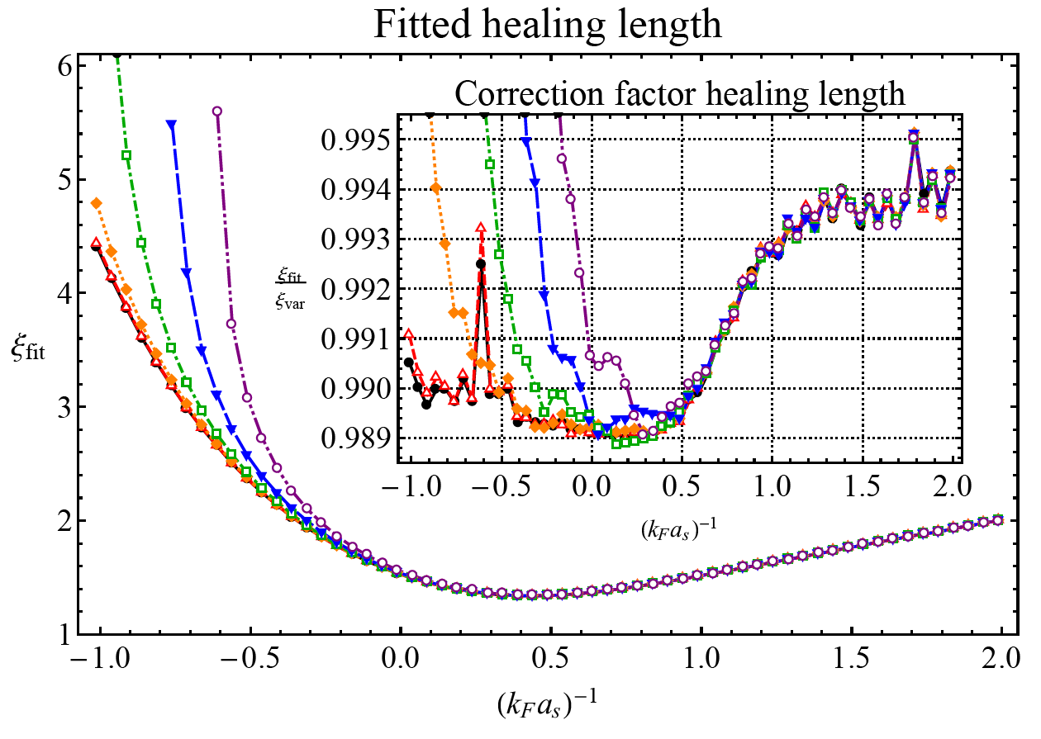
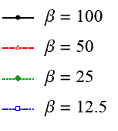
Describing vortices in the KTD effective field theory
Looking for the exact numerical solution we find:
BdG^{[1]} finds oscillations around a tanh profile in low-T, deep BCS regime – here this is never observed.
Imbalance increases the deviation from a hyperbolic-tangent form, especially on the BCS side (nearing the Clogston limit). Note that imbalance will always increase the vortex core size.
Comparison with numerical solution yields an error bar on the value of the free energy
[1] S. Simonucci, P. Pieri, G.C. Strinati, Phys. Rev. B 87, 214507 (2013).
Our results: N. Verhelst, S.N. Klimin, J.T. arXiv: 1603.02523

Slide 13
In conclusion
The hyperbolic tangent gives a good estimate of the real structure, except around the Clogston limit.
Imbalance increases healing length of the vortex.
The error on the energy is around 0,5%-1% for the hyperbolic tangent.

Slide 14
For next year’s BPS meeting!
Vortex structure itself not measurable
  Solution: either count number of vortices or look at structure of vortex lattice
Theoretical challenges:
  Determine intervortex potential from KTD theory
  Derive the possible equilibrium configurations

Slide 15
Other interesting KTD research
Solitons
See: lecture “Soliton-core filling in superfluid Fermi gasses with spin imbalance”
(Mr. Wout Van Alphen – 16:25 – Atoms, Molecules, Optics and photonics).
G. Lombardi, W. Van Alphen, S.N. Klimin and J. Tempere, Phys. Rev. A 93, 013614 (2016).
S.N. Klimin, J. Tempere and J.T. Devreese, Phys. Rev. A 90, 053619 (2014).
Multiband systems
S.N. Klimin, J. Tempere, G. Lombardi and J.T. Devreese, Eur. Phys. Journ. B 88, 122 (2015).
Rotational charge
See: poster session “Vortices in a rotating Fermi gas within the finite temperature effective field theory” (Dr. Serghei Klimin and Prof. Jacques Tempere).

