Slide 1
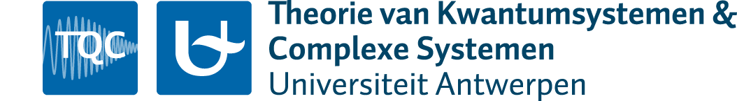
Conference of the Belgian Physical Society
Gent, 18 May, 2016
Superconductivity in strontium titanate and SrTiO₃-based structures due to the electron –
LO-phonon interaction
S. N. Klimin¹, J. Tempere^{1, 2} and J. T. Devreese¹
¹ Theorie van Kwantumsystemen en Complexe Systemen (TQC),
Universiteit Antwerpen, Universiteitsplein 1, B-2610 Antwerpen, Belgium
² Lyman Laboratory of Physics, Harvard University, Cambridge, MA 02138, USA

Slide 2
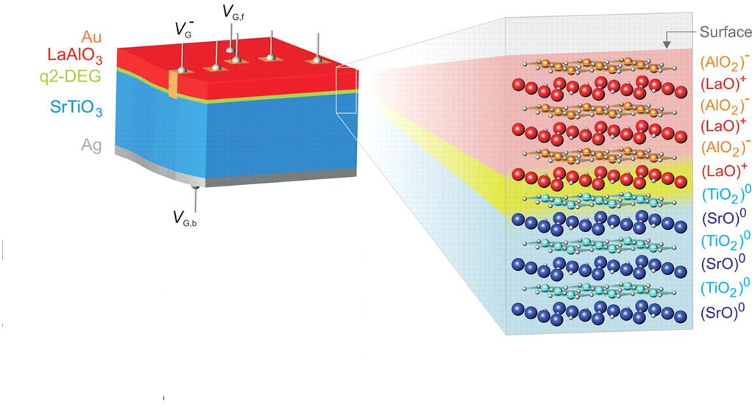
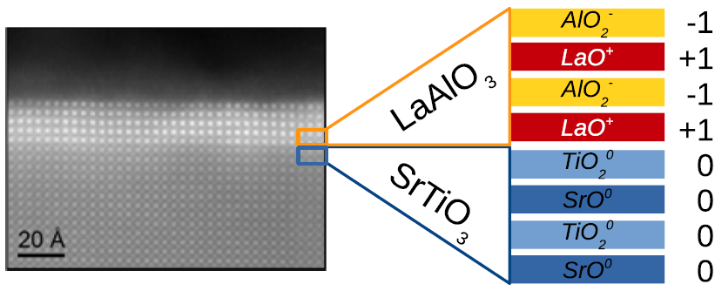
Structures with highly conducting 2DEG
“Recently, the discovery of interfacial superconductivity in heterostructures whose building blocks consist of transition metal oxide compounds has attracted a lot of attention. A frontrunner in that category is the interface between the two band-insulators LaAlO₃ and SrTiO₃.”
[J.-M. Triscone et al., Physica C 514, 189 (2015)]
High-mobility
quasi 2D electron gas
Picture from: S. Thiel et al., Science 313, 1942 (2006)
Picture from: J.-M. Triscone et al., Physica C 514, 189 (2015)
¹ A. Ohtomo, H. Y. Hwang, Nature 427, 423 (2004)
² N. Nakagawa, H. Y. Hwang, D. A. Muller, Nat. Mater. 5, 204 (2006)
³ S. Thiel, G. Hammerl, A. Schmehl, C. W. Schneider, and J. Mannhart, Science 313, 1942 (2006)
⁴ S. Gariglio, M. Gabay, J. Mannhart, J.-M. Triscone, Physica C 514, 189 (2015)
⁵ J.-F. Ge et al., Nature Materials, 14, 285 (2015)
Notes:
A few words on the motivation of the present study. It was inspired by progress in the development of multilayer structures based on complex oxides.
The discovery of superconductivity combined by other interesting effects such as ferromagnetim at the LaAlO₃-SrTiO₃ interface has stimulated increasing interest in the experimental and theoretical study of these structures.
Strontium titanate and Lanthanum-Aluminum oxide belong to the family of complex oxides. They exhibit an interesting spectrum of intrinsic properties, such as ferroelectricity, magnetism, superconductivity.
The complex oxides can therefore be used and combined in electronic devices that are based on epitaxially grown heterostructures. Physical effects may be detected in such multilayers that are not found in either of their constituents.
One example is a highly conducting quasi-two-dimensional electron gas which is formed at the interface between the two insulating, dielectric perovskites, LaAlO₃ and SrTiO₃ reported in many works – for example, references 1-3.
The electrons at this interface are highly mobile, and were found to have densities orders of magnitude higher than the densities of two-dimensional electron gases induced at interfaces in heterostructures based on III-V semiconductors.
As summarized in the recent review by Triscone and collaborators (2015), the discovery of interfacial superconductivity in structures based on transition metal oxide compounds has attracted a lot of attention. A frontrunner in that category is the interface between the two band-insulators: lantanium oxide and strontium titanate.
Strontium titanate possesses unique properties as a superconductor.
SrTiO₃ exhibits superconductivity at very low electrton densities $n_{0}≈5.5×{10}^{17}{cm}^{−3}$.
It was called “the most dilute superconductor” [1].
SrTiO₃ is a strongly polar crystal. The static dielectric constant of strontium titanate reaches $ε_{0}\sim {10}^{4}$ at helium temperatures.
SrTiO₃ exhibits an interesting spectrum of intrinsic properties, such as ferroelectricity, magnetism, superconductivity.
At a LaAlO₃-SrTiO₃ interfaces, the electrons form a highly conducting gas which exhibits two-dimensional ferromagnetism and superconductivity.
The electron-phonon interaction with LO phonons is the most likely candidate to provide superconductivity in strontium titanate.

Slide 3
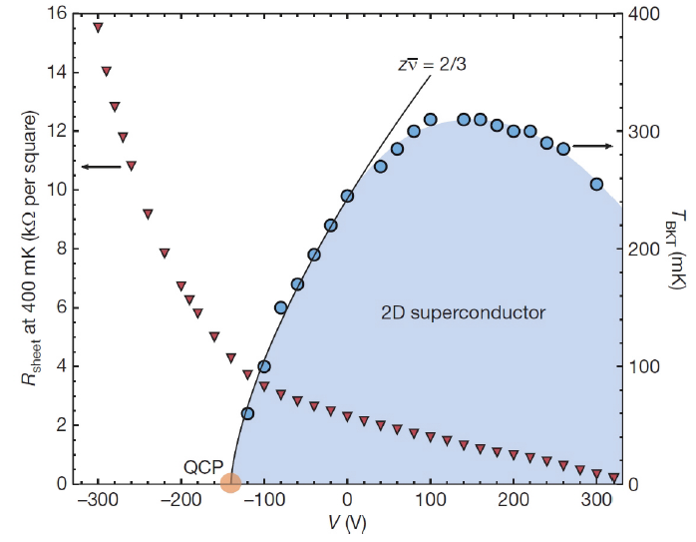
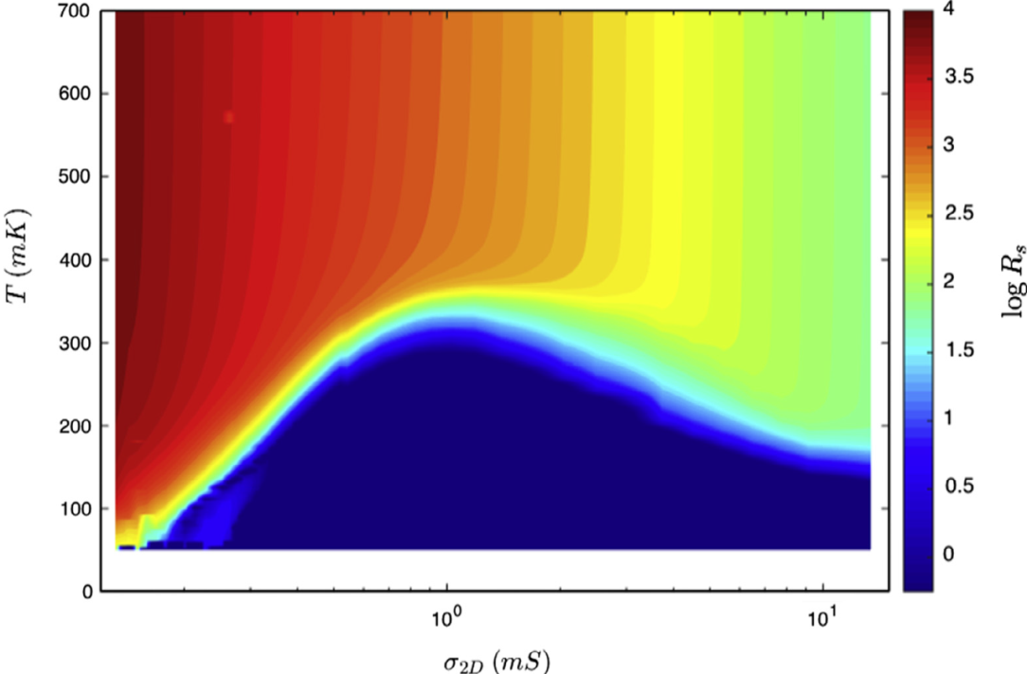
Concentration-dependent superconductivity in the LAO-STO structure
(From Refs. [1,2])
(From Ref. [4])
A modulation of the gate voltage leads to a modulation of the carrier density and/or the confinement width for the quasi two-dimensional electron gas at the interface.
As a consequence, the density-dependent critical temperature is experimentally detected.
A. D. Caviglia, S. Gariglio, N. Reyren, D. Jaccard, T. Schneider, M. Gabay, S. Thiel, G. Hammerl, J. Mannhart, and J.-M. Triscone, Nature (London) 456, 624 (2008).
S Gariglio, N Reyren, A D Caviglia and J-M Triscone, J. Phys.: Condens. Matter 21, 164213 (2009).
S. Hurand et al., Sci. Rep. 5, 12751 (2015).
S. Gariglio, M. Gabay, J. Mannhart, J.-M. Triscone, Phys. C 514, 189 (2015).
Notes:
At the LaAlO3/SrTiO3 interface, the electron gas is sandwiched between two insulators.
It is thus rather natural to try and explore the system’s ground states by modulating the carrier density with an electric field.
In recent experiments, the critical temperature of the superconducting phase transition at the LAO-STO interface is controlled by the gate voltage.
A modulation of the gate voltage leads to a modulation of the carrier density in the quasi two-dimensional electron gas at the interface.
As a consequence, the density-dependent critical temperature is experimentally detected.
This series of experiments, using the strontium titanate substrate as the gate dielectric, has revealed a very interesting phase diagram.
The critical temperature exhibits a dome-shaped behavior: a superconducting dome appears within a certain range of carrier densities.
Quantum critical points separate the superconducting state from a peculiar insulating state at low voltage and from a metallic state at high voltage, respectively.
For optimal doping, the critical temperature reaches a maximum of about 300 mK.

Slide 4
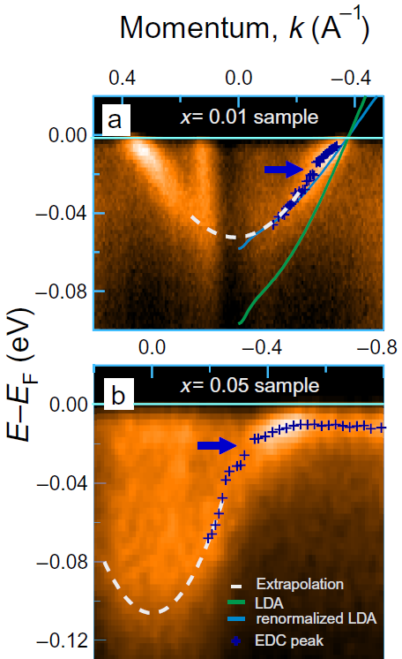
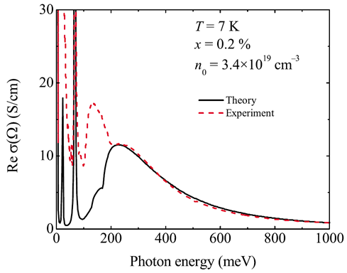
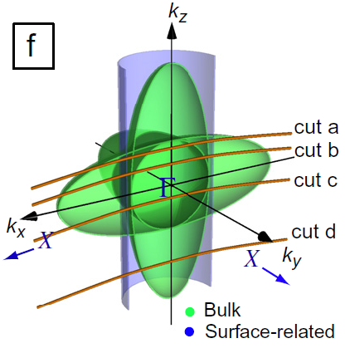
Renewed interest to bulk SrTiO₃
Band structure
Electron-phonon interaction: large or small polarons?
Superconductivity
Measurements of the effects of electron–phonon coupling using angle-resolved photoemission (ARPES) [1]
Direct evidence of the band energy spectrum
Optical conductivity: agreement with the large-polaron theory
¹ W. Meevasana et al., New J. Phys. 12, 023004 (2010).
² J. L. M. van Mechelen et al., Phys. Rev. Lett. 100, 226403 (2008)
³ J. T. Devreese, S. N. Klimin, J. L. M. van Mechelen, and D. van der Marel, Phys. Rev. B 81, 125119 (2010)
Notes:
Strontium titanate possesses unique properties as a superconductor.
SrTiO₃ exhibits superconductivity at very low electrton densities $n_{0}≈5.5×{10}^{17}{cm}^{−3}$.
It was called “the most dilute superconductor” [1].
SrTiO₃ is a strongly polar crystal. The static dielectric constant of strontium titanate reaches $ε_{0}\sim {10}^{4}$ at helium temperatures.
SrTiO₃ exhibits an interesting spectrum of intrinsic properties, such as ferroelectricity, magnetism, superconductivity.
At a LaAlO₃-SrTiO₃ interfaces, the electrons form a highly conducting gas which exhibits two-dimensional ferromagnetism and superconductivity.
The electron-phonon interaction with LO phonons is the most likely candidate to provide superconductivity in strontium titanate.

Slide 5
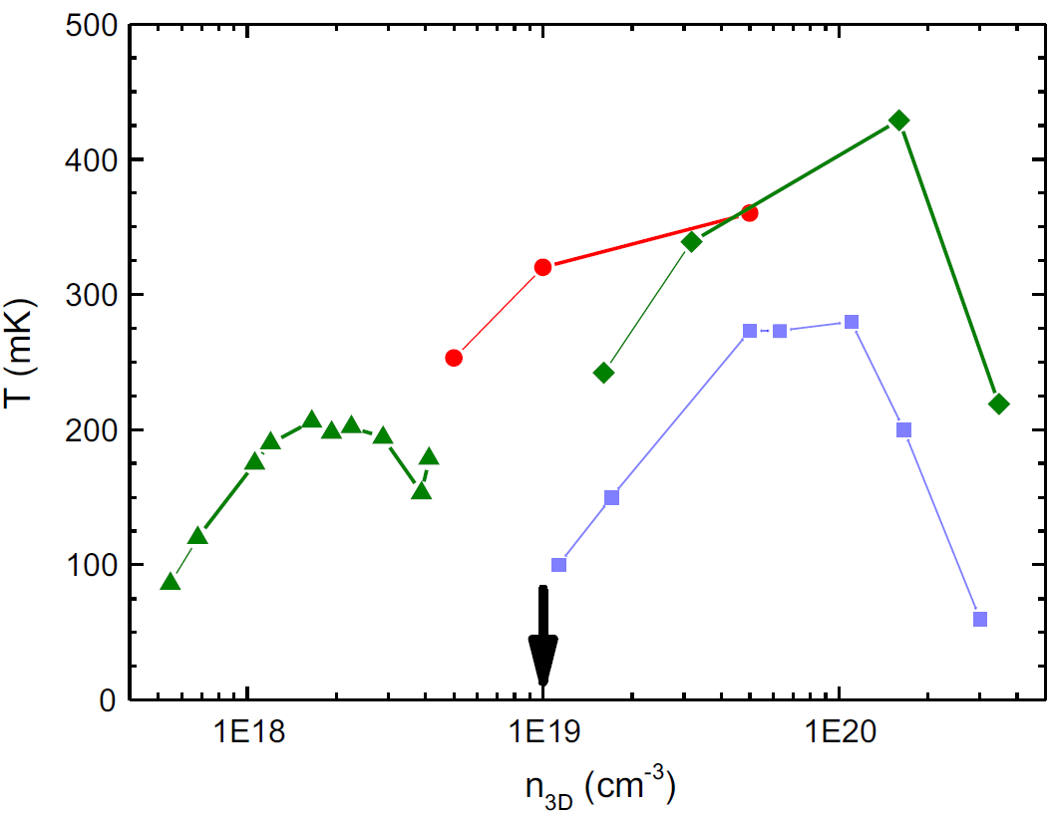
Renewed interest to bulk SrTiO₃
Band structure
Electron-phonon interaction: large or small polarons?
Superconductivity
From: S. Gariglio et al., Physica C 514, 189 (2015)
Doped, SrTi_{1−x}Nb_{x}O_{3−δ}
Reduced, SrTiO_{3−δ}
¹ C. S. Koonce et al., Phys. Rev. 163, 380 (1967)
² X. Lin et al., Phys. Rev. Lett. 112, 207002 (2014)
³ S. Gariglio et al., Physica C 514, 189 (2015)
Notes:
Because strontium titanate is a highly polar crystal, the electron-phonon mechanism of superconductivity seems to be the most promising for the explanation of the experimental data on superconductivity at the LaAlO₃-SrTiO₃ interfaces.
This assumption is supported by the fact that critical temperatures detected in recent experiments with the LAO-STO structures are of the order of 0.1K to 1 K. In other words, these critical temperatures lie in the same range as the critical temperatures of the superconducting phase transition observed many years ago, by Koonce with co-authors and Binnig with co-authors.
The early theoretical interpretation of superconductivity in the work [1] was not confirmed by the subsequent theoretical studies, because it was based on the multi-valley band model, which contradicts to later experimental results revealing the band structure of strontium titanate, for example, in Ref. [3]. However, the physical mechanism proposed in the early works seems to be quite correct: this is the Froehlich electron-phonon interaction with the polar optical phonons – the same mechanism which is responsible for the formation of polarons.
Strontium titanate is a unique example of a polar medium in which superconductivity has been detected at very low carrier densities, so that the optical-phonon energies can be larger than the Fermi energy.

Slide 6
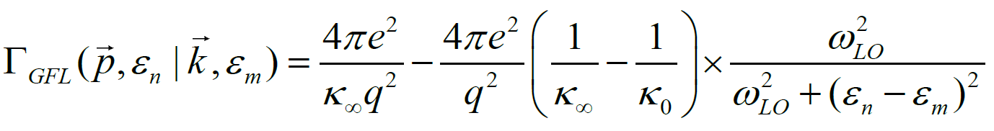
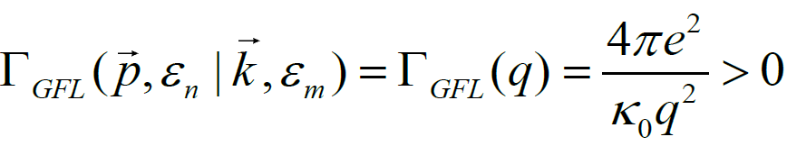
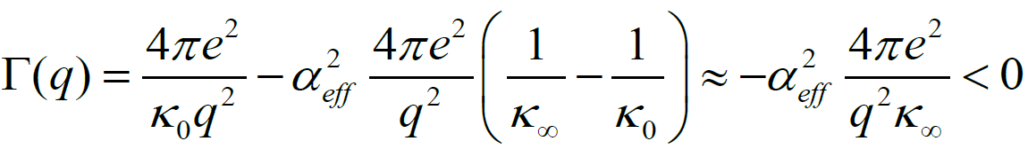
Electron-phonon mechanism of superconductivity
Different approaches
For polar crystals with sufficiently high optical-phonon frequencies and/or low carrier densities, the conditions for the Migdal theorem are not fulfilled.
There are extensions beyond the Migdal-Eilashberg approach, e. g. ¹⁻⁵.
We use the dielectric function method ⁴⁻⁶ valid beyond the adiabatic case.
The alternative method ⁵: LO-phonon-mediated effective interaction
The scattering matrix element
for a single-mode crystal
In the antiabatic limit:
For a multimode crystal:
The antiadiabatic approximation is not sufficient
Contradiction with the thermodynamic stability condition
¹ C. Grimaldi, L. Pietronero and S. Strässler, Phys. Rev. Lett. 75, 1158 (1995); Phys. Rev. B 52, 10516 (1995); 52, 10530 (1995).
² D. A. Kirzhnits, E. G. Maksimov and D. I. Khomskii, J. Low Temp. Phys. 10, 79 (1973).
³ Y. Takada, J. Phys. Soc. Jpn. 49, 1267 (1980).
⁴ S. N. Klimin, J. Tempere, J. T. Devreese, and D. van der Marel, Phys. Rev. B 89, 184514 (2014)
⁵ L. P. Gor’kov, arXiv:1508.00529 (2015); Phys. Rev. B 93, 060507(R) (2016).
Notes:
Because strontium titanate is a highly polar crystal, the electron-phonon mechanism of superconductivity seems to be the most promising for the explanation of the experimental data on superconductivity in the LaAlO₃-SrTiO₃ heterostructures.
The Migdal – Eliashberg theory of superconductivity, as well the standard BCS theory, is valid when the phonon frequencies are much smaller than the electron Fermi energy. This is not the case for polar crystals with sufficiently high optical-phonon frequencies, like strontium titanate.
To tackle such systems, several non-adiabatic extensions of the theory of superconductivity have been developed. For example, Pietronero (Refs. 1-3) generalized the Eliashberg equations to include non-adiabatic corrections beyond Migdal's theorem. The method developed by Kirzhnits et al. is focused on the superconductivity caused by the Fröhlich electron-phonon interaction with polar optical phonons. It uses the total dielectric function of a polar crystal.
The approaches mentioned here are complementary: the former is non-perturbative with respect to the coupling strength and perturbative with respect to the Debye energy, while the latter is weak-coupling but non-perturbative with respect to the optical-phonon energies.
Strontium titanate is a unique example of a polar medium in which superconductivity has been detected at very low carrier densities, so that the optical-phonon energies can be larger than the Fermi energy. Moreover, as found in 2008 by D. van der Marel et al., the electron -- LO-phonon coupling constant in SrTiO₃ is not very large. Therefore for the investigation of superconductivity in a LaAlO₃-SrTiO₃ heterostructure, the Kirzhnits method seems to be appropriate. In our recent study, we reformulated the Kirzhnits method for a multilayer structure with several polar layers.

Slide 7
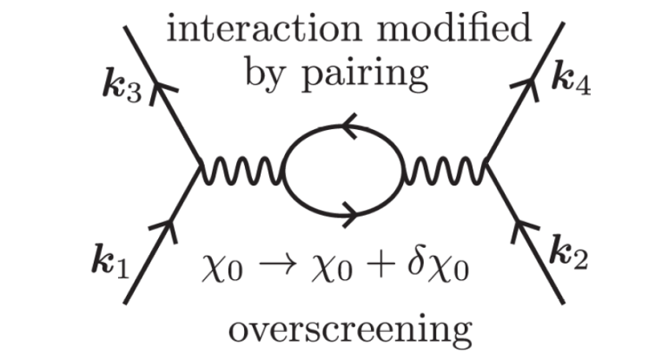
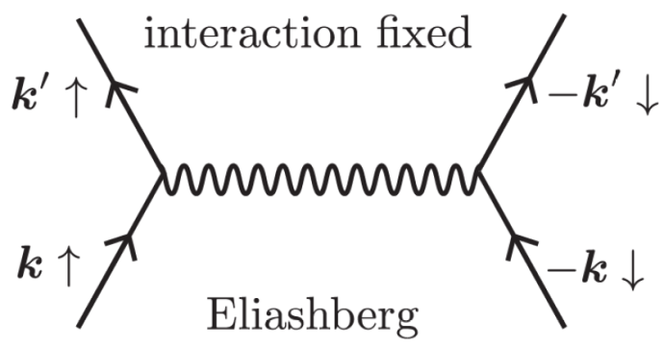
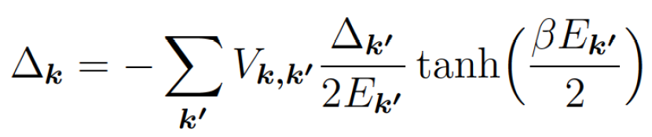
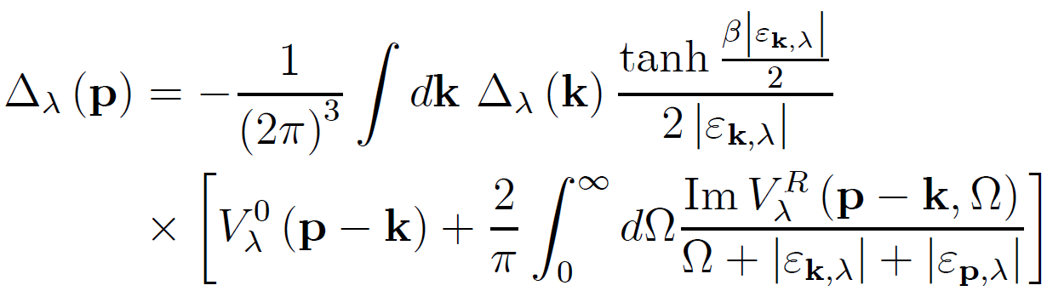
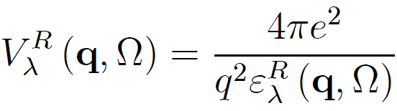
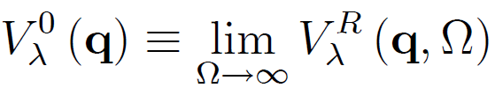


Dielectric function method for superconductivity
Account of a dynamic electron-phonon response
BCS-Eliashberg theory:
A. J. Leggett, «Exotic Superconductivity»
(set of lectures, 2011)
Dielectric function method [1]
extended for a multiband crystal [2]:
The effective potential is expressed through the total dielectric function constituted by both many-electron and phonon responses.
¹ D. A. Kirzhnits, E. G. Maksimov and D. I. Khomskii, J. Low Temp. Phys. 10, 79 (1973).
² S. N. Klimin, J. Tempere, J. T. Devreese, and D. van der Marel (to be published, 2016)
³A. J. Leggett, Proc. Natl Acad. Sci. USA 96, 8365-8372 (1999)
⁴Microscopic approach: R. Akashi and R. Arita, Phys. Rev. Lett. 111, 057006 (2013)
Notes:
Because strontium titanate is a highly polar crystal, the electron-phonon mechanism of superconductivity seems to be the most promising for the explanation of the experimental data on superconductivity in the LaAlO₃-SrTiO₃ heterostructures.
The Migdal – Eliashberg theory of superconductivity, as well the standard BCS theory, is valid when the phonon frequencies are much smaller than the electron Fermi energy. This is not the case for polar crystals with sufficiently high optical-phonon frequencies, like strontium titanate.
To tackle such systems, several non-adiabatic extensions of the theory of superconductivity have been developed. For example, Pietronero (Refs. 1-3) generalized the Eliashberg equations to include non-adiabatic corrections beyond Migdal's theorem. The method developed by Kirzhnits et al. is focused on the superconductivity caused by the Fröhlich electron-phonon interaction with polar optical phonons. It uses the total dielectric function of a polar crystal.
The approaches mentioned here are complementary: the former is non-perturbative with respect to the coupling strength and perturbative with respect to the Debye energy, while the latter is weak-coupling but non-perturbative with respect to the optical-phonon energies.
In the standard BCS-Eliashberg approach, crudely speaking, we generate an effective attraction between pairs of electrons, the electron with k and -k will form a pair with that attraction. The attraction may be an exchange of some kinds of bosons, such as phonons, spin fluctuations, or excitons , but it must be attractive.
In the dynamic picture, the main effect of pairing is not coming from the electrons interacting in the opposite momentum, but from all momenta. The contribution comes from the modification of the interaction energy between those electrons. The advantage of this picture is that it does not require an attractive interaction in the normal phase. Thus it is a different picture from the BCS-Eliashberg types of theories.
Strontium titanate is a polar medium in which superconductivity has been detected at very low carrier densities, so that the optical-phonon energies can be larger than the Fermi energy. Moreover, as found in 2008 by D. van der Marel et al., the electron - LO-phonon coupling constant in SrTiO₃ is not very large. Therefore for the investigation of superconductivity in a LaAlO₃-SrTiO₃ heterostructure, the Kirzhnits method seems to be appropriate. In our recent study, we reformulated the Kirzhnits method for a multilayer structure with several polar layers and for a multiband bulk superconductor.

Slide 8
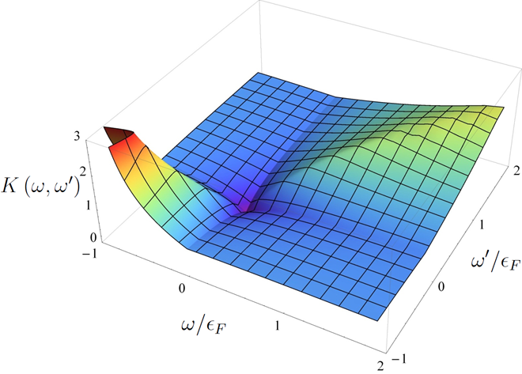
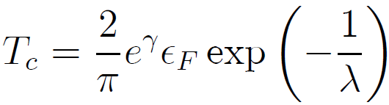
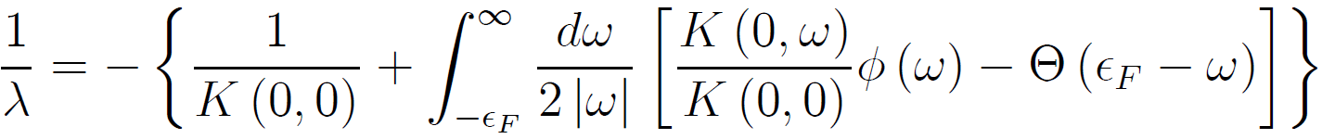
Kernel function, solution of the gap equation and critical temperature
The kernel function is energy-nonlocal, as distinct from the BCS and Migdal-Eliashberg approaches, since it is provided by a retarded effective electron-electron interaction through the plasmon-phonon excitations.
Beyond the Migdal theorem, superconductivity in an electron-phonon system can exist, provided by the fact that the kernel is a non-uniform function of the energy.
The critical temperature has been explicitly determined:
S. N. Klimin, J. Tempere, J. T. Devreese, and D. van der Marel, Phys. Rev. B 89, 184514 (2014)
Notes:
The kernel function which enters the gap equation is a key element of the approach to superconductivity based on the dielectric function.
As distinct from the BCS and Migdal-Eliashberg approaches, the kernel function within the present approach is essentially energy dependent. This is explained by the fact that the effective electron-electron interaction through the plasmon-phonon excitations is retarded.
Consequently, the frequency dependence of the gap Δ(ω) can differ from that within the BCS or Migdal-Eiashberg pictures.
Beyond the Migdal theorem, superconductivity in an electron-phonon system can exist despite the fact that the kernel function is positive for all energies. The kernel for energies larger than the Fermi energy is dominated by the Coulomb repulsion between two electrons whose spatial distance is small, while the behavior of the kernel near the Fermi surface is due to both the Coulomb interaction and the attraction mediated by the plasmon-phonon excitations, between two electrons whose distance is rather large. Because of the nonlocal kernel function, the effective attraction may overcome the Coulomb repulsion, that makes superconductivity possible.
As soon as the kernel function is found numerically, the critical temperature has been explicitly expressed through the kernel function.
The superconducting transition temperature is obtained within the dielectric function method from the linearized gap equation with pairing kernel K. The critical temperature was then determined as a function of carrier concentration. The key finding is that the interplay between the screening of the Coulomb interaction, as encoded in the pairing kernel, and the size of the Fermi energy gives rise to a non-monotonic dome-shape of the critical temperature, in qualitative agreement with experiment.
Another interesting aspect of the theory is that the effective pairing interaction is always repulsive, i.e. , an effect primarily caused by the rather moderate screening of the Coulomb repulsion at low carrier concentrations. A sizable frequency dependence of the kernel function does, however, allow for non-trivial solutions of the superconducting gap-equation. Such solutions should come along with a significant variation of the gap function as a function of frequency, where one expects a sign change of the gap in the vicinity of the Fermi energy. This behavior might be visible in tunneling experiments.

Slide 9
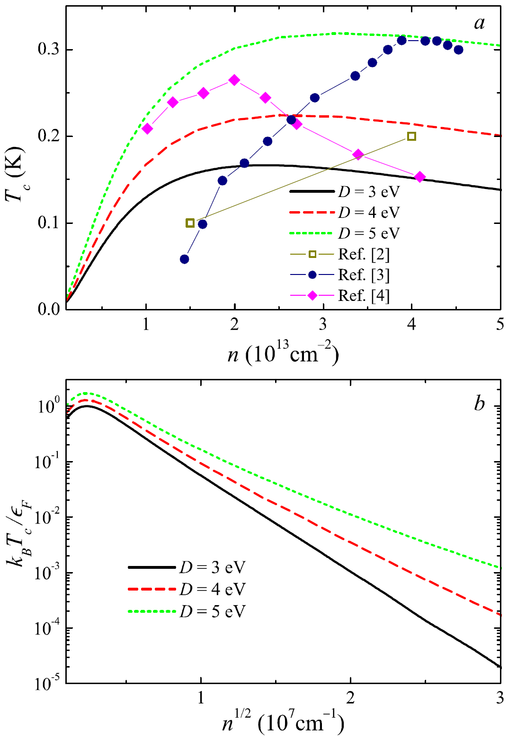


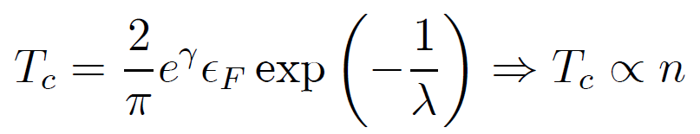
Critical temperatures: theory and experiment
The calculation, performed without fit and using parameter values known from literature, yields the critical temperatures within the same range as in the experiments.
At low densities, the critical temperature depends on the carrier density almost linearly. In this regime it is well described by a BCS-like expression with the Fermi energy instead of the Debye energy:
with λ independent on the density at low densities. This is a direct consequence of the anti-adiabatic regime at low densities.
S. N. Klimin, J. Tempere, J. T. Devreese, and D. van der Marel, Phys. Rev. B 89, 184514 (2014)
N. Reyren et al., Science 317, 1196 (2007).
A. Caviglia et al., Nature 456, 624 (2008).
C. Richter et al., Nature 502, 528 (2013).
Notes:
For the numerical calculations of the critical temperatures in the LAO-STO structure, we use a well-determined set of material parameters already used in earlier works: the high-frequency and static dielectric constants, the band structure parameters, and the LO- and TO-phonon frequencies.
The only material parameter which is not yet well-determined, is the acoustic deformation potential D in strontium titanate. It should be noted that the deformation potential responsible for the interaction of an electron with the acoustic phonons is the "absolute" rather than "relative" deformation potential. In the literature, we can find several different suggestions on the values of the deformation potential in strontium titanate. In our calculation, we use several reasonable values for D.
For the comparison of the calculated critical temperatures with the known experimental data, we use in the numeric calculations the model of the LaAlO₃-SrTiO₃ heterostructure accounting for the presence of an electrode at the oxide layer.
The calculation, performed without fit and using parameter values known from literature, yields the critical temperatures within the same range as in the experiments.
At low densities, the critical temperature depends on the carrier density almost linearly. In this regime it is well described by a BCS-like expression with the Fermi energy instead of the Debye energy.

Slide 10
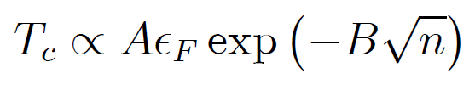
Critical temperatures: theory and experiment
The calculation, performed without fit and using parameter values known from literature, yields the critical temperatures within the same range as in the experiments.
At high densities, the density dependence of the critical temperature
shows the domination of the plasmon mechanism of superconductivity.
S. N. Klimin, J. Tempere, J. T. Devreese, and D. van der Marel, Phys. Rev. B 89, 184514 (2014)
N. Reyren et al., Science 317, 1196 (2007).
A. Caviglia et al., Nature 456, 624 (2008).
C. Richter et al., Nature 502, 528 (2013).
Notes:
At high densities, the density dependence of the critical temperature shows the domination of the plasmon mechanism of superconductivity.
The observed differences of the experimental results on the critical temperatures in the LaAlO₃-SrTiO₃ heterostructures can be explained as follows.
In different experiments, the LaAlO₃-SrTiO₃ heterostructures have been grown independently. Therefore those heterostructures can at least slightly differ from each other. The thermal energy is extremely small compared to the characteristic energies involved in the superconducting phase transition: the Fermi energy of the electrons and the LO-phonon energies (which both are of order ∼100 meV).
Under these conditions, the critical temperatures can be very sensitive to relatively small difference of the internal properties of the fabricated heterostructures. Additional factors (e. g., disorder, local phonons, defects, etc.) can substantially influence T_{c}.
Moreover, the critical temperatures for bulk strontium titanate measured in different experiments differ substantially from each other.
Consequently, the relatively large variation of the experimental results on the critical temperature in LaAlO₃-SrTiO₃ heterostructure is not surprising. Despite that uncertainty, the measured critical temperatures in different experiments are of the same order.
We can see that for each D, the curve is close to only few data points. However (i) experimental data are obtained with a substantial numeric inaccuracy, (ii) experimental data from different sources do not agree even with each other.
It should be noted also that, since the thermal energy corresponding to the critical temperature in the LAO-STO structure is very small with respect to other energies participating in the superconductivity (the optical-phonon energies and the Fermi energy), even a small uncertainty of these parameters can then lead to a significant change of the critical temperature.
Our calculation, performed without fit using parameter values known from literature, yields the critical temperatures within the same range as in the experiments. We can therefore conclude that, taking into account the uncertainty of the experimental results on the critical temperatures, the suggested theoretical explanation of the superconducting phase transition in the LaAlO₃-SrTiO₃ heterostructures leads to tentative agreement with experiment.

Slide 11
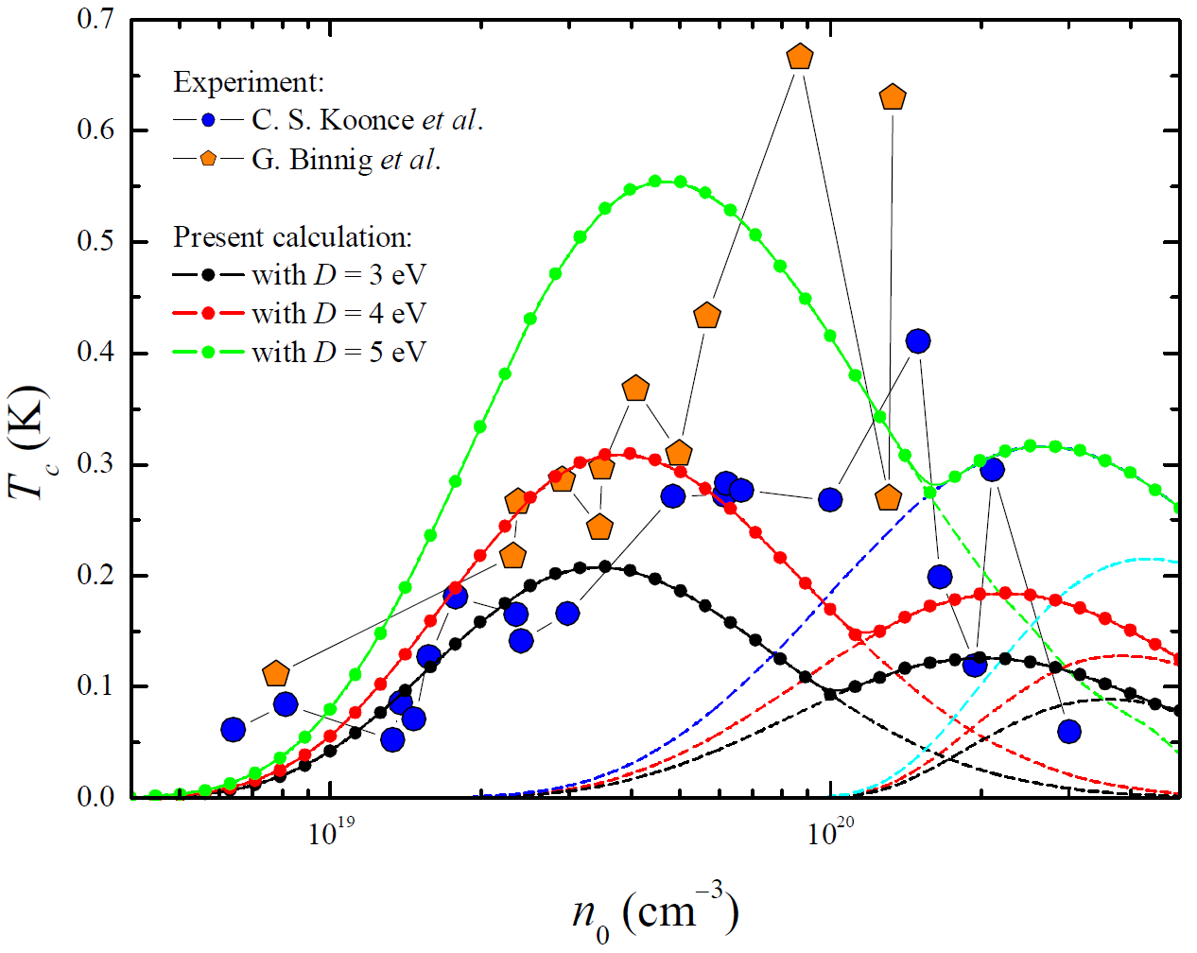
Dielectric function method for superconductivity: application to SrTiO₃
Using realistic parameters and the band structure of strontium titanate,
the multi-peak dome-shaped density dependence of T_{c} is explained [2]
¹ D. A. Kirzhnits, E. G. Maksimov and D. I. Khomskii, J. Low Temp. Phys. 10, 79 (1973).
² S. N. Klimin, J. Tempere, J. T. Devreese, and D. van der Marel (to be published, 2016)

Slide 12
Conclusions
The dielectric function method is capable to interpret superconductivity in bulk strontium titanate and in a SrTiO₃-based multilayer structure.
All phonon branches existing in the multilayer structure are taken into account.
The calculated critical temperatures lie within the same range as in the experiments without fitting.
The obtained critical temperatures support the hypothesis that the mechanism of superconductivity in SrTiO₃ and on the LaAlO₃-SrTiO₃ interface is provided by the electron - optical-phonon interaction.

Slide 13
Appendices

Slide 14
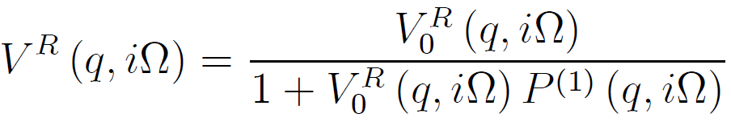
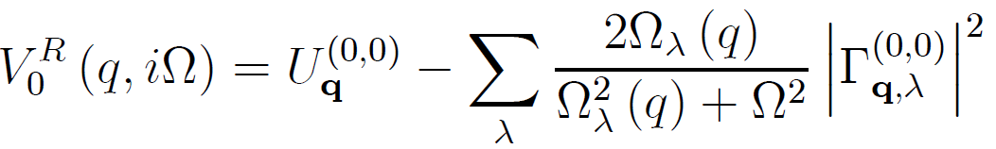
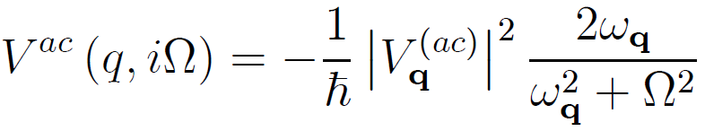
Electron-phonon mechanism for superconductivity
Dielectric function method
The effective interaction potential:
Screening is taken into account within RPA:
The non-screened potential
The acoustic-phonon contribution:
Coulomb d Electron-phonon
matrix elements
S. N. Klimin, J. Tempere, J. T. Devreese, and D. van der Marel, Phys. Rev. B 89, 184514 (2014)
Notes:
The calculation of the superconducting transition temperature is performed following the scheme proposed by Kirzhnits and Takada using the gap equation shown in the previous slide, with the effective interaction potential which is constituted by tho contributions:
(1) the effective interaction potential provided by a rather complicated interplay of the electron – LO-phonon
and the electron-electron interactions,
(2) the effective interaction potential provided by the electron – acoustic-phonon interaction.
Since the Kirzhnits theory assumes the weak-coupling regime, we suggest that the effective phonon-mediated interaction due to the acoustic phonons can be taken into account in an additive way with respect to the combined contribution of Coulomb interaction and optical phonons.
The first of the aforesaid effective interaction potentials is expressed in terms of the dielectric function.
This interaction potential contains the non-screened effective potential (the third formula at the slide) which consists of the Coulomb contrinution and the electron-phonon contribution.
The screening is accounted for within the random-phase approximation (RPA) as expressed in the second formula at the slide, through the polarization function of the electron gas P⁽¹⁾(q,i \Omega).
Finally, the acoustic-phonon contribution to the effective interaction potential is expressed in the straightforward way, similarly to the LO-phonon contribution.

Slide 15
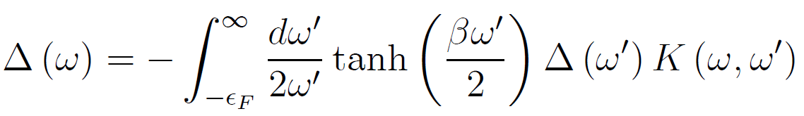
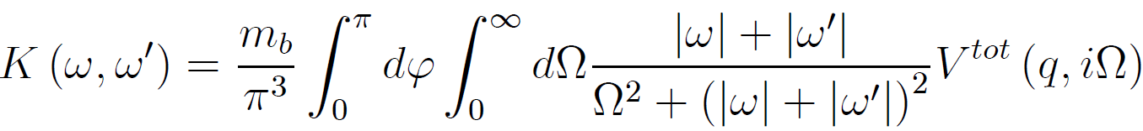
Electron-phonon mechanism for superconductivity
Dielectric function method
For polar crystals with sufficiently high optical-phonon frequencies and/or low carrier densities, the conditions for the Migdal theorem are not fulfilled.
There are extensions beyond the Migdal-Eilashberg approach, e. g. ¹⁻⁵.
We use the dielectric function method ⁴⁻⁶ valid far beyond the adiabatic case.
The gap equation
contains the kernel function:
with
¹ C. Grimaldi, L. Pietronero and S. Strässler, Phys. Rev. Lett. 75, 1158 (1995); Phys. Rev. B 52, 10516 (1995); 52, 10530 (1995).
² D. A. Kirzhnits, E. G. Maksimov and D. I. Khomskii, J. Low Temp. Phys. 10, 79 (1973).
³ Y. Takada, J. Phys. Soc. Jpn. 49, 1267 (1980).
⁴ S. N. Klimin, J. Tempere, J. T. Devreese, and D. van der Marel, Phys. Rev. B 89, 184514 (2014)
⁵ L. P. Gor’kov, arXiv:1508.00529 (2015); Phys. Rev. B 93, 060507(R) (2016).
⁶ R. Akashi and R. Arita, Phys. Rev. Lett. 111, 057006 (2013)
Notes:
Because strontium titanate is a highly polar crystal, the electron-phonon mechanism of superconductivity seems to be the most promising for the explanation of the experimental data on superconductivity in the LaAlO₃-SrTiO₃ heterostructures.
The Migdal – Eliashberg theory of superconductivity, as well the standard BCS theory, is valid when the phonon frequencies are much smaller than the electron Fermi energy. This is not the case for polar crystals with sufficiently high optical-phonon frequencies, like strontium titanate.
To tackle such systems, several non-adiabatic extensions of the theory of superconductivity have been developed. For example, Pietronero (Refs. 1-3) generalized the Eliashberg equations to include non-adiabatic corrections beyond Migdal's theorem. The method developed by Kirzhnits et al. is focused on the superconductivity caused by the Fröhlich electron-phonon interaction with polar optical phonons. It uses the total dielectric function of a polar crystal.
The approaches mentioned here are complementary: the former is non-perturbative with respect to the coupling strength and perturbative with respect to the Debye energy, while the latter is weak-coupling but non-perturbative with respect to the optical-phonon energies.
Strontium titanate is a unique example of a polar medium in which superconductivity has been detected at very low carrier densities, so that the optical-phonon energies can be larger than the Fermi energy. Moreover, as found in 2008 by D. van der Marel et al., the electron -- LO-phonon coupling constant in SrTiO₃ is not very large. Therefore for the investigation of superconductivity in a LaAlO₃-SrTiO₃ heterostructure, the Kirzhnits method seems to be appropriate. In our recent study, we reformulated the Kirzhnits method for a multilayer structure with several polar layers.

Slide 16
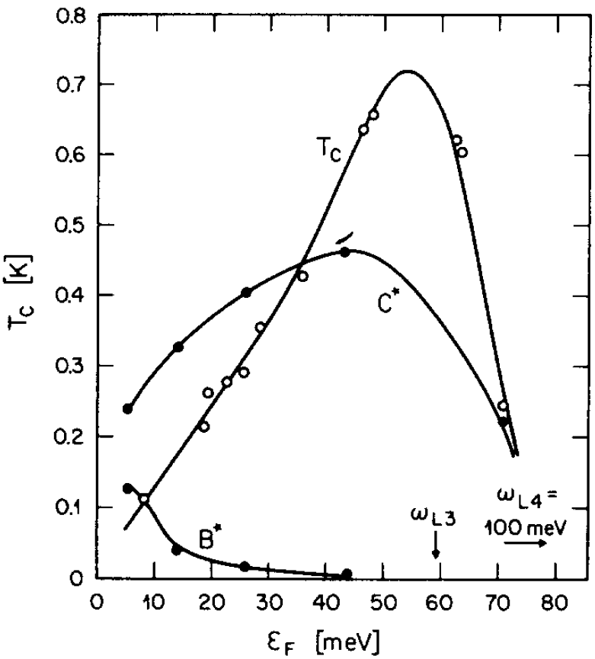
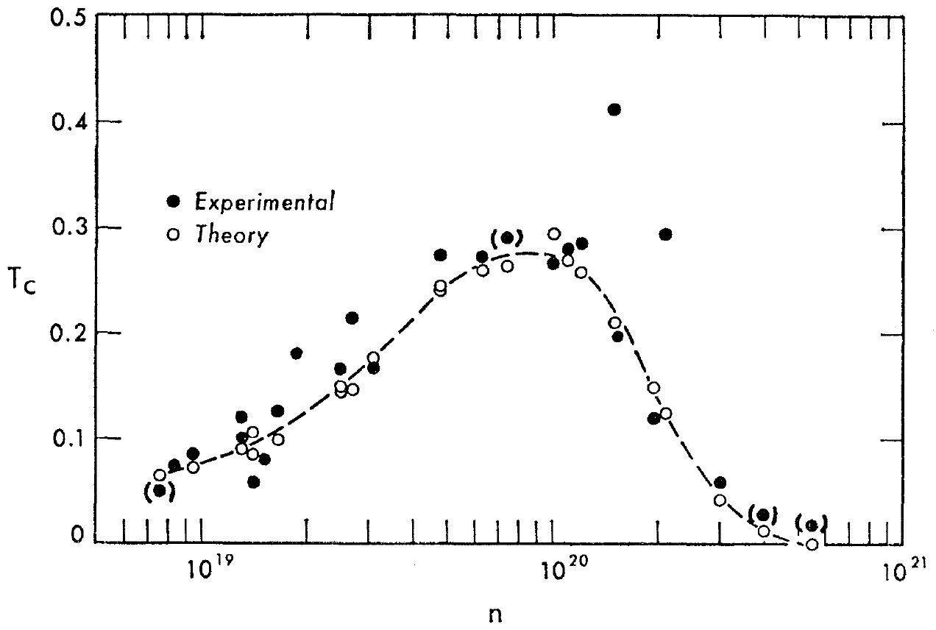
Superconductivity in bulk strontium titanate
Superconductivity occurs in strontium titanate at very low temperatures T < 1 K
The critical temperature non-monotonically depends on the carrier density
Baratov & Binnig, 1981
Koonce et al., 1967
¹ C. S. Koonce et al., Phys. Rev. 163, 380 (1967).
² G. Binnig et al., Phys. Rev. Lett. 45, 1352 (1980); A. Baratoff and G. Binnig, Physica B+C 108, 1335 (1981).
Notes:
Because strontium titanate is a highly polar crystal, the electron-phonon mechanism of superconductivity seems to be the most promising for the explanation of the experimental data on superconductivity at the LaAlO₃-SrTiO₃ interfaces.
This assumption is supported by the fact that critical temperatures detected in recent experiments with the LAO-STO structures are of the order of 0.1K to 1 K. In other words, these critical temperatures lie in the same range as the critical temperatures of the superconducting phase transition observed many years ago, by Koonce with co-authors and Binnig with co-authors.
The early theoretical interpretation of superconductivity in the work [1] was not confirmed by the subsequent theoretical studies, because it was based on the multi-valley band model, which contradicts to later experimental results revealing the band structure of strontium titanate, for example, in Ref. [3]. However, the physical mechanism proposed in the early works seems to be quite correct: this is the Froehlich electron-phonon interaction with the polar optical phonons – the same mechanism which is responsible for the formation of polarons.
Strontium titanate is a unique example of a polar medium in which superconductivity has been detected at very low carrier densities, so that the optical-phonon energies can be larger than the Fermi energy.

Slide 17
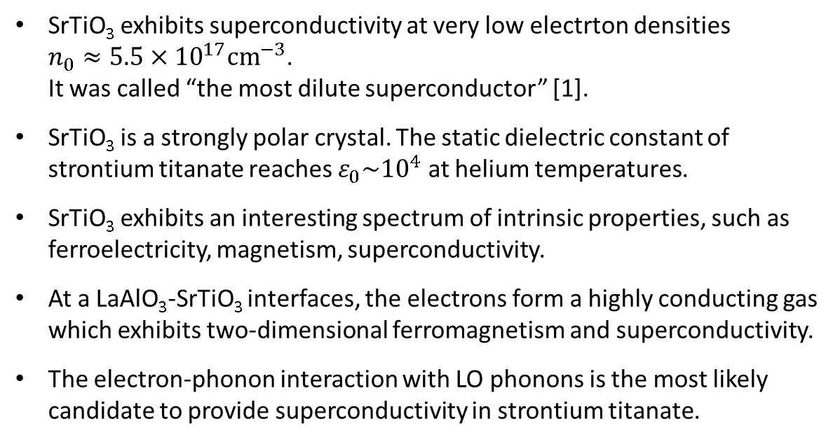
Strontium titanate: why is it interesting?
Strontium titanate possesses unique properties as a superconductor.
SrTiO₃ exhibits superconductivity at very low electrton densities $n_{0}≈5.5×{10}^{17}{cm}^{−3}$.
It was called “the most dilute superconductor” [1].
SrTiO₃ is a strongly polar crystal. The static dielectric constant of strontium titanate reaches $ε_{0}\sim {10}^{4}$ at helium temperatures.
SrTiO₃ exhibits an interesting spectrum of intrinsic properties, such as ferroelectricity, magnetism, superconductivity.
At a LaAlO₃-SrTiO₃ interfaces, the electrons form a highly conducting gas which exhibits two-dimensional ferromagnetism and superconductivity.
The electron-phonon interaction with LO phonons is the most likely candidate to provide superconductivity in strontium titanate.
¹ X. Lin et al., Phys. Rev. X 3, 021002 (2013)
Notes:
Because strontium titanate is a highly polar crystal, the electron-phonon mechanism of superconductivity seems to be the most promising for the explanation of the experimental data on superconductivity at the LaAlO₃-SrTiO₃ interfaces.
This assumption is supported by the fact that critical temperatures detected in recent experiments with the LAO-STO structures are of the order of 0.1K to 1 K. In other words, these critical temperatures lie in the same range as the critical temperatures of the superconducting phase transition observed many years ago, by Koonce with co-authors and Binnig with co-authors.
The early theoretical interpretation of superconductivity in the work [1] was not confirmed by the subsequent theoretical studies, because it was based on the multi-valley band model, which contradicts to later experimental results revealing the band structure of strontium titanate, for example, in Ref. [3]. However, the physical mechanism proposed in the early works seems to be quite correct: this is the Froehlich electron-phonon interaction with the polar optical phonons – the same mechanism which is responsible for the formation of polarons.
Strontium titanate is a unique example of a polar medium in which superconductivity has been detected at very low carrier densities, so that the optical-phonon energies can be larger than the Fermi energy.

Slide 18
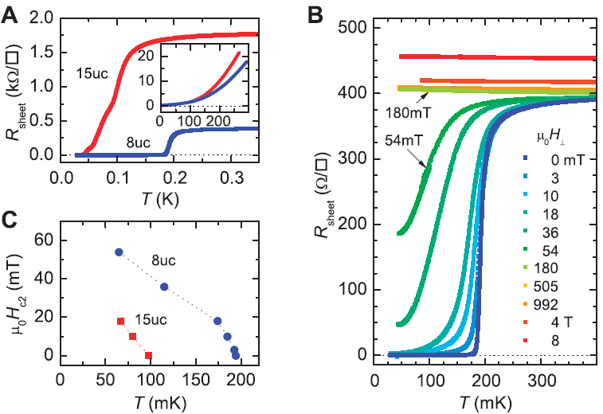
Interface superconductivity
Superconductivity at the LaAlO₃-SrTiO₃ interface (Reyren et al., 2007)
Renewed interest to strontium titanate
1. N. Reyren, S. Thiel, A. D. Caviglia, L. F. Kourkoutis, G. Hammerl, C. Richter, C. W. Schneider, T. Kopp, A.-S. Ruetschi, D. Jaccard, M. Gabay, D. A. Muller, J.-M. Triscone, and J. Mannhart, Science 317, 1196 (2007).
2. BKT in superconductors: B. I. Halperin and D. R. Nelson, J. Low Temp. Phys. 36, 599 (1979)
3. Q.-Y. Wang et al., Chin. Phys. Lett. 29, 037402 (2012)
4. S. Gariglio, M. Gabay, J. Mannhart, J.-M. Triscone, Physica C 514, 189 (2015)
Notes:
Quasi two-dimensional conducting electron systems are generated at interfaces between a large variety of insulating oxides. These quasi two-dimensional systems exhibit a lot of interesting properties, in particular superconductivity.
The seminal example is the experiment by Reyren with collaborators in 2006. They reported on the superconducting phase transition in the LaAlO₃-SrTiO₃ structure at temperatures about 0.1 to 0.2 K.
Starting from this work, many experimental and theoretical efforts were concentrated on the interface superconductivity in these structures, as well as those based on other materials, for example, iron selenide, which also exhibits interesting properties as a superconductor. Evidence for high-T_{c} superconductivity has been reported for FeSe atomically thin films prepared on strontium titanate, see Reference 3.
The discovery of high electron mobility and superconductivity at the interface between LAO and STO resulted in a large amount of work aiming at an understanding of the origin of the conduction and superconductivity in these structures.
Particularly, the physical mechanism of the interface superconductivity attracted a lot of attention. Many different explanations were proposed, but a common opinion has not yet been achieved.

Slide 19
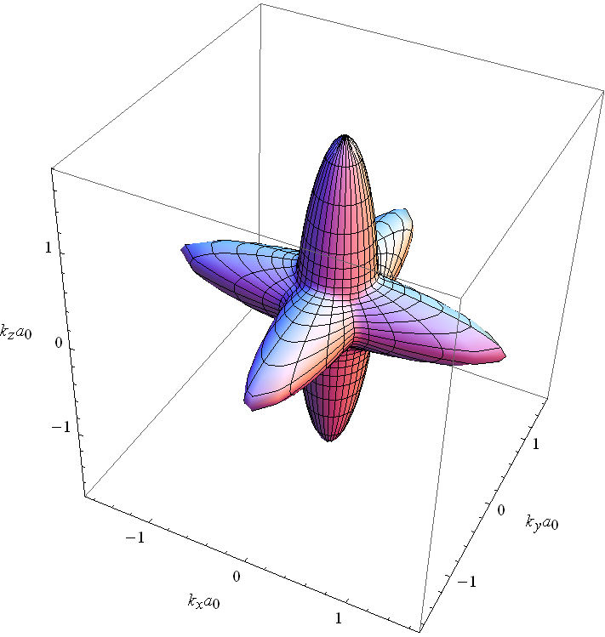
SrTiO₃: band structure
Band dispersion of the lowest unoccupied bands of SrTiO₃
Fermi surface of the cubic phase at 2% doping, showing the large anisotropy of the lowest band
D. van der Marel, J. L. M. van Mechelen, and I. I. Mazin, Phys. Rev. B 84, 205111 (2011)
Notes:
SrTiO3 has a cubic crystal structure at room temperature, which becomes tetragonal below a structural phase transition at 105 K.
In the literature, there are different and even contradictory theoretical models for the band structure of strontium titanate. In this connection, D. van der Marel with co-workers have independently performed the first-principles calculations of the band structure of strontium titanate using the linear augmented plane wave method.
Here, a detailed view of the band structure around the zone center is shown. In this limited region of k space, the band structure can be effectively described by a tight-binding model (the details are in the Appendix).
When neglecting the spin-orbit interaction, the result is a set of three mutually orthogonal ellipsoidal bands. They are degenerate at k = 0.
Consequently, the Fermi surface consists of three ellipsoids centered at the zone center, with the ellipsoids oriented along the x, y, and z axes of the reciprocal lattice of the cubic crystal structure.
The aforesaid zone-center degeneracy is, however, lifted by the spin-orbit interaction. This results in two degenerate spin-orbit doublets at the lowest energy and an additional doublet at 29.2 meV higher energy.
The result is the following set of bands having their minimum energy at the zone center:
(1) The lowest band is the “heavy-electron” band.
(2) The second and third bands are the “light-electron” bands, which become occupied at sufficiently high critical carrier concentrations.
The resulting Fermi surface is strongly warped at sufficiently high electron concentrations.

Slide 20
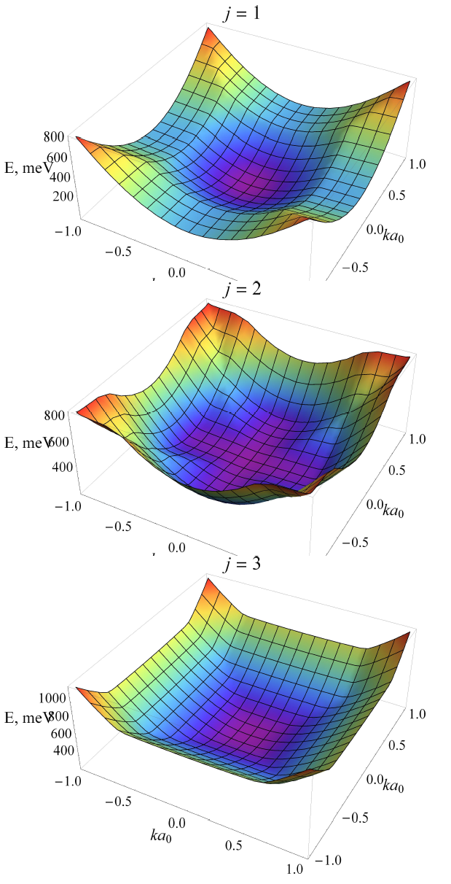
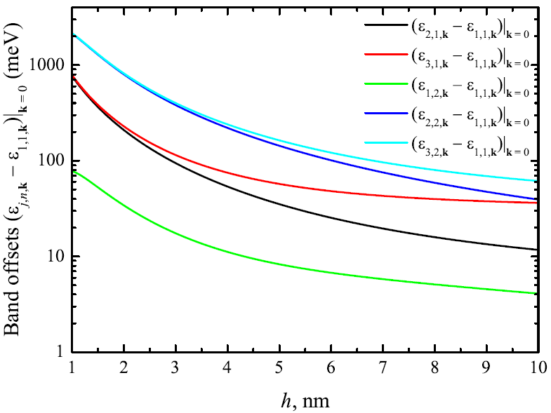



Band splitting for the quasi 2D electron gas
In addition to the enhanced splitting of the bulk bands, the size-quantization subbands appear
S. N. Klimin, J. Tempere, J. T. Devreese, and D. van der Marel, Phys. Rev. B 89, 184514 (2014)
Notes:
The 3D plots of the aforesaid three subbands (showing all directions of the electron in-plane momentum are represented the left-hand figure.
We can see again that an enhancement of confinement results in an increasing splitting of the lowest subband from the higher subbands.
This trend is even more clearly seen from the right-hand figure, where the bottoms of several lowest subbands are plotted as a function of the width of the confinement potential well. At sufficiently narrow AaAlO3 layer, the splitting can be significant.
As far as the z-component of the electron wave vector is size-quantized, in the quasi 2D system, there is an additional splitting of the conduction band (with respect to bulk) -- due to the size quantization of the motion of the electrons along the growth axis of the layers (the z axis). The bottoms of these subbands are shown in the right-hand figure.

Slide 21
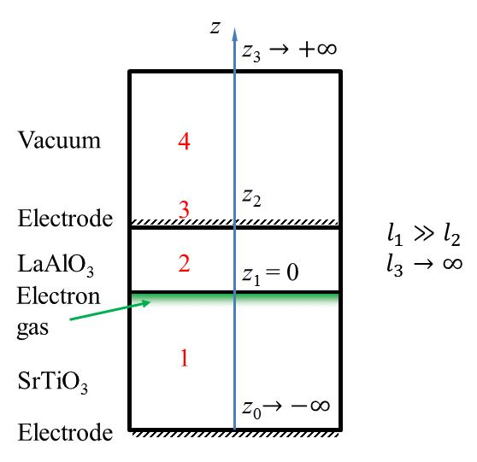
Our theoretical model: multilayer structure
Scheme of a multilayer structure
The coordinate z for the n-th layer lies in the range z_{n−1} < z < z_{n}
z
LaAlO₃-SrTiO₃: the asymmetric three-layer structure
z_{K}
K
z_{K−1}
z_{n}
n
l_{n}
z_{n−1}
z₂
2
z₁
1
z₀
L
Notes:
We consider a multi-layer structure consisting of K parallel layers with the lateral size L (in the final results, L→∞) and the sizes along the growth axis l_{n}.
The layers are numbered by the index n=1,2,…,K, and the interfaces by
n=1,2,…,K-1.
Thus the coordinate z for the n-th layer lies in the range z_{n-1}<z<z_{n}.
The particular case is the LaAlO₃-SrTiO₃ structure, which can be described as an asymmetric three-layer system.
In this system, SrTiO₃, LaAlO₃ and vacuum represent the layers 1, 2 and 3, respectively. We suggest that the width of the lanthanum oxide is extremely smaller than the width of the SrTiO₃ substrate.
Therefore we assume z₀ -> -∞, and z₃ -> +∞.
In the planar multilayer structure, the electrostatic potential of a spatially distributed charge with the charge density in the n-th layer obeys the Poisson equation.
We solve the poisson equation accounting for the electrostatic boundary conditions:
(1) the continuity of the electrostatic potential (or, the same, the continuity of the tangential components of the electric field E),
(2) the continuity of the normal components of the electrostatic displacement D.
As a result, we obtain the potential energy of the electrostatic electron-electron interaction in a multilayer structure, different from the bulk Coulomb potential.

Slide 22

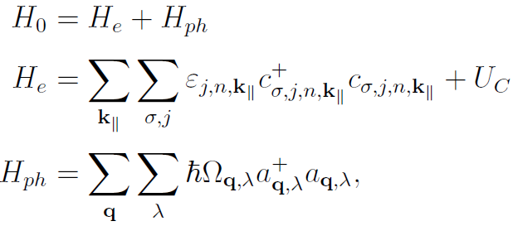
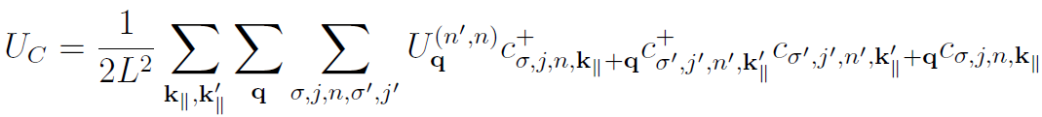
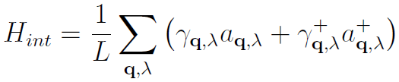

Mechanism of superconductivity
The system
Hamiltonian
One-electron energy
Coulomb interaction
Electron subsystem
Phonon energy
Phonons
Electron-phonon interaction
Matrix element for the Coulomb interaction
Matrix element for the electron-phonon interaction
Because the optical-phonon energies can exceed the Fermi energy, the BCS and Eliashberg approaches can be inapplicable
S. N. Klimin, J. Tempere, J. T. Devreese, and D. van der Marel, Phys. Rev. B 89, 184514 (2014)
Notes:
As discussed, the conduction band in the LAO-STO heterostructure is split in three subbands numbered here by the index j.
Moreover, the size quantization of the motion along the growth axis leads to additional multiple subbands (numbered here by the index n).
Within this approach the quasi 2D electron-phonon system is described by the Hamiltonian, which includes the Hamiltonian of non-interacting electrons and phonons, the Hamiltonian of the Coulomb-like electron-electron interaction, and the Hamiltonian of the electron-phonon interaction.
The latter one includes the electron-phonon interaction with all types of the phonons presenting in the heterostructure.
They are:
(1) the interface phonons, which, in general are not purely STO or LAO but belong to the whole structure;
(2) the half-space LO phonons;
(3) the acoustic phonons.
The amplitudes of the electron-electron and electron-phonon interactions written here are expressed through the matrix elements of the corresponding interactions with the size-quantization functions for the electron motion perpendicular to the layer (the details can be found in the Appendix).

Slide 23
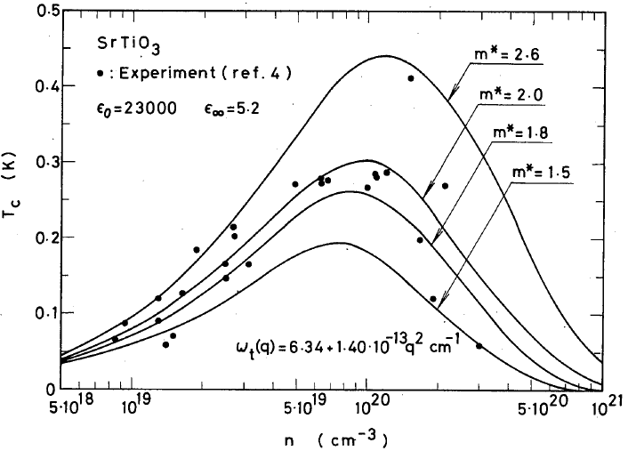
Dielectric function method for superconductivity: application to bulk SrTiO₃
(Takada, 1980)
The dome-shaped density dependence of T_{c} is explained
¹ D. A. Kirzhnits, E. G. Maksimov and D. I. Khomskii, J. Low Temp. Phys. 10, 79 (1973).
² Y. Takada, J. Phys. Soc. Jpn. 49, 1267 (1980).
Notes:
Because strontium titanate is a highly polar crystal, the electron-phonon mechanism of superconductivity seems to be the most promising for the explanation of the experimental data on superconductivity in the LaAlO₃-SrTiO₃ heterostructures.
The Migdal – Eliashberg theory of superconductivity, as well the standard BCS theory, is valid when the phonon frequencies are much smaller than the electron Fermi energy. This is not the case for polar crystals with sufficiently high optical-phonon frequencies, like strontium titanate.
To tackle such systems, several non-adiabatic extensions of the theory of superconductivity have been developed. For example, Pietronero (Refs. 1-3) generalized the Eliashberg equations to include non-adiabatic corrections beyond Migdal's theorem. The method developed by Kirzhnits et al. is focused on the superconductivity caused by the Fröhlich electron-phonon interaction with polar optical phonons. It uses the total dielectric function of a polar crystal.
The approaches mentioned here are complementary: the former is non-perturbative with respect to the coupling strength and perturbative with respect to the Debye energy, while the latter is weak-coupling but non-perturbative with respect to the optical-phonon energies.
Strontium titanate is a unique example of a polar medium in which superconductivity has been detected at very low carrier densities, so that the optical-phonon energies can be larger than the Fermi energy. Moreover, as found in 2008 by D. van der Marel et al., the electron -- LO-phonon coupling constant in SrTiO₃ is not very large. Therefore for the investigation of superconductivity in a LaAlO₃-SrTiO₃ heterostructure, the Kirzhnits method seems to be appropriate. In our recent study, we reformulated the Kirzhnits method for a multilayer structure with several polar layers.

Slide 24
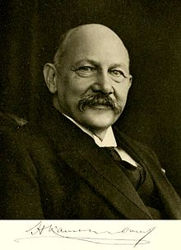
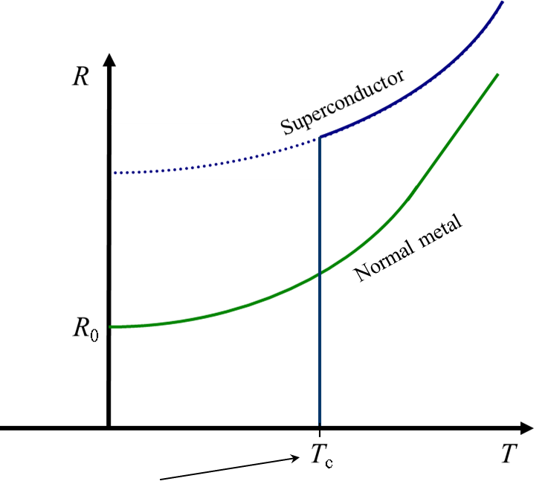
Phenomenon of superconductivity
In 1911, H. Kamerlingh Onnes found that the resistance of a mercury sample disappeared suddenly below a critical temperature.
In 1913, he was awarded with the Nobel prize “for his investigations on the properties of matter at low temperatures”
Transition temperature

Slide 25
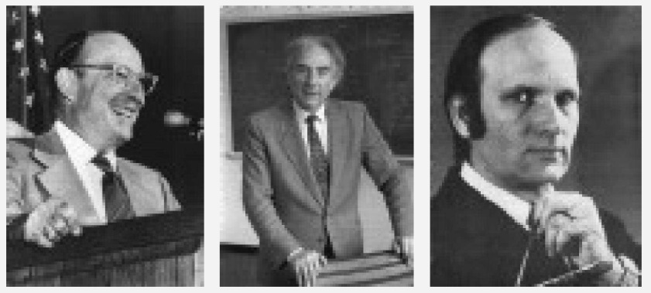
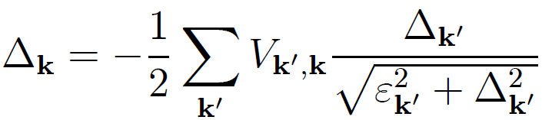
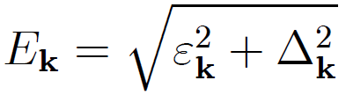
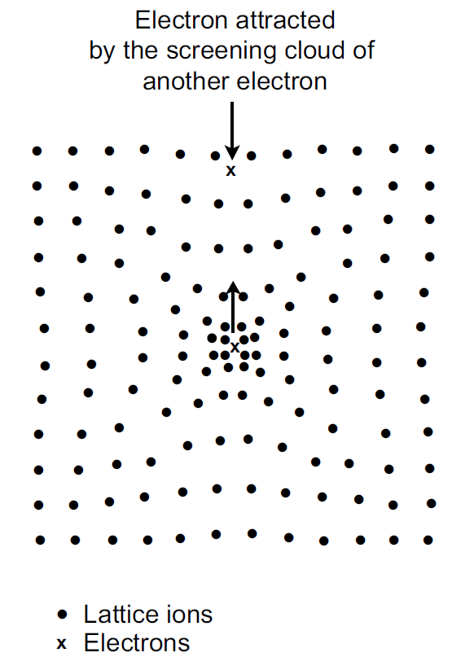
Physics of Superconductivity: BCS picture
Gap equation in the BCS theory
Excitations are separated by the energy gap Δ_{k} from the ground state
BCS theory (1957)
Nobel prize 1972:
John Bardeen, Leon N. Cooper and J. Robert Schrieffer “for their jointly developed theory of superconductivity, usually called the BCS theory”
When the electron-electron interaction is attractive, a normal fermi-liquid is unstable against the formation of pairs.

Slide 26
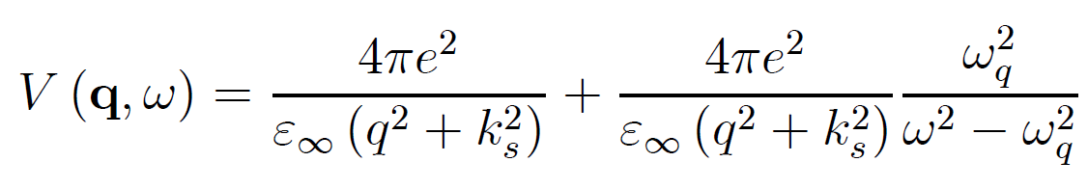
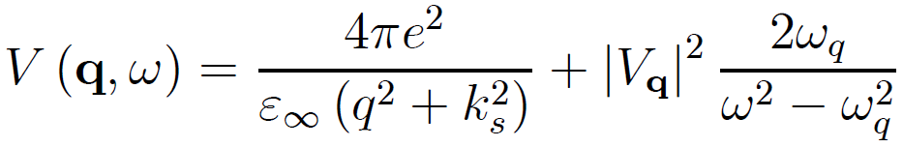



Physics of Superconductivity: BCS picture
The exchange of phonons can produce an attractive interaction between electrons.
The simplest model for the total interaction between two electrons interacting both by direct Coulomb and electron-phonon forces, is given by the scattering matrix element for the effective potential
For LO phonons
Electrons scattered by phonon exchange are confined to shell of thickness ω_{D} about Fermi surface
When the electron-electron interaction is attractive, a normal fermi-liquid is unstable against the formation of pairs.
$${ℏω}_{D}≪E_{F}$$
In the BCS theory, the adiabatic regime is assumed:
Strontium titanate is not the case of the adiabatic regime: in SrTiO₃,
$${ℏω}_{LO}≫E_{F}$$
Notes:
The simplest model for the total interaction between two electrons in momentum states k and k0, with q = k−k0,
interacting both by direct Coulomb and electron-phonon forces, is given by a sum of the Coulomb and phonon-mediated contributions.

