Slide 1
Optical gain in 2D solution processable CdSe nanoplatelets
Belgian Physical Society Meeting
18th May 2016
Ghent, Belgium
Presented by
Renu Tomar
Ph.D Student
Physics and Chemistry of Nanostructures
(Supervisor: Prof. Zeger Hens)
Ghent University, Belgium

Slide 2
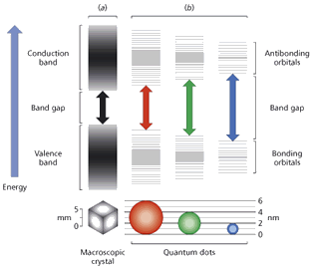
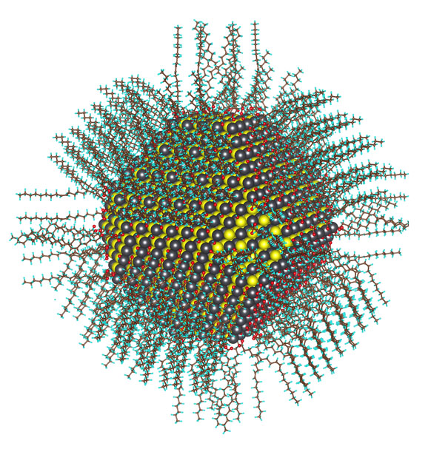
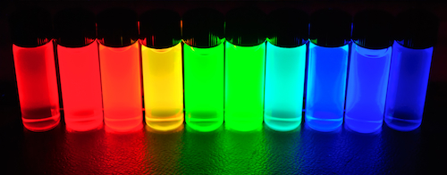
Colloidal Quantum Dots
Colloidal quantum dots are nanometer sized (2 to 10nm) semiconductor crystallites obtained by solution-based synthesis.
Advantages:
Cheap and up-scalable synthesis
Size tunable optical properties
Shape tunable optical properties

Slide 3
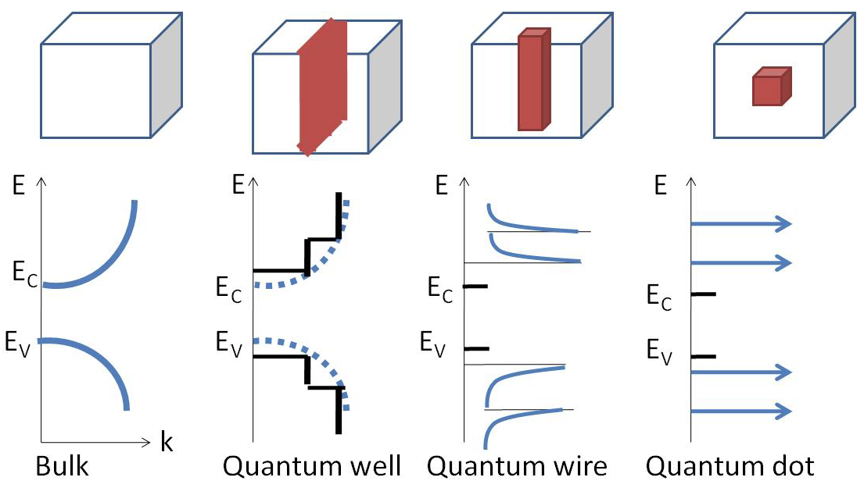
Energy level Diagram
CdSe Platelets ≈ Quantum well

Slide 4
CdSe Platelets Synthesis
N₂
N₂
And Cd(Ac)₂
140-250 °C
140-250 °C
CdSe Platelets
Cadmium precursor: Cadmium Acetate and Cadmium myristate in ODE
Selenium precursor: TOP-Se or ODE-Se

Slide 5
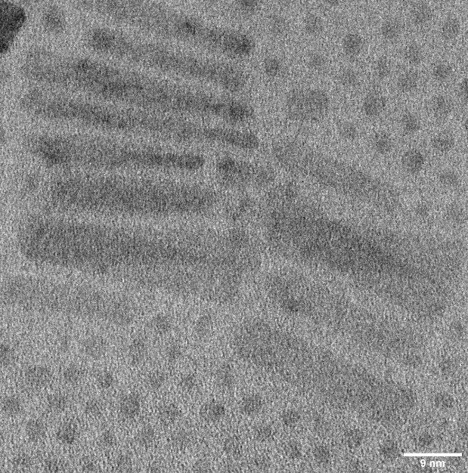
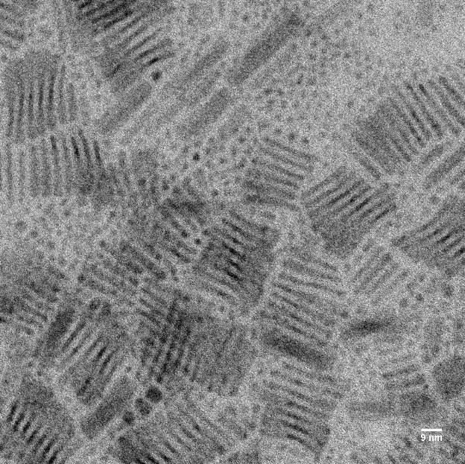
Characterization of CdSe Platelets
Light hole (LH)
Heavy hole (HH)
TEM images of CdSe 5MLs platelets

Slide 6
Pump-Probe Spectroscopy
ΔA(t,λ)=A(t,λ)–A0(λ)
ΔA<0: Bleach,reduced absorption due to state filling
ΔA>0: Photoinduced absorption,due to intraband absorption
ΔA>0 or <0: Photo-­‐induced absorptioon/bleach,due to spectral shifts

Slide 7
Interaction of light with colloidal QDs
Absorption
Stimulated emission
Auger recombination
Intraband Absorption
Intraband relaxation
Multi-exciton Generation

Slide 8
Motivation

Slide 9
Nanoplatelets Advantages : large optical cross section, slow auger recombination rates and narrow emission linewidth
Gain in Nanoplatelets: Two different exciton density regiem
Single or biexciton regime
Multiexciton (~ 40 exciton per platelet)
Lateral Size-Dependent Spontaneous and Stimulated Emission Properties in Colloidal CdSe Nanoplatelets (Hilmi Volkan Demir et.al. ACS Nano, 2015, 9, 5, 5041)
Continuous-wave biexciton lasing at room temperature using solution-processed quantum wells (Iwan Moreels et. al. Nature Nanotechnology, 2014, 9, 891)
Amplified Spontaneous Emission and Lasing in Colloidal Nanoplatelets (Hilmi Volkan Demir et. al. ACS Nano, 2014, 8, 7, 6599)
Carrier Cooling in Colloidal Quantum Wells (Dmitri V. Talapin et. al. Nano Letter. 2012, 12, 6158)

Slide 10
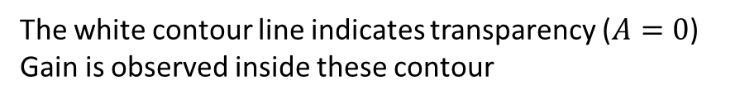
Transient Absorption Study on 4MLs CdSe Platelets
Spectra after photo-excitation with 400 nm with Pump power: 32.5 mW
Non-linear absorption
∆A
A = A₀ + ∆A
The white contour line indicates transparency ($A=0$) Gain is observed inside these contour

Slide 11
Characterization of CdSe Platelets
$A$ spectra, taken at 2.5 ps after photo-excitation for different pump fluences.

Slide 12
Characterization of CdSe Platelets
$A$ spectra, taken 2.5 ps after photo-excitation for different pump fluences.
Retain the excitonic feature
Gain observed in both Heavy hole (HH) and Light hole (LH)

Slide 13
Intrinsic absorption and <N> Calculation
… 1
Intrinsic absorption, μ_{i}(ω) =δ ⁽¹⁾ (ω)/V_{P} ,
Where V_{P} being the platelet volume and δ⁽¹⁾ the linear absorption cross section
… 2
… 3
μ_{i}(400) = 1.466 * 10⁵ cm⁻¹
Number of excitons per platelet, <N> = J_{p}* σ _{pump}
Where Absorption crossection of platelets, σ _{pump} = μ_{i}(pump) * V_{P}
And Pump fluence, J_{p} = Pump power* Frequency/ (E _{pump}* Area of pump beam)
Achtstein, A. W., Antanovich, A., Prudnikau, A., Scott, R., Woggon, U., Artemyev, M., J. Phys. Chem. C 2015, 119, 20156−20161

Slide 14
The wavelength dependent gain threshold
LH
HH
Gain threshold is 160 excitons for HH at 521 nm.
Gain threshold is 239 excitons for LH at 500 nm.

Slide 15
Allowed optical transitions
S^{e} - S^{h}
P_{x} ^{e} - P_{x} ^{h}

Slide 16
Characterization of CdSe Platelets
Bleach with increase in pump power
Similar decay rate for lower pump power till onset of gain
Faster decay with increase for higher pump fluence

Slide 17
Conclusions
  Four different monolayer thick CdSe platelets has been synthesized.
  Surface area analysis form TEM images.
  Observed gain in 4MLs Platelets in multi exciton regime.
  Need of model other than quantum-dot like models to interpret the optical properties of CdSe nanoplatelets.

Slide 18
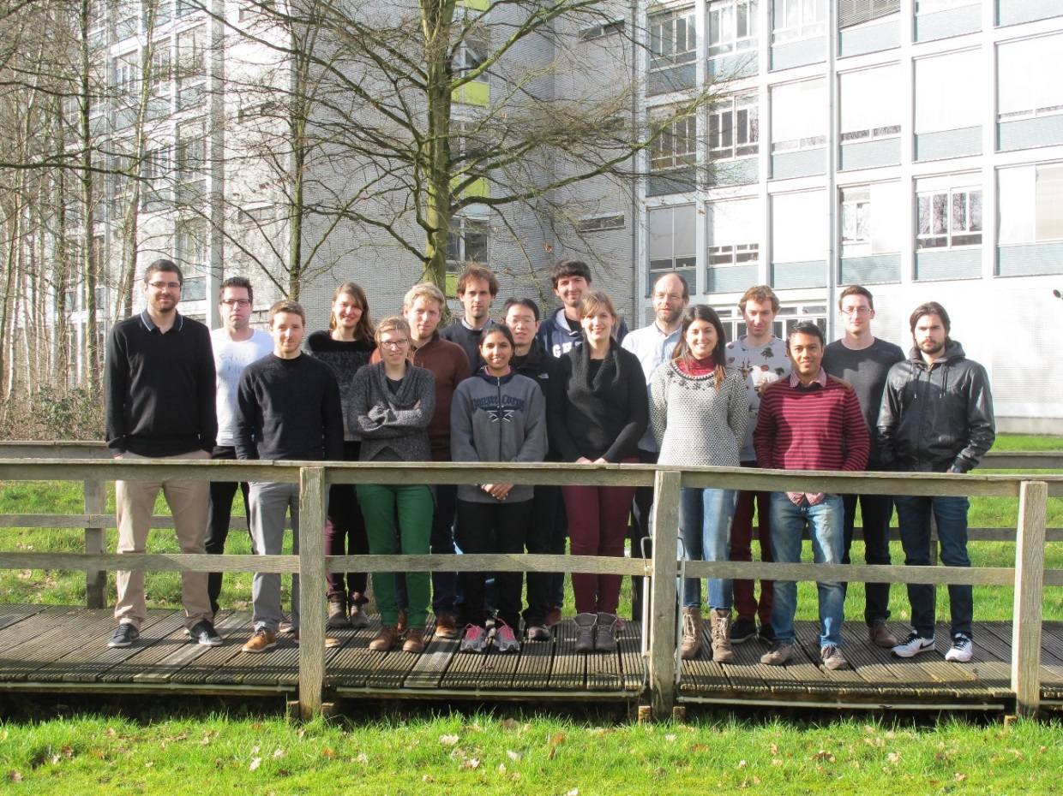


Thank you for your kind attention

Slide 19
Pump-Probe Spectroscopy
Half Wave Plate
ND Filter
Pump
110 fs
Chopper
500 Hz
800nm
110 fs
Non-linear
Crystal
Broadband Probe
Delay Stage
Fiber to CCD
Cuvette

Slide 20
The wavelength dependent gain threshold
Wavelength dependence of bleach around Heavy hole (HH) bleach wavelength.
Wavelength dependence of bleach around Light hole (LH) bleach wavelength.

