Slide 1
Thermal and Plasma-Enhanced
Atomic Layer Deposition on Powders and Particles
Geert Rampelberg, Véronique Cremers, Delphine Longrie, Davy Deduytsche, Johan Haemers, Christophe Detavernier
Belgian Physical Society
General Scientific Meeting 2016
CoCooN
Conformal Coating of Nanomaterials

Slide 2
Outline
Atomic layer deposition
Industrial applications
ALD on powders and particles
Conclusions

Slide 3
Outline
Atomic layer deposition
  What is ALD?
  Plasma-enhanced ALD
  Advantages and limitations
  Examples of conformal nanocoatings by ALD
Industrial applications
ALD on powders and particles
Conclusions

Slide 4
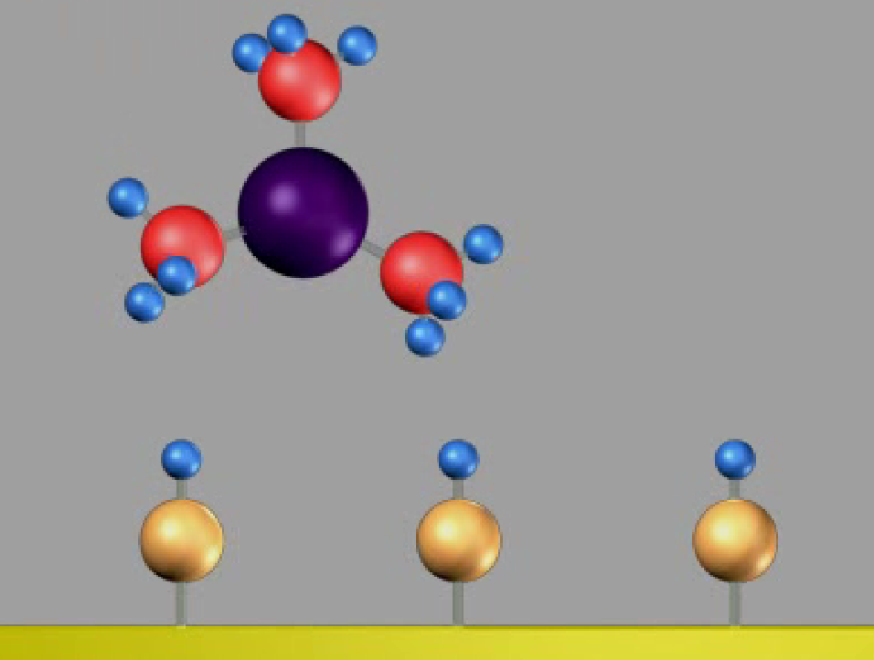
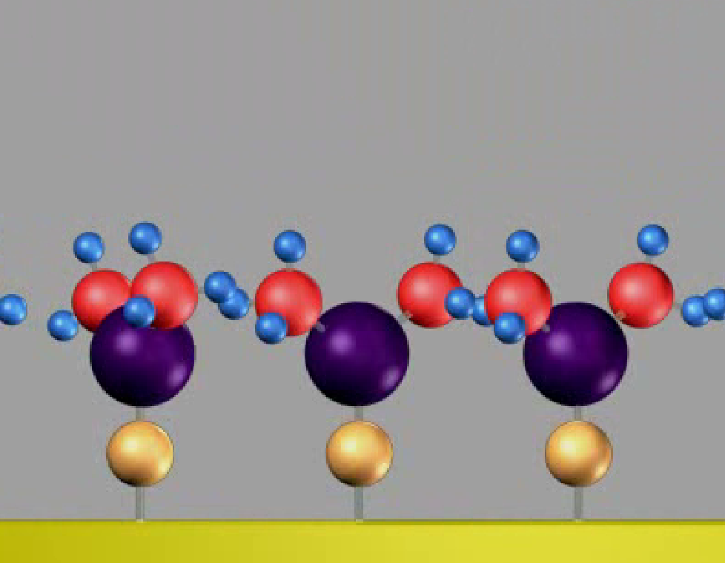
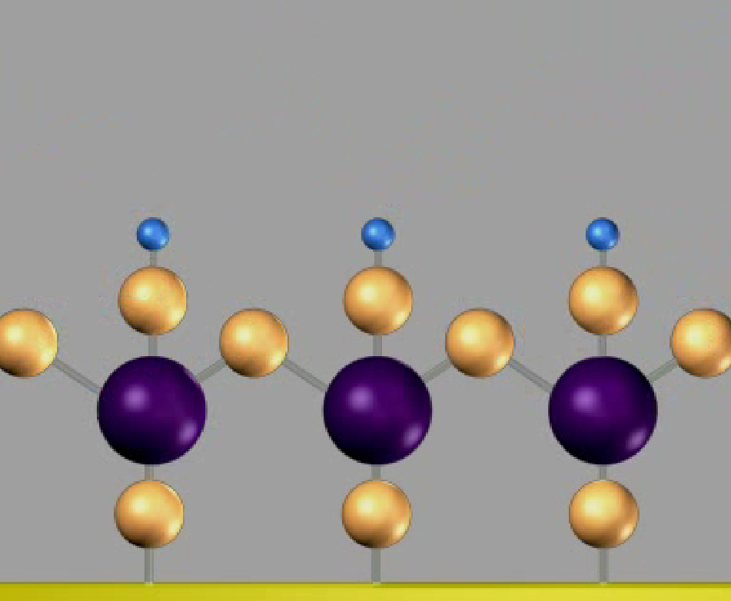
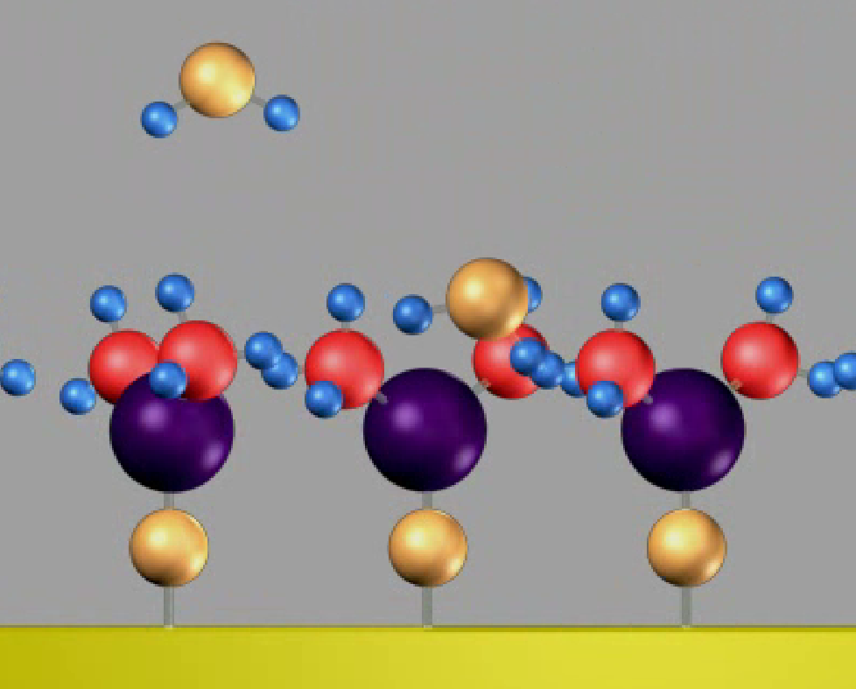
Atomic layer deposition
Gas-phase thin film deposition technique
Cyclic process of self-limiting surface reactions
→ layer-by-layer growth
Example :
ALD growth of Al₂O₃ from trimethyl aluminum (TMA) and H₂O
Self-saturated
chemisorption
TMA pulse
One layer of Al₂O₃
H₂O pulse

Slide 5
Plasma-enhanced atomic layer deposition
Plasma:
Highly energetic plasma species facilitate surface reactions
More coating materials available
Coating of temperature-sensitive substrates
Cheaper chemicals
...
Self-saturated
chemisorption
TMA pulse
One layer of Al₂O₃
O₂ plasma

Slide 6
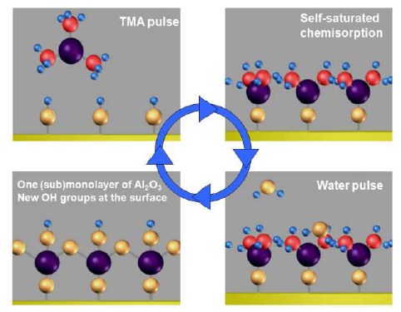
Advantages and limitations
Advantages:
Excellent control of thickness
Growth rate from linear fit:
0.85Å/cycle

Slide 7
Advantages and limitations
Advantages:
Excellent control of thickness
Stoichiometry determined by chemistry
Limitations:
Slow: ~1Å/cycle
2 Al(CH₃)₃ + 3 H₂O → Al₂O₃ + 6 CH₄

Slide 8
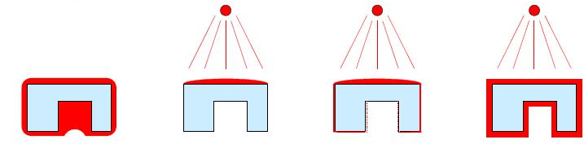
Advantages and limitations
Advantages:
Excellent control of thickness
Stoichiometry determined by chemistry
Excellent uniformity
Highest degree of conformality
Sol-gel
PVD
CVD
ALD

Slide 9
Advantages and limitations
Advantages:
Excellent control of thickness
Stoichiometry determined by chemistry
Excellent uniformity
Highest degree of conformality
Limitations:
Slow: ~1Å/cycle
Growth rate from linear fit:
0.85Å/cycle
ALD = ideal technique for 3D surface engineering

Slide 10
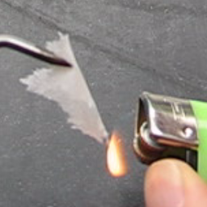
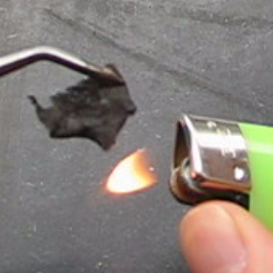
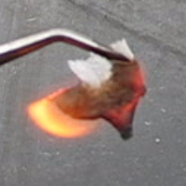
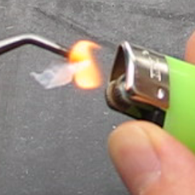
Al₂O₃ coated paper
ALD coated tissue paper
Thermal ALD, TMA + H₂O, 50°C, 200 cycles.

Slide 11
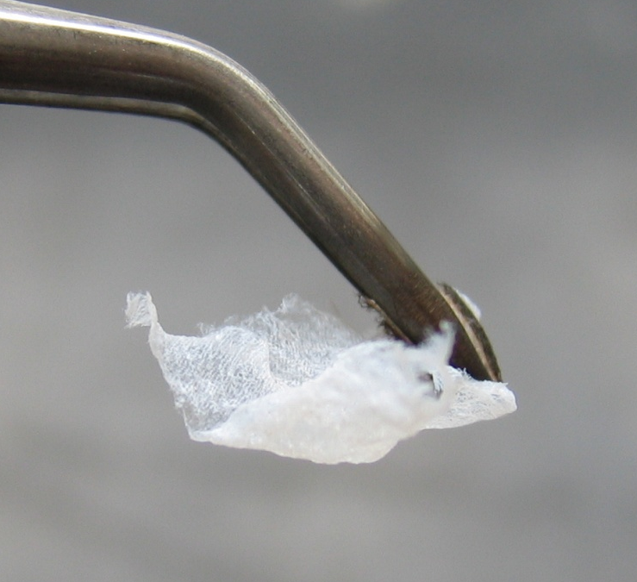
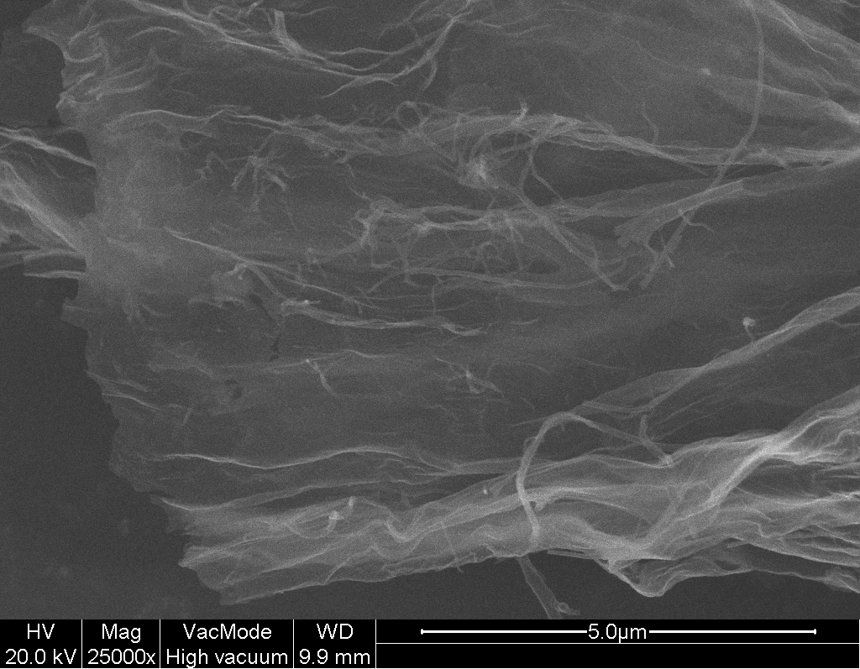
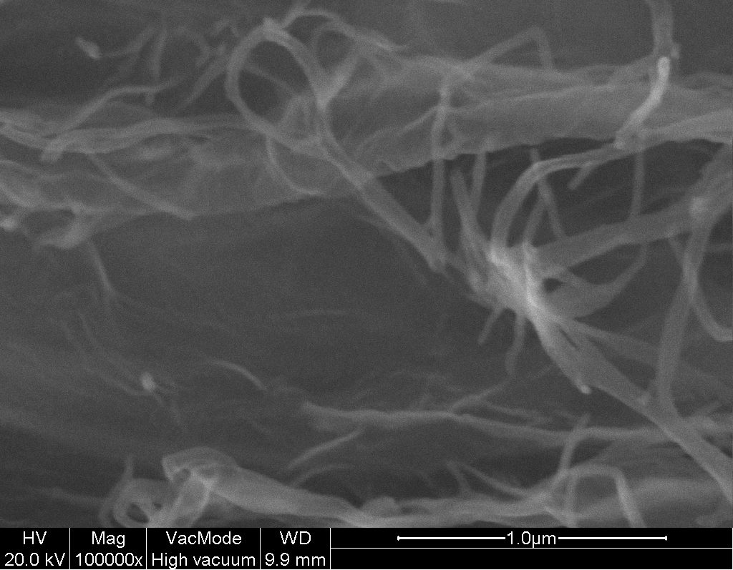
Al₂O₃ coated paper
After combustion of the cellulose template: hollow structure, consisting of freestanding 20nm Al₂O₃ ALD film.
Direct, macroscopic illustration of the conformality of ALD, and of its potential for coating porous and fibrous materials.

Slide 12
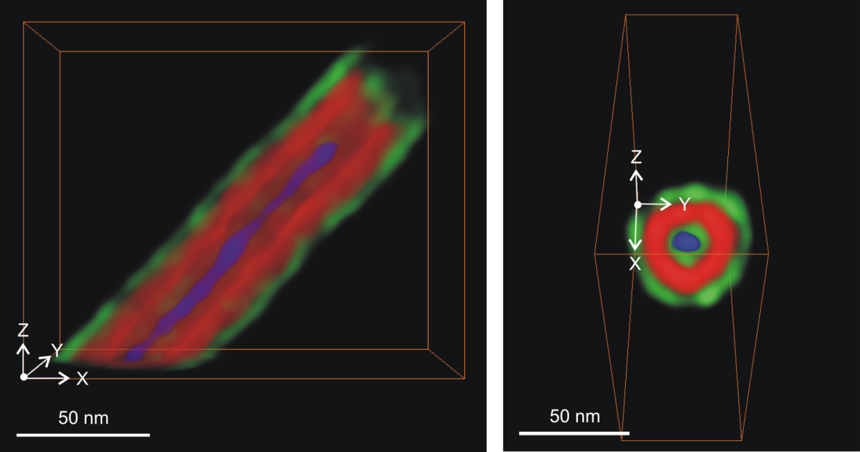
ALD – a coating technique for the nano era
CNT
V₂O₅
TiO₂
TiO₂/V₂O₅/TiO₂ multilayer coating of a carbon nanotube
TEM imaging by EMAT (UA)

Slide 13
Outline
Atomic layer deposition
Industrial applications
  Microelectronics
  Solar energy
  Flexible electronics
ALD on powders and particles
Conclusions

Slide 14
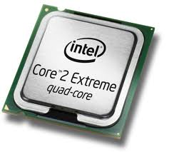
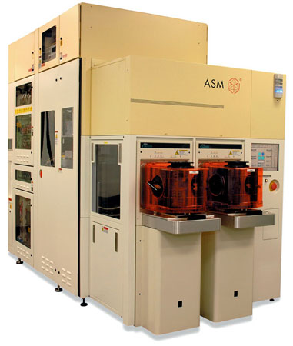
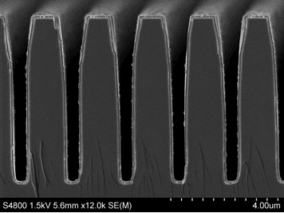
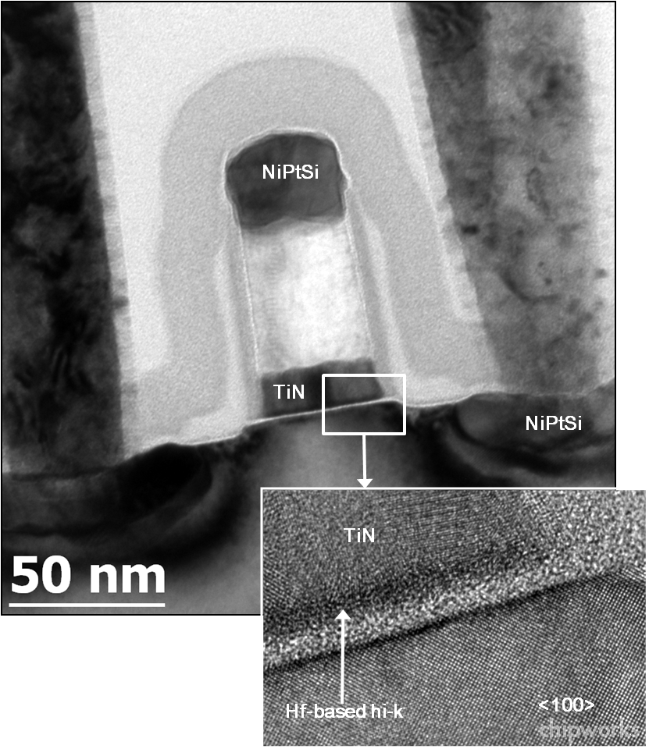
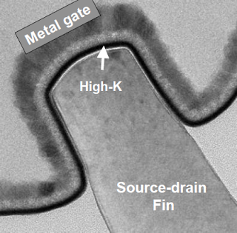
Functional nanocoatings in micro-electronics
JACS 2008, 131 (10), 3478
DRAM
Transistors
Patterning
Panasonic

Slide 15

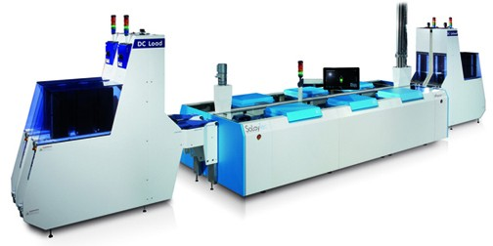
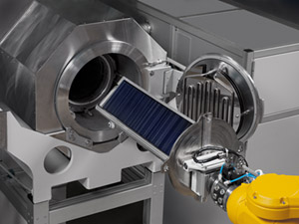
Surface passivation in photovoltaics
Increased efficiency by enhanced lifetime of charge carriers
Dedicated reactor design
Batch ALD (Beneq):
2000 wafers/hour
Spatial ALD (SolayTec, Levitech):
4500 wafers/hour

Slide 16
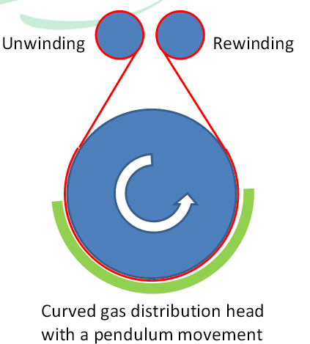
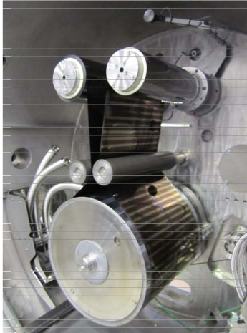
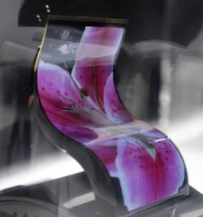
Roll-to-roll ALD
Development of roll-to-roll ALD for ALD on flexible substrates
Potential use in flexible electronics
Beneq: 400,000m²/year (20nm Al₂O₃)

Slide 17
Outline
Atomic layer deposition
Industrial applications
ALD on powders and particles
  UGent rotary reactor
  Applications
Conclusions

Slide 18
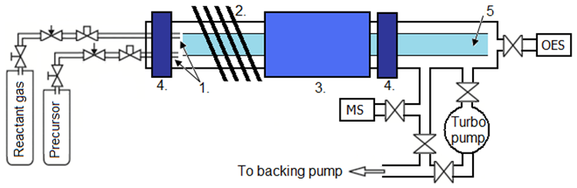
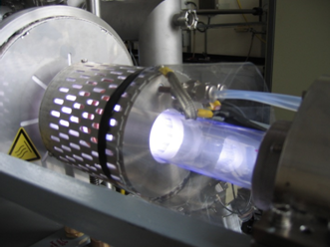
Powder coater at UGent
Rotary reactor for powder agitation during gas-solid reactions
First plasma-enhanced ALD powder coater
In-situ characterization of reaction chemistry and saturation:
  Mass spectroscopy
  Optical emission spectroscopy

Slide 19
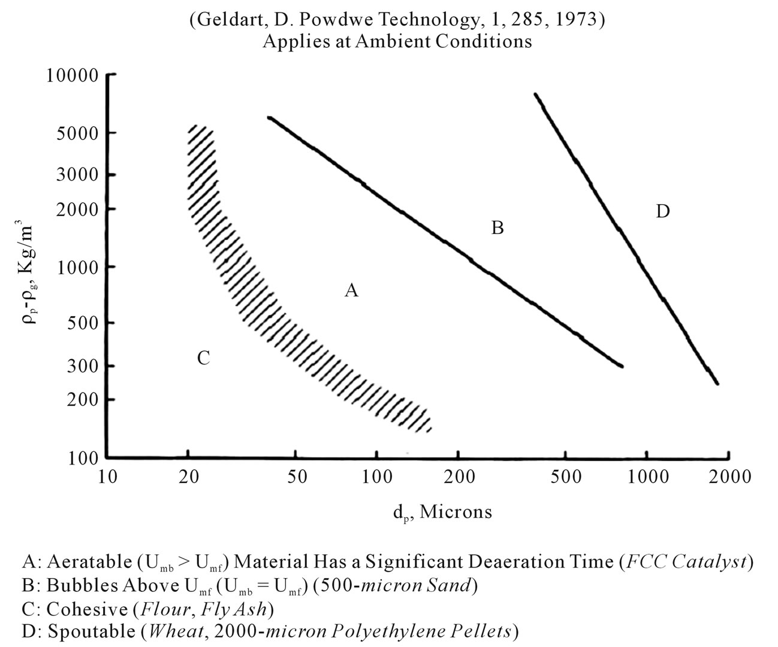
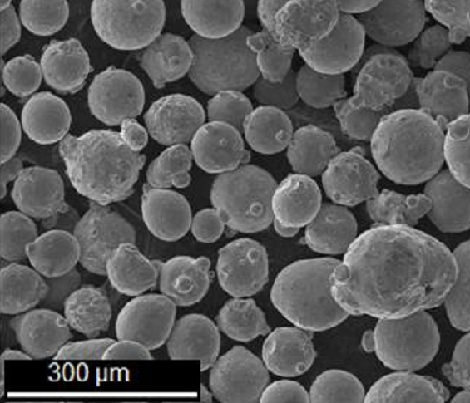
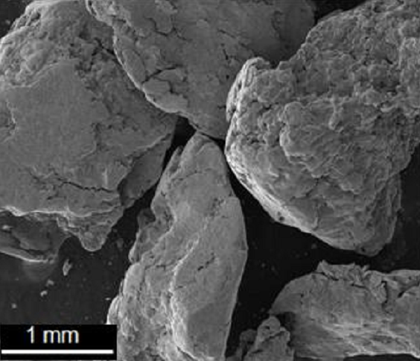
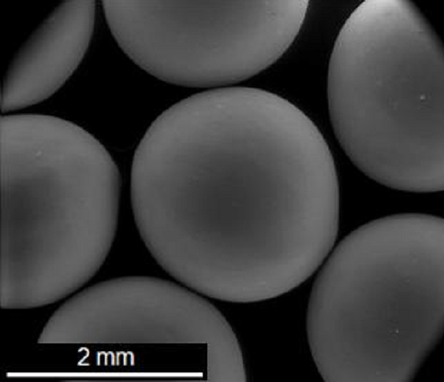
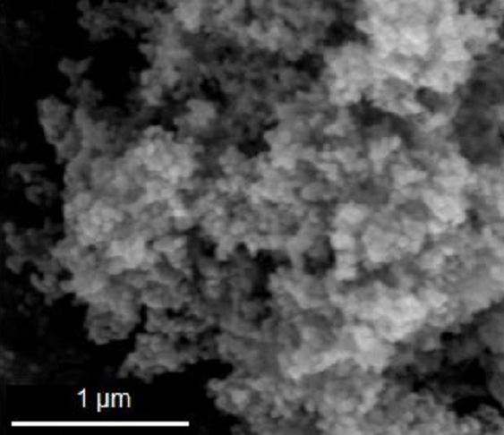
ALD coatings on a wide range of particle sizes
Both thermal and plasma enhanced ALD can be performed on a broad range of particle sizes:
Ti
Glass beads
Stainless
steel
Nano ZnO
D. Longrie et al., Surface & Coatings Technology, 213, 183-191, 2012.

Slide 20
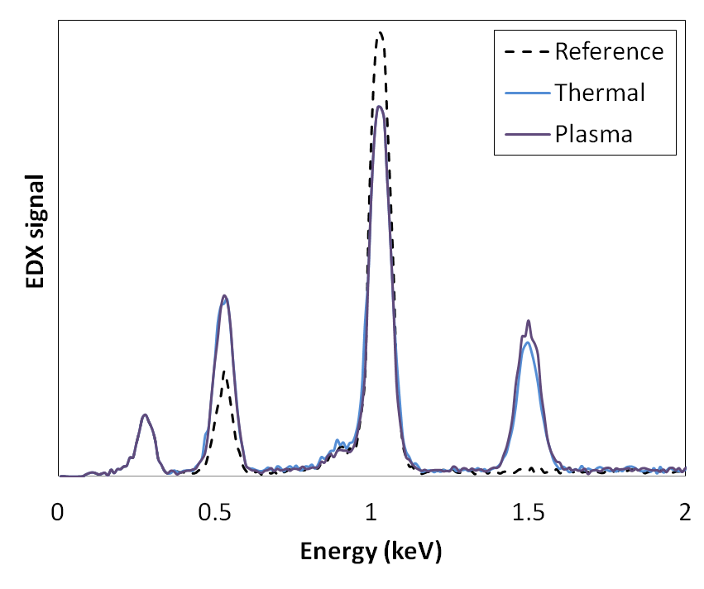
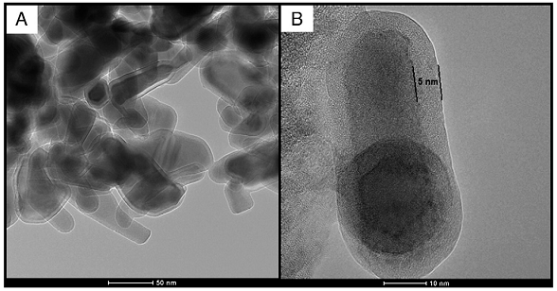
Conformal Al₂O₃ coating on nano ZnO powder
Nano ZnO: 20-120nm particle size, 33.2 m²/g
Zn
O
Al
C
Nanopowders often form micron-sized aggregates, however, ALD is capable of conformally coating the individual nanoparticles
5nm Al₂O₃
D. Longrie et al., Surface & Coatings Technology, 213, 183-191, 2012.

Slide 21
Surface functionalization of powders
Protective coatings
Active functionalities
Particle-matrix interaction
Particle-particle interaction
Moisture/oxidation:
phosphors, copper,...
Catalysts
Dispersion:
inks, paint,...
Rheology:
3D printing, pharmaceutics,...
Aggressive chemicals:
batteries
Optical coatings
Adhesion:
fiber reinforcement ,...
UV radiation:
inks, paint,...
Conductive coatings
Hydrophobicity:
e.g. Teflon
Sintering:
3D printing,...
CoCooN experience

Slide 22
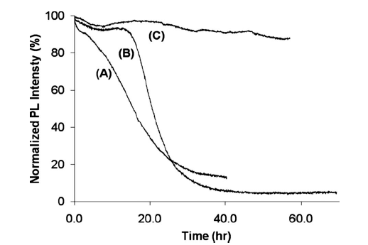
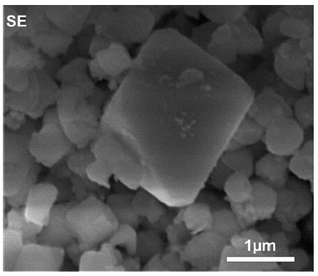
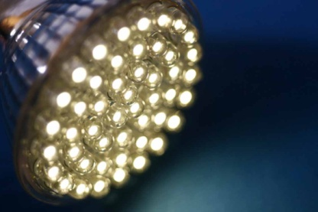
Surface functionalization of powders
Protective coatings
Active functionalities
Particle-matrix interaction
Particle-particle interaction
Moisture/oxidation:
phosphors, copper,...
Catalysts
Dispersion:
inks, paint,...
Rheology:
3D printing, pharmaceutics,...
Aggressive chemicals:
batteries
Optical coatings
Adhesion:
fiber reinforcement ,...
UV radiation:
inks, paint,...
Conductive coatings
Hydrophobicity:
e.g. Teflon
Sintering:
3D printing,...
Phosphors for LED lighting
Long term stability by
encapsulation
Uncoated
10nm Al₂O₃
20nm Al₂O₃
Avci et al., J. Electrochem. Soc., 156, J333, 2009.

Slide 23
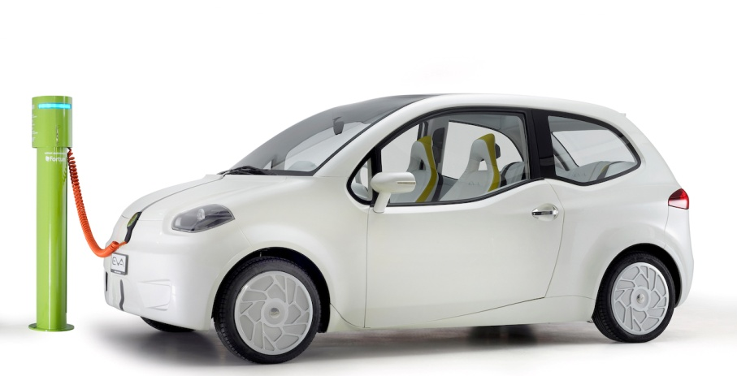
Surface functionalization of powders
Protective coatings
Active functionalities
Particle-matrix interaction
Particle-particle interaction
Moisture/oxidation:
phosphors, copper,...
Catalysts
Dispersion:
inks, paint,...
Rheology:
3D printing, pharmaceutics,...
Aggressive chemicals:
batteries
Optical coatings
Adhesion:
fiber reinforcement ,...
UV radiation:
inks, paint,...
Conductive coatings
Hydrophobicity:
e.g. Teflon
Sintering:
3D printing,...
Batteries for Electrical Vehicles
5x longer lasting
5x faster charging
High-temperature performance
ALD coated particles
(LiNiMnO_{x})
Energy density
70% capacity fade after 10 years
Current Li-ion
Life cycle
Source: Pneumaticoat

Slide 24
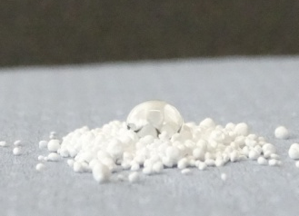
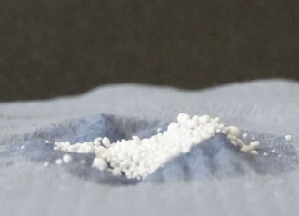
Surface functionalization of powders
Protective coatings
Active functionalities
Particle-matrix interaction
Particle-particle interaction
Moisture/oxidation:
phosphors, copper,...
Catalysts
Dispersion:
inks, paint,...
Rheology:
3D printing, pharmaceutics,...
Aggressive chemicals:
batteries
Optical coatings
Adhesion:
fiber reinforcement ,...
UV radiation:
inks, paint,...
Conductive coatings
Hydrophobicity:
e.g. Teflon
Sintering:
3D printing,...
Hydrophilic coating on Teflon
Coating of Teflon (hydrophobic) with ceramic
coating (Al₂O₃, TiO₂,...) results in hydrophilic
behavior
Requirement of plasma-enhanced ALD!
Untreated Teflon: hydrophobic
Hydrophilic coating
water
droplet
water easily penetrates

Slide 25
Outline
Atomic layer deposition
Industrial applications
ALD on powders and particles
Conclusions

Slide 26
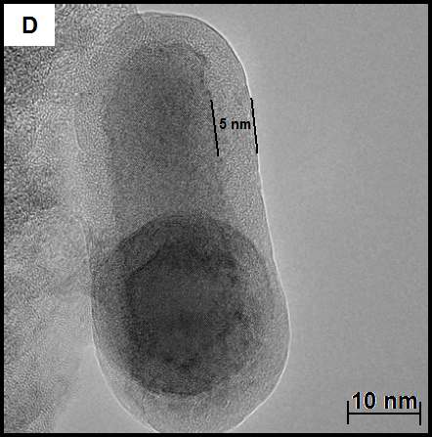
Conclusions
Atomic layer deposition:
  3D surface engineering by conformal nanocoatings
  Industrially applied in microelectronics, photovoltaics, roll-to-roll
Plasma-enhanced ALD:
  Highly energetic plasma species allow for lower deposition temperatures, wider range of coatings,...
ALD / PE-ALD on powders and particles enabled by rotary reactor:
  Nanopowders to millimeter-sized particles
  New range of applications: battery, catalysts, LED lighting,...

Slide 27





Acknowledgements
Research Foundation Flanders
CoCooN
Conformal Coating of Nanomaterials

Slide 28
THANK YOU

