Slide 1
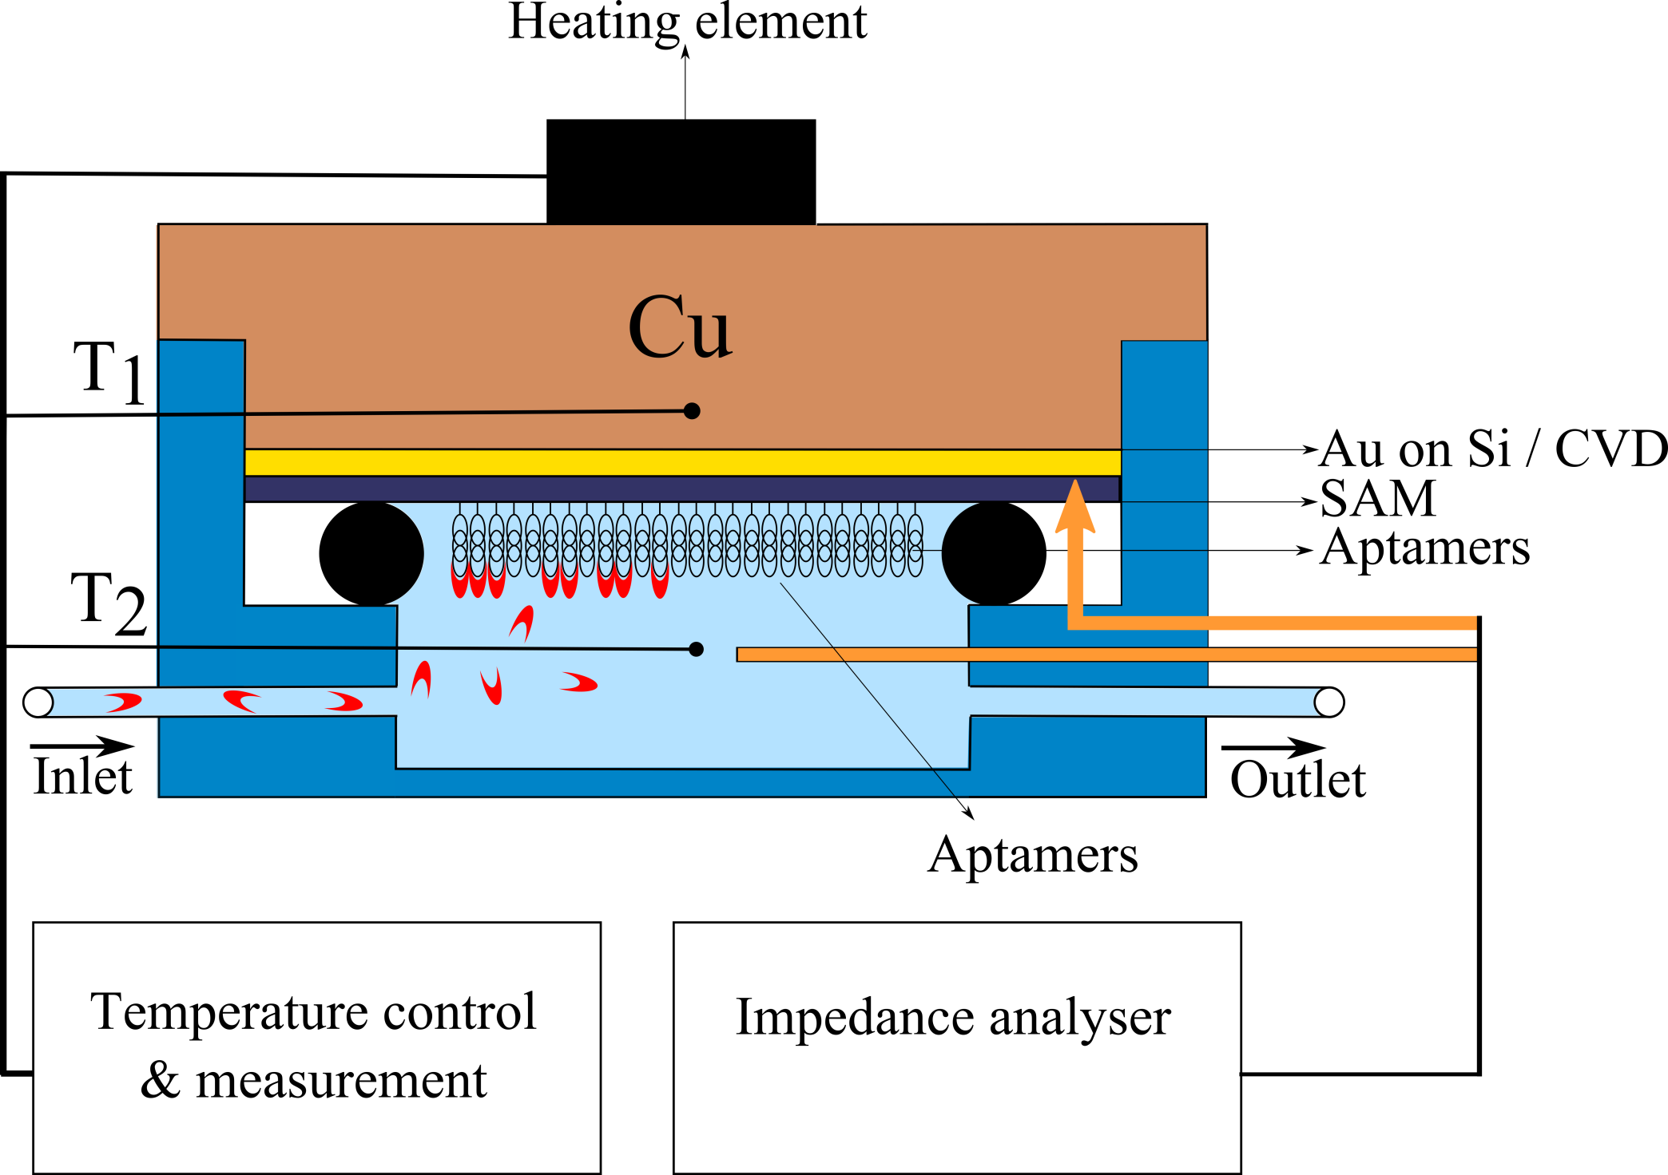
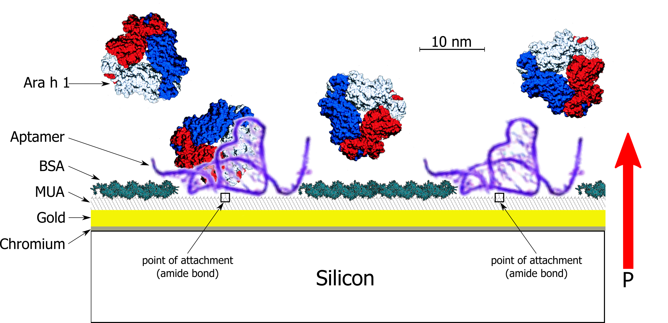
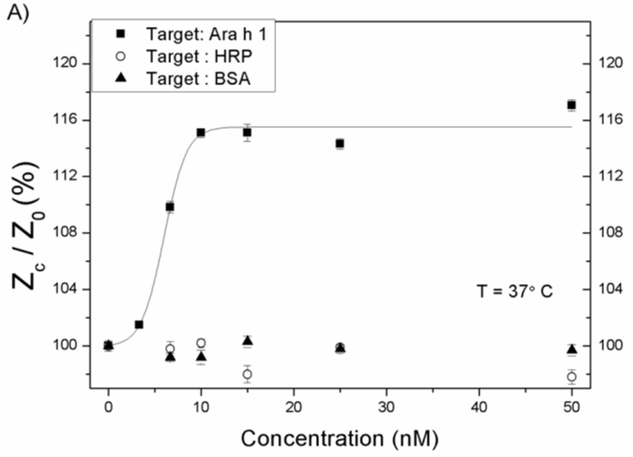
Detection of the peanut allergen Ara h 1 by electrochemical impedance spectroscopy and the heat-transfer method W. Stilman*, G. Wackers, M. Khorshid, P Losada-Perez, M. Peeters, W. De Ceuninck, J. Lammertyn, E. Pérez-Ruiz and P. Wagner
*) Hasselt University, Diepenbeek, Belgium
Introduction
About 1% of the world population is affected by a peanut allergy, which is the most common cause of fatal-food-related anaphylaxis. The protein Ara h 1 was identified as the culprit in 95% of all allergic reactions to peanuts. To date the assays to detect the Ara h 1 allergen rely on the ELISA assay, lateral flow assays and mass spectroscopy all of which are neither cheap nor fast. Aptamers, which are single DNA or RNA oligonucleotides, offer a cheaper and more stable receptor element.
Experimental
Amino (NH₂)-terminated Ara h 1 aptamers were covalently attached to carboxylated gold surfaces and to nanocrystalline diamond using the EDC coupling chemical route. Subsequently, the functionalized surfaces were used in a setup that combines both electrochemical impedance spectroscopy and heat transfer measurements. Two thermocouples were used in order to monitor the temperatures of the copper lid, T₁, and of the fluid, T₂. For impedance spectroscopy measurements, gold electrodes served as counter electrode within a range of 100 Hz to 100 kHz.
Aptamer sequence: NH₂ – C₆ – 5’ TCGCACATTCCGCTTCTACCGGGGGGGTCGAGCTGAGTGGATGCGAATCTGTGGGTGGGCCGTAAGTCCGTGTGTGCGAA 3’
Figure 1. Schematic representation of the sensor cell (left) and surface of the sensor (right)
In this work, the aptamer functionalized surfaces were exposed to increasing amounts of Ara h 1 in order to acquire response curves. Non-specific binding of contaminants was avoided through BSA washing to block any non-specific binding sites.
Figure 2. Normalized impedance at 316 Hz for increasing concentrations of Ara h1
Figure 3A. Raw data displaying the heat transfer resistance of the aptamer functionalized sensor chip for various concentrations of Ara h 1 in TGK buffer.
Figure 3B. Data of panel A with normalized scale and allometric fit. The open boxes display a sensor identical in preparation except for the functionalisation with apatamers. Error bars were calculated from 3 seperate measurements.
Figure 4. Pure TGK, peanut butter extract in TGK and peanut butter extract in spiked TGK resulting in a 2.2% and 12% increase respectively .
Conclusion
Electrochemical impedance spectroscopy and the heat transfer method can be used to detect Ara h 1 concentrations down to a detection limit of 3 nM. This allows the detection of Ara h 1 in a dilution of 50 mg peanut butter in a 20.000 times larger volume of buffer solution and confirms the possibility of protein detection with the heat-transfer method.
References
[1] Peeters M.; van Grinsven B.; Cleij T.; Jiménez-Monroy K.; Cornelis P.; Pérez-Ruiz E.; Wackers G.; Thoelen R.; de Ceuninck W.; Lammertyn J.; and Wagner P. ACS applied materials and interfaces 2015, 7, 10316–10323
[2] van Grinsven B.; Eersels K.; Peeters M.; Losada-Perez P.; Vandenryt T.; Cleij T.; and Wagner P. ACS applied materials and interfaces 2014, 6, 13309–13318
Acknowledgements
Financial support by the Research foundation Flanders FWO (project G.0B62.13N and G.0B25.14N) is gratefully acknowledged.

