Slide 1
The europeaN Physical journal
Christian Caron, Ph.D.
Executive Publishing Editor | Physics
Springer
The European Physical Journal
(member of the Steering Committee)
Lecture Notes in Physics
Springer Complexity
Science and Fiction

Slide 2
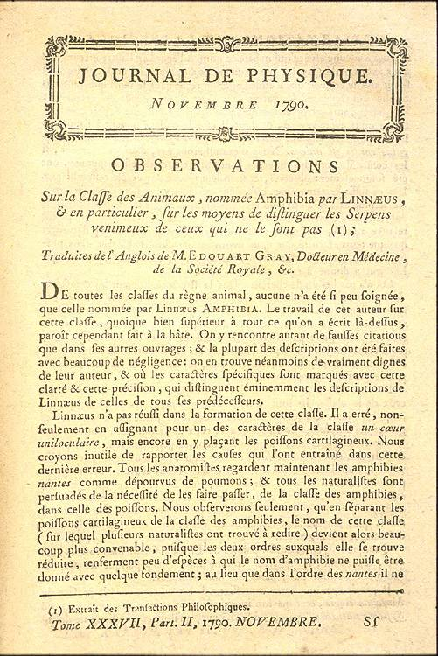
The europeaN Physical journal
In 1998 The European Physical Journal (EPJ) was launched by EDP Sciences, Società Italiana di Fisica and Springer.
3 illustrious founding journals →
Meanwhile EPJ is a merger and continuation of
Acta Physica Hungarica
Anales de Física
Czechoslovak Journal of Physics
Fizika A
Il Nuovo Cimento
Journal de Physique
Portugaliae Physica
Zeitschrift für Physik.

Slide 3
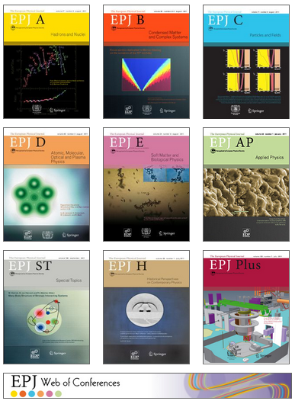
The europeaN Physical journal
8 subscription-based journals
Global readership: accessed in well over
8000 institutions worldwide
Hybrid journals, i.e. it is possible to publish individual papers in open access.
1 journal (EPJ C) that has become full OA in 2014.
SCOAP3 sponsorship (phase II: 2017-19)
CC BY 4.0

Slide 4
The europeaN Physical journal
7 open access journals →
1 open access repository
for proceedings:
EPJ Web of Conferences

Slide 5
The europeaN Physical journal
How to extract meaningful data from socio-technico-economic systems with ever increasing complexity
How to analyze “big data” in a way that allows new insights
Data-driven fundamental complex systems research: how to find new empirical laws or more fundamental theories.
First IF this year (for 2015)
Frank Schweitzer
Alessandro Vespignani

Slide 6
The europeaN Physical journal
Focuses on the design, implementation, and application of new techniques in all areas of the physical and applied sciences
Laboratory-specific custom instrumentation and diagnostics
Innovative and clever experimental techniques
Subtle refinements to established experimental setups
Novel analytical methods
Stephen Buckman
Peter Grütter / Martin Hegner

Slide 7
The europeaN Physical journal
Quantum measurement, metrology and lithography
Quantum electro/optomechanical systems
Quantum machines, engineering and nanorobotics
Quantum information
Quantum biology
Quantum sensing
Hybrid quantum systems
Quantum simulations
Gerard Milburn

Slide 8
The europeaN Physical journal
Complete topical issues in all fields of pure and applied physical sciences - often interdisciplinary.
Research Networks: final reports, white papers, physics cases for proposed large experimental facilities.
Discussion and Debate Issues

Slide 9
The europeaN Physical journal
Discussion and Debate issues: balanced critical presentation of specific unsolved problems, controversial topics, rival theories, alternative methodologies, and negative results of interest at the cutting edge of scientific and technological development.
Some Discussion and Debate issue titles:
Rogue Waves - Towards a Unifying Concept?
Quantum Annealing: The Fastest Route to Quantum Computation?
From Black Swans to Dragon-Kings - Is There Life Beyond Power Laws?
The Carnot Principle Revisited: Towards New Extensions?

Slide 10
The europeaN Physical journal
Fosters and disseminate an awareness and understanding of the historical development of ideas in contemporary physics.
The only journal to address the history of physics primarily from the physics and physicists' perspective
Supports physicists in any serious attempts to reflect, understand, and improve on the culture of their own discipline.
Example:
The fifth force: A personal history by Ephraim Fischbach
(addresses in particular the issue of research methodology in the context of discovery and justification in modern physics)

Slide 11
The europeaN Physical journal
Some Special Features of EPJ:
1. EPJ Scientific Advisory Committee
- 24 representatives from European Physical Societies
- is consulted on matters of editorial policies, publishing ethics and models, Editor-in-Chief suggestions, ….
representative from BPS:
Jef Ongena

Slide 12
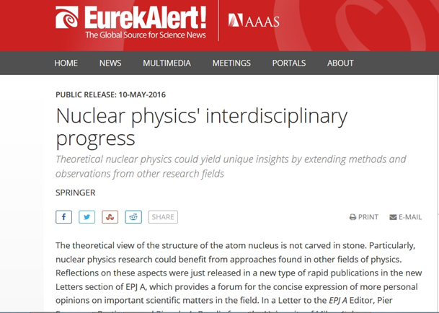
The europeaN Physical journal
2. Editorial Transfer Agreements : between EPL and EPJ, and within EPJs.
Keeps original submission date
Transfers the referee reports to speed up procedures
3. Highlight Papers
Selected by editorial boards
Texts written by science journalist
Published on:
Europhysics News
EPJ portal
Internet press centers
…

Slide 13
The europeaN Physical journal
4. Distinguished EPJ Referees
selected every year by the journal editors based on the quality, number, and timeliness of their reports.
Names are published on the EPJ web portal – referees receive:
a certificate signed by the Editors-in-Chief of the corresponding EPJ journal and by the chair of the EPJ Steering Committee
a personalized electronic badge for the use of homepages and similar
a complimentary book of their choice from the publishers' catalogue

Slide 14
The europeaN Physical journal
5. EPJ as sponsor
…at selected national
and international meetings
Long tradition with BPS:
EPJ co-sponsors traditionally the Young Speakers Contest and the Poster Prizes.

Slide 15
The europeaN Physical journal
Thank you for the cordial invitation to the BPS annual meetings!
Twitter: Follow @EPJscience

