Slide 1
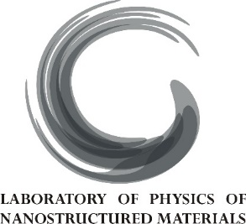
Imprinting superconducting vortex footsteps in a magnetic layer
Jérémy Brisbois
Laboratory of Physics of Nanostructured Materials, ULg

Slide 2
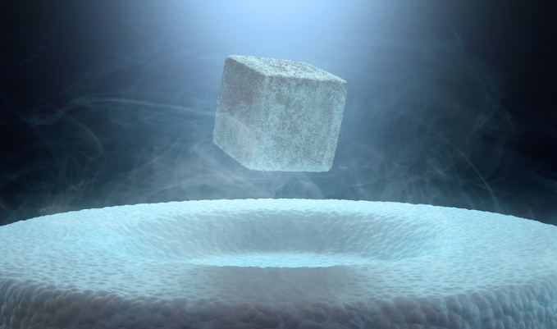
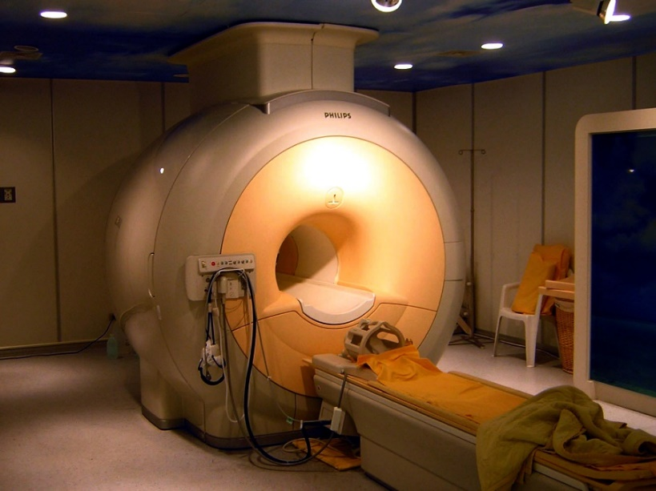
What is superconductivity?
$$B=0$$
Perfect diamagnetism
$$R=0$$
Perfect conductivity

Slide 3
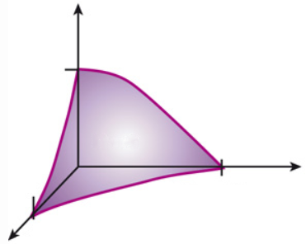
Conditions of existence
H
Magnetic field
Screening currents
H_{c}
$$B=0$$
T_{c}
J_{c}
superconductor
Temperature
Electric current
Superconductivity survives only under particular conditions.

Slide 4
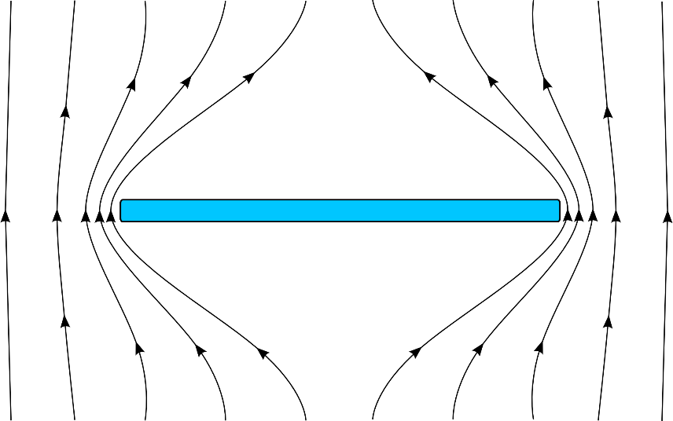
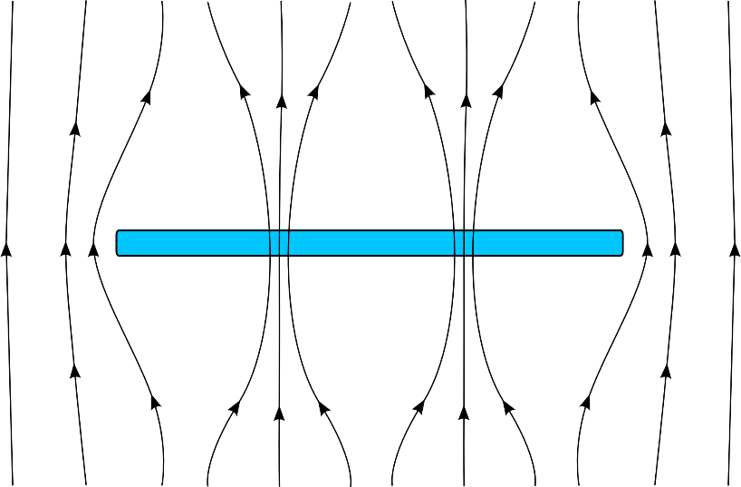
Superconducting flux vortices
$$H$$
$$H$$
$$B=0$$
$$B≠0$$
$H$ increased
Superconducting vortices are quantized unit of magnetic flux with a normal state core ~ 100 nm.

Slide 5
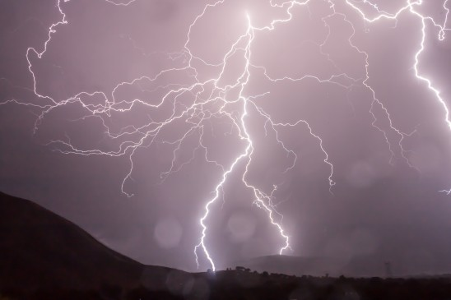
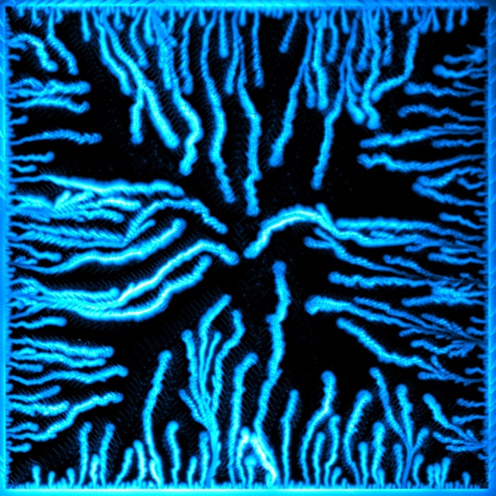
Flux penetration in superconductors
observed by magneto-optical imaging (MOI)
H increased
vortex motion
dissipation in normal core
T raises locally
efficient heat removal
Smooth
flux penetration
Flux avalanches

Slide 6
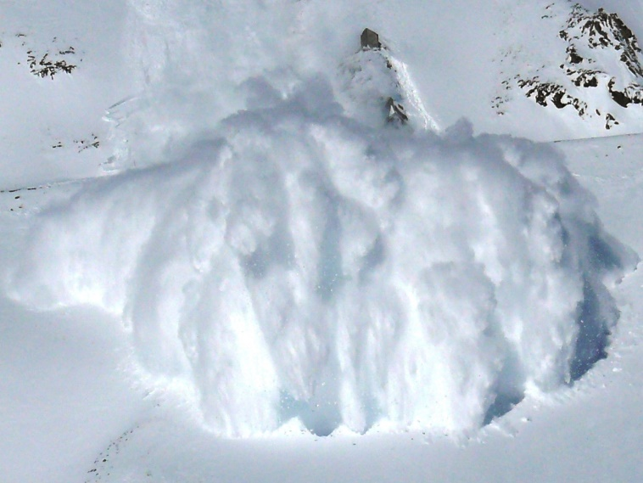
Why study avalanches?
The system undergoes a dramatic transition to a state of lower energy.
v_{avalanches} ~ 100 km/s
T can largely rise over T_{c}, even over the melting point of the material.
Avalanches are harmful to superconductivity and practical applications.
→ observe, control and avoid flux avalanches.

Slide 7
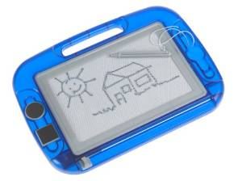
Imprinting magnetic fields
Idea: use a magnetic layer to record the vortex trajectories.

Slide 8
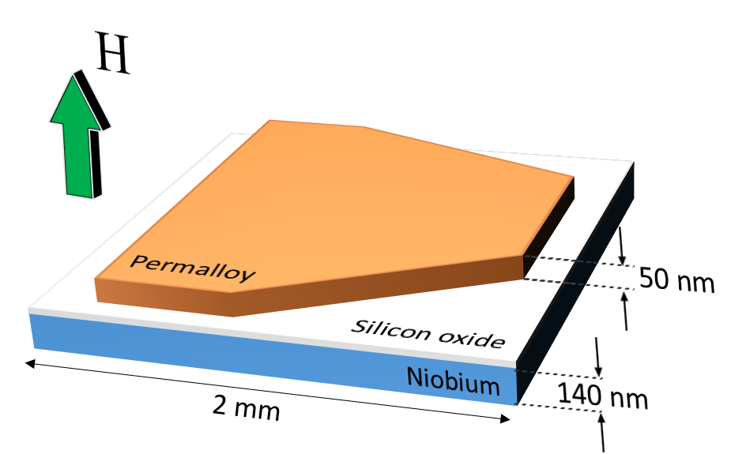
Sample design
T_{c} = 9 K
Avalanches reach the Py at full speed and at different angles.

Slide 9
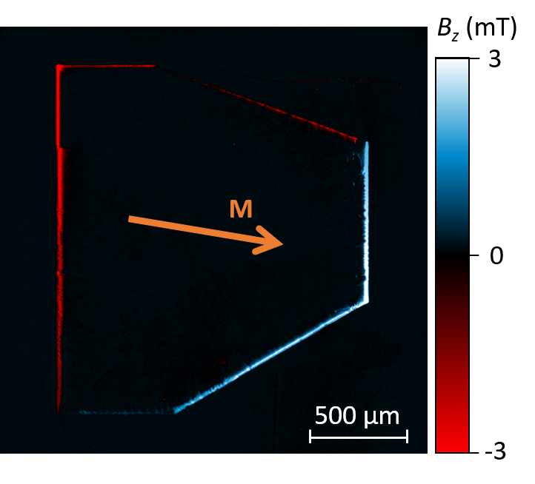
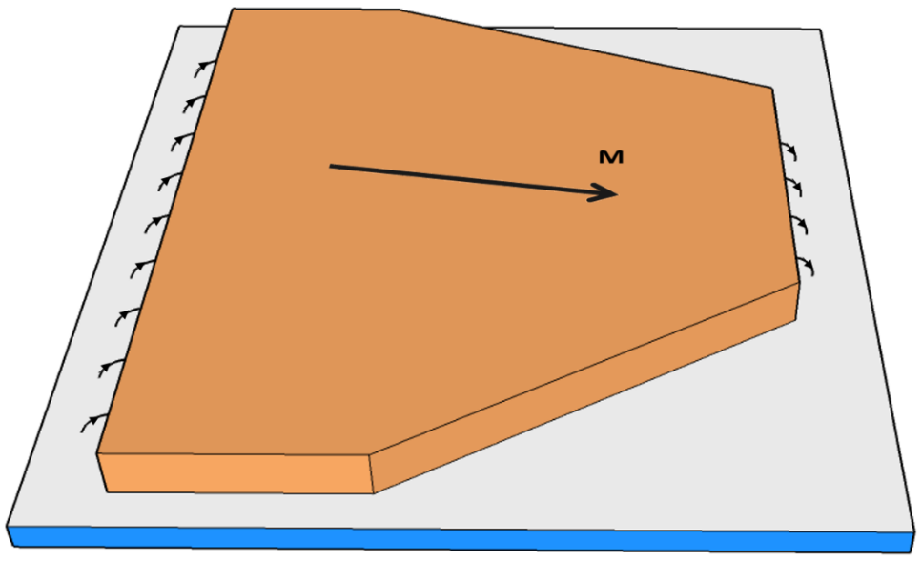
Magnetic field of the Py layer
The direction of the magnetization is easily controlled…
In-plane saturation field ~ 2 mT
… and easily reversed!

Slide 10
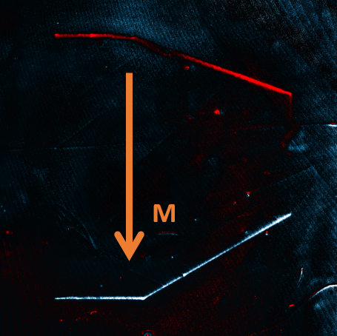
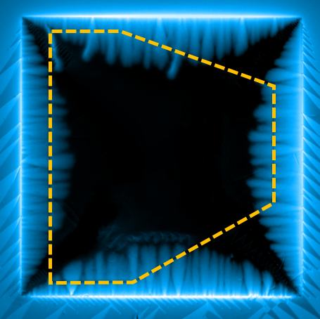
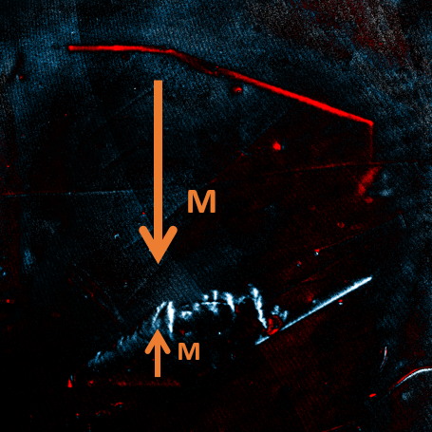
Vortex footprints in the Py layer
Before
After
The reversal of the in-plane magnetization leaves a head-to-head domain wall with out-of-plane field.

Slide 11
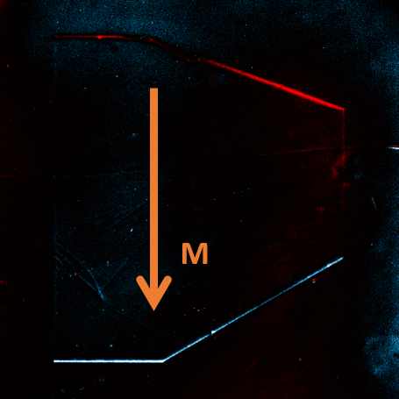
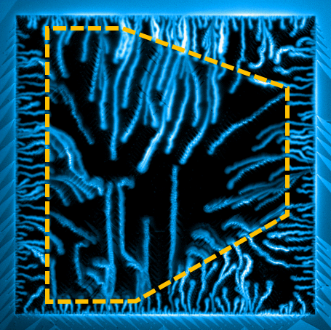
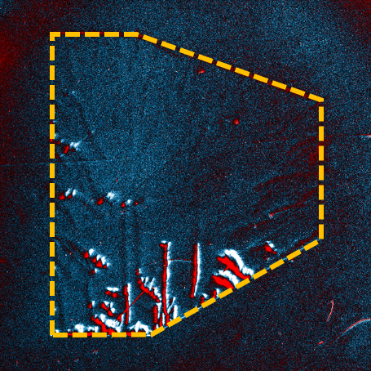
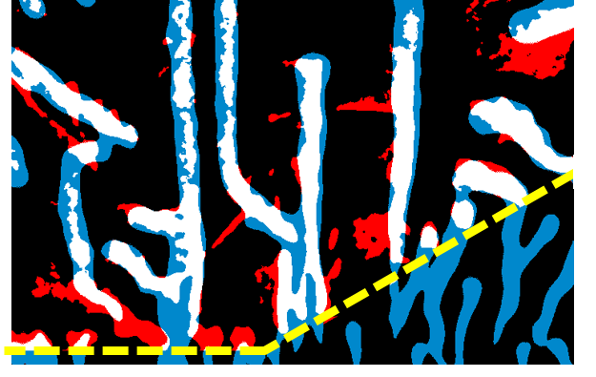
Imprinting flux avalanches
Before
After
Guiding along the direction of magnetization
Printings are stable, even up to room temperature!

Slide 12
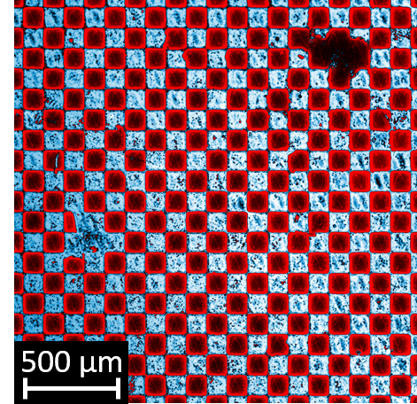
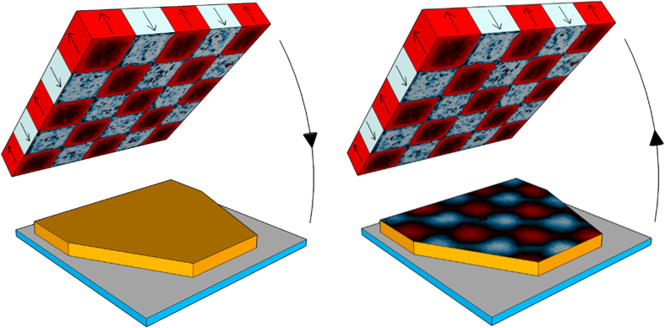
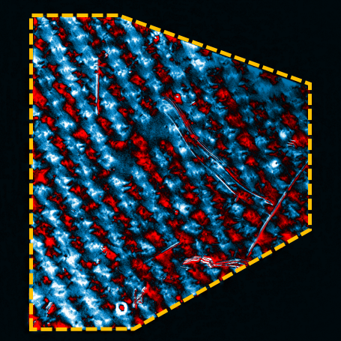
Room temperature printings
Chessboard
Printing
Imprinting works also at room temperature
→ tune the magnetic landscape at will

Slide 13
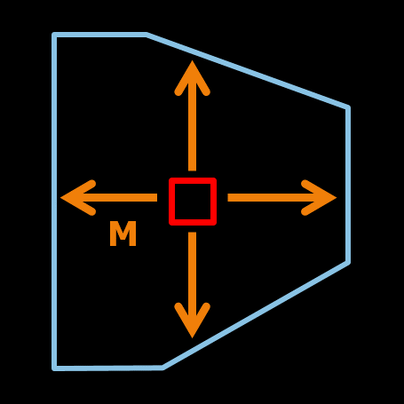
Conclusions
Avalanches are guided by the Py layer.
The flux penetration (smooth and avalanches) can be imprinted in a magnetic layer.
The printings are stable and can even be observed at room temperature.
Perspectives:
Improve the magnetic recording of flux penetration
Tune the magnetic landscape at will to guide avalanches

Slide 14
Thank you for your attention!

Slide 15
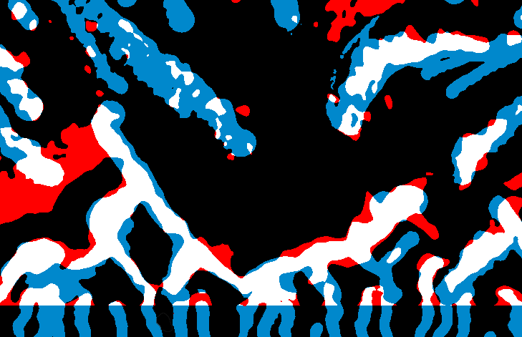
Vortex footprints in the Py layer II
Before
After
M

Slide 16
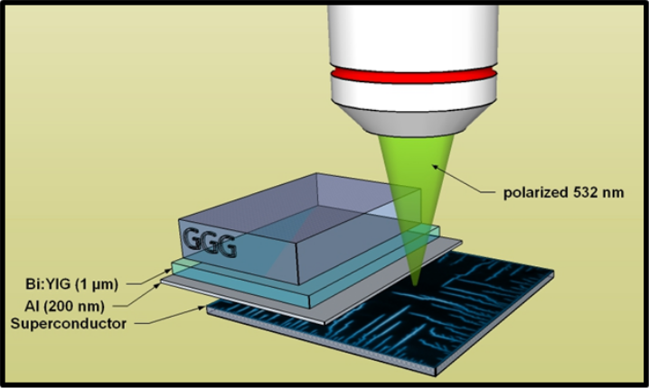
Magneto-optical imaging

