Slide 1
Controlling the CO adsorption on Pt clusters by dopant induced electronic structure modification
Piero Ferrari,^{[a]} Luis M. Molina,^{[b]} Vladimir E. Kaydashev,^{[a]} Julio A. Alonso,^{[b]} Peter Lievens,^{[a]} and Ewald Janssens^{[a]}
^{[a]} Laboratory of Solid State Physics and Magnetism, KU Leuven, Belgium ^{[b]} Department of Theoretical, Atomic and Optical Physics, Universidad de Valladolid, Spain
BPS meeting 2016

Slide 2
Motivation
Direct Methanol Fuel Cell
M. M. Kimberly, J. Ind. Eng. Chem. 2004, 10, 1063.
Pt particles widely used as reaction catalysts
Problem: CO poisoning effect of Pt
DMFC performance
Time
J. Baschuk, and X. Li, Int. J. Energy Res. 2001, 25, 695.

Slide 3
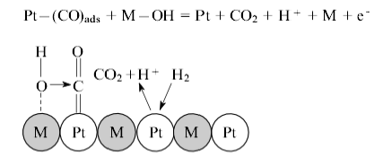
Solution: Pt alloys, Pt–X (X = Sn, Ru, Mo, Nb, W, Ag, Ni)
S. Ehteshamia and S. Chan, Electrochim. Acta 2003, 93, 334.
?
Bifunctional mechanism
Electronic effect
OH groups adsorbed on X interact with CO on Pt forming CO₂ and H₂
Alteration of the local Pt electronic structure upon alloying
Y. Ishikawa et al., Surf. Sci. 2002, 513, 98.
N. Dimakis et al., J. Phys. Chem. C 2009, 113, 18730

Slide 4
Experiment
Reaction cell
Cluster
CO
Needle
valve
No other functional groups present in UHV → Bifunctional mechanism excluded
Simultaneous measurements on bare and doped Pt clusters
Comparison of experimental results with DFT calculations
Clusters in the gas phase

Slide 5
Reaction kinetics
Mass spectra of Nb_{l}Pt_{n}⁺ clusters
Lower intensity of (CO)₂ complexes for NbPt_{n-1}⁺ compared with Pt_{n}⁺
Model
Inside reaction cell
Outside reaction cell
X = Nb, Mo, Sn, Ag

Slide 6
Reaction kinetics
Backward reaction coefficients
CO pressure dependence
Mo or Nb doping leads to a strong increase in k_{D}⁽²⁾
Experimental data fitted with the assumed reaction mechanism
k_{D}⁽²⁾ is not significantly affected by Sn or Ag dopants

Slide 7
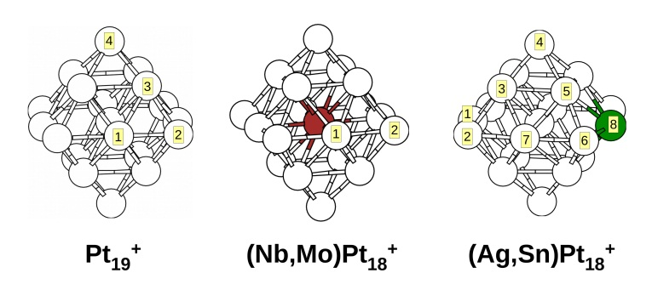
DFT simulations
Calculations with PAW method and PBE functional
Cluster | Bader charge X | CO E_{B} (eV)
Pt₁₉⁺ | - | 2.38
Pt₁₈Nb⁺ | +1.73 | 1.81
Pt₁₈Mo⁺ | +1.40 | 1.83
Pt₁₈Ag⁺ | +0.37 | 2.26
Pt₁₈Sn⁺ | +0.95 | 2.21
Pt₁₉⁺CO
NbPt₁₈⁺CO
MoPt₁₈⁺CO
AgPt₁₈⁺CO
SnPt₁₈⁺CO

Slide 8
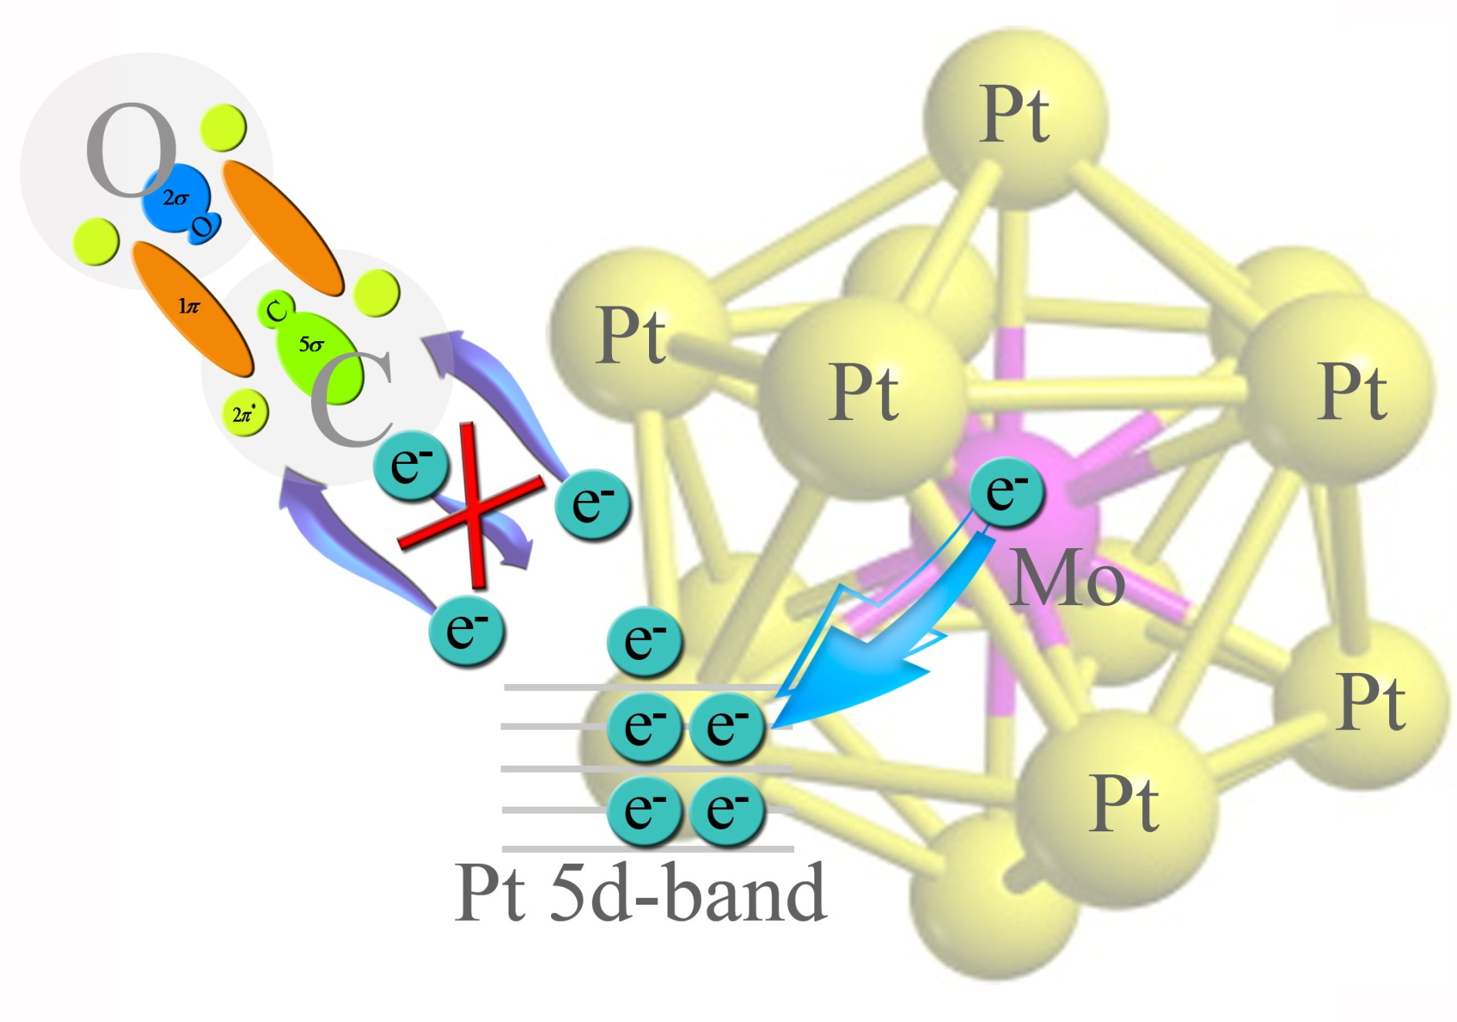
Charge analysis
The smaller CO binding energy on (Nb,Mo)Pt₁₈⁺ is rationalized by the large dopant to Pt charge transfer

Slide 9
Conclusions
A combined mass spectrometric and DFT study showed the influence of doping on the CO interaction with small cationic Pt clusters
The magnitude of the effect strongly depends on the dopant atom
Nb and Mo occupy highly coordinated positions concomitant with a large dopant–Pt charge transfer, affecting the local electronic structure of all Pt atoms
Sn and Ag occupy low coordinated positions in the investigated Pt clusters
Current results show the importance of local electronic effects on the CO adsorption. Similar mechanisms may also be present in larger Pt-X alloy nanoparticles showing enhanced CO tolerance

Slide 10
Thanks for your attention

Slide 11
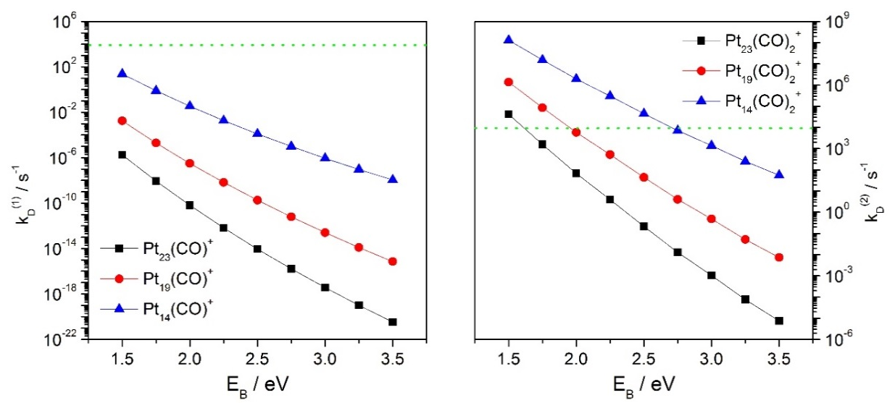
RRKM simulation
Statistical modelling explains why under current experimental conditions
No effect of dopant on the adsorption of the first CO molecule
Second CO molecule only adsorb on larger clusters (n > 16)
Dopant-induced decrease adsorption of (CO)₂ (reaction rates) reflects reduced CO chemisorption energy, E_{B}.

