Slide 1
Information propagation in long-range interacting quantum systems
Mathias Van Regemortel, Dries Sels, Michiel Wouters
Reference article: Mathias Van Regemortel, Dries Sels, and Michiel Wouters
Phys. Rev. A 93, 032311 (2016)

Slide 2

Quantum Quenches
Isolated quantum system:
We kick the system out of equilibrium
Unitary dynamics
In general the system is not in an eigenstate of H

Slide 3
Quantum Quenches
The protocol:
Central questions:
How fast can information be exchanged between distant points?
How does the system relax again after the quench?
What is the equilibrium ensemble after relaxation?
Notes:
\hat{H}(g_0) \xrightarrow[]{t=0} \hat{H}(g)

Slide 4
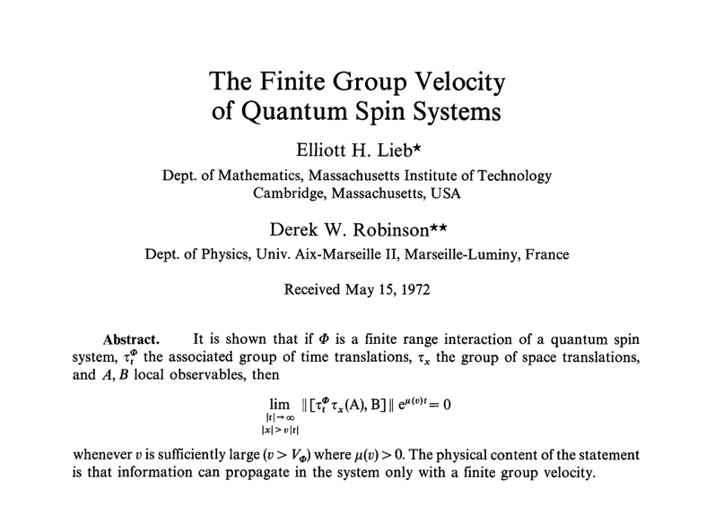
The Lieb-Robinson Bound

Slide 5
L
Short-range interactions
0
L/c
t
Bound on commutator:
(Lieb Robinson ‘72)
characteristic velocity c
Bound on correlation function:
(PRL ’97 Bravyi, Hastings, Verstraete)
Extra factor 2!
Emergent light cone, effective locality
Notes:
|| [O_A(t),O_B(0)] || \leq C \cdot||O_A||\; ||O_B||\cdot e^{-\frac{L-ct}{\xi}}
\big|\langle\Psi(t)|O_A O_B|\Psi(t)\rangle \big| \leq D\cdot e^{-\frac{L-2ct}{\xi}}
\hat{H} = \sum_{i\in \mathcal{D}} \hat{H}_i
Prentje operator maken

Slide 6
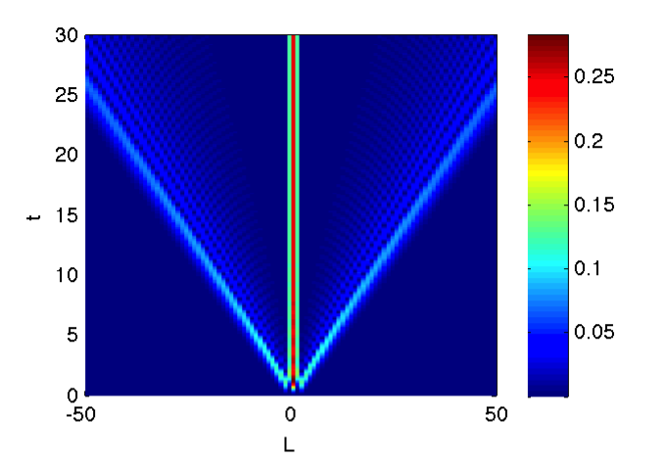
L
Transverse Ising Model:
Quasiparticle view
(Calabrese, Cardy ‘05)
After quench quasiparticles start travelling at speed c through system
Notes:
H(h) = -\frac{1}{2}\sum_j{ \left(\sigma^x_j \sigma^x_{j+1} + h\sigma^z_j\right)}
\langle \sigma^+_i \sigma^+_{i+L} \rangle

Slide 7
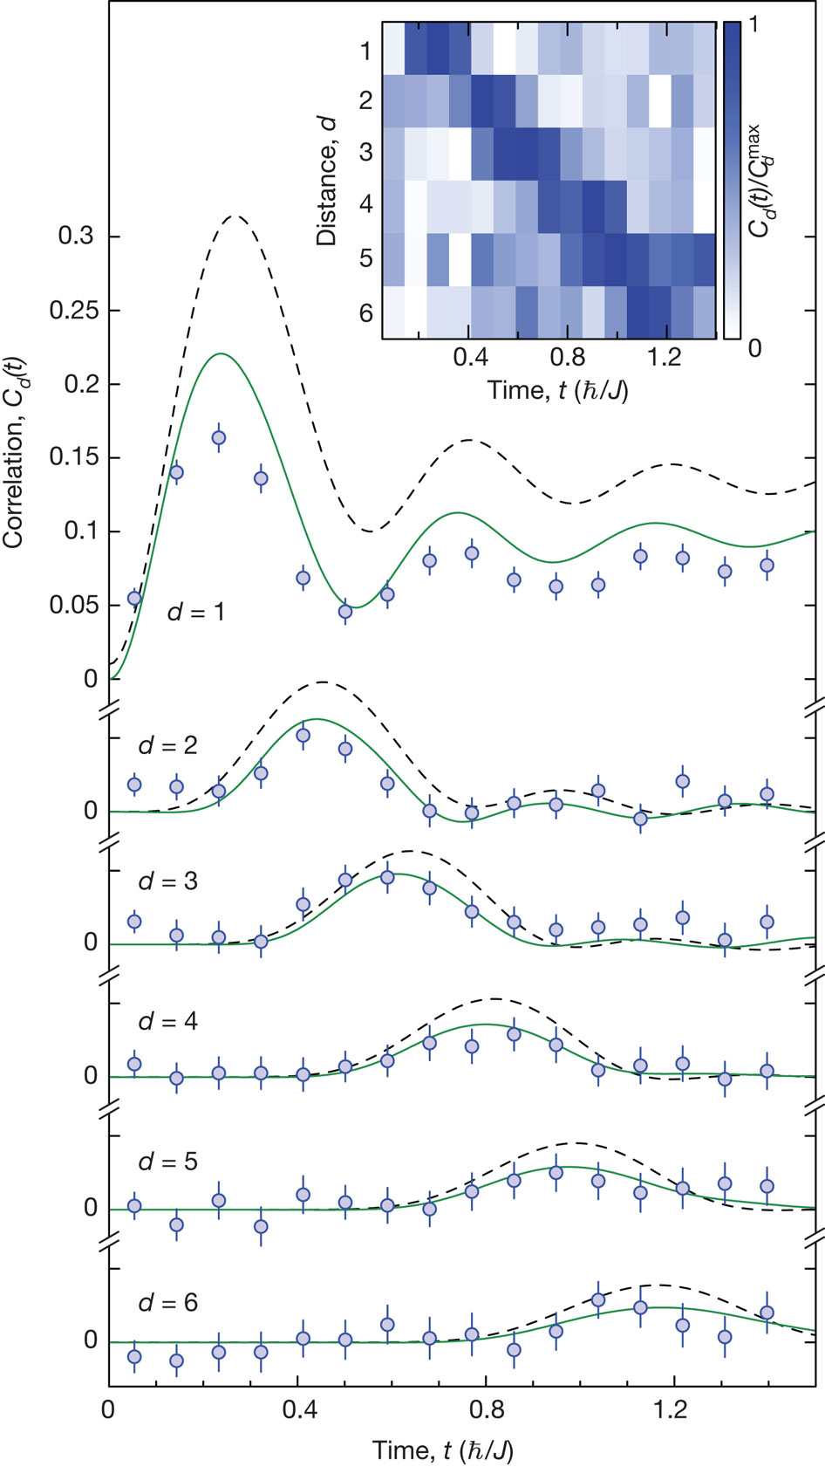
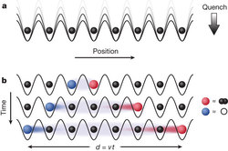
Experiment
One-dimensional quantum gas in optical lattice
M Cheneau et al. Nature 481, 484-487 (2012) doi:10.1038/nature10748
Notes:
Deze slide eventueel weglaten

Slide 8
?
L
Short-range interactions
0
L/c
t
Bound on commutator:
(Lieb Robinson ‘72)
characteristic velocity c
Bound on correlation function:
(PRL ’97 Bravyi, Hastings, Verstraete)
Extra factor 2!
Emergent light cone, effective locality
Notes:
|| [O_A(t),O_B(0)] || \leq C \cdot||O_A||\; ||O_B||\cdot e^{-\frac{L-ct}{\xi}}
\big|\langle\Psi(t)|O_A O_B|\Psi(t)\rangle \big| \leq D\cdot e^{-\frac{L-2ct}{\xi}}
\hat{H} = \sum_{i\in \mathcal{D}} \hat{H}_i
Prentje operator maken

Slide 9
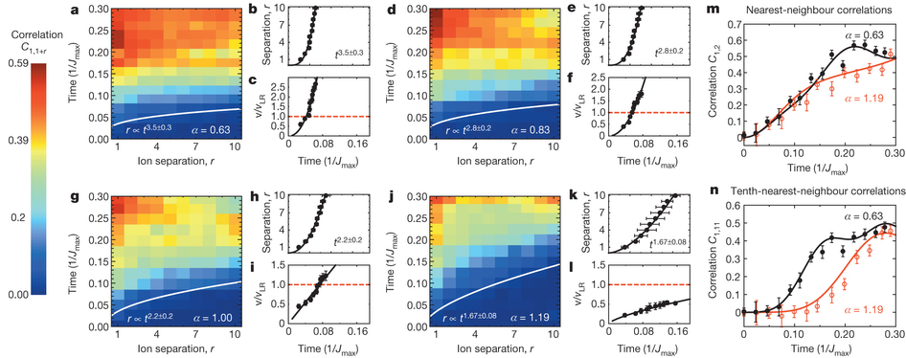
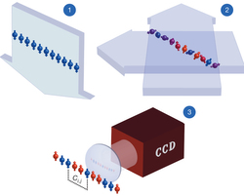
Long-range interactions
Hamiltonian with interactions
Ubiquitous in nature, e.g. Coulomb interaction
Can be implemented with trapped ions:
P Richerme et al. Nature 511, 198-201 (2014) doi:10.1038/nature13450
Notes:
H = -\frac{J}{2}\sum_{ij}{ \frac{1}{|i-j|}\sigma_i^x\sigma_j^x} - h\sum_i \sigma_z
Kan eventueel nog weg

Slide 10
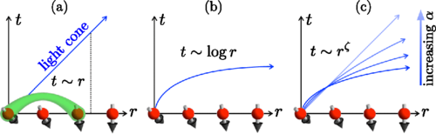
The light cone
Michael Foss-Feig et al., Phys. Rev. Lett. 114 (2015)
Notes:
H = -\frac{J}{2}\sum_{ij}{ \frac{1}{|i-j|}\sigma_i^x\sigma_j^x} - h\sum_i \sigma_z

Slide 11
The Long-Range Kitaev Model
J, Δ describes hopping and pairing of fermions
Exponent α controls range of long-range pairing interactions
Quenches from
Exactly solvable model
Reference article: Mathias Van Regemortel, Dries Sels, and Michiel Wouters
Phys. Rev. A 93, 032311 (2016)
Notes:
H_\text{LRK} =-J \sum_{j=1}^{L}{ \left(c^\dagger_j c_{j+1} + c^\dagger_{j+1} c_j\right)} - \mu \sum_{j=1}^L {\left( c^\dagger_j c_j -\frac{1}{2}\right)}
\\+\Delta \sum_{j=1}^L{ \sum_{l=1}^{j-1}{ \left(\frac{c_j c_l + c^\dagger_l c^\dagger_j}{|l-j|^\alpha} \right)} }
\mu = +\infty \rightarrow \mu = \pm 1
H = \sum_k \left[-(\cos{k}+\mu ) c^\dagger_{k} c_{k} + f^{(\alpha)}(k) \left( c_{k} c_{-k} + \text{h.c} \right) \right]

Slide 12
Notes:
Formule weg

Slide 13
Quasiparticle velocities
From the spectrum we can compute the quasiparticle velocity distribution:
Divergent group velocities
Yet, most weight inside well-defined peaks
Notes:
N(c),\;c_k = \partial\epsilon_k/\partial k

Slide 14
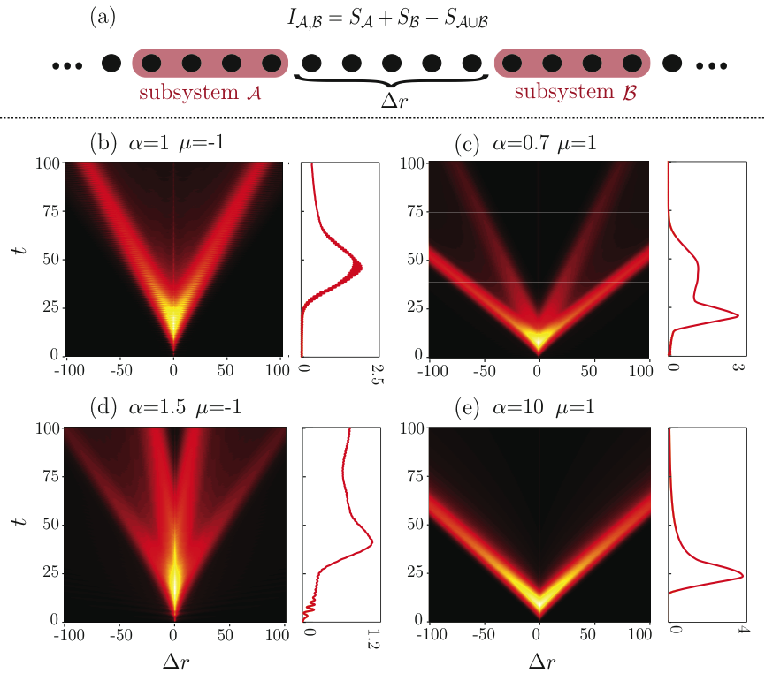
Mutual information
Causality well preserved for LR interactions!

Slide 15
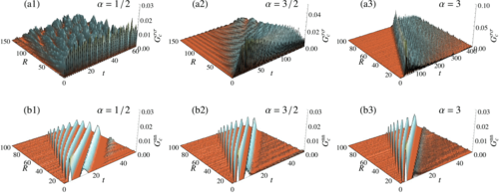
Different systems with LR interactions
L. Cevolani et al., Phys. Rev. A 92, 041603 (2015)
Ising
Bose-Hubbard

Slide 16
Conclusions
Lieb-Robinson bounds provide very powerful limits on information propagation in short-range interacting quantum systems
The Lieb-Robinson bound for long-range interacting quantum systems is too loose in many cases
In the LRK model by far most of the information propagates inside a well-defined light cone
The quasiparticle spectrum allows for a consistent explanation
The physics of long-range interacting quantum systems seems to be very much model-dependent
Reference article: Mathias Van Regemortel, Dries Sels, and Michiel Wouters
Phys. Rev. A 93, 032311 (2016)

Slide 17
Thank you for your attention!

Slide 18
Correlation function
α>1: Locality preserved
α<1: Power-law decay at large distances
Light cone:
Notes:
\mathcal{F}^\alpha(r,t) = C^{(\alpha)}t^\gamma r^{-\chi}
\langle c_j^\dagger c_{j+r} \rangle_t= C^{(\alpha)}(r,t)\;t^\gamma r^{-\chi}

Slide 19
Relaxation after quench
Long-range interactions allow for slowing down, rather than speeding up dynamics!

