Slide 1
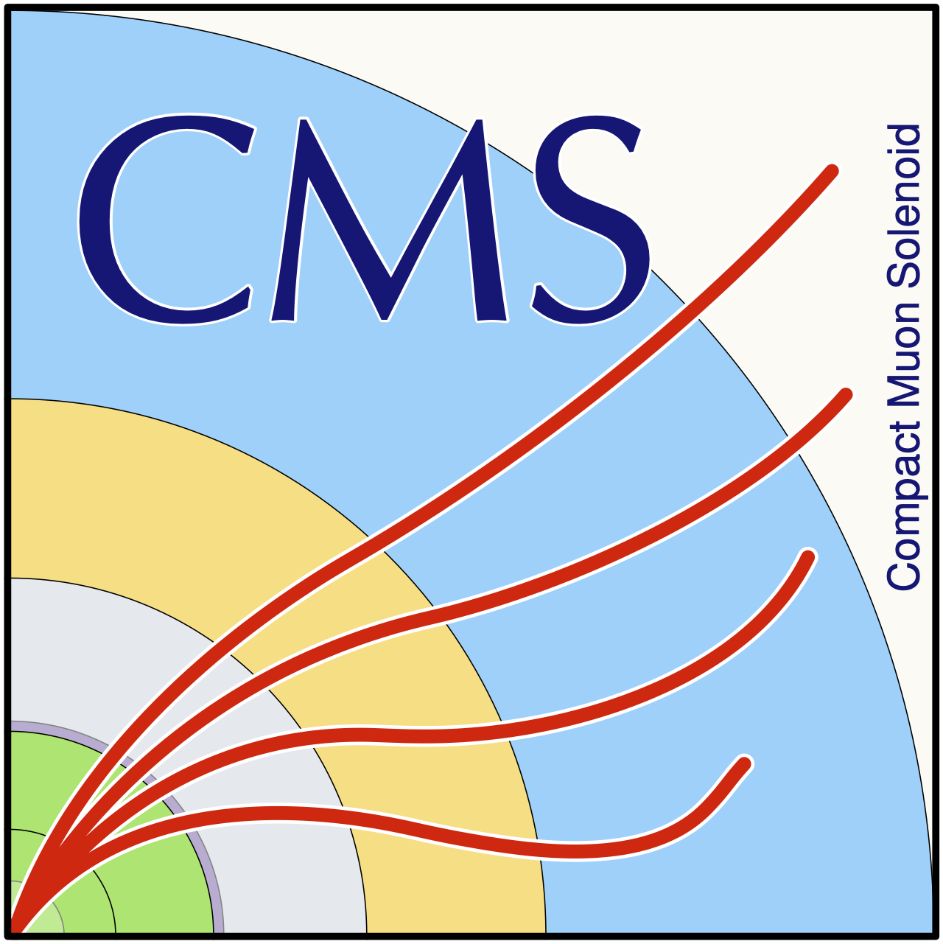
Towards quantum state tomography with elementary qutrits
Measuring spin correlations in diboson systems
department Of physics and astronomy
  research group elementary particle physics and gravity
Gill Jacobs, 30/06/2025

Slide 2
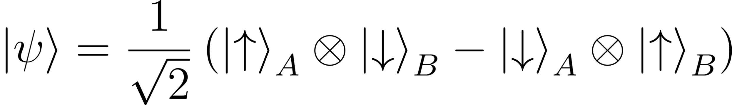


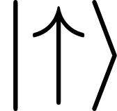
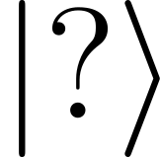
What is entanglement?
Electron A
Electron B
Measurement
Measurement
Alice
Bob

Slide 3
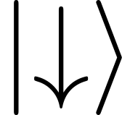
What is entanglement?
Electron A
Electron B
Measurement
Measurement
Alice
Bob

Slide 4
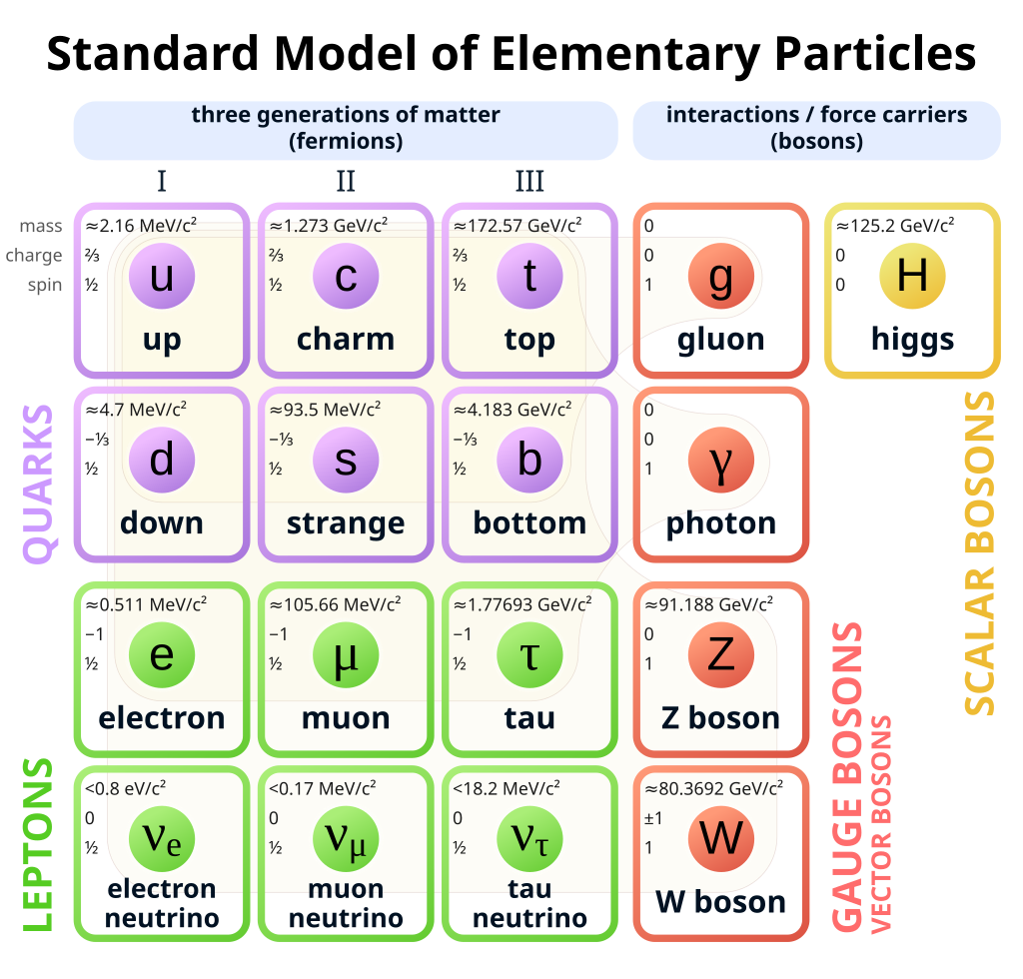
The Standard Model
https://en.wikipedia.org/wiki/Standard_Model

Slide 5
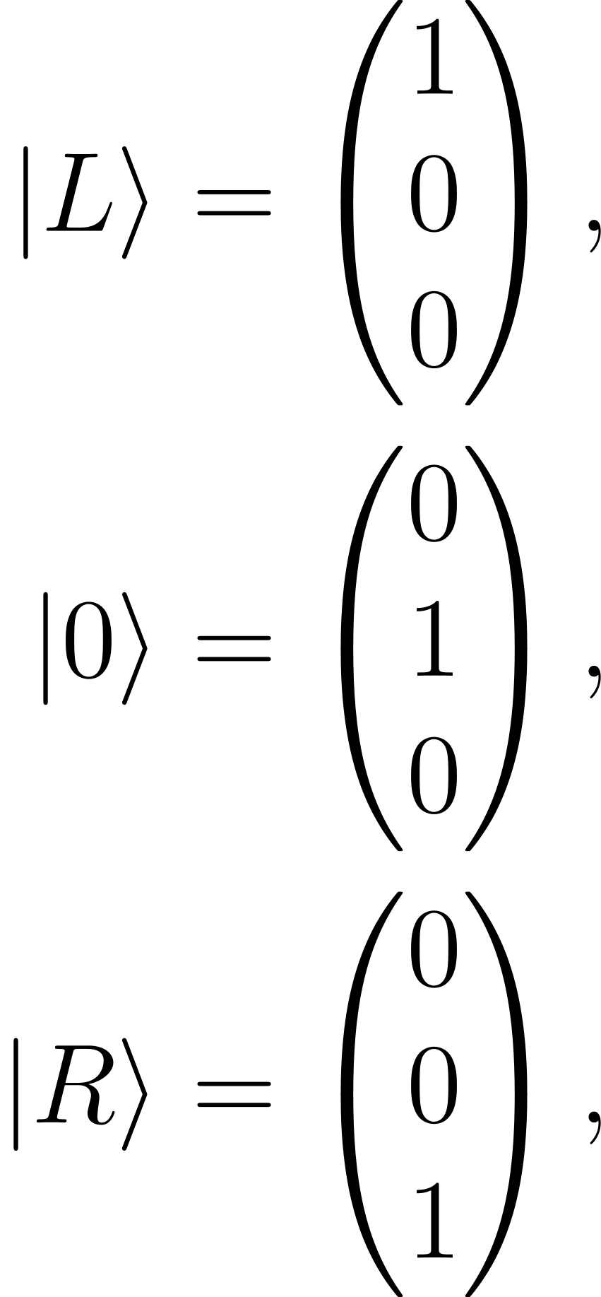
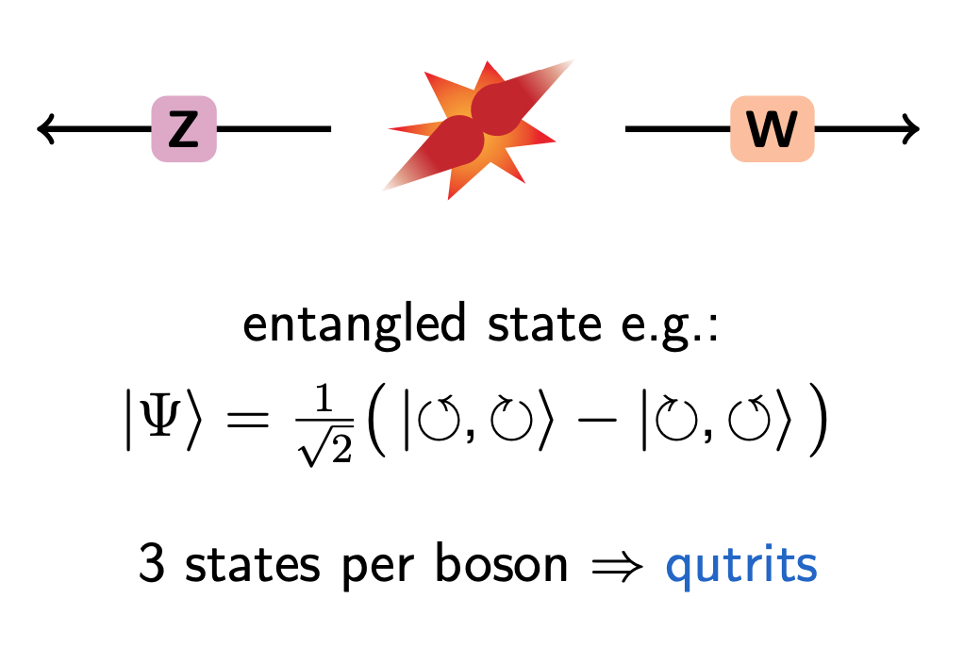
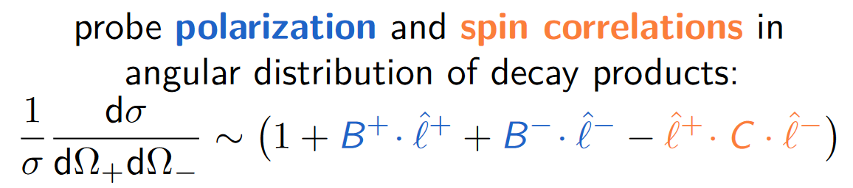
Probing WZ entanglement
Courtesy of Joscha Knolle

Slide 6
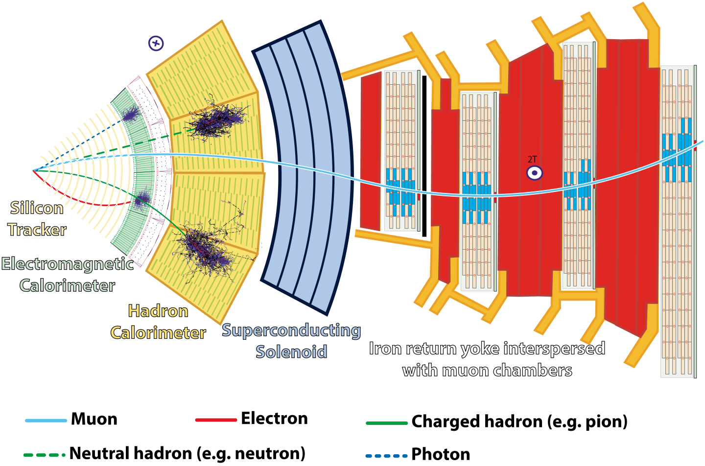
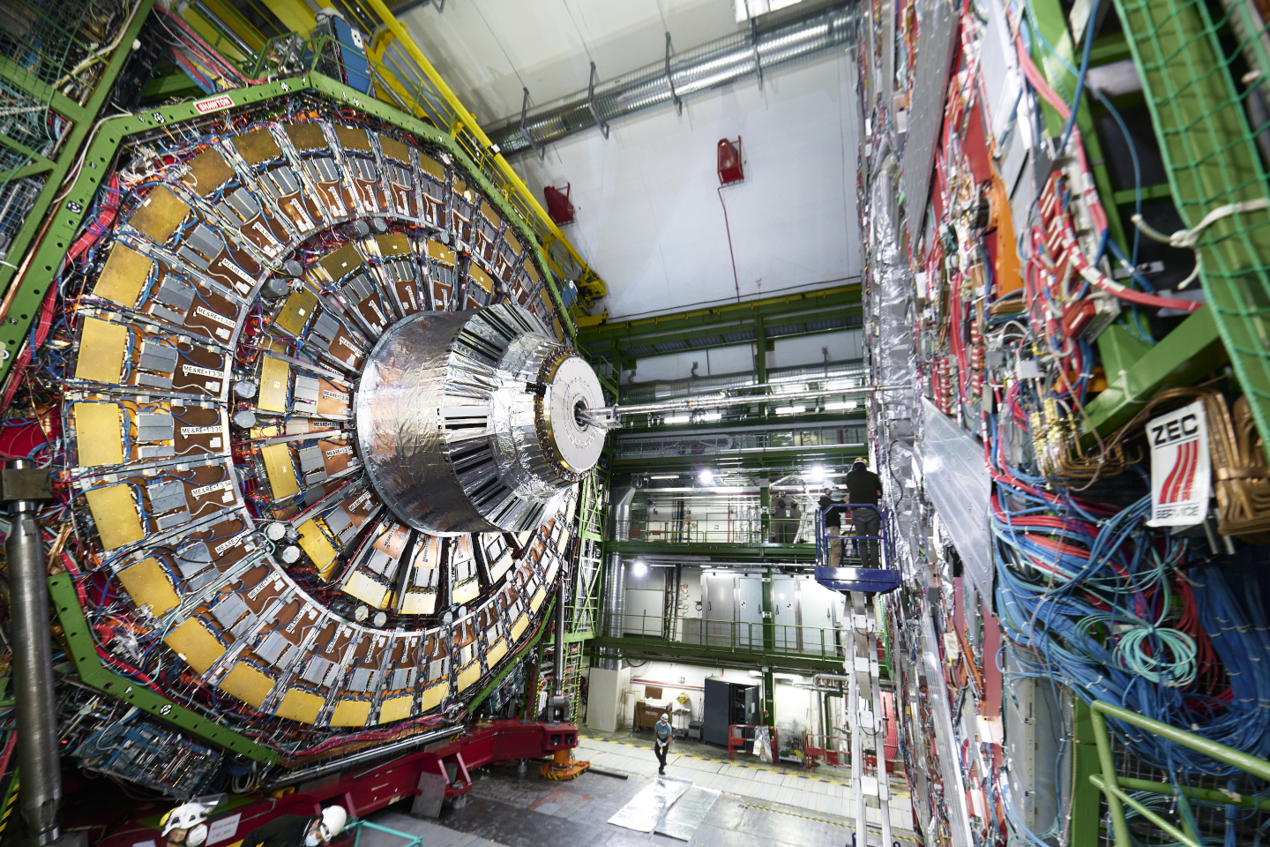
The CMS detector
https://home.cern/science/experiments/cms
https://cds.cern.ch/record/2120661

Slide 7
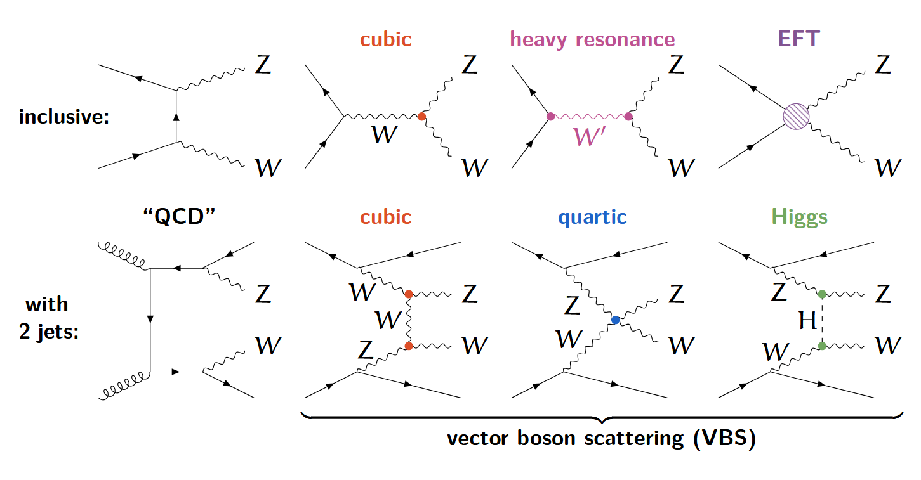
WZ production
Courtesy of Joscha Knolle

Slide 8
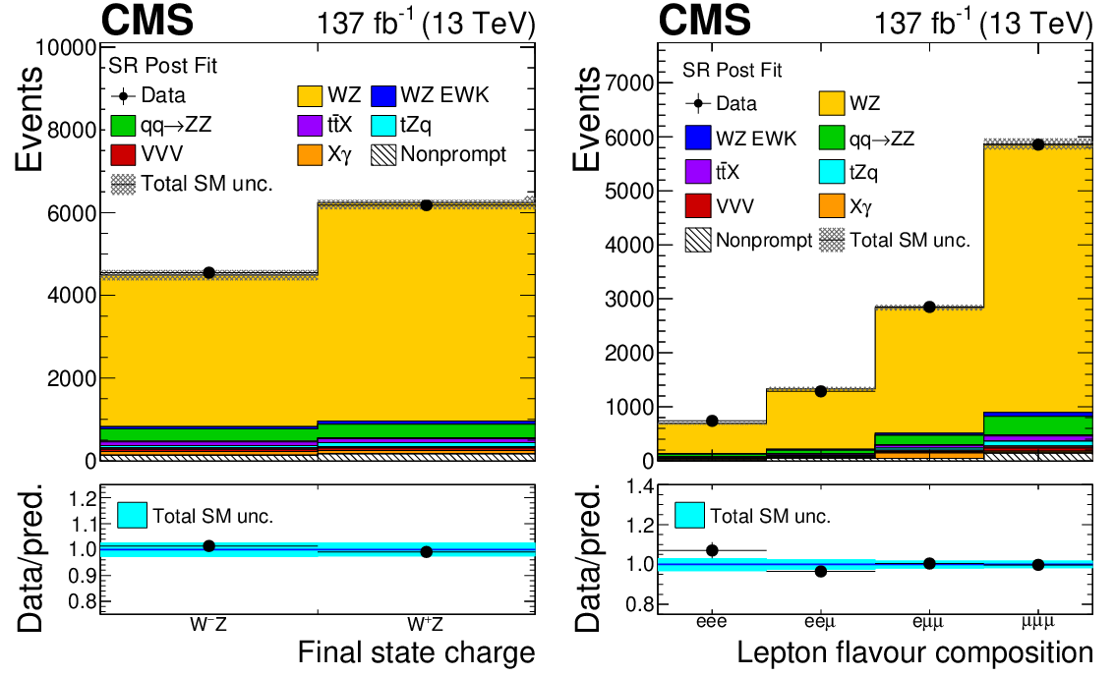
How to measure WZ events
We select the following events:
Exactly 3 leptons (electrons or muons)
Exactly 1 OSSF pair of leptons with invariant mass M(ℓℓ) ~ M(Z)
p_{T}^{miss} > 30 GeV
…
JHEP 07 (2022) 032

Slide 9
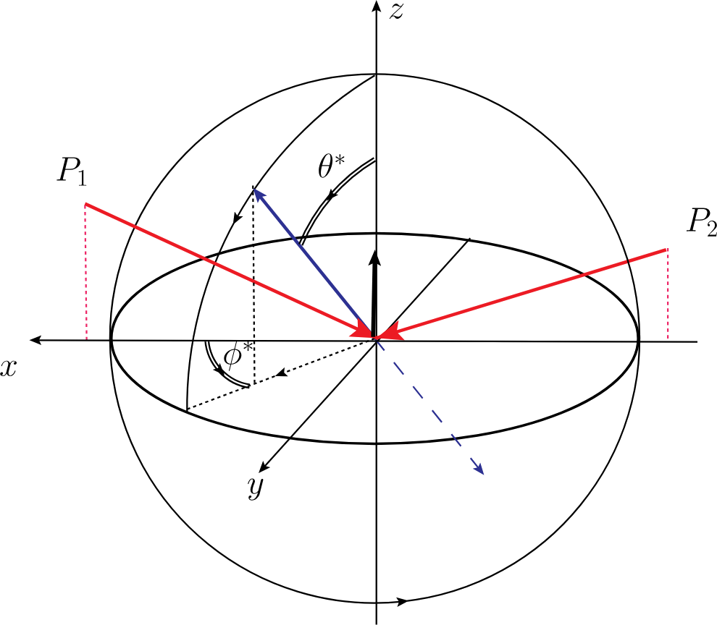
The helicity frame
Phys.Rev.D 84 (2011) 034008

Slide 10
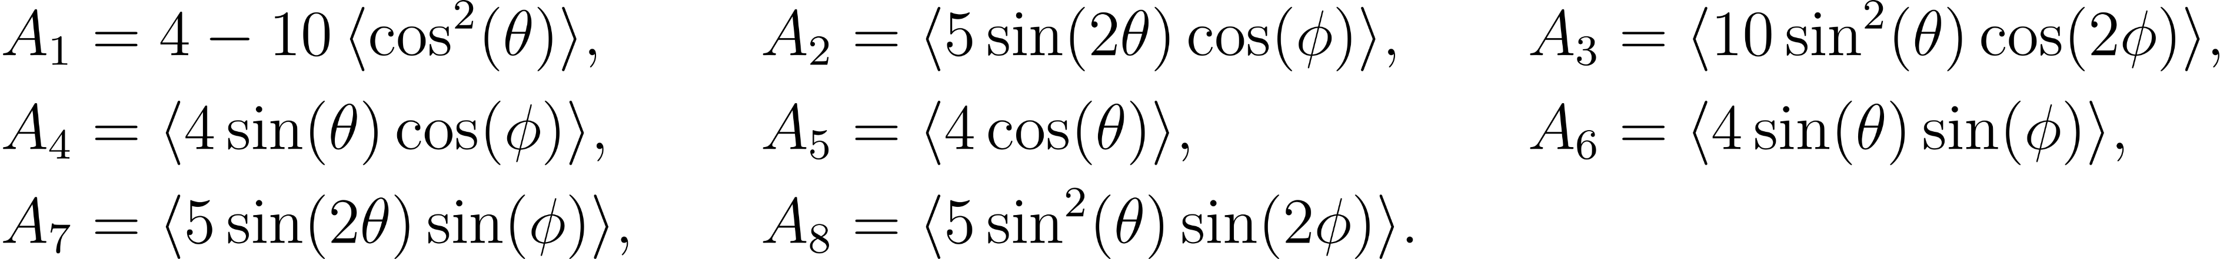
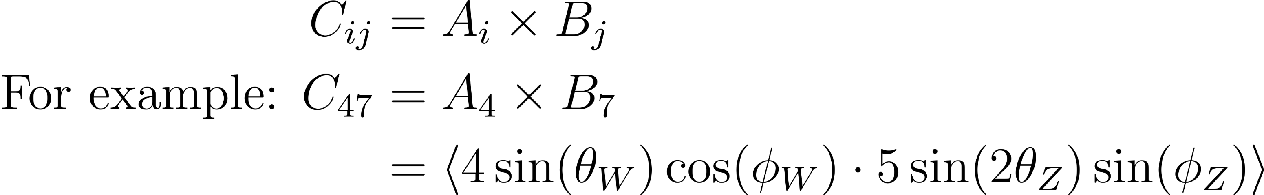
Polarization & correlation coefficients
Phys.Rev.D 84 (2011) 034008

Slide 11
MATRIX and MadGraph
MATRIX
Calculates differential cross-section directly
Needs to be specified before running
Limited number of processes
Up to NNLO
MadGraph
Monte Carlo event generator
For any (B)SM process whose Feynman rules are implemented
Can be interfaced to simulate parton shower/ detector int.
Up to NLO

Slide 12
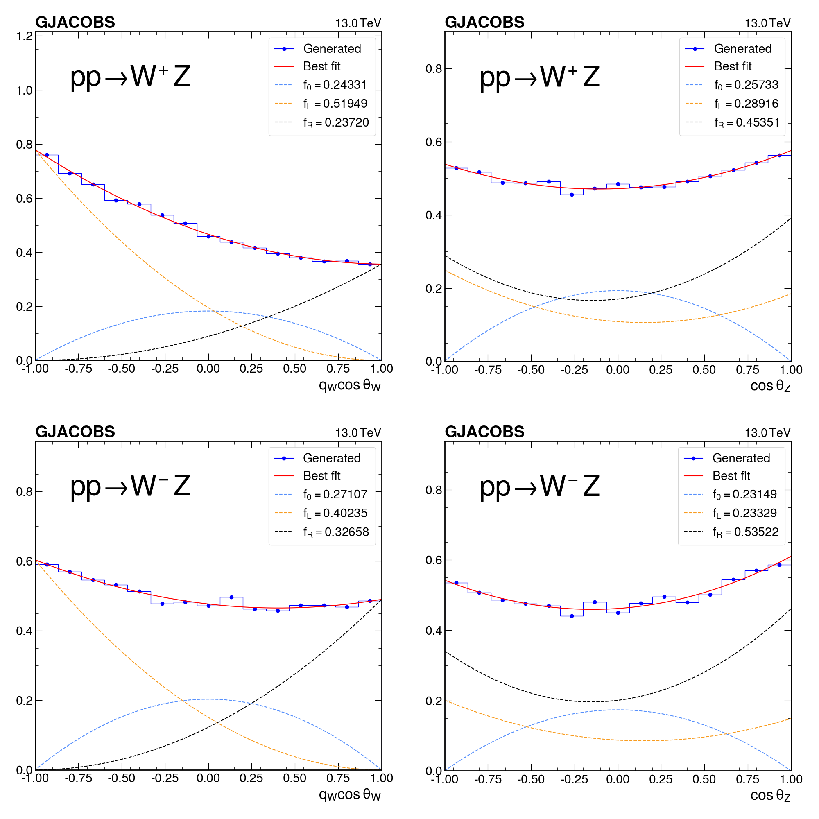
MATRIX cos(θ)

Slide 13
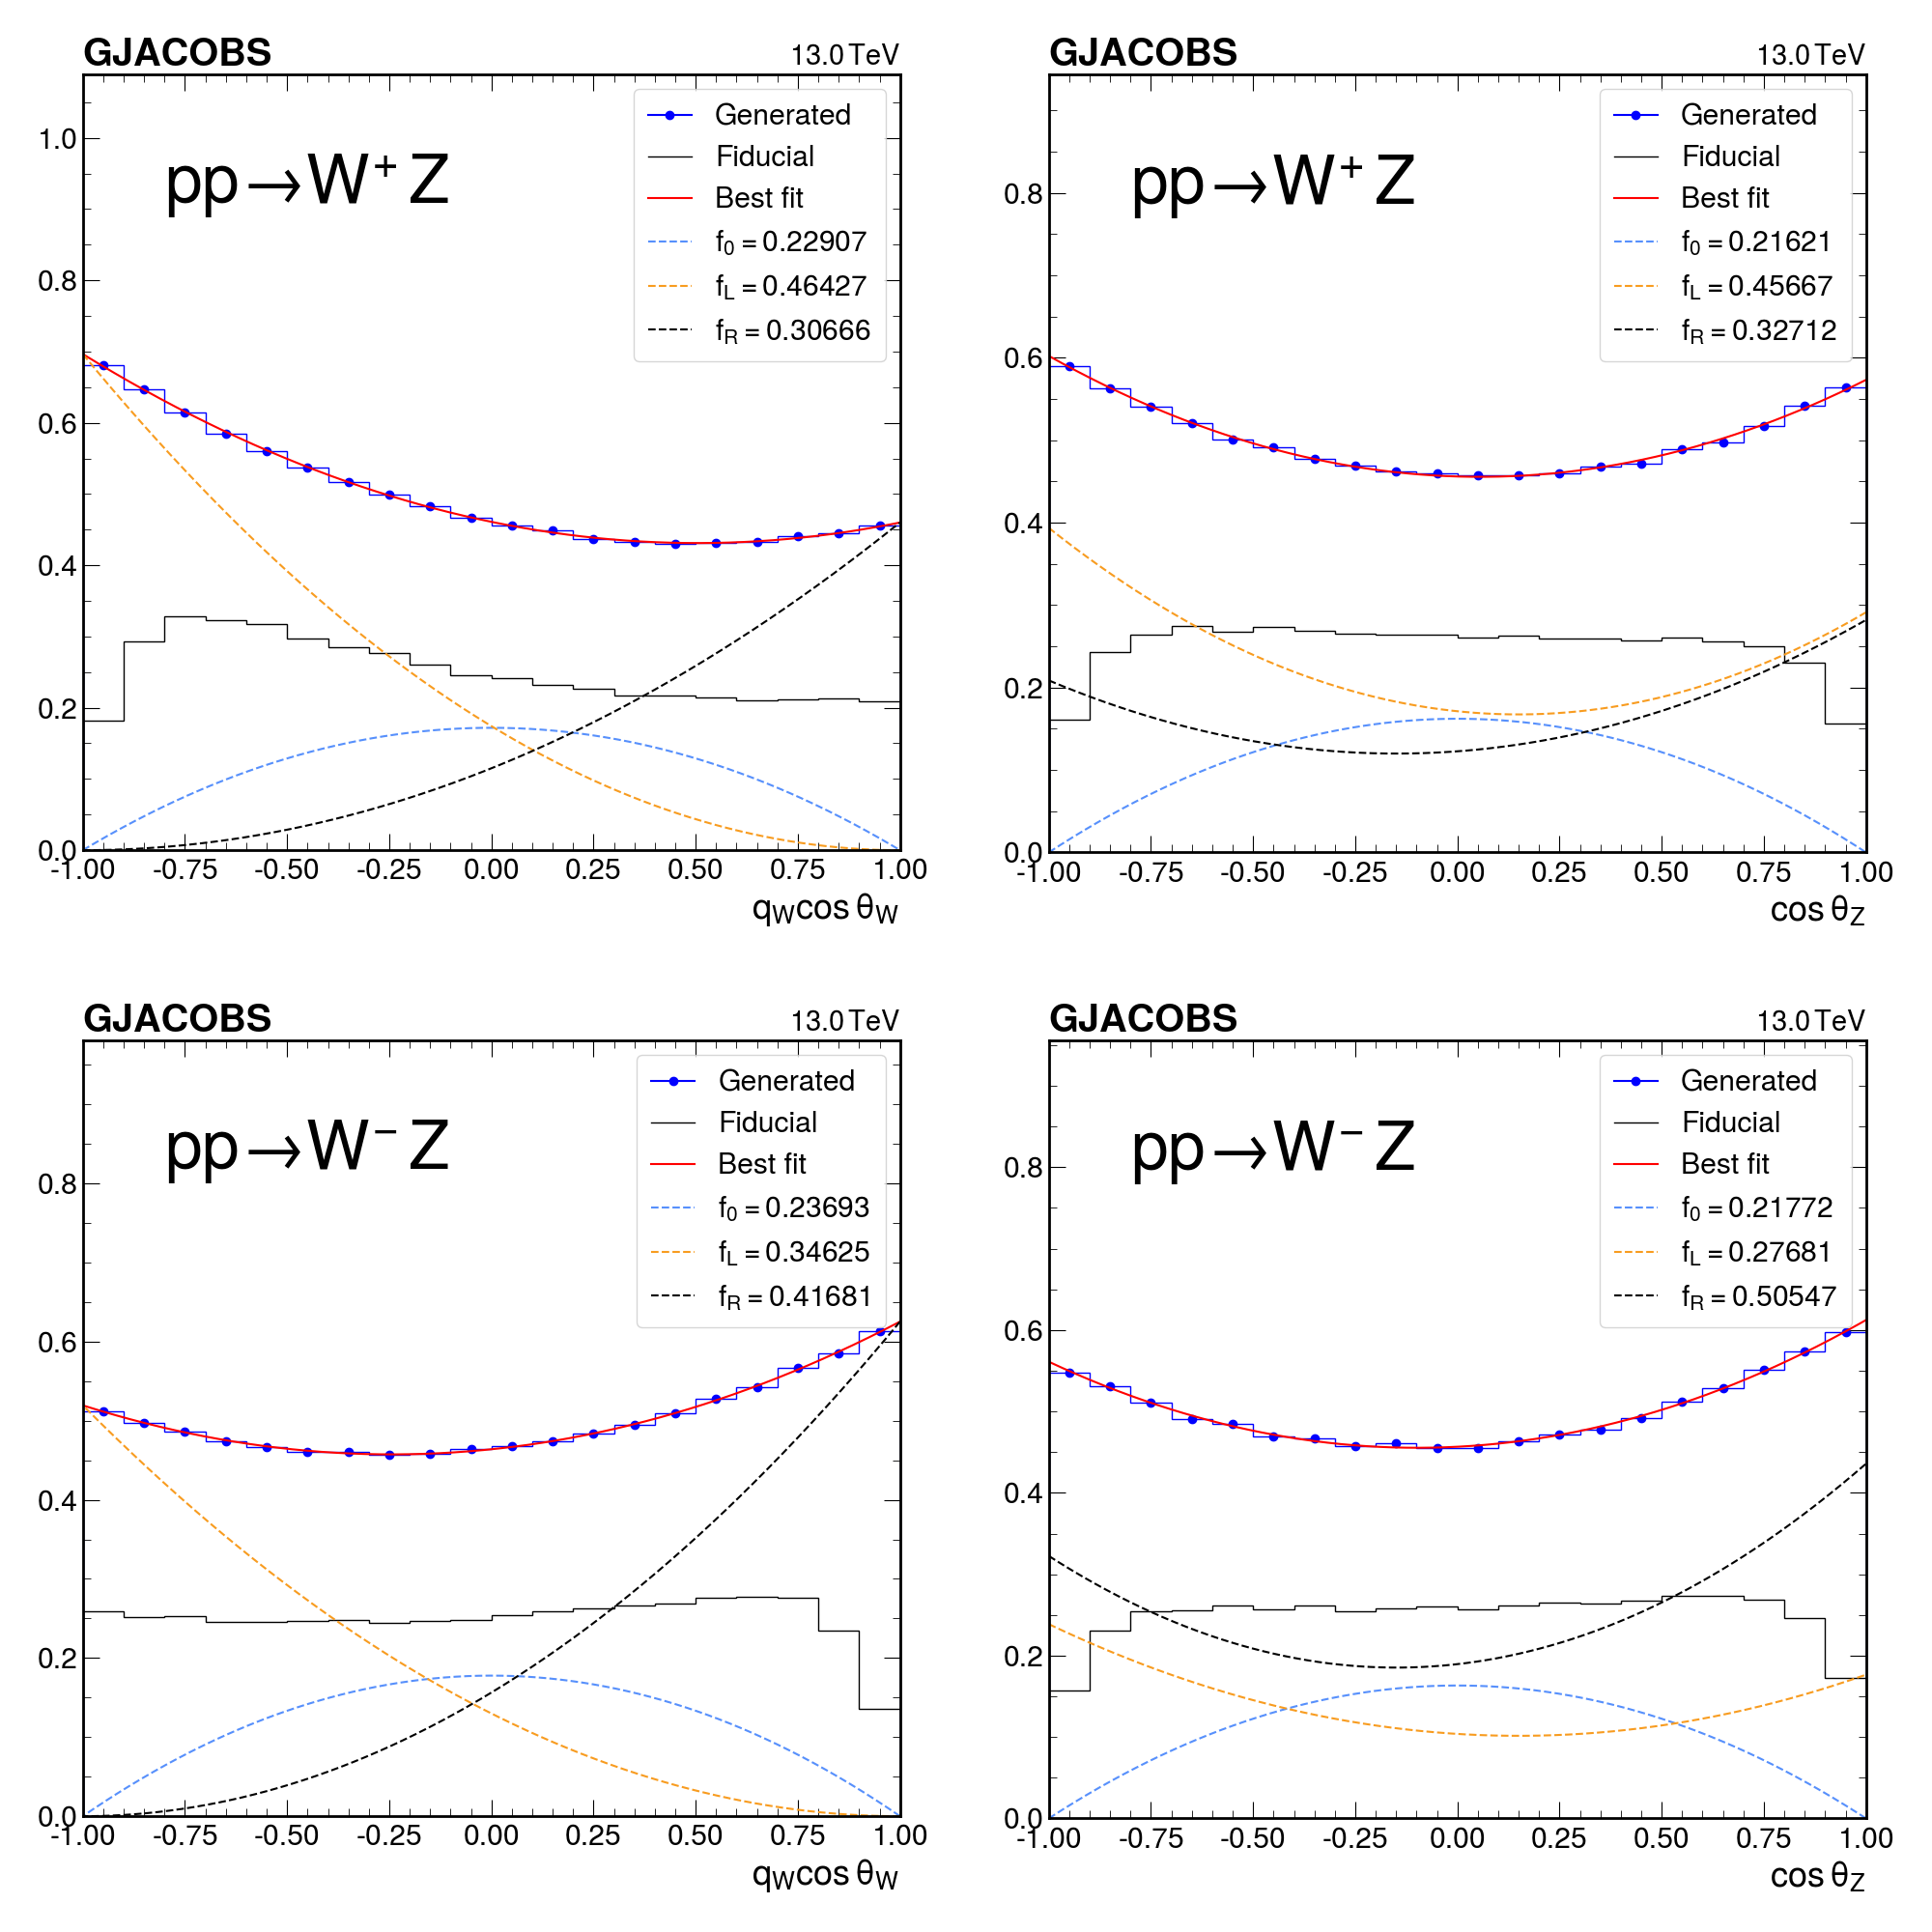
MadGraph cos(θ)

Slide 14
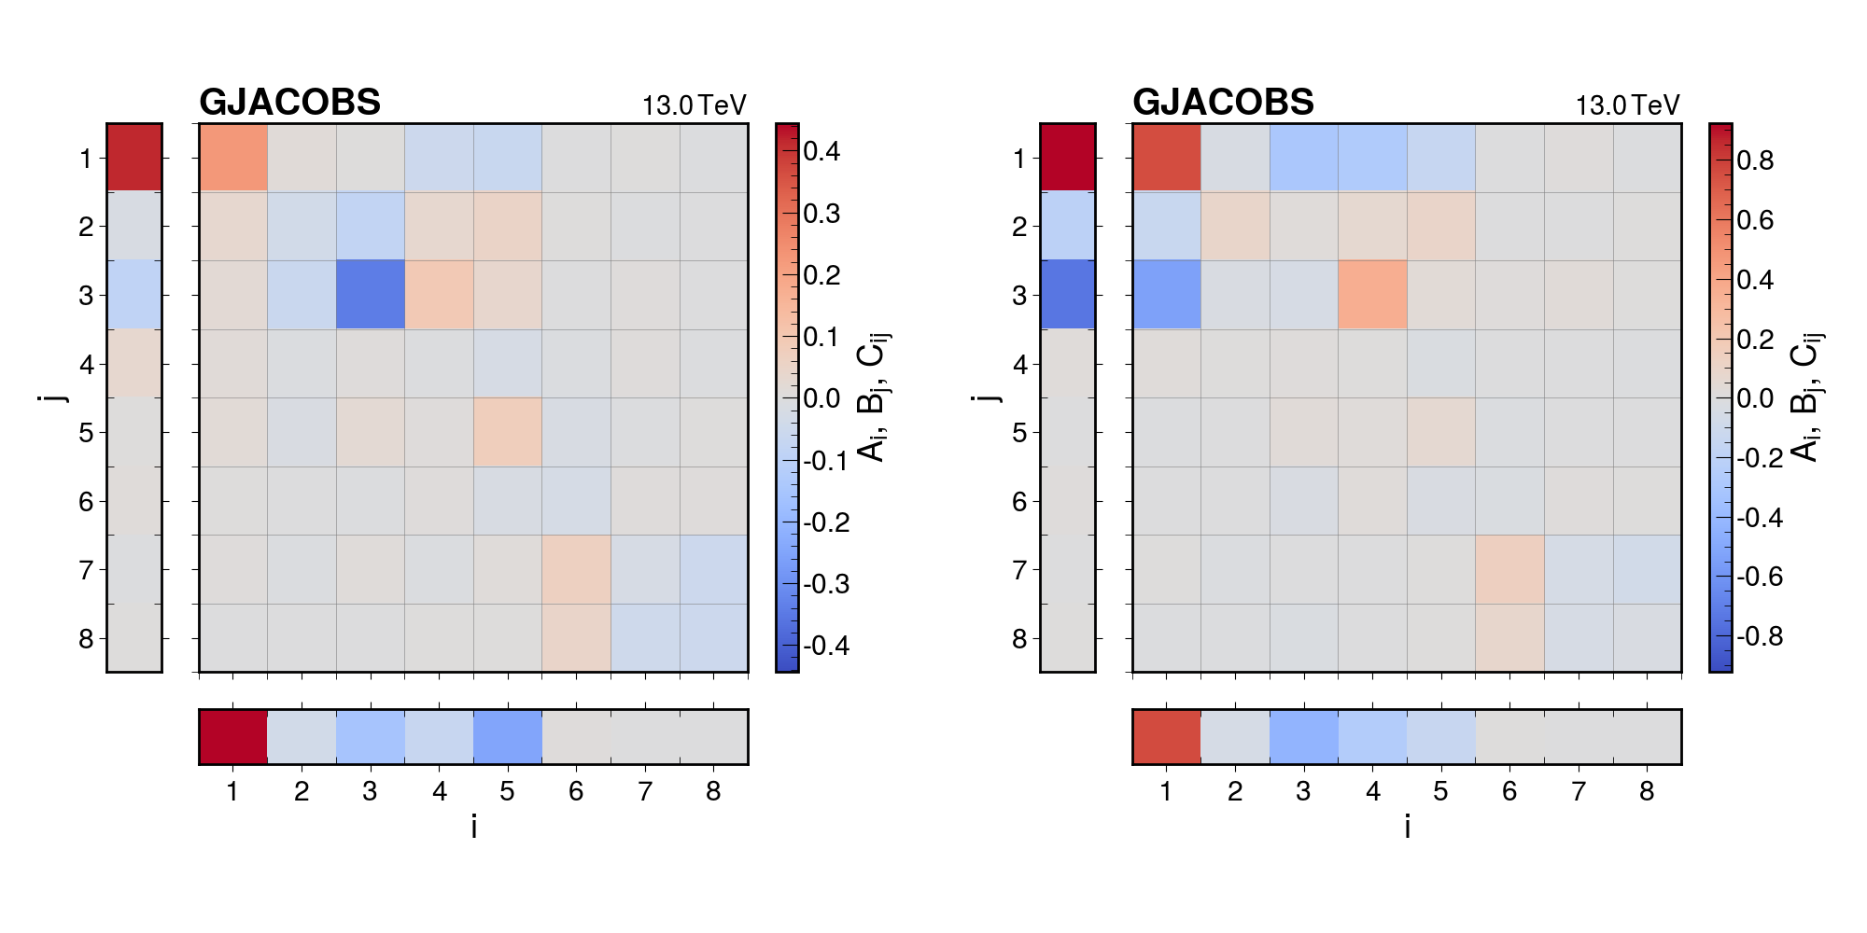
Combined A_{i}, B_{j}, C_{ij} (MadGraph)
Full phase space
With fiducial cuts

Slide 15
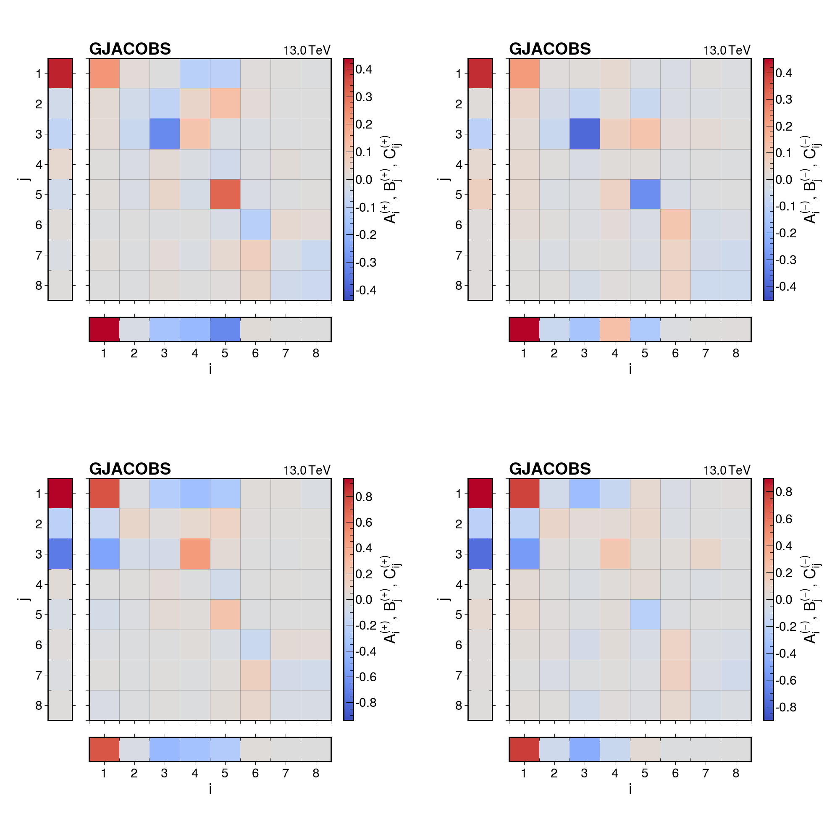
A_{i}, B_{j}, C_{ij} separated by charge
(MadGraph)
Full (+)
Full (-)
Fid. (+)
Fid. (-)

Slide 16
Conclusion and future research
Conclusion
Discrepancy between MadGraph and MATRIX cos(θ)
Some correlations between W and Z boson were found
No entanglement in full phase space was found
Future research
Extend results using the MATRIX framework
Reconstruction of full phase space from detector data
Look into specific phase space regions
Other two-particle systems

Slide 17



Gill Jacobs
Master Student
Elementary Particle Physics and Gravity
E Gill.Jacobs@ugent.be
M +32 489 00 58 05 www.ugent.be
Universiteit Gent
@ugent
@ugent
Ghent University

Slide 18
Why the WZ system?
Great test for electroweak interactions
Fully leptonic decay channels are clean
Relatively easy to separate from background
MATRIX and MadGraph for calculation
Some research for comparison already exists

Slide 19
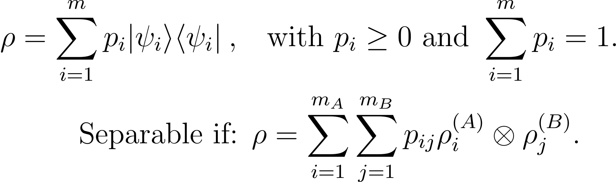
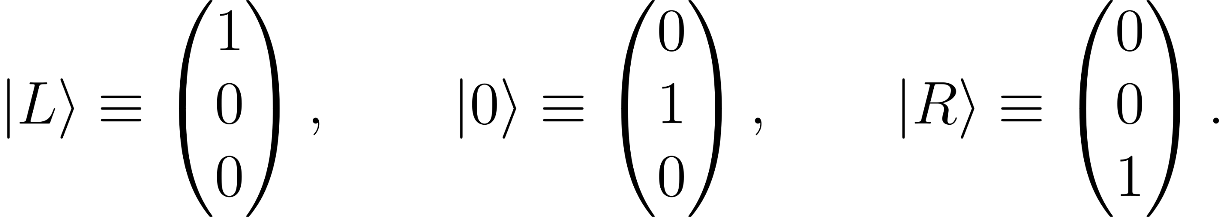
Qutrit framework and entanglement
Prog.Part.Nucl.Phys. 139 (2024) 104134

Slide 20
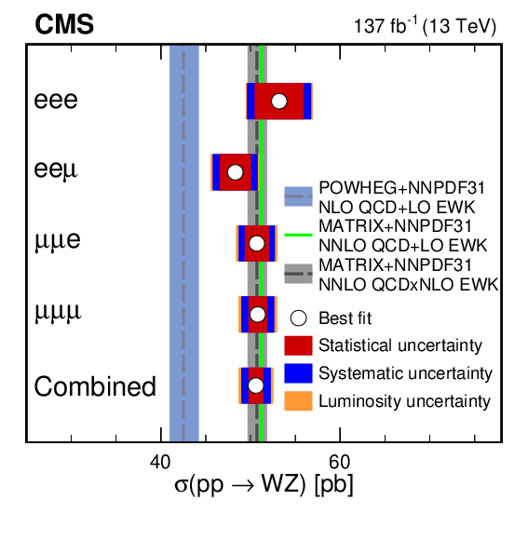
WZ cross-section
JHEP 07 (2022) 032

Slide 21
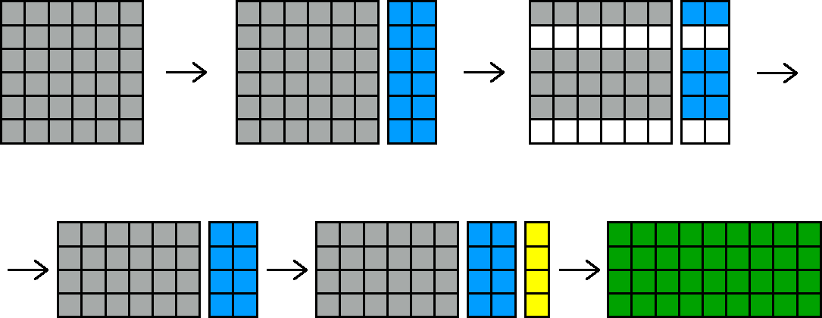
Processing MadGraph data with ColumnFlow

Slide 22
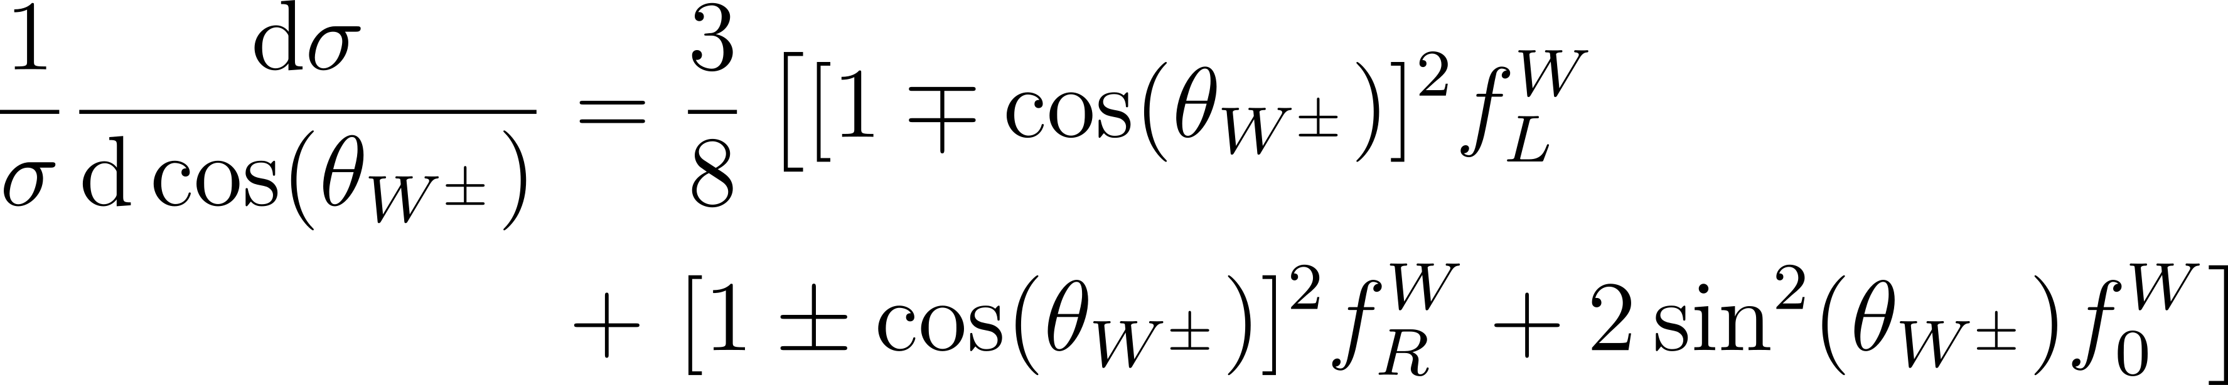
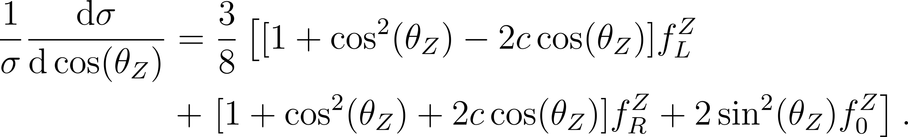
cos(θ) formula

Slide 23
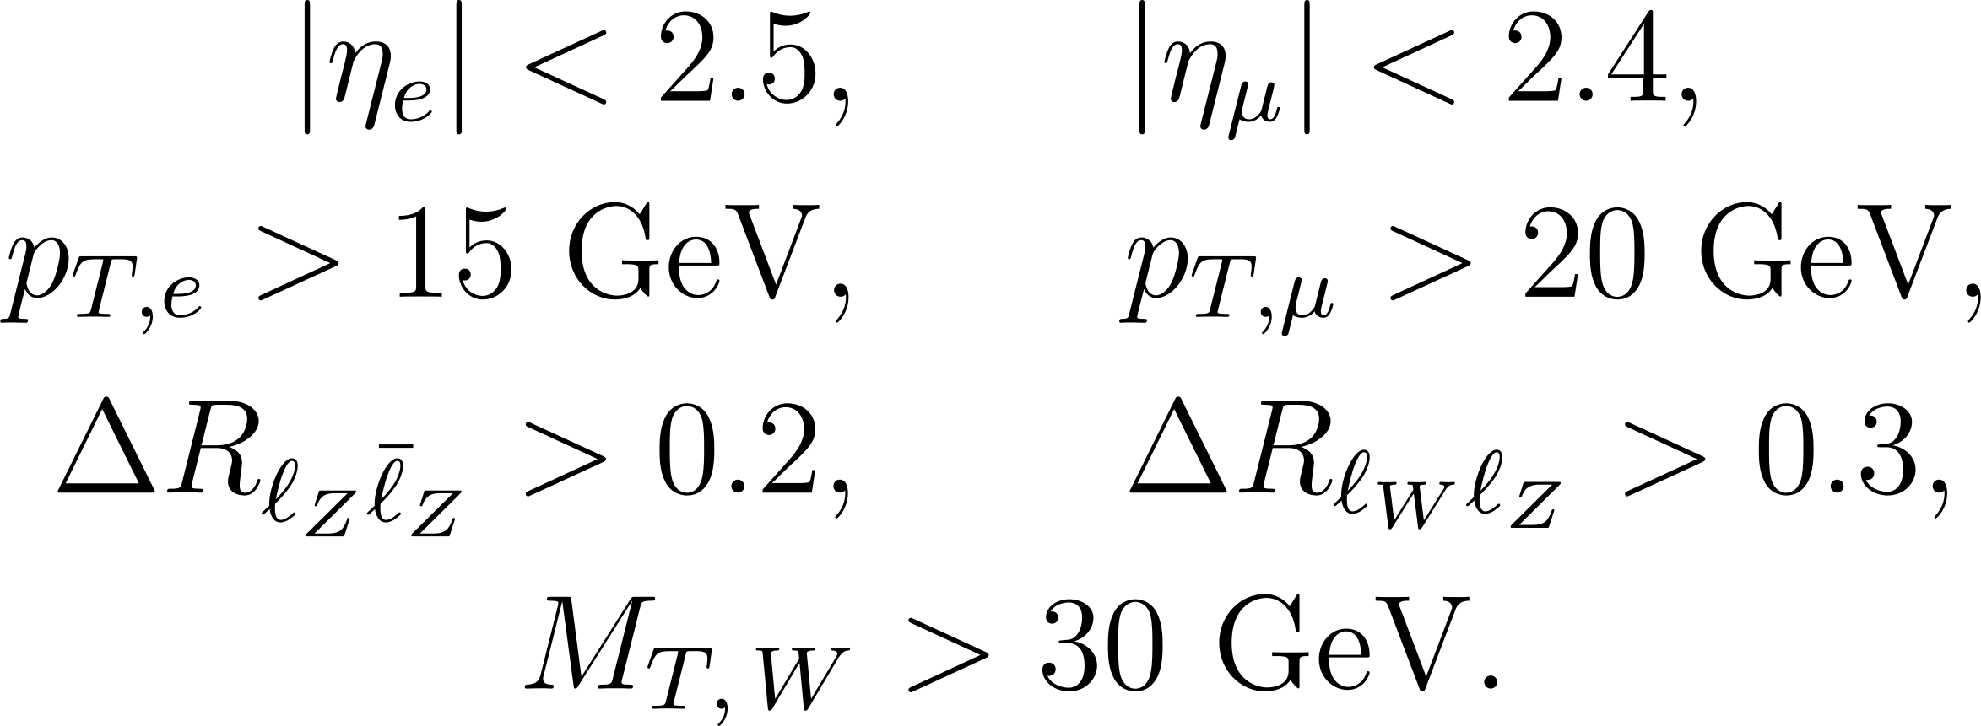
Fiducial cuts

Slide 24
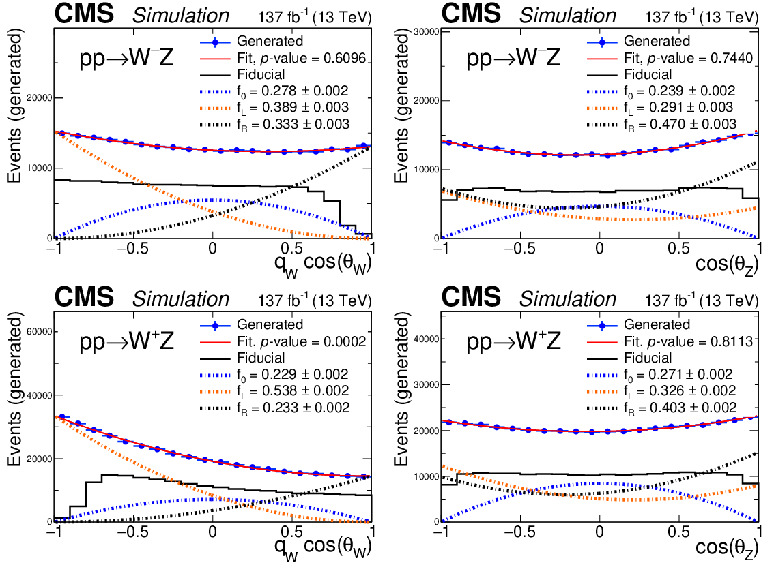
Previous CMS results: polarization fractions
JHEP 07 (2022) 032

Slide 25
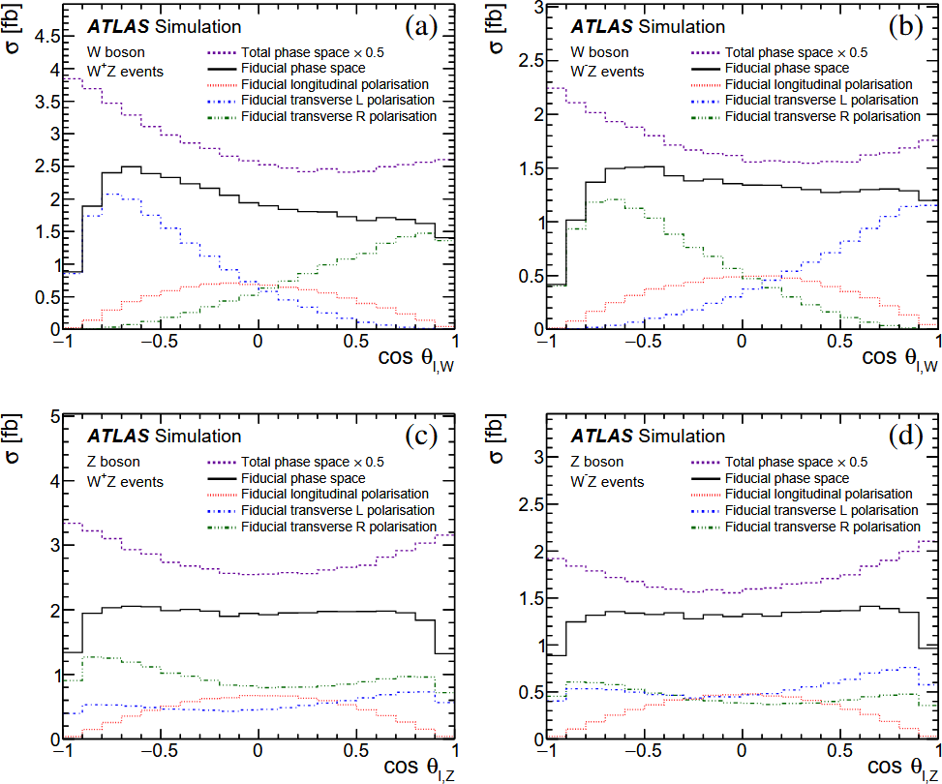
Previous ATLAS results: polarization fractions
Eur.Phys.J.C 79 (2019) 6, 535

Slide 26
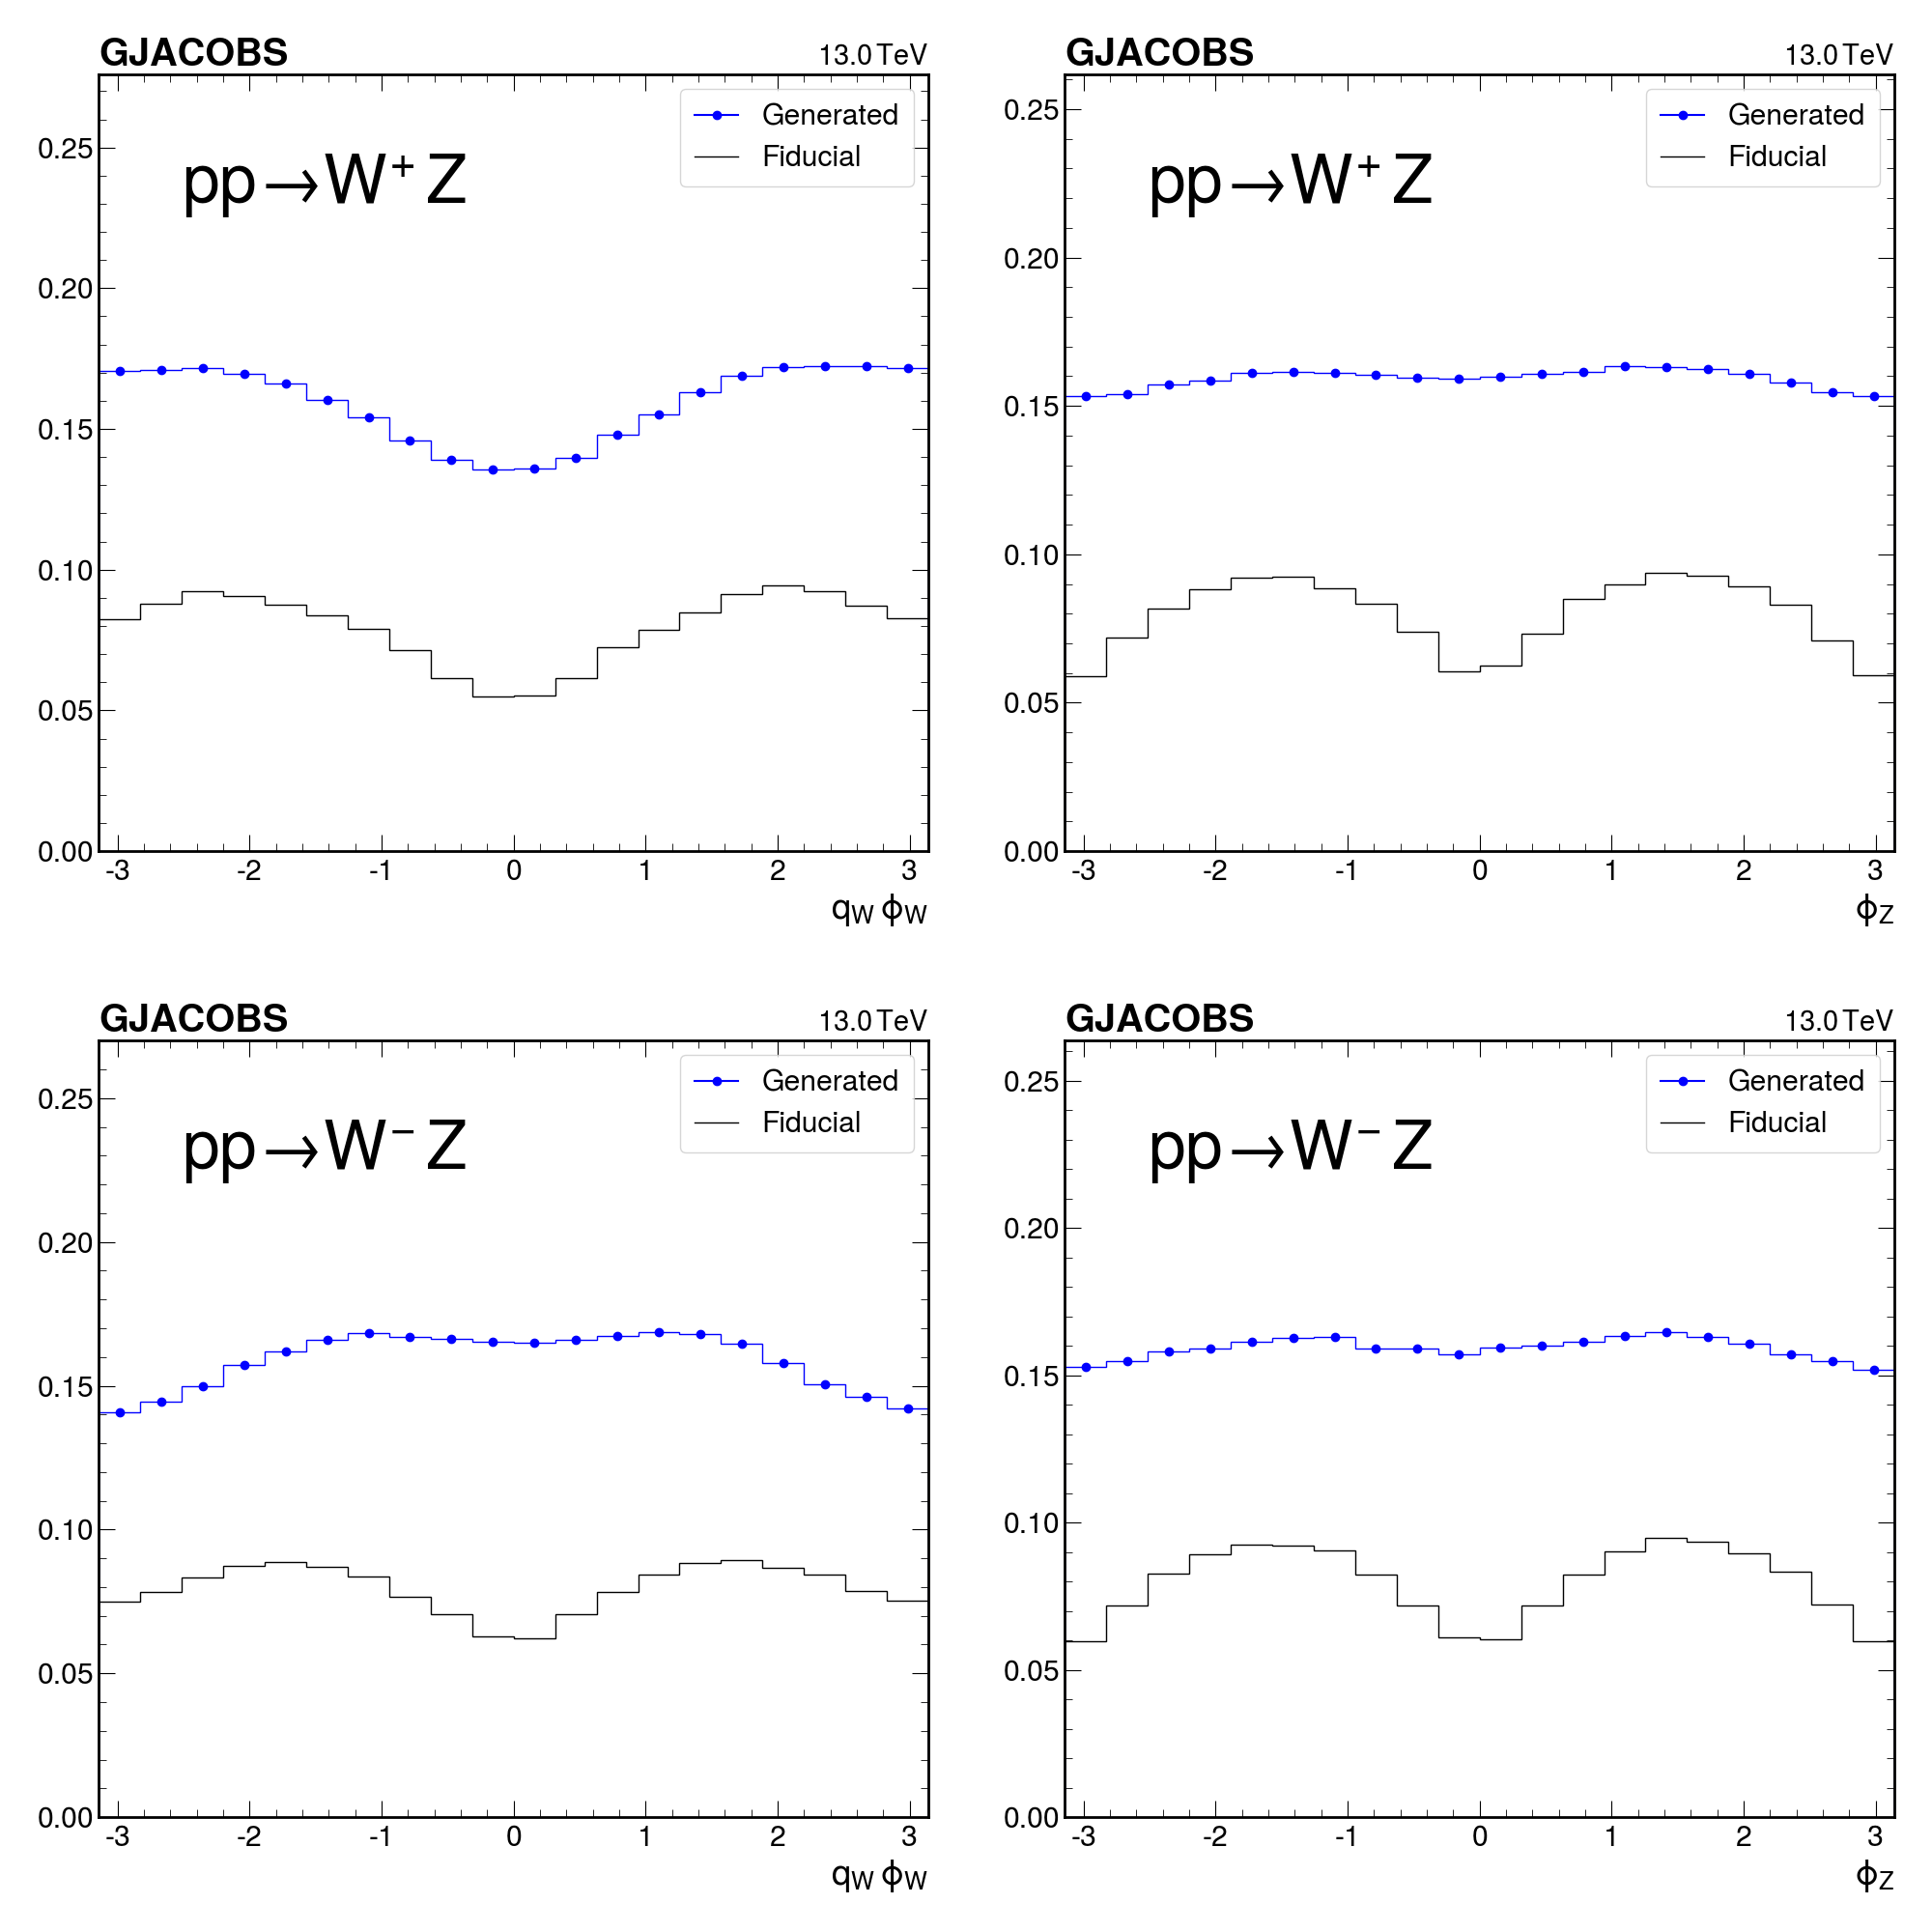
MadGraph φ

Slide 27
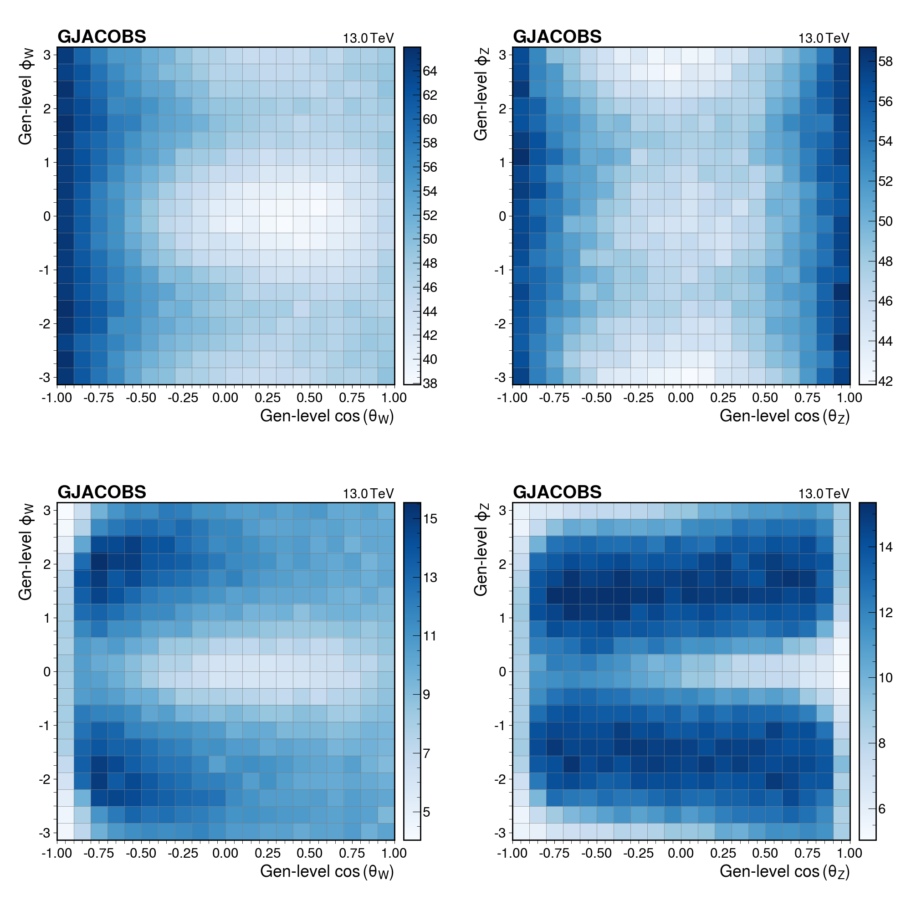
cos(θ) x φ

