Slide 1
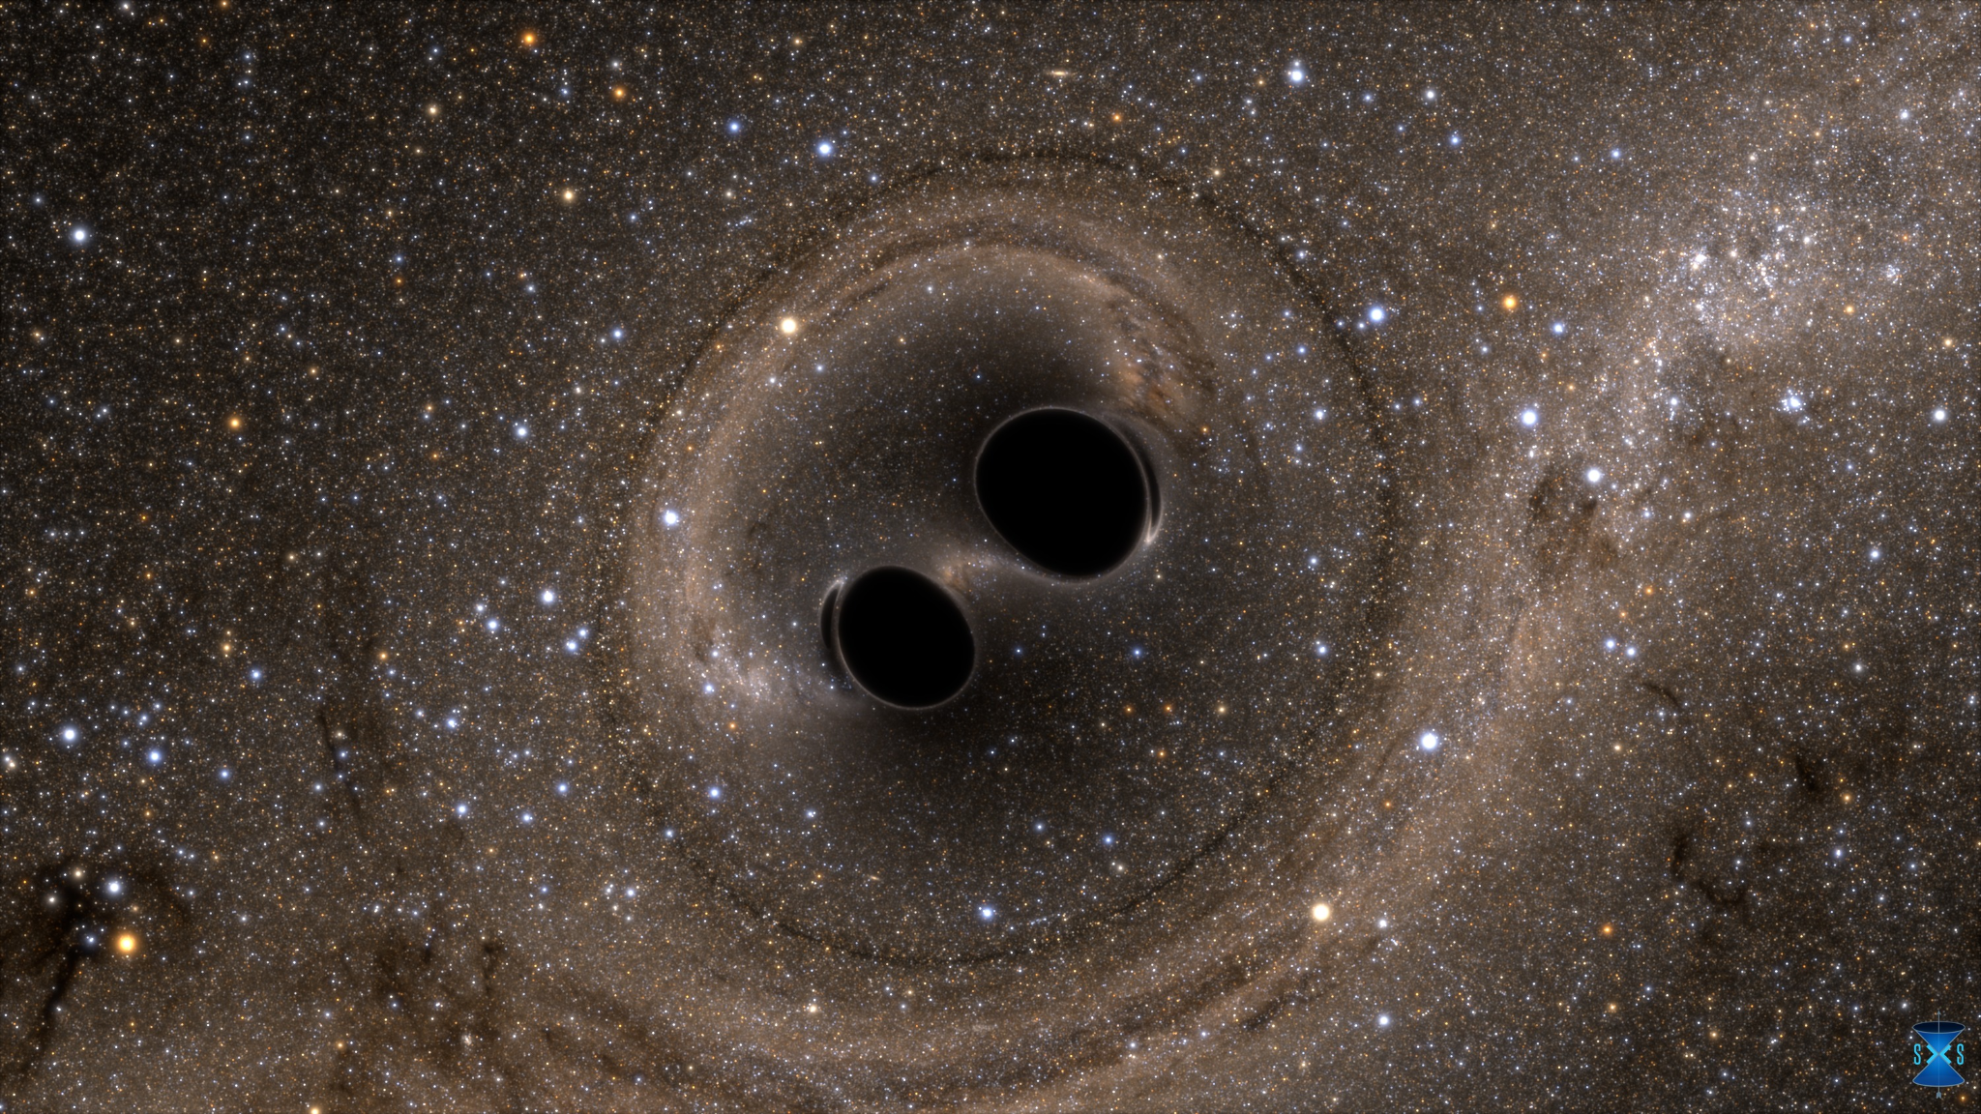
“Finding”
Luca² to leading order (+ NNLO)
GW150914

Slide 2
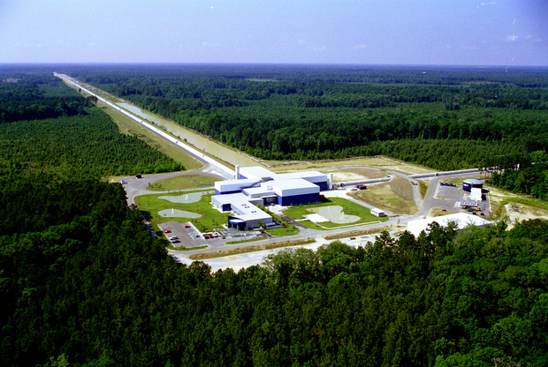
The basic principle

Slide 3
Reality

Slide 4
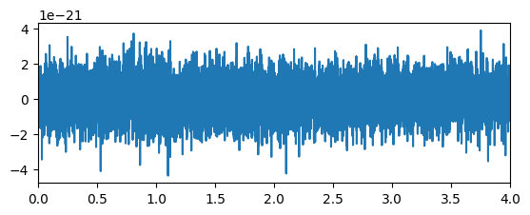
Pseudo Reality

Slide 5
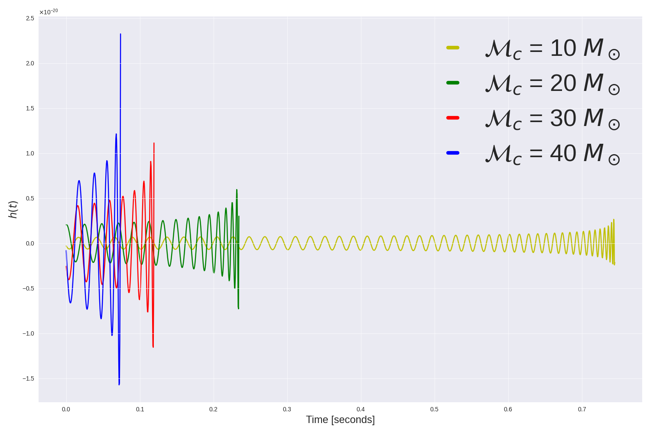
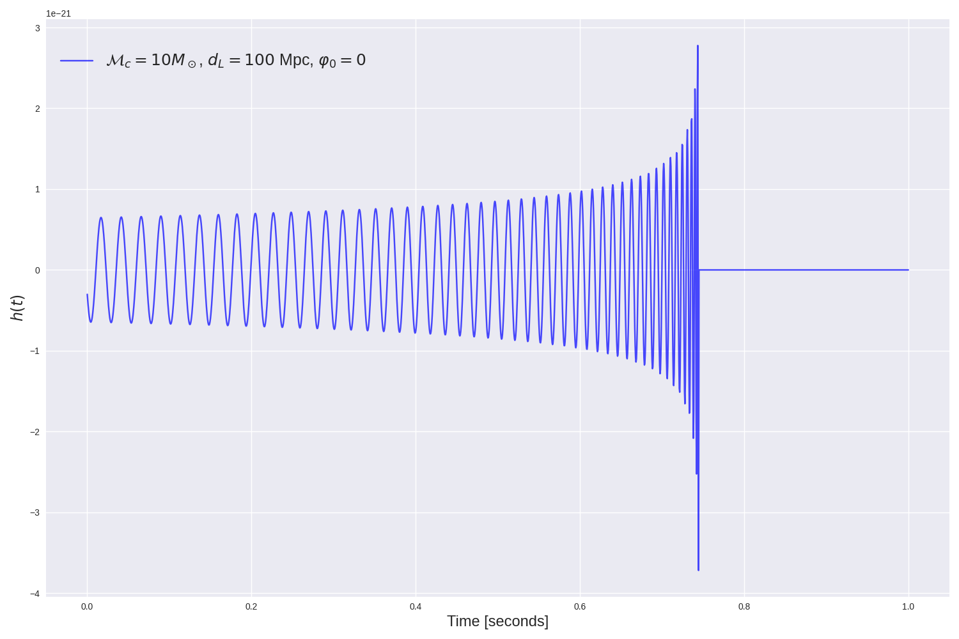
Finding a signal in pseudo data
Creating templates Function of: Chirp mass, distance, phase, time
Template bank of different masses

Slide 6
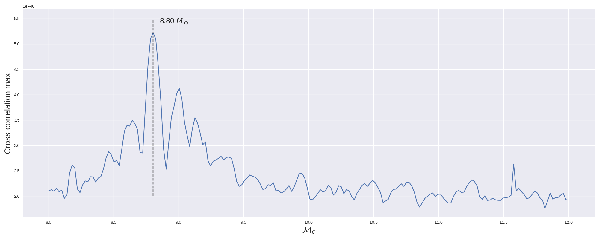
Finding a signal in pseudo data
Correlating templates to the data.

Slide 7
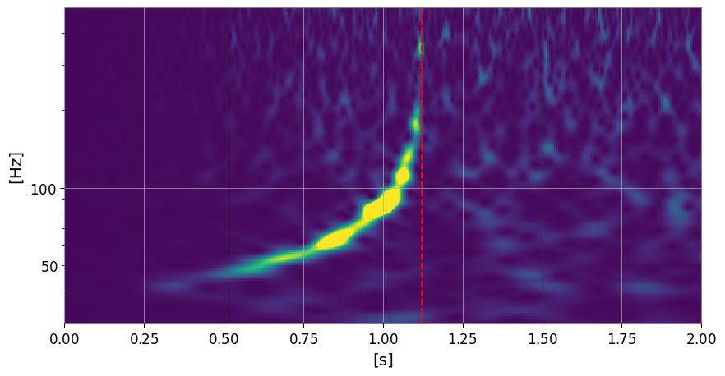
So did we find it?
Yippie!
Chirp mass found by the match filter : 8.8 msun

Slide 8
Going to real data
Complications :
Need to colour the template
Need a lot of templates
(Need to clean the data)
((Need post newtonian corrections))
We will try to find a Gravitational wave in the data (but we look up the specifics)

Slide 9
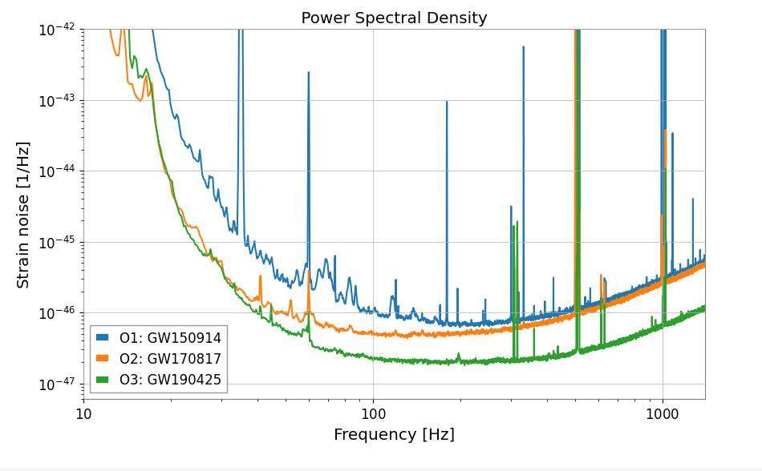
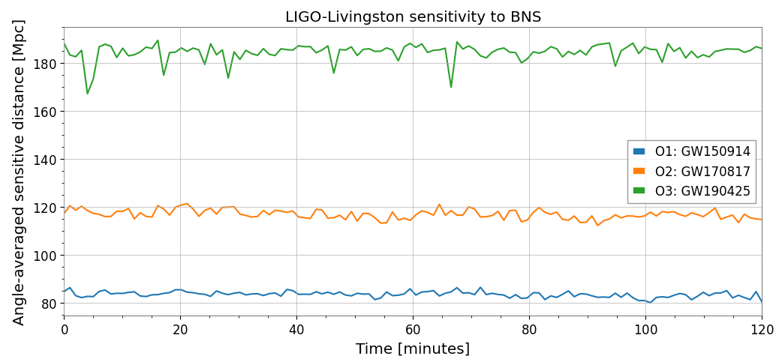
Power spectrums

Slide 10
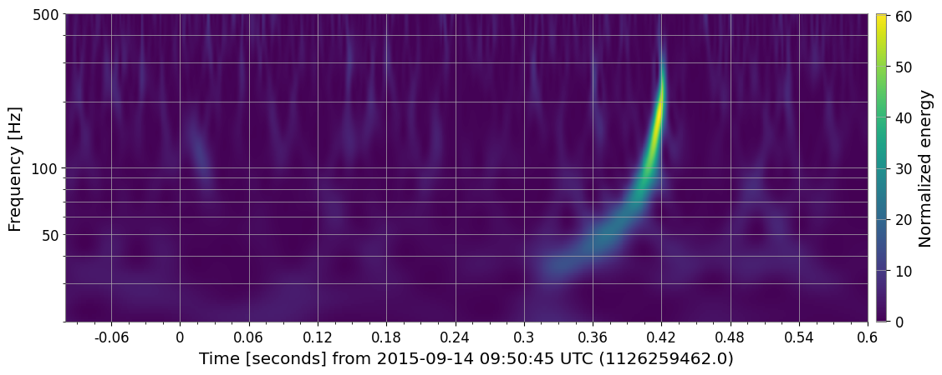
GW150914

Slide 11
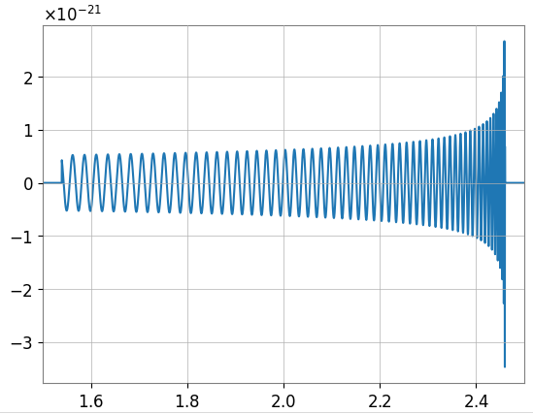
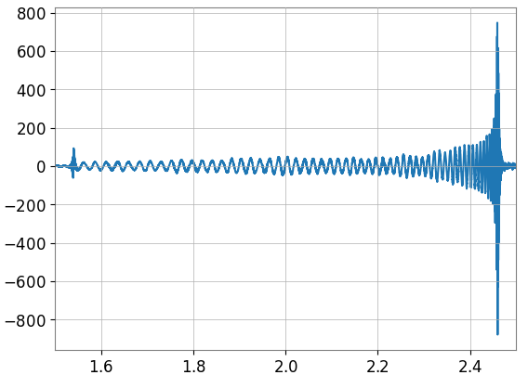
Colouring the template
Use the PSD to colour the template (Ignore the factor ~10²³ difference on the y-axis)

Slide 12
So, did we find it?

Slide 14
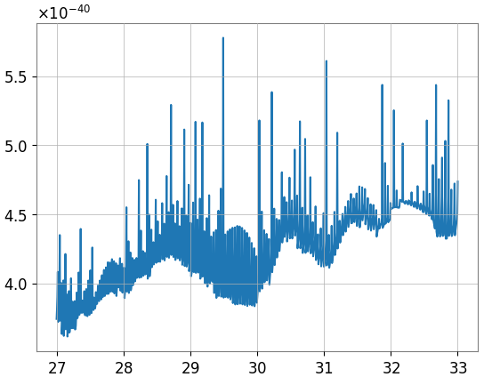
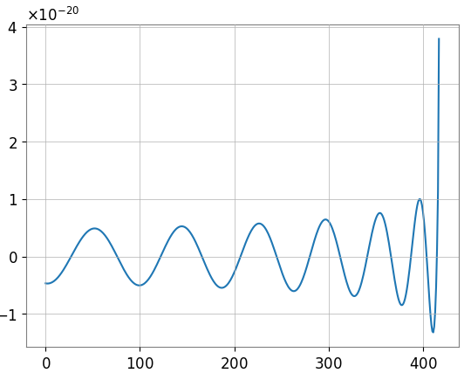
Looking for GW150914 (First effort)
Our candidate wave
Chirp Mass

Slide 15
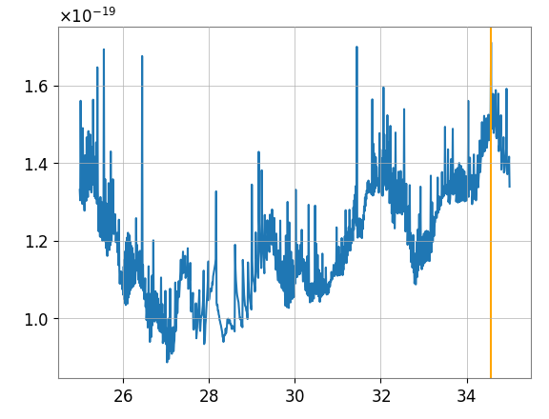
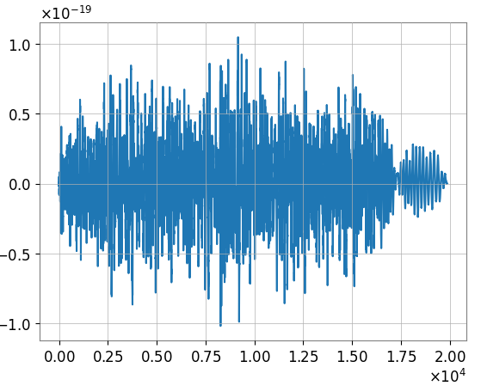
Second attempt (Improvement of 21 orders of magnitude!!!)
Correlation
Chirp mass
Time

Slide 16
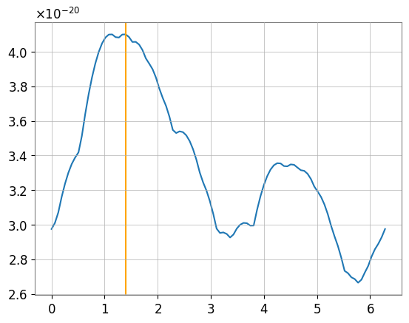
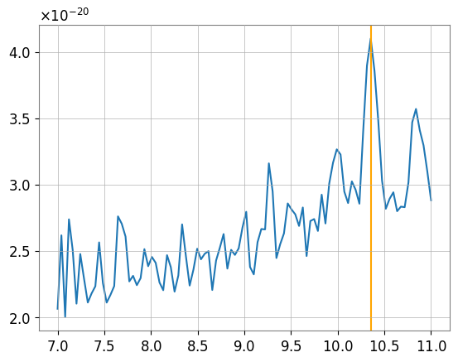
Third attempt with new event (GW151226) and expanded grid: looks better! Still wrong
Should be here …
Chirp mass
Phase

Slide 17
Why didn’t we find it?
Conclusion
Not enough corrections (only NNLO) while Post Newtonian corrections are needed.
We prefer Pseudo reality

Slide 18
Questions?

