Slide 1
Gravitational wave detection

Slide 2
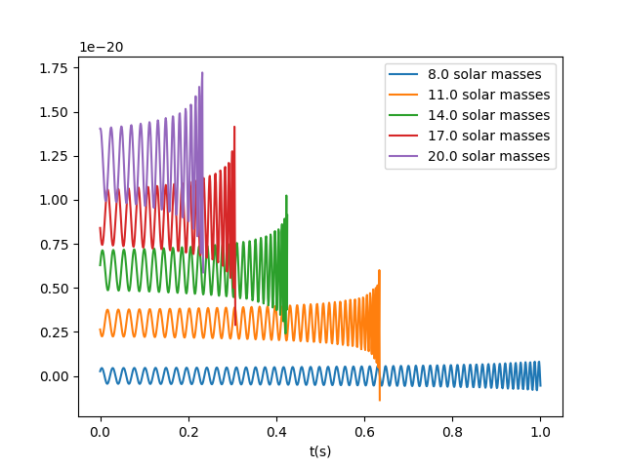
GW waveforms
Chirp mass Mc
Distance dL
Starting frequency F0

Slide 3
GW waveforms
Chirp mass Mc
Distance dL
Starting frequency F0

Slide 4
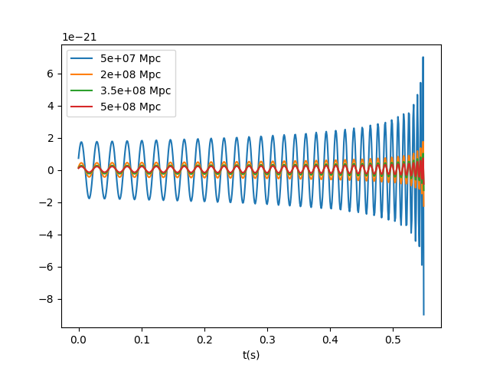
GW waveforms
Chirp mass Mc
Distance dL
Starting frequency F0

Slide 5
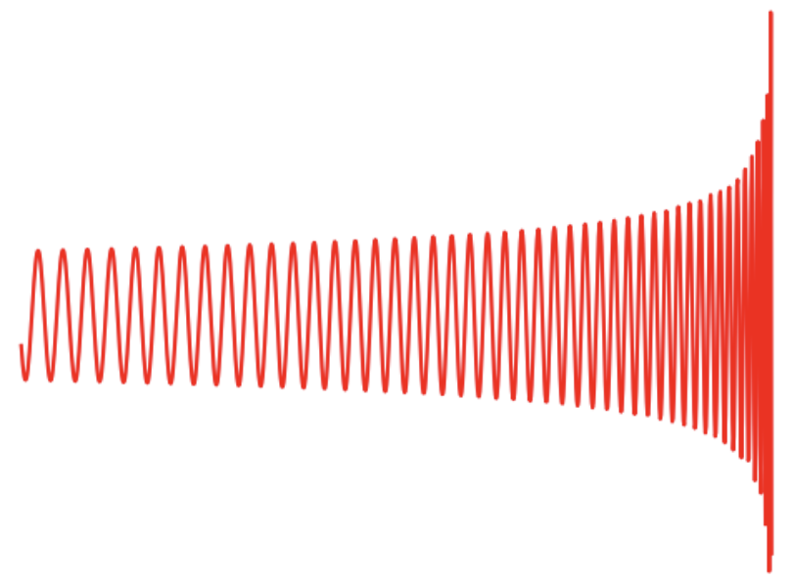
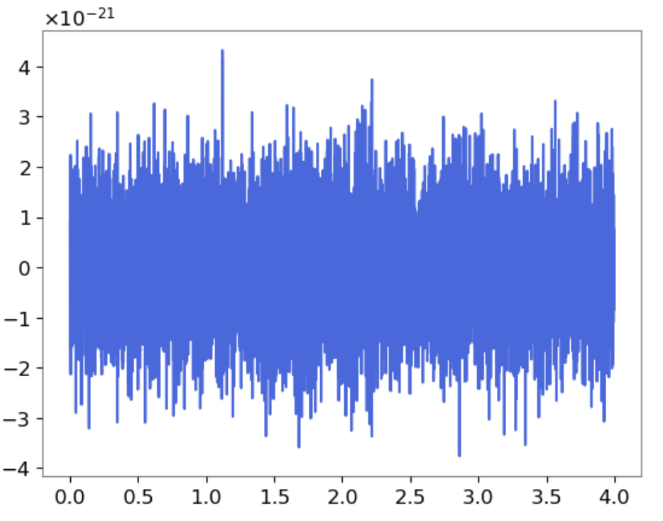
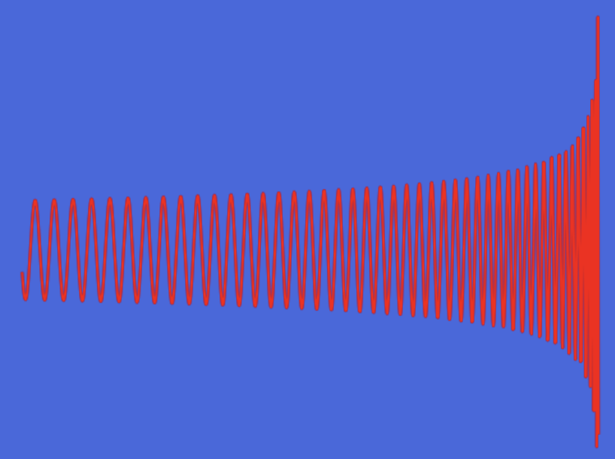
Noisy data
Signal template
Wally
Simulate real signal by adding gaussian noise
How to find signal?
Matched filter: signal extraction from Gaussian background
Correlation between the signal template and the data sample
Wally
signal

Slide 6
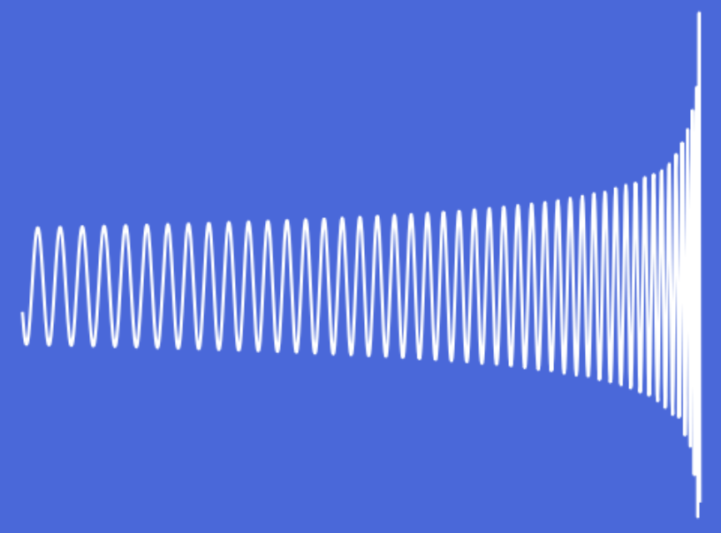
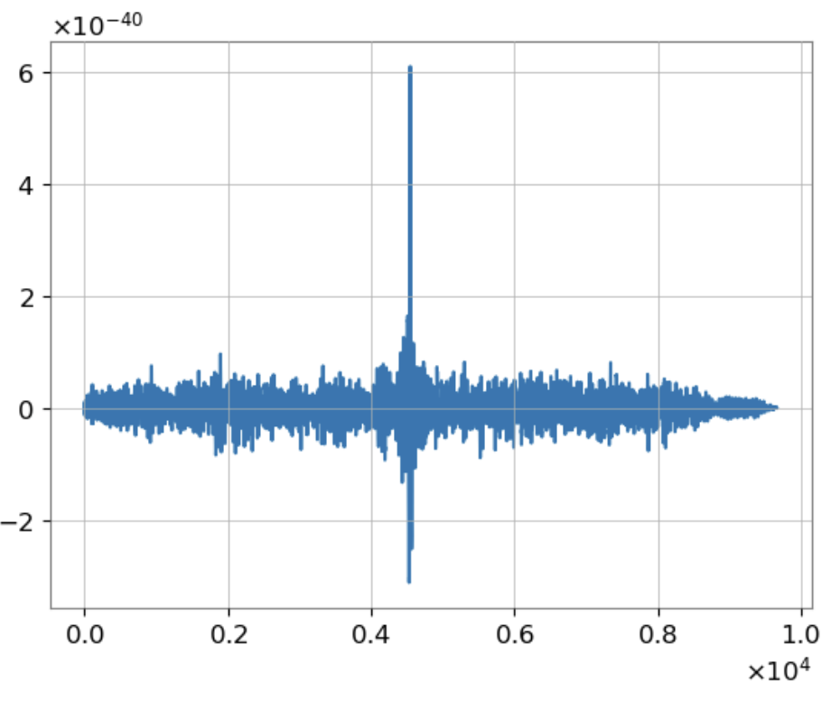
Matched filter
signal template
signal
signal template
signal
Scan the data sample with our template
For each time step compute the correlation between template and data sample
time(s)
time(s)
Low correlation
High correlation
correlation

Slide 7
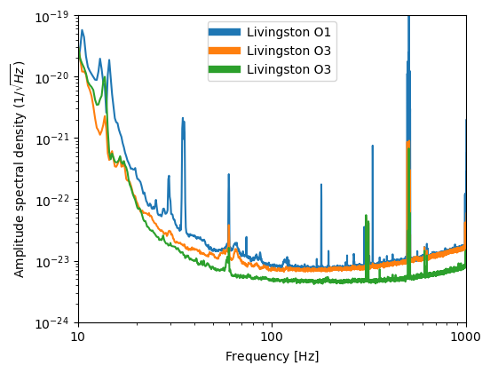
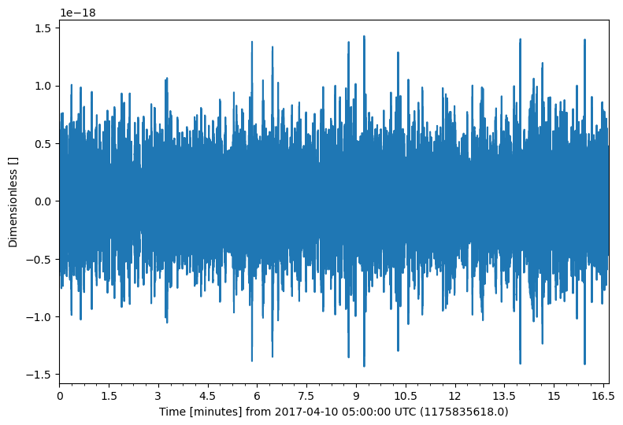
Interferometer noise spectra
Fourier
Transform
Radiation pressure
Seismic
Newtonian
Shot noise / Thermal
Time series of random data (without signal) Amplitude spectral density

Slide 8
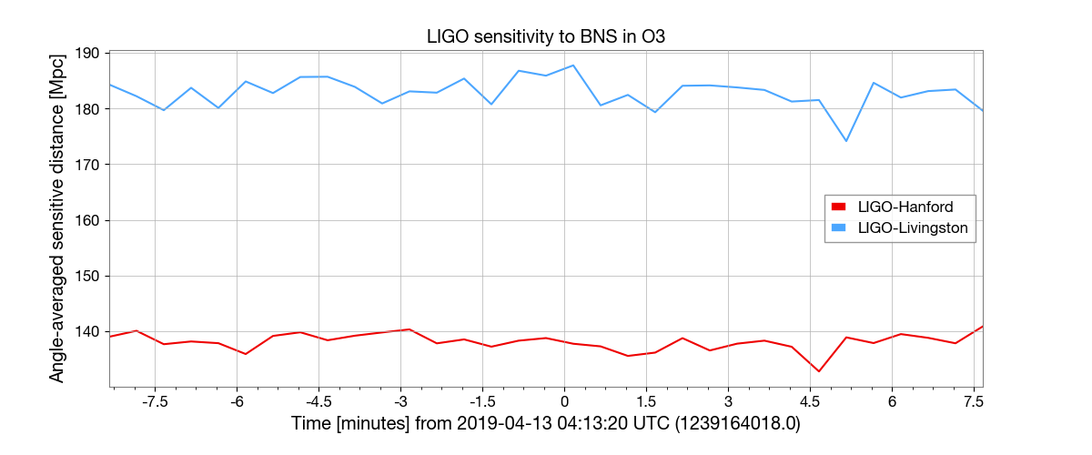
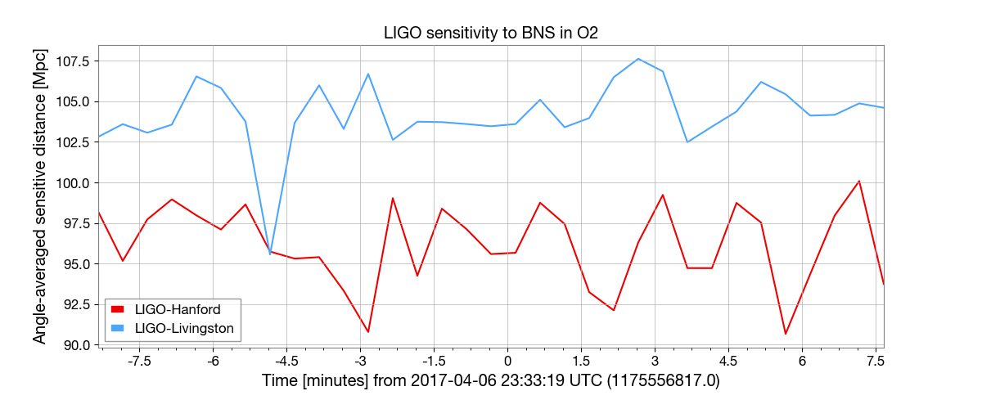
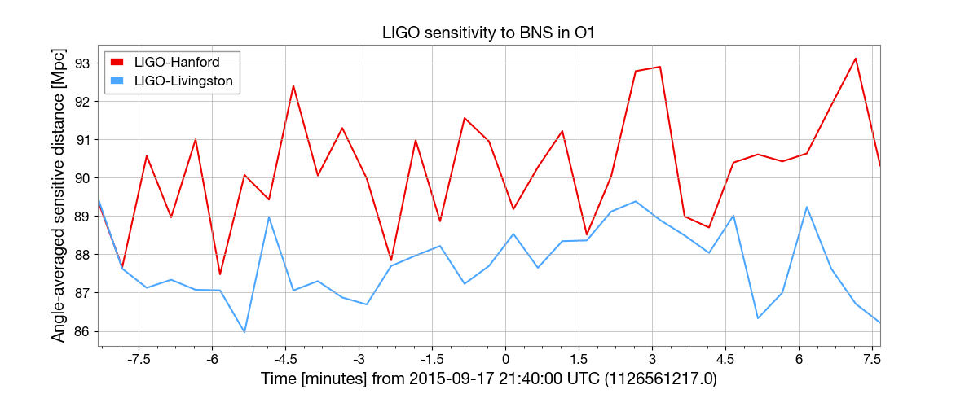
Binary neutron star range

Slide 9
Binary neutron star range

Slide 10
Binary neutron star range
lol
Virgo somewhere down here

Slide 11
Waveform correlation to real data
2 real detector data are studied: GW150914, GW151226
GW150914: merge of 2 black holes of 36 and 29 solar mass, observed at 440 Mpc
Expected chirp mass: 28.6 solar mass
GW151226: merge of 2 black holes of 14.2 and 7.5 solar mass, observed at 440 Mpc
Expected chirp mass: 8.9 solar mass

Slide 12
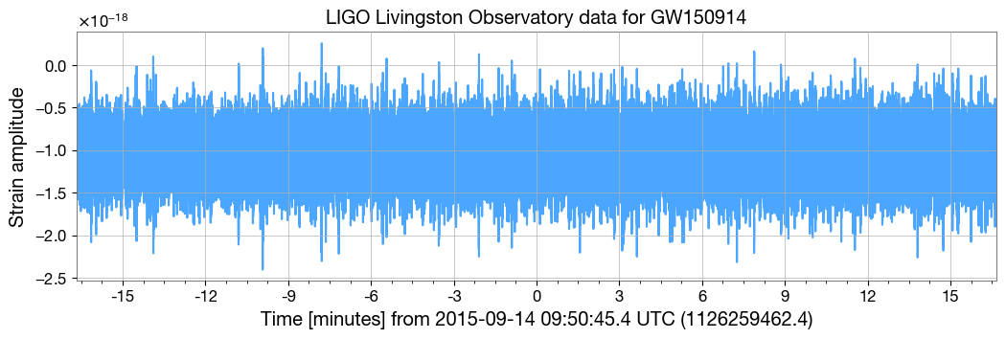
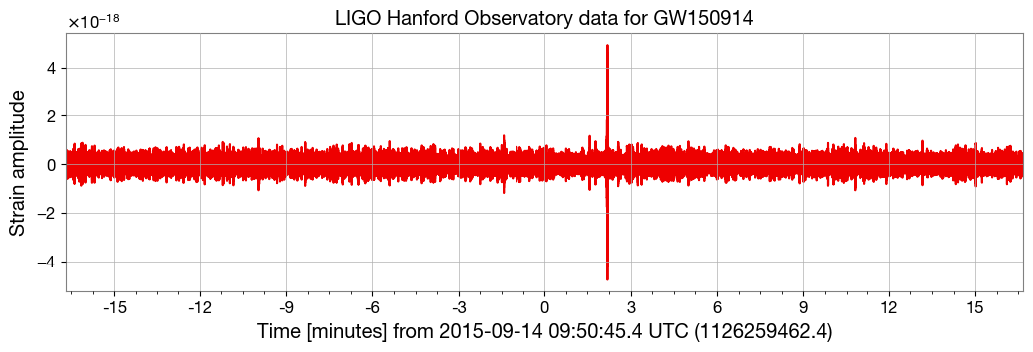
Real detector data GW150914

Slide 13
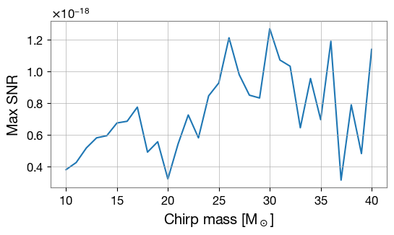
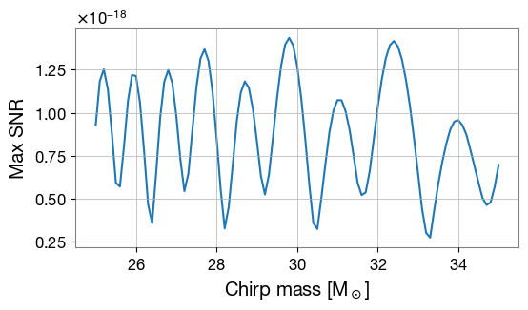
Correlation to GW150914 Livingston observation
Correlation with a scan over chirp mass from 10 to 40 solar mass with step of 1 solar mass
Maximum SNR is found at chirp mass = 30 solar mass
Second scan with chirp mass from 25 to 35 solar mass with step of 0.1 solar mass
Maximum SNR is found at chirp mass = 29.8 solar mass

Slide 14
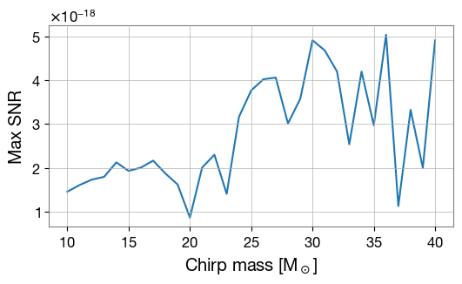
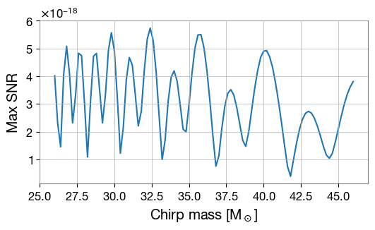
Correlation to GW150914 Hanford observation
Correlation with a scan over chirp mass from 10 to 40 solar mass with step of 1 solar mass
Maximum SNR is found at chirp mass = 36 solar mass
Second scan with chirp mass from 26 to 46 solar mass with step of 0.2 solar mass
Maximum SNR is found at chirp mass = 32.4 solar mass

Slide 15
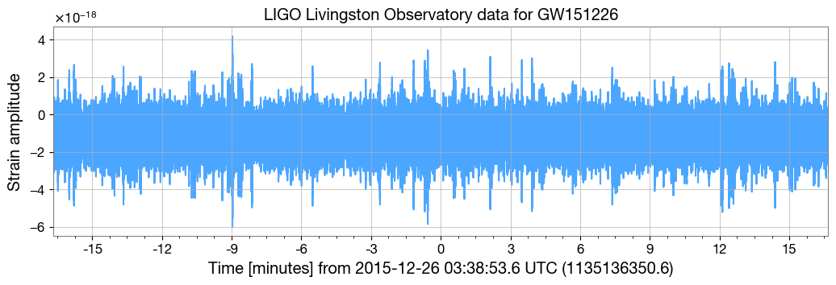
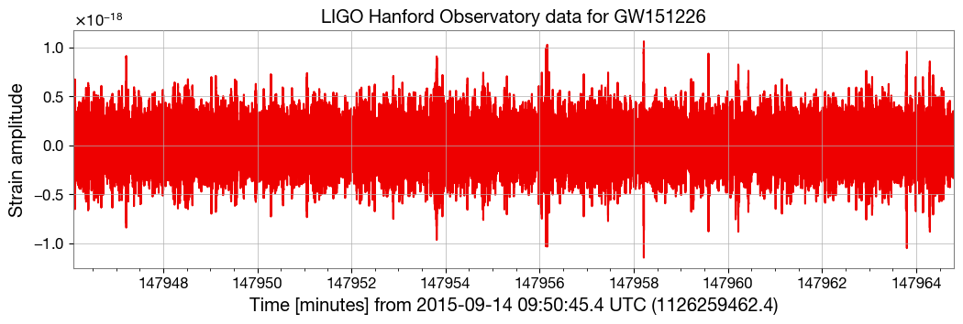
Real detector data GW151226

Slide 16
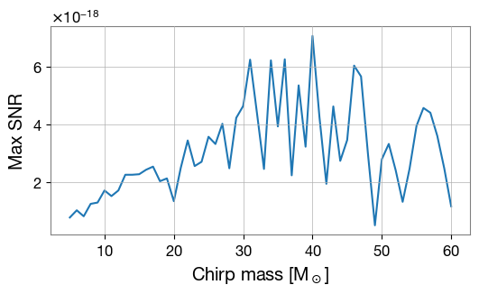
Correlation to GW151226 observation
With Livingston: scan over chirp mass from 5 to 60 solar mass with step of 1 solar mass
Maximum SNR is found at chirp mass = 40 solar mass
With Hanford: problem encountered with correlation, still under investigation

