Slide 1
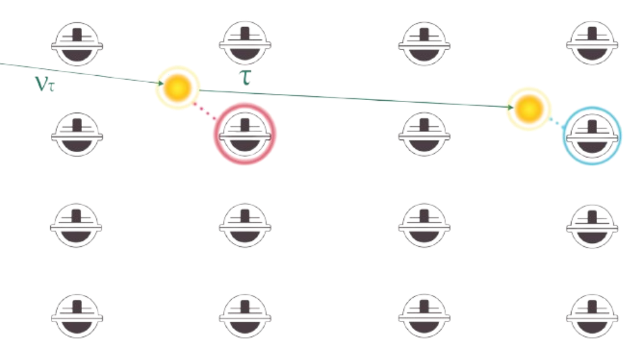


Tau Neutrinos in IceCube
EPPG internal seminar 12/05/26
Christopher Eldridge

Slide 2
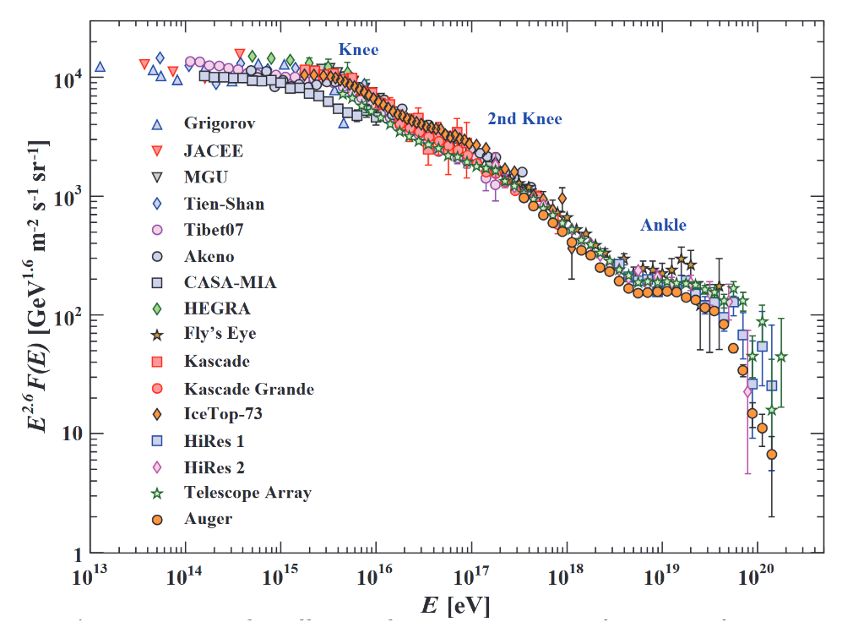
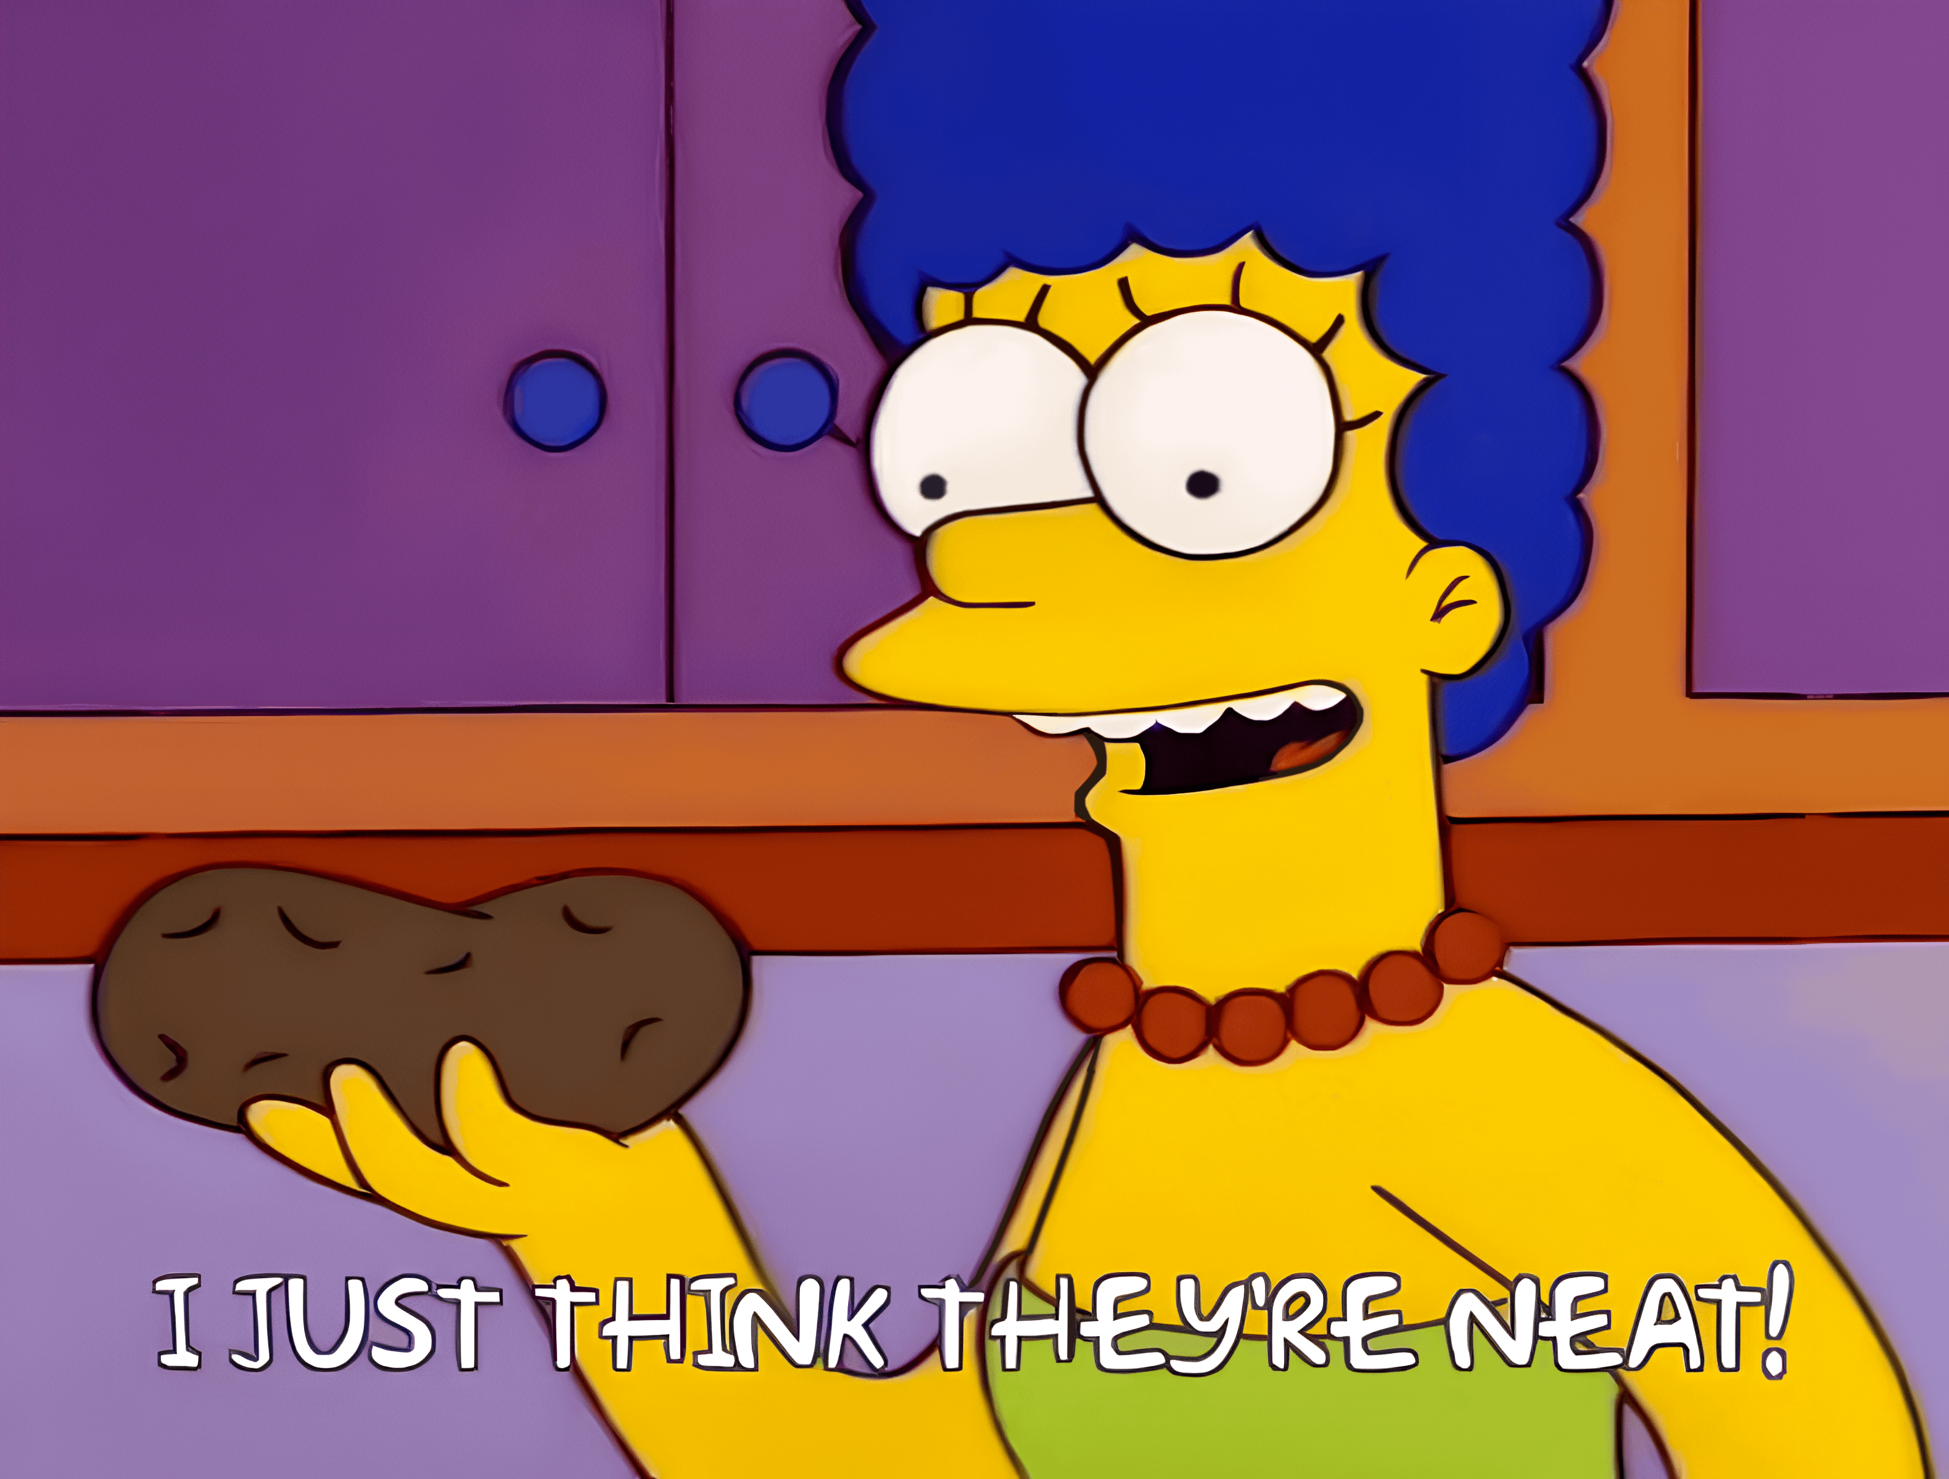
Motivation
Astrophysical neutrinos are another window on the universe
Complementary to optical, gamma ray, gravitational waves, etc
As charged particles, cosmic rays do not point back to their sources
Determining their origins has been an open problem for over a century
Interactions near cosmic ray sources produces “neutral messengers”: gamma rays and neutrinos
1/18
Tau Neutrinos in IceCube
Christopher Eldridge

Slide 3
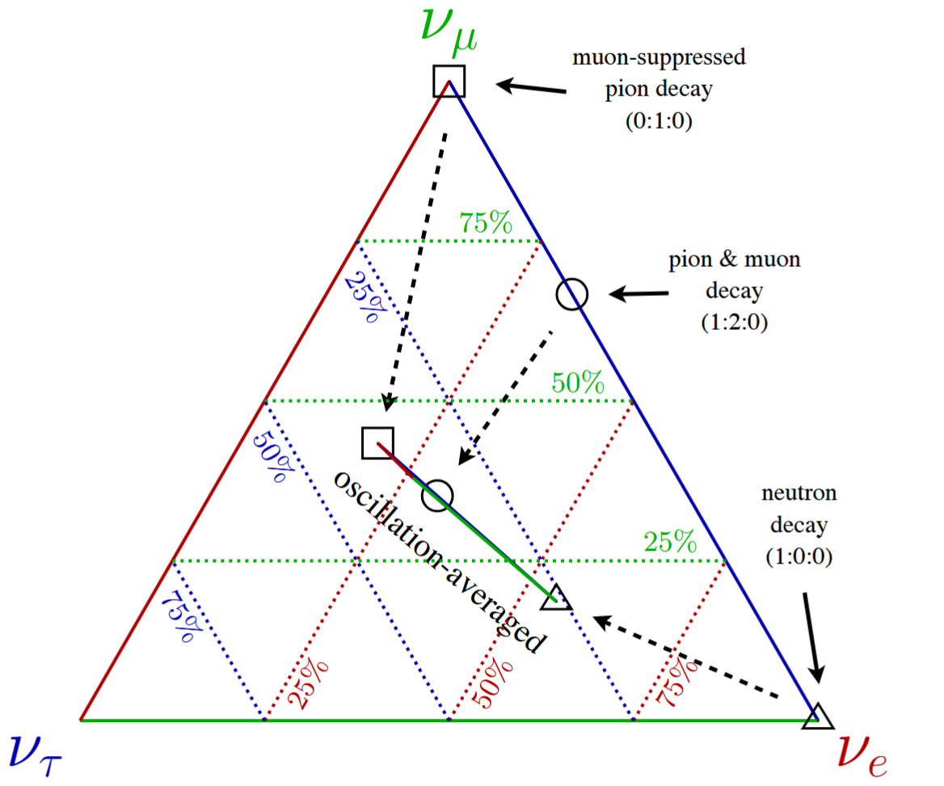
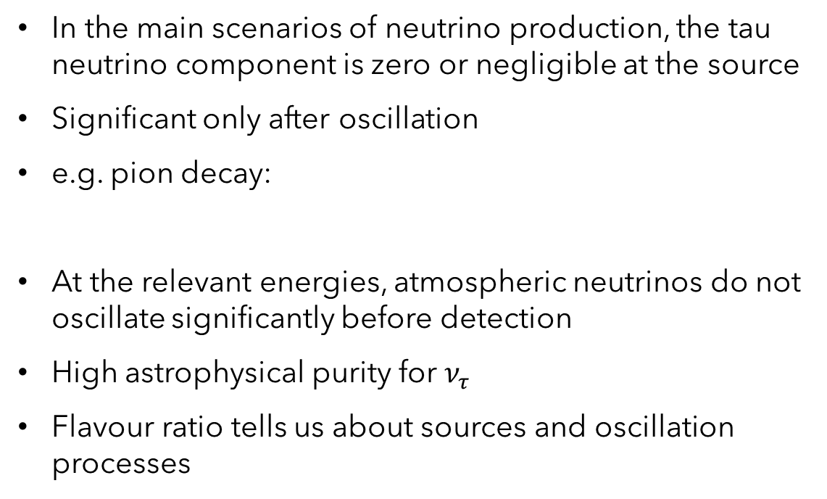
Why tau neutrinos?
In the main scenarios of neutrino production, the tau neutrino component is zero or negligible at the source
Significant only after oscillation
e.g. pion decay:
At the relevant energies, atmospheric neutrinos do not oscillate significantly before detection
High astrophysical purity for $ν_{τ}$
Flavour ratio tells us about sources and oscillation processes
Image: IceCube Collaboration (2014)
2/18
Tau Neutrinos in IceCube
Christopher Eldridge

Slide 4
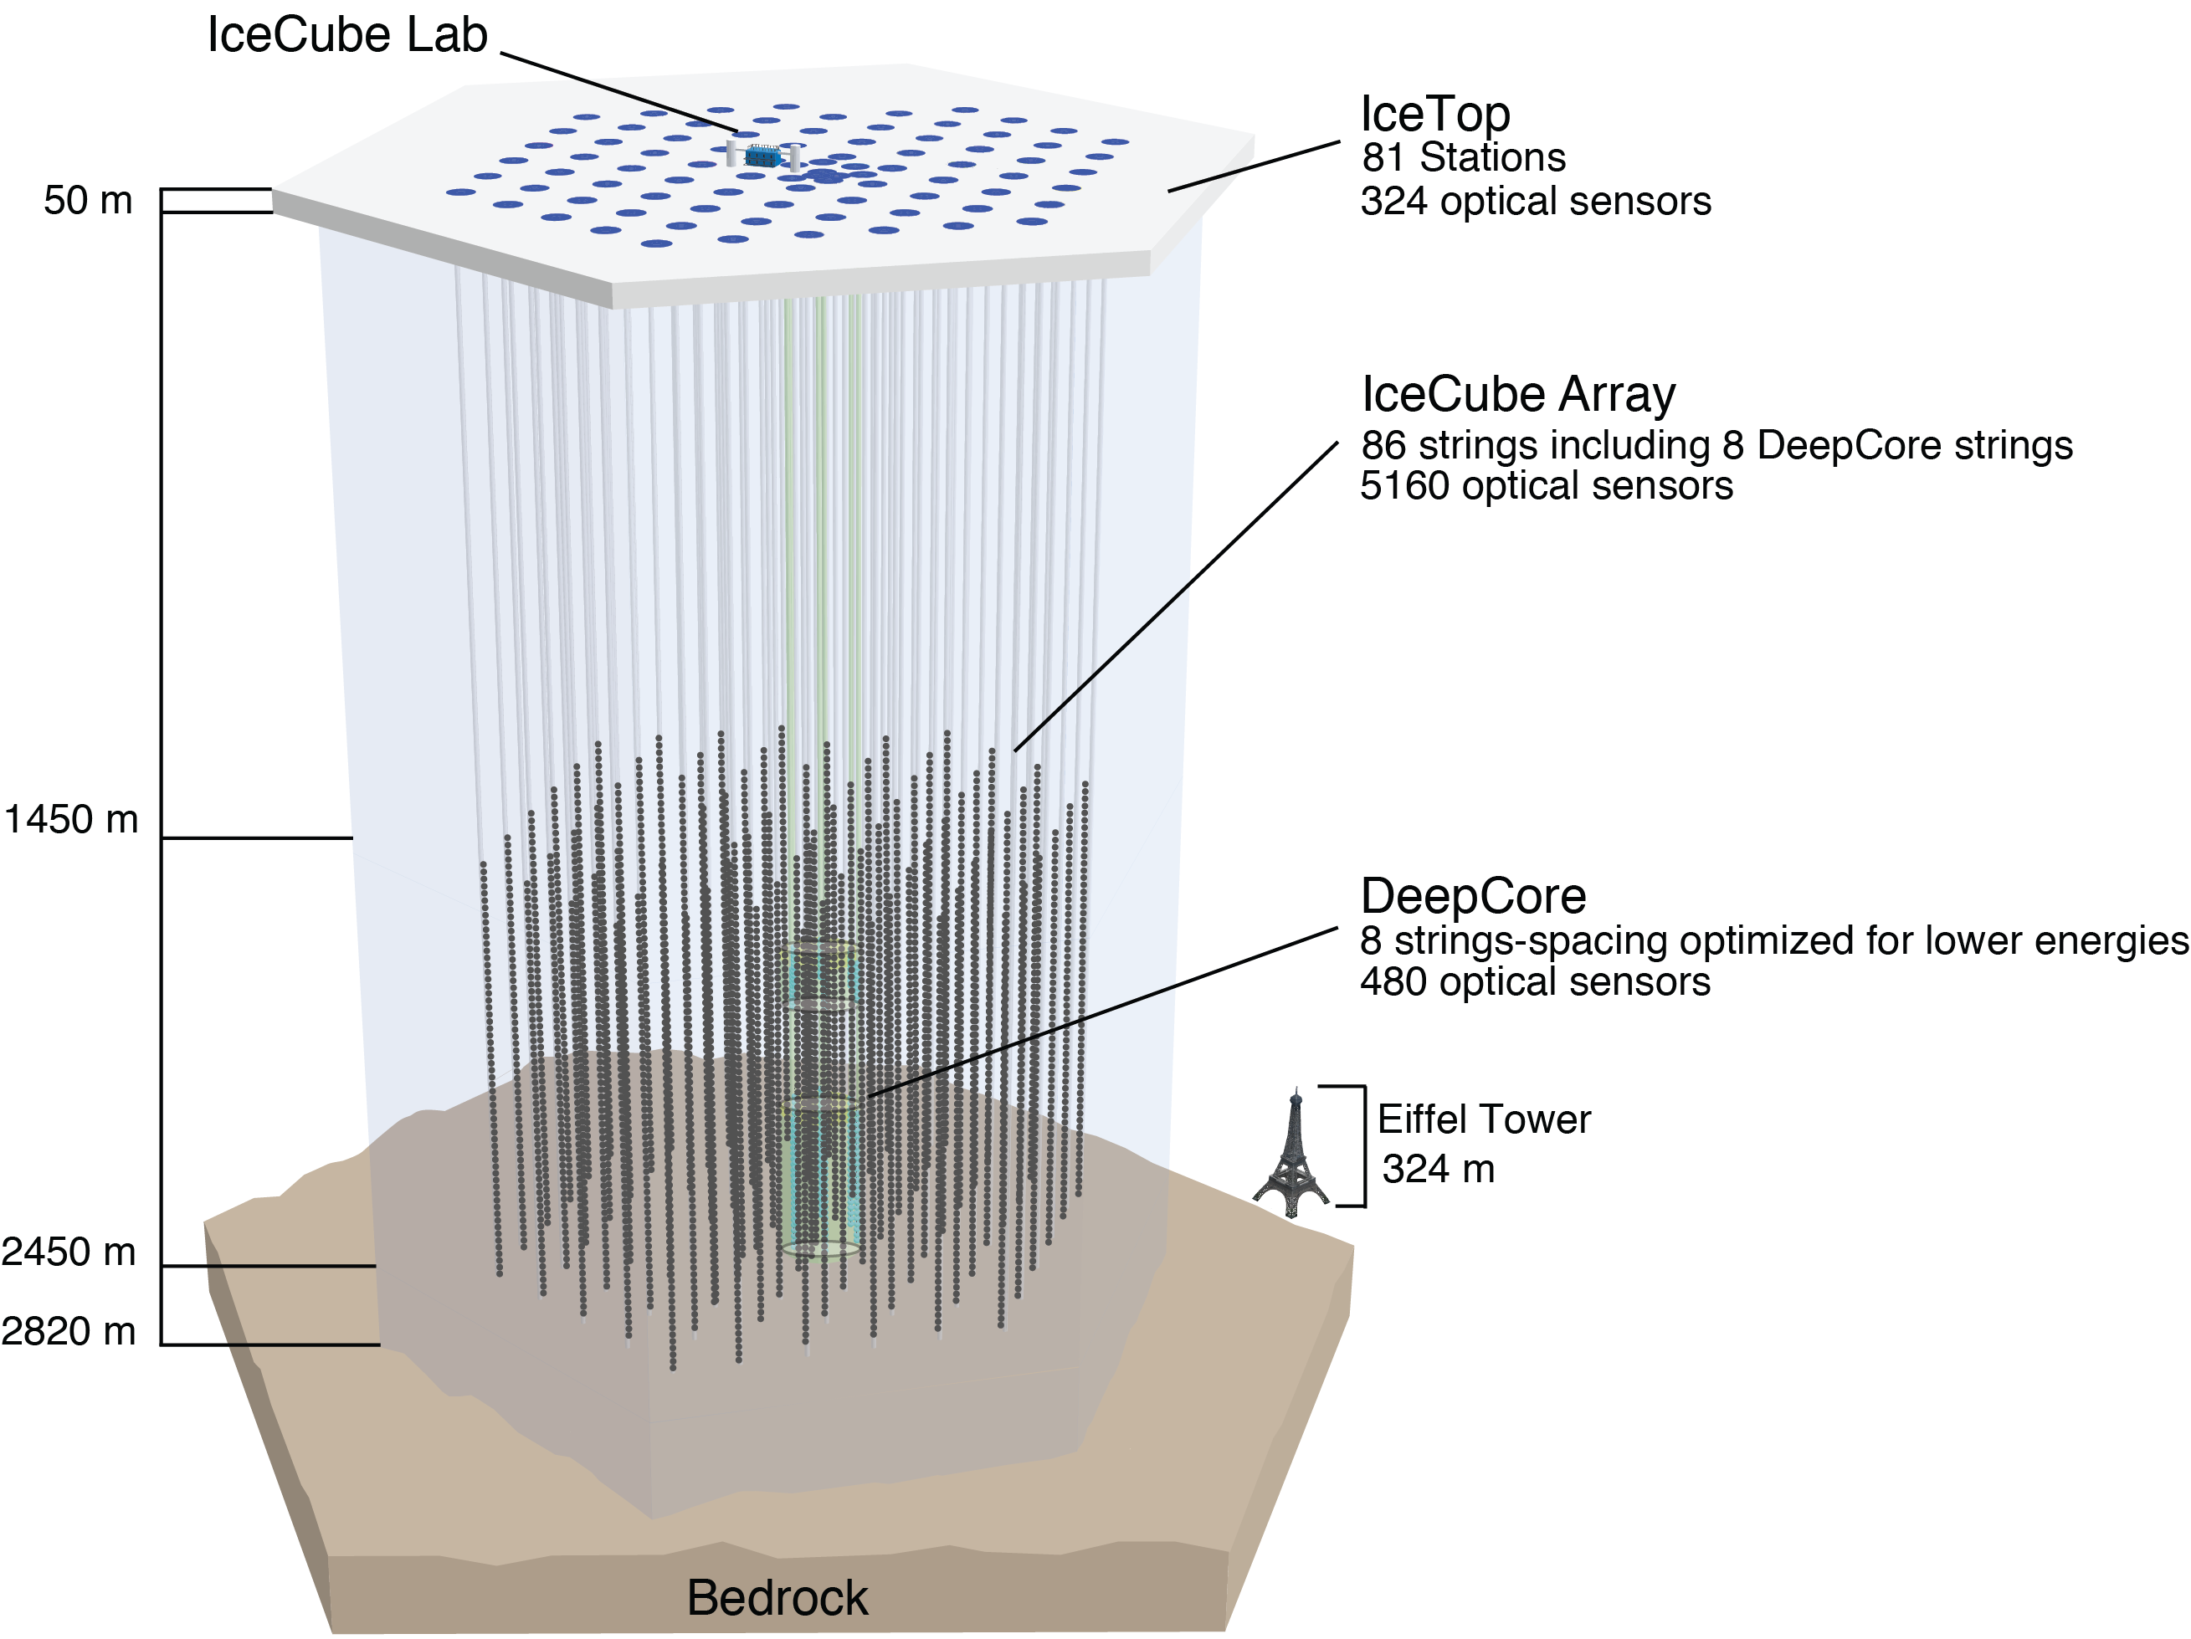
IceCube
World’s coolest neutrino detector 😎
Components:
  Main in-ice array
  IceTop surface detector
  DeepCore
  Upgrade!
  Future prospects: Gen2?
Digital optical modules (DOMs) detect Cherenkov light
~125 m between strings, 17 m between DOMs
Image: IceCube gallery
3/18
Tau Neutrinos in IceCube
Christopher Eldridge

Slide 5
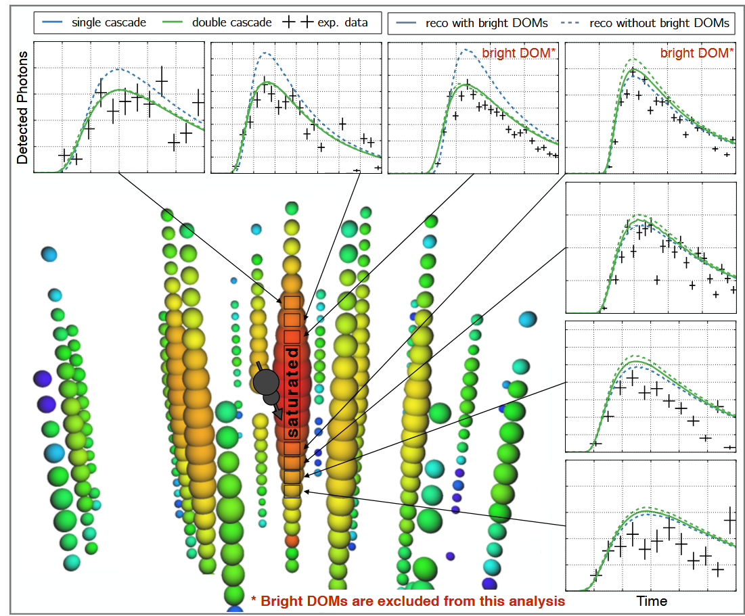
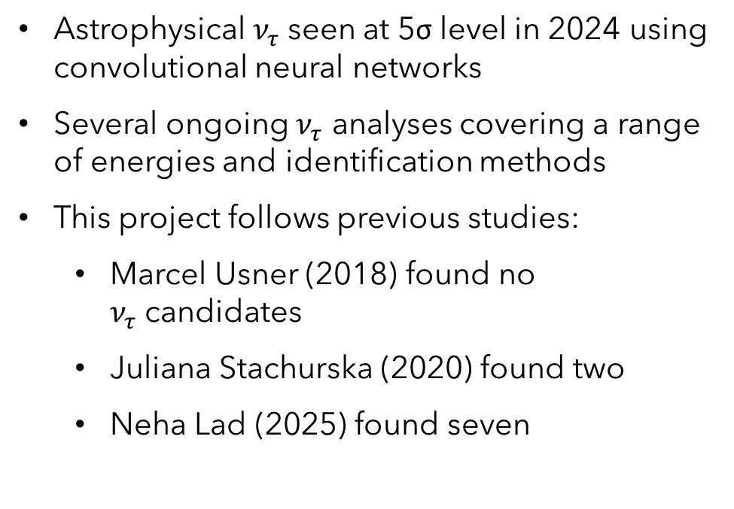
Tau neutrinos in IceCube
Astrophysical $ν_{τ}$seen at 5σ level in 2024 using convolutional neural networks
Several ongoing $ν_{τ}$ analyses covering a range of energies and identification methods
This project follows previous studies:
  Marcel Usner (2018) found no $ν_{τ}$candidates
  Juliana Stachurska (2020) found two
  Neha Lad (2025) found seven
Image: Stachurska (2020)
4/18
Tau Neutrinos in IceCube
Christopher Eldridge

Slide 6
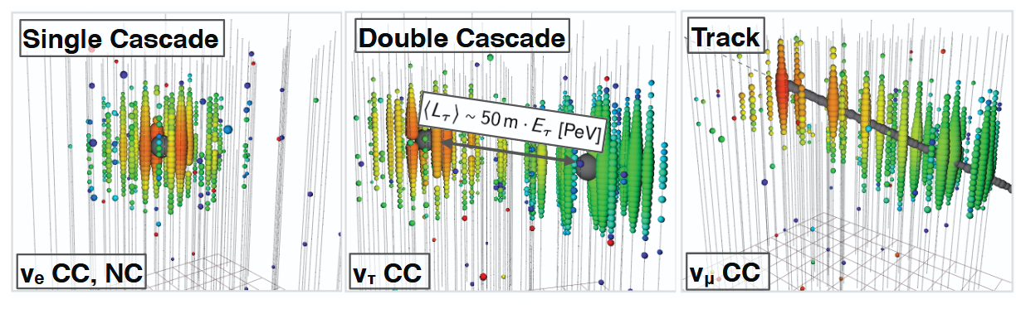
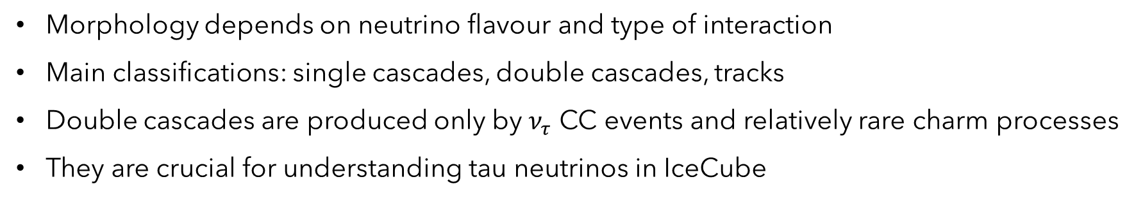
Neutrino interactions in IceCube
Morphology depends on neutrino flavour and type of interaction
Main classifications: single cascades, double cascades, tracks
Double cascades are produced only by $ν_{τ}$ CC events and relatively rare charm processes
They are crucial for understanding tau neutrinos in IceCube
Images: Usner (2018), Stachurska (2020)
5/18
Redo
Christopher Eldridge

Slide 7


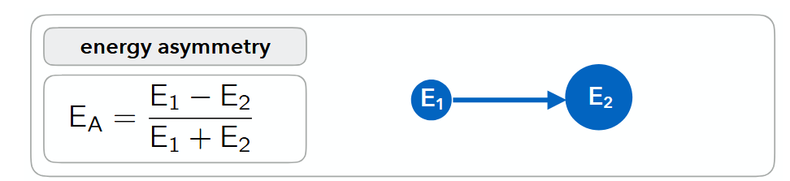
Event reconstruction
We reconstruct events using the likelihood-based framework
Source model depends on the event hypothesis:
  Single cascade
  Track
  Double cascade
Also of interest: energy asymmetry from
Image: Usner (2018)
6/18
Tau Neutrinos in IceCube
Christopher Eldridge

Slide 8
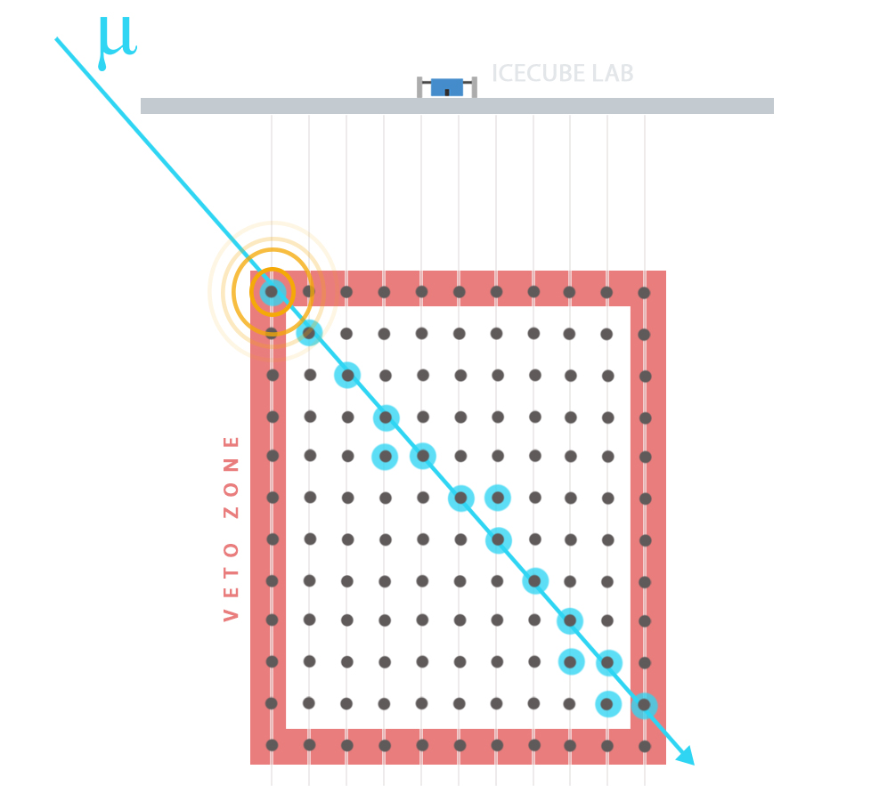
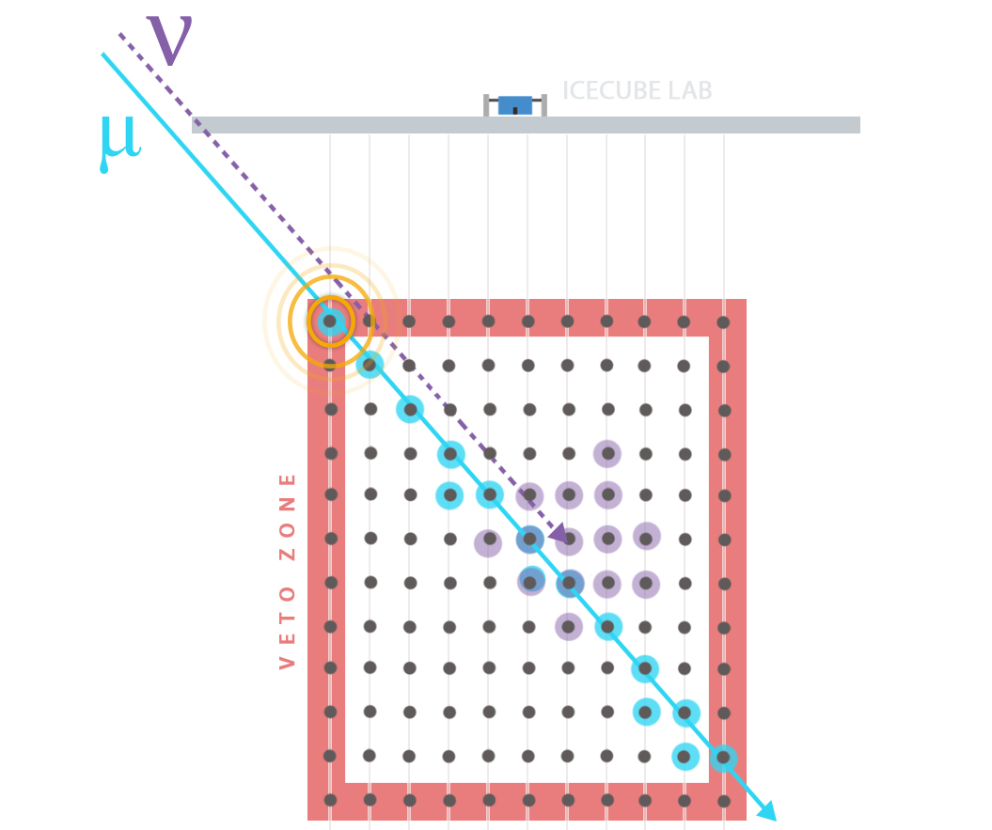
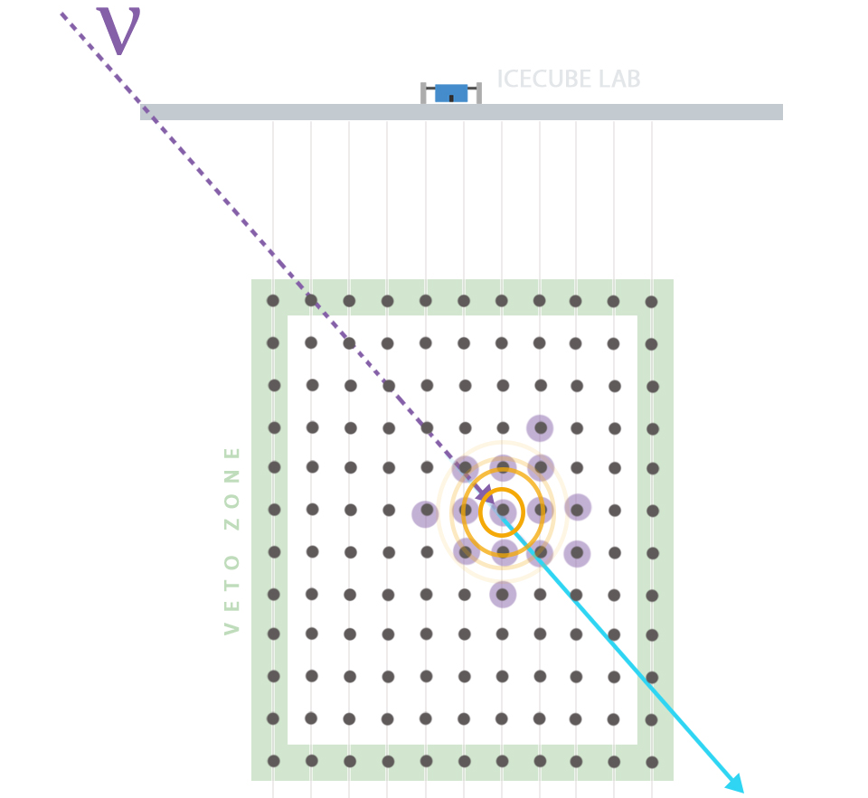
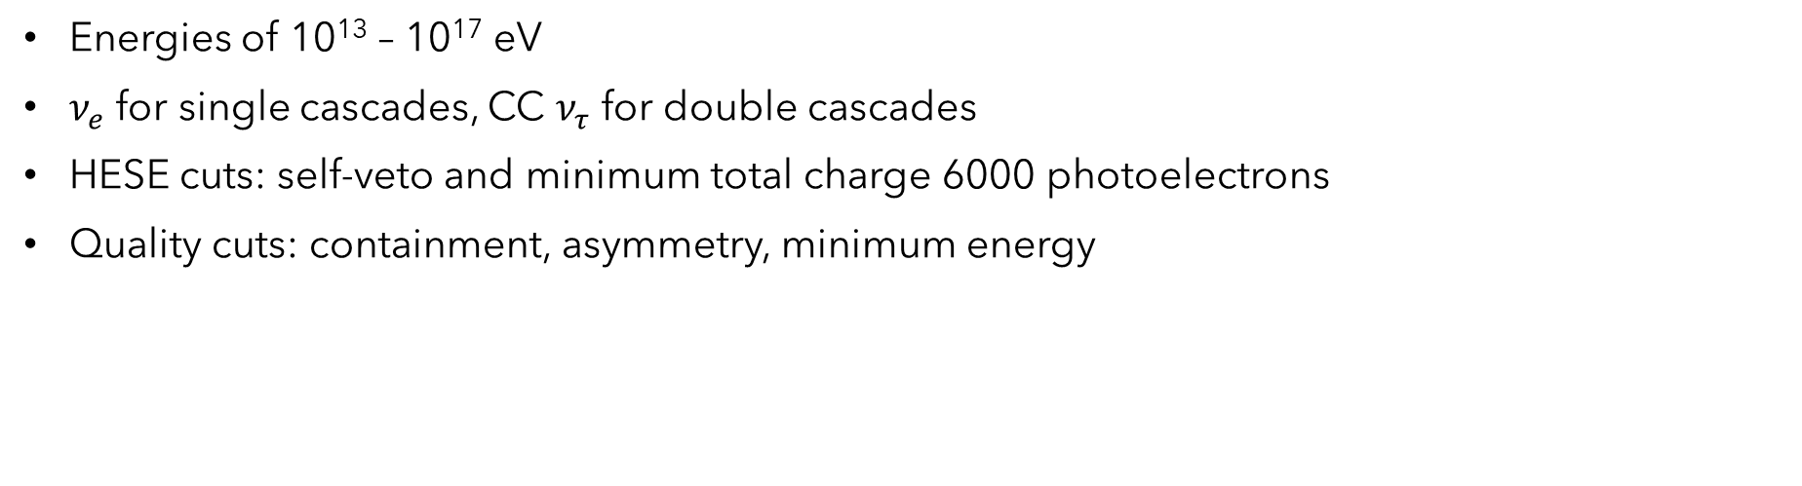
Taupede testing: simulation selection
Energies of 10¹³ – 10¹⁷ eV
$ν_{e}$ for single cascades, CC $ν_{τ}$ for double cascades
HESE cuts: self-veto and minimum total charge 6000 photoelectrons
Quality cuts: containment, asymmetry, minimum energy
Images: IceCube gallery
7/18
Tau Neutrinos in IceCube
Christopher Eldridge

Slide 9
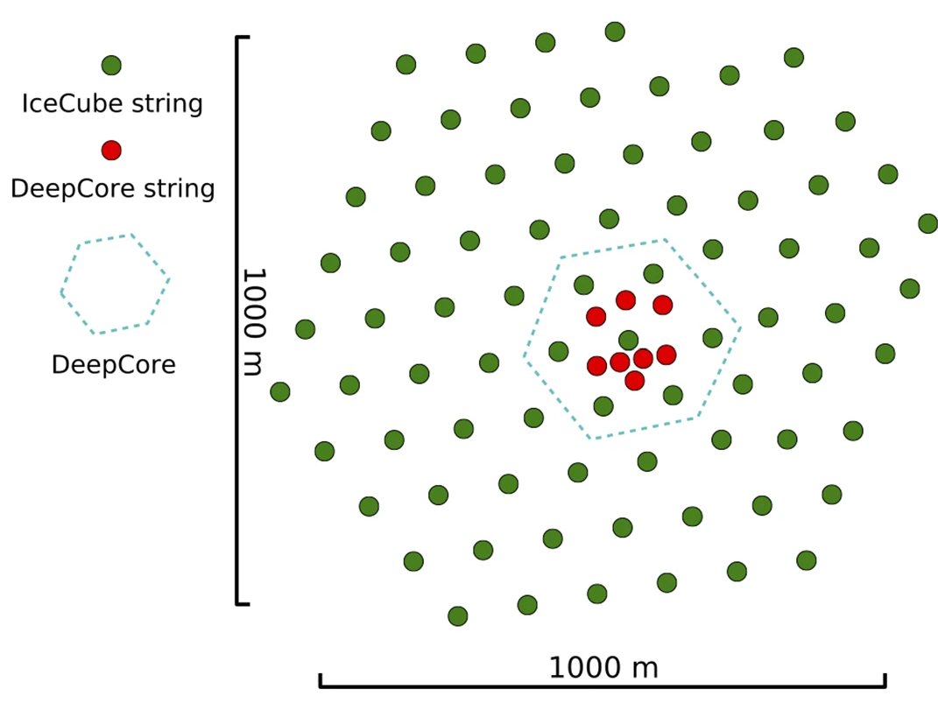
Bright and DeepCore DOMs
A DOM is bright if the amount of light it collects exceeds the average by a threshold factor
Excluded from previous analyses
Angular resolution issues (partially resolved), modelling questions
DeepCore is a subarray within IceCube
Denser instrumentation, higher quantum efficiency
8 strings, 480 DOMs
Excluded for homogeneity reasons
Image: IceCube Collaboration (2017)
8/18
Tau Neutrinos in IceCube
Christopher Eldridge

Slide 10
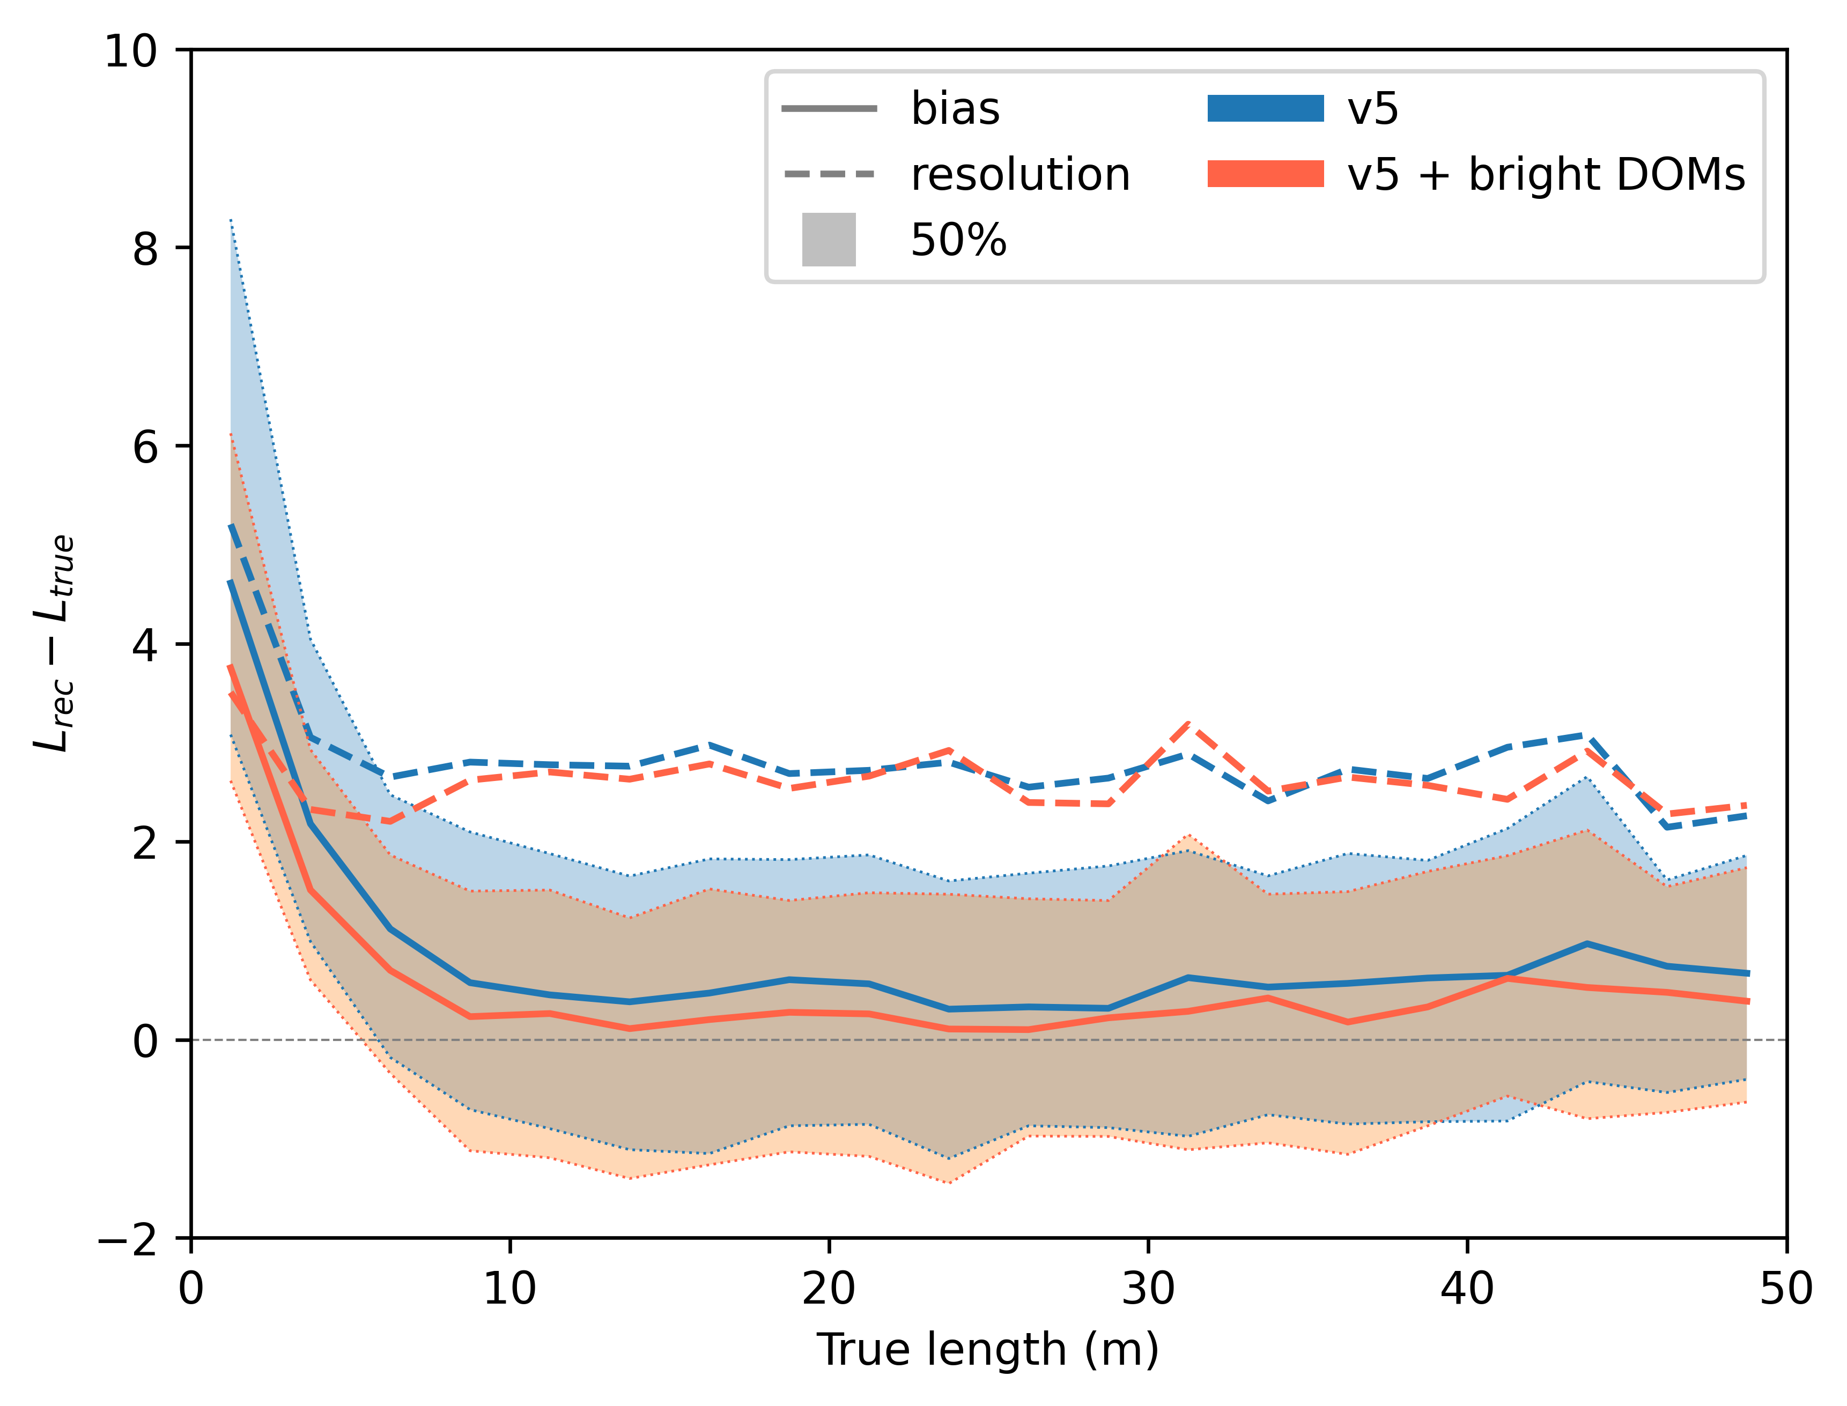
Double cascade reconstruction: Bright DOMS
Does not appear to worsen reconstruction for any parameter of interest
Apparent improvements in some areas
9/18
Tau Neutrinos in IceCube
Christopher Eldridge

Slide 11
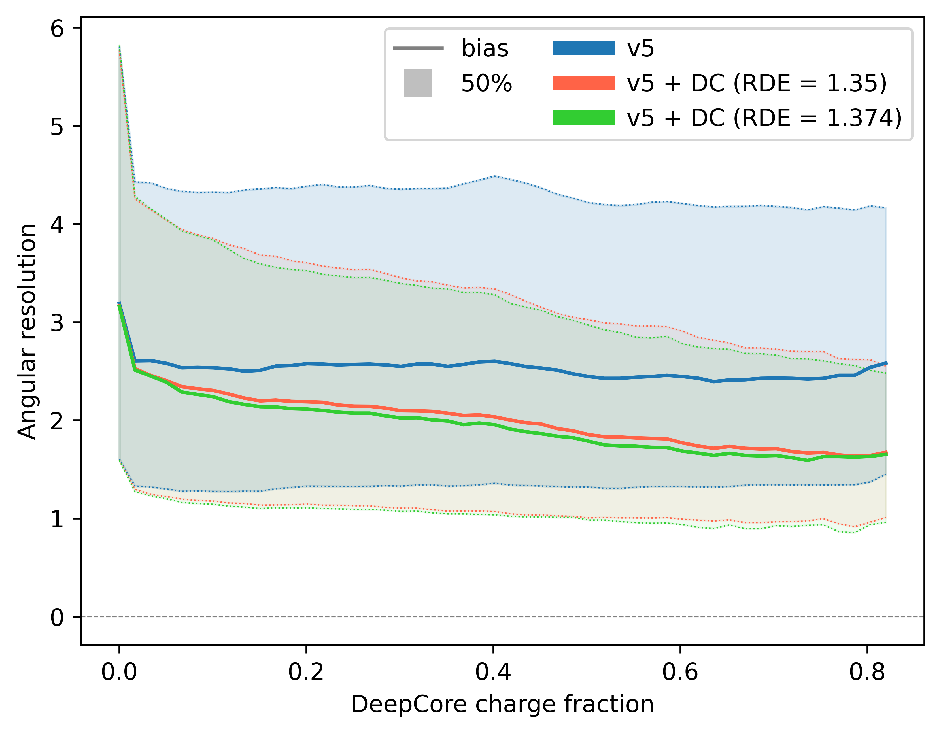
Double cascade reconstruction: DeepCore
No significant change in most observables for most events
For DeepCore-heavy events, almost all parameters tend to be better-reconstructed
10/18
Tau Neutrinos in IceCube
Christopher Eldridge

Slide 12
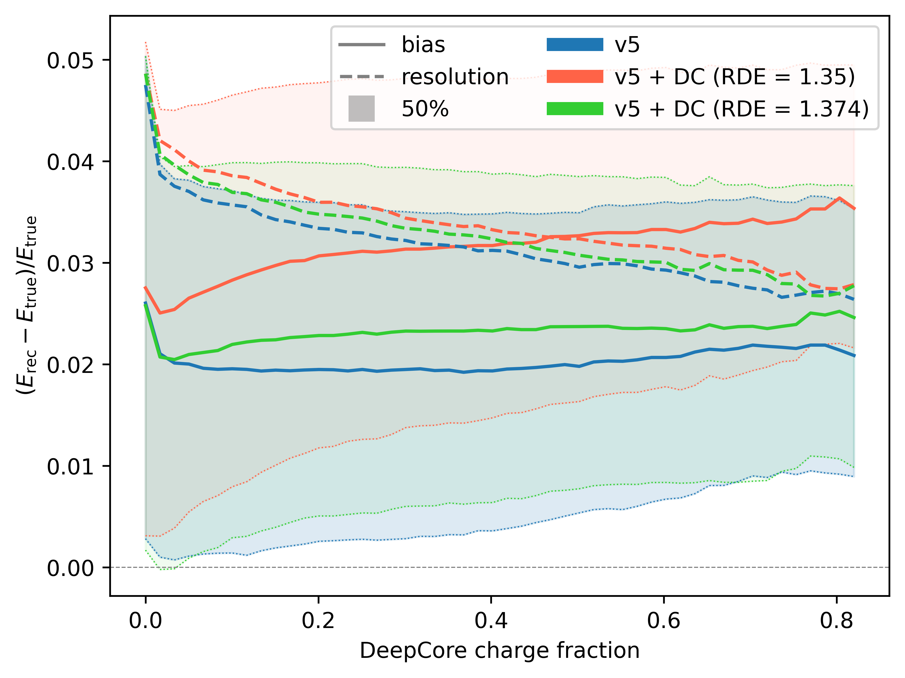
Double cascade reconstruction: DeepCore
Energy reconstruction is worse
This can be partially ameliorated by changing RDE
11/18
Tau Neutrinos in IceCube
Christopher Eldridge

Slide 13
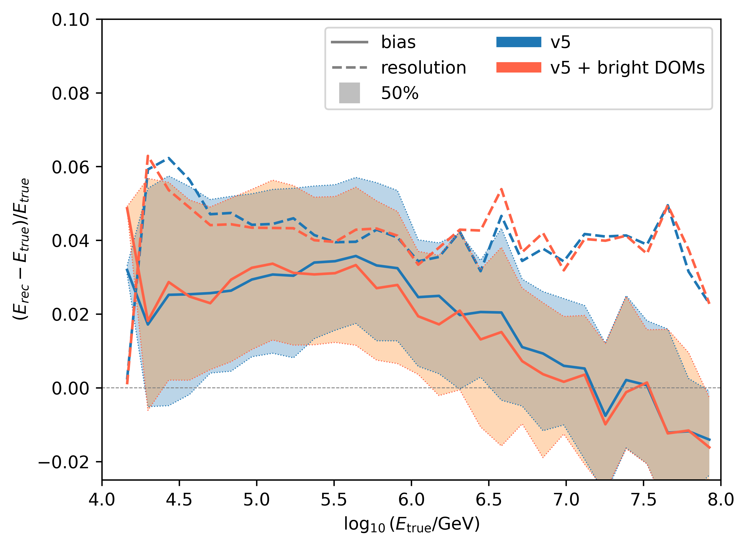
Single cascades: Monopod
No significant difference
12/18
Tau Neutrinos in IceCube
Christopher Eldridge

Slide 14
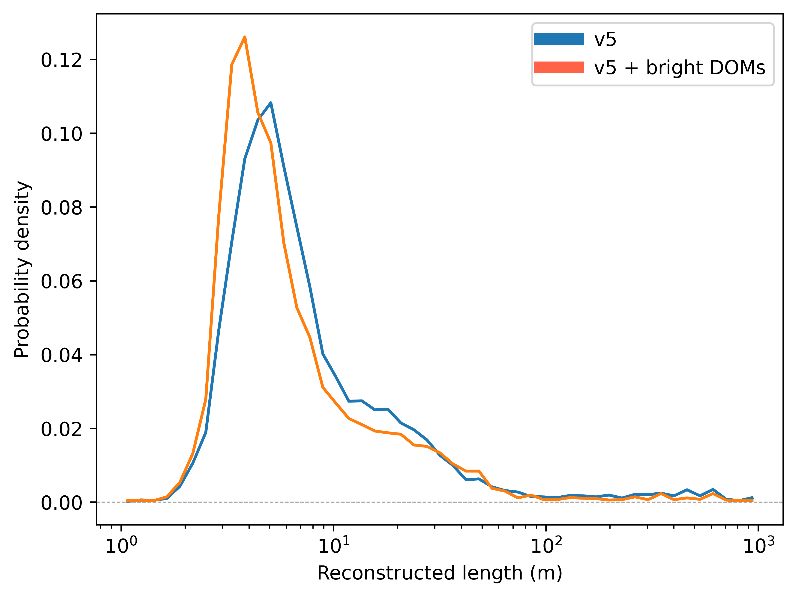
Single cascades: Taupede
Reconstructed lengths with bright DOMs tend to be lower (i.e. more accurate)
Otherwise, no major changes
13/18
Tau Neutrinos in IceCube
Christopher Eldridge

Slide 15
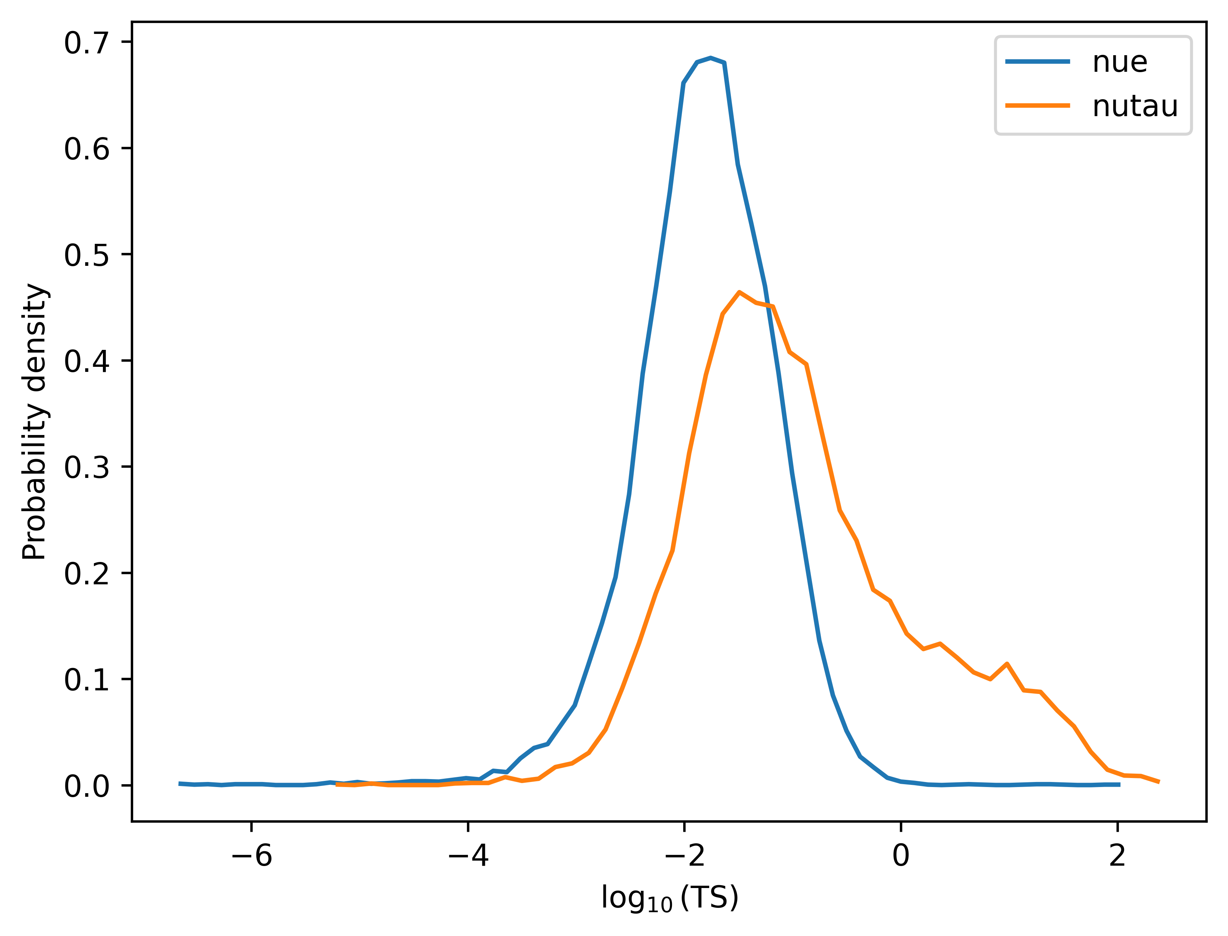
Test statistic
We also reconstruct events using Taupede with the length forced to zero
The difference in rlogl between the best fit and the zero-length quantifies how much a nonzero length is favoured
Very different distributions for cascades and double cascades
Hopefully, this will have convenient statistical properties (TBD)
14/18
Tau Neutrinos in IceCube
Christopher Eldridge

Slide 16
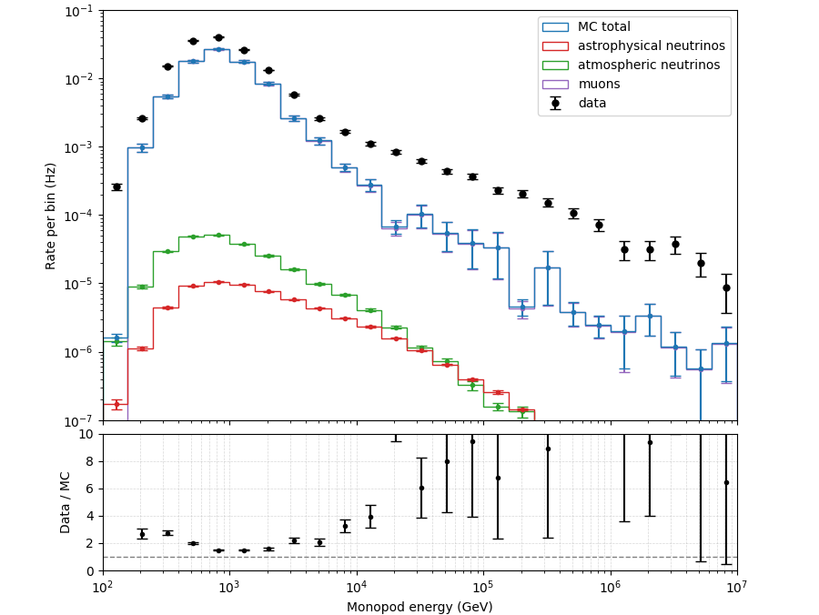
Data-MC agreement: Level 3 cascades
We need to see if everything works as expected on real data, not just simulations
“Burn sample”: 10% of IceCube data (~1 year)
First test: level 3 cascade reconstruction
Not good…… :(
15/18
Tau Neutrinos in IceCube
Christopher Eldridge

Slide 17
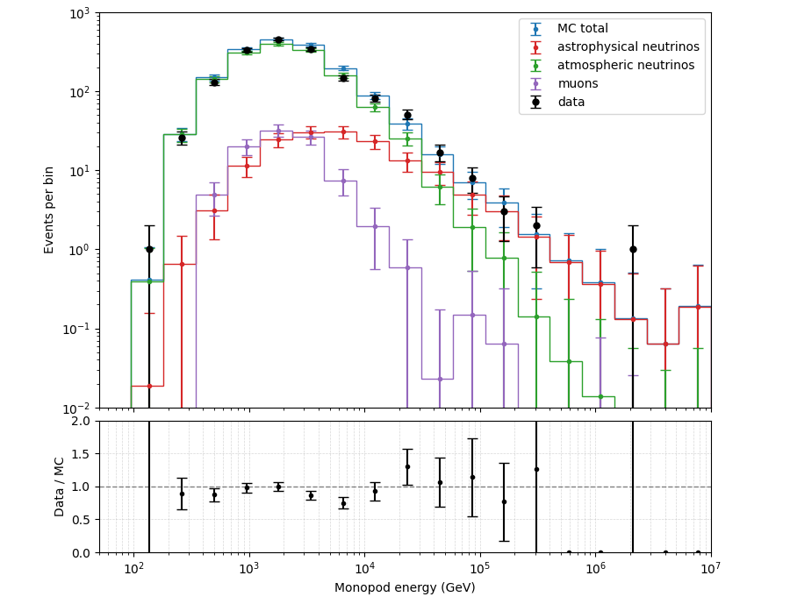
Data-MC agreement: Stony Brook cascades
Much more stringent cuts to ensure cascade purity
Consequently lower statistics
Much better agreement :)
Everything looks as expected
Data-MC mismatch in rlogl from both Monopod and Taupede - known issue
16/18
Tau Neutrinos in IceCube
Christopher Eldridge

Slide 18
Next steps
Further data-MC investigation
Test statistic
Flavour triangle
Different event selections
Longer-term plan: analysis!
17/18
Tau Neutrinos in IceCube
Christopher Eldridge

Slide 19
Summary
Knowing the astrophysical neutrino flavour composition is useful for understanding sources and oscillation processes
Tau neutrinos are essential for flavour composition and are also highly astrophysically pure
They can be identified by double-cascade morphology
Including bright DOMs appears to give some improvement in length reconstruction for both single and double cascades
Adding DeepCore DOMs improves reconstruction of some quantities for a few events at the cost of worsening energy
Testing on burn sample showed severe data-MC issues for level 3 cascades
Much better with Stony Brook burn sample
18/18
Tau Neutrinos in IceCube
Christopher Eldridge

