Slide 1
Past and current national HEP involvement
A. Pellegrino
Future colliders for early-career researchers (Belgium and the Netherlands)
Gent, 13-Sep-2024
The Netherlands in High-Energy Physics
Nikhef
major international collaborations
public support

Slide 2
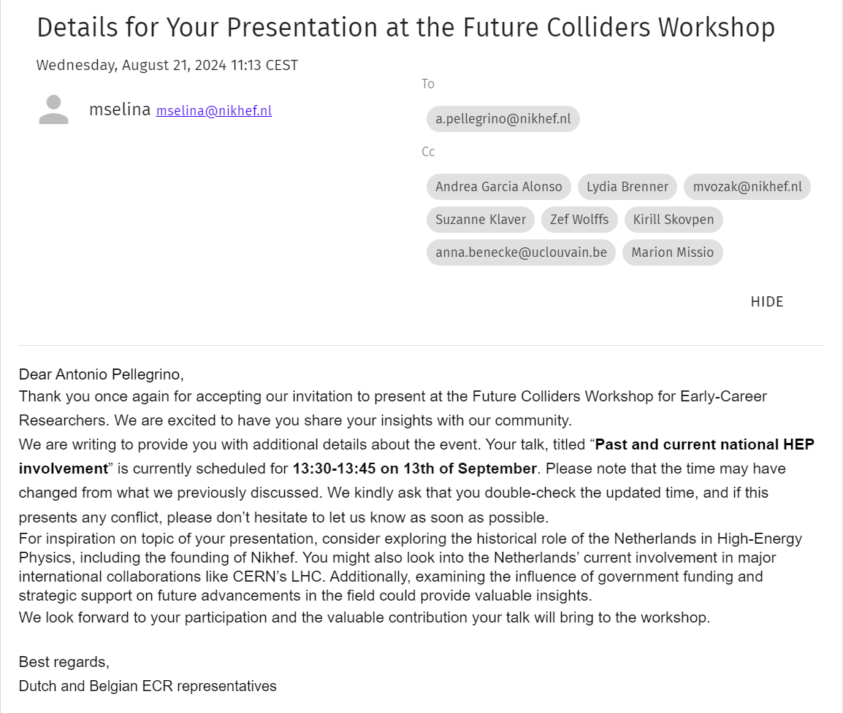
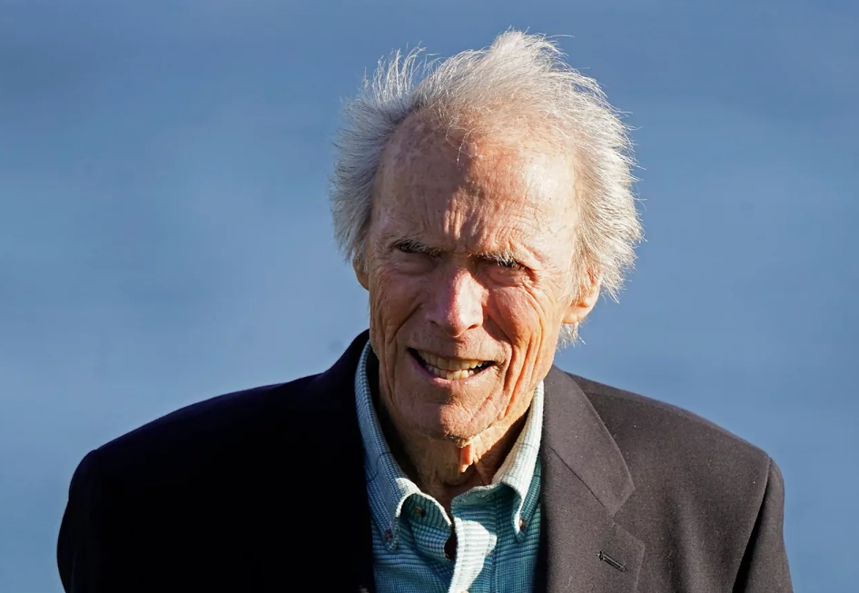
My assignment
…just how old do you think I am??

Slide 3
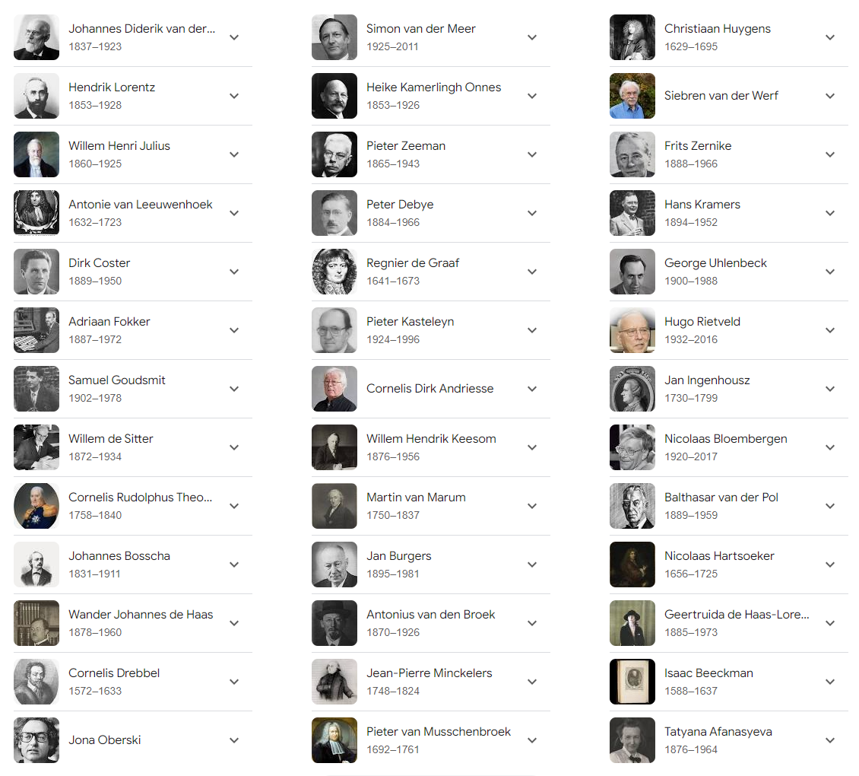

Quiz: how many do you know?
59% score?!
Spectacular failure to qualify as Expert of NL Physics history

Slide 4
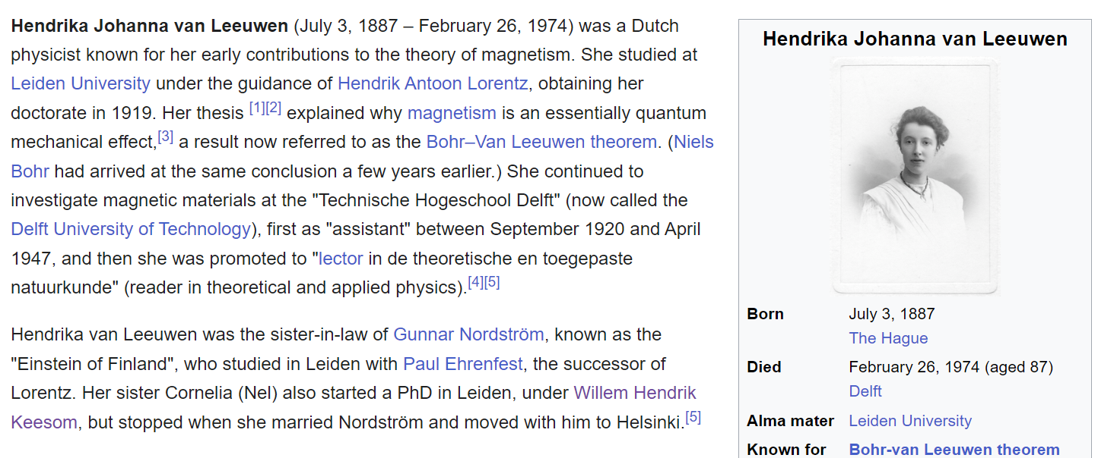
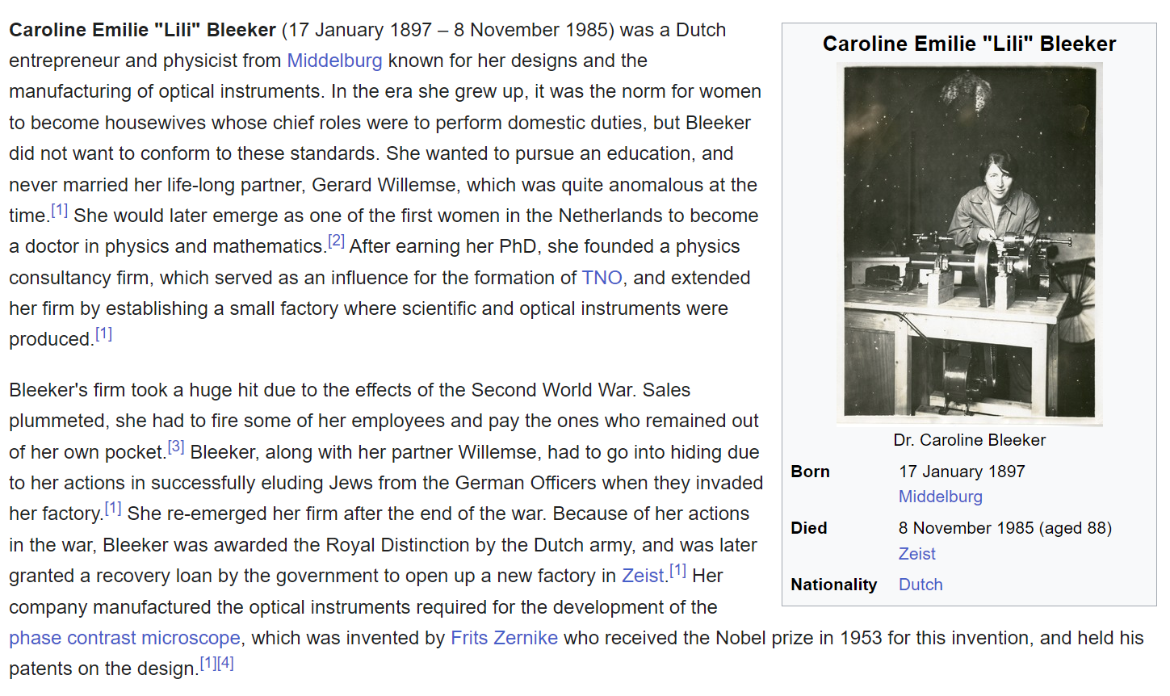
don’t take those lists too seriously…

Slide 5
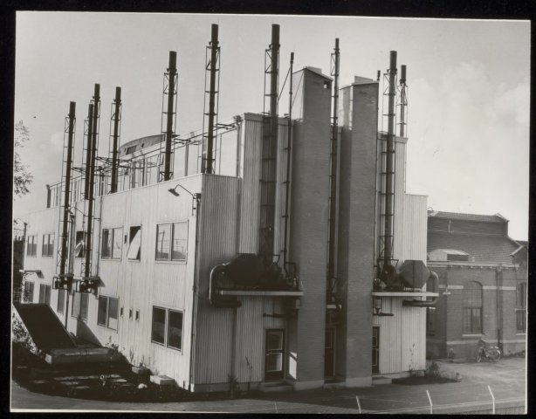
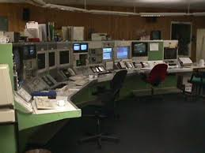
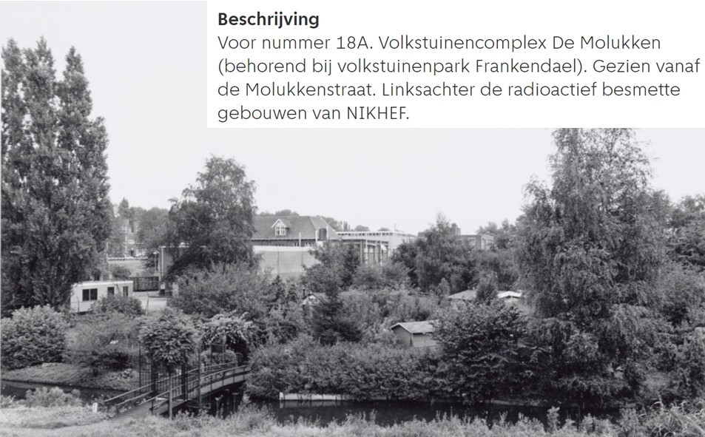
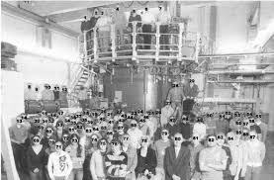

To put it in perspective
LEP starts
LEP ends
LHC starts
LHC ends
Nobel to F. Zernike
Nikhef joins ANTARES
My PhD @NIKHEF-K
Collider Deetector Fermilab (CDF) starts
Collider Deetector Fermilab (CDF) ends
First NIKHEF website
Instituut voor Kernfysisch Onderzoek (IKO)
cyclotron & LINAC: nuclear physics & radiochemistry
Kernfysisch Versneller Instituut (KVI) te. Groningen
Nationaal Instituut voor Kernfysica en Hoge-Energiefysica (NIKHEF)
CERN is founded
SSC canceled
Nikhef staff in LHCb
Nobel to G. 't Hooft, M.J.G. Veltman
accelerator and NIKHEF-K closes
Nobel to S. v.d. Meer
Nobel to F. Englert
LHC approved
HERA ends
HERA starts
me

Slide 6
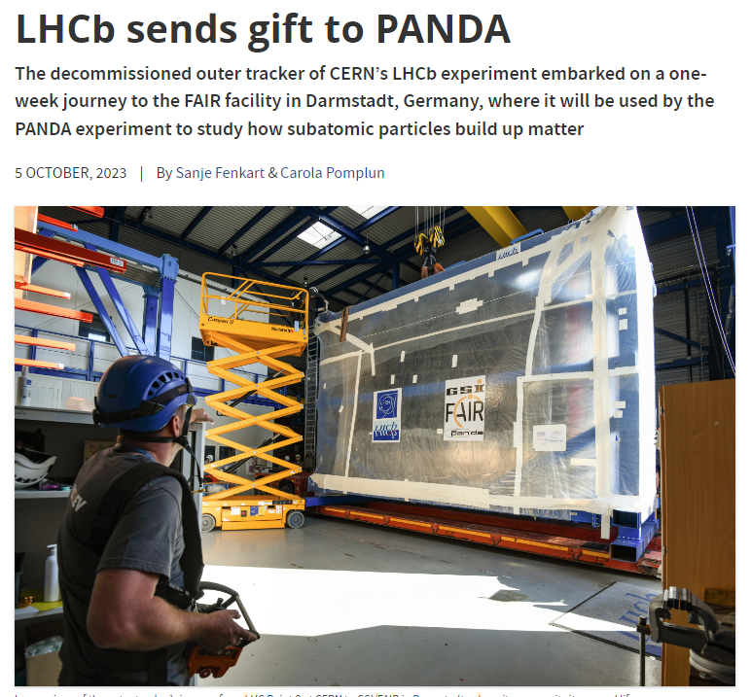

Lifecycles
Accelerators, some examples
  Large Electron–Positron Collider (LEP) @CERN: 1989 – 2000 (11 y)
  Large Hadron Collider (LHC) @CERN: 2010 – 2041 (31 y)
  Tevatron @Fermilab: 1983 – 2011 (28 y)
  HERA @DESY: 1992 – 2007 (25 y)
Detectors, some (random) examples
  LHCb Outer Tracker (straw tubes): 2001 – 2009 (inst.) – 2018 (removed)
  LHCb SciFi Tracker (scintillating fibers): : 2013 – 2022 (inst.) – 2033 (remove)
  LHCb VELO Upgrade II: 2026 – 2033 (inst.) – 2041 (remove)
Experiments lifecycles 20-30 years, with 2-3 detector “iterations”
In the career of a HEP physicist: 1-2 facilities, 3-4 detectors

Slide 7
Nikhef Research
LHC Research programs
  ALICE
  ATLAS
  LHCb
    High-Lumi LHC (→future)
    Future Colliders
eEDM
Cosmic Rays
  Auger
    GRAND, GCOS (→future)
Neutrino Physics
  KM3NeT
  ProtoDUNE
    DUNE (→future)
Dark Matter
  Xenon (1T,nT)
    Darwin/LXZD (→future)
    Synergies with DUNE (→future)
Gravitational Waves
  Virgo+
    ETPathfinder → ET (→future)
    LISA (→future)
Detector R&D
Physics Data Processing (PDP)
Theory

Slide 8
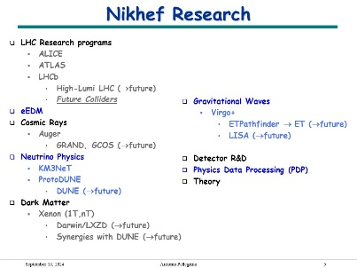

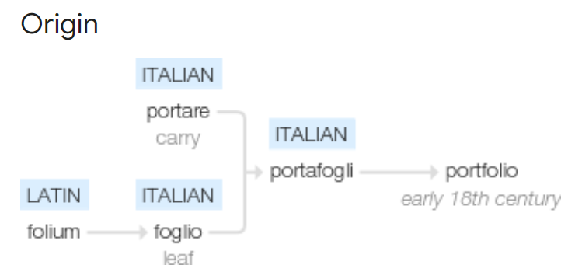
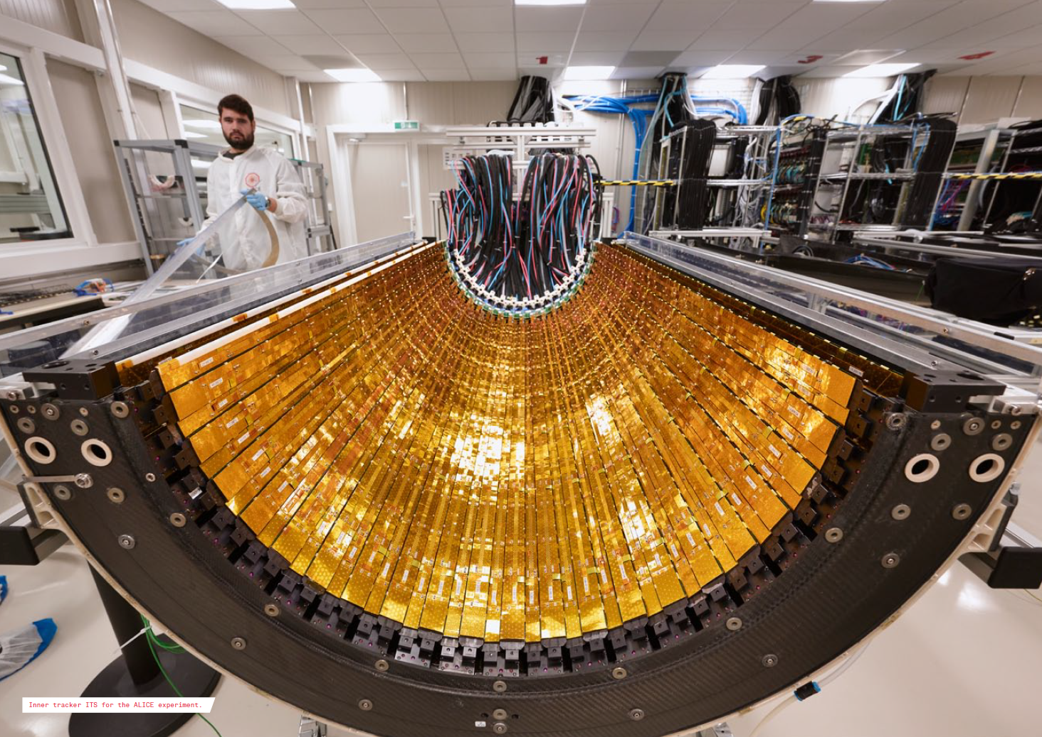

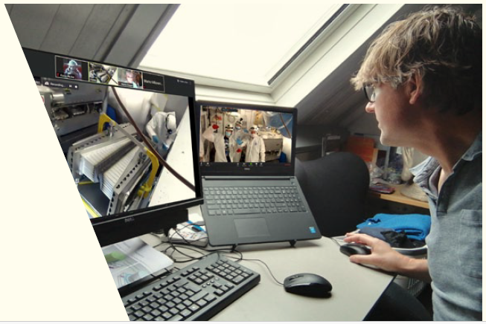
Typical path to experiment + project
Scientific interest
Scientific portfolio
(see slide 5)
portfolio
Technological portfolio

Slide 9
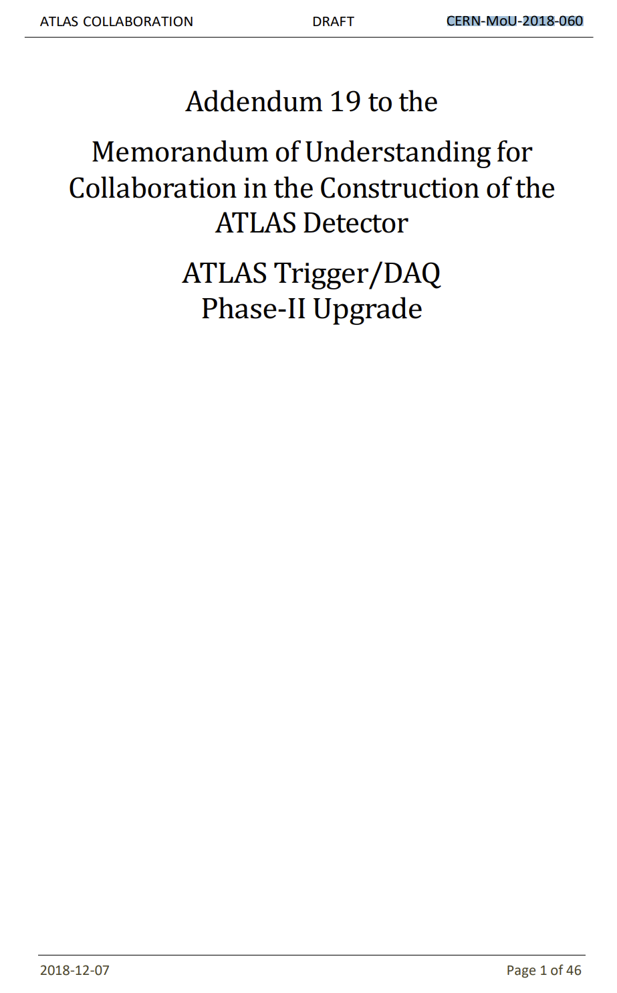



Sell/Buy
You receive
  Access to CERN and experiments
  Possibility to participate to science harvesting
  Authorship of papers/reports/etc.
You give
  Money
    “core” contribution to detector
    Maintenance & Operation (M&O cat. A)
    Maintenance & Repair (M&O cat. B)
  Work
    Technical expertise (“deliverables”)
    Manpower for service work (“ATLAS Operation Tasks”)

Slide 10
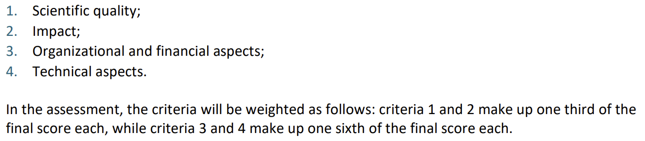
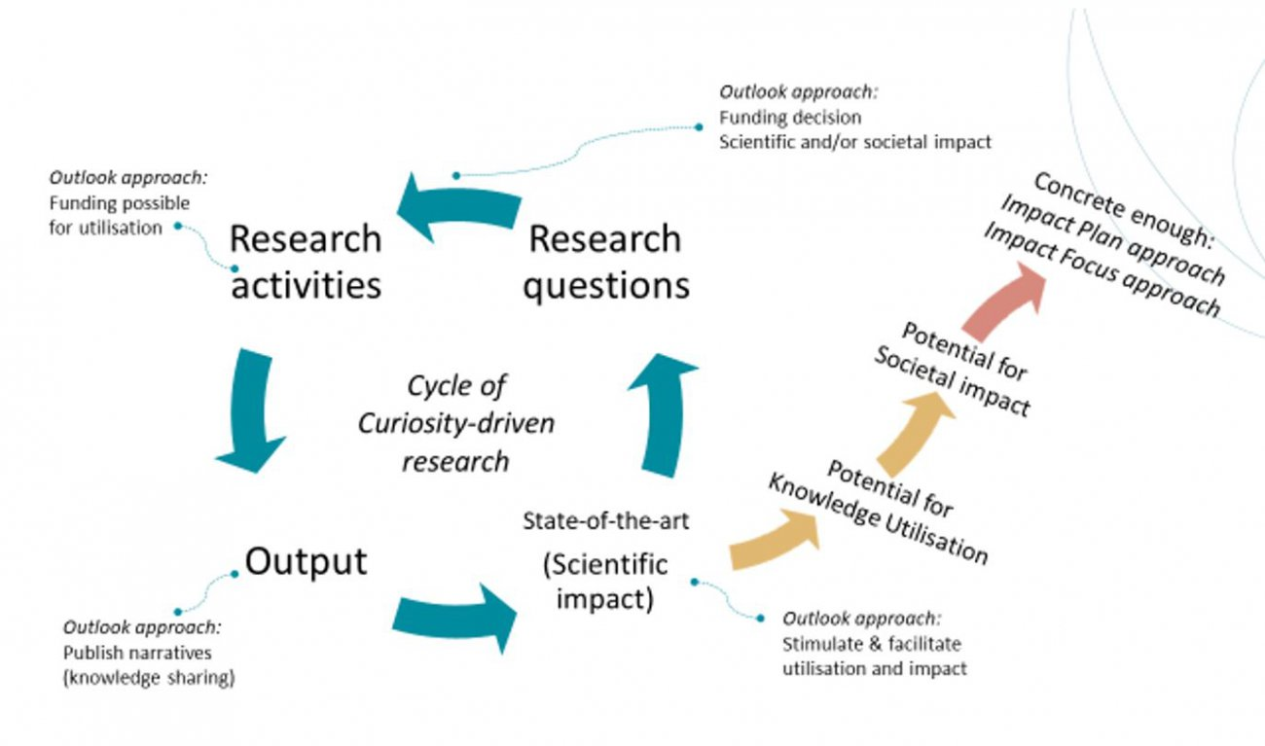
How a funding agency looks at this…
The approach explicitly offers room for fundamental scientific research. The approach is a strategy that focuses on discovering and monitoring (unforeseen) opportunities for knowledge utilization and societal impact during all phases of the research. These opportunities may have been foreseen at the start of the research but may also arise during the research.
"Impact Outlook Approach"
developed for funding instruments where the scientific question is the starting point

Slide 11






Is money an issue?
General public is fascinated by what we do
Stan Bentvelsen, yesterday in his last address as Nikhef director: “we only exist because of public support, we have the obligation to show what we do, to be transparent…”
funding agencies, all in all, sort-of, try to accommodate us in their “schemes”… hard to pretend more than that in a society like ours…
Do not be paranoid (they don’t like us)
Do not be cynical (they don’t care about science, they are after the money)
Do not be arrogant (these idiots should just give us the money and thank us)
Be honest, do not bullshit, be proud of what you do and explain it well, transmit your enthusiasm: money, job, career will come

