Slide 1
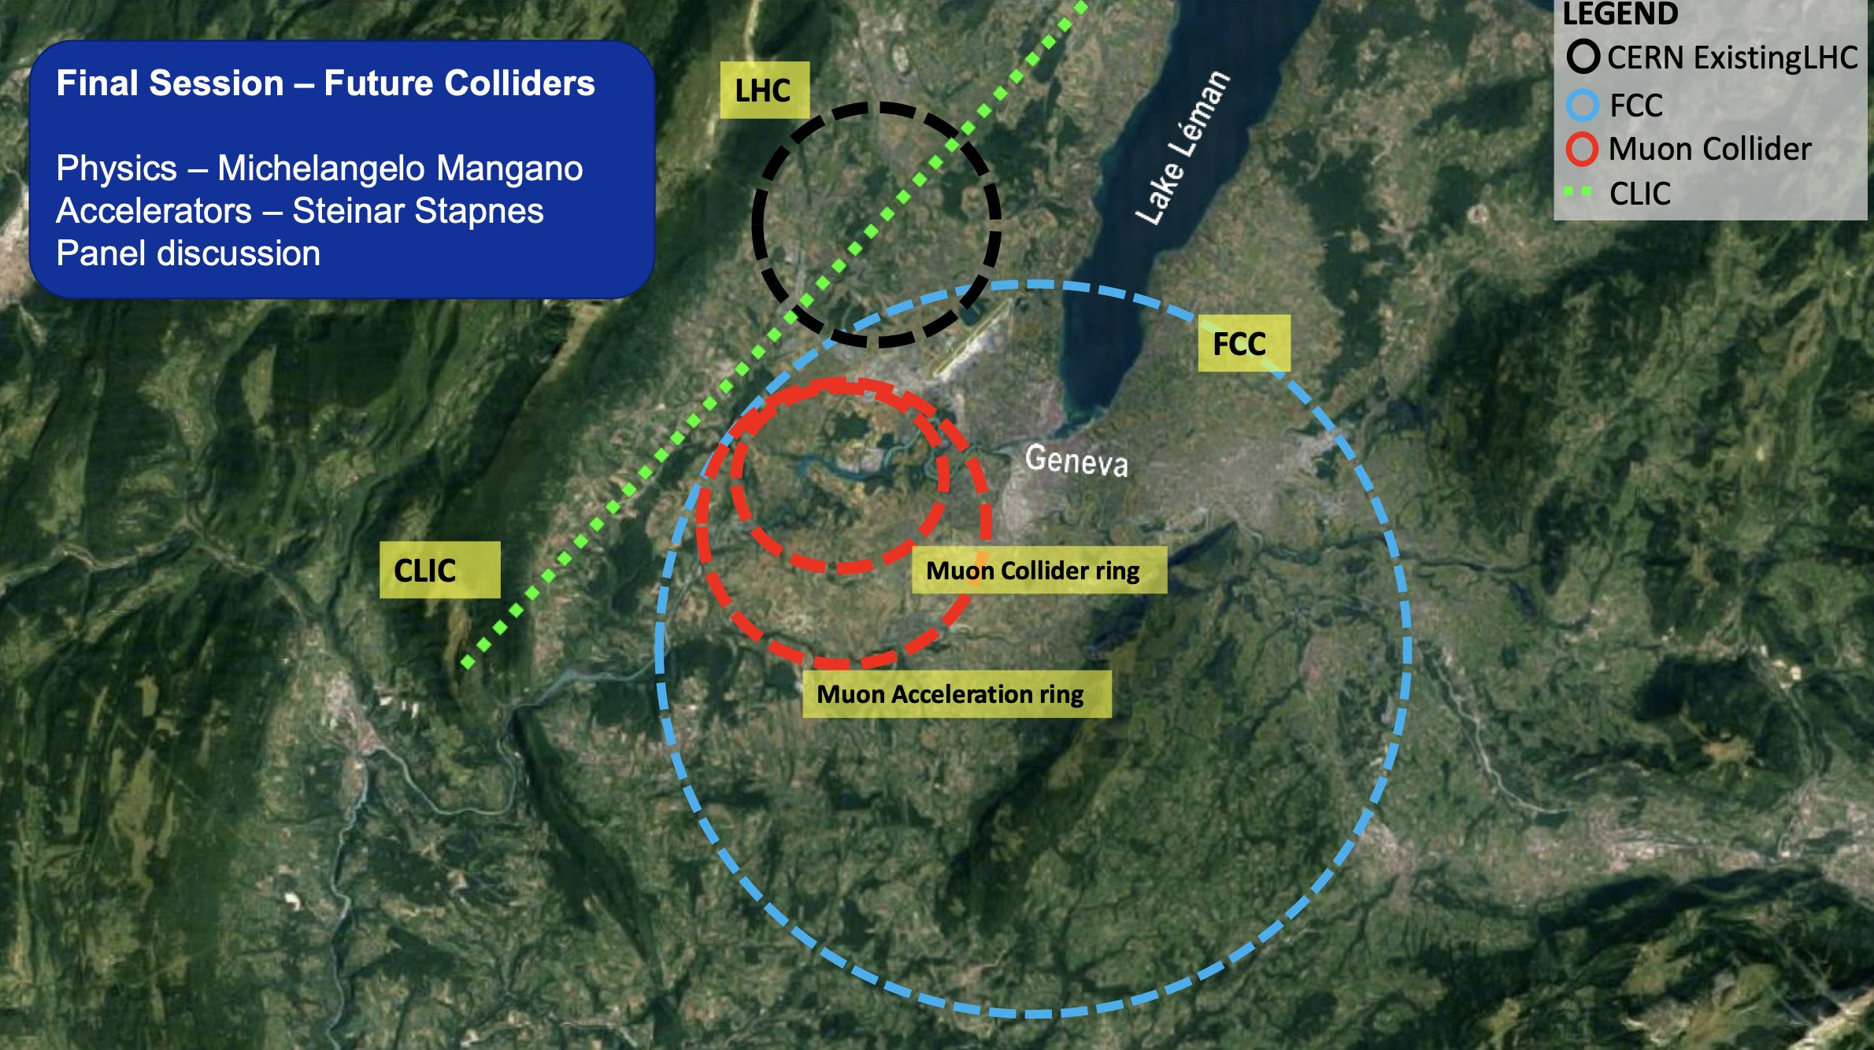
CERN’s future
HL-LHC
+ CLIC?
+ FCC?
+ MuCol?

Slide 2
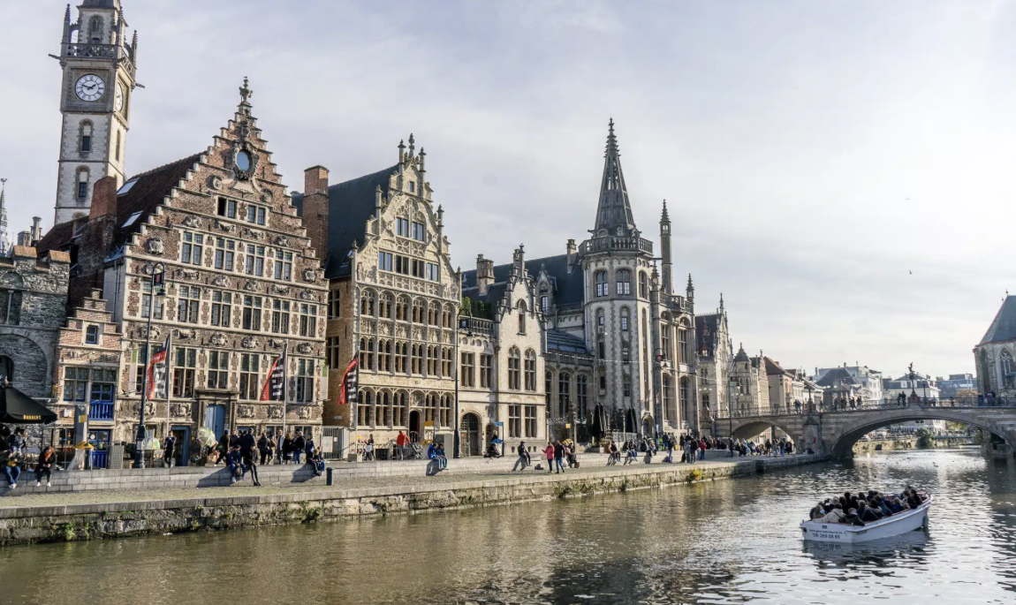
LINEAR OR CIRCULAR?
…preference for linear in Ghent?

Slide 3
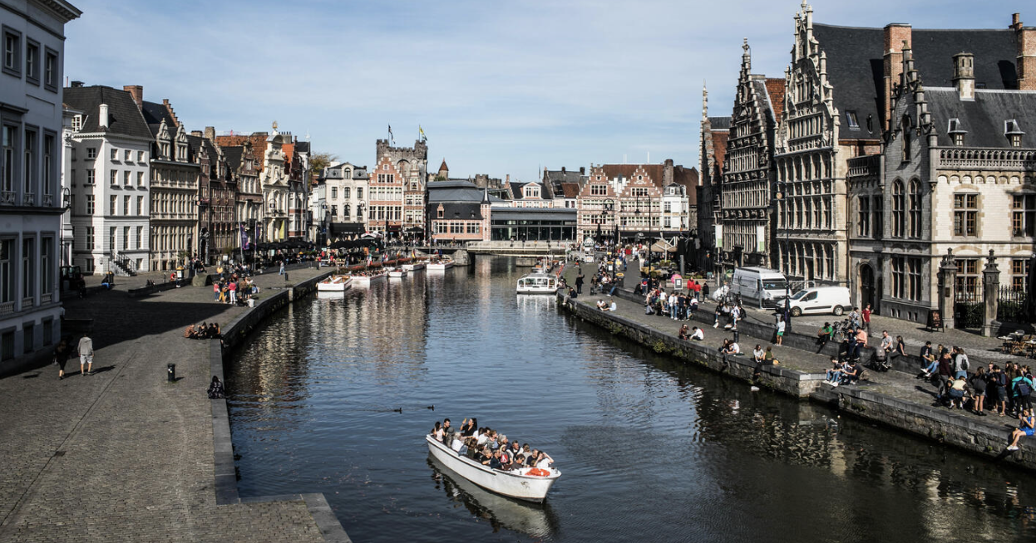
LINEAR OR CIRCULAR?
No conclusive answer in Ghent either…

Slide 4
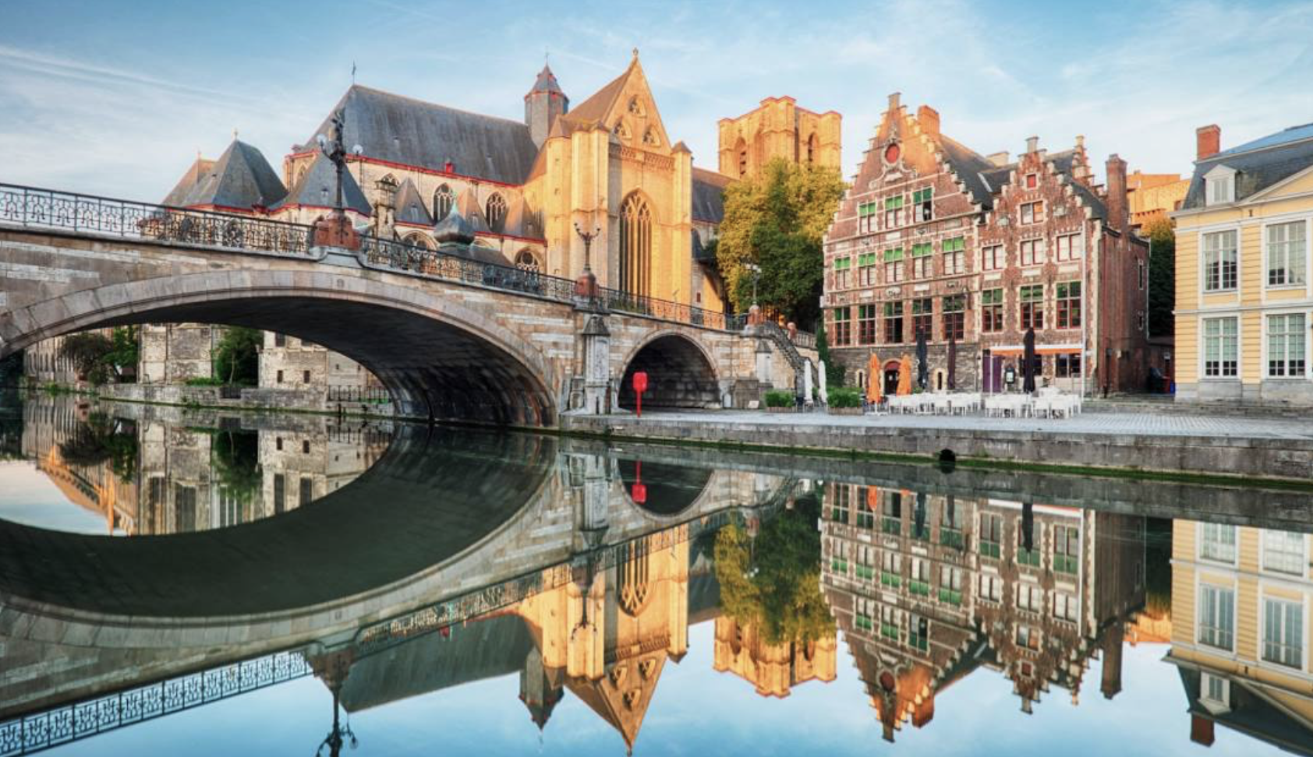
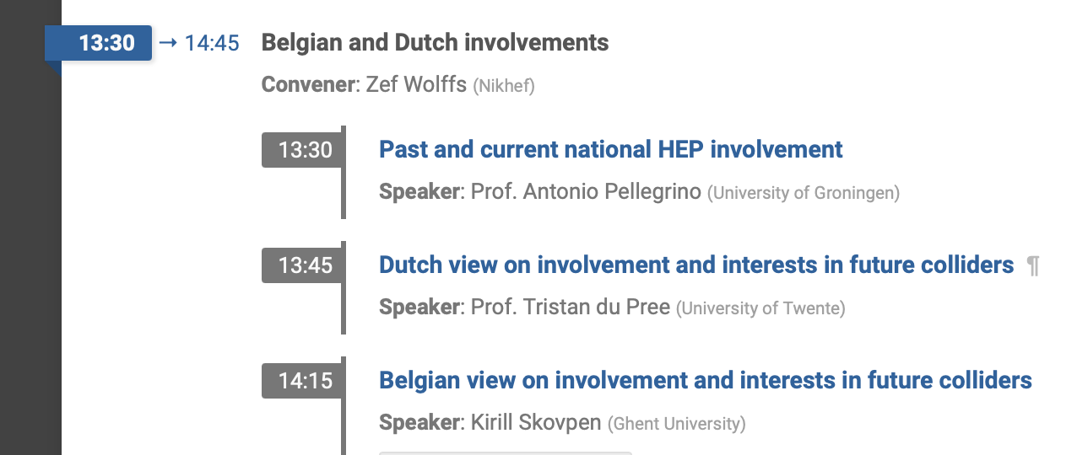
WHAT MY TALK WILL BE ABOUT

Slide 5
WHAT MY TALK WILL BE ABOUT
There is no “Dutch view” (yet) so I cannot speak on behalf of whole NL

Slide 6
WHAT MY TALK WILL BE ABOUT
What we are doing
What we should be doing
What you should be doing
What you could be doing

Slide 7
MY PROFESSIONAL LIGHTCONE
2050
Retirement
Start physics studies
2000

Slide 8
MY PROFESSIONAL LIGHTCONE
2050
Retirement
2017++ ATLAS
2010-17 PD CMS
2006-10 PhD LHCb
2000-05 MSc Theory
2000

Slide 9
MY PROFESSIONAL LIGHTCONE
2050
Retirement
New collider?
2022 C^3
2017++ ATLAS
2020 MuCol
2010-17 PD CMS
2017 FCC report
2013 ILC cand.site
2006-10 PhD LHCb
2008 Start of the LHC
2000-05 MSc Theory
2000

Slide 10
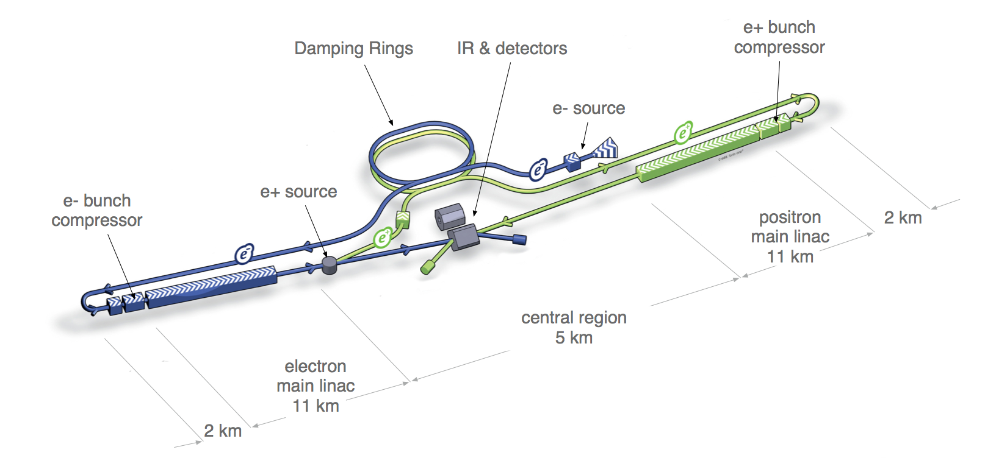
MY ACtIVITIES (SO FAR)
ILC
2013: ILC site visit

Slide 11
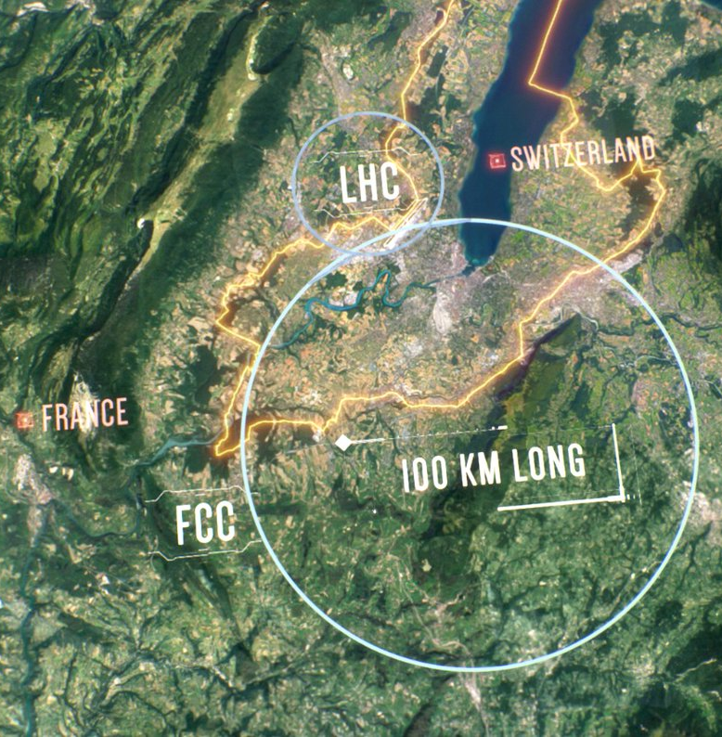
MY ACtIVITIES (SO FAR)
FCC
2017: Yellow report co-author
2021-23: FCC national contact
ILC
2013: ILC site visit

Slide 12
MY ACtIVITIES (SO FAR)
FCC
2017: Yellow report co-author
2021-23: FCC national contact
ILC
2013: ILC site visit
C³
2022+: Accelerator alignment R&D 2024: European workshop organizer

Slide 13
MY ACtIVITIES (SO FAR)
FCC
2017: Yellow report co-author
2021-23: FCC national contact
ILC
2013: ILC site visit
Muon Collider
2020+: Enthusiastic co-author
2024: NWO grant submission 🤞
C³
2022+: Accelerator alignment R&D 2024: European workshop organizer

Slide 14
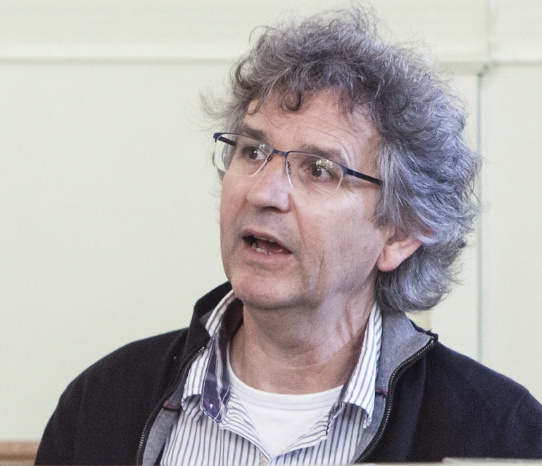
ILC
Netherlands involvement
Detector R&D for e⁺e⁻
Goal: ultra precise!

Slide 15
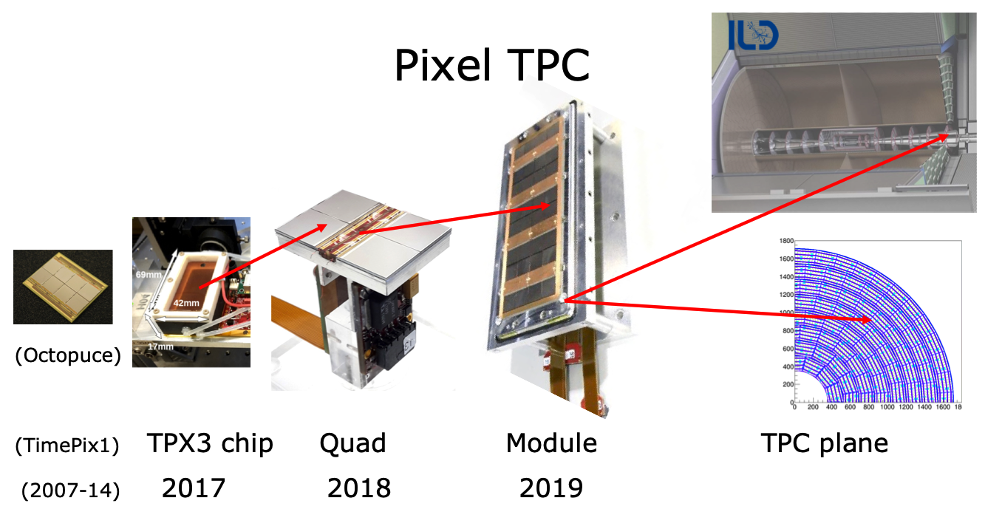
ILC
ILD: Detector R&D for e⁺e⁻
Very low material budget

Slide 16
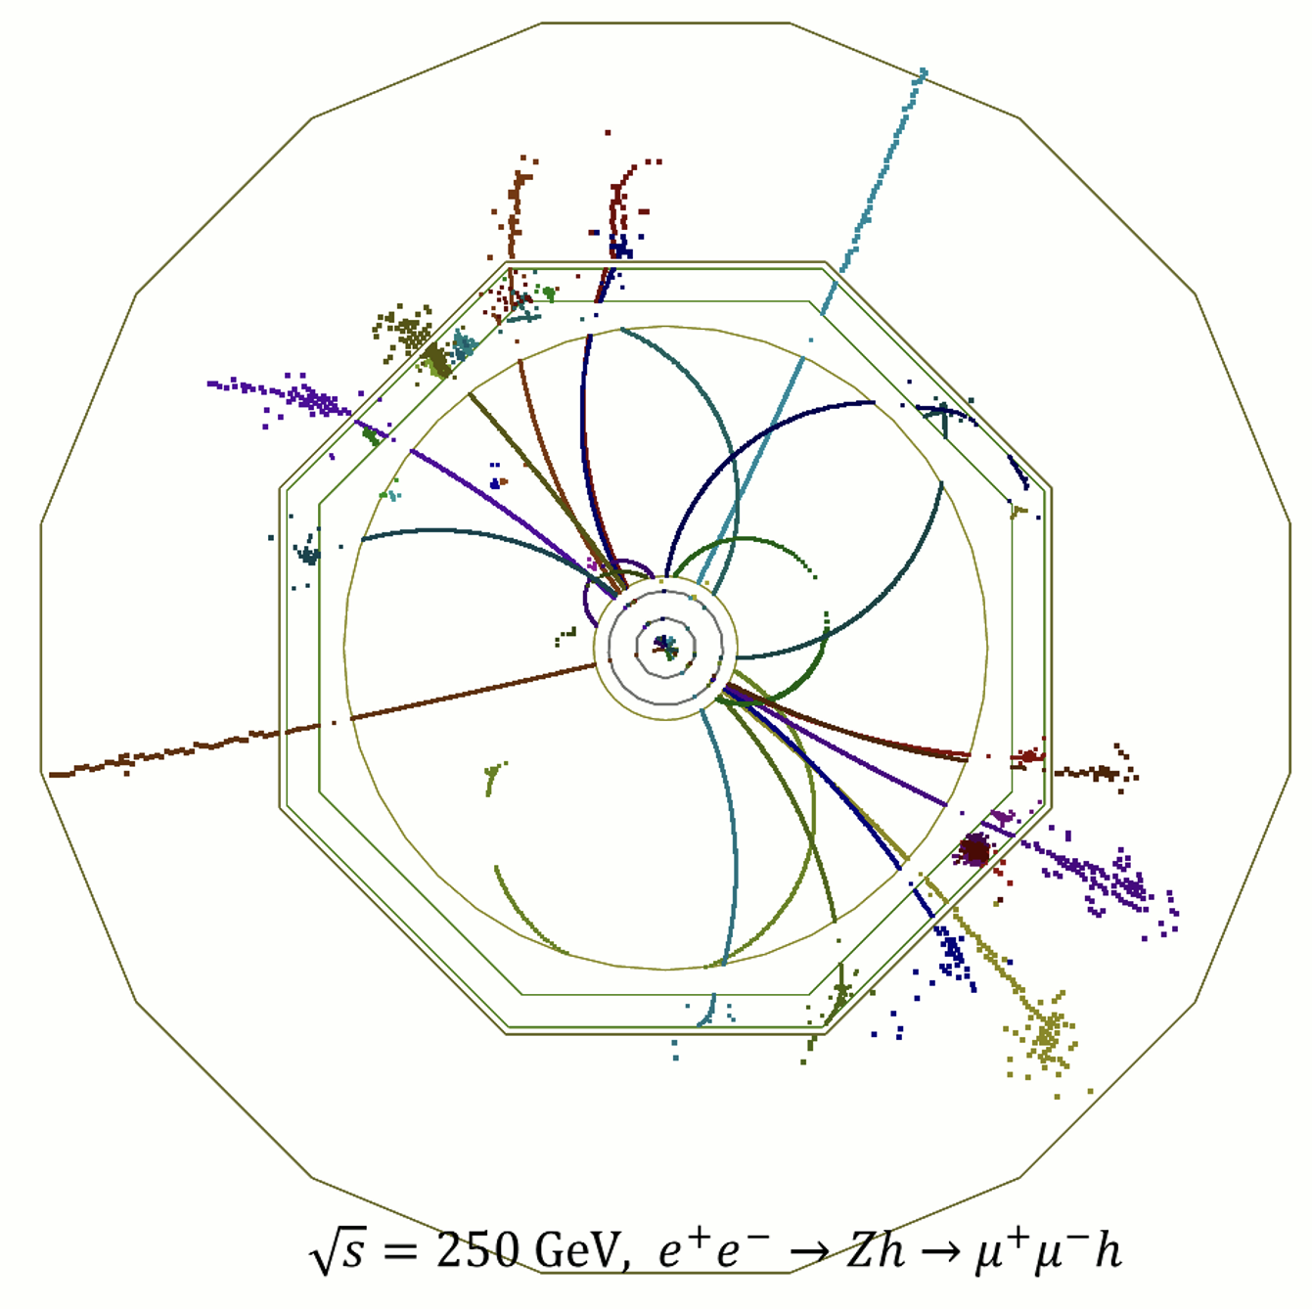
ILC PHYSICS
Precision at e⁺e⁻
Order of magnitude in Higgs physics

Slide 17
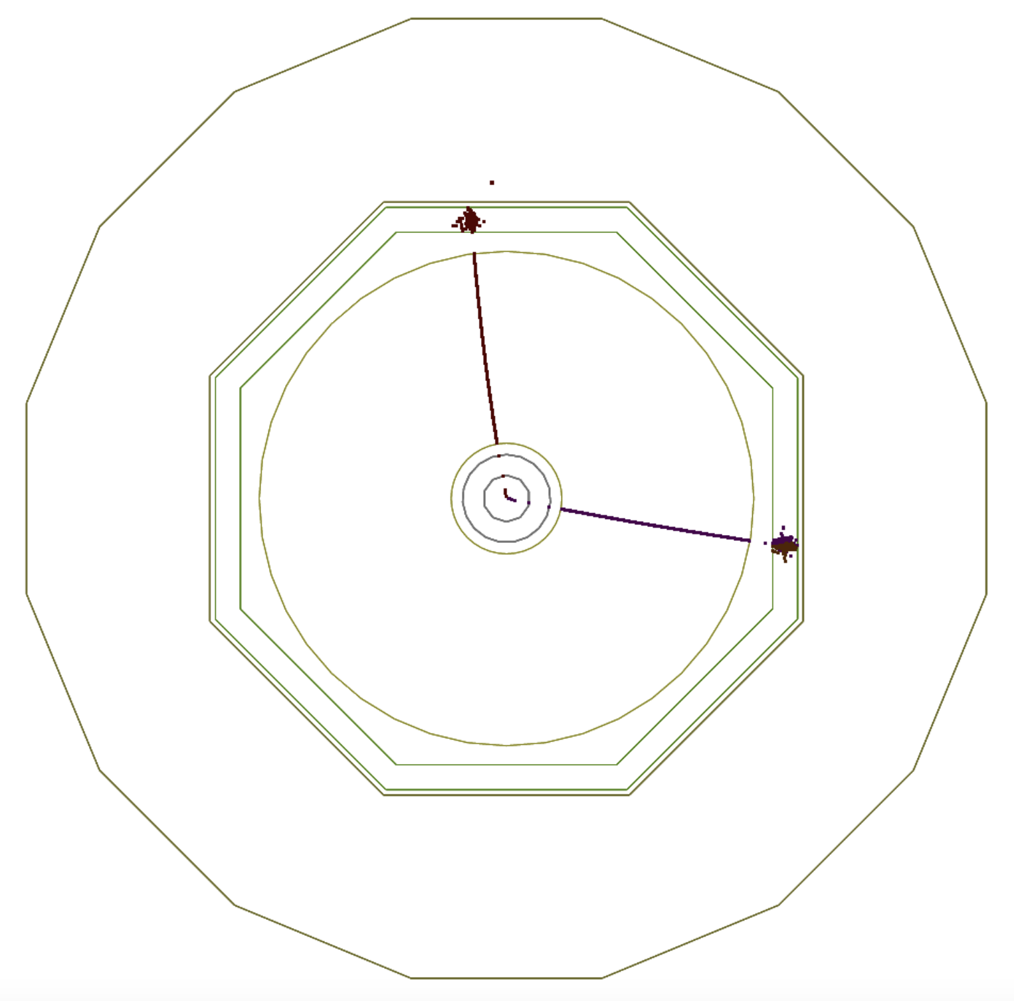
ILC PHYSICS
Precision phyics, but…
“Elk voordeel heb z’n nadeel”
J.Cruijff

Slide 18
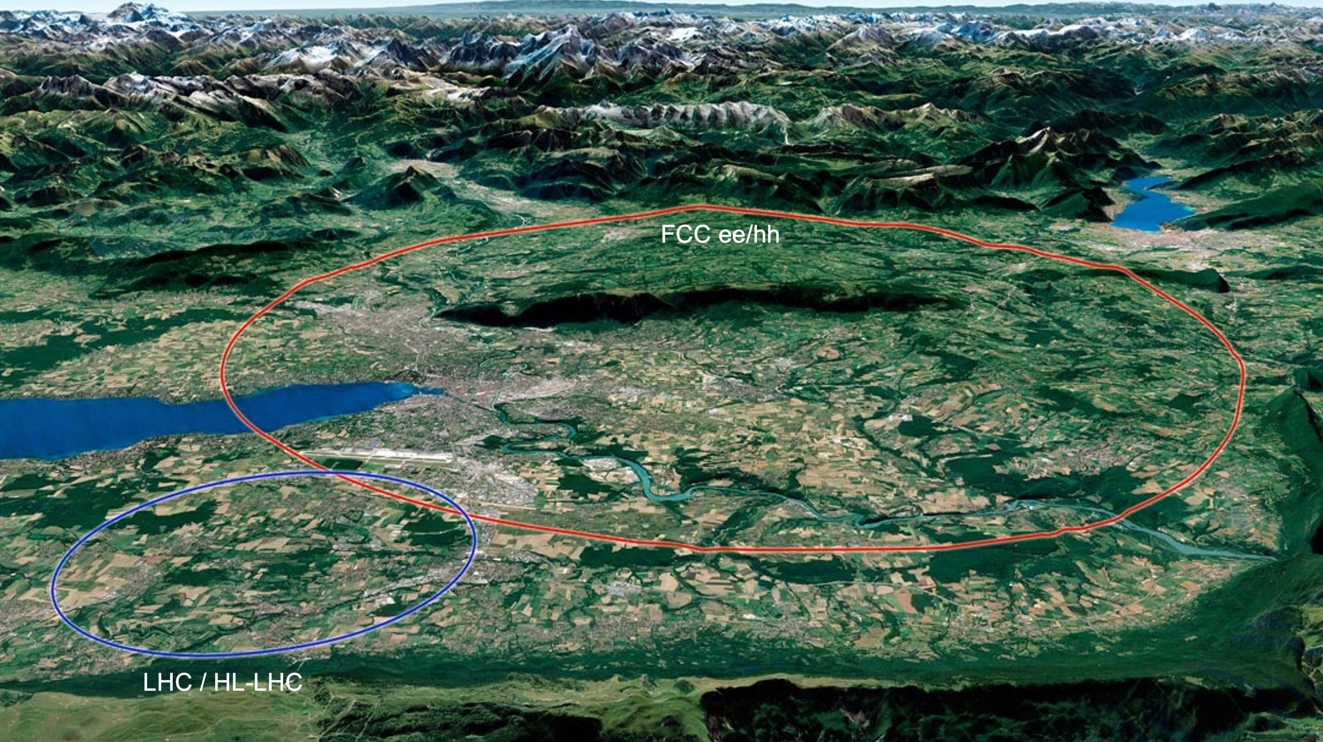
FCC

Slide 19
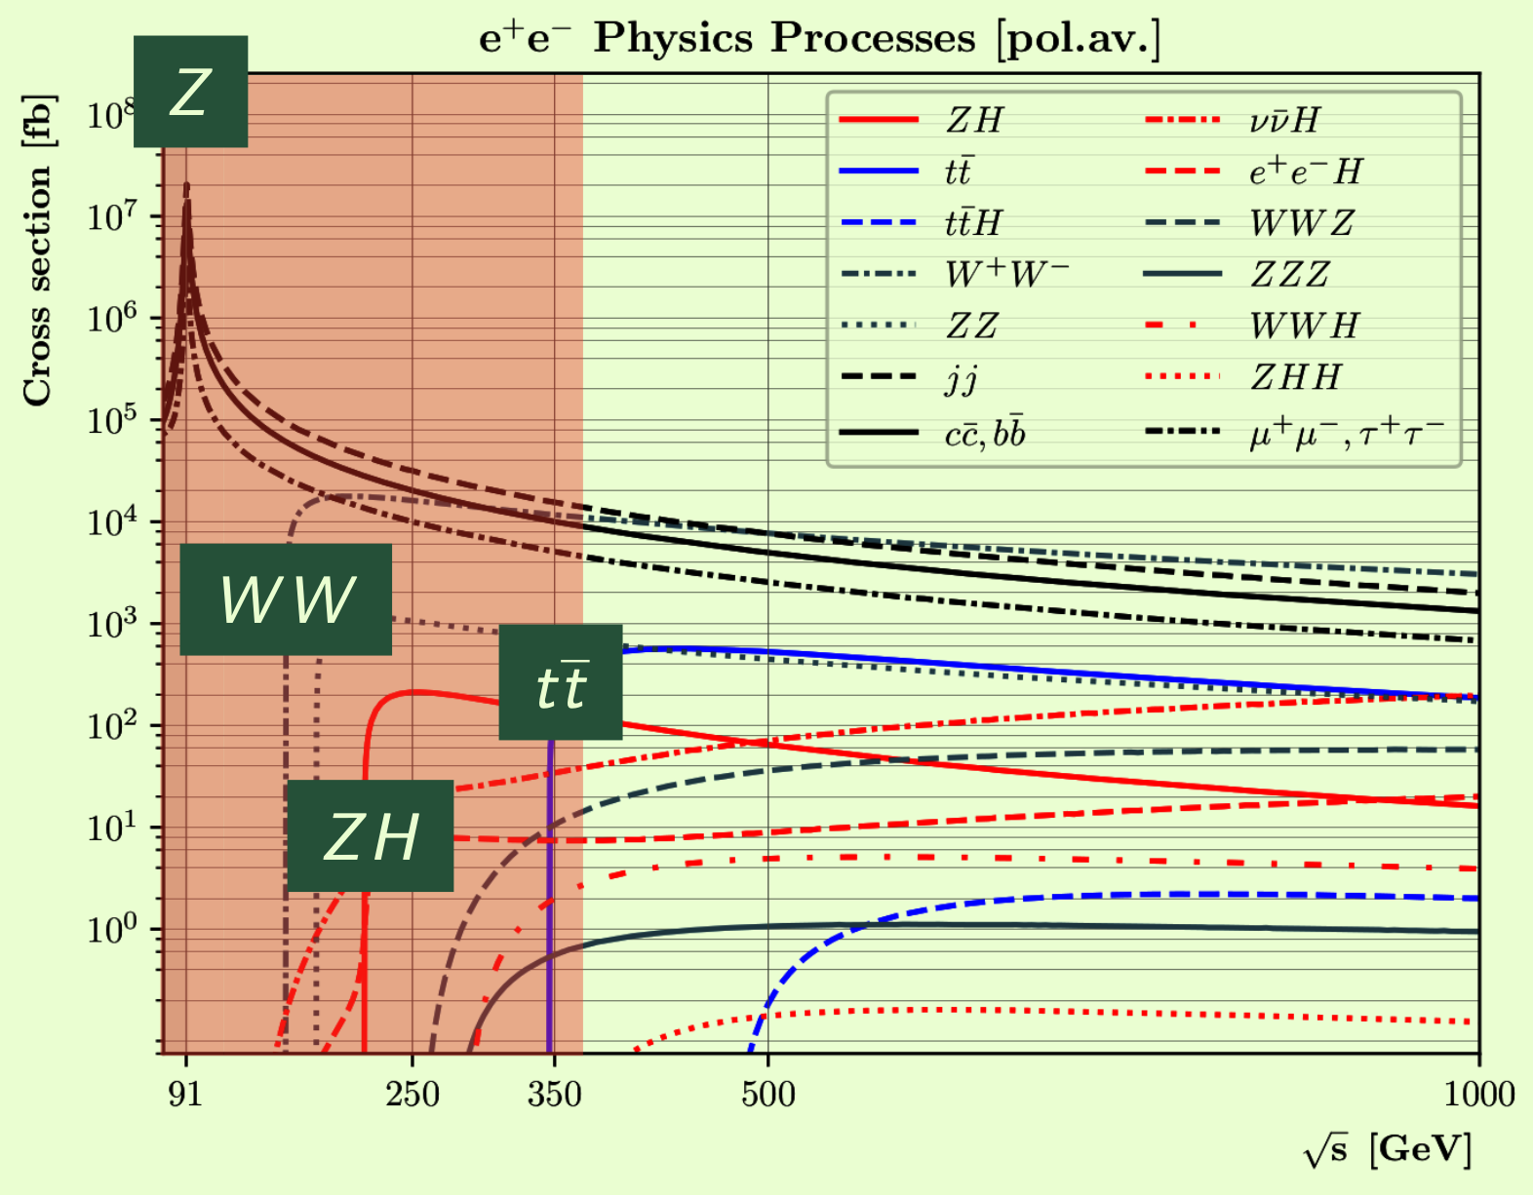
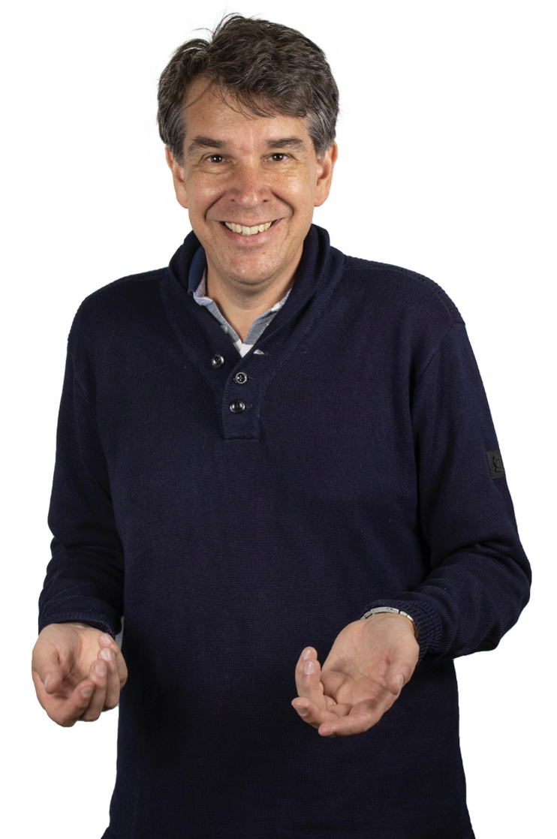
E+E- colliderS
ECFA studies: e+e-
Z, WW, ZH, tt
‘Focus topics’
NL contact: Patrick Koppenburg
BE contact: Fabio Maltoni

Slide 20
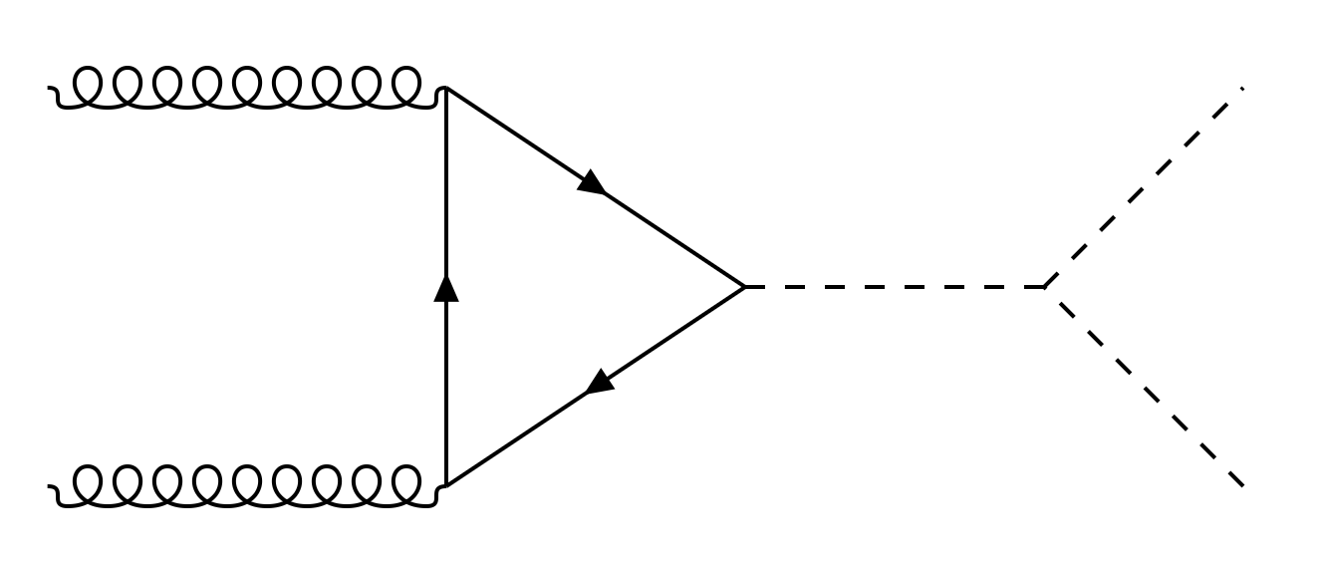
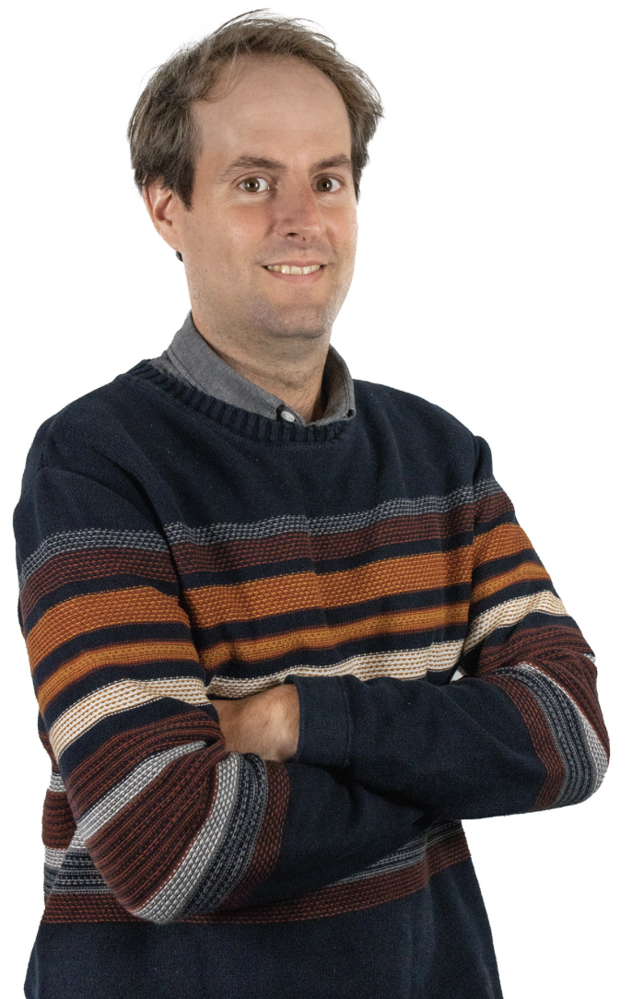
FCC-ee
Global SMEFT analysis
Higgs, top, electroweak
With LEP, LHC and FCC-ee
H
H
H

Slide 21
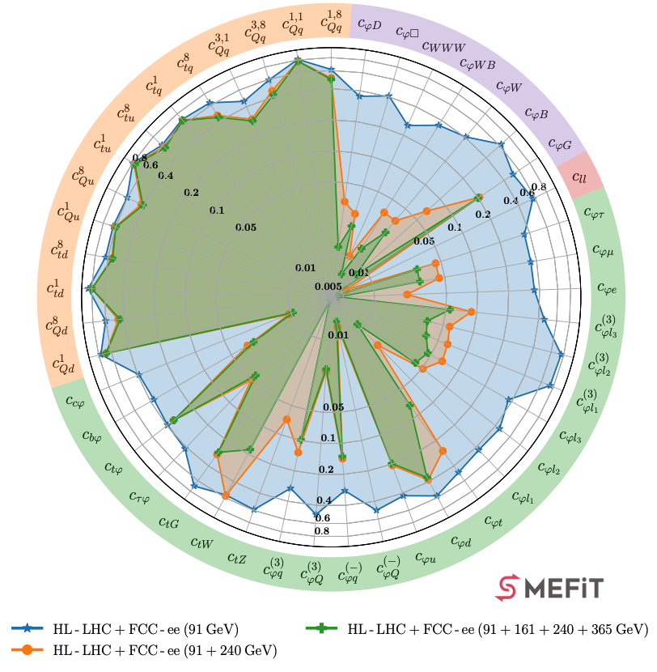
FCC-ee
Global SMEFT analysis
Higgs, top, electroweak
With LEP, LHC and FCC-ee
J.Rojo et al, arXiv:2404.12809

Slide 22
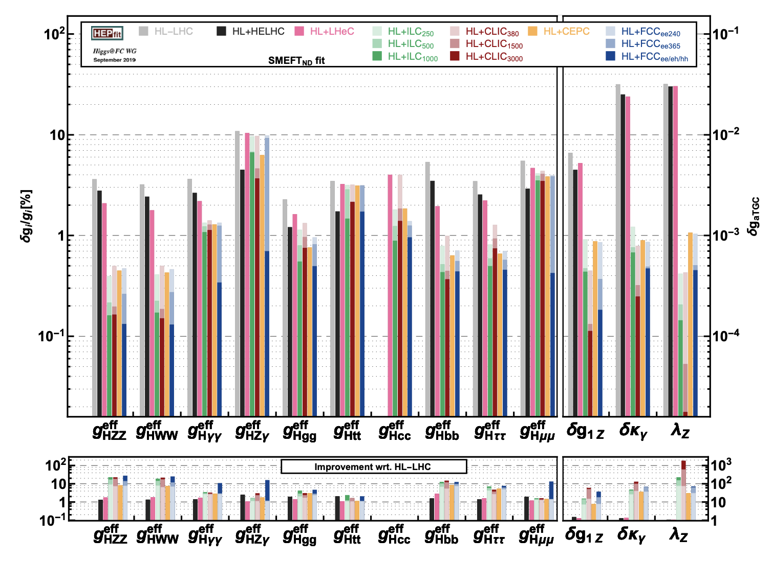
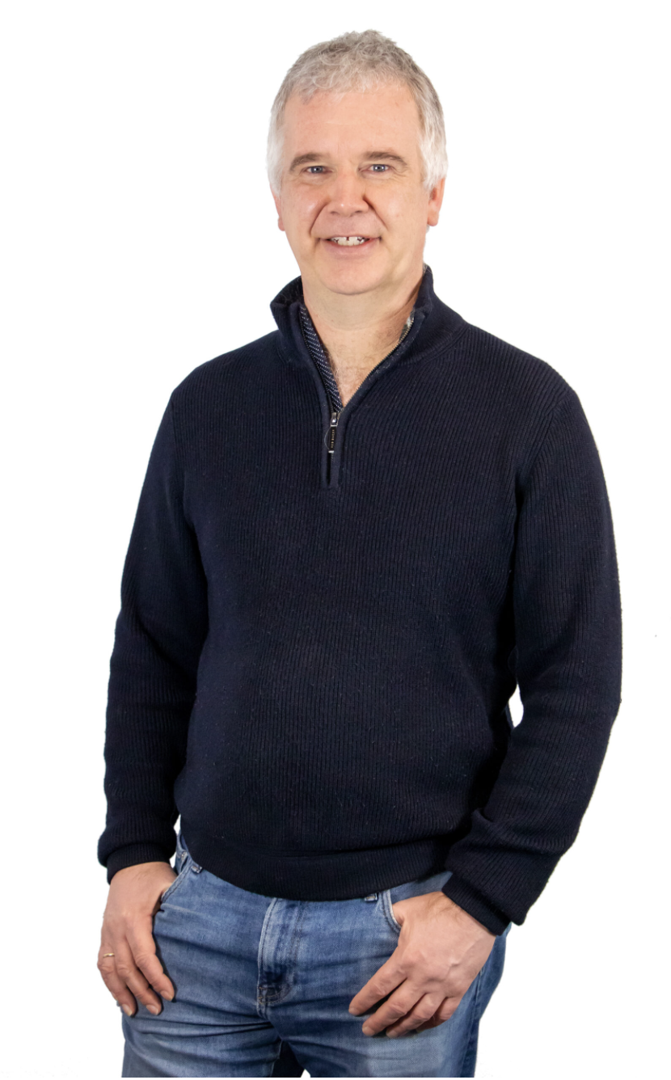
combinATIONS & COMPARISONS
Higgs factories sensitivities
Factor ~10 wrt HL-LHC
Overall similar performance!
Particulary Γ, K_{W,Z}, K_{b,c}
W.Verkerke, J.D’Hondt, F.Maltoni et al, arXiv:1905.03764

Slide 23
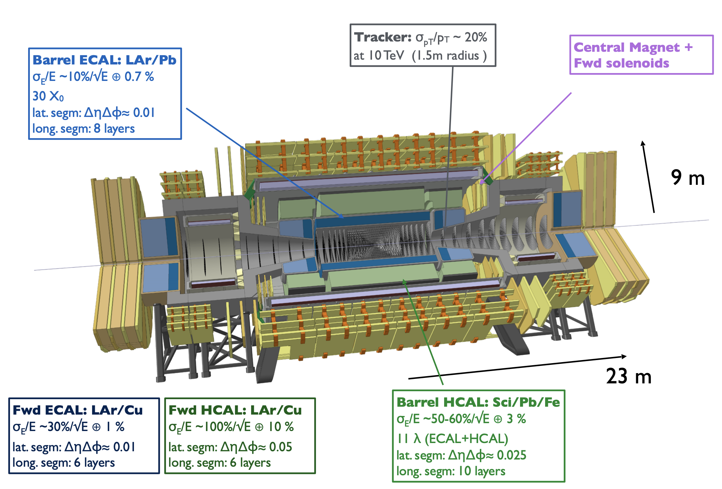
FCC-hh
M.Selvaggi et al

Slide 24
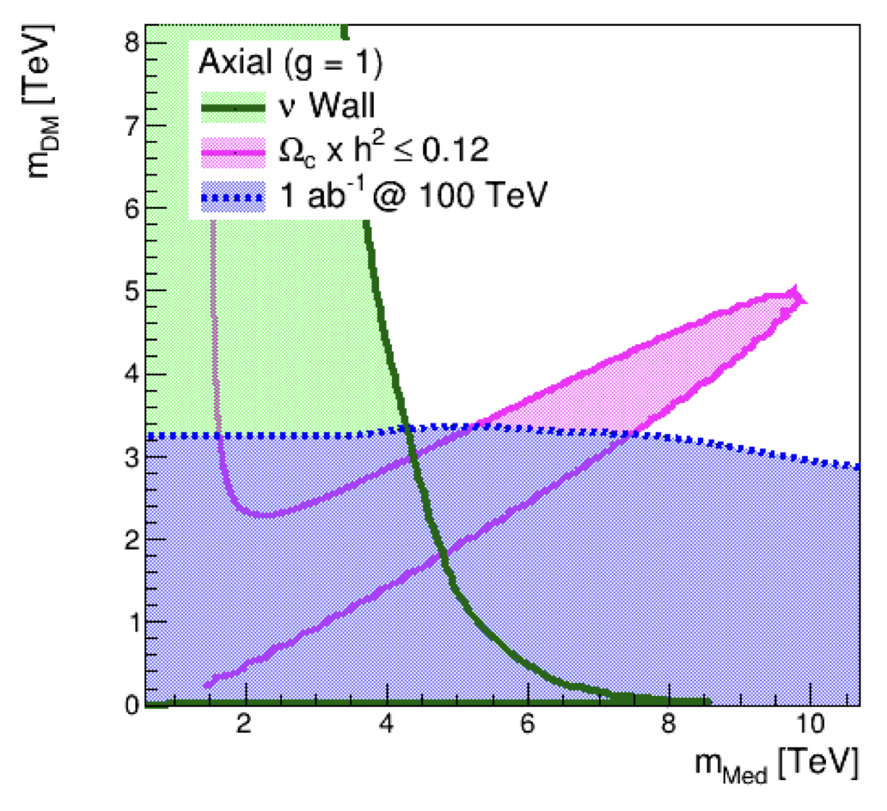
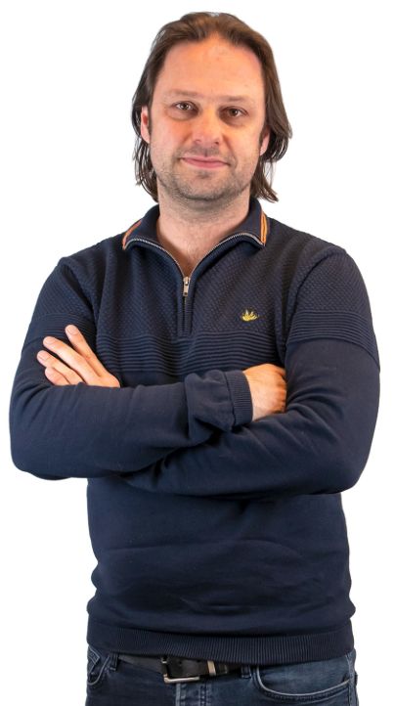
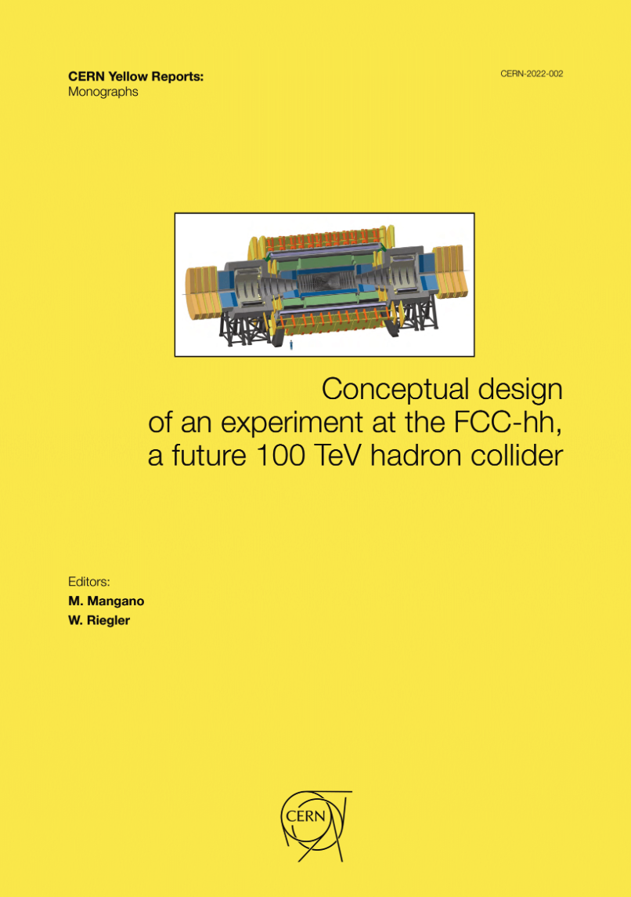
FCC-HH
FCC-hh: direct searches
Scales LHC limits
BSM: factor 100/14~7
FCC yellow report, 2017
Dark Matter from LHC to FCC-hh
T.du Pree et al, arXiv: 1603.08525

Slide 25
FCC-hh
F.Zimmermann, 3 Sep 2024
Ongoing studies for FCC-hh
Accelerator magnets
University Twente
Scenario studies
Mini-workshop 3 Sep 2024
➔ Study scenarios for different magnets
M.L.Mangano, 3 Sep 2024

Slide 26
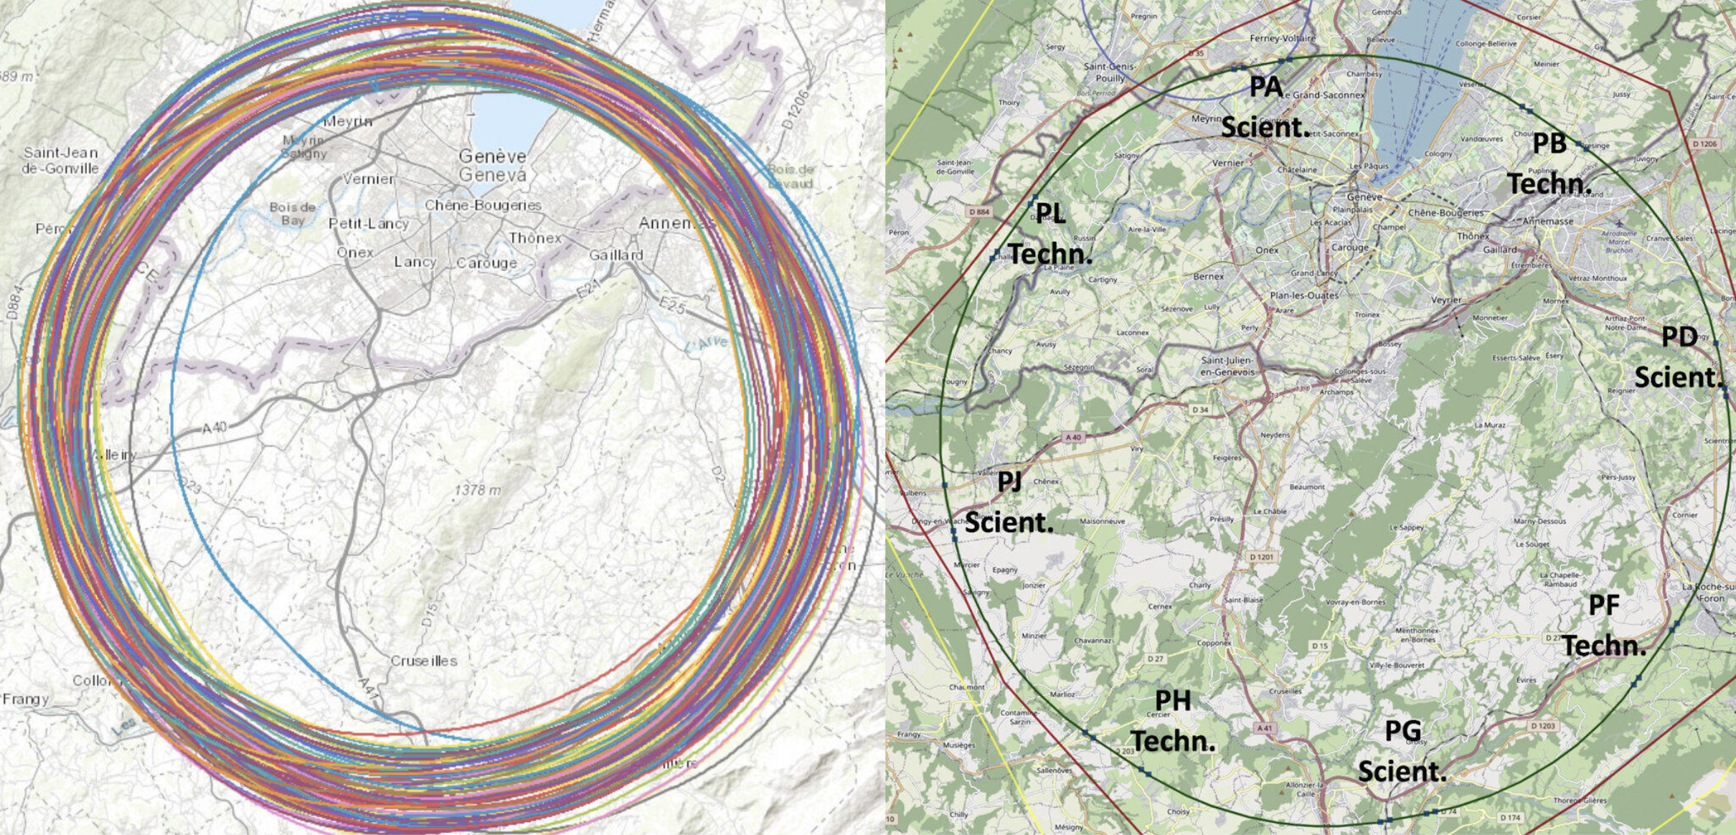
FCC
Current priorities
Practicalities & politics
Money, location
Tunnel digging

Slide 27
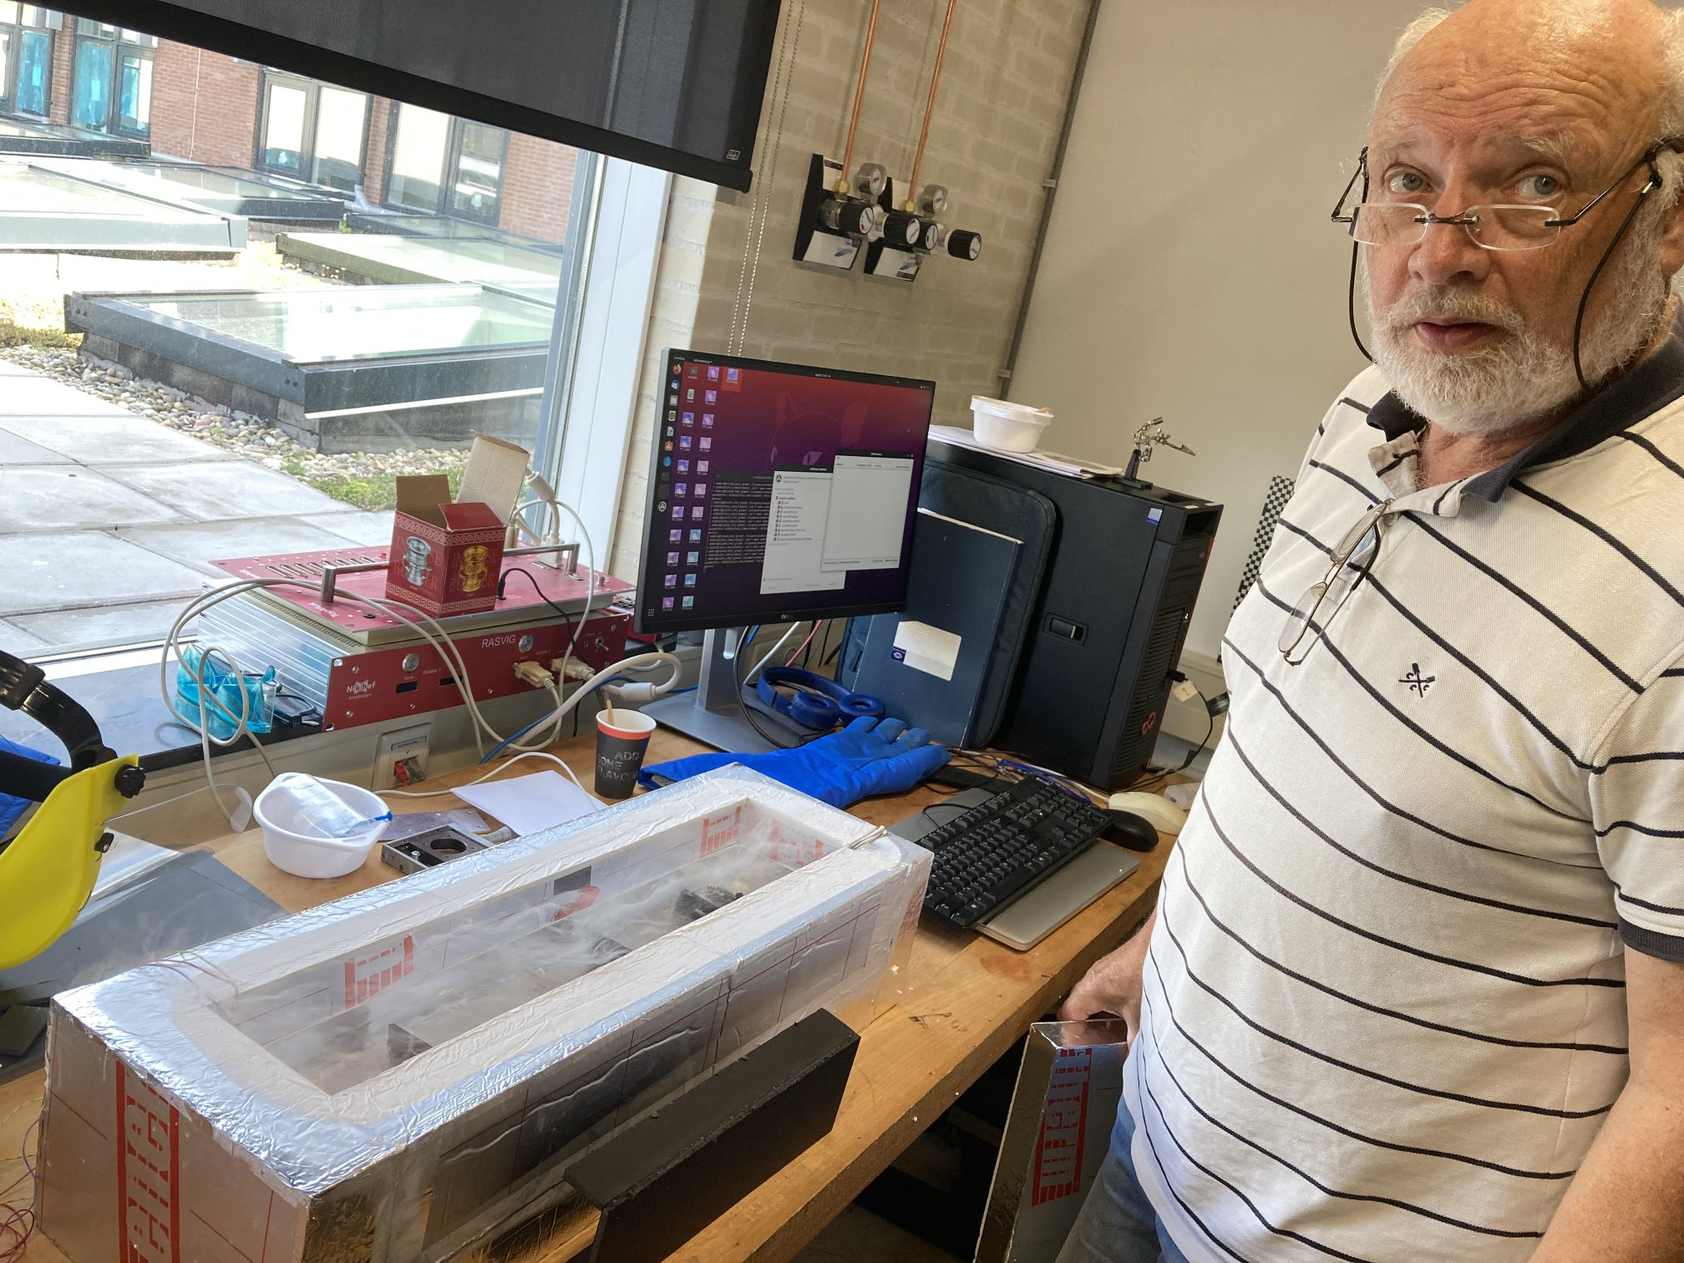
C3
H. v/d Graaf at Nikhef
Alignment for C³ accelerator
With Nikhef engineer Harry v/d Graaf
Based on system used for ATLAS Muon
“RasNik”

Slide 28
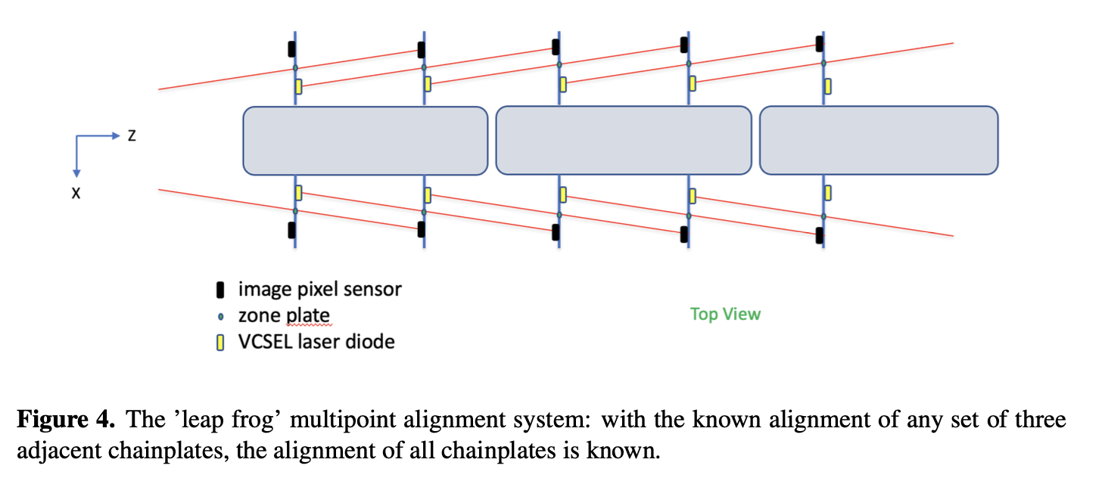
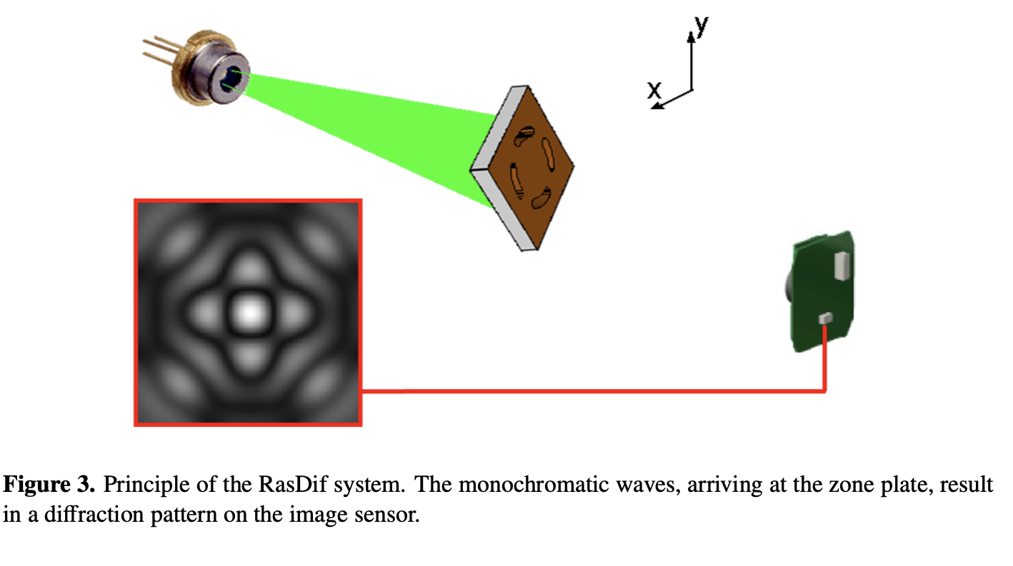
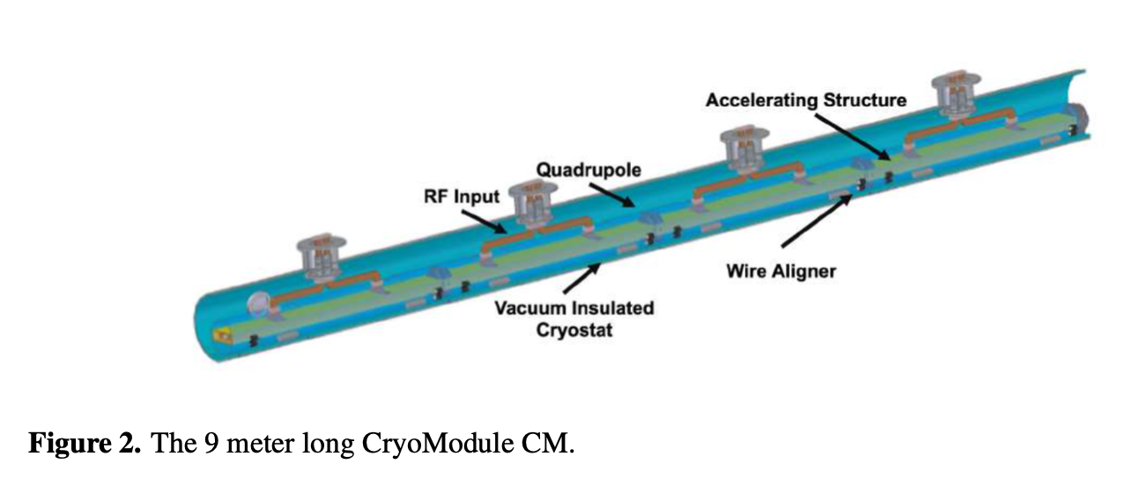
C3
Alignment for C3 accelerator
With engineer Harry v/d Graaf
“RasNik”
H. v/d Graaf, T.du Pree et al, arXiv:24xx.yyyy

Slide 29
C3
Workshop in Amsterdam
7-8 October at Nikhef
You’re welcome!
https://indico.slac.stanford.edu/ event/9113/overview

Slide 30
“LINEAR COLLIDER VISION”
Possible scenario for ECFA
Start with ILC
Mature technology
Upgrade with new technology
CLIC ?
C³ ?
Wakefield?

Slide 31
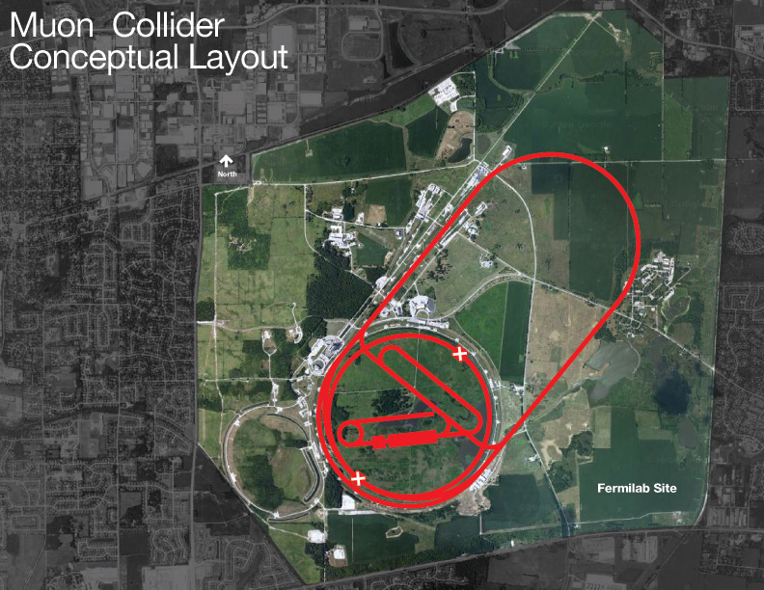
A MUON COLLIDER: PRECISION AND ENERGY

Slide 32
THE BEST OF BOTH WORLDS!
μ⁺μ⁻
✅ Precision physics
✅ And high energy
m_{e} = 0.5 MeV
m_{μ} = 106 MeV
m_{p} = 938 MeV

Slide 33
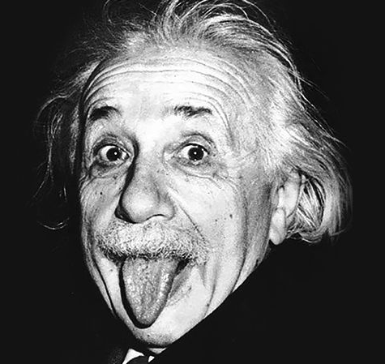
MAIN CHALLENGE
The main challenge:
Finite lifetime
τ_{μ} = 2μs
Example: 5 TeV muon
ɣ = 50,000
ɣτ_{μ} ~ 0.1s
ɣcτ_{μ} = 3x10⁷m
1000 x LHC!
“Een echte muoncollider-fysicus kan niet zonder gamma”

Slide 34
MUON COLLIDER: SCHEME
In 0.1s 😅
Approach: p → π → μ → cool → accelerate → collide
Various exciting challenges for accelerator technology

Slide 35
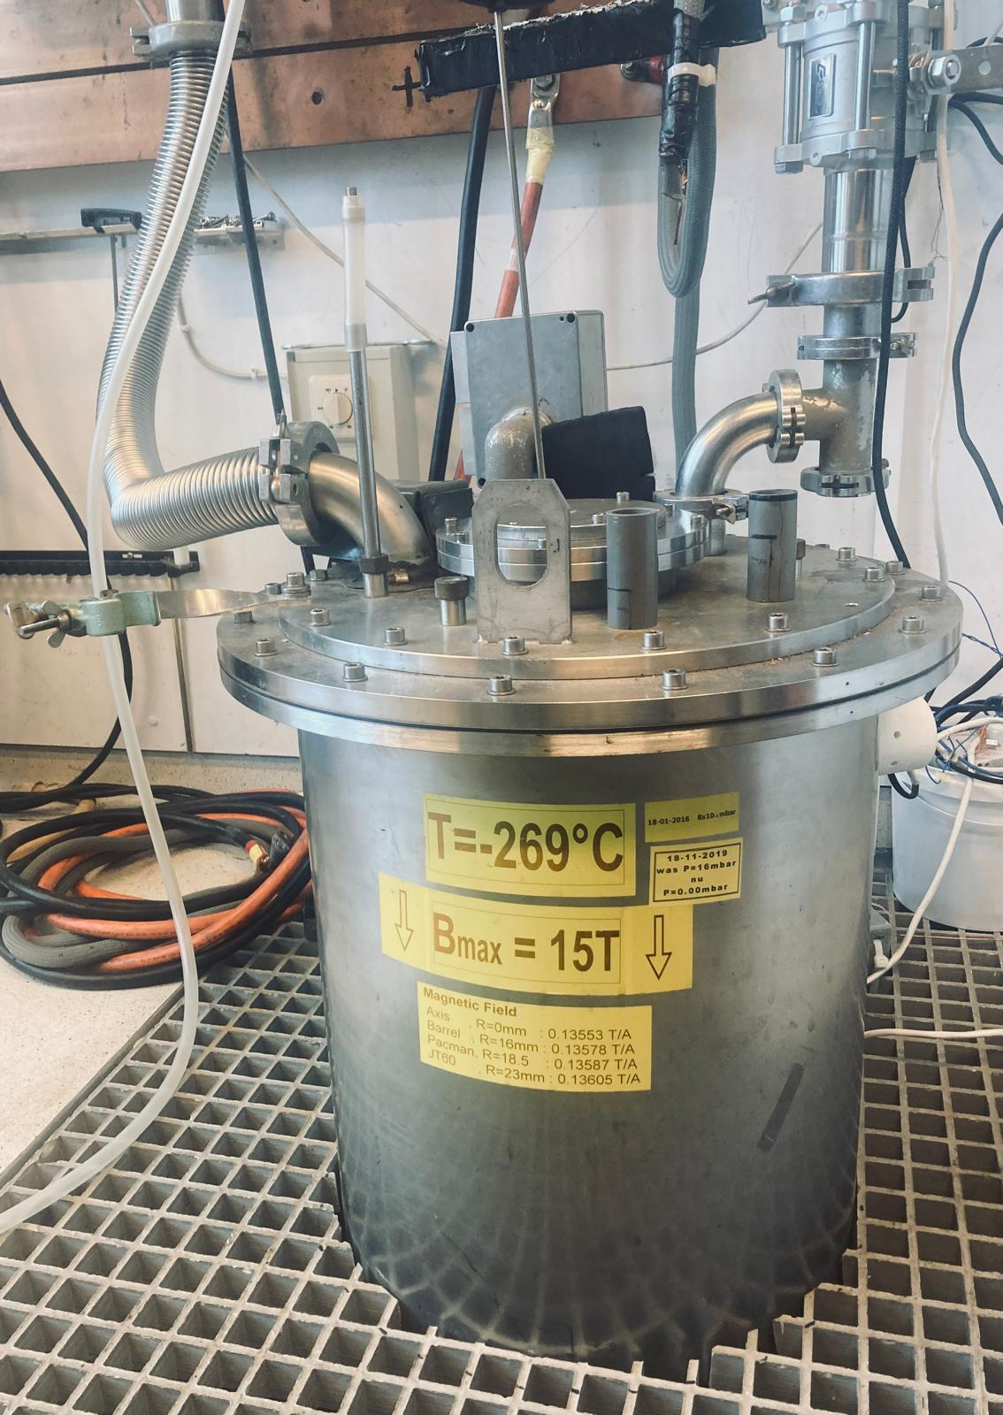
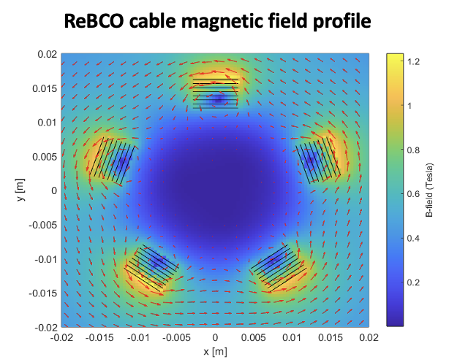
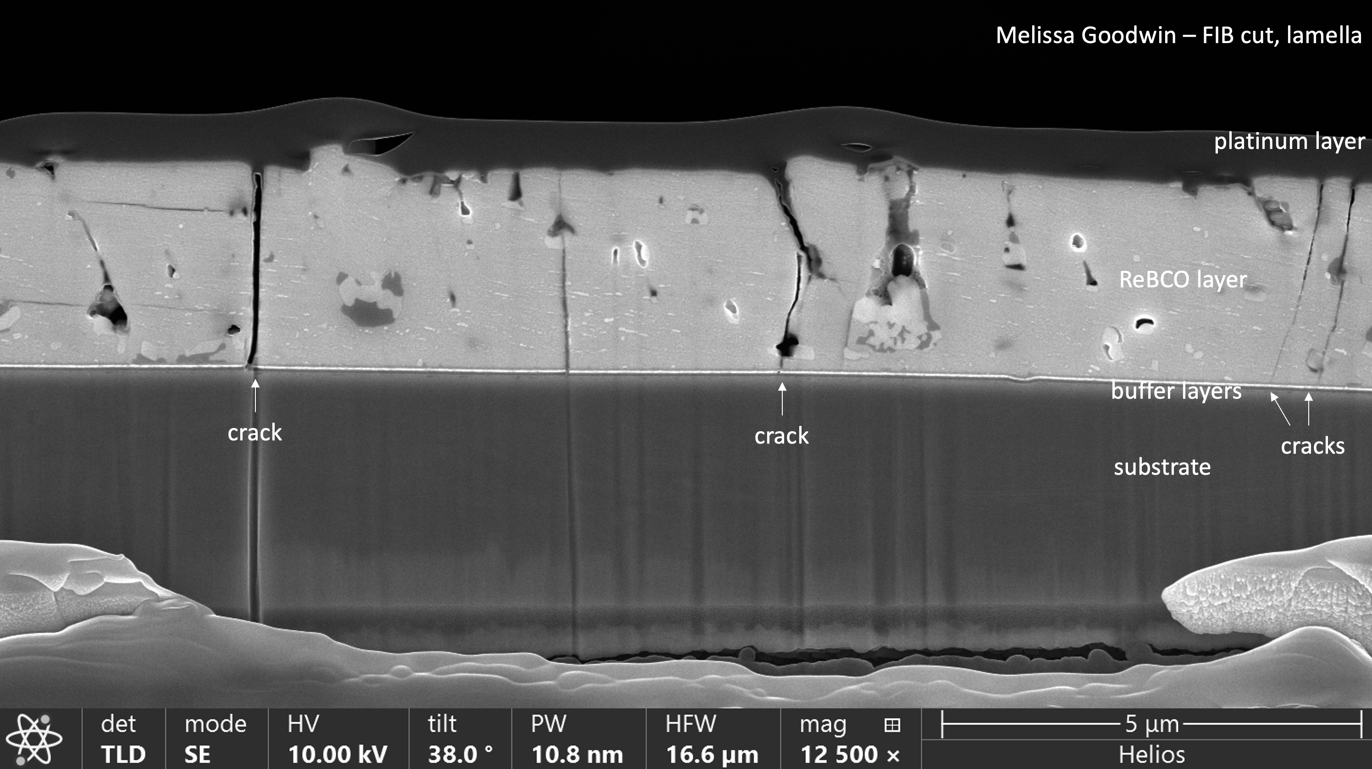
ACCELERATOR TECHNOLOGIES
University of Twente

Slide 36
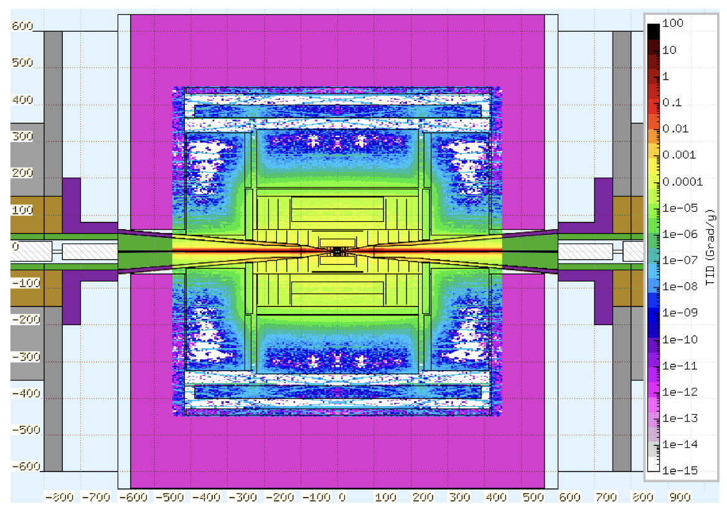
MUON COLLIDER: DETECTOR CHALLENGE
Beam Induced Background
Muon decays
5TeV: 10⁵ muon decays/m
Secondary products
In detector and in accelerator!

Slide 37
MUON COLLIDER: DETECTOR TECHNOLOGY
Main challenge: ‘BIB’
Detector designs ongoing
Trackers & calorimeters
Crucial solution: timing

Slide 38
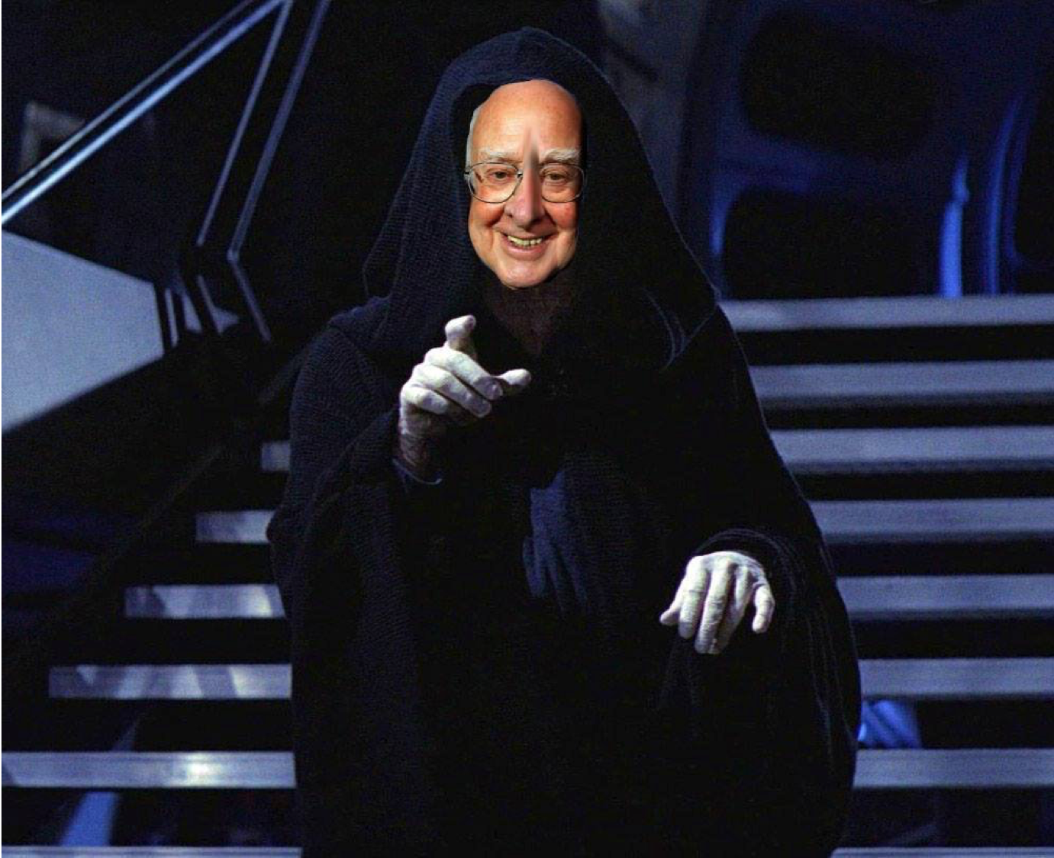
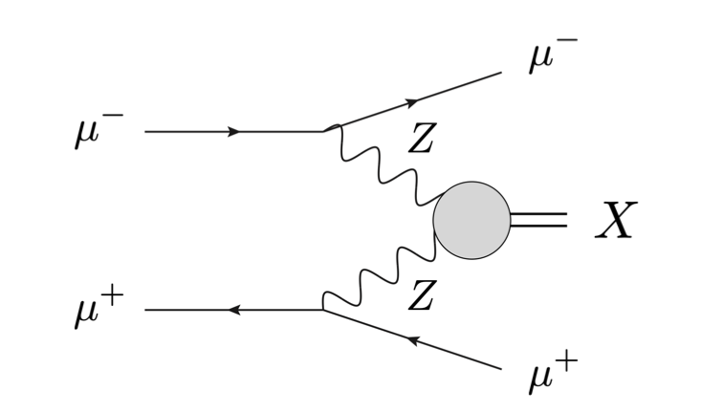
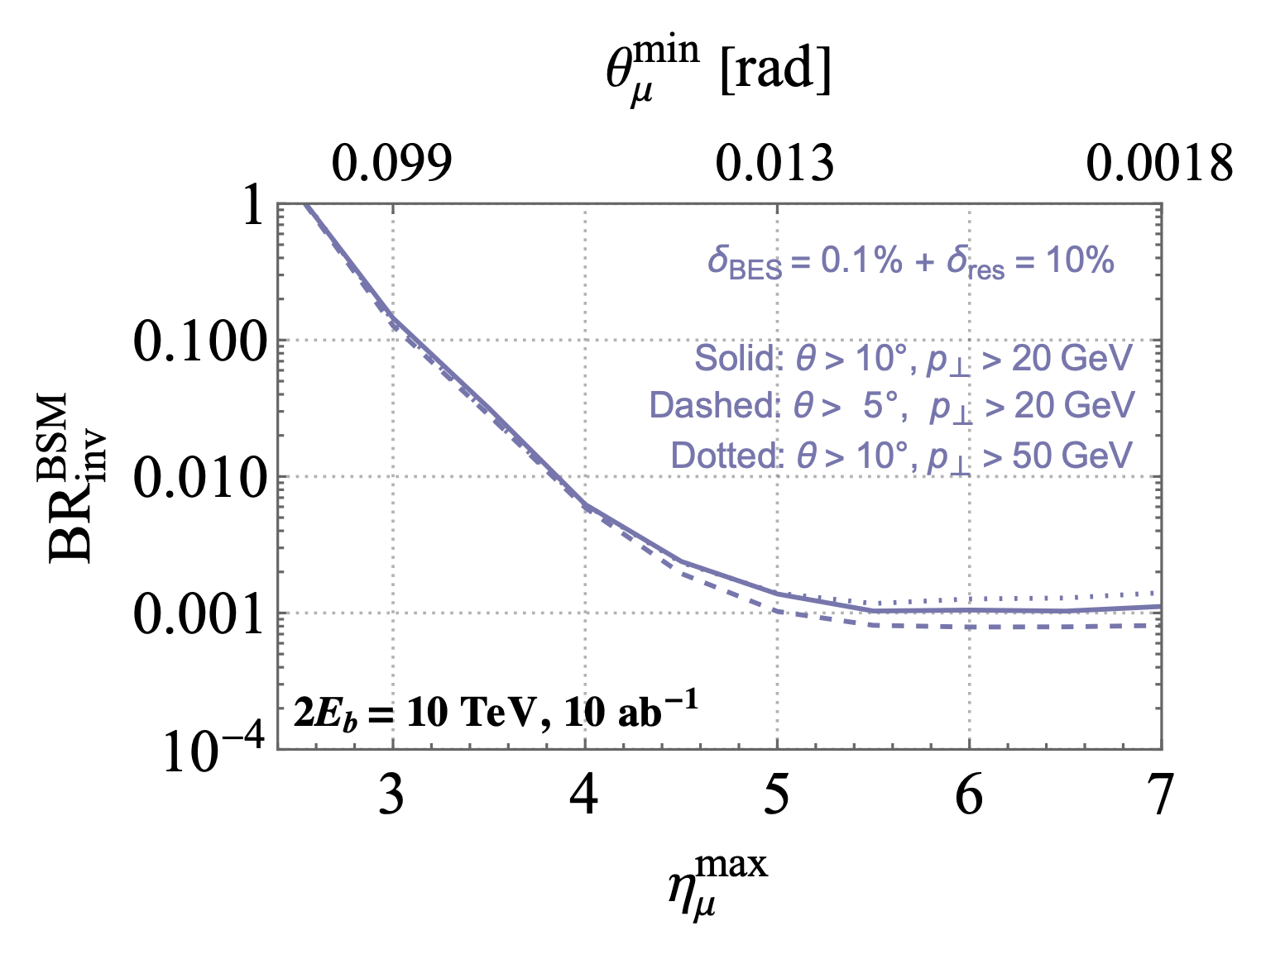
MUCOL PHYSICS
Ex: H→invisible
Studies still needed
Higgs vs Dark Matter?
Important at future colliders
H→inv
HL-LHC
MuC?

Slide 39
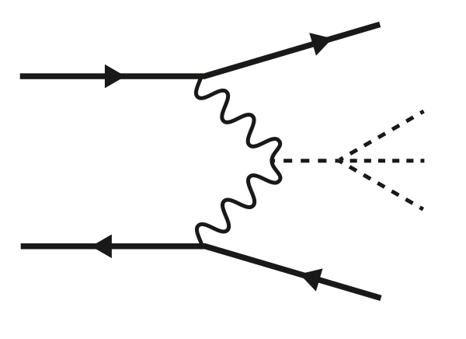
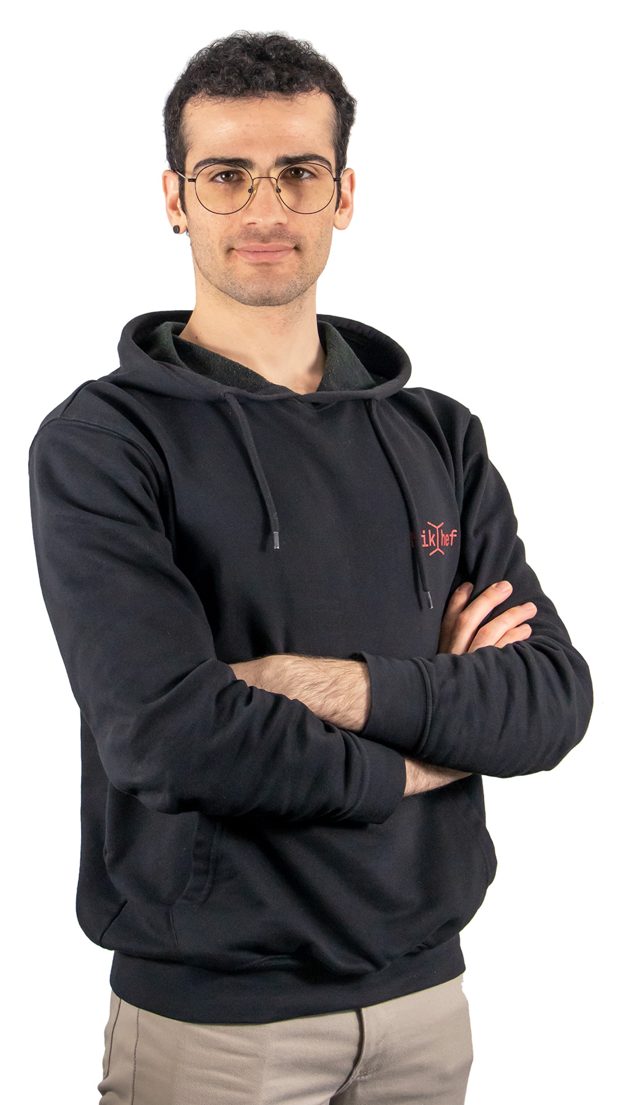
MUON COLLIDER
E.g. HHH at MuCol
Backgrounds
Simulation
Work needed for muon collider studies
H
H
H
ATLAS publication in the works!

Slide 40
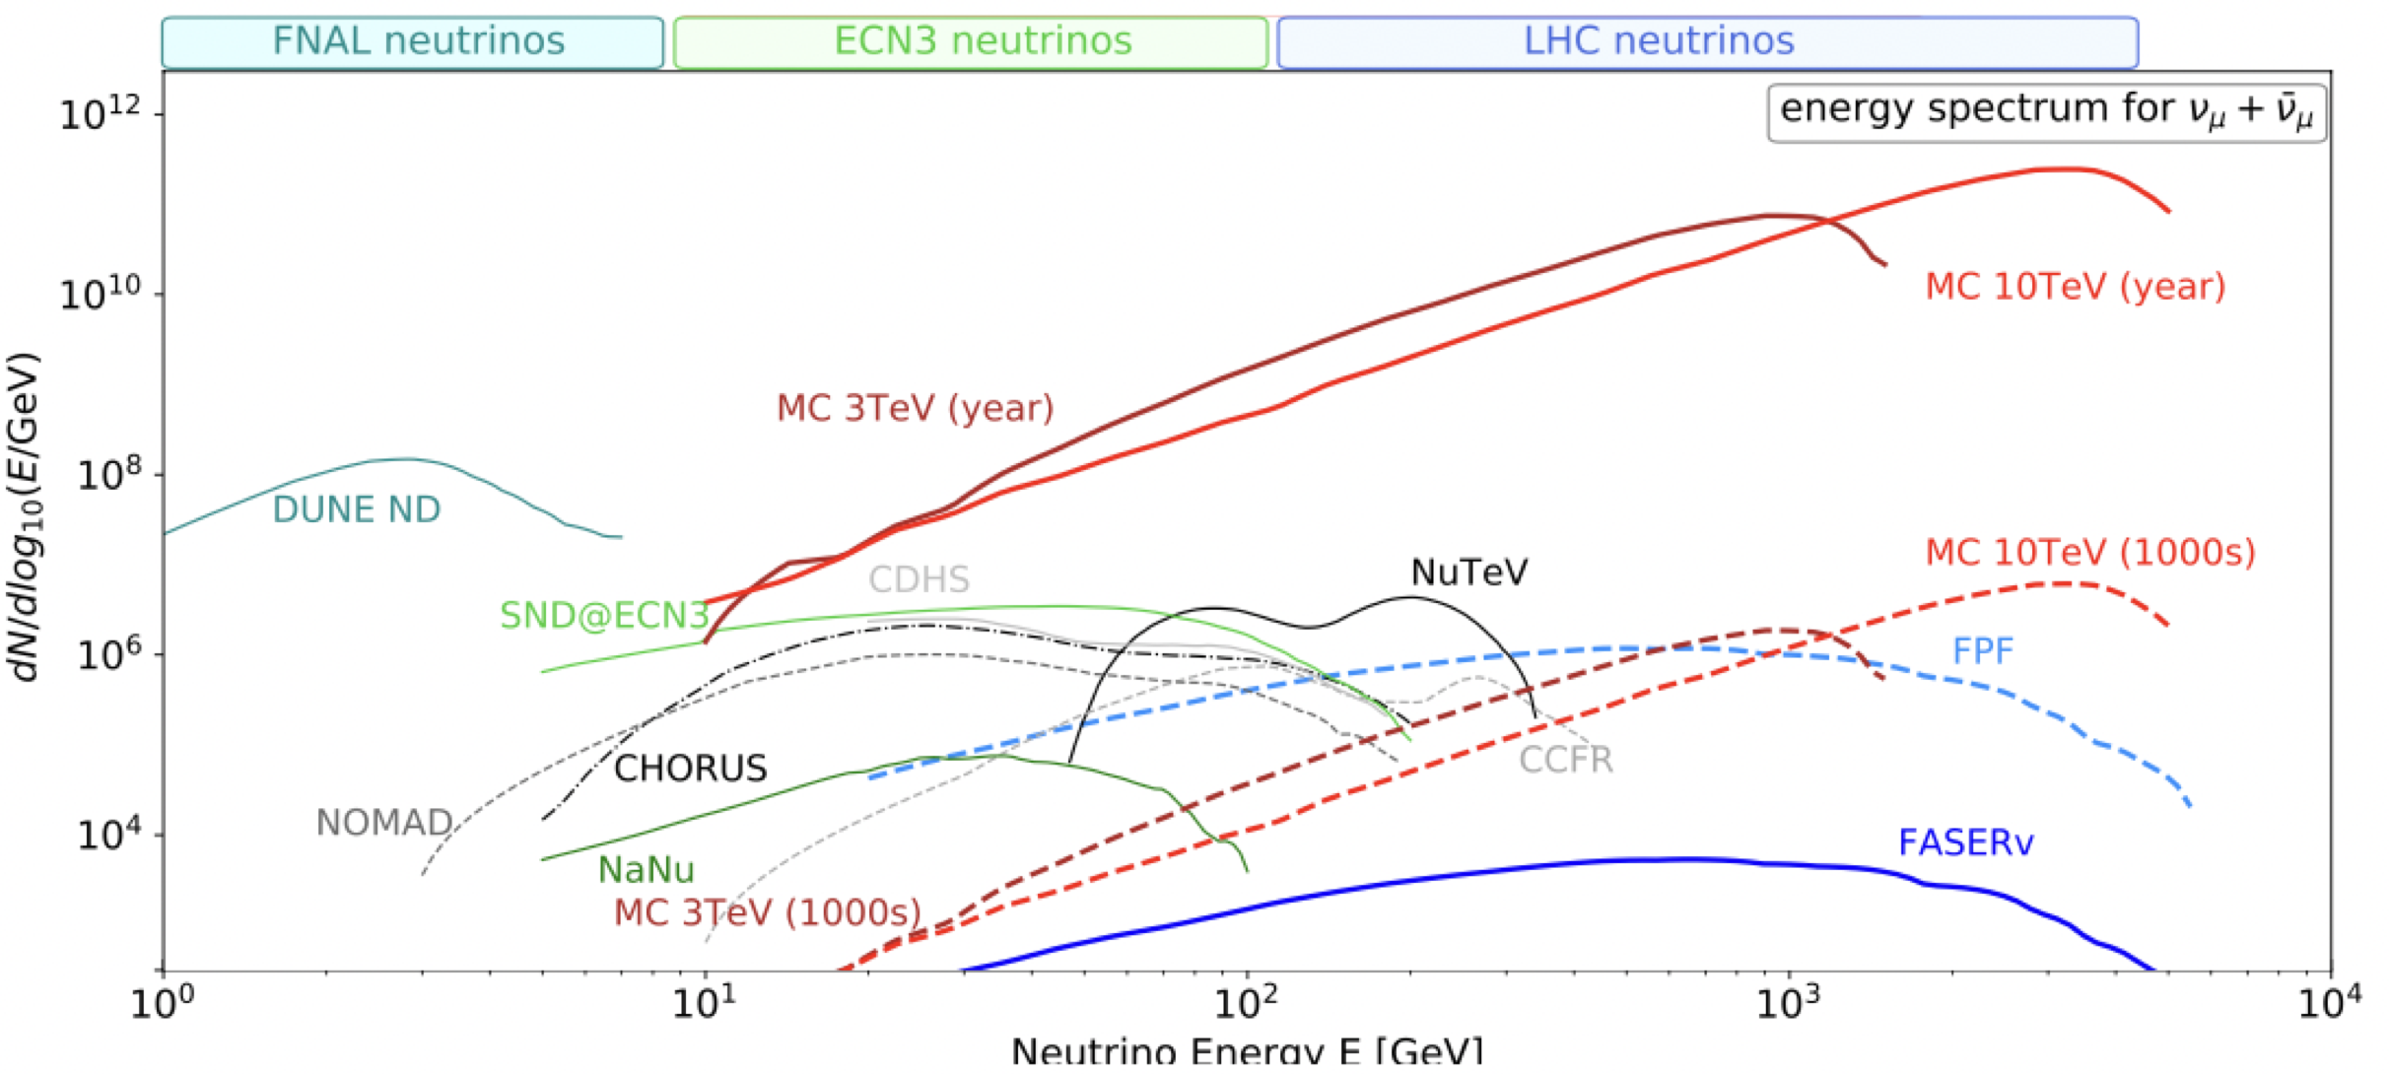
NEUTRINOS AS COLLIDER SPIN-OFFS
Muon collider as source for additional research
Neutrino physics
Use flat sections
Short baseline
J.Rojo et al
Neutrinos at muon collider
https://inspirehep.net/literature/2808571
Faser-like at FCC-hh
https://inspirehep.net/literature/2824738

Slide 41
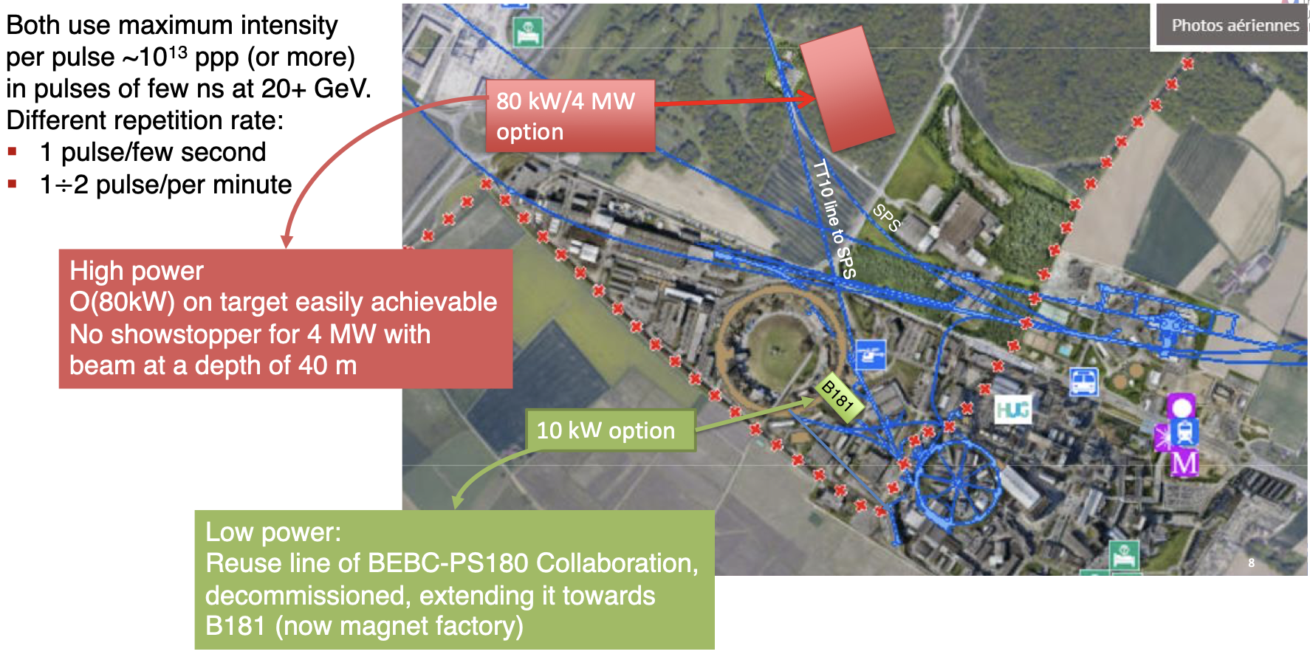
PLANS FOR A MUON COLLIDER DEMONSTRATOR
D.Lucchesi, for the IMCC – 17 Oct 2023 at CERN
At CERN site?

Slide 42
NIKHEF STATUS TOWARDS FUTURE COLLIDERS
ESUPP
CERN Council
NL representation
European strategy update
Voice your opinion!
At Nikhef
Future collider activities
Clara, Patrick, Wouter
Colloquia, topical lectures, etc
Future collider research
ILC, C3, FCC, MuCol
Case-by-case basis
Actual science
No clear structure (yet)
Research suggestions on next pages

Slide 43
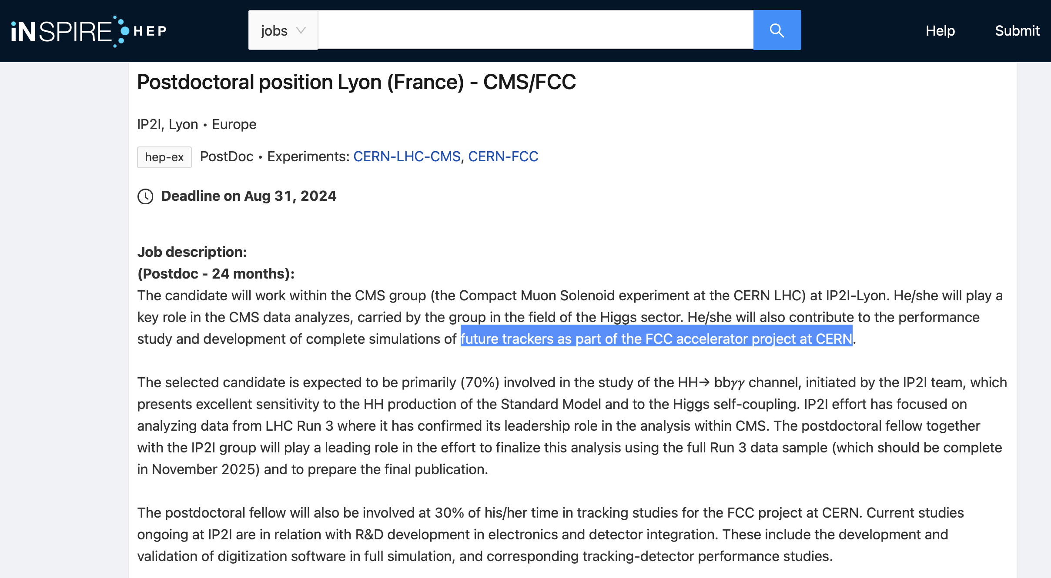
WHY YOU SHOULD GET INVOLVED
It’s exciting & interesting
I hope ;-)
It’s important
For CERN
For the field
For your next job
Postdoc / staff

Slide 44
SOME IDEAS
Higgs physics
H→cc, H→ss, H→gg
c-/s-/g-tagging
H→invisible
ee→H
HH and HHH
Boosted tagging
Other physics
EWK, ttbar?
B-physics at Z→bb?
My advice: do something
New / exciting
Low-hanging fruit
Exploit ongoing activities
NB: The ‘right’ choice also depends on the stage of the project

Slide 45
SOME IDEAS
Higgs physics
H→cc, H→ss, H→gg
c-/s-/g-tagging
H→invisible
ee→H
HH and HHH
Other physics
EWK, ttbar?
B-physics at Z→bb?
Theory/combinations
Higgs self-coupling
SMEFT, NLO, jets
BSM, Dark Matter
Technology
Detector R&D – e.g. timing
Reconstruction – e.g. calorimetry
Accelerators, sustainability
AOB, e.g. alignment

Slide 46
DETECTOR R&D
Nikhef grant proposal for HL-LHC detector upgrades
Nikhef: emphasis on “timing”
In view of HL-LHC
Upgrades for Run-4+
Also very relevant for future colliders
Out-of-time pileup
Beam-induced backgrounds

Slide 47
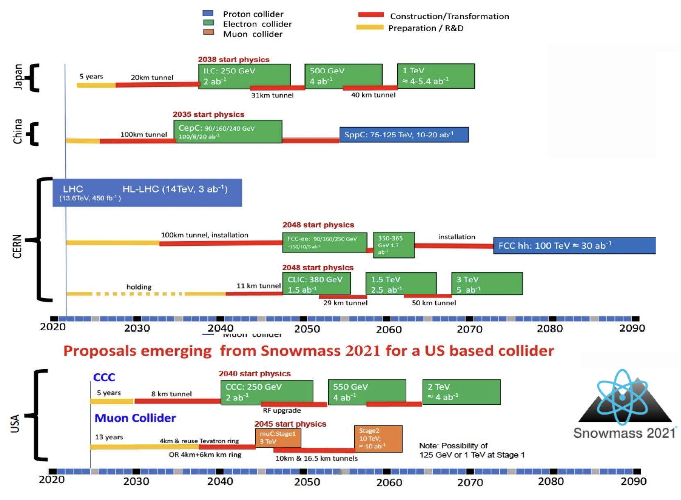
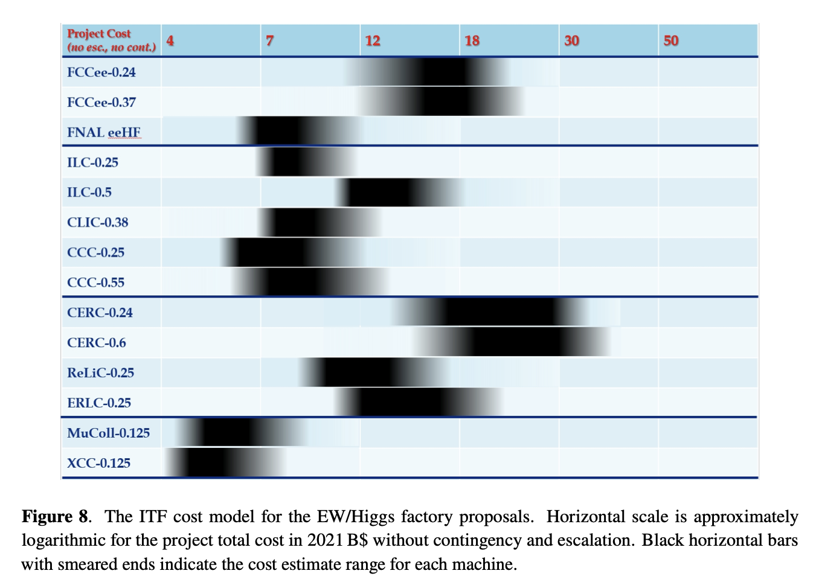
IT’S MORE THAN JUST PHYSICS!
Physics
+Society +Money
+Time
+R&D +…

Slide 48
MY RECOMMENDATION TO YOU
It might be challenging to work on future colliders, since you already have to:
Do your LHC analysis
Work on reconstruction/software
Detector upgrade & operation
Maybe some HL-LHC projection
And also some theory interpretation
Plus all the schools, courses, etc…
And then future colliders is at the end of the list…
But I think you should try!

Slide 49
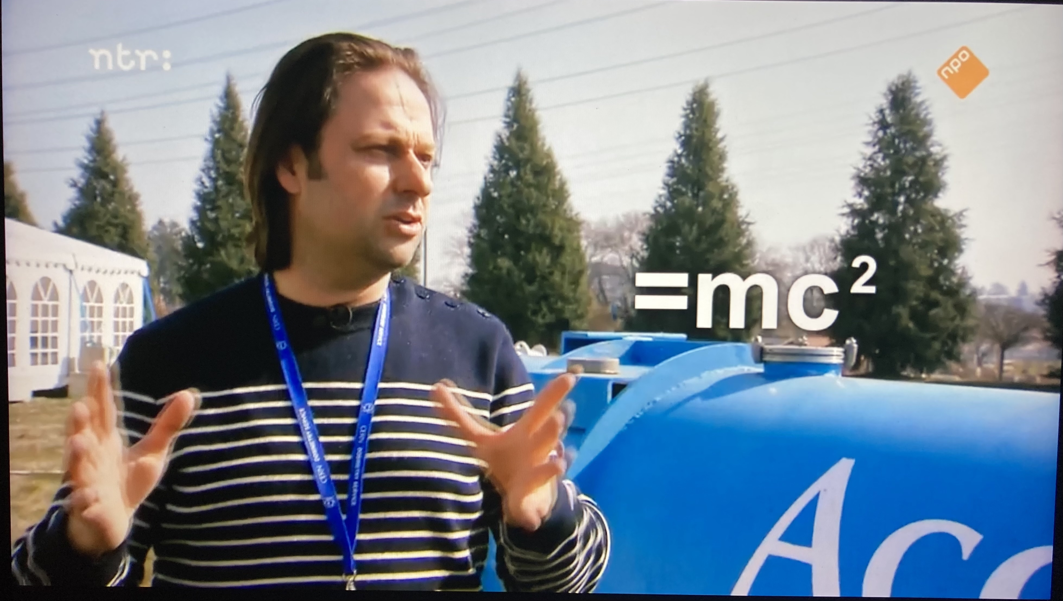
JOIN THE ADVENTURE TOWARDS THE NEXT ESUPP!
E
NPO2 with Diederik Jekel, 13 April 2022

Slide 51
MUCOL Physics
Multi-TeV collider: Higgs precision and Searches

Slide 52
MUCOL Physics
Multi-TeV collider: Higgs precision and Searches
BSM direct reach in similar ballpark as FCC-hh!

Slide 53
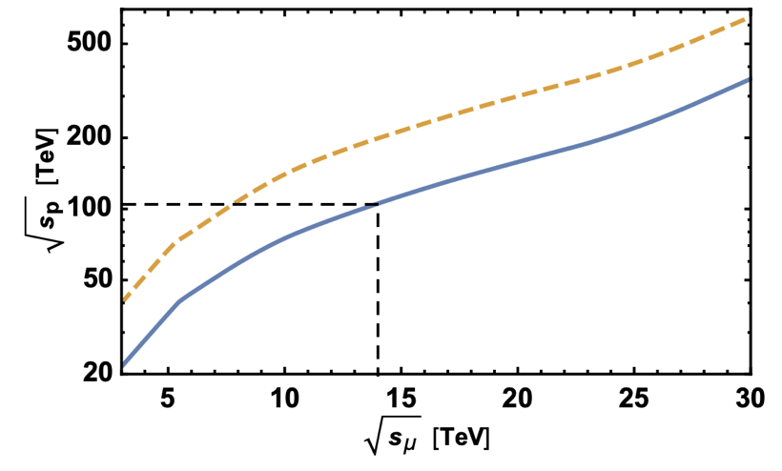
MUCOL Physics
Multi-TeV collider: Higgs precision and Searches
BSM direct reach in similar ballpark as FCC-hh!

Slide 54
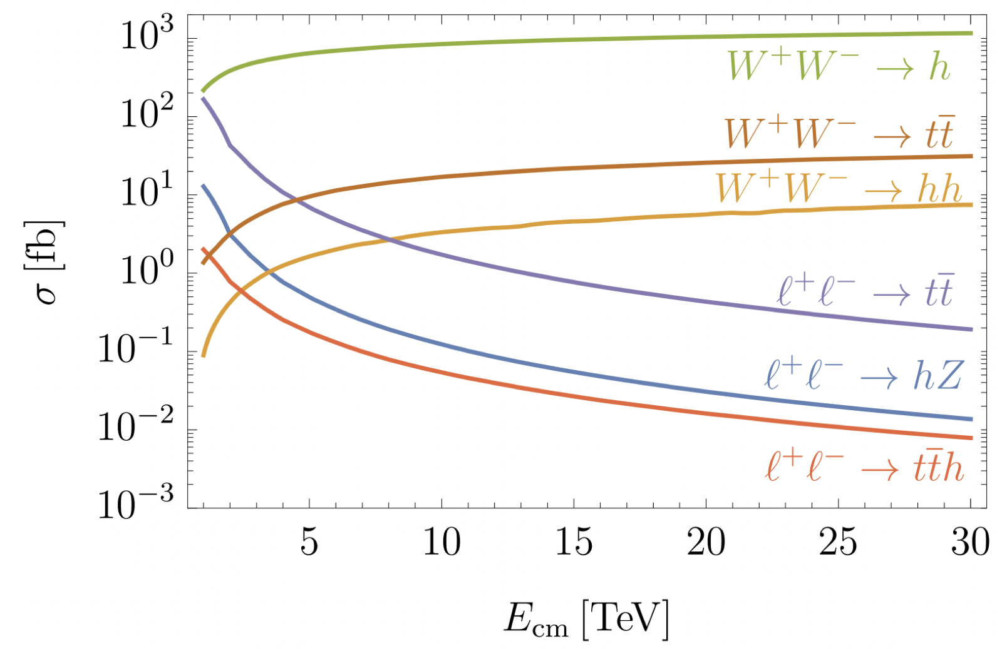
MUCOL PHYSICS: HIGGS
VBF-H production increases with energy
10/ab @ 10 TeV
10,000,000 single-H
Sizable sensitivity improvement
K_{W}, K_{Z}, K_{g}, K_{c}, K_{b}, K_{μ}, K_{τ},…
Comparable to (other) Higgs factories!

Slide 55
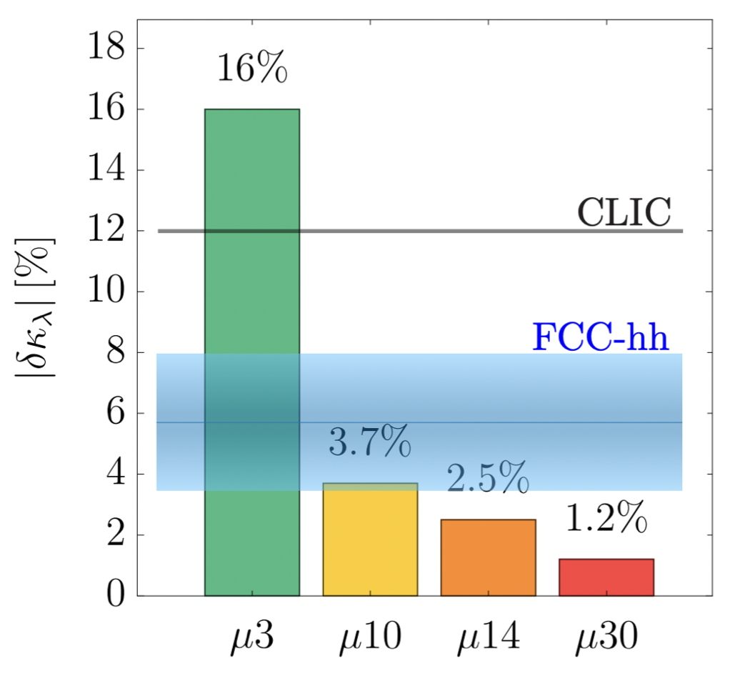
HH @ MUCOL
Self-coupling from HH
10/ab @ 10TeV
30,000 VBF-HH
10TeV MuCol
<5% uncertainty on the self-coupling
Similar to FCC-hh

Slide 56
HH @ MUCOL
Self-coupling from HH
10/ab @ 10TeV
30,000 VBF-HH
10TeV MuCol
<5% uncertainty on the self-coupling
Constrain shape of Higgs potential

Slide 57
HH(H) @ MUCOL
Self-coupling from HH(H)
10/ab @ 10TeV
Constrain HH K₃ self-coupling
Possibly even K₄
Unique HHH production
H
H
H

Slide 58
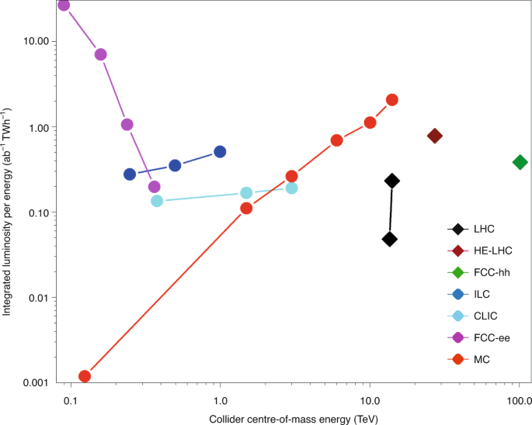
LUMI
Z
WW
VBF H
VH
tt

Slide 59
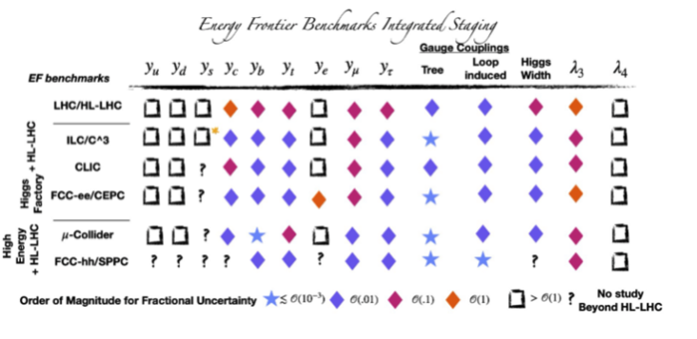
HIGGS PHYSICS SENSITIVITIES SUMMARY
Similar reach in Higgs physics for different future accelerators
➔ The muon collider is a discovery machine and a precision machine!

Slide 60
MUCOL PHYSICS SUMMARY
Main physics programme
Higgs precision
Higgs self-coupling
New energy scale
Additional possibilities
Long-lived particles
Neutrinos
And it’s compact!

Slide 61
CERN’s future
HL-LHC
+ CLIC?
+ FCC?
+ MuCol?

Slide 62
COOLING
Main challenge
‘6D’ ionization cooling
Minimize energy loss:
Low-Z material → LH₂
In strong magnetic field

Slide 63
COOLING
Main goal of demonstrator
Prove cooling
Absorber + magnet + RF
Challenges
Large bore solenoid
High gradient RF
Large intensity absorber
All together!
x

Slide 64
COOLING
Main goal of demonstrator
Prove cooling
Absorber + magnet + RF
Challenges
Large bore solenoid
High gradient RF
Large intensity absorber
All together!

Slide 66
COSTS
Relative costs in MuCol project
Largest costs in 6D cooling and accelerator (RCS)
Target, capture, final cooling only small fraction
Not dominated by (relatively) small collider
10TeV
3TeV

Slide 67
COSTS (1)
Snowmass 21 - https://iopscience.iop.org/article/10.1088/1748-0221/18/05/P05018/pdf
125-600 GeV
Overall: 5-15B$
MuC on lower side of spectrum

Slide 68
COSTS (2)
Snowmass 21 - https://iopscience.iop.org/article/10.1088/1748-0221/18/05/P05018/pdf
1-10 TeV
Overall: 10-30B$
MuC on lower side of spectrum

Slide 69
COSTS (3)
Snowmass 21 - https://iopscience.iop.org/article/10.1088/1748-0221/18/05/P05018/pdf
Other projects
FCC-hh >25B$

Slide 70
MUON COLLIDER BENEFITS
High energy
Discovery machine
Higgs self-coupling
Like FCC-hh
And in the meantime we will do a lot of accelerator+detector R&D
Precision physics
Luminority frontier
Higgs factory
Like FCC-ee
Compact & efficient
√s=10 TeV: 10-30km
Like LHC

Slide 71
MUON COLLIDER
Physics case of a muon collider is great
But it might not even be the main criterium
Muon collider has many advantages
Physics: Precision & Discovery
Technology and Innovation
Practicalities: Footprint & Cost
Outreach: It’s New & Exciting!
Now: Let’s study physics, detector, accelerator

Slide 72
CERN’s future
HL-LHC
+ CLIC?
+ FCC?
+ MuCol?

